Slide 1
Wrapping LAPPS Services

Slide 2
Wrapping a Service
Preliminaries: Java, Maven and Emacs
Background:
LAPPS API: consistent inteface
discriminators
JSON format
LAPPS Vocabulary
Wrapping
web service sec
LAPPS services, various compliance levels
Deplying and Registering
Service Grid and Composer

Slide 3
Wrapping a Service
Availability & Interoperability of NLP Tools
Java, Python, tools
OpenNLP, Stanford NLP, Gate, NLTK
Language Application (Lapps) Grid Project
Language Service
Lapps API Design

Slide 4
Background: Consistent Interface

Slide 5
Background: Discriminators
Used to determine what components can be pipelined
Composer
Planner
Types (hypothetical)
Identifier Discriminators
Format Discriminators
Content Discriminators

Slide 6
Logical flow
(client-server communication not represented)
Data
source
UIMA
service
UIMA CAS
UIMA
service
GATE
service
GATE
service
GATE XML
OpenNLP
service
OpenNLP
service
Stanford NLP
service
Stanford NLP
service
LAPPS services for OpenNLP and Stanford NLP tools are wrapped to produce and consume JSON-LD
JSON-LD output
Converter to JSON-LD
Converter from JSON-LD

Slide 7
Examples (hypothetical)
 | requires()
OpenNLP.Splitter | text
OpenNLP.Tokenizer | text OR opennlp-splitter-output
OpenNLP.JsonTokenizer | json AND sentences
OpenNLP.Tagger | opennlp-tokenizer-output OR (text AND tokens AND otpl)
OpenNLP.JsonTagger | json AND tokens
 | produces()
OpenNLP.Splitter | opennlp-splitter-output AND sentences
OpenNLP.Tokenizer | opennlp-tokenizer-output AND text AND tokens AND otpl
OpenNLP.JsonTokenizer | json AND tokens
OpenNLP.Tagger | opennlp-tagger-output AND text AND pos
OpenNLP.JsonTagger | json AND postags AND tagset:penn

Slide 8
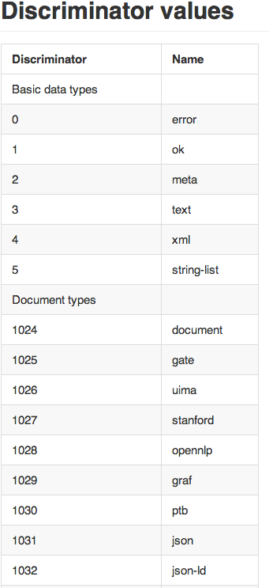
long requires()
log produces()

Slide 9
Background: JSON
Consistent syntax for intermediate data
All annotations live as JSON objects inside of annotation lists in annotation steps
Stand-off annotation

Slide 10
JSON – LAPPS Interchange Format

Slide 11
Background: LAPPS Repository
http://vocab.lappsgrid.org

Slide 13
Creating a Web Service
Take a simple program with just one class

Slide 14
Creating a Web Service
Make a simple web service with a class and an interface
(in two source files)

Slide 15
Creating a LAPPS Service (1)
First level of compliance
Use the standard LAPPS service interface

Slide 16
Source code to wrap
Hello revisited

Slide 17
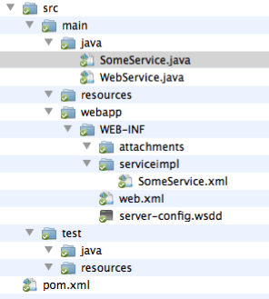
Project Template

Slide 18
Web Service Interface

Slide 19
The Standard Service Class

Slide 20
Hello Adapted

Slide 21
Editing the POM file
POM: Project Object Model
Maven’s way to declare elements of a project

Slide 22
Define what class to use
Rename SomeService.xml
src/main/webapp/WEB-INF/serviceimpl
Define top-level class for service

Slide 23
Maven
mvn clean
mvn compile
mvn package
mvn jetty:run
(mvn clean compile package jetty:run)

Slide 24
LSD - LAPPS Services DSL

Slide 25
Deployment & Registration
Deploy the war file to some server (we use Tomcat)
Register the service with the LAPPS grid

Slide 26
Tomcat Manager

Slide 27
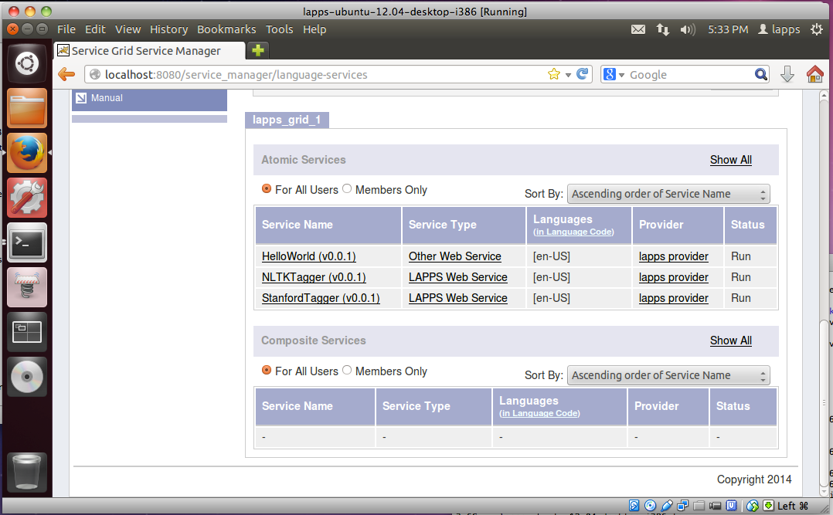

Slide 28
In real life now…

Slide 29
Creating a LAPPS Service (2)
Second level of compliance
Create output in the JSON-LD based LAPPS Interchange Format (LIF)
Stand-off annotation
Whitespace Tokenizer

Slide 30
Output Generated

Slide 31
Import

Slide 32
Code Snippets

Slide 33
The Full Code

Slide 34
In real life again…

Slide 35
Creating a LAPPS Service (3)
Third level of compliance
Use categories from the LAPPS vocabulary

Slide 36
JSON-LD
LAPPS services are not required to exchange data in any particular format.
LAPPS GATE services exchange GATE XML
Must be prepared to deal with the consequences.
JSON(-LD) is becoming more popular for data exchange on the web.
Good support across programming languages.
Recommended that if services do not use JSON-LD they provide a mapping from their format to JSON/JSON-LD
Ideally LAPPS services will exchange JSON-LD using a common vocabulary.

Slide 37
LEDS: LAPPS Exchange Data Structures
Java/Groovy classes for serializing JSON
Will be refactored soon but basic concepts will remain the same
Three main classes
Container
ProcessingStep (View)
Annotation
Other supporting classes for manipulating metadata
Contains, etc.

Slide 38
LEDS Classes
Container
Map metadata
List<ProcessingStep> step
ProcessingStep
Map metadata
List<Annotation> annotations
Annotation
String id
String type
long start
long end
Map features
Map metadata

Slide 39
LAPPS Exchange Data Structures
Available on the ANC’s Nexus repository
http://www.anc.org:8080/nexus
<groupId>org.anc.lapps</groupId>
<artifactId>serialization</artifactId>
<version>0.13.0</version>
Will be refactored into the org.lappsgrid namespace

Slide 40
LAPPS Exchange Data Structures
Provides simple round tripping between Java objects and their JSON-LD serialization
Uses Jackson for JSON serialization
Container container = new Container()
String json = container.toJson()
json = container.toPrettyJson()
…
Container = new Container(json)

Slide 41
LAPPS Exchange Data Structures
Can link to a remote @context at http://vocab.lappsgrid.org/context-1.0.0.jsonld
Container container = new Container(false);
Can include a local @context that can be manipulated at runtime
Container container = new Container();
Map context = new HashMap()
context.put(“Token”, “http://…”);
Context.put(“Sentence”, “http://…”)”
Container.setContext(context)

Slide 42
LAPPS Exchange Data Structures
{
"@context" : {
"Sentence" : "http://example.com/Sentence",
"Token" : "http://example.com/Token"
},
"metadata" : { },
"text" : { },
"steps" : [ ]
}

Slide 43
Metadata
Everything can contain metadata
Services are free to use the metadata maps as needed.
LAPPS does not impose many restrictions on metadata
Except for ProcessingStep (View)
Each step should have a contains map
Allows other processors to quickly find views they are interested in.

Slide 44
Metadata: contains
Lists the annotation types in each ProcessingStep
Key is the annotation type (label)
Value is another map
producer: the name of the service that produced the annotation
url: the url of the service that produces the annotations
type: an IRI to a description of the annotation type
POS tag set
rules used for tokenization

Slide 45
Metadata: contains
Container container = new Container(false);
ProcessingStep step = container.newStep();
String producer= “com.example.Tokenizer”
String type = “tokenizer:example”
step.addContains(“Token”, url, type);
{
"@context" : "http://vocab.lappsgrid.org/context-1.0.0.jsonld",
"metadata" : { },
"text" : { },
"steps" : [ {
"metadata" : {
"contains" : {
"Token" : {
"producer" : "com.example.Tokenizer",
"type" : "tokenization:example"
}
}
},
"annotations" : [ ]
} ]
}

Slide 46
Metadata: contains
{
"http://vocab.lappsgrid.org/metadata/contains": [
{
"http://vocab.lappsgrid.org/Token": [
{
"http://vocab.lappsgrid.org/metadata/producer": [
{
"@value": "com.example.Tokenizer"
}
],
"http://vocab.lappsgrid.org/metadata/type": [
{
"@id": "http://vocab.lappsgrid.org/types/tokenization/example"
}
]
}
]
}]
}

Slide 47
More Wrapping Examples

Slide 48
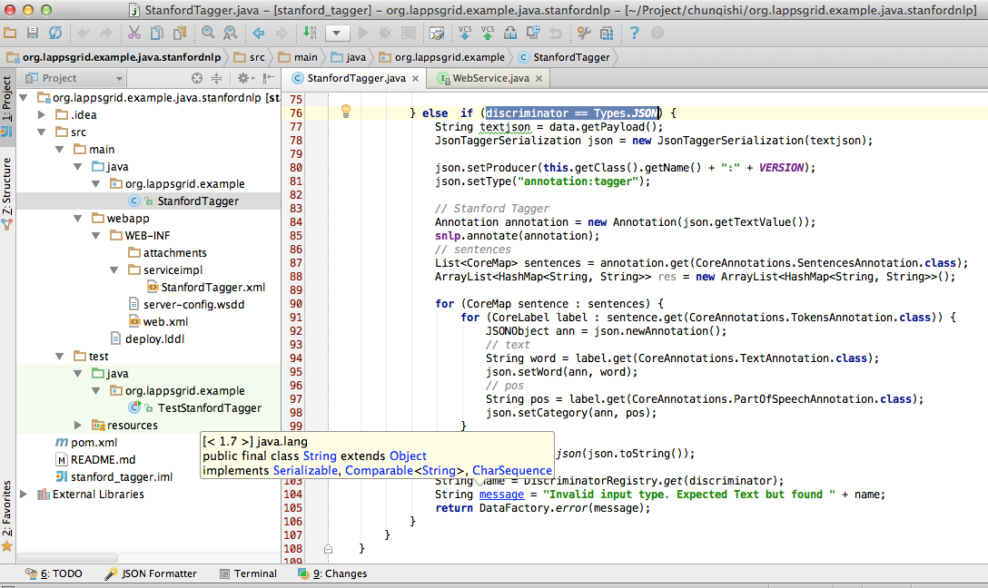
Development Template
https://github.com/chunqishi/org.lappsgrid.example.java.stanfordnlp

Slide 49
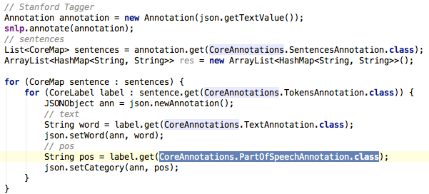
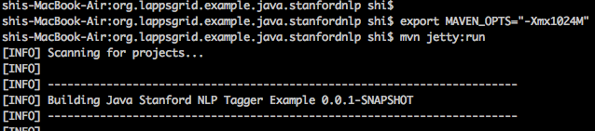
Stanford Tagger Wrapping
Java Wrapping
Jetty Running

Slide 50
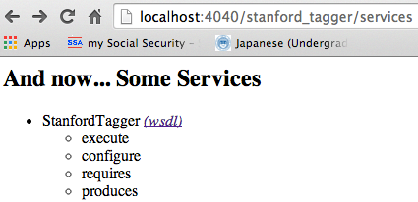
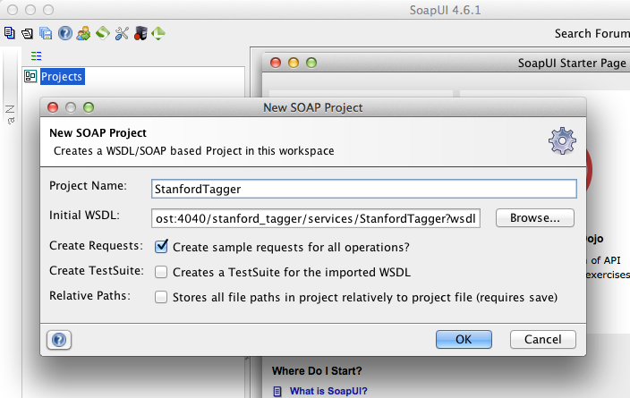
Stanford Tagger Testing
Local Service
SoapUI Testing

Slide 51
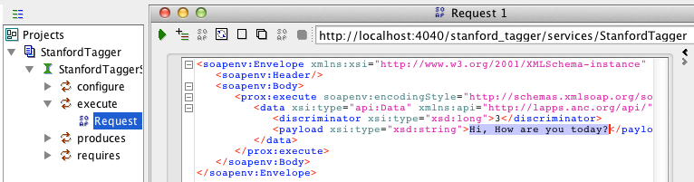
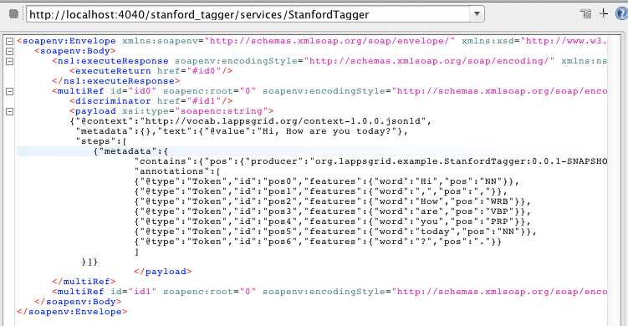
Stanford Tagger Testing Result
Request
Response

Slide 52
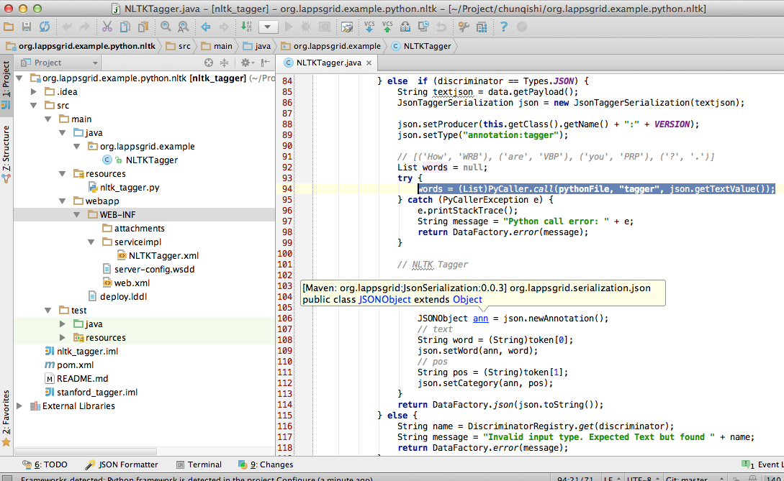

Developing Template

Slide 53
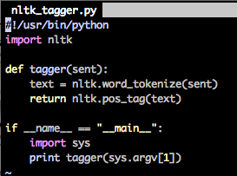
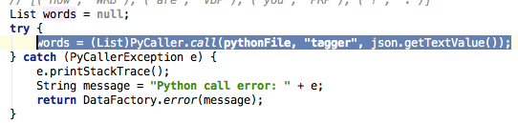
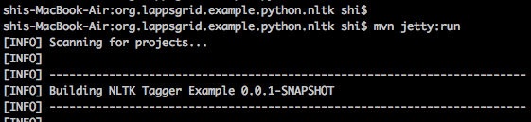
NLTK Python
Python Program
Python Result
Java Wrapping
Jetty Running

Slide 54
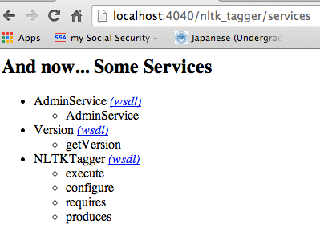
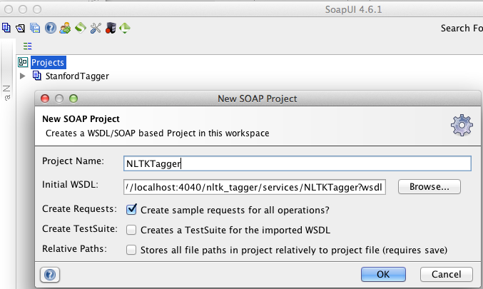
NLTK Tagger Testing
Local Service
SoapUI Testing

Slide 55
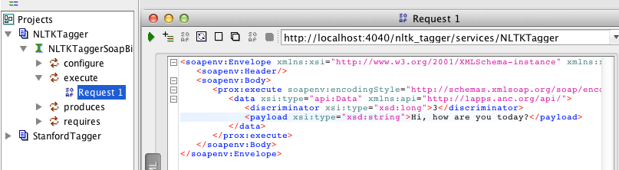
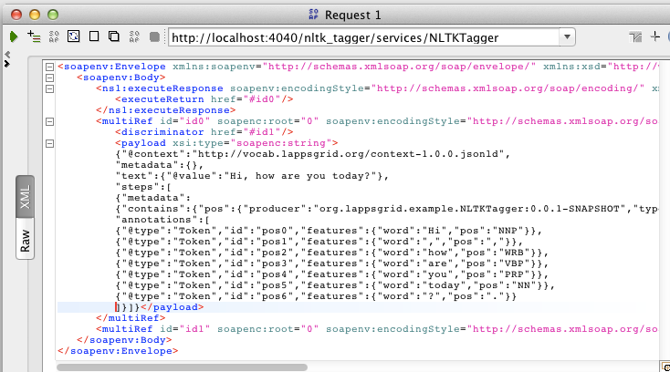
NLTK Tagger Testing Result
Request
Response

Slide 56
Reference
API Docs: http://www.anc.org/projects/lapps/api/project-info.html
Service Templates:
https://github.com/chunqishi/org.lappsgrid.example.java.helloworld
https://github.com/chunqishi/org.lappsgrid.example.java.stanfordnlp
https://github.com/chunqishi/org.lappsgrid.example.python.nltk
Service Managers:
http://eldrad.cs-i.brandeis.edu/service_manager/language-services
http://grid.anc.org:8080/service_manager/language-services
VirtualBox Image:
http://eldrad.cs-i.brandeis.edu/download/lapps-ubuntu-12.04-desktop-i386.tar.gz

Slide 57
It’s a Wrap

