Slide 1

The Language Application Grid and Galaxy
Nancy Ide, Keith Suderman
Vassar College
James Pustejovsky, Marc Verhagen
Brandeis University
Christopher Cieri
Linguistic Data Consortium
Eric Nyberg
Carnegie-Mellon University

Slide 2
The LAPPS Grid
Framework for development of Natural Language Processing (NLP) applications
Information extraction/Question answering
Google search, mining information in unstructured textual data
Machine translation
Speech recognition
Sentiment analysis
“What is the current attitude toward Trump on Twitter?”
… and many more

Slide 3
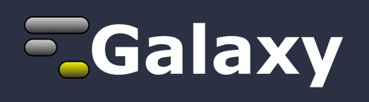
LAPPS Galaxy Interface
http://galaxyproject.org
The LAPPS Grid recently adopted the GALAXY workflow engine as a front end for construction of pipelines etc.

Slide 4
What we have in common
Processing large amounts of (mostly text) data
Data needs to be run through a pipeline of processors
pipelines are application dependent
Searching for patterns
Processors in the pipeline may not have been designed to work together.

Slide 5
What is different
Data sets
Genomes vs millions of small texts
Data
You have genes, proteins, etc. (ACGT)
We have Twitter and Emoji
The OED added 2,000 new entries in the June 2016 update
Most of our processors are web services
The network is the bottleneck

Slide 6
Pipeline architecture for loosely-coupled linguistic analyses
text
Split sentences
Detect sentiment
Split words (tokenize)
Find relevant documents
Extract entities
Tag words with part of speech
Extract relations
Parse for syntactic structure
Build model
Produce a summary
Semantic analysis
Co-reference detection
Produce translation

Slide 7
The LAPPS Grid
Provides interoperable access to
Wide array of NLP processing tools and components
language resources such as mono- and multi-lingual corpora and lexicons
Enables pipelining tools to create custom NLP applications and “black box” composite services
Provides an open advancement (OA) framework for component- and application-based evaluation
Actively pursuing creation of an interoperable global network of grids and frameworks

Slide 8
Interoperability
LAPPS Interchange Format (LIF)
allows services to exchange information
Syntactic interoperability
handled by JSON-LD
enforced by the LIF JSON schema
Semantic interoperability
enhanced by using the Linked Data aspect of JSON-LD to link to the LAPPS Web Services Exchange Vocabulary
Not a problem for genomic research!

Slide 9
Current collaborations/projects
Federation of Service Grids
LAPPS Grid, Language Grid (Kyoto University, Japan), NECTEC (Thailand), University of Indonesia, Xinjiang University (China), ELRA Grid
Access to all tools, applications, and resources on any grid through any portal
LAPPS/CLARIN
CLARIN/WebLicht (Tubingen) and LINDAT/CLARIN (Prague)
Mellon Foundation proposal to create a trust network between LAPPS and CLARIN
OpenMinted
Advisory board—work together on harmonization
LAPPS Grid used in
DARPA LORELEI project for under-resourced languages
HathiTrust Research Center (HTRC) text mining project
Multi-day course for government analysts
Undergraduate and graduate Computational Linguistics courses at CMU, Brandeis, Vassar
? IBM Watson

Slide 10
Replicability and Sharing
The field of NLP research and development has been plagued by a chronic lack of replicability of results
A great deal of re-inventing of the wheel and wasted effort
Evaluation of results hampered when details of a study (including versions and parameters for data, software) are not included in papers
The field of NLP is still hampered by a lack of widespread sharing of resources that are the basis of research results

Slide 11
LAPPS/Galaxy
LAPPS/Galaxy components are LAPPS web services
Access to 100+ LAPPS services plus those of federated partners
Interoperability
LAPPS services among each other
LAPPS services and external grid components
handled by LAPPS converters

Slide 12
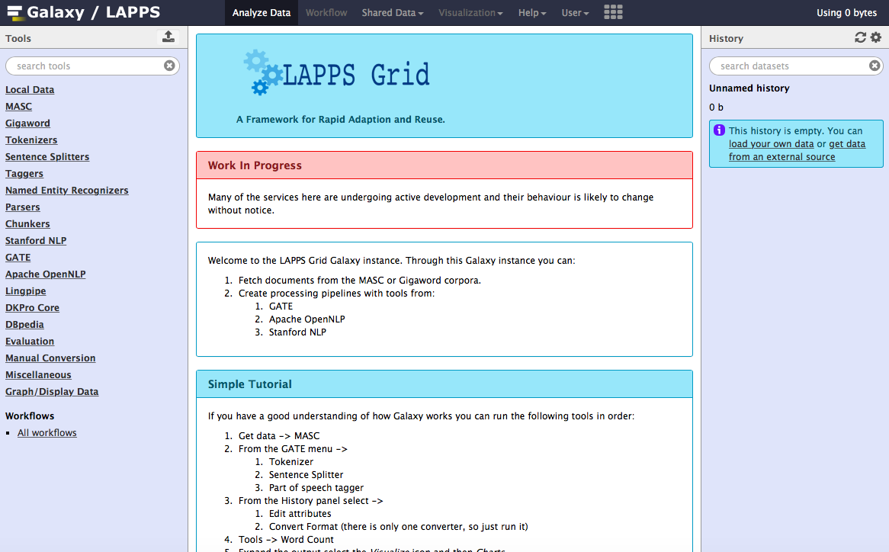

Slide 13
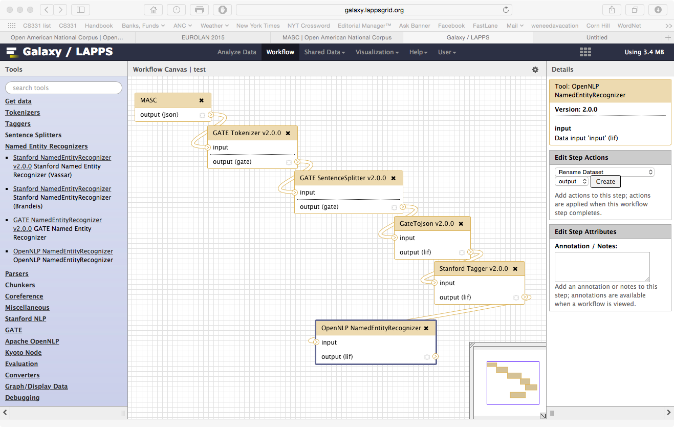
Workflow construction
LAPPS provides interoperability among…
… GATE tools
…Stanford tools
…OpenNLP tools
…others!

Slide 14
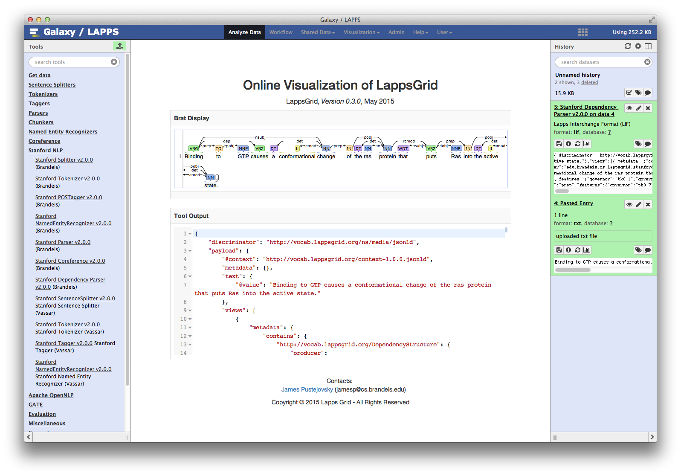

Slide 15
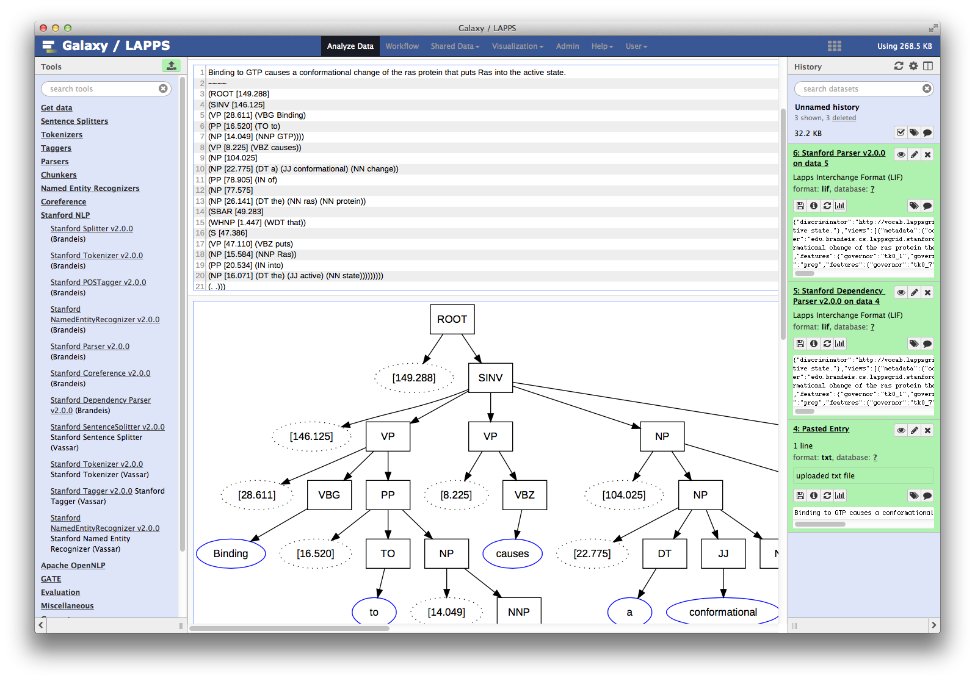

Slide 16
Evaluation in LAPPS/Galaxy
CMU has implemented services for state-of-the-art Open Advancement techniques
Enables rapid identification of
frequent error categories within modules and documents
which module(s) and error type(s) have the greatest impact on overall performance
Used in the development of IBM’s Watson to achieve steady performance gains over the four years of its development

Slide 17
Open Advancement in a Nutshell
Analyzes results in/from alternative pipelines
Can be comparison to gold standard, or comparison to another pipeline or pipelines
Potentially any number of pipelines can be compared
CMU working on methods for finding an optimal solution among all multiple possible paths
Tokenizer1
POS tagger1
Parser1
NER1
Overall evaluation/
comparison
Document
Statistics
Statistics
Statistics
OAQA
Evaluation
Statistics
Statistics
Statistics
Tokenizer2
POS tagger2
Parser2
NER2

Slide 18
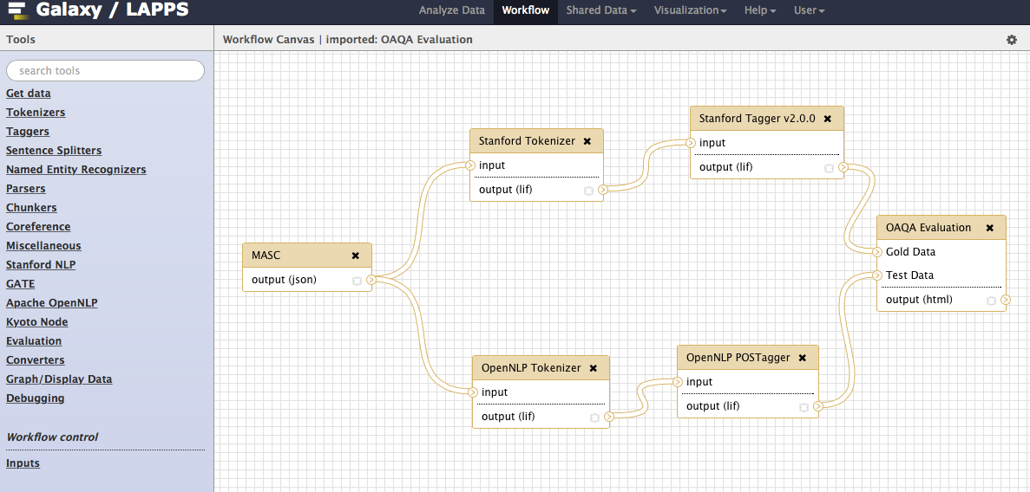
Parallel workflows

Slide 19
Potential benefits of LAPPS/Galaxy collaboration
Galaxy contains a huge number of tools for analyzing genomic and other biomedical data
LAPPS includes tools to perform NLP analyses on unstructured textual data
Combining LAPPS services with Galaxy tools can allow for analysis of data mined from the vast stores of biomedical literature (Biomed, PubMed, PLOS, etc.)
BIONLP meets bio-analysis!

Slide 20
Machine Reasoning 101
Literally dumber than a bag of light switches
Actually literally is a bag of light-switches
Symbolic reasoning using triples
OWL/RDF expressed as triples
subject predicate object
The system doesn't actually understand anything
follows simple rules to manipulate symbols

Slide 21
Machine Reasoning 101
Given a simple Knowledge Base
A P B
A Q C
D P B
D Q E
F P G
H P G
F Q A
H Q D

Slide 22
Machine Reasoning 101
Can construct a simple query
?x P G (1)
?x Q ?y (2)
?y Q C (3)
Solve for ?x and ?y
Two triples match (1)
F P G (x=F)
H P G (x=H)

Slide 23
Machine Reasoning 101
Given x=F or x=H solve ?x Q ?y
F Q A (x=F, y=A)
H Q D (x=H, y=D)
Given y=A or y=D solve ?y Q C
One triple matches : A Q C
x=F and y=A
If unable to match any triple the answer is False (no)

Slide 24
Machine Reasoning 101
Human readable knowledge base
Toronto is-a City
Toronto is-in Canada
New-York is-a City
New-York is-in USA
Pearson is-a Airport
LaGuardia is-a Airport
Pearson is-in Toronto
LaGuardia is-in New-York

Slide 25
Machine Reasoning 101
Find all the airports in Canada
?x is-a Airport
?x is-in ?city
?city is-in Canada
Supporting facts (triples)
Pearson is-a Airport
Pearson is-in Toronto
Toronto in-in Canada

Slide 26
Example
Binding to GTP causes a conformational change of the ras protein that puts Ras into the active state. GTP-bound ras binds to the raf protein kinase. This binding of raf to ras has the effect of activating the raf kinase and localizing the raf kinase to the cell membrane. Activated raf now phosphorylates and activates the Mek1 kinase. The Mek1 kinase then phosphorylates the ERK kinase on both threonine and tyrosine residues which activate ERK kinase activity. The phosphorylated ERK protein then translocates to the nucleus where it regulates gene expression in part by phosphorylating the Elk1 transcription factor. Phospho-Elk then upregulates the gene expression of target genes such as the proto- oncogene c-fos. The entire signaling cascade is terminated by the intrinsic GTPase activity of ras which hydrolyzes the bound GTP into GTP, thus returning ras to the GDP bound state where it releases bound raf. The GTPase activity of ras is accelerated by interaction with another protein called GAP. The oncogenic rasv12 mutant has diminished GTPase activity and therefore stays in the active GTP bound state constitutively. Deletion of GAP or the related NF1 genes will also enhance ras activity by slowing the rate of ras-GTP hydrolysis.

Slide 27
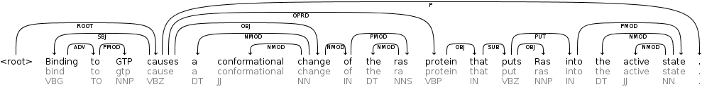
Information Extraction
Binding to GTP causes a conformational change of the ras protein that puts Ras into the active state.

Slide 28
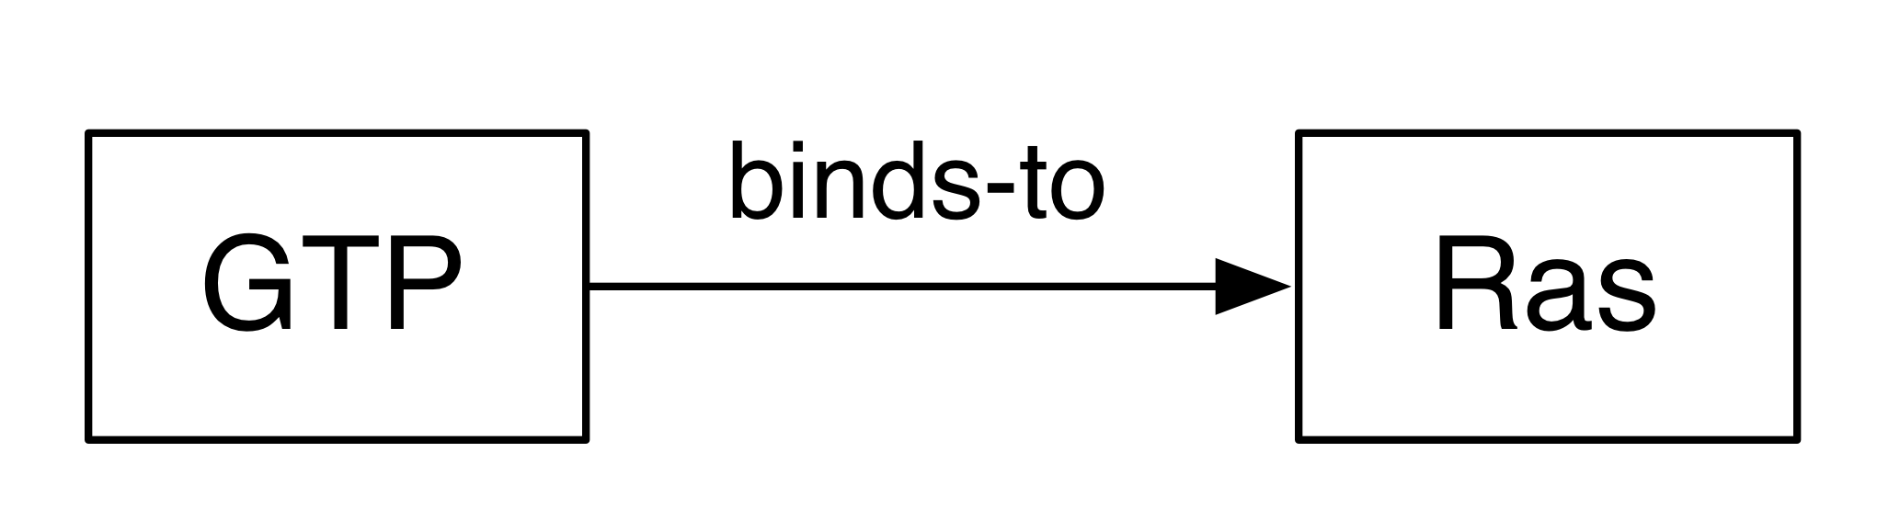
Binding to GTP causes a conformational change of the ras protein that puts Ras into the active state.
Stanford Parser
Pathway Extractor
Validate
Update Model
Model

Slide 29
Binding to GTP causes a conformational change of the ras protein that puts Ras into the active state
Stanford Parser
Pathway Extractor
Validate
Update Model
Model
Binding to GTP causes a conformational change of the ras protein that puts Ras into the active state

Slide 30
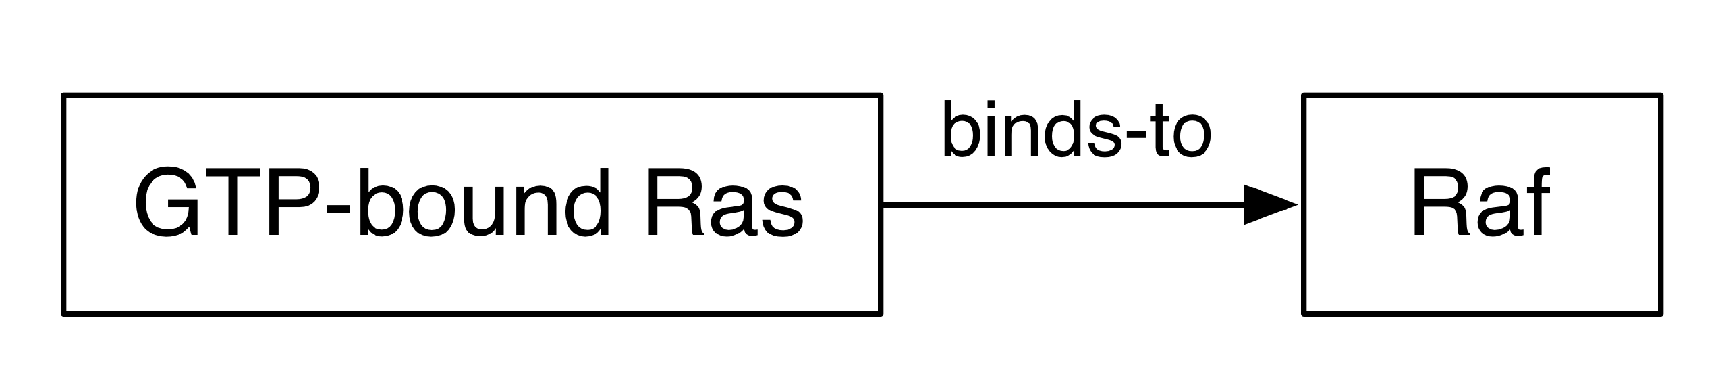
GTP-bound ras binds to the raf protein kinase.
Stanford Parser
Pathway Extractor
Validate
Update Model
Model
Binding to GTP causes a conformational change of the ras protein that puts Ras into the active state

Slide 31
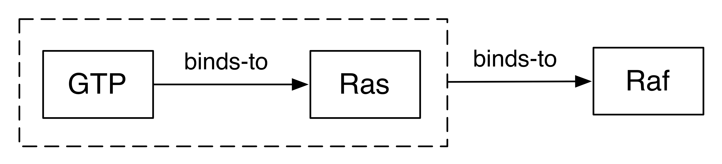
GTP-bound ras binds to the raf protein kinase.
Stanford Parser
Pathway Extractor
Validate
Update Model
Model
Binding to GTP causes a conformational change of the ras protein that puts Ras into the active state
GTP-bound ras binds to the raf protein kinase.

Slide 32
Potential
Feed model /extracted information to tools in Galaxy for analysis/visualization
The LAPPS Grid team is very interested in collaborations to explore and develop such capabilities!

Slide 33
Potential
Siri, which coding exon has the highest number of single nucleotide polymorphisms on chromosome 22?
If you ask Siri or Google this question you get the Galaxy 101 Tutorial page.
Wouldn't it be nice to get the Galaxy pipeline that answered the question?
Or better, just the output from the pipeline

Slide 34
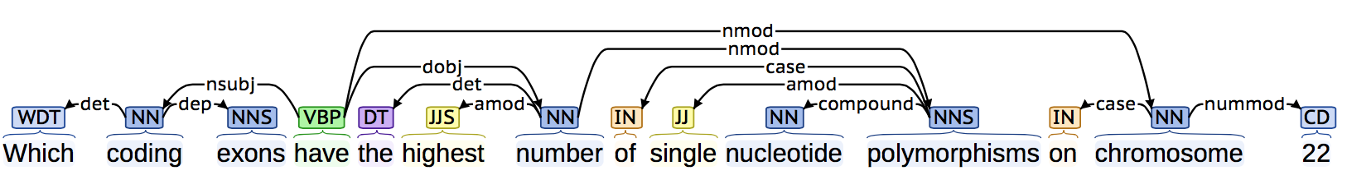
Parse the Question

Slide 35
Parse the Question
Predicate: have
Subject: coding exon
Object: number of
SNP on chromosome 22
Plan steps to answer question
data required
processing steps required

Slide 36
Answer the Question
Data required
Coding Exons
Single Nucleotide Polymorphisms
How do we know where to find this data?
Steps required
Join exons with SNP
Group by column 4 (how do we know this?)
Count SNP per exon
Sort and return top five.

Slide 37
Thank
You

Slide 38
Pipeline architecture for loosely-coupled linguistic analyses
text
Split sentences
Detect sentiment
Split words (tokenize)
Find relevant documents
Extract entities
Tag words with part of speech
Extract relations
Parse for syntactic structure
Build model
Produce a summary
Semantic analysis
Co-reference detection
Produce translation

Slide 39
Natural Language Processing
LAPPS provides a component framework for developing NLP applications
What is an NLP application
Question Answering
Sentiment Analysis
Machine Translation
Message Understanding

Slide 40
Question Answering
Siri/Google do a reasonable job.
Typically need to be trained for a specific domain.
When they are wrong they are spectacularly wrong
IBM Watson got the Final Jeopardy! question hilariously wrong because it did not know Toronto Canada was not a US city.

Slide 41
Sentiment Analysis
Does the message express a positive or negative viewpoint?
Challenges
Sarcasm
People make things up
I don't want to harsh on your mellow but words have no meaning.

Slide 42
Machine Translation
Getting better
Mostly "not-gibberish" now.
Same problems with sentiment analysis
English, "I have a bone to pick with you."
German, "I have a chicken to pluck with you."
Starts to perform very badly in multi-step translations
Japanese-> English -> Arabic

Slide 43
Message Understanding
Topic Analysis
Summarization
What are the main points of the article
Typically represented as a "bag of words"

Slide 44
NLP Pipeline
Segmentation
Split the text into sentences
Split the sentences into words
You would think this would be easy
You would be wrong
gonna, wanna, ur, even things like don't
do not
do n't
don 't

Slide 45
NLP Pipeline
Tagging
Part-of-speech
Named entities
Semantic Role Labeling
John sold the book to Mary.
Verb "to sell"
"John" is the seller
"Mary" is the recipient
"the book" was the thing that was sold

Slide 46
Knowledge Bases
Where do they come from?
Hand crafted
very time consuming (expensive)
Machine generated
Easy to generate large KB
full of noise
More data == Better data
use statistics to reduce noise

Slide 47


LAPPS Grid Overview
Vassar Server
LAPPS/Galaxy instance
User data
Service Grid Manager
Web Services
Directory of Tools, Resources,
Usage Info
Brandeis Server
Service Grid Manager
Galaxy workflow engine
Web Services
Data, Task, & Results Repository
CMU Server
Evaluation/IAA Services
User Server
Local Services
Local Data
Docker
LDC Server
Data Delivery Services

Slide 48
Why Galaxy?
Accessible: Accommodates users with a broad range of expertise (non-computational to expert programmer)
Reproducible: Galaxy captures information so that any user can understand and repeat a complete computational analysis
Transparent: Users share and publish analyses via the web and create interactive, web-based documents that describe a complete analysis
Well-developed, supported, open !

Slide 49
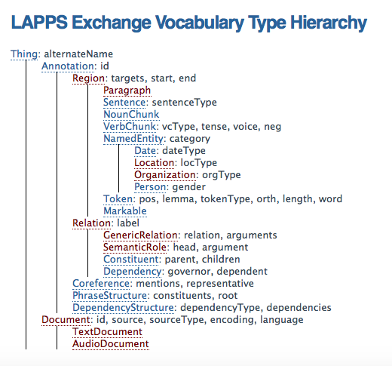

Slide 50
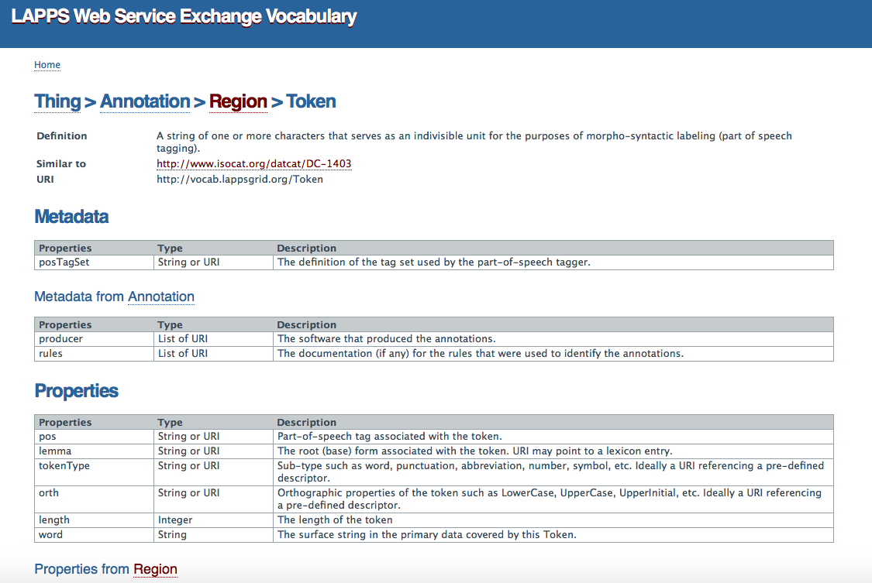

Slide 51
Logical flow
(client-server communication not represented)
Data
source
UIMA
service
UIMA CAS
UIMA
service
GATE
service
GATE
service
GATE XML
OpenNLP
service
OpenNLP
service
Stanford NLP
service
Stanford NLP
service
LAPPS services for OpenNLP and Stanford NLP tools are wrapped to produce and consume JSON-LD
JSON-LD output
Converter to LIF JSON-LD
Converter from LIF JSON-LD

Slide 52
All tools’ input/output formats mapped into and out of LIF
Linguistic categories etc. mapped to WSEV
Tool 1
Input/output format/concepts
WSEV
LIF JSON-LD
Tool 2
input/output format/concepts

Slide 53
LAPPS Web Service Exchange Vocabulary
Specifies a terminology for a core of linguistic objects and features exchanged among NLP tools that consume and produce linguistically annotated data
Linked wherever possible to existing repositories such as ISOCat (CLARIN Concept Repository), schema.org, FoLiA categories, etc.
References in JSON-LD representation point to URIs providing definitions for specific linguistic categories in the WS-EV

Slide 54
Interoperability
LAPPS Interchange Format (LIF)
allows services to exchange information
Syntactic interoperability
handled by JSON-LD
enforced by the LIF JSON schema
Semantic interoperability
enhanced by using the Linked Data aspect of JSON-LD to link to the LAPPS Web Services Exchange Vocabulary
Not yet-another-repository! Linked to others where possible

