Slide 1
Contributing to the Lapps Grid
Lapps Service Wrapping
Lapps Grid Group
May 26, 2014

Slide 2
Outline
Introduction
From Software to Web Service
From NLP Tool to Lapps Service
Java Example
Python Example
Conclusion
Reference

Slide 3
The Language Application Grid
Availability & Interoperability of NLP Tools
Java, Python, tools
OpenNLP, Stanford NLP, Gate, NLTK
Language Application (Lapps) Grid Project
Language Service
Lapps API Design

Slide 4
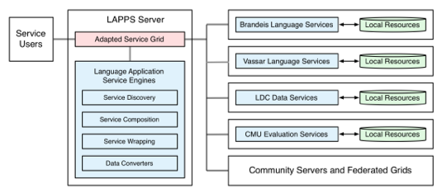
Lapps Grid Architecture
Using Composite Lapps Services
Wrapping Atomic Lapps Services

Slide 5
Lapps API Design
Consistent Interface
Discriminator
JSON Format

Slide 6
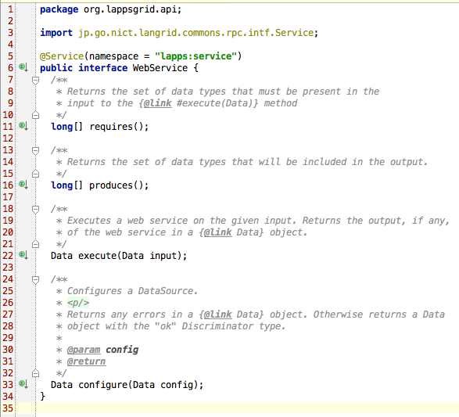
Consistent Interface (Java)

Slide 7
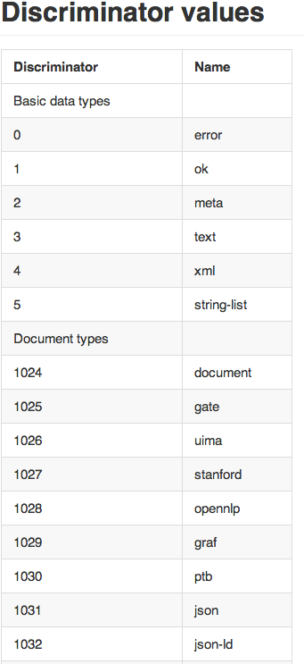
Discriminator
long [] requires()
long [] produces()

Slide 8
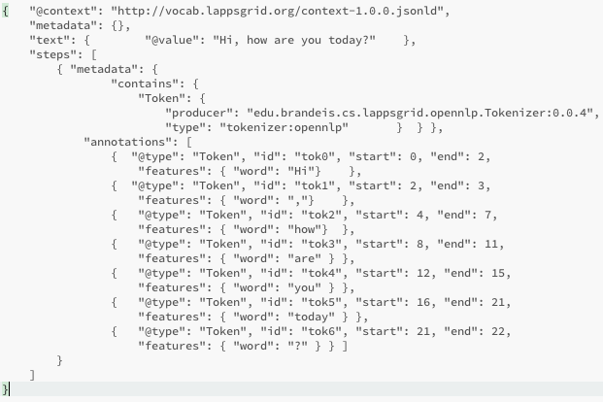
JSON

Slide 9
Contributing to Lapps Grid
Wrapping Lapps Service
NLP tools + Lapps API to atomic Lapps service
Registering to Service Manager
Atomic Lapps services become available for searching and compositing

Slide 10
Service Wrapping Tutorial
Web Service: “Hello World!”
“Hello World” Program (Java) —> WSDL
Lapps Service: “Stanford Tagger”
Stanford Tagger (Java) + Lapps API —> WSDL
Lapps Service: “NLTK Tagger”
NLTK Tagger (Python) + Lapps API —>WSDL

Slide 11
Web Service Wrapping

Slide 12
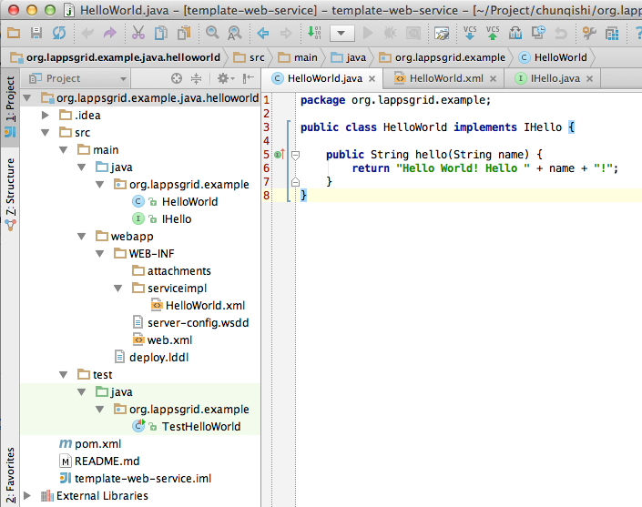
Hello World (Java)
https://github.com/chunqishi/org.lappsgrid.example.java.helloworld

Slide 13
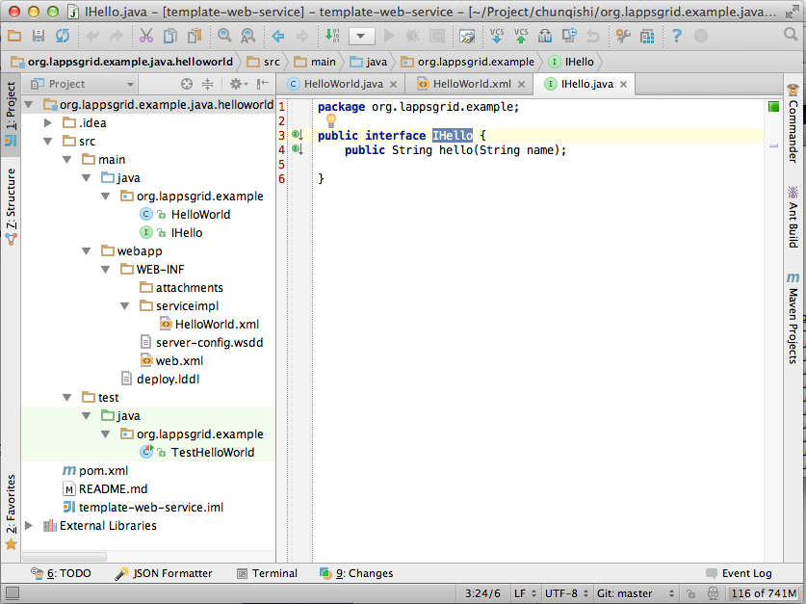
Interface Design

Slide 14
Developing Template
Developing Template
Maven for Dependency Library Management
Github Repository
https://github.com/chunqishi/org.lappsgrid.example.java.helloworld
Local Test
Maven Compile/Package & Jetty Server based Testing
Command: mvn clean package jetty:run

Slide 15
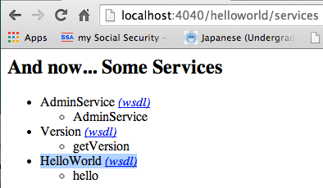
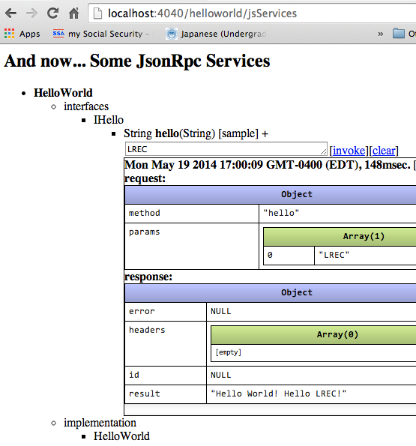
Web Service WSDL

Slide 16
Lapps Service Wrapping (Java)

Slide 17
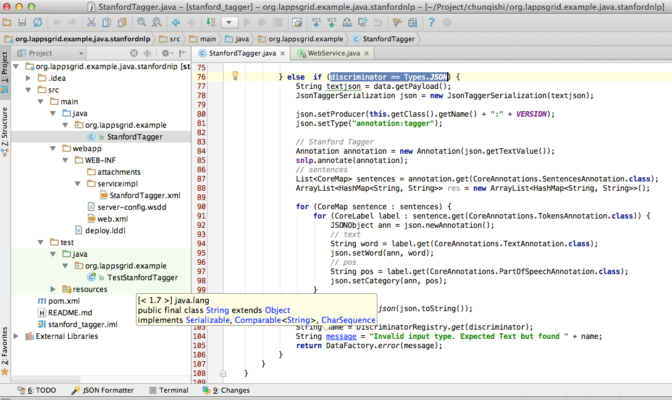
Developing Template
https://github.com/chunqishi/org.lappsgrid.example.java.stanfordnlp

Slide 18
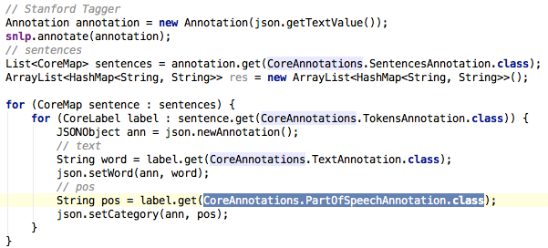
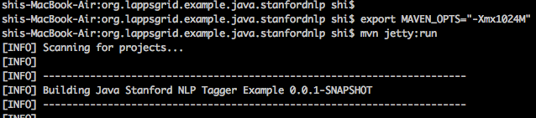
Stanford Tagger Wrapping
Java Wrapping
Jetty Running

Slide 19
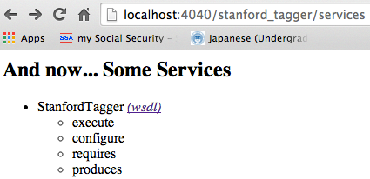
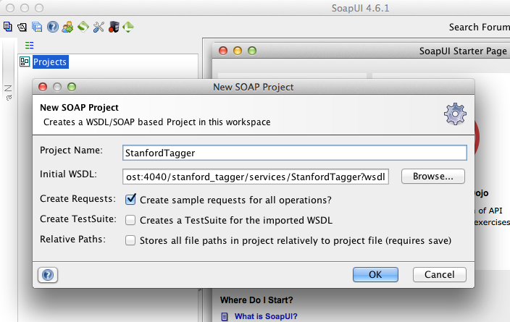
Stanford Tagger Testing
Local Service
SoapUI Testing

Slide 20
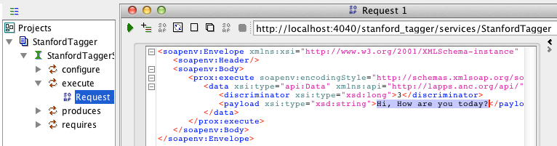
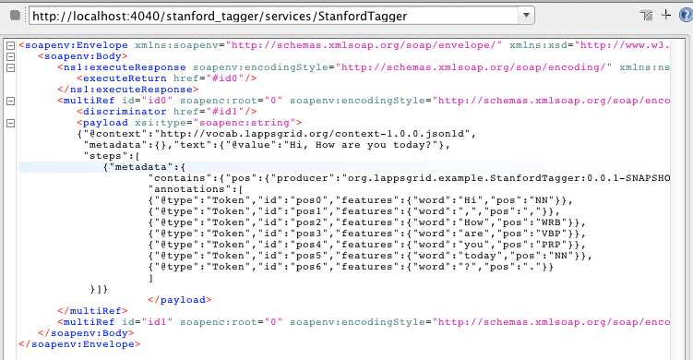
Stanford Tagger Testing Result
Request
Response

Slide 21
Lapps Service Wrapping (Python)

Slide 22
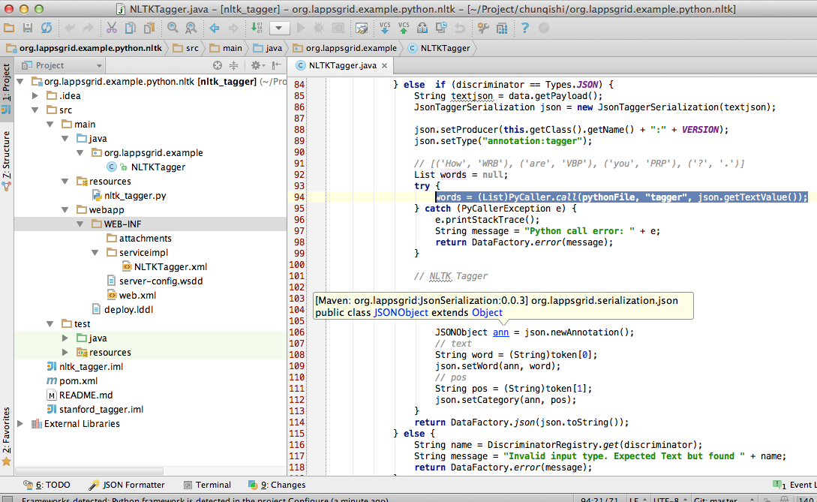

Developing Template

Slide 23
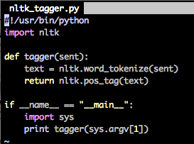
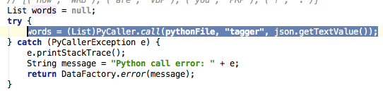
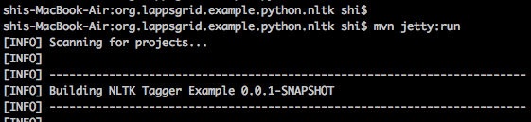
NLTK Python
Python Program
Python Result
Java Wrapping
Jetty Running

Slide 24
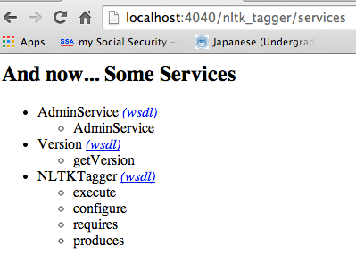
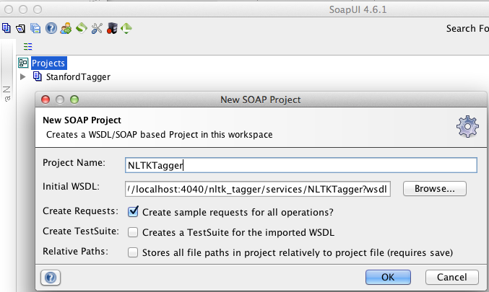
NLTK Tagger Testing
Local Service
SoapUI Testing

Slide 25
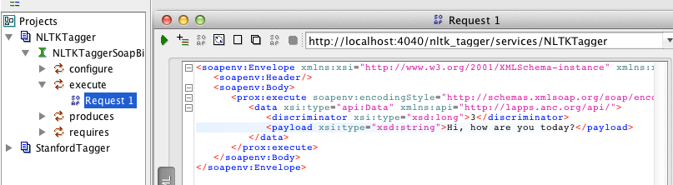
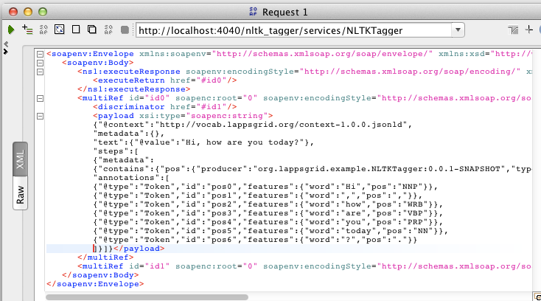
NLTK Tagger Testing Result
Request
Response

Slide 26
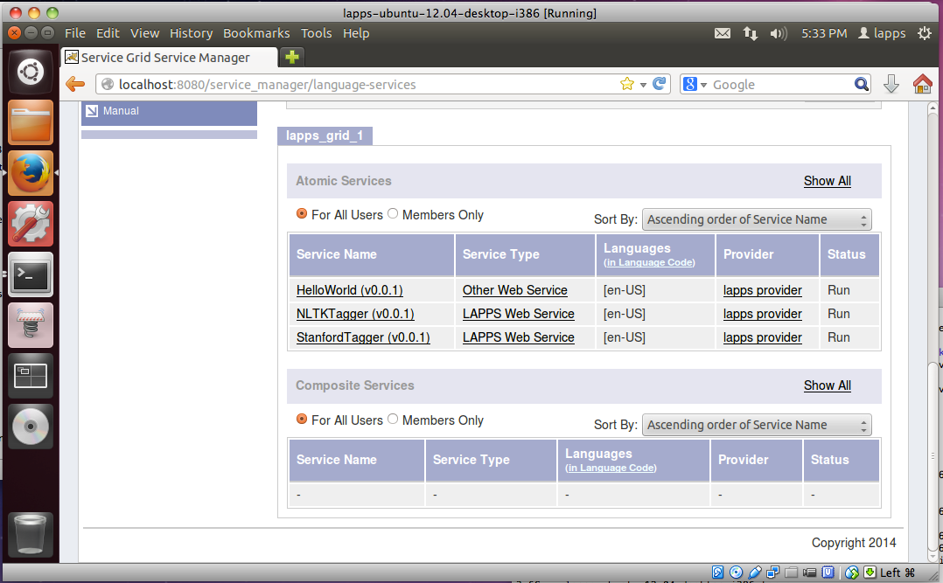
Service Register
Service Manager

Slide 27
Conclusion
Contributing to the Lapps Grid
Wrapping Lapps Service
Java / Python Wrapping
Templates from Github Repository
Registering into Service Manager
Service Manager Installation Script
Developing Environment
VirtualBox Image: Ubuntu

Slide 28
Reference
API Docs: http://www.anc.org/projects/lapps/api/project-info.html
Service Templates:
https://github.com/chunqishi/org.lappsgrid.example.java.helloworld
https://github.com/chunqishi/org.lappsgrid.example.java.stanfordnlp
https://github.com/chunqishi/org.lappsgrid.example.python.nltk
Service Managers:
http://eldrad.cs-i.brandeis.edu/service_manager/language-services
http://grid.anc.org:8080/service_manager/language-services
VirtualBox Image:
http://eldrad.cs-i.brandeis.edu/download/lapps-ubuntu-12.04-desktop-i386.tar.gz

