Slide 1
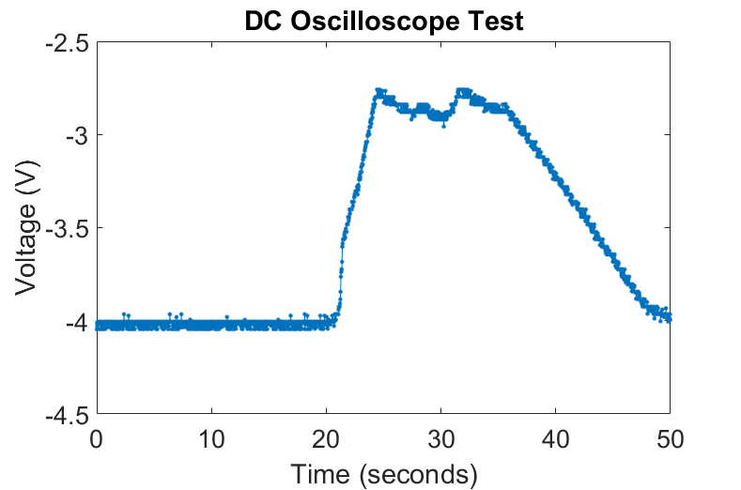




$$V_{G}=0 V$$
$$V_{S}=200 mV$$
$$V_{G}=20 V$$
$$V_{G}<20 V$$

Slide 2
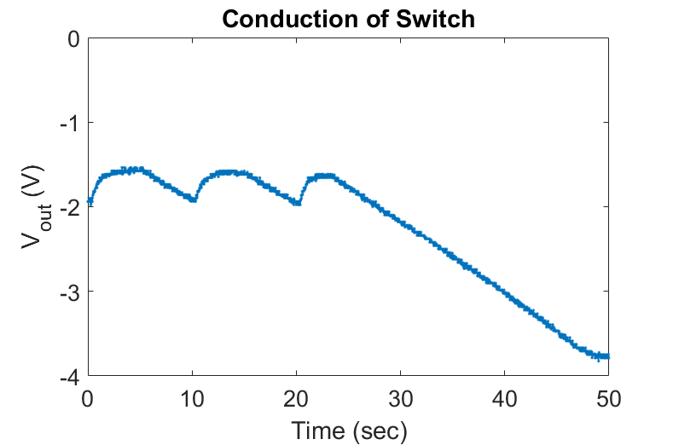


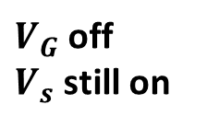





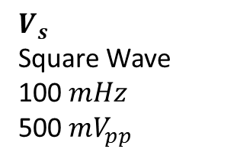

Square wave on closed switch
$$V_{D}$$
$$V_{out}$$
$$V_{G}$$
$$R_{P}$$
$$C_{osc}$$
$$R_{osc}$$
$$R_{P}$$
$$R_{D}$$
$$V_{s}$$
Square Wave
100 $mHz$
500 $mV_{pp}$
$V_{G}$ off
$V_{s}$ still on
Closed switch allows a pathway for the square wave to be read from the oscilloscope.

Slide 3
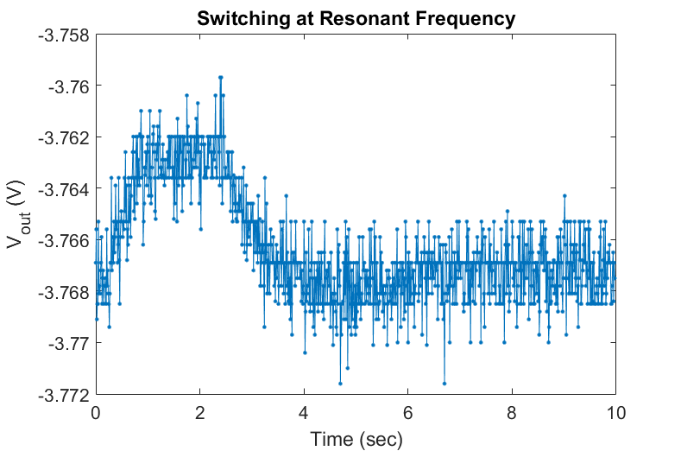
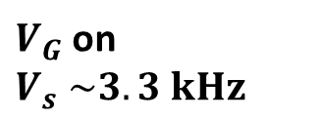
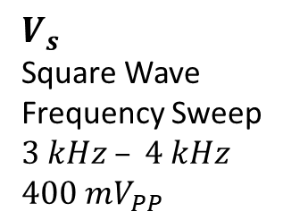
Square wave on closed switch
$$V_{D}$$
$$V_{out}$$
$$V_{G}$$
$$R_{P}$$
$$C_{osc}$$
$$R_{osc}$$
$$R_{P}$$
$$R_{D}$$
$$V_{s}$$
Square Wave
Frequency Sweep
$$3 kHz – 4 kHz$$
$$400 mV_{PP}$$
$V_{G}$ on
$$V_{s} \sim 3.3 kHz$$
6 mV jump at output when driving switch with 3.3 kHz

