Slide 1
CLIENT LAYER
Hiring Manager Portal
Resume & JD Upload UI
Seniority & Technical Category Selector.
INPUT & ORCHESTRATION LAYER
[ Data Ingestion ]
• PDF/DOCX/Text Parsing
• Metadata Extraction
• Structure Normalization
[ Seniority & Category Mapping ]
• BAH Level Selection
• Technical Category Selection
• Logic Mapping Engine
[ NLP Extraction & Prompt Builder ]
• Resume Skill Extraction
• JD Competency Extraction
• Difficulty Calibration
• Prompt Orchestration for Llama 3.x
OUTPUT & VERIFICATION LAYER
[ LLM Question Generator ]
• Baseline Questions
• Probing Questions
• Ideal Answers
• Difficulty Labels
[ SME & Compliance Validation ]
• Pre‑Approved Question Bank Check
• Governance & Neutrality Filters
• Question Swap Mechanism
[ PDF Generator ]
• Final Interview Guide
• Standard + Probing Questions
• Ideal Answers
• Rubric (1–5 scoring across BAH dimensions)

Slide 2
DATA SOURCES
• Resume Files (PDF / DOCX / TXT)
• Job Descriptions (PDF / DOCX / TXT)
• Hiring Manager Inputs (BAH Level, Technical Category)
INGESTION & EXTRACTION
• File Parsers (PDF/DOCX/Text)
• Metadata Extractor
• Text Normalization Pipeline
• Section Detection (Skills, Experience, Projects)
NLP PROCESSING LAYER
• Resume Skill Extraction (NER / Pattern Models)
• JD Competency Extraction
• Experience Claim Extraction
• Embedding Generation (Skills, Competencies, Claims)
• Semantic Similarity Matching
LOGIC & MAPPING ENGINE
• BAH Level → Difficulty Mapping
• Technical Category → Competency Mapping
• Resume Claims → Probing Question Triggers
• Data Validation & Normalization
LLM GENERATION LAYER
• Baseline Questions
• Probing Questions
• Ideal Answers
• Difficulty Labels
PROMPT CONSTRUCTION
• Structured Prompt Assembly
• Inject: Skills, Competencies, Difficulty, Claims
• Apply Linguistic Neutrality Filters
• Apply Compliance Filters

Slide 4
DATA SOURCES
• Resume Files (PDF / DOCX / TXT)
• Job Descriptions (PDF / DOCX / TXT)
• Hiring Manager Inputs (BAH Level, Technical Category)
INGESTION & EXTRACTION
• File Parsers (PDF/DOCX/Text)
• Metadata Extractor
• Text Normalization Pipeline
• Section Detection (Skills, Experience, Projects)
NLP PROCESSING LAYER
• Resume Skill Extraction (NER / Pattern Models)
• JD Competency Extraction
• Experience Claim Extraction
• Embedding Generation (Skills, Competencies, Claims)
• Semantic Similarity Matching
LOGIC & MAPPING ENGINE
• BAH Level → Difficulty Mapping
• Technical Category → Competency Mapping
• Resume Claims → Probing Question Triggers
• Data Validation & Normalization
LLM GENERATION LAYER
• Baseline Questions
• Probing Questions
• Ideal Answers
• Difficulty Labels
PROMPT CONSTRUCTION
• Structured Prompt Assembly
• Inject: Skills, Competencies, Difficulty, Claims
• Apply Linguistic Neutrality Filters
• Apply Compliance Filters

Slide 5
VALIDATION & GOVERNANCE LAYER
• SME‑Approved Question Bank
• Question Swap Logic
OUTPUT DATA
• Final Question Set (Standard + Probing)
• Ideal Answers
• Difficulty Metadata
• Rubric (1–5 scoring across BAH dimensions)
• Final PDF Interview Guide

Slide 6
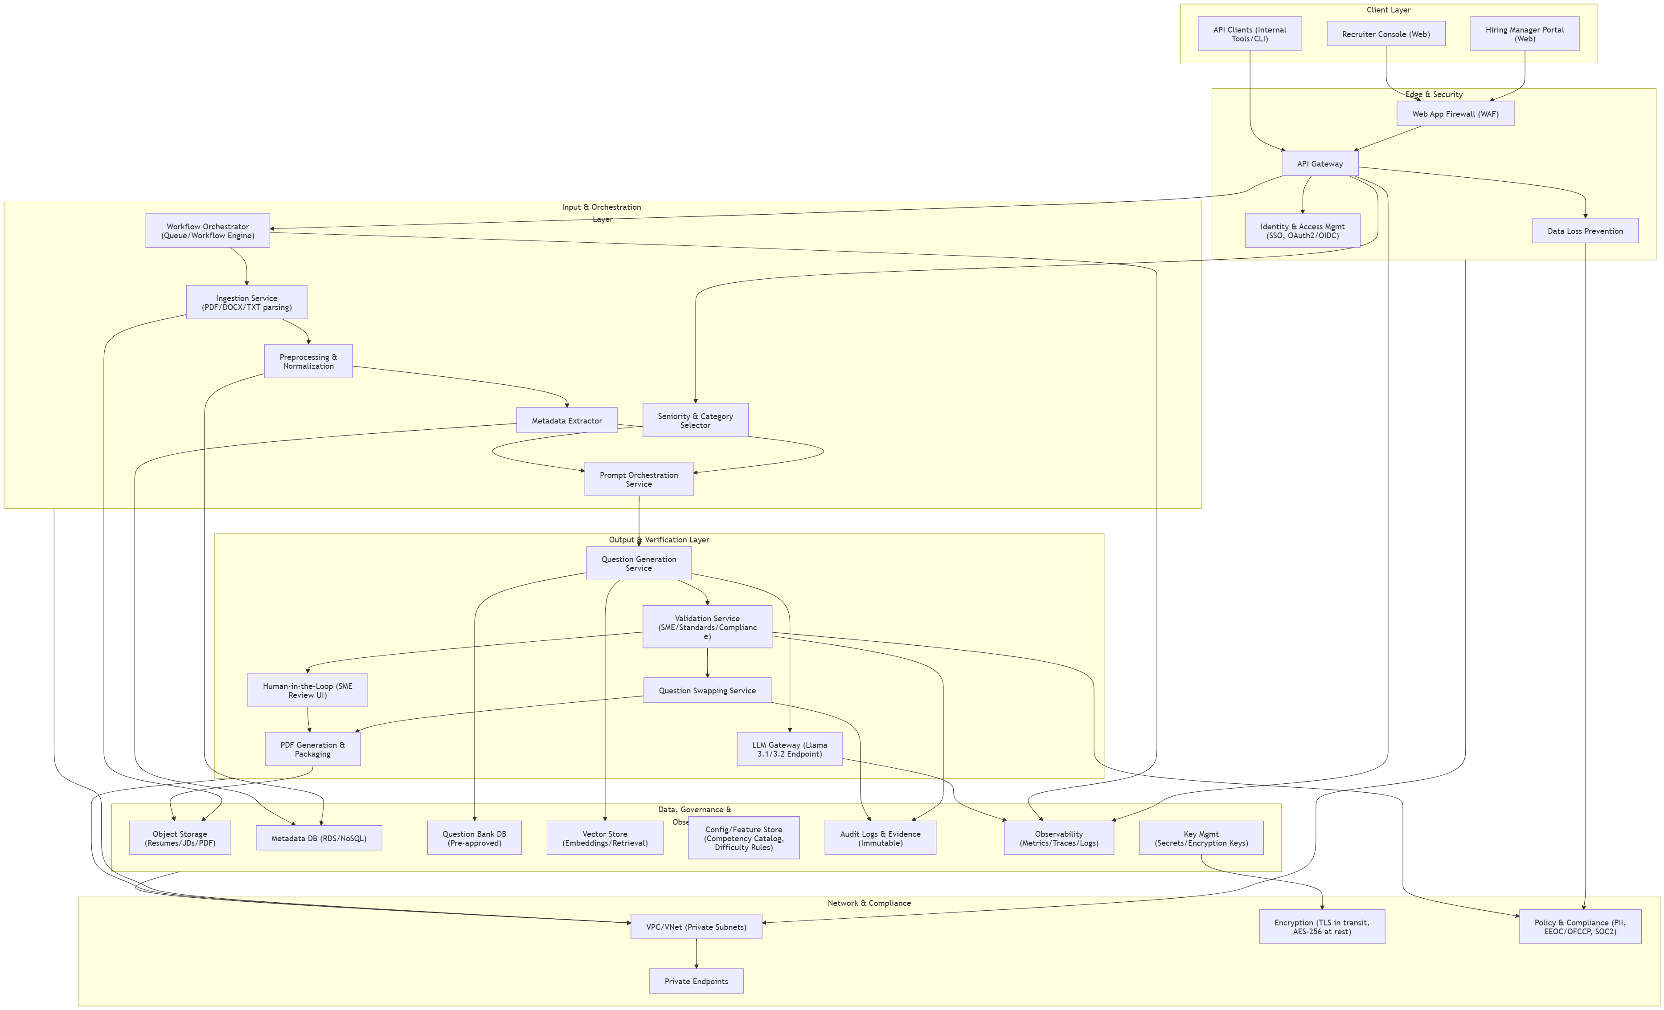

Slide 7
┌────────────────────────────────────────┐
│ Inputs to AI Layer │
│ • Resume (PDF/DOCX/TXT) │
│ • Job Description │
│ • Selected BAH Level & Tech Category │
└────────────────────────────────────────┘
│
▼
┌──────────────────────────────┐
│ 1. NLP Extraction Layer │
│ • Parse documents │
│ • Extract claimed skills │
│ • Extract experience clues │
└──────────────────────────────┘
│
▼
┌──────────────────────────────┐
│ 2. Logic Mapping Layer │
│ • Map BAH level → competencies│
│ • Map tech category → topics │
│ • Set difficulty (Easy/Med/Hard)│
└──────────────────────────────┘
│
▼
┌──────────────────────────────┐
│ 3. Retrieval Layer (RAG) │
│ • Search pre-approved │
│ question bank │
│ • Pull relevant examples │
└──────────────────────────────┘
│
▼
┌──────────────────────────────┐
│ 4. Prompt Builder │
│ • Build structured prompt │
│ • Insert: competencies, skills│
│ JD highlights, difficulty │
└──────────────────────────────┘
│
▼
┌──────────────────────────────┐
│ 5. LLM Generation (Llama) │
│ • Baseline questions │
│ • Probing questions (resume) │
│ • Ideal answers │
└──────────────────────────────┘
│
▼
┌──────────────────────────────┐
│ 6. Safety & Compliance │
│ • Remove PII │
│ • Gender-neutral language │
│ • Remove coded words │
└──────────────────────────────┘
│
▼
┌──────────────────────────────┐
│ 7. Validation & SME Review │
│ • Ensure coverage │
│ • Managers can swap questions│
└──────────────────────────────┘
│
▼
┌──────────────────────────────┐
│ 8. Final Output │
│ • Structured PDF │
│ • Questions + Ideal Answers │
│ • Difficulty labels │
│ • Rubric (1–5 scale) │
└──────────────────────────────┘

