Slide 1
Sequential Design
Jiahui Fan , Ömercan Mısırlıoğlu ,Yordan Saputra

Slide 2
What is Sequential Design?
It is a specific form of experiment, where information is collected in subsequent stages over time
Unlike static designs, surrogate model is updated after each batch and new points based are selected based on uncertainty, error, or optimization needs
It combines the strengths of space-filling and adaptive learning while offering more efficiency, however, have certain disadvantages
Pros: More efficient use of sample budget, Adaptive, Flexible, Improved Accuracy
Cons: Higher complexity, early stage dependency, being harder to parallelize and risk of unbalanced exploration

Slide 3
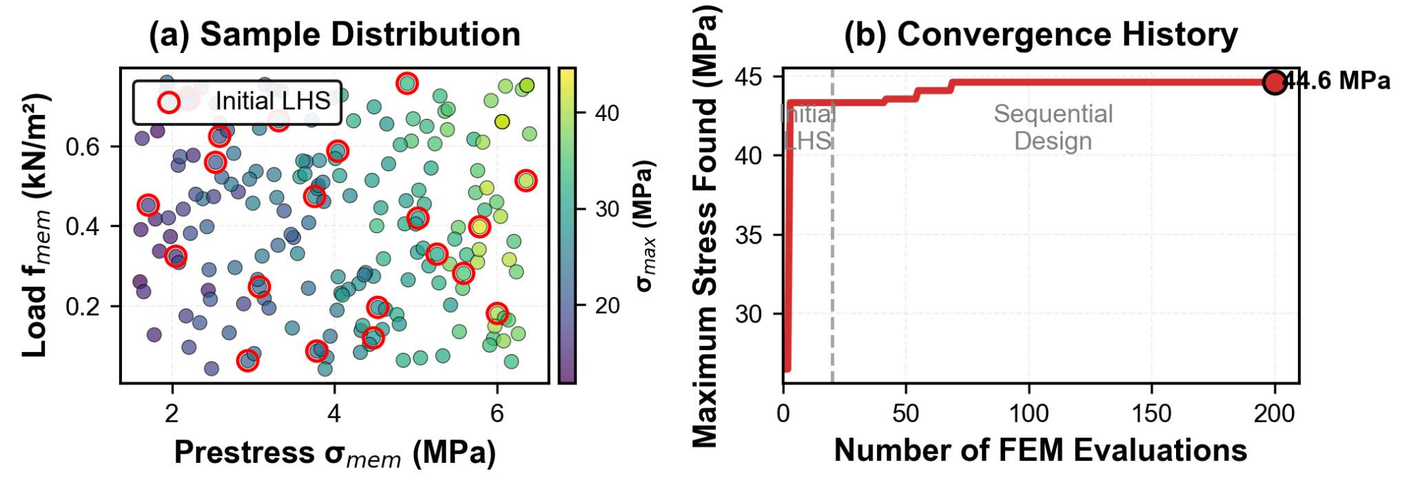
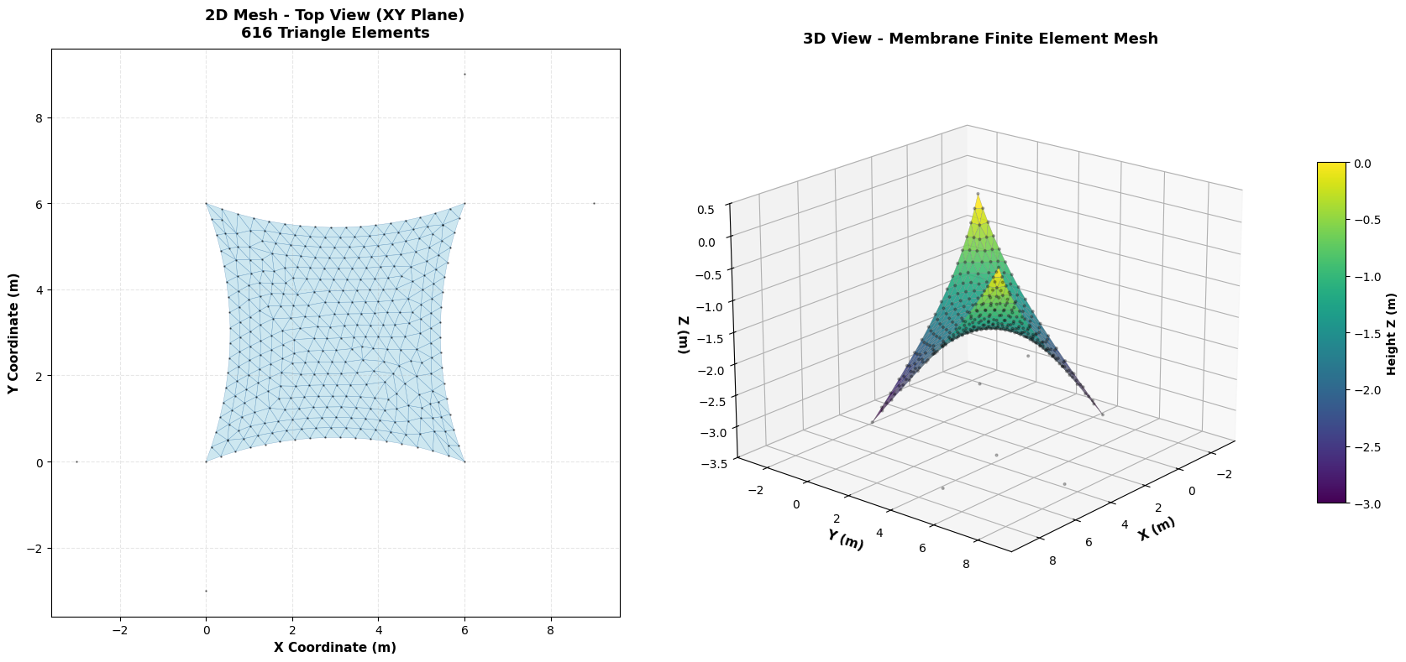
Why use Sequential Design in Sun Sail FEM?
Sun Sail FEM is expensive
Geometric nonlinearity
Cauchy stress evaluation
Iterative nonlinear solver
Each run takes seconds–minute
6D Input Space is large
Six uncertain parameters
High-dimensional design space (6D)
Flat regions
Highly sensitive regions
GP Surrogate helps guide sampling
Prediction of membrane stress
Uncertainty / variance σ²(x) indicating where model is unsure.

Slide 4
How does it work?（Sequential Design Algorithm）
Start with a small but space-filling design.
  Since we know almost nothing about the system at the beginning, we need to pick input parameter combinations that cover the entire range of possibilities.
  A common method is Latin Hypercube Sampling (LHS), which ensures the points are evenly spread out across each input dimension.
  In our case, we have 6 input parameters and we start with 100 points chosen by LHS.
  Run the FEM solver for each of these 100 points to obtain the initial training data for the surrogate model.
Fit a Gaussian Process / Kriging surrogate model on the initial training data.
  The surrogate predicts the FEM output for any new input.
  It also provides a prediction uncertainty, indicating how confident it is in each prediction.
Identify regions where the surrogate shows high predictive uncertainty.
  Add new design points in the regions with high uncertainty.
  Select new 20 sample points in those regions, run the FEM solver, and add the new results to the training set.
  Refit the surrogate model with the updated dataset.
Repeat step 3 until simulation budgets is used up.
  Continue adding points in uncertain regions, running FEM, and updating the surrogate until all allowed simulations (200 runs) are completed.
  Note: The number of points at each step can be adjusted as needed.
Minimizing Predictive Uncertainty (Core Idea)
Surrogate model: Gaussian Process (GP)
GP provides
  Prediction: ŷ(x)
  Uncertainty: variance σ²(x)
Sequential Design chooses the next FEM run where: x_next = arg max σ²(x)
This strategy is known as Active Learning MacKay (ALM) (MacKay, 1992)
References
MacKay, DJC. 1992. “Information-Based Objective Functions for Active Data Selection.” Neural Computation 4 (4): 590–604.

Slide 5
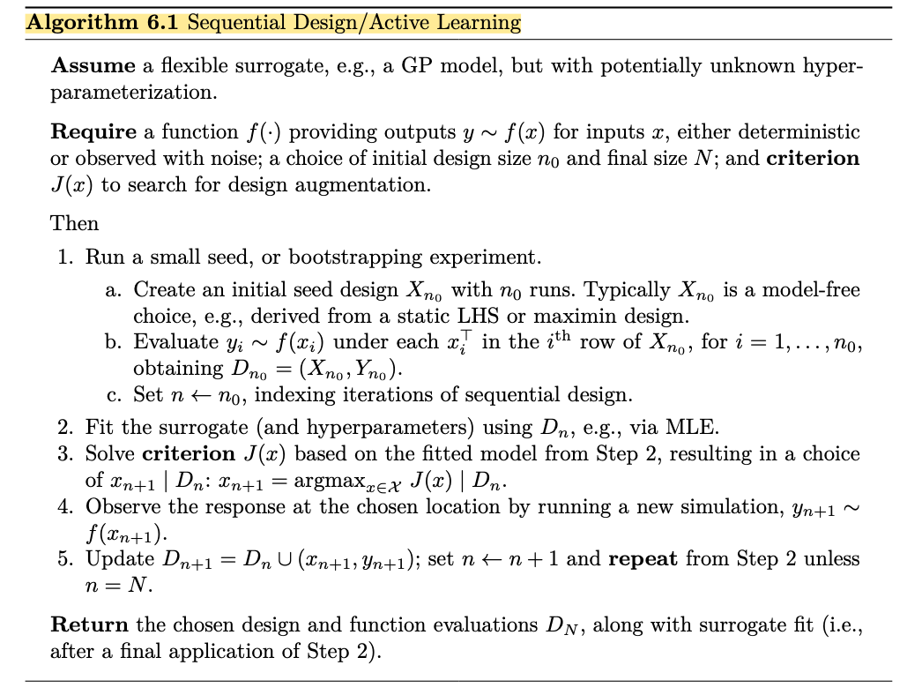

Slide 6
How does it work?（Sequential Design Algorithm）
Sequential Design Algorithm
Initial design → Latin Hypercube Sampling
Fit GP surrogate on current FEM results
Select next point
x_{\text{next}}=\arg\max \sigma^2(x)
Run FEM, update GP, repeat until budget is reached
Minimizing Predictive Uncertainty (Core Idea)
Surrogate model: Gaussian Process (GP)
GP provides
• Prediction: \hat{y}(x)
• Uncertainty: variance \sigma^2(x)
Sequential Design chooses the next FEM run where
x_{\text{next}} = \arg\max_x \sigma^2(x)
This strategy is known as
Active Learning MacKay (ALM)
Example Result (Simplified)
Sequential Design quickly reduced model uncertainty and concentrated FEM evaluations in informative regions.

Slide 7
Why use Sequential Design in Sun Sail FEM?
The Sun Sail FEM model is computationally expensive
Total simulation budget is limited (≤ 200 runs)
Input parameters include 6 uncertain variables:
  E_mem, 𝜈_mem, σ_mem, f_mem, σ_edg, σ_sup
Sequential design concentrates samples in regions where FEM response changes the most (high variance / uncertainty)
Prevents wasting runs in “flat” or unimportant regions

