Slide 1
Ensemble techniques
Group 2

Slide 2
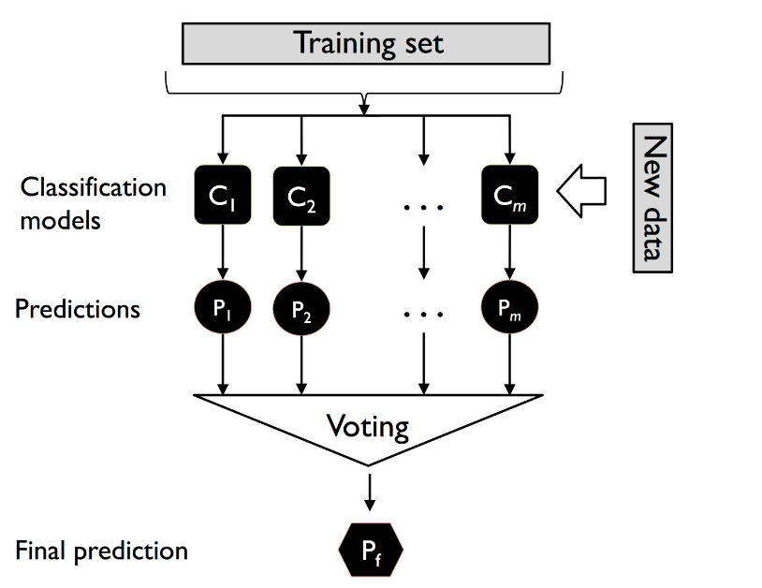
What are Ensemble techniques?
Ensemble techniques combine multiple learners (typically decision trees) to produce a more accurate and robust surrogate model. They reduce variance (bagging), reduce bias (boosting), and capture nonlinear interactions without needing heavy feature engineering.
Key Idea:
Many simple models working together outperform one complex model.

Slide 3
2 main types of ensemble techniques
Types of Ensemble Techniques
1. Bagging (Bootstrap Aggregation)
Trains many models independently on bootstrapped samples
Focus: variance reduction
2. Boosting
Models trained sequentially
Focus: bias reduction

Slide 4
Let us take Random Forest as an example for Bagging
Random Forest is an ensemble learning method that builds many independent decision trees and averages their predictions for regression tasks.
Based on bagging (bootstrap aggregation): each tree sees a different random subset of data
Random subset of features used at each split
Final prediction = mean of all tree predictions

Slide 5
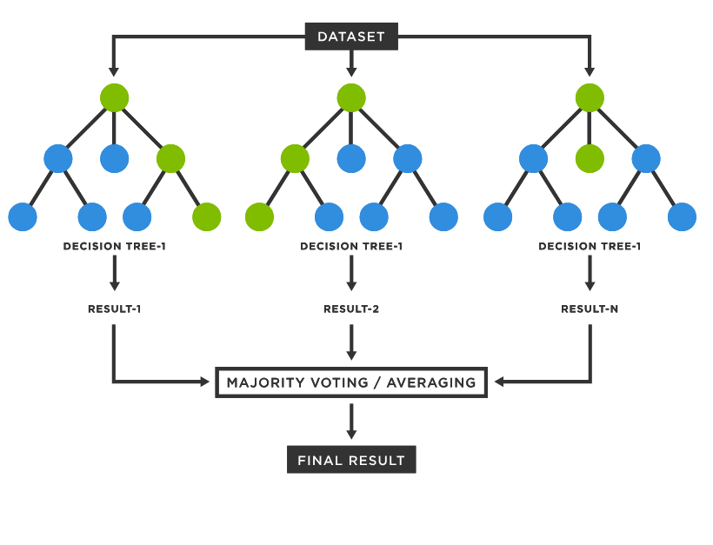
Random Forest - As an example

Slide 6
Random Forest - As an example
Core Ensemble Principles Shown by example:
Diversity among models: Each tree is slightly different
Aggregation (averaging predictions)
Reduced variance and improved generalization
Notes:
It builds many decision trees
Trees “vote” or average their predictions
→ This demonstrates exactly how ensemble learning improves accuracy and robustness.

Slide 7
Random Forest - As an example
Random Forest introduces randomness in two ways:
Bootstrap sampling → Each tree trains on a different subset of the data
Random feature selection → Each split sees different subsets of features
This enforces decorrelation between trees — the key requirement of powerful ensembles.

Slide 8
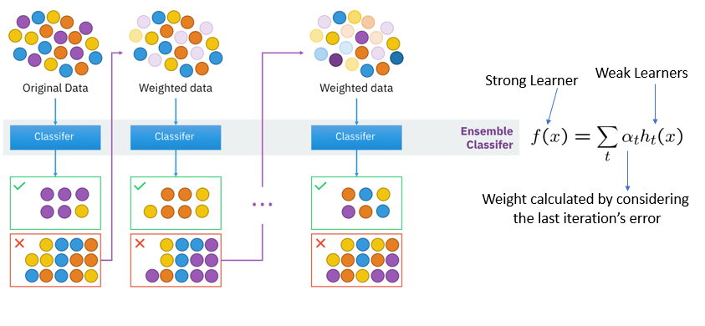
Boosting learning Procedure

Slide 9
Bagging vs Boosting
Independent learners | Dependant learners
Equal weight to all models | Weights a model’s contribution
Aggregation of model results

Slide 10
Thank you

