Slide 1
Design via Optimality Criteria: MSE
Case Study – Sun Sail Computer Experiment
By Group 2

Slide 2
Goal: Construct a set of design points that minimizes the surrogate model’s prediction error (MSE)

Slide 3
What is an Optimal Design?
Choose input points (design) for the expensive computer model.
Number of computer model runs is limited
(n < 200). So our choice of design points must be efficient.

Slide 4
MSE Optimality Criterion
Minimize Mean Squared Error of surrogate predictions
Ensures accurate global approximation across parameter space

Slide 5
Why Use MSE Optimality?
Good global coverage of design space
Avoids large uncertainty regions
Ideal for Gaussian Processes / Kriging

Slide 6
What is MSE and why it matters?
Deterministic model: GP variance = MSE
The FEM model has no noise
For deterministic simulators:
MSE = Variance
Minimizing MSE = minimizing prediction uncertainty

Slide 7
What is MSE and why it matters?
MSE focuses on global accuracy
Not just accuracy at sampled points
Ensures the surrogate is good everywhere in the input space
Critical when parameters vary widely

Slide 8
Essential for downstream tasks
Lower MSE ⇒ more reliable:
  Failure probability estimation
  Uncertainty analysis
  Sensitivity analysis
Why MSE is the right criterion?

Slide 9
Best match for Gaussian Processes
MSE is the theoretically appropriate loss for GP regression
Other criteria (A-optimality, D-optimality) are not suitable for surrogate modeling
MSE gives the lowest global prediction error
Why MSE is the right criterion?

Slide 10
Benefits of minimizing MSE
Produces better design points
Minimizing MSE naturally leads to space-filling designs
→ avoids clustering
→ covers the entire parameter space

Slide 11
Benefits of minimizing MSE
Essential for downstream tasks
Lower MSE ⇒ more reliable:
  Failure probability estimation
  Uncertainty analysis
  Sensitivity analysis

Slide 12
Methods for Achieving MSE-Optimal Designs
Space-filling designs
Gaussian Process

Slide 13
Space filling design
Here, we choose the design points so that they are spread out as evenly as possible across the whole input parameter space.

Slide 14
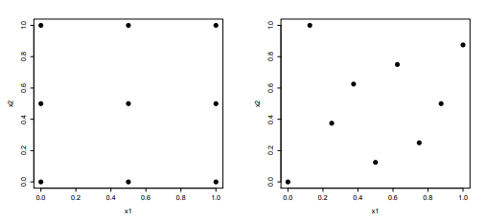
Space filling design
Imagine, the input parameter space is a hypercube, then
No large gaps exist in this hypercube.
No points cluster together.
Random sampling does not ensure the above two.

Slide 15
Latin Hypercube sampling
Imagine a hypercube with d sides and each side has a unit length. This unit length represents the probability function, not the actual input.
d - number of dimensions, in this case 7.

Slide 16
Latin Hypercube sampling
We sample points [0,1]^d that evenly cover the
probability space, ie by assuming a uniform
distribution in [0,1].
To go back from the probability space to the actual input
parameter, apply the inverse cumulative distribution function (of each
parameter’s true distribution) to each coordinate.

Slide 17
Latin Hypercube sampling - To summarise
As a result, we get a set of input design points that covers the input space uniformly in terms of probability.

Slide 18
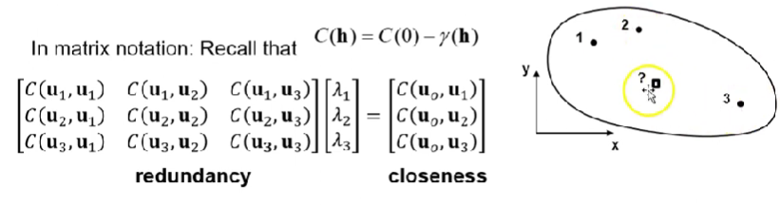
MSE on Gaussian Process (or Kriging)
General:
In a computer experiment we may want to know f(x_1), f(x_2),.... f(x_N) but we only know f(x_1), f(x_2),.... f(x_n) where n<N. We want to choose points with the minimum prediction uncertainty
To find optimal points for training a surrogate model we can use MSE. Simply choose input parameters with maximum uncertainty.
Variance is decreased where we have samples
We can have an iterative procedure where we find new sample points until a stopping criterion is reached
Simple Kriging:
Weights are mathematically based on minimizing MSE

Slide 19
Application to Sun Sail Model
Input parameters: Emem, νmem, σmem, fmem, cable stresses, etc.
Output: maximum membrane Cauchy stress
Use MSE-optimal design to improve surrogate model’s accuracy.

Slide 20
Summary
Designed an MSE-optimal experimental design for the Sun Sail computer model
Objective: minimize surrogate model prediction uncertainty (MSE/variance)
Method: iteratively add points where GP prediction variance is highest
Achieves better global accuracy with fewer simulation runs
Produces a more reliable surrogate for stress prediction, uncertainty analysis, and sensitivity analysis

