Slide 1

Actor Model
Lapusneanu Gabi
Akka.NET

Slide 2


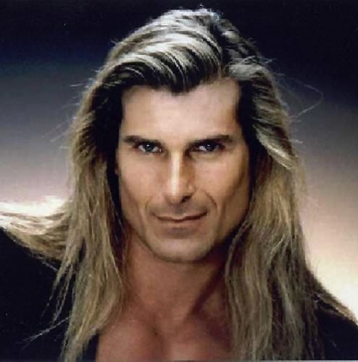
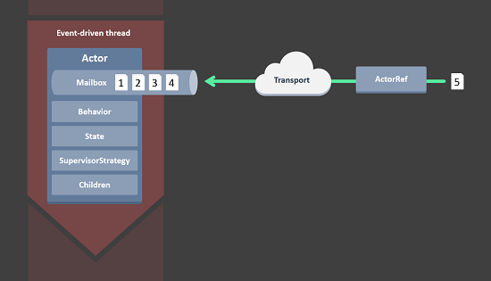

Akka.NET
Introduction
Concepts
Demo

Slide 3
Akka.NET
Introduction
Concepts
Demo

Slide 4

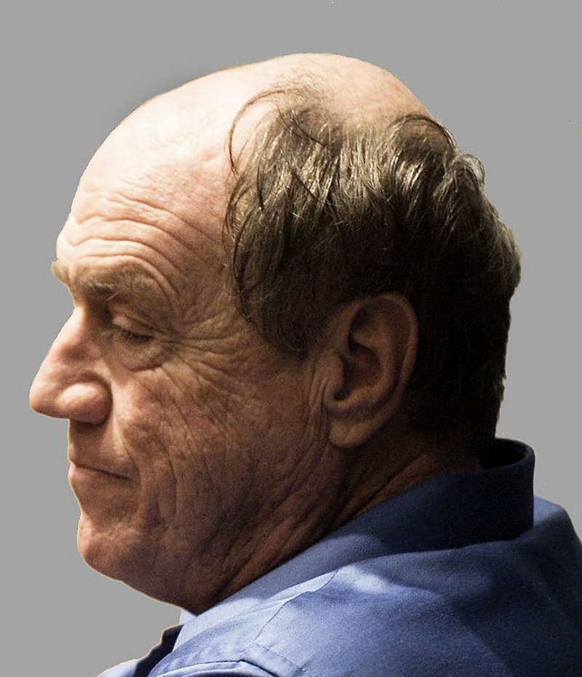
Introduction
Actor Model originated in 1973.
Actor Model is a mathematical model of concurrent computation.
Carl Hewitt

Slide 5


Introduction
Actor Model has mostly been associated with Erlang programming language.

Slide 6


Released
2015

Slide 7

Akka.NET
Introduction
Concepts
Demo

Slide 8
Akka.NET
Introduction
Concepts
Demo

Slide 9

The Actor System
Cofiguration

Slide 10
The Actor System
The Actor System
The Actor System is our root on actors structure.
Cofiguration
Configuration

Slide 11






The Actor System
The Actor System is our root on actors structure.
The Actor System as a collaborating ensemble of actors is the natural unit for managing shared facilities like scheduling services, configuration, logging, etc.
01
Dead Letter Office
Scheduler
04
02
User Guardian Actor
05
Event System
03
06
System Guardian Actor
Configuration

Slide 13
Akka.NET
Introduction
Concepts
Demo

Slide 14
Akka.NET
Introduction
Concepts
Demo

Slide 15
Akka.NET
Introduction
Concepts
Demo

