Slide 1
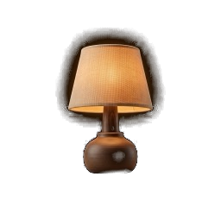
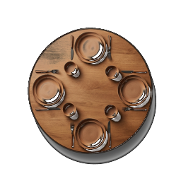
BAINSA HACKATHON 2026 · I MISSED THAT / SILENT SPECS
I Missed That
Transcription tells you what was said. We tell you what you missed.
For hard-of-hearing and late-deafened adults, at their hearing family's table.
Team: [Name] · [Name] · [Name] · [Name]
Notes:
Roles: Presenter narrates and holds the phone/laptop. Alex, Sam, Priya play a family Sunday lunch — three teammates as relatives (each phone is its owner's mic).
"Transcription tells you what was said. We tell you what you missed."
If Deepgram or the camera acts up, say so and press A to switch to ?replay=demo2 — it reproduces the exact same cards deterministically.

Slide 2

Every accessibility tool puts the whole burden on the deaf person.
Read faster. Ask again. Get told never mind. We built the other side.
“Dinner table syndrome and I want to cry.”
“DTS - Dinner Table Syndrome. Deaf people in hearing families are too familiar with this, myself included. It's simply too much work to follow along. Thats why you feel like you could sleep for a week, we have to work much harder than a hearing person to understand verbal conversations.”
“I'd say the hardest part for me as a Deaf person in a hearing family during the holidays is extreme dinner table syndrome.”
— thread title, r/deaf, 174↑⁷
— r/deaf, “Exhausted and sad after family Sunday lunch,” 36↑⁷
— r/deaf, “Christmas family diner experiences”⁷
Notes:
0:00–0:15 — the flip (before any card is on screen)
"Every accessibility tool puts the whole burden on the deaf person. Read faster. Ask again. Get told never mind. We built the other side."
(A relative's phone is already visible on screen, lying on the table like a placemat. As the presenter says this line, two relatives start talking over each other — that phone goes amber. This happens before a single card appears. The burden flips first; the product shows up second.)

Slide 3

THE NUMBERS
50M
~1/3
56%
51.9%
of them use hearing aids¹
say the family table matters most. Work: 21%.²
of DHH live-caption users are frustrated with them³
people in the EU say they have trouble hearing. One in nine.¹
170 wpm
4%
>90%
And the place they most want to hear isn't the office. It's the family table.
caption comprehension drops. Group talk runs 160–220.³
of videos caption non-speech sound: laughter, tone⁴
of deaf children have hearing parents⁵
Sources on the last slide. ¹ EU27 figure derived from the 59M Europe (EU+UK+NO+CH) total. ⁵ US data, children.
Notes:
Q10: Why family, and not work?
The numbers said so before we did: in the EuroTrak Italy survey, 56% of people with hearing loss say home with family is where hearing well matters most, against 21% for the workplace. And practically, a family will put their phones down for you in a way a client on a Zoom call never will. Work is the second scenario, not the first.
(Deck line: In the EU, about 50 million people say they have trouble hearing. Only about a third use hearing aids. And the place they most want to hear isn't the office — it's the family table. >90% of deaf children have hearing parents is US-sourced child data, say ">90%" and nothing stronger.)

Slide 4
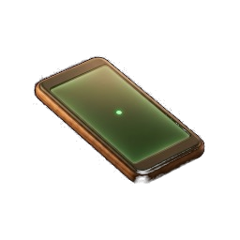


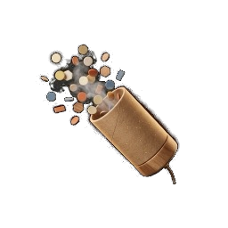
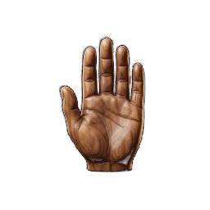


THE CONTRACT
A table is a contract. We hold both sides to it.
THE TABLE'S SIDE
YOUR SIDE
Phones as mics
Plans, with why
Asked you
QR join, no install. Each voice arrives named.
Sunday at nonna's: who brings what, and why.
The moment someone asks you, with a buzz.
Crosstalk lamp
Why they laughed
Look-away catch-up
Glows amber when two people talk at once.
The joke itself, so you can laugh for real.
Look back up and the card opens itself.
One at a time
Say it as text
Doubt words
A gentle nudge when the talk keeps flapping.
One tap, shown on every phone at the table.
Unsure words dimmed. Tap to ask again.
Notes:
Accessibility at a table is a contract between everyone present. We're the clerk that holds both sides to it — Claude is the clerk any family or team can hire; the contract and the evidence are ours.
Q2: Doesn't the crosstalk lamp shame the fast talker, or the loud aunt?
It goes amber, never red, and it's ambient light on the table's own phones — a mirror, not a scolding. Nobody has to be the one saying "one at a time" for the hundredth time; the lamp says it instead.
Q1: What if the AI says something I didn't mean?
It never speaks anything you haven't picked and can edit first. Say-it-as-text queues candidate lines from what's actually being said; you tap the one you want, you can edit it, and only then does it appear on the table's phones. It's autocomplete for the moment you're locked out of, not autopilot.

Slide 5
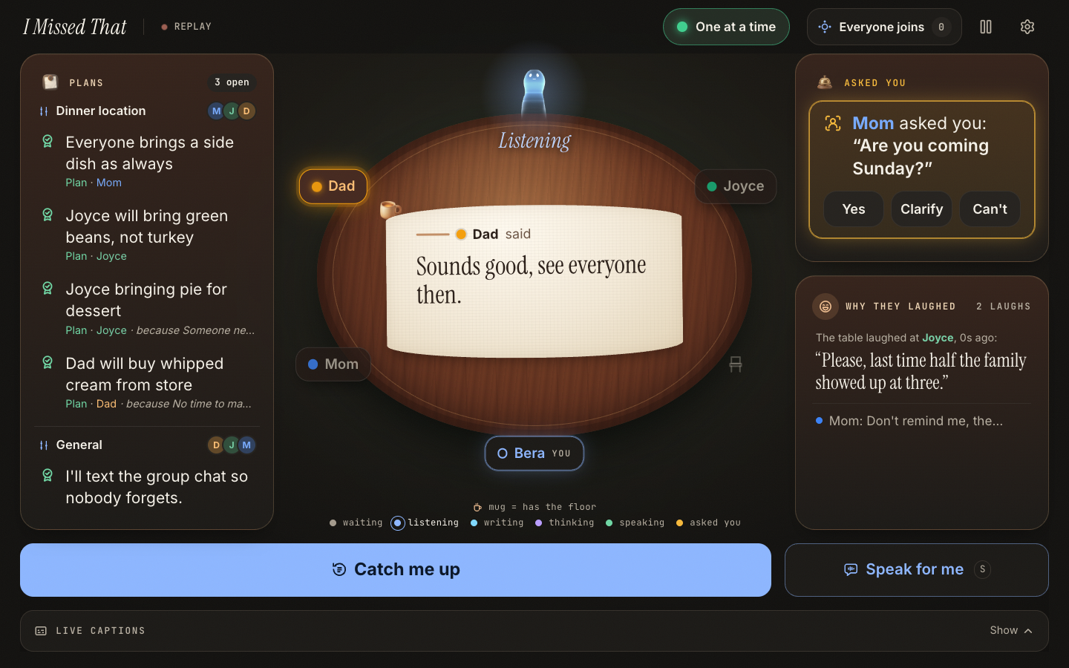
LIVE DEMO · 90 SECONDS
A family Sunday lunch. Three phones, one clerk.
Not a transcript. The plan, the joke, the question aimed at you, and a way back in.
Backup: ?replay=demo2 replays the same cards, no mic needed.
0:00
0:15
0:35
0:45
0:55
1:05
The flip
Plans form
Why they laughed
Look-away
Asked you
Speak for me
Notes:
0:15–0:35 — phones on the table, plans form
Alex: "So are we doing Sunday at nonna's again?" Sam: "I can bring the dessert if someone else does the pasta." Priya: "I'll do the pasta, but not before 2."
(A Plans card fills live: "Sunday at nonna's — Sam: dessert, Priya: pasta (after 2)," each with the reason attached.)
0:35 — the joke. Someone tells a joke; the table laughs. A "Why they laughed" card appears: the last ~12 seconds, so the presenter gets the joke, not just the laughter.
0:45 — looking away. Presenter looks down at their phone; a pill reads "Away." Presenter looks up; a card opens by itself: "While you looked away: Sam changed dessert to tiramisu."
0:55 — asked you. Alex: "Bera, are you coming Sunday?" Phone buzzes. An "Asked you" card pulses.
1:05 — speak for me. Presenter taps a queued line — "yes, I'll bring wine" — and it appears as text on everyone's phone at the table. "I didn't have to shout over the table. It just showed up where everyone was already looking."
Close: "Not a transcript. The plan, the joke, the question aimed at you, and a way back in. Ava does the mics. We do what the mics are for."
Fallback: press A for ?replay=demo2.

Slide 6
WHAT'S NEW
Ava does the mics. We do what the mics are for.
TOOL | ALREADY DOES | DOESN'T DO
Ava | Phones join as named mics, speaker colours, type-to-speak | No plans, no “asked you,” no “why they laughed.”
Otter / Teams “Catch me up” | A summary after the fact, or on demand | Built for a meeting room, not a dinner table
MS Teams captions | Live captions, logged-in speaker names | Breaks on overlap. Nothing addressed to you.
Caption glasses (XRAI, Captify, AirCaps) | Captions in your line of sight | Arms clash with hearing aids. Still just words.
I Missed That | Phones as mics, like Ava | Plans with why · asked you · why they laughed · look-away catch-up · say it as text
Sources: research/06-github-landscape.md, research/04-final-synthesis.md
Notes:
Q8: Why not just use Ava or Otter?
Ava gets you named, colored mics from every phone — genuinely good infrastructure, and we don't pretend to compete on it. Otter and Teams' "catch me up" give you a transcript or a summary after the fact, built for a meeting room. Neither one has ever heard of a plan forming, a joke landing, or a question aimed at you by name. Ava does the mics. We do what the mics are for.

Slide 7
HOW IT WORKS
From the table to a card, in seconds.
Phones on the table
Deepgram nova-3
Browser ledger
Claude, structured calls
One mic per person, joined by QR
Streaming ASR per phone. English, Italian, Turkish.
Who said what, when. Lives in memory.
gate 0.7 s · ledger 4–6 s · catch-up 4 s. Returns fields, never prose.
On-device camera sends only “away” / “back.” No video leaves the phone.
the cards
Nothing stored. In memory only, gone when the session closes.
Notes:
Q7: Other languages? It works in English, Italian and Turkish end to end, verified on Deepgram's nova-3 streaming model. Family tables code-switch — nonna in dialect, kids in English — so lines are labeled per language, not forced into one.
Q5: Bystander privacy? Nothing is stored after the session — in-memory ring buffer only, gone on refresh or close. There's an always-visible listening indicator and a pause button.
Q9: If Deepgram or Claude is down mid-demo? ?replay= needs neither key nor a mic and reproduces the exact same cards deterministically. Short of that, it degrades to the browser's Web Speech API: you keep live captions, you lose the plans/asked-you/why-they-laughed extraction until the connection's back. Neither is a crash.

Slide 8
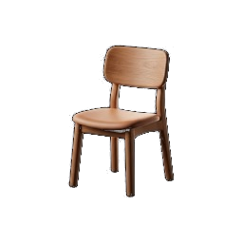
SCOPE, LIMITS, NEXT
What this is, and isn't.
SOURCES
1 AEA / EFHOH / EHIMA (EuroTrak), Getting the numbers right on hearing loss in Europe, 2024
https://www.ehima.com/wp-content/uploads/2024/03/Getting-the-numbers-right-on-Hearing-Loss-Hearing-Care-and-Hearing-Aid-Use-in-Europe-2024.pdf
2 EHIMA / Anovum, EuroTrak Italy 2022
https://www.ehima.com/wp-content/uploads/2022/11/EuroTrak_Italy_2022.pdf
3 Live-caption quality and reading-speed metrics (51.9%, 170 wpm), via NotebookLM synthesis, research/05
4 Non-speech information in captions, EEG study, PMC7040021; May et al. 2025
https://pmc.ncbi.nlm.nih.gov/articles/PMC7040021/
5 Mitchell & Karchmer 2004, Sign Language Studies 4(2), US data
https://eric.ed.gov/?id=EJ747626
6 Meek 2020, Dinner Table Syndrome, The Qualitative Report 25(6)
https://nsuworks.nova.edu/tqr/vol25/iss6/16/
7 r/deaf and r/hardofhearing threads
https://www.reddit.com/r/deaf/comments/n8msyg/
https://www.reddit.com/r/deaf/comments/1fh8h7h/
https://www.reddit.com/r/deaf/comments/1pqqqbs/
https://www.reddit.com/r/hardofhearing/comments/1tmpx4t/
BUILT FOR
hard-of-hearing and late-deafened adults at a hearing family's table.
NOT FOR
sign-first Deaf users.
TESTED
not yet with a hard-of-hearing user.
REACH
~10M in the EU could use it. Tonight it reaches tens.
NEXT
HoH user tests, a table mode for 65+, glasses as a display.
Notes:
Q3: Why not build for sign-first Deaf users?
Scoped out on purpose. Sign-first Deaf users are often better served by an interpreter or a full visual language — that's a different, well-served problem. We target the group in between: hard-of-hearing and late-deafened adults who rely on spoken language in rooms full of hearing people, where nobody brings an interpreter to Sunday lunch.
Q6: Cards on a phone at dinner — isn't that just more screens? One card at a time, no scrolling wall; they let you look up sooner, not later. A shared screen in the middle of the table (table mode) is on the roadmap for relatives who won't read a phone.
Close: "Not a transcript. The plan, the joke, the question aimed at you, and a way back in. Ava does the mics. We do what the mics are for."

