Slide 1
Ruby on Rails Short Course
Part 3: Basic Rails
Armando Fox
UC Berkeley RAD Lab

Slide 2
Outline of the day
Web apps, MVC, SQL, Hello World
Just enough Ruby
Basic Rails
Lunch break
Advanced model relations
AJAX & intro to testing
Configure & deploy
Informal discussion: RoR and pedagogy

Slide 3
Outline of Session 3
Overview of ActiveRecord
  accessors and attributes, constructors, finders
  validations, model lifecycle & callbacks
  after lunch: ActiveRecord associations—coolness
Overview of ActionView
  RHTML, RXML, RJS, HAML
  Forms and model objects, tag helpers
  Preview: AJAX
Overview of ActionController
  connections between controller & view
  sessions: the hash & the flash
  stupid filter tricks

Slide 4
Outline of Session 3
Overview of ActiveRecord
  accessors and attributes, constructors, finders
  validations, model lifecycle & callbacks
  after lunch: ActiveRecord associations—coolness
Overview of ActionView
  RHTML, RXML, RJS, HAML
  Forms and model objects, tag helpers
  Preview: AJAX
Overview of ActionController
  connections between controller & view
  sessions: the hash & the flash
  stupid filter tricks

Slide 5
Quick review: hashes and function call notation
Immediate hash (any object can be a key, any object can be an attribute)
  my_hsh = {:foo => 1, "x" => nil, 3 => ['a',4]}
  my_hsh[:nonexistent_key] returns nil
Parens can be omitted from function calls if parsing is unambiguous
  x = foo(3, "no") ⇔ x = foo 3, "no"
Braces can be omitted from hash if parsing is unambiguous
  x = foo( {:a=>1,:b=>2}) ⇔ x = foo(:a=>1,:b=>2)
  easy way to do keyword arguments
  Caveat: passing immediates to a function that accepts multiple hashes as its arguments

Slide 6
Active Record: what is it?
A class library that provides an object-relational model over a plain old RDBMS
Deal with objects & attributes rather than rows & columns
  query result rows ⇔ enumerable collection
  object hierarchy ⇔ join query

Slide 7
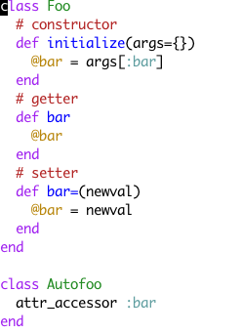
Review: the Student Example
object attributes are “just” instance methods
ActiveRecord accessors/mutators...
  default attr_accessor for each table column
  perform type-casting as needed
  can be overridden, virtualized, etc.

Slide 8
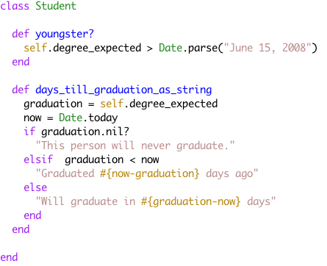
Example: open up Student class...

Slide 9
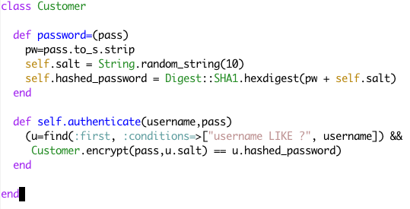
Virtual attributes example: simple authentication
Only salt & hashed password are stored

Slide 10
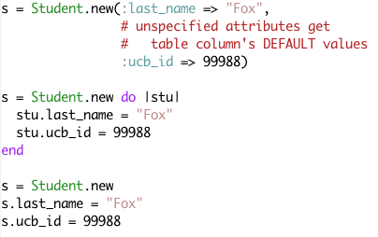
Constructors
Initializer knows if it’s been handed a block (predicate method Kernel#block_given?)

Slide 11
New != Create
Call s.save to write the object to the database
  s.create(args) ≈ s.new(args); s.save
  s.update_attributes(hash) can be used to update attributes in place
  s.new_record? is true iff no underlying database row corresponds to s
save does right thing (INSERT or UPDATE)
Convention over configuration:
  if id column present, assumes primary key
  updated_at/created_at (resp. *_on) automatically set if present to update/creatiion date (resp. time)

Slide 12
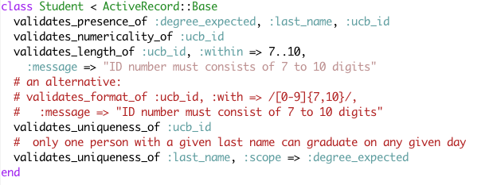
But!...validations
model lifecycle specifies well-defined callbacks for ActiveRecord manipulation
  allows keeping validation semantics with the model
  allows keeping validation code separate from mainline
are those macros, language keywords, or what?

Slide 13
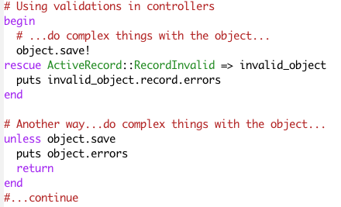
How would you use these?
Note convention: save! vs. save (also create, update, ...)
Scaffolding provides a default use via a view helper method errors_for

Slide 14
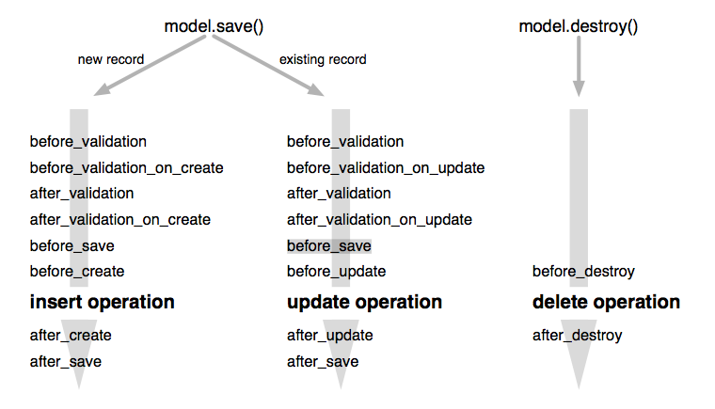
Callbacks: the Return (get it?) of Aspect-Oriented Programming
Allows Pre and Post Operations

Slide 15
Another way to do passwords
Encrypt a password before saving the record
# Encrypts some data with the salt.
def self.encrypt(password, salt)
Digest::SHA1.hexdigest("--#{salt}--#{password}--")
end
def before_save
return if password.blank?
self.salt = Digest::SHA1.hexdigest("--#{Time.now.to_s}--#{login}--") if new_record?
self.crypted_password = encrypt(password)
end

Slide 16
find() ≈ SQL SELECT
# To find an arbitrary single record:
s = Student.find(:first)
# To find all records:
students = Student.find(:all)
# find by 'id' primary key (Note! throws RecordNotFound)
book = Book.find(1235)
# Find a whole bunch of things
ids_array = get_list_of_ids_from_somewhere()
students = Student.find(ids_array)
# To find by column values:
armando = Student.find_by_last_name('Fox')
a_local_grad = Student.find_by_city_and_degree_expected('Berkeley', Date.parse('June 15,2007')
# To find only a few, and sort by an attribute
many_localgrads = Student.find_all_by_city_and_degree_expected('Berkeley', Date.parse('June 15,2007'),:limit=>30,:order=>:last_name)

Slide 17
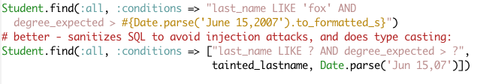
Find by conditions
Use ? for values from parameters. Rails will sanitize the SQL and prevent any SQL injection
You can also specify ordering and use arbitrary SQL operators
(caveat emptor: database portability may be jeopardized)
# Using SQL conditions
books = Book.find(:all,
:conditions => [‘pub_date between ? and ?’,
params[:start_date], params[:end_date]],
:order => ‘pub_date DESC’)

Slide 18
Advanced Find
You can also specify limits and offsets, and oh so much more
books = Book.find(:all,
:conditions => [‘pub_date between ? and ?’,
params[:start_date], params[:end_date]],
:limit => 10, :offset => params[:page].to_i * 10)
:lock - Holds lock on the records (default: share lock)
:select - Specifies columns for SELECT (default *)
:group - (used with select) to group
:readonly - load as read-only (object can’t be saved)
:include - Prefetches joined tables (try :include first; more about this in Section 4)
Note: use SQL-specific features at your own risk....

Slide 19
Caveat!
The result of a find-all operation mixes in Enumerable
Enumerable defines methods find and find_all
Not to be confused with ActiveRecord::Base#find!

Slide 20
Outline of Session 3
Overview of ActiveRecord
  accessors and attributes, constructors, finders
  validations, model lifecycle & callbacks
  after lunch: ActiveRecord associations—coolness
Overview of ActionView
  RHTML, RXML, RJS, HAML
  Forms and model objects, tag helpers
  Preview: AJAX
Overview of ActionController
  connections between controller & view
  sessions: the hash & the flash
  stupid filter tricks

Slide 21
Action View
A template for rendering views of the model that allows some code embedding
  commonly RHTML; also RXML, HAML, RJS
  note...too much code breaks MVC separation
  convention: views for model foo are in app/views/foo/
“Helper methods” for interacting with models
  model values→HTML elements (e.g. menus)
  HTML form input→assignment to model objects
DRY (Don’t Repeat Yourself) support
  Layouts capture common page content at application level, model level, etc. (app/views/layouts/)
  Partials capture reusable/parameterizable view patterns

Slide 22
Helper Methods for Input & Output
Review: we saw a simple view already...
  Anatomy: <% code %> <%= output %>
But these form tags are generic...what about model-specific form tags?
In the RHTML template:
<%= text_field 'student', 'last_name' %>
In HTML delivered to browser:
<input id="student_last_name" name="student[last_name]" size="30" type="text" value="Fox" />
What happened? For that we have to look at partial.

Slide 23
Partials
Reusable chunk of a view
  e.g., one line of a Student table
  e.g., form to display/capture Student info that can be used as part of Edit, Show, Create,...
  file naming convention: the partial foo for model bar is in app/views/bar/_foo.rhtml
default partial form generated by scaffolding
  so edit.rhtml (the edit view) is really trivial, and differs minimally from new.rhtml
  but both of them set the instance variable student
So what’s the point of model-specific form fields? We’ll revisit shortly when we discuss controllers.

Slide 24
What about a collection?
Common idiom:
@students.each do |student|
render :partial => 'student'
Captured by:
render :partial => :student, :collection => @students
  other options allow passing local variables to partial & specifying “divider” template

Slide 25
Validation error reporting in views: CSS+HTML+Rails
form partial sets ID, class of specific elements
  text_field helper conditionally wraps HTML element in <div class="fieldWithErrors">
  error_messages_for (in 'form' partial) wraps @student.errors (set by ActiveRecord validation callbacks) with <div id="errorExplanation">
Default layout for class (app/views/layouts/students.rhtml)
  generated by script/generate scaffold student
  pulls in stylesheet scaffold.css (generic scaffolding styles) that define visual appearance for element ID errorExplanation and class fieldWithErrors
Yow!

Slide 26
Note what does not happen
No explicit conditional code in views
No conflation of logical structure with visual appearance (CSS used wisely)
  error_messages_for returns generic HTML tagged with (user-specified) id’s and classes
No needless repetition: use templates to DRY out code
  'form' partial
  'student' layout: elements common to all Student-related views, e.g. page title
  (not in this example) reuse of top-level formatting via application.rhtml template
Another way of looking at it: the world’s going declarative

Slide 27
Outline of Session 3
Overview of ActiveRecord
  accessors and attributes, constructors, finders
  validations, model lifecycle & callbacks
  after lunch: ActiveRecord associations—coolness
Overview of ActionView
  RHTML, RXML, RJS, HAML
  Forms and model objects, tag helpers
  Preview: AJAX
Overview of ActionController
  connections between controller & view
  sessions: the hash & the flash
  stupid filter tricks

Slide 28

Action Controller
Each incoming request instantiates a new Controller object with its own instance variables
  Routing (Sec. 4) determines which method to call
  Parameter unmarshaling (from URL or form sub.) into params[] hash
  ...well, not really a hash...but responds to [], []=
Controller methods set up instance variables
  these will be visible to the view
  controller has access to model’s class methods; idiomatically, often begins with Model.find(...)
Let’s see some examples...

Slide 29

Then we render...
Once logic is done, render the view
  exactly one render permitted from controller method (1 HTTP request ⇔ 1 response)
  Convention over configuration: implicit render looks for template matching controller method name and renders with default layouts (model, app)
  language geek side note: use of CLU-inspired yield in content rendering

Slide 30
What about those model-specific form elements?
Recall:
<input type="text" id="student_last_name" name="student[last_name]"/>
Related form elements for student attributes will be named student[attr ]
  marshalled into params as params[:student][:last_name], params[:student][:degree_expected], etc.
  i.e, params[:student] is a hash :last_name=>string, :degree_expected=>date, etc.
  and can be assigned directly to model object instance
  helpers for dates and other “complex” types...magic

Slide 31
What else can happen?
redirect_to allows falling through to different action without first rendering
  fallthrough action will call render instead
  works using HTTP 302 Found mechanism, i.e. separate browser roundtrip
example: create method
  success: redirect to list action
  fail: render the new action (without redirect)...why?

Slide 32
The Session Hash
Problem: HTTP is stateless (every request totally independent). How to synthesize a session (sequence of related actions) by one user?
Rails answer: session[] is a magic persistent hash available to controller
  Actually, it’s not really a hash, but it quacks like one
  Managed at dispatch level using cookies
  You can keep full-blown objects there, or just id’s (primary keys) of database records
  Deploy-time flag lets sessions be stored in filesystem, DB table, or distributed in-memory hash table

Slide 33
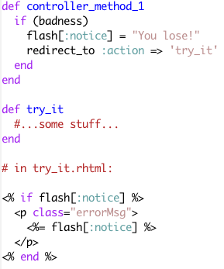
The Flash
Problem: I’m about to redirect_to somewhere, but want to display a notice to the user
yet that will be a different controller instance with all new instance variables
Rails answer: flash[]
  contents are passed to the next action, then cleared
  to this action: flash.now[:notice]
  visible to views as well as controller
Strictly speaking, could use session & clear it out yourself

Slide 34
Controller predicates: verify
A declarative way to assert various preconditions on calling controller methods
You can check selectively (:only, :except) for...
  HTTP request type (GET, POST, Ajax XHR)
  Presence of a key in the flash or the session
  Presence of a key in params[]
And if the check fails, you can...
  redirect_to somewhere else
  add_to_flash a helpful message
A simple example in our simple controller

Slide 35
More General Filters
Code blocks that can go before, after or around controller actions; return Boolean
  before_filter :filter_method_name
  before_filter { |controller| ... }
  before_filter ClassName
  options include :only,:except, etc.
  multiple filters allowed; calls provided to prepend or append to filter chain
  subclasses inherit filters but can use skip_filter methods to selectively disable them
If any before-filter returns false, chain halted & controller action method won’t be invoked
  so filter should redirect_to, render, or otherwise deal with the request
Simple example: authentication

Slide 36
Summary
ActiveRecord provides (somewhat-)database-independent object model over RDBMS
  made much more powerful through use of associations
ActionView supports display & input of model objects
  facilitates reuse of templates via layouts & partials
ActionController dispatches user actions, manipulates models, sets up variables for views
  declarative specifications capture common patterns for checking predicates before executing handlers
Pervasive use of CSS and HTML class/ID attributes separates appearance from structure, avoids need for explicit conditional code in views

Slide 37
Questions

