Slide 1
Ruby on Rails Short Course:
Additional Info

Slide 2
Framework LOC
Version 1.2.3
  ActiveRecord: 32750
  ActionPack: 34142
  ActionMailer: 10224
  ActionWebService: 7096
  ActiveSupport: 7049
  Railties: 7433
  Total: 98694

Slide 3
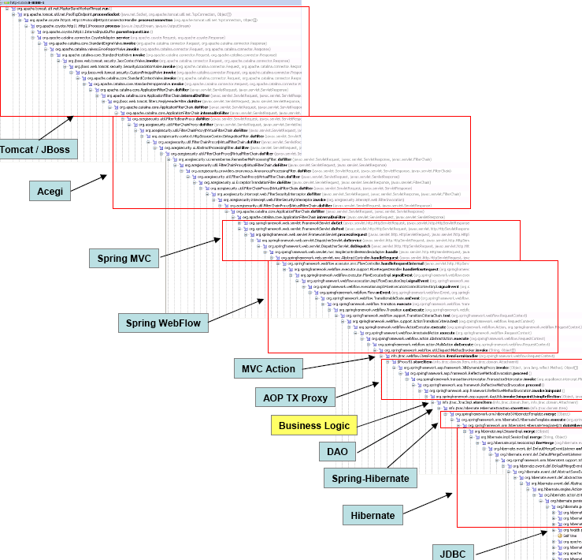
J2EE Call Stack

Slide 4
Ruby Call Stack
#1 ./script/../config/../vendor/rails/activerecord/lib/active_record/connection_adapters/mysql_adapter.rb:242:in `execute'
#2 ./script/../config/../vendor/rails/activerecord/lib/active_record/connection_adapters/mysql_adapter.rb:395:in `select'
#3 ./script/../config/../vendor/rails/activerecord/lib/active_record/connection_adapters/abstract/database_statements.rb:7:in `select_all'
#4 ./script/../config/../vendor/rails/activerecord/lib/active_record/base.rb:424:in `find_by_sql'
#5 ./script/../config/../vendor/rails/activerecord/lib/active_record/base.rb:992:in `find_every'
#6 ./script/../config/../vendor/rails/activerecord/lib/active_record/base.rb:1025:in `find_one'
#7 ./script/../config/../vendor/rails/activerecord/lib/active_record/base.rb:1011:in `find_from_ids'
#8 ./script/../config/../vendor/rails/activerecord/lib/active_record/base.rb:416:in `find'
#9 ./script/../config/../app/controllers/subscription_controller.rb:542:in `view_subscription'
#10 ./script/../config/../vendor/rails/actionpack/lib/action_controller/base.rb:1095:in `perform_action_without_filters'
#11 ./script/../config/../vendor/rails/actionpack/lib/action_controller/filters.rb:632:in `call_filter'
#12 ./script/../config/../vendor/rails/actionpack/lib/action_controller/filters.rb:638:in `call'
#13 ./script/../config/../vendor/rails/actionpack/lib/action_controller/filters.rb:637:in `call_filter'
#14 ./script/../config/../vendor/rails/actionpack/lib/action_controller/filters.rb:638:in `call'
#15 ./script/../config/../vendor/rails/actionpack/lib/action_controller/filters.rb:637:in `call_filter'
#16 ./script/../config/../vendor/rails/actionpack/lib/action_controller/filters.rb:619:in `perform_action_without_benchmark'
#17 ./script/../config/../vendor/rails/actionpack/lib/action_controller/benchmarking.rb:66:in `measure'
#18 ./script/../config/../vendor/rails/actionpack/lib/action_controller/benchmarking.rb:66:in `perform_action_without_rescue'
#19 ./script/../config/../vendor/rails/actionpack/lib/action_controller/rescue.rb:83:in `perform_action'
#20 ./script/../config/../vendor/rails/actionpack/lib/action_controller/base.rb:430:in `process_without_filters'
#21 ./script/../config/../vendor/rails/actionpack/lib/action_controller/filters.rb:624:in `process_without_session_management_support'
#22 ./script/../config/../vendor/rails/actionpack/lib/action_controller/session_management.rb:114:in `process'
#23 ./script/../config/../vendor/rails/actionpack/lib/action_controller/base.rb:330:in `process'
#24 ./script/../config/../vendor/rails/railties/lib/dispatcher.rb:41:in `dispatch'
#25 ./script/../config/../vendor/rails/railties/lib/webrick_server.rb:114:in `handle_dispatch'
#26 ./script/../config/../vendor/rails/railties/lib/webrick_server.rb:79:in `service'
#27 /opt/local/lib/ruby/1.8/webrick/httpserver.rb:104:in `service'
#28 /opt/local/lib/ruby/1.8/webrick/httpserver.rb:65:in `run'
DB Connector
ActiveRecord
Application
Controller
Dispatch + Sessions
Web Server

