Slide 1
Twitter Recommender
Lara Vieira – 22/02/22

Slide 2
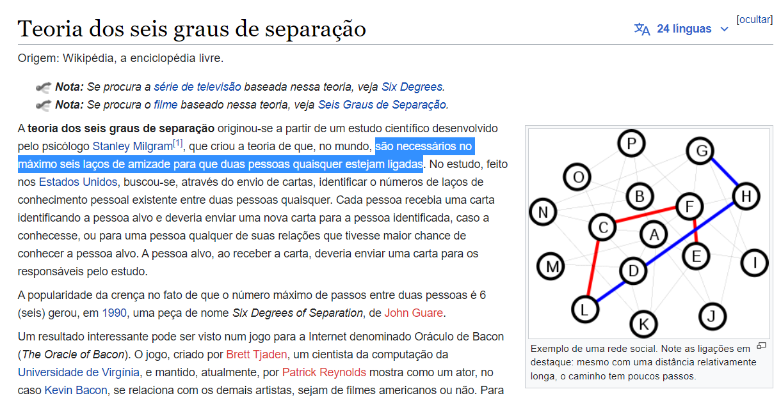
Twitter Recommender

Slide 3
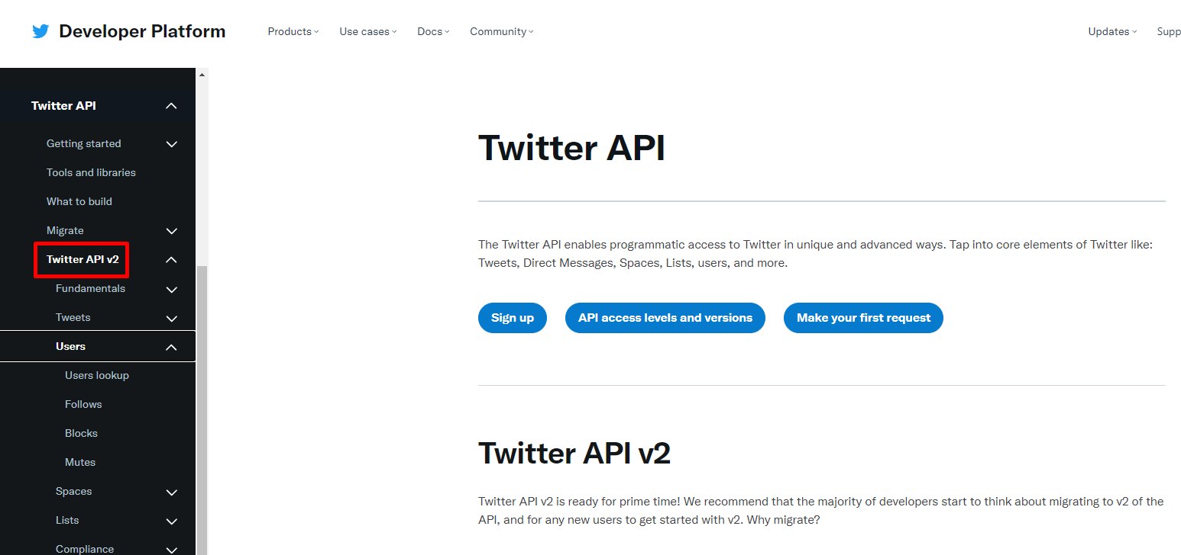
API

Slide 4
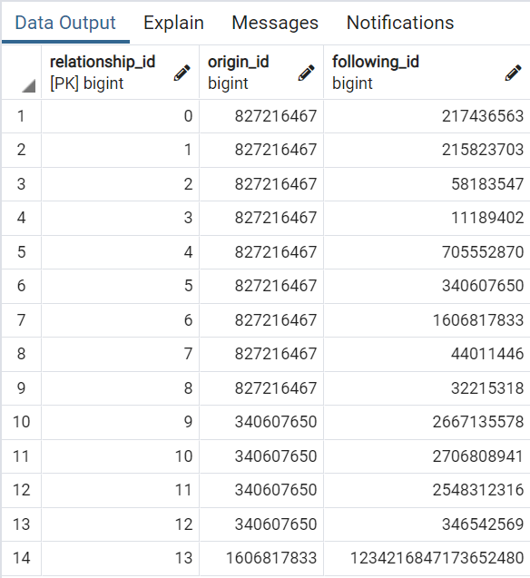
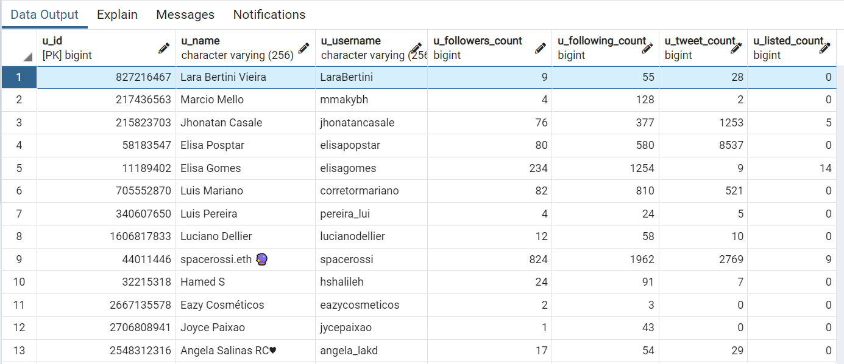
Information extracted
Users
User ID
Username
Name
Followers count
Followers (only public)
Following count
Tweets count
Listed count

Slide 5
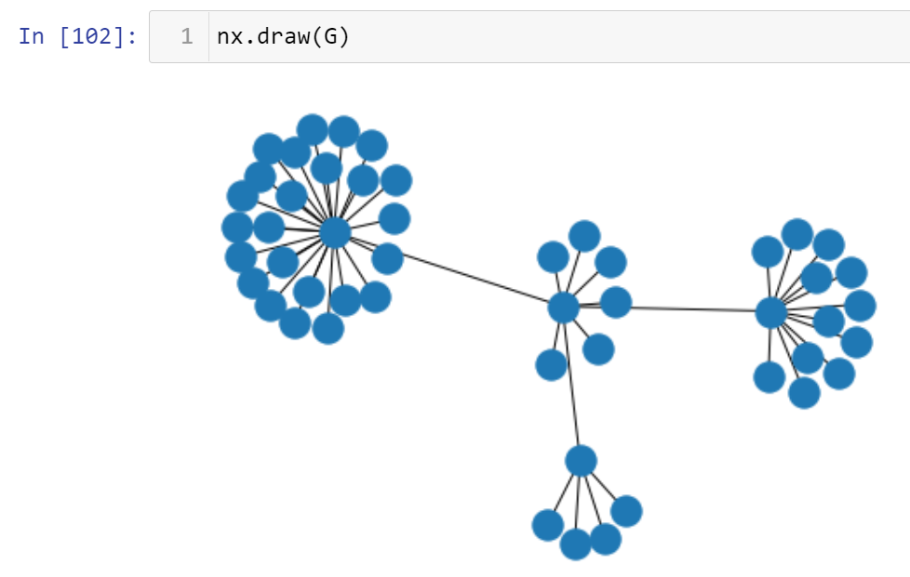
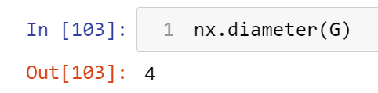
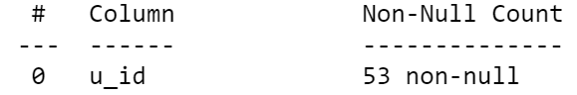
2nd Degree Tree

Slide 6
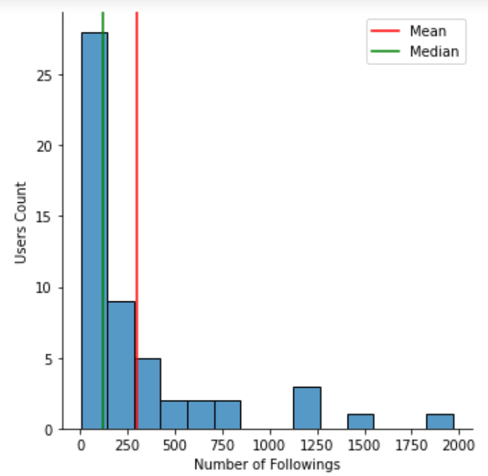
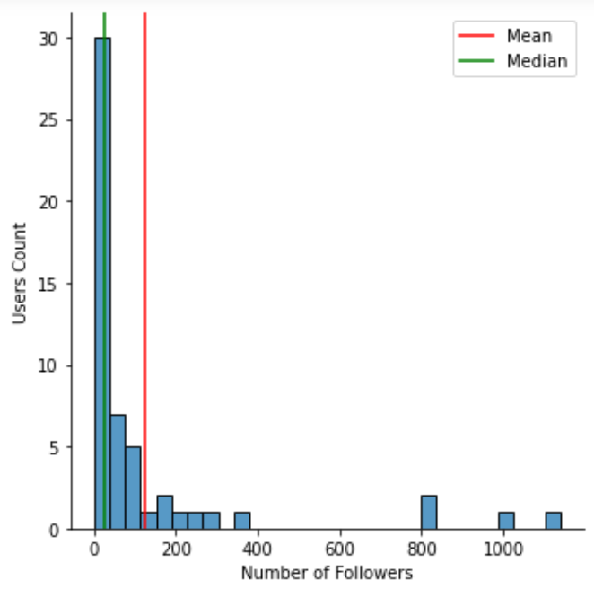
Exploring 2nd Degree Tree 53 Unique Users

Slide 7
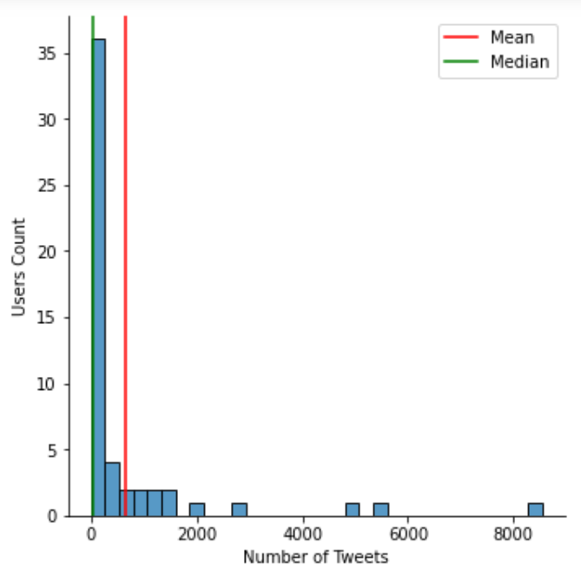
Exploring engagement through Tweets

Slide 8

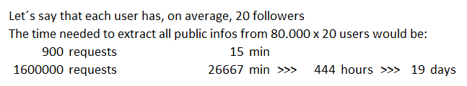
Cost of time to extract data
Users: 15 requests per 15-minute
Infos about users: 900 requests per 15 min

Slide 9
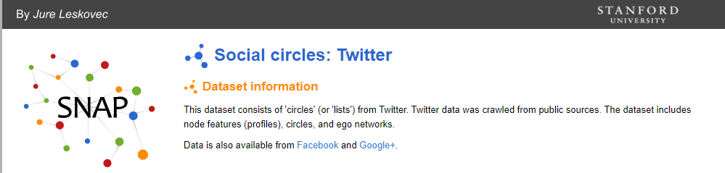
Exploring public Tweeter DB
About Dataset:
81.306 users
2.420.766 connections

Slide 10
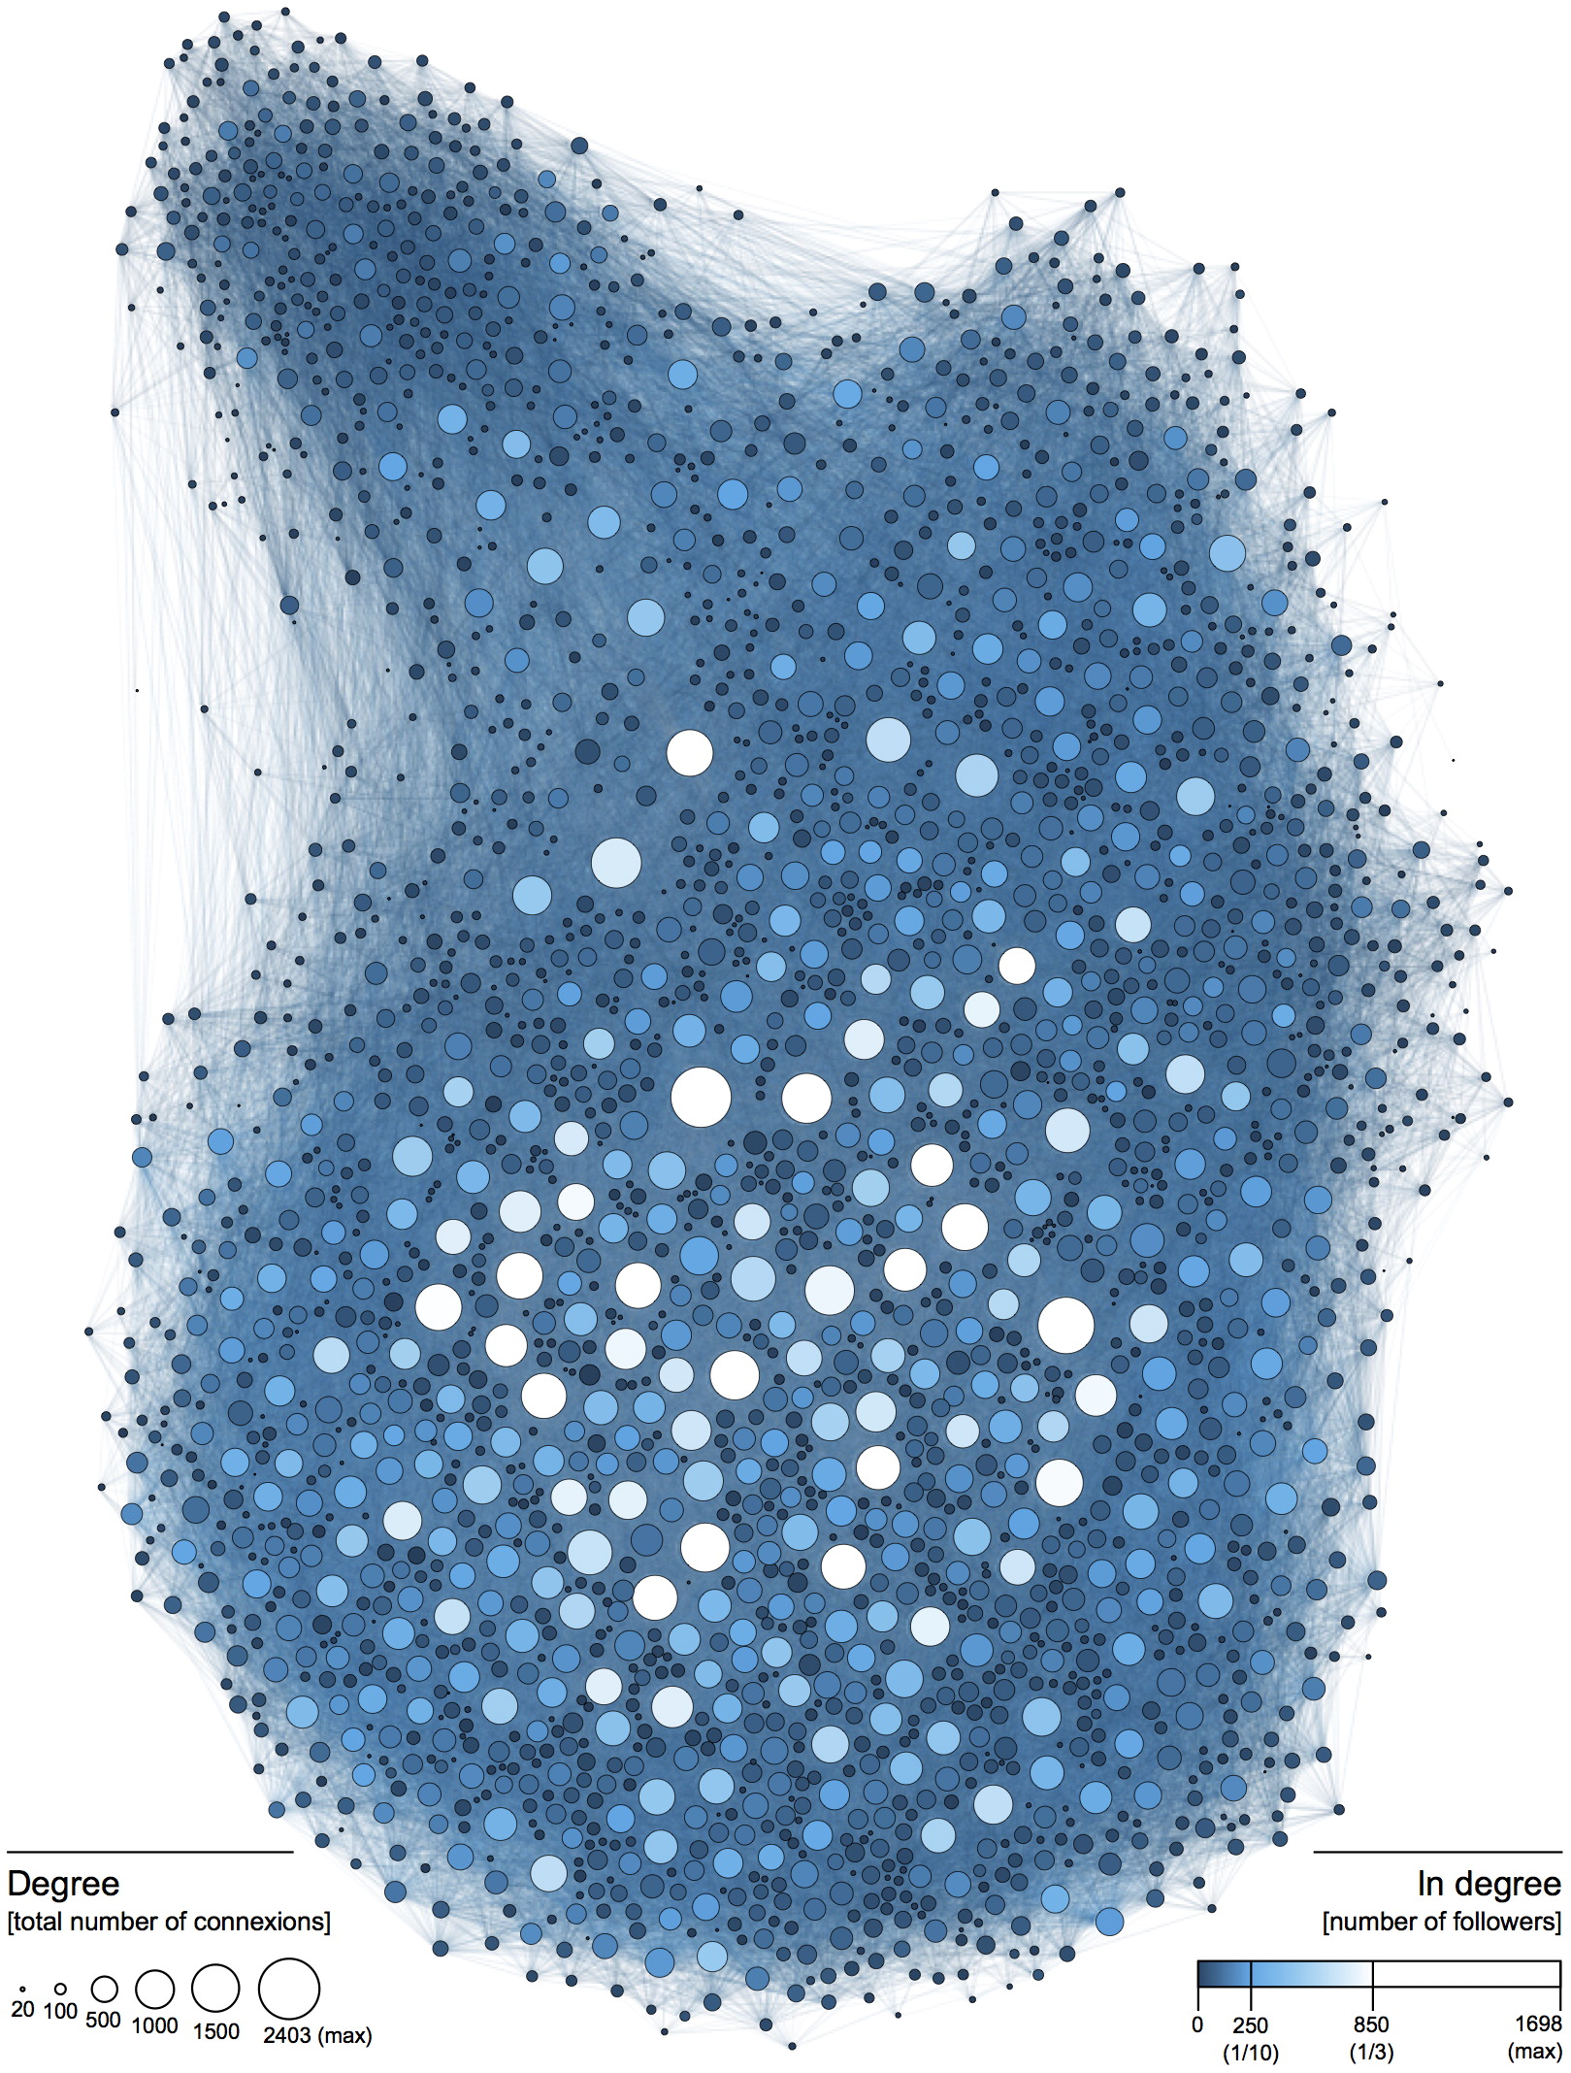
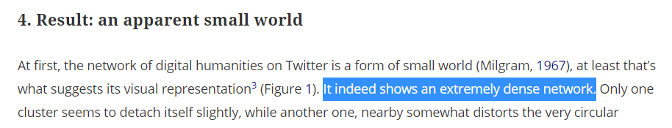
Exploring public Tweeter DB
About Dataset:
0,04% density
Example of a portion of network in Twitter with 3% density
Source (link)

Slide 11
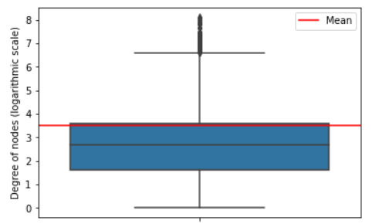
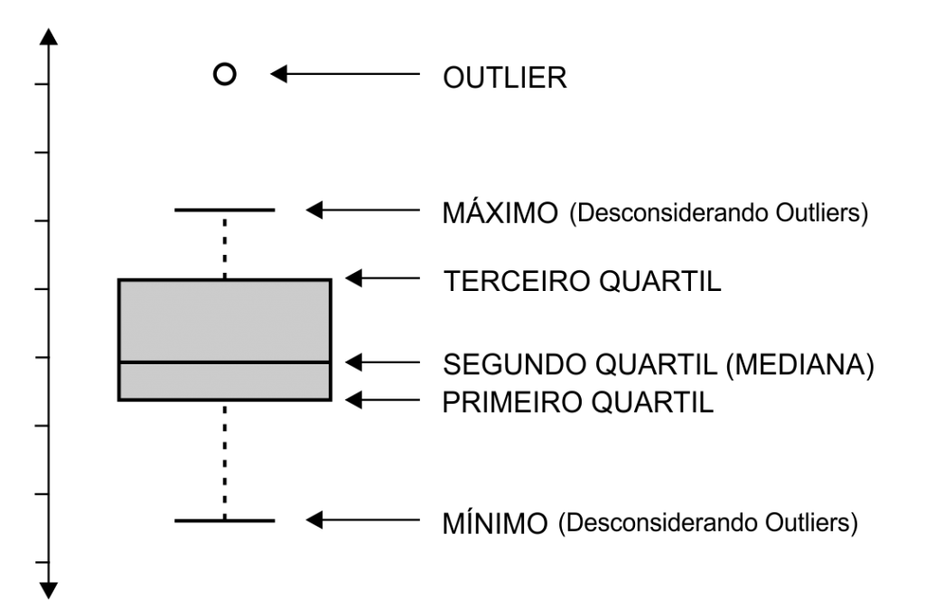
Exploring public Tweeter DB
Degree of connections in logarithmic scale shows outliers with > 1.000.000 connections;
Degree of connections:
Mean: 33
Median: 15

Slide 12
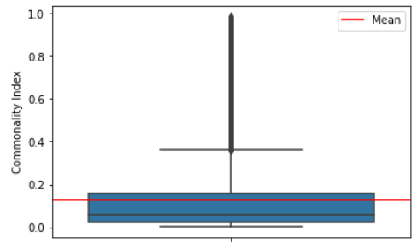
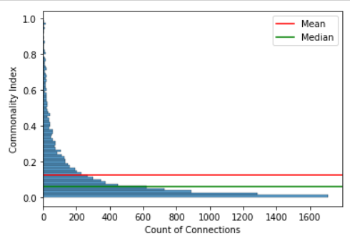
Exploring relationship between set of users
Commonality index definition: for nodes A and B, the commonality index between A and B is calculated through the number of connections that A and B have in common devided by the total number of connections of node A.
For a set of 10.000 connections, you can see the commonality index distribution;
Median: 6%
Mean: 12%

Slide 13
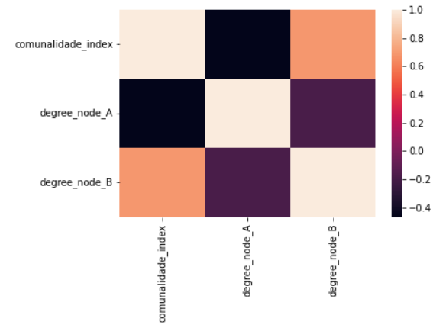
Exploring relationship between set of users
Apparently we have a positive correlation between the degree of connections of node B with the commonality index between A and B.
However, the correlation is negative compared to the degree of connections of node A.
The more connections node A has, the less likely it is to be a high % of elements in common if you compare it to another node.

Slide 14
Next Step: simple recommendation algorithm design
Let's say that the commonality index between nodes A and B is 80%.
This means that if node A has 100 connections, 80 of them node B will also have in common.
So, lets imagine that node B has 120 connections in total, I could recommend 120-80 = 40 connections for node A.

Slide 15
Fazer readme file
Subir apresentação no git

