Slide 1
Problem Statement
■ Knowledge representation and insight generation from structured datasets.

Slide 2
Unique Idea Brief (Solution)
Precision Crop Recommendation: FarmGuard uses sophisticated algorithms to analyze various data points such as soil quality, climate conditions, and historical crop performance. This analysis enables it to recommend the most suitable crops for a particular farm, optimizing yields and promoting sustainable farming practices.
Optimized Fertilizer Management: By leveraging real-time data and advanced analytics, FarmGuard recommends precise types and quantities of fertilizers based on the specific nutrient needs of the soil. This approach minimizes over-application, reduces costs, and decreases environmental impact, while still maximizing crop productivity.
Early Disease Detection and Management: Using AI-driven image recognition and sensor data, FarmGuard can identify potential diseases and pest infestations early. This early detection allows farmers to take timely action, reducing crop losses and minimizing the use of pesticides

Slide 3
Features Offered
Crop recommendation
Get personalized crop recommendations based on your soil type and weather conditions.
Fertilizer recommendation
Discover the best fertilizers to use for the crops to ensure optimal growth and yield
Disease detection
Identify potential diseases in the crops early to prevent spread and minimize damage

Slide 4
Process flow
The methodology used in crop and fertilizer recommendation model is as follows:
Data Loading: Loading the data for the Machine Learning task from Kaggle Crop recommendation Fertilizer recommendation
Pre-processing & Data cleaning: In this stage, the loaded data will be cleaned and prepared for using Machine Learning algorithms. This involves handling missing values, outliers, and selecting relevant features such as soil type, pH level, rainfall, temperature, and historical crop yield in case of crop recommendation and selecting relevant features such as soil nutrient levels (nitrogen, phosphorus, potassium), pH, moisture content, and crop type in fertilizer recommendation.
Dataset Preparation: Split the dataset into training and testing sets.
Classification: Implement various Machine Learning Classification models to recommend
the most suitable crops for given soil and climate conditions. Models can include Decision Trees, Random Forest, Support Vector Machines (SVM), k-Nearest Neighbors(k-NN) and Logistic regression.
Model Training: Choose a classification algorithm, such as Random Forest, and train the model using the training set and the extracted features.
Model Evaluation: Test the trained model on the testing set to evaluate its performance.
Use metrics such as accuracy, and confusion matrices to assess the modelaA" Zs effectiveness.
Model selection and reporting: In this final stage, based on various performance measures, the best model will be selected and the model performance metrics will be reported.

Slide 5
Process flow
The methodology used in plant disease detection model is as follows:
Data Collection: Images: Collect a dataset of images showing healthy and diseased plants.
Labels: Label each image with the corresponding disease type or healthy status.
Data Pre-processing: Resizing: Ensure all images are of the same size. Normalization:
Normalize pixel values. Augmentation: Apply transformations (e.g., rotation, flipping, cropping) to increase dataset diversity.
Model Selection: Use CNN architectures suitable for image classification, such as Inception, DenseNet, or custom models designed for feature extraction from images.
Model Training: Split the dataset into training and testing sets Train the model using a suitable deep learning framework like TensorFlow or PyTorch. Implement techniques like data augmentation
Model Evaluation: Evaluate model performance using metrics such as accuracy, precision, recall, and F1-score

Slide 6
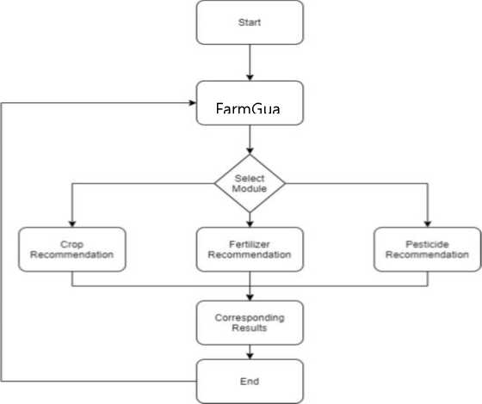
Architecture Diagram
FarmGuard
Figure 10: Imgreat Workflow Diagram

Slide 7
Technologies used
1. Machine Learning: Machine learning algorithms, both classical (like Random Forest, SVM, KNN) and advanced (like CNN, RNN), are employed to analyze structured datasets. These algorithms are used to model relationships between various agricultural factors (such as soil composition, weather conditions, crop types) and outcomes (crop yield, disease presence).
2. HTML and CSS: These technologies are used for developing the user interface (UI) of the FarmGuard application. HTML provides the structure of web pages, defining elements such as buttons, forms, and navigation menus. CSS is used for styling these elements, ensuring a visually appealing and intuitive user experience

Slide 8
Technologies used
3. Flask: Flask is a Python-based web framework used for building web applications. In the FarmGuard project, Flask serves as the backend framework responsible for integrating the machine learning models with the frontend (HTML/CSS) interface. Flask handles HTTP requests from users, processes data, and communicates with the machine learning models to generate real-time recommendations and insights. It also enables data persistence, allowing users to save and retrieve personalized recommendations or historical data for further analysis.

Slide 9
Team members and contribution:
Lara Marium Jacob- Front end and backend, ML code (Disease Detection)
Lekshmipriya S- ML code (Fertilizer), Report writing
Nandana A - Front end and backend, ML code (Disease Detection)
Prathitha S- ML code (Crop), Report writing
Samudra S Sunil- Report writing, ML code (Disease Detection), MLcode(Crop)

Slide 10
Conclusion
In conclusion, the FarmGuard project exemplifies the transformative power of knowledge representation and insight generation from structured datasets in agriculture. By leveraging both classical machine learning algorithms and advanced deep learning techniques, FarmGuard has effectively optimized crop recommendations, fertilizer usage, and plant disease detection. This integrated approach not only enhances decision-making processes but also fosters sustainable agricultural practices by utilizing computational efficiency and capturing intricate relationships within agricultural data. As technologies continue to evolve, the ongoing development of such data-driven solutions holds promise for addressing global food security challenges, ensuring resilience and efficiency in agricultural systems for a more sustainable future.

