Slide 1

DEPI DATA ENGINEERING PROGRAM — PROJECT 9
Sales Data Modeling with dbt and BigQuery
End-to-end ELT pipeline transforming 1.5M+ raw sales records into clean, tested, and analytics-ready models
Basmalah · Lara · Salma · Mariam · Nour · Menna

Slide 2
Problem & Objective
❌ The Problem
✅ Our Solution
ELT pipeline with dbt + BigQuery
Automated data transformation
Star Schema (fact + dimensions)
47 automated data quality tests
CI/CD via GitHub Actions
Raw sales data scattered across 3 tables
No standardized column names
No revenue or profit calculations
Manual analysis takes hours
No data quality checks

Slide 3
SALES DATA MODELING · DBT · BIGQUERY
Data Architecture & Process Diagrams
A guided walkthrough of the star schema and the four UML diagrams that describe how sales data moves from source to dashboard.
Star Schema
Use Case
Sequence / CI-CD
DFD
Activity

Slide 4
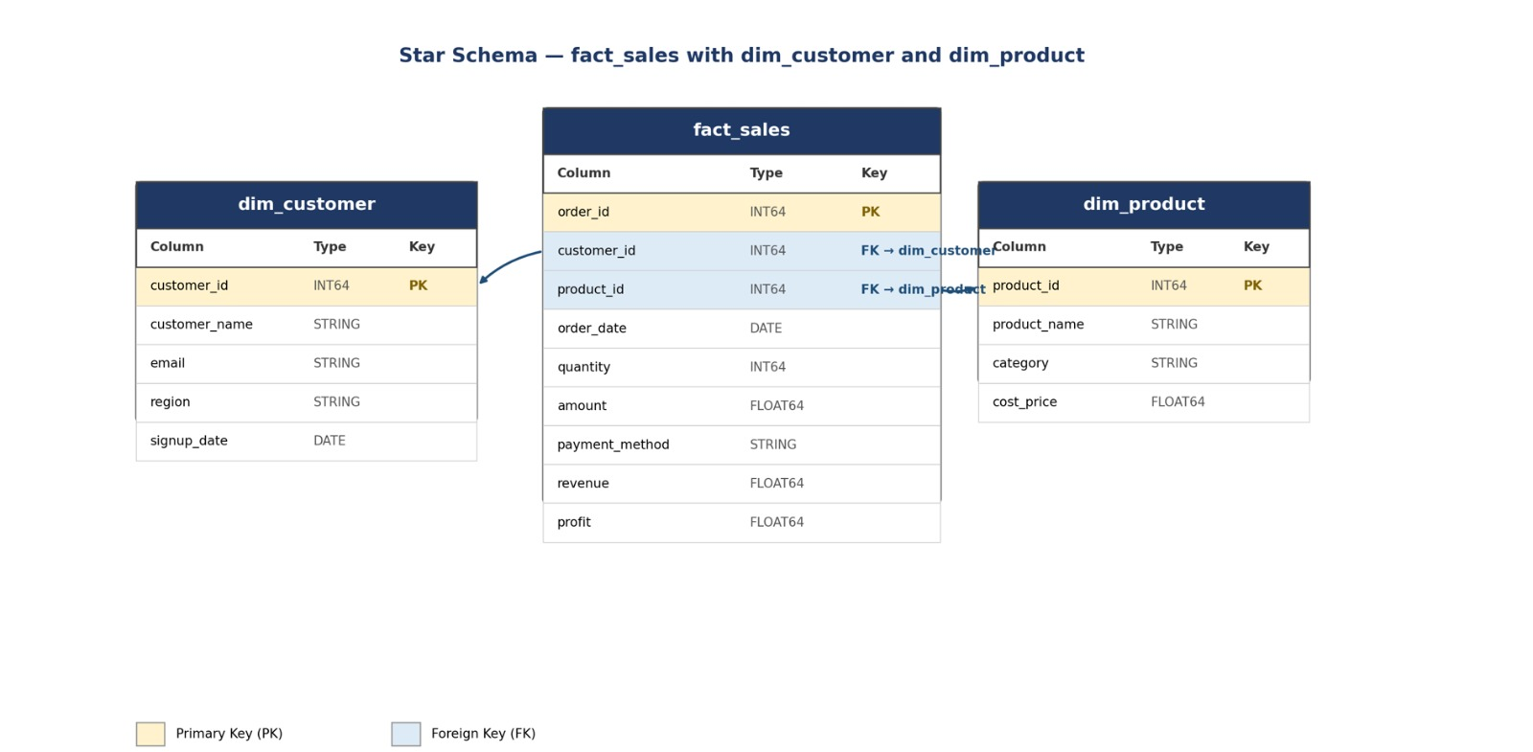
DIAGRAM 1 · DATA MODEL
Star Schema — fact_sales, dim_customer, dim_product
What it shows
A star schema built for analytics: one central fact table surrounded by descriptive dimension tables.
fact_sales
Every order line: quantity, amount, revenue, profit, and foreign keys to who bought and what was bought.
dim_customer & dim_product
Descriptive attributes — name, region, category, cost — kept separate so they aren't repeated on every row.
Star Schema
2

Slide 5
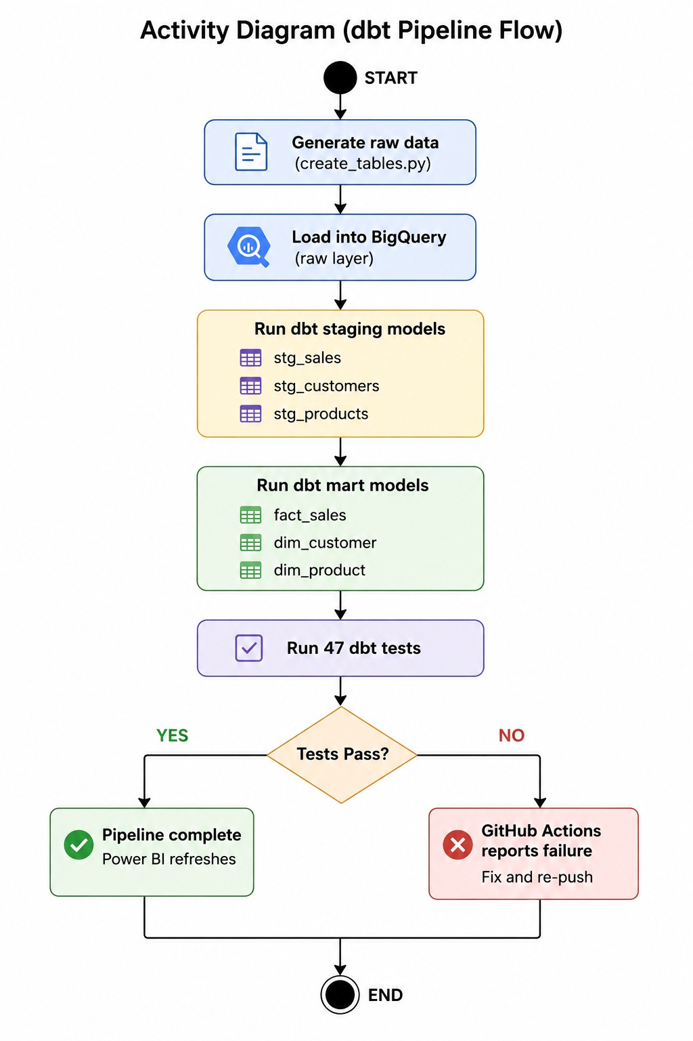
DIAGRAM 2 · UML
Use Case Diagram
What it shows
A use case diagram captures the system from the outside: who interacts with it (the actors) and what they can accomplish (the use cases) — without describing the internal steps.
Actors
The people or systems that trigger the workflow — for example a data engineer, an analyst, and the BI/reporting layer.
Use cases
The distinct capabilities each actor needs: loading raw sales data, running dbt transformations, and querying the resulting model.
Why it matters
It scopes the project before any implementation detail exists — a shared reference for who needs what from the pipeline.
Use Case Diagram
3

Slide 6
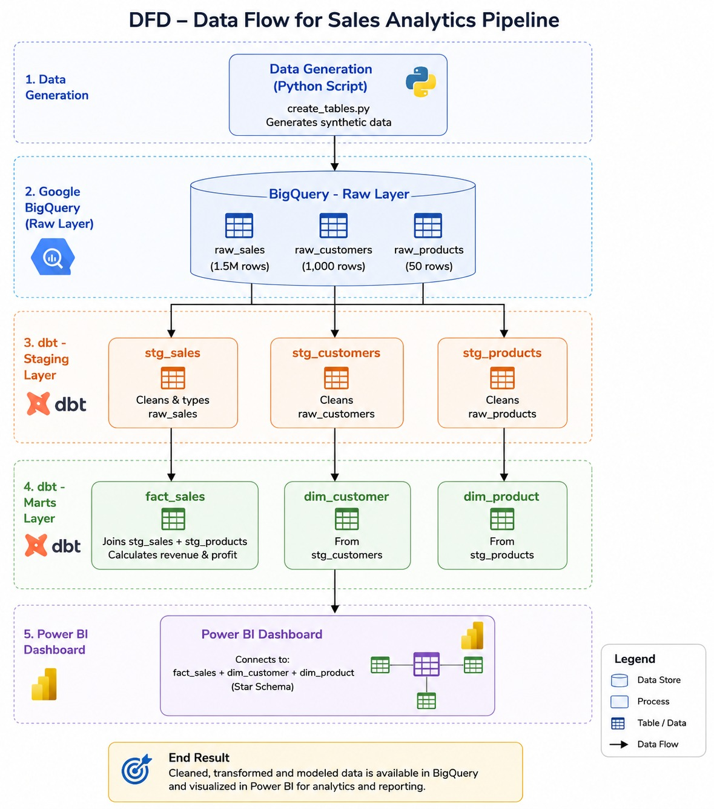
DIAGRAM 3 · UML
Sequence Diagram — CI/CD Pipeline
What it shows
A sequence diagram reads left to right and top to bottom, tracing the exact order of messages exchanged between components as a code change moves toward production.
1
A commit is pushed to the repository, which triggers the pipeline automatically.
2
The pipeline installs dependencies and runs the dbt build and test suite.
3
If tests pass, models are deployed and materialized in BigQuery.
4
The pipeline reports success or failure back to the developer.
Sequence Diagram
4

Slide 7
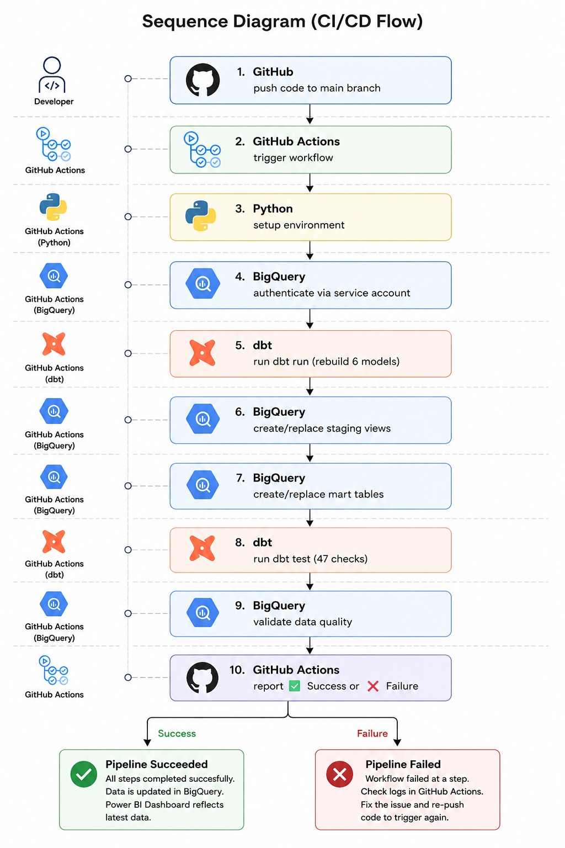
DIAGRAM 4 · STRUCTURED ANALYSIS
Data Flow Diagram (DFD)
What it shows
Where a sequence diagram tracks time and a use case diagram tracks scope, a DFD tracks the data itself — where it originates, which processes touch it, and where it comes to rest.
External entities
Sources and consumers outside the system boundary — source sales systems on one end, business users and dashboards on the other.
Processes
The transformations applied in between, such as extraction, staging, and dbt modeling into the star schema.
Data stores
The raw, staging, and modeled tables (including fact_sales and its dimensions) where data is held at each stage.
Data Flow Diagram
5

Slide 8
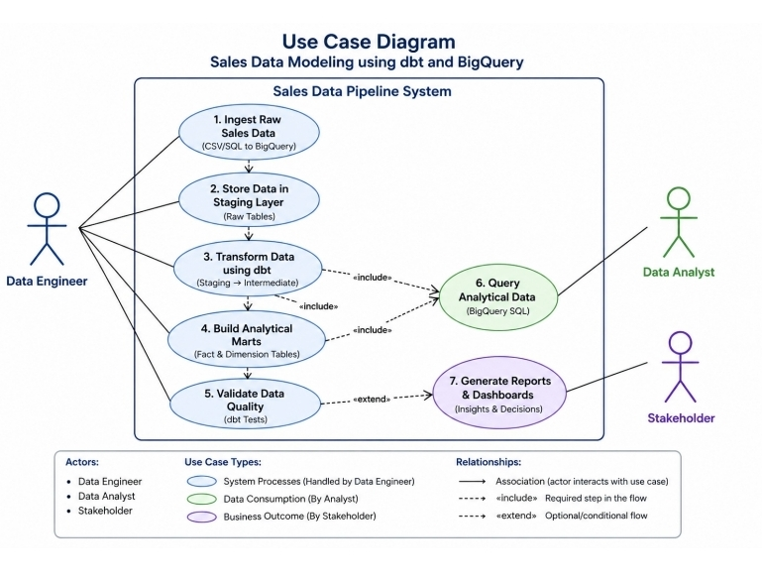
DIAGRAM 5 · UML
Activity Diagram
What it shows
An activity diagram is the closest thing to a flowchart of the workflow itself: the ordered steps, any parallel work, and the decision points that route execution one way or another — for example, what happens when a data-quality check fails.
It complements the sequence diagram: the sequence diagram shows which components talk to each other, while the activity diagram shows the logic each step follows.
Activity Diagram
6

Slide 9
HOW THEY FIT TOGETHER
Five views of one pipeline
1
2
3
4
5
Star Schema
Use Case
Sequence / CI-CD
DFD
Activity
The destination — how sales data is finally structured for fast, simple analytics.
The scope — who needs the pipeline and what they need it to do.
The timeline — the exact order components talk to each other during deployment.
The journey — where data comes from, what touches it, and where it lands.
The logic — the step-by-step process and decisions inside the workflow.
Together, these diagrams take a sales dataset from raw source systems, through a tested dbt/CI-CD pipeline, into the fact_sales star schema that powers reporting.

Slide 10





Tech Stack
Google BigQuery
dbt Core 1.11
Python 3.11
Cloud Data Warehouse
Data Transformation
Runtime Environment
GitHub Actions
Power BI
CI/CD & Scheduling
Business Intelligence

Slide 11
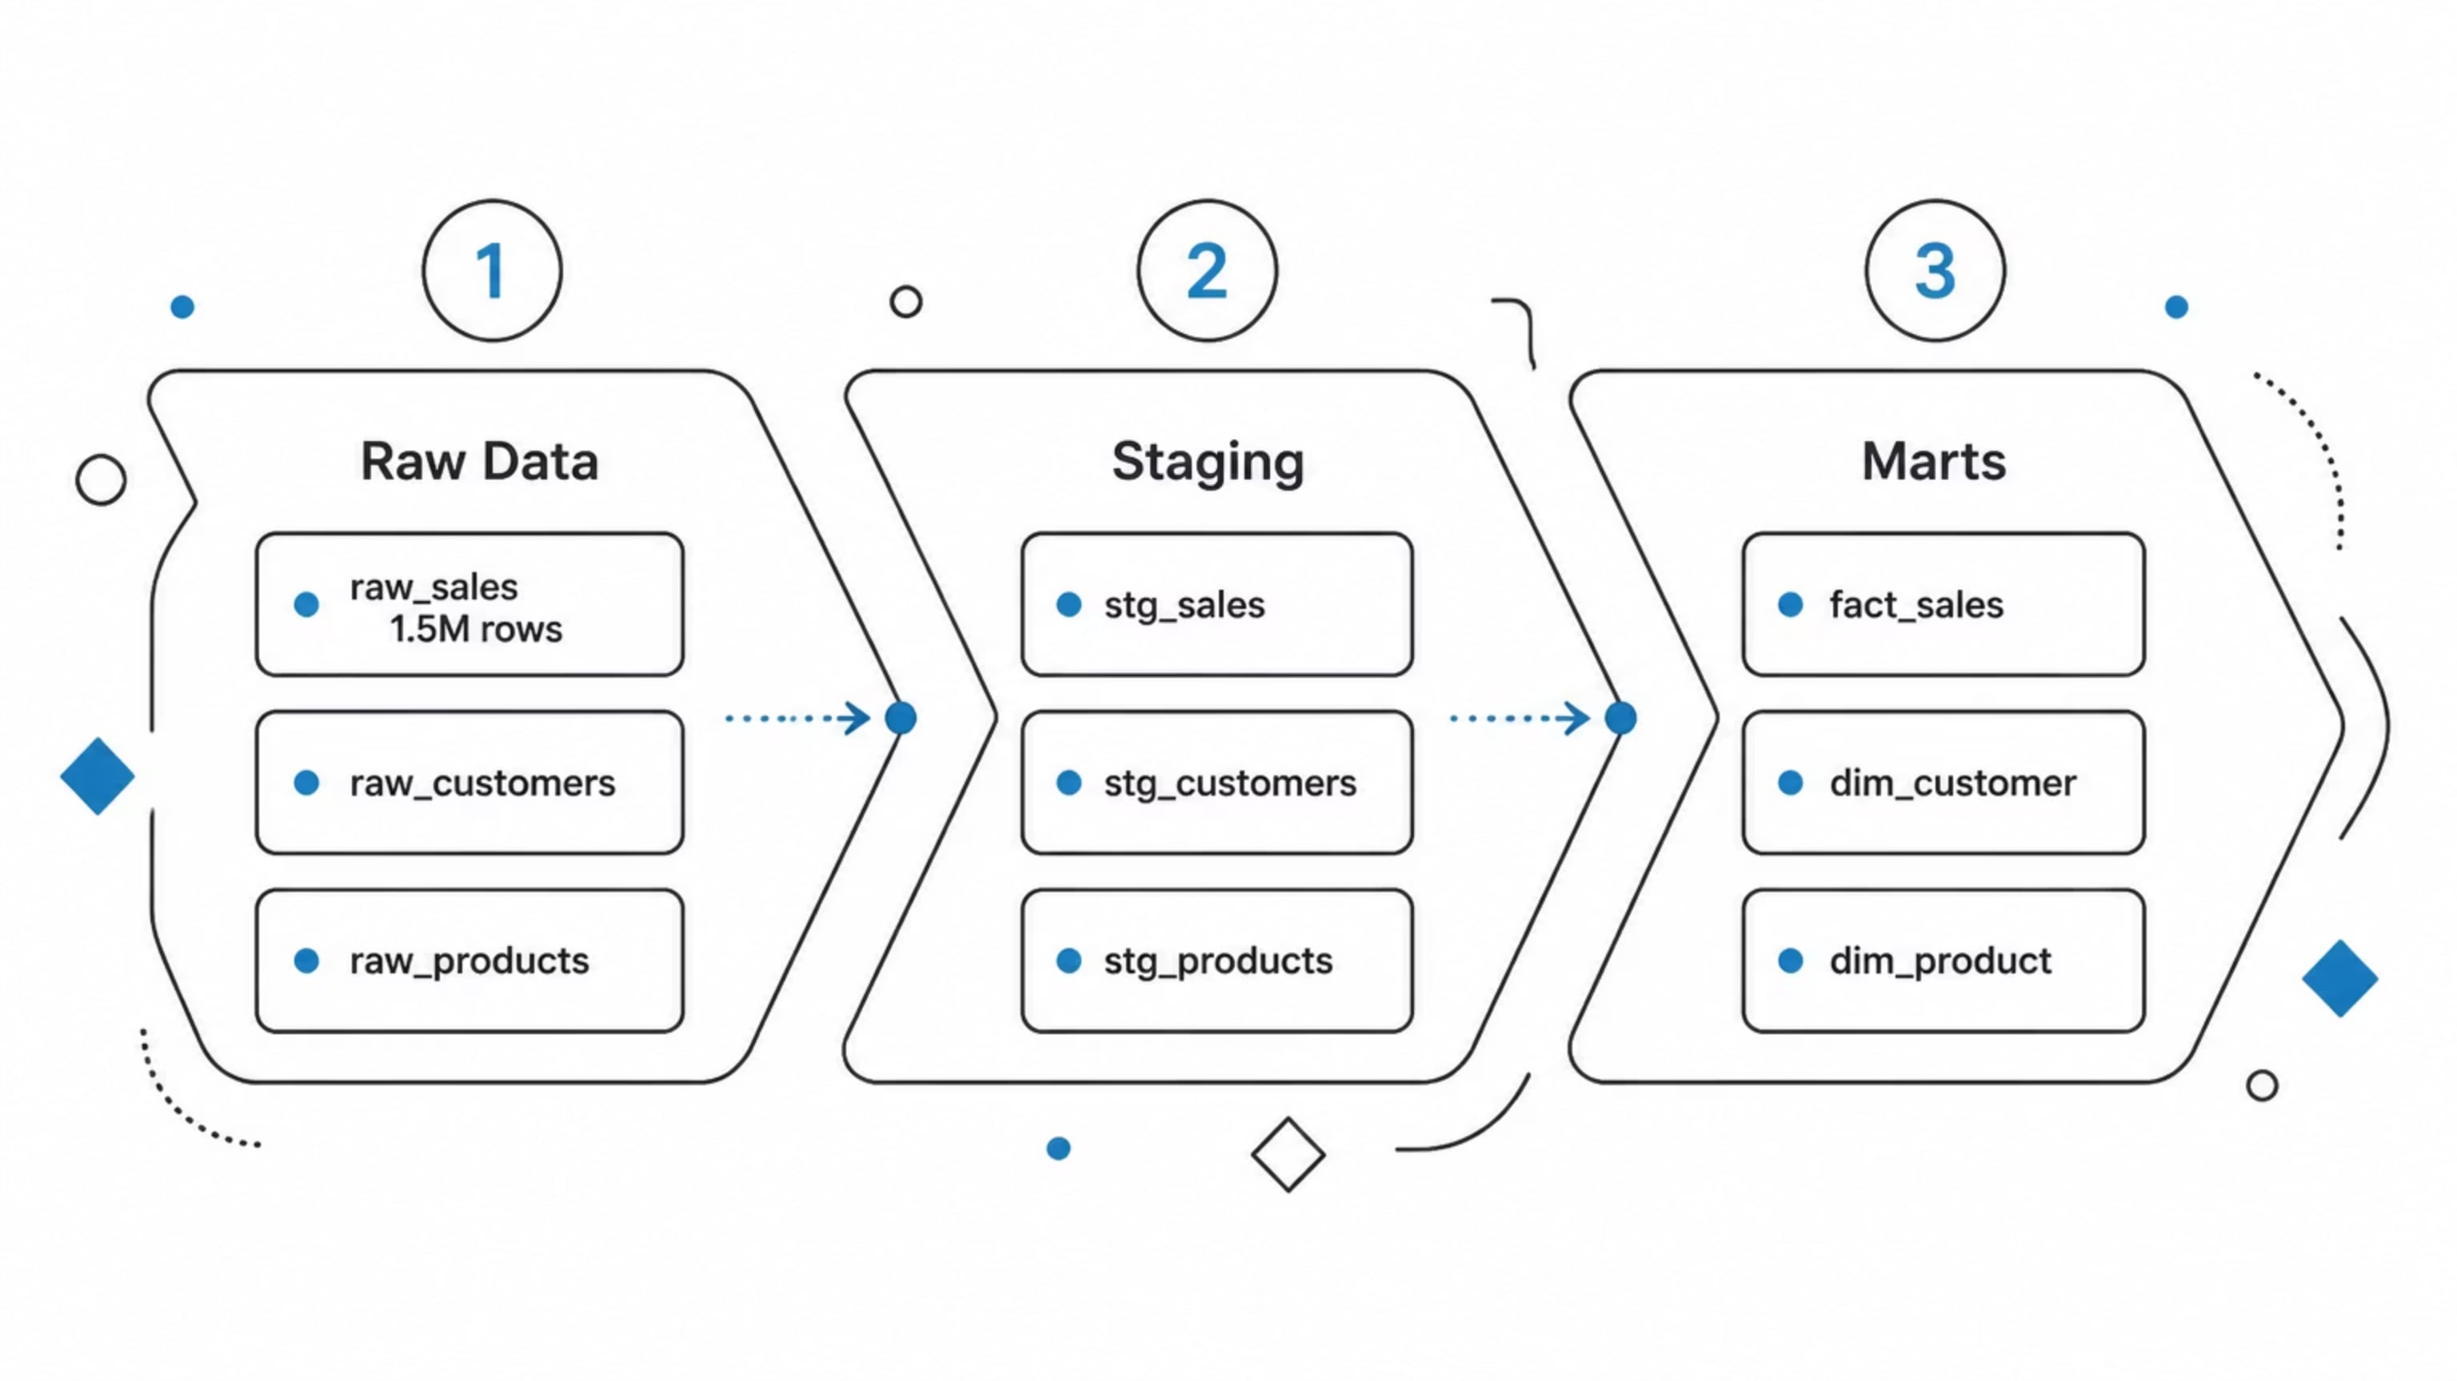
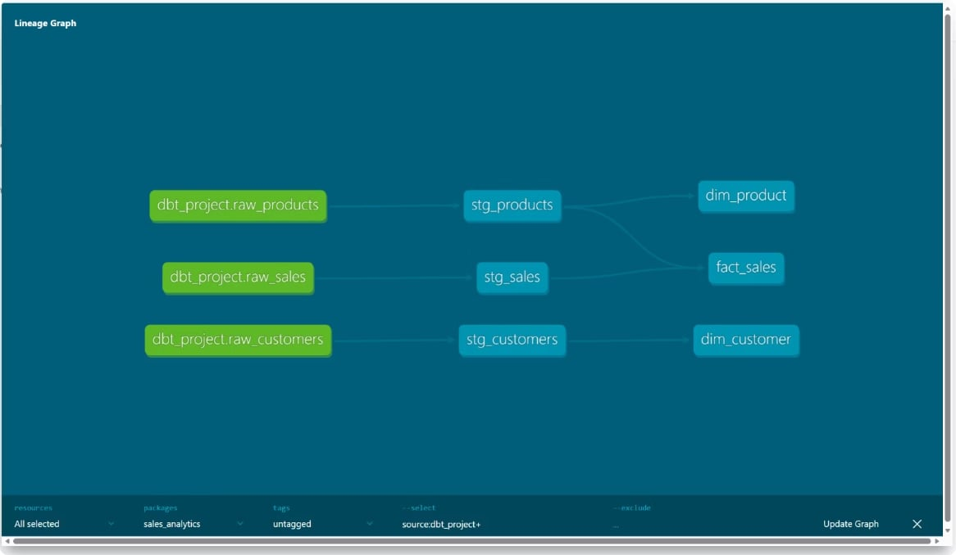
Pipeline Architecture & Lineage
dbt Lineage Graph

Slide 12
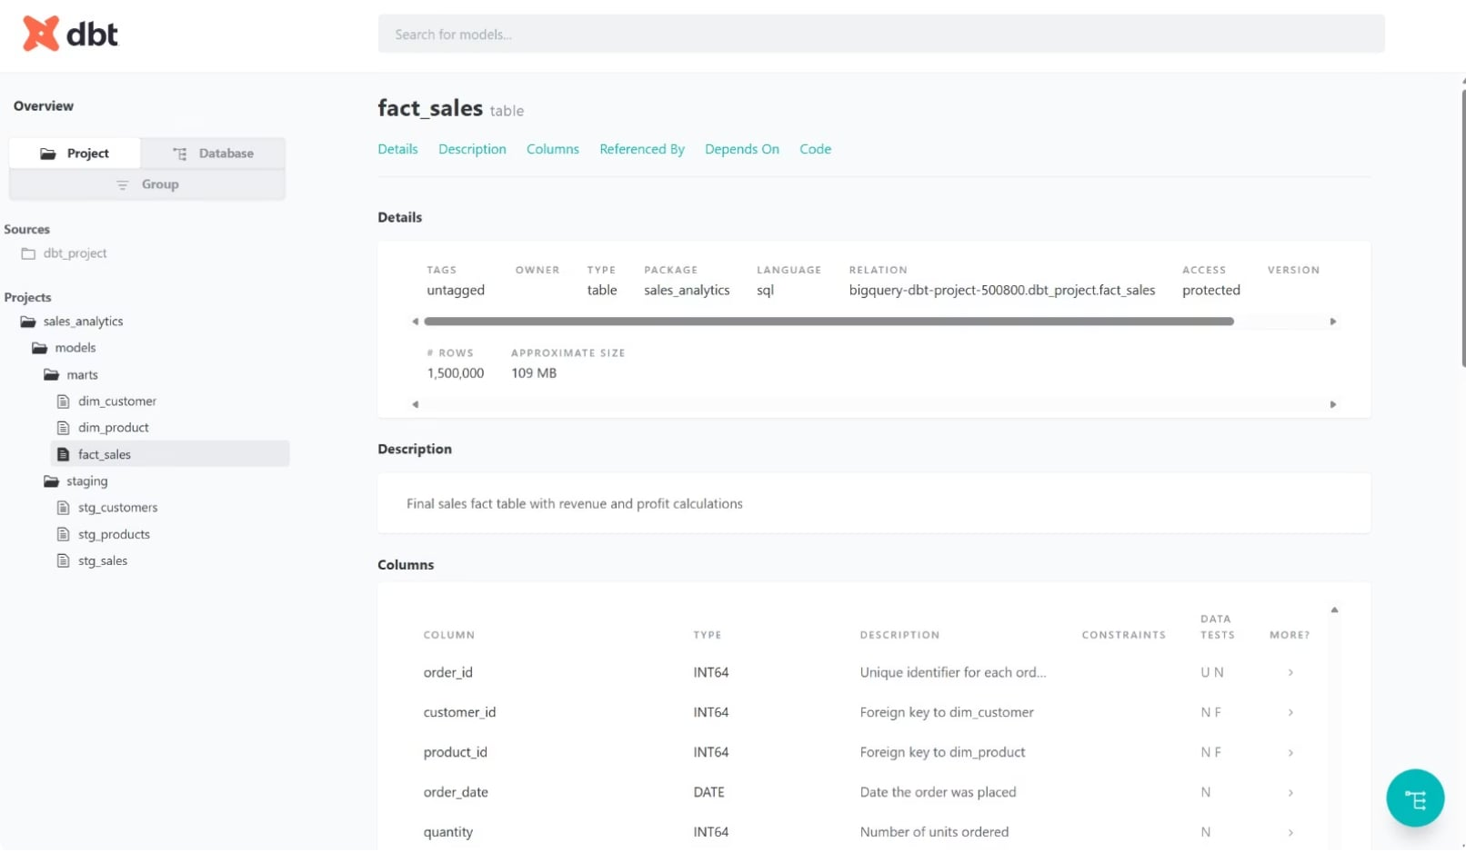
dbt Documentation — Live Models
stg_sales
View · 1.5M rows
stg_products
View · 50 rows
dim_customer
Table · 1,000 rows
stg_customers
View · 1,000 rows
fact_sales
Table · 1.5M rows
dim_product
Table · 50 rows
dbt Docs — fact_sales

Slide 13
Data Quality & Testing
47
Tests Passing ✅
unique
not_null
No duplicate primary keys
No missing values in key columns
accepted_values
relationships
Valid values only in category fields
FK integrity between fact & dims

Slide 14
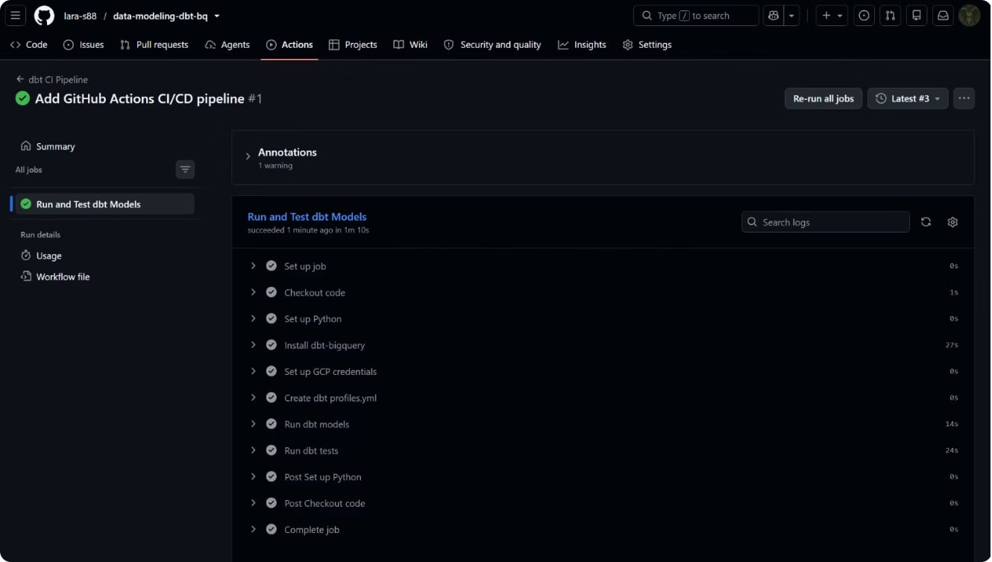
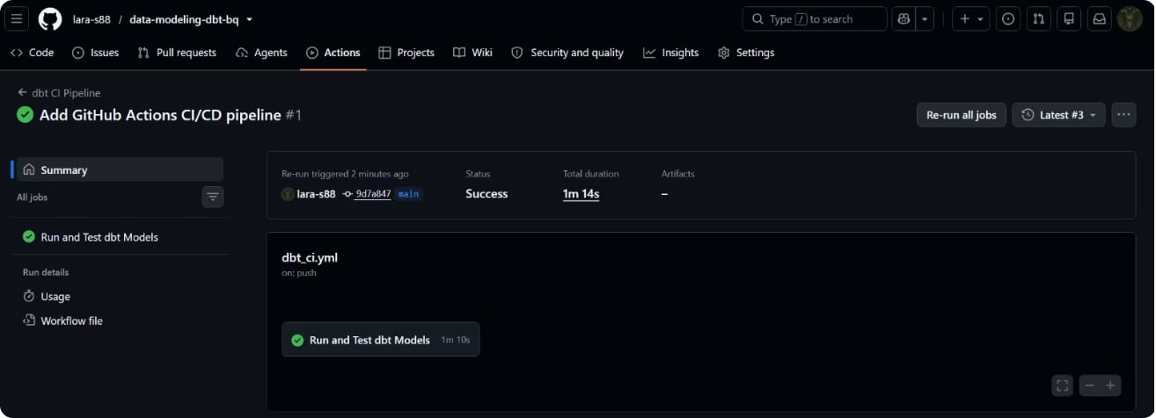
CI/CD — GitHub Actions
✅ Pipeline Status: Success
Pipeline Steps
⏱ 1m 14s
✅ Success
Duration
Status
🔄 On Push + Daily
🧪 47 Passed
Trigger
Tests

Slide 15
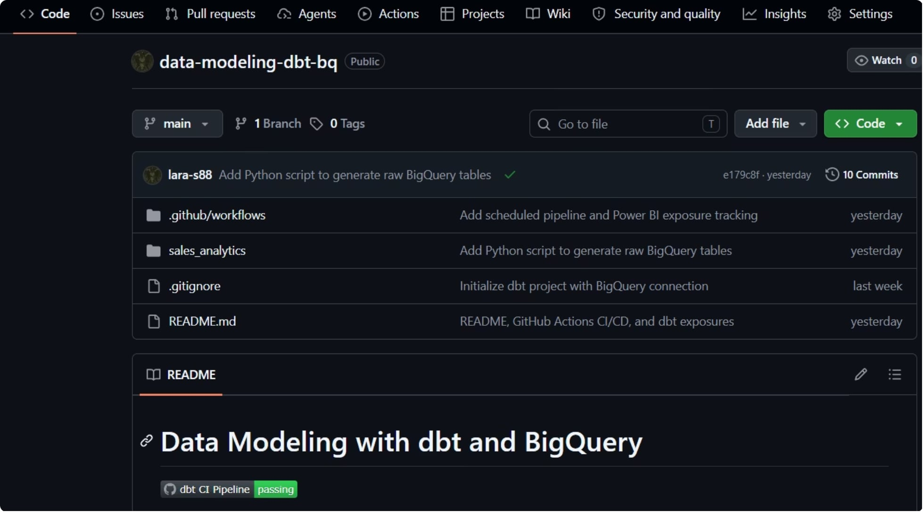
GitHub Repository
🟢 CI Badge
📁 Commits
Passing
10+
🔀 Branch
📄 README
main
Professional

Slide 16
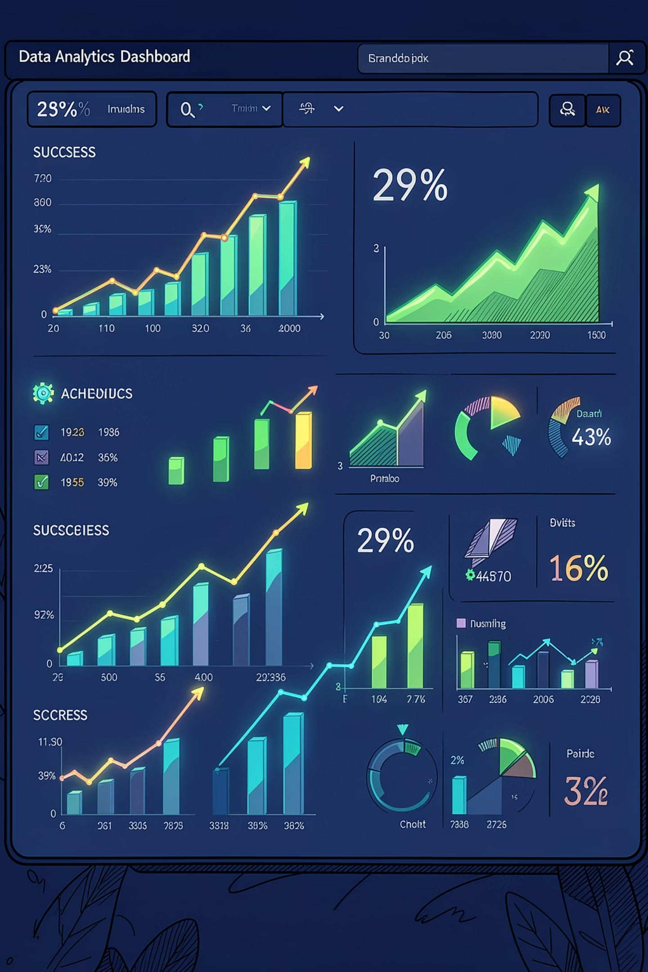
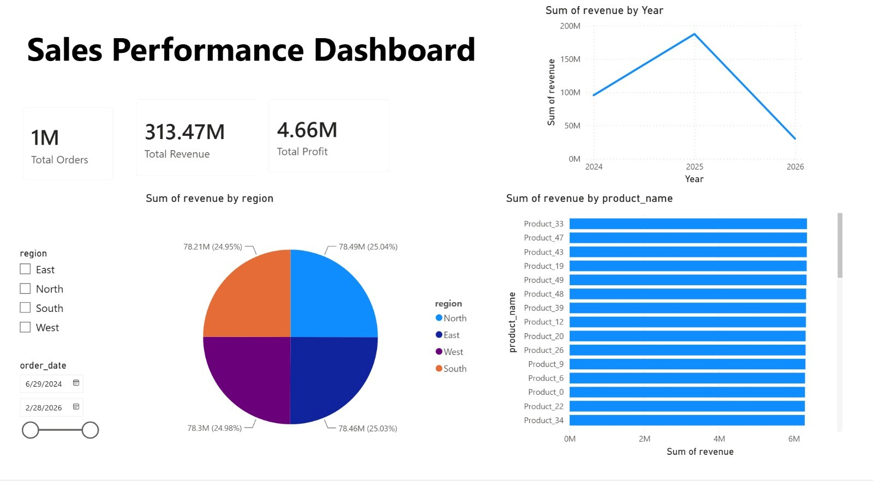

Key Results
1.5M+
Records Processed
6
dbt Models Built
47
Tests Passing
100%
CI/CD Automated
✓ Raw data transformed into clean Star Schema tables in BigQuery
✓ Automated pipeline runs daily — zero manual intervention needed
✓ Full data lineage tracked from raw sources to Power BI dashboard
✓ Professional GitHub repository with CI/CD badge passing ✅

