Slide 1

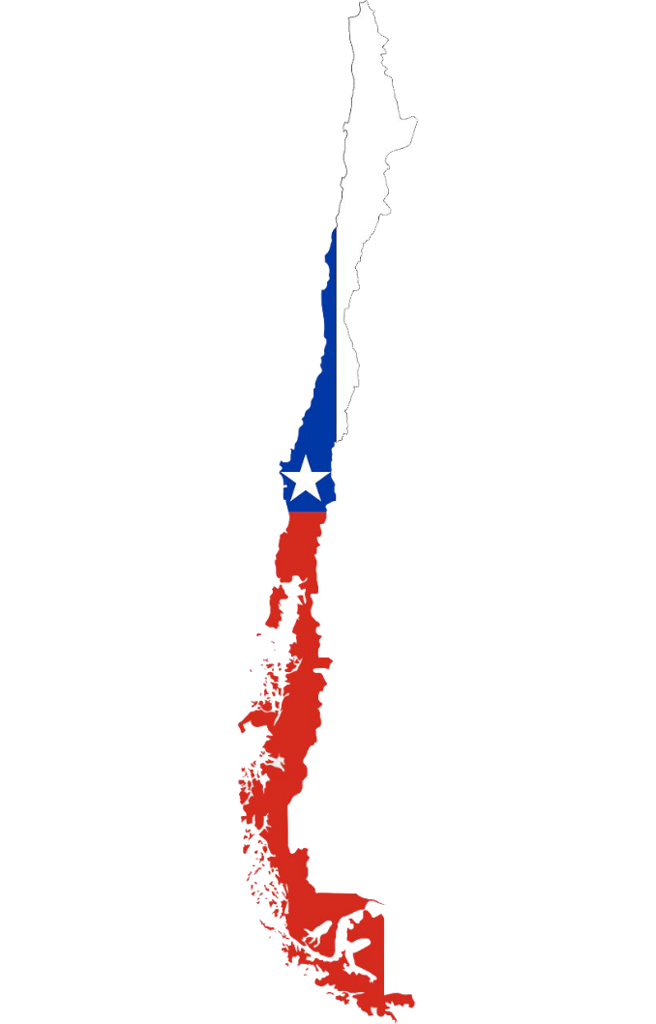
REGRESSION MODELING for PREDICTING OPTIMAL REAL ESTATE PRICES
in CHILE
By:
Lara Baltaji
Hadi Knaiber
Shadi Youssef

Slide 2

OUTLINE
Introduction
Problem
Correlation Analysis
Floor
Bedrooms
Bathrooms
Size
View
Region
Predictive Models
Conclusion

Slide 3

The Chilean Real Estate Market has been considered a market in demand for a very long time now.
People choose Chile for Real Estate not only for its spectacular scenery and fascinating culture, but mainly for its thriving economy.
The Republic of Chile is situated in the Western part of South America between the Andes to the east and the Pacific Ocean to the west. The map of Chile shows a very unique shape of the Chilean land which is long and narrow.
OUTLINE
Introduction
Problem
Correlation Analysis
Floor
Bedrooms
Bathrooms
Size
View
Region
Predictive Models
Conclusion

Slide 4
OUTLINE
Purpose of this study
Our study uses a multiple linear regression model to analyze the real estate property market in Santiago and Norte, Chile, for the aim of predicting list price based on certain predictors.
The difference between List price and the sale price
The list price is the initial price amount of a property offered by a market.
The sale price is the transaction price amount which is the amount the consumer has actually paid for the property.
Usually, sale prices are lower than list prices as they are affected by negotiations.
Introduction
Problem
Correlation Analysis
Floor
Bedrooms
Bathrooms
Size
View
Region
Predictive Models
Conclusion

Slide 5
OUTLINE
We used a dataset collected by a Real Estate company called Disca.
What is Disca?
Disca is a leading Real Estate company in Chile that implements several projects related to real estate. They construct the apartments from A to Z including all structural calculations, land preparations for construction, and the construction process until the apartments become ready for sale.
Introduction
Problem
Correlation Analysis
Floor
Bedrooms
Bathrooms
Size
View
Region
Predictive Models
Conclusion

Slide 6

Data Description:
Our data set consists of several variables, some are quantitative such as floor number, size, and price, and others are qualitative such as region and view orientation.
Target variable $y$
Sold price per $m^{2}$ is the sale price of the apartment in $m^{2}$
Possible predictors $x_{i}$:
Floor represents the floor number of the apartment
Status refers to the status of the apartment (sold, available, reserved or promised)
Bedrooms refers to the number of bedrooms per apartment
Bathrooms refers to the number of bedrooms per apartment
The view orientation refers to the compass direction of the view of each apartment (East, West, North, South, North Eastern, North Western, South Eastern, South Western
Size per $m^{2}$ represents the size of each apartment in $m^{2}$
Region is the region were the apartment is located (Norte or Santiago)
OUTLINE
Introduction
Problem
Correlation Analysis
Floor
Bedrooms
Bathrooms
Size
View
Region
Predictive Models
Conclusion

Slide 7
OUTLINE
The major factor which people consider when buying their household properties is the price of the property.
The prices of residential properties depend on many factors including but not limited to age of the property, size, view, floor number, typology, and location.
In order to determine the main factors that affect the prices of apartments in Chile we first studied the correlations of the different independent variable with our dependent variable Price of the Apartment. Then we performed two multiple linear regression model for predicting prices of apartments in Chile.
Introduction
Problem
Correlation Analysis
Floor
Bedrooms
Bathrooms
Size
View
Region
Predictive Models
Conclusion

Slide 8
OUTLINE
Introduction
Problem
Correlation Analysis
Floor
Bedrooms
Bathrooms
Size
View
Region
Predictive Models
Conclusion

Slide 9
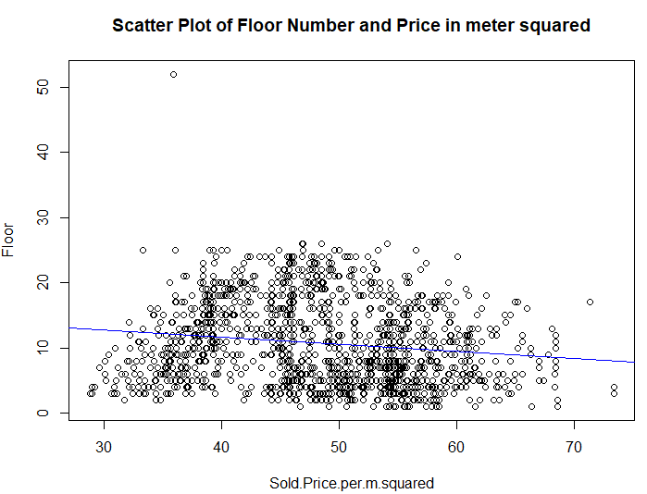
To check if there exists a correlation between the floor number and price we plotted a scatter plot.
OUTLINE
t = -5.3882, df = 1348,
p-value = 8.389e-08
alternative hypothesis: true correlation is not equal to 0
95 percent confidence interval:
-0.19702801 -0.09256721
sample estimates:
cor
-0.1452022
Introduction
Problem
Correlation Analysis
Floor
Bedrooms
Bathrooms
Size
View
Region
Predictive Models
Conclusion
The results show a negative correlation between floor number and price. To validate this, we conducted a correlation test which verified our results with a p-value much less than our chosen alpha (0.05) and a negative correlation value of -0.145.

Slide 10
OUTLINE
This means that as the floor number increases, the price of the apartment decreases, when in usual cases the apartments become more expensive as their floor number increases.
Why do you think is it the case in Chile?
Introduction
Problem
Correlation Analysis
Floor
Bedrooms
Bathrooms
Size
View
Region
Predictive Models
Conclusion

Slide 11
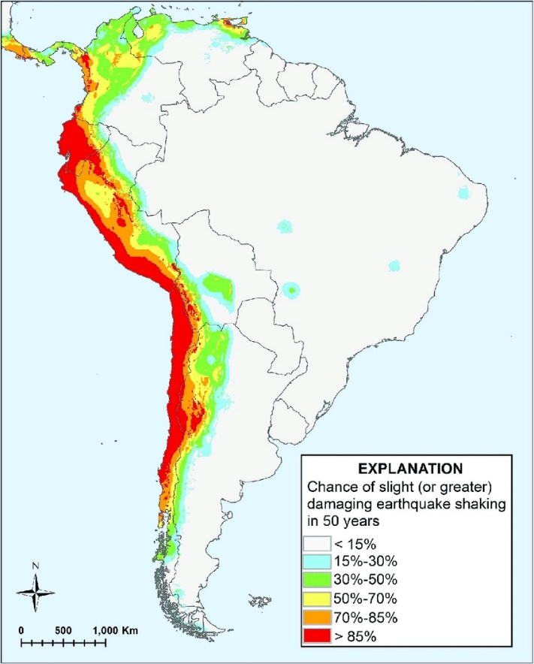

It is because of Chile’s location which is subject to EARTHQUAKES.
Chile is one of the few locations on Earth where three major earthquake plates meet; in other words, Chile is a “triple junction”.
Earthquakes occur in Chile on a regular basis with a frequency of almost 18 major earthquakes and 2 million minor earthquakes yearly. The demand is higher for low apartments since they are safer when an earthquake happens since there are less wave vibrations on lower floors, which makes lower apartments more expensive.
OUTLINE
Introduction
Problem
Correlation Analysis
Floor
Bedrooms
Bathrooms
Size
View
Region
Predictive Models
Conclusion

Slide 12
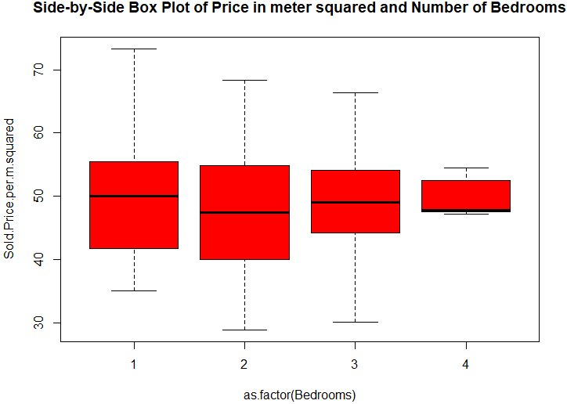
To check if there exists a correlation between the number of bedrooms and price we plotted a boxplot. We treated bedroom number as a quality in this case since there are only 4 numerical values.
OUTLINE
Introduction
Problem
Correlation Analysis
Floor
Bedrooms
Bathrooms
Size
View
Region
Predictive Models
Conclusion
Do you think there is correlation between the two?

Slide 13

To check if there exists a correlation between the number of bedrooms and price we plotted a boxplot. We treat bedroom number as a quality in this case since they are only 4 numerical values.
OUTLINE
Introduction
Problem
Correlation Analysis
Floor
Bedrooms
Bathrooms
Size
View
Region
Predictive Models
Conclusion
Df Sum Sq Mean Sq F value Pr(>F)
as.factor(Bedrooms) 3 654 217.86 2.939 0.0322 *
Residuals 1346 99771 74.12
---
Signif. codes: 0 ‘***’ 0.001 ‘**’ 0.01 ‘*’ 0.05 ‘.’ 0.1 ‘ ’ 1
You guessed right!
We can notice that the medians and quartiles differ significantly. For that, we expect a strong correlation between the number of bedrooms and price per $m^{2}$.
The ANOVA test validates our hypothesis with a p-value almost equal to zero.

Slide 14
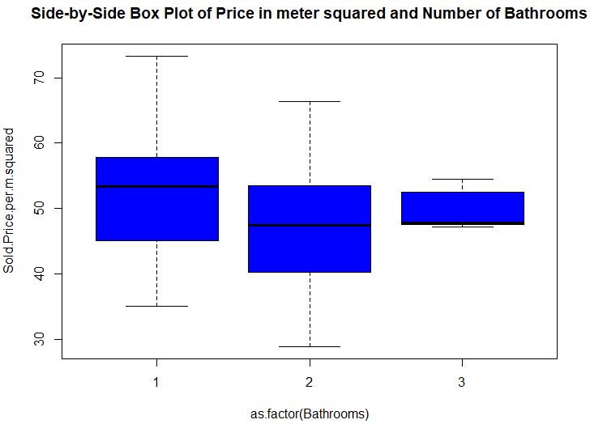
To check if there exists a correlation between the number of bathrooms and price we plotted a boxplot. We treated the bathroom number as a quality also since there are only 3 numerical values.
OUTLINE
Introduction
Problem
Correlation Analysis
Floor
Bedrooms
Bathrooms
Size
View
Region
Predictive Models
Conclusion
Do you think there is correlation between the two?

Slide 15
To check if there exists a correlation between the number of bathrooms and price we plotted a boxplot. We treated the bathroom number as a quality also since there are only 3 numerical values.
OUTLINE
Introduction
Problem
Correlation Analysis
Floor
Bedrooms
Bathrooms
Size
View
Region
Predictive Models
Conclusion
Df Sum Sq Mean Sq F value Pr(>F)
as.factor(Bathrooms) 2 6154 3077 43.97 <2e-16 ***
Residuals 1347 94271 70
---
Signif. codes: 0 ‘***’ 0.001 ‘**’ 0.01 ‘*’ 0.05 ‘.’ 0.1 ‘ ’ 1
You guessed right!
We can notice that the medians and quartiles differ significantly. For that, we expect a strong correlation between the number of bedrooms and price per $m^{2}$.
The ANOVA test validates our hypothesis with a p-value almost equal to zero.

Slide 16
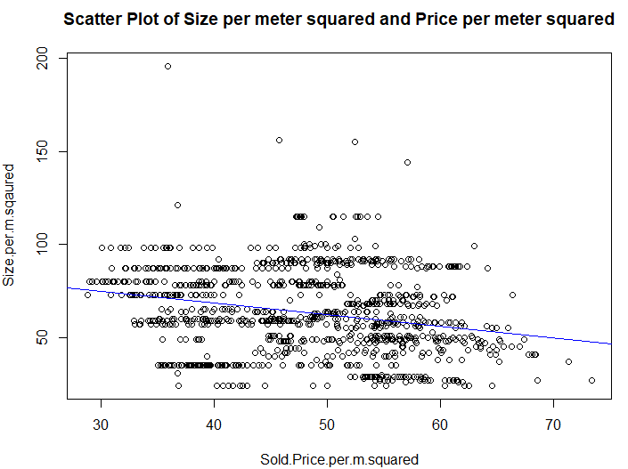
To check if there exists a correlation between the size in meter squared and price in meter squared we plotted a scatter plot.
OUTLINE
t = -9.4853, df = 1348, p-value < 2.2e-16
alternative hypothesis: true correlation is not equal to 0
95 percent confidence interval:
-0.2994917 -0.1994459
sample estimates:
cor
-0.2501364
Introduction
Problem
Correlation Analysis
Floor
Bedrooms
Bathrooms
Size
View
Region
Predictive Models
Conclusion
The scatter plot results show a negative correlation between size and price. To validate this, we conducted a correlation test which verified our results with a p-value much less than our chosen alpha (0.05) and a negative correlation value of -0.25.

Slide 17
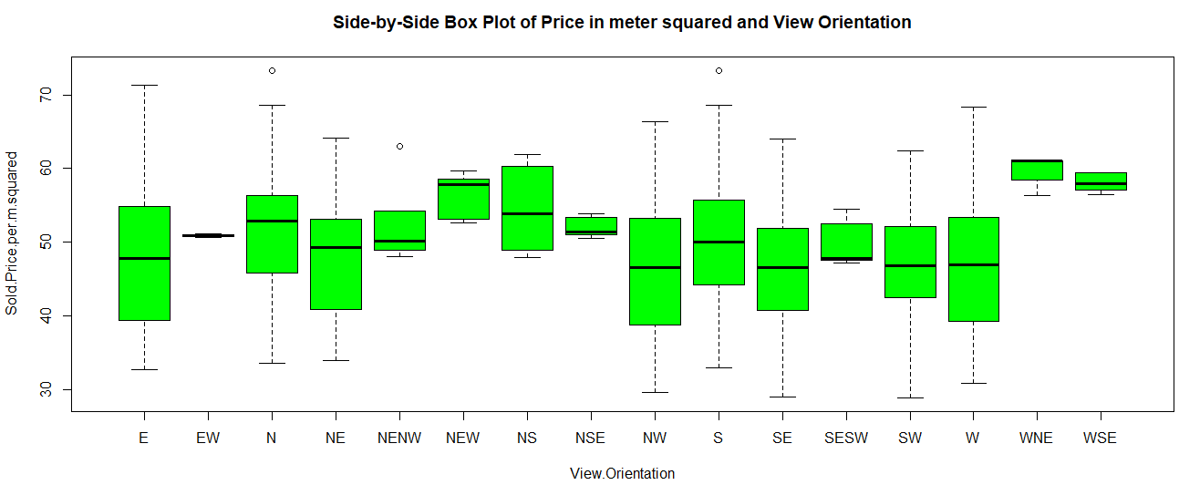
To check if there exists a correlation between the view orientation and price we plotted a side-by-side boxplot.
OUTLINE
Introduction
Problem
Correlation Analysis
Floor
Bedrooms
Bathrooms
Size
View
Region
Predictive Models
Conclusion
Do you think there is correlation between the two?

Slide 18

To check if there exists a correlation between the view orientation and price we plotted a side-by-side boxplot.
OUTLINE
Introduction
Problem
Correlation Analysis
Floor
Bedrooms
Bathrooms
Size
View
Region
Predictive Models
Conclusion
You guessed right!
We can notice that the medians and quartiles differ significantly. For that, we expect a strong correlation between the view orientation and price per $m^{2}$.
The ANOVA test validates our hypothesis with a p-value almost equal to zero.
Df Sum Sq Mean Sq F value Pr(>F)
View.Orientation 15 6657 443.8 6.313 4.32e-13 ***
Residuals 1334 93768 70.3
---
Signif. codes: 0 ‘***’ 0.001 ‘**’ 0.01 ‘*’ 0.05 ‘.’ 0.1 ‘ ’ 1

Slide 19
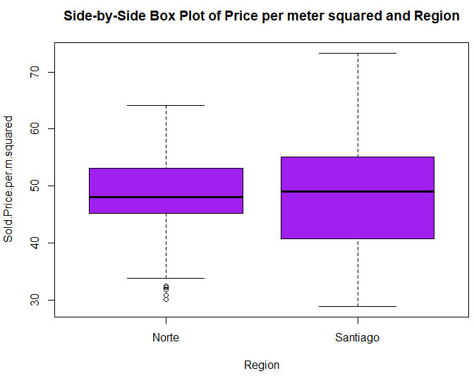
Finally, to check if there exists a correlation between the region and price we plotted a side-by-side boxplot.
OUTLINE
Introduction
Problem
Correlation Analysis
Floor
Bedrooms
Bathrooms
Size
View
Region
Predictive Models
Conclusion
Do you think there is correlation between the two?

Slide 20
Finally, to check if there exists a correlation between the region and price we plotted a side-by-side boxplot.
OUTLINE
Introduction
Problem
Correlation Analysis
Floor
Bedrooms
Bathrooms
Size
View
Region
Predictive Models
Conclusion
Df Sum Sq Mean Sq F value Pr(>F)
Region 1 9 9.16 0.123 0.726
Residuals 1348 100415 74.49
We predict a little correlation between price and region since the medians of the two regions seem to be very close. However, it is not very clear. The ANOVA test shows that there exists no significant correlation between the two as the p-value is 0.73 which is much bigger than 0.05.
We predict that this may be due to the stability of the currency (UF Chileno) which is a non-circulating currency and which used in bank loans, financing, purchases and investments. .

Slide 21
To build our predictive model, we first split our data into 70% training and 30% validation. Then, we tried fitting two multiple linear regressions on the training dataset.
The first MLR included all the independent variables regardless of their correlations with price (Floor, Bedrooms, Bathrooms, Size, View Orientation, Region).
The results of this MLR show that all the used variables turned out to be significant predictors as they all resulted in small p-values relative to alpha.
The second MLR only included the potential predictors which are the variables having a significant correlation with price (all but Region).
The results of this MLR also show that all the variables turned out to be significant as they all resulted in small p-values relative to alpha.
OUTLINE
Introduction
Problem
Correlation Analysis
Floor
Bedrooms
Bathrooms
Size
View
Region
Predictive Models
Conclusion

Slide 22
In order to asses the predictive performance of both models and thus evaluate which is better at predicting prices of residential apartments, we applied the two models on the validation dataset.
The results were as follows:
The first MLR resulted in a 6.9 RMSE
The second MLR resulted in a 7.3 RMSE.
Hence, even though the second MLR includes only the potential predictors determined previously, it turned to have a larger rate of prediction error.
Therefore, we choose the first MLR which includes all the independent variables as our final predictive model.
In order to further investigate the chosen predictive model, we compare its RMSE with double the mean of prices which is 97. Hence, the percentage error marks a 7% rate which is relatively low displaying an accurate predictive performance.
OUTLINE
Introduction
Problem
Correlation Analysis
Floor
Bedrooms
Bathrooms
Size
View
Region
Predictive Models
Conclusion

Slide 23
OUTLINE
Despite the fact that region is not significantly correlated with price, the first model performed better in terms of prediction and region turned out to be a significant predictor after all. This may be due to the existence of multicollinearity between region and some other variable in our model.
There are limitations in our study:
1. The listed prices were exactly the same as the sold prices, suggesting that prices are on-negotiable and fixed. Usually, this is not what happens since in most cases as negotiations take place regularly, even if on a minimal scale.
2. The data includes only two regions in Chile. The studied analysis might or might not be the same in other regions.
3. The age of properties is not included in our dataset when it is known world-wide that the age of the apartment plays a significant role in the pricing.
Future research can use additional variables for prediction models such as the age and specific location of the apartment. They can also use other predictive techniques such as Random Forest, Support Vector Machine and Neural Networks which can provide better options for prediction
Introduction
Problem
Correlation Analysis
Floor
Bedrooms
Bathrooms
Size
View
Region
Predictive Models
Conclusion

Slide 24
Thank You!

