Slide 1
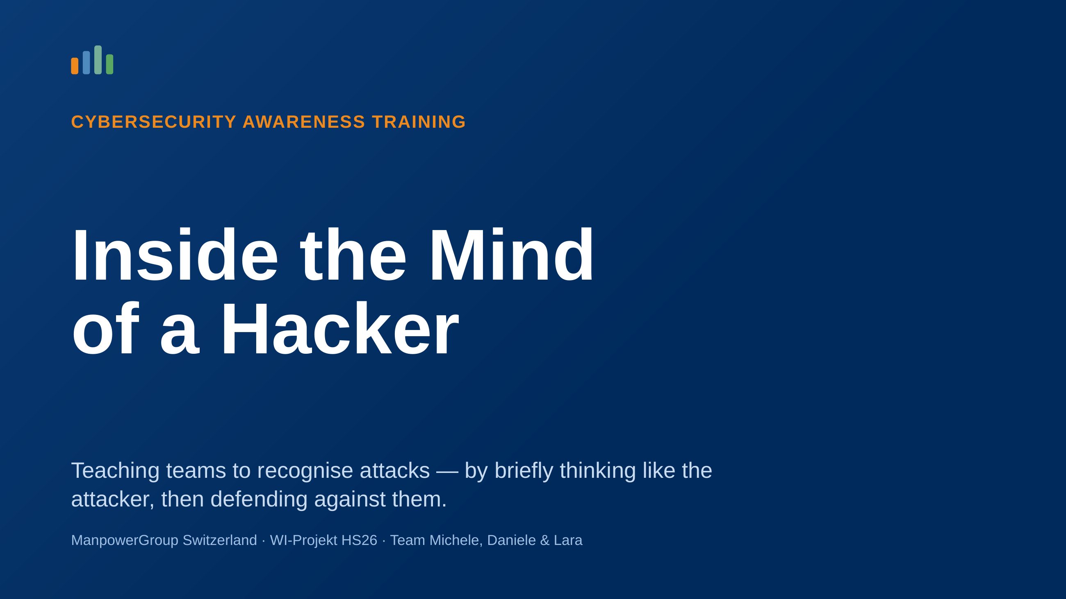
Notes:
Welcome. This deck introduces our cybersecurity awareness training: the idea behind it, how it works, and what it is based on.

Slide 2
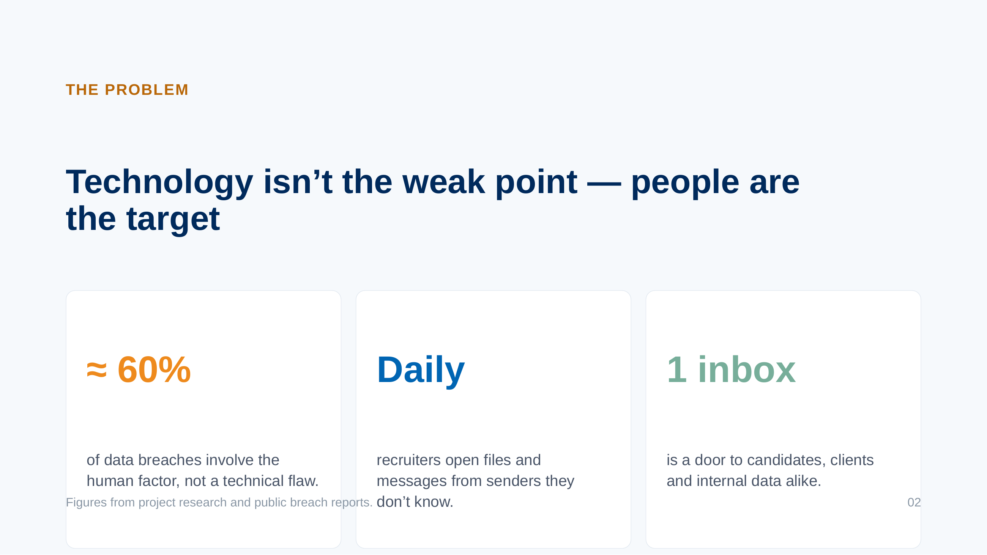
Notes:
Awareness trainings exist because attackers target people, not firewalls. Recruiting is especially exposed: opening unknown files is the job.

Slide 3
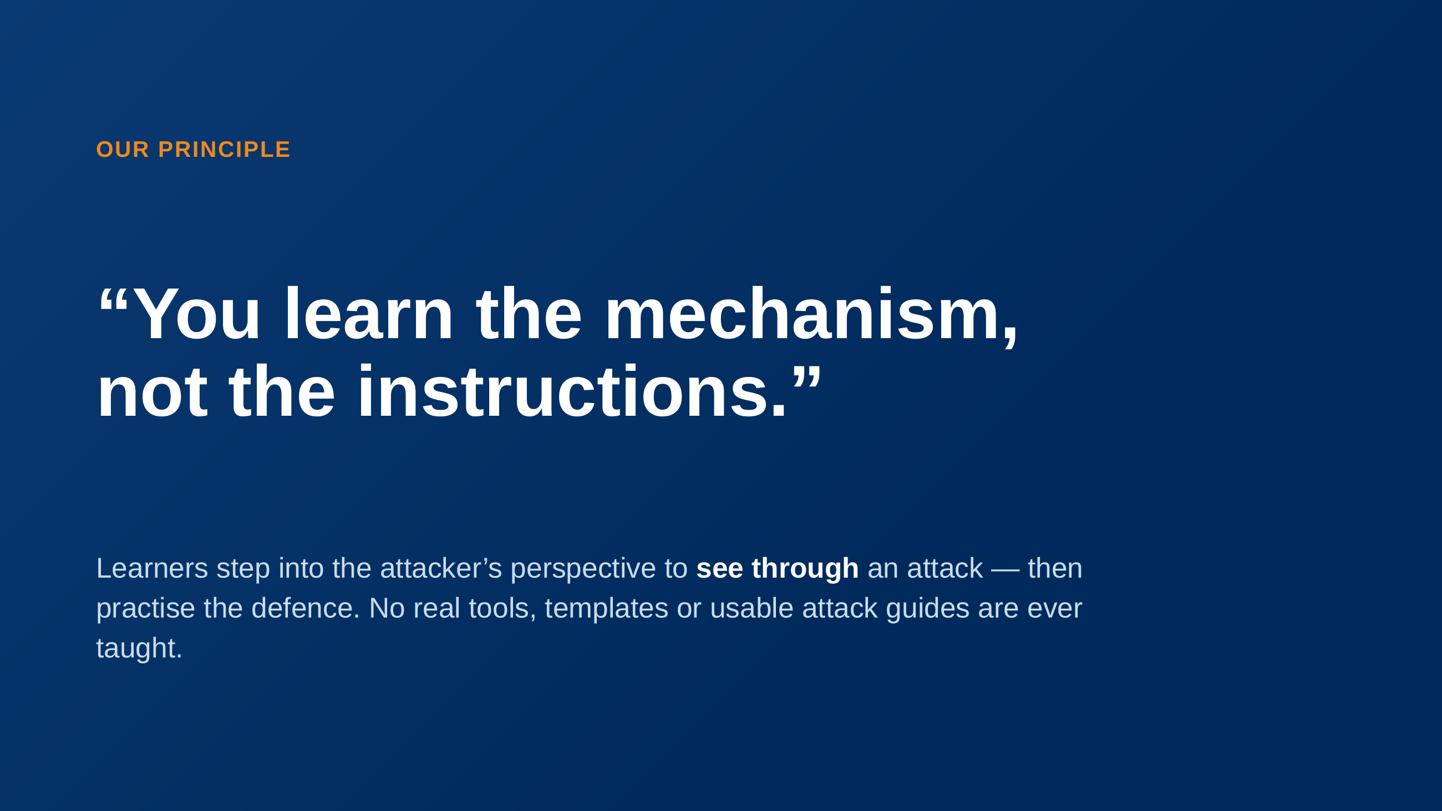
Notes:
This is the guardrail of the whole concept. The attacker’s view makes the lesson memorable; the recognition-and-defence framing keeps it safe.

Slide 4
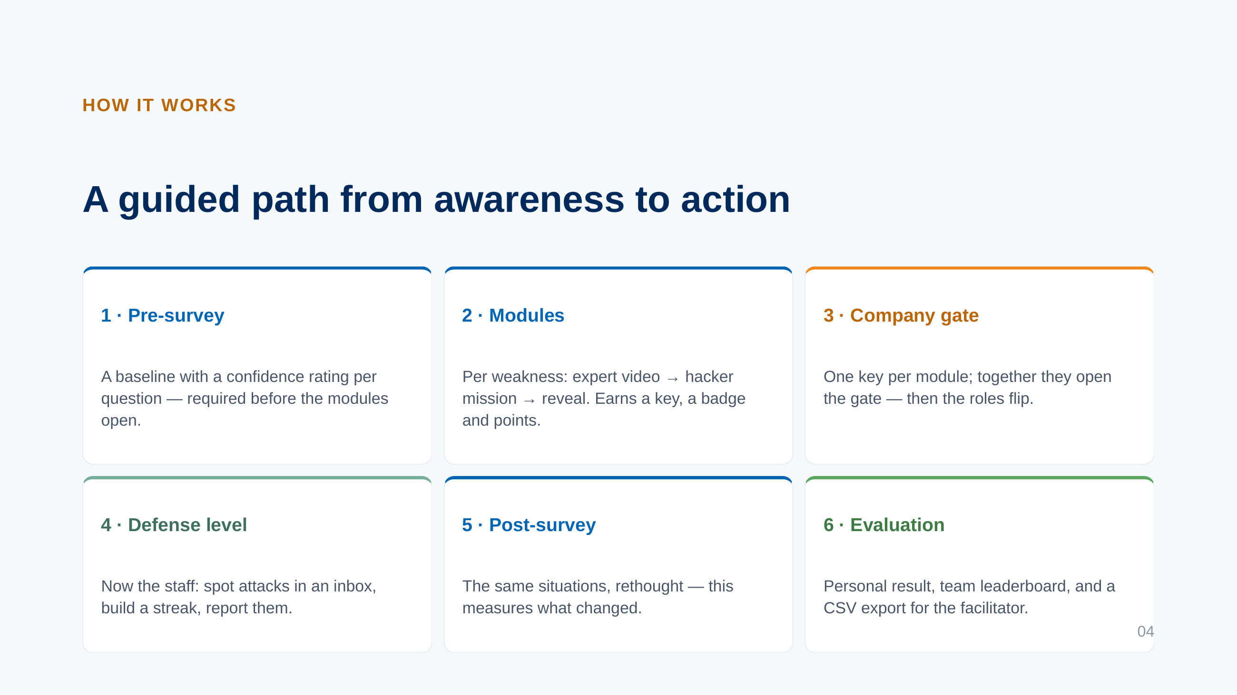
Notes:
The flow is linear and gated: survey first, then modules, then the defence level, then the closing survey and evaluation.

Slide 5
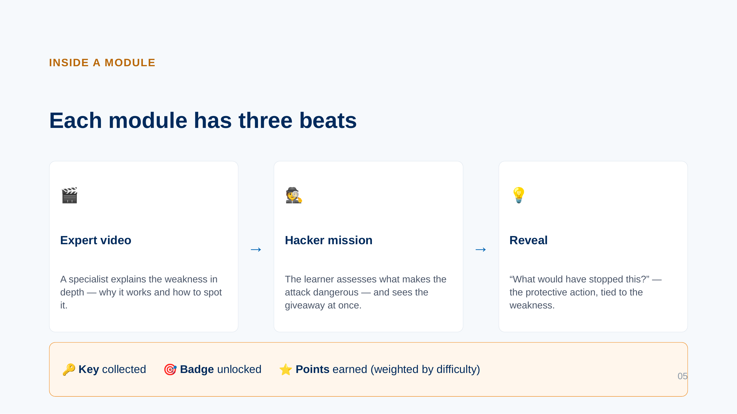
Notes:
Every module follows the same rhythm, so learners always know where they are. Completing it rewards a key, a badge and points.

Slide 6
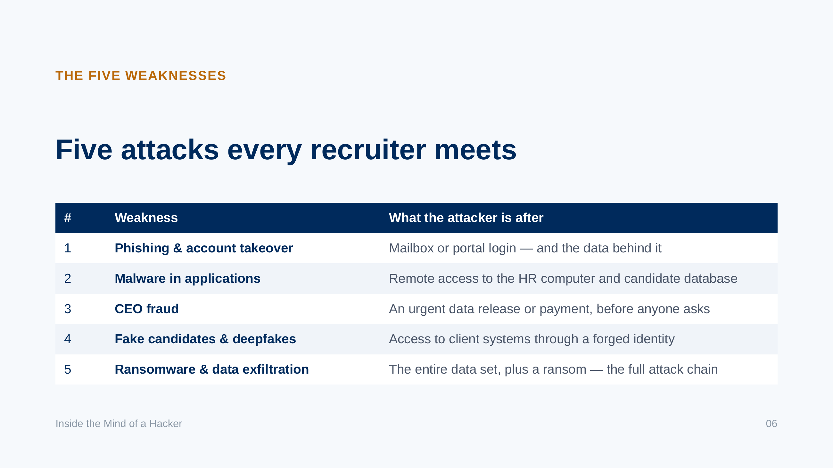
Notes:
The five modules cover the attacks a staffing agency realistically faces. Module 5 builds on the others and shows the whole chain.

Slide 7
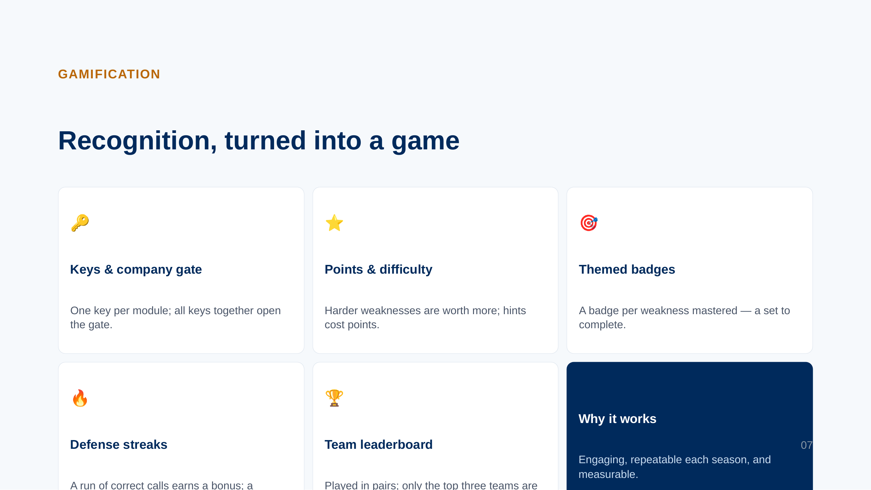
Notes:
Gamification keeps attention and makes the training repeatable. Points and streaks also feed the evaluation.

Slide 8
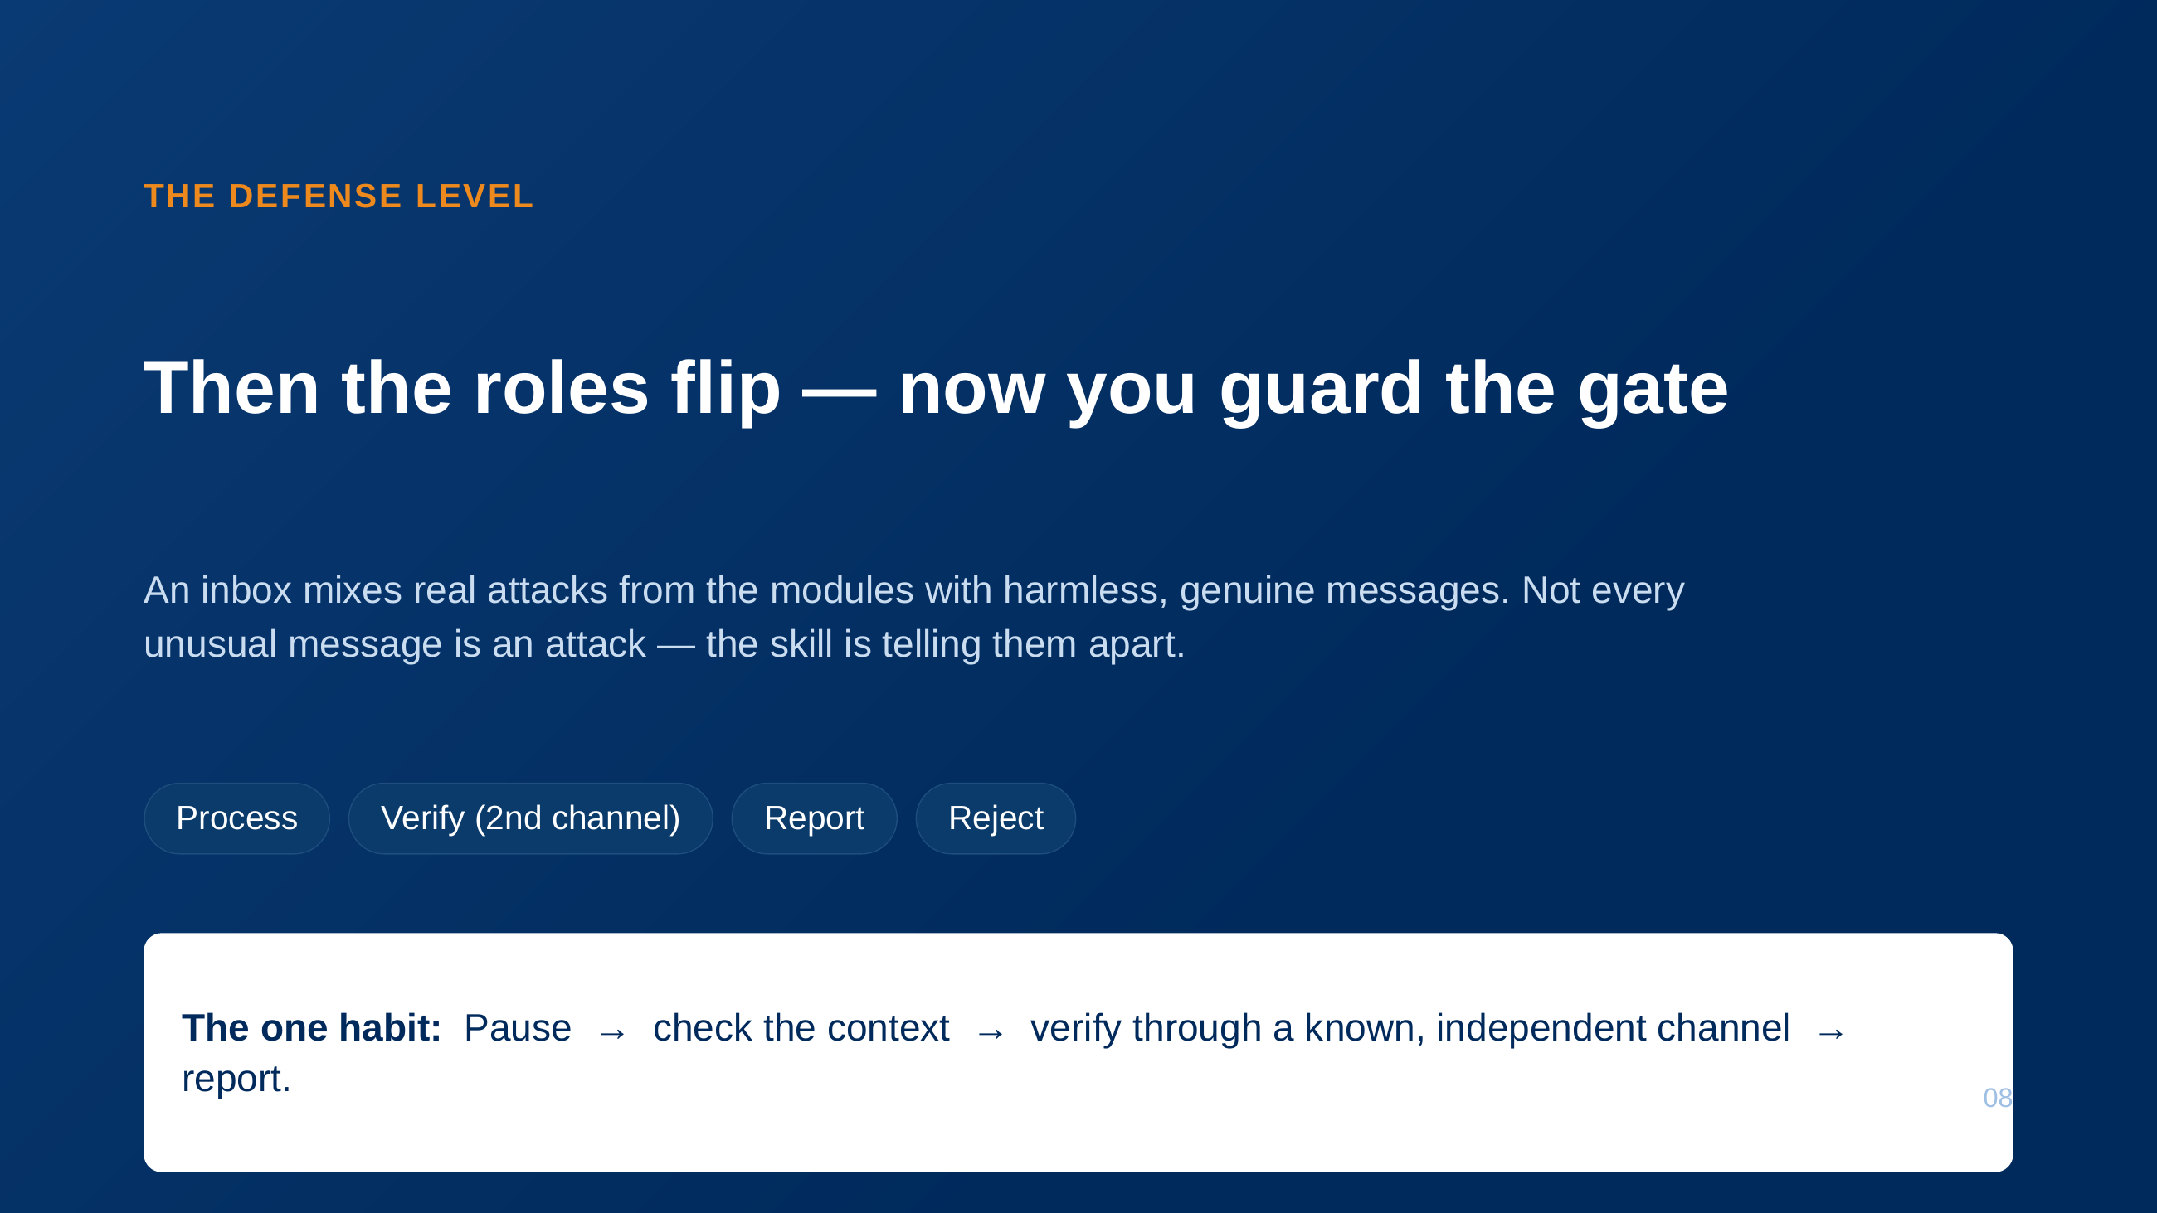
Notes:
The defence level turns the attacker’s view into a defender’s reflex. The closing habit is what the whole training builds toward.

Slide 9
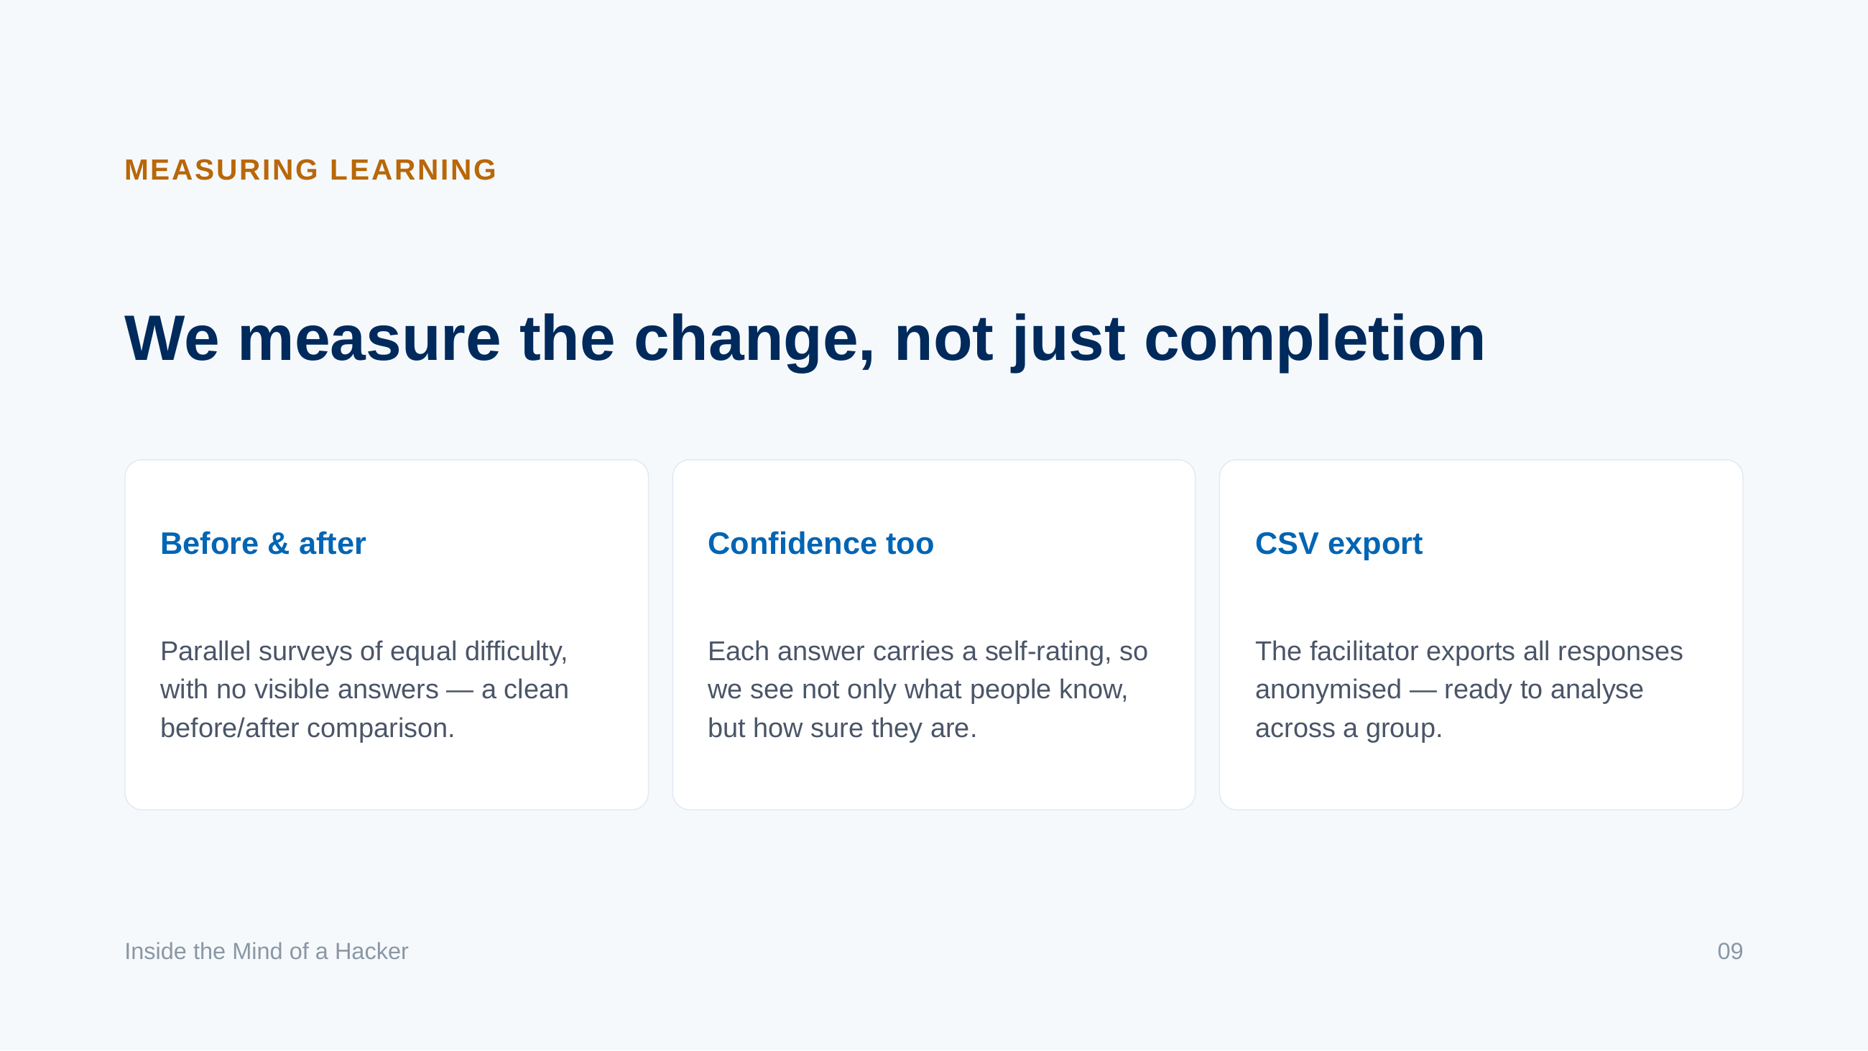
Notes:
The pre/post design with confidence ratings lets the test phase show measurable learning, not just attendance.

Slide 10
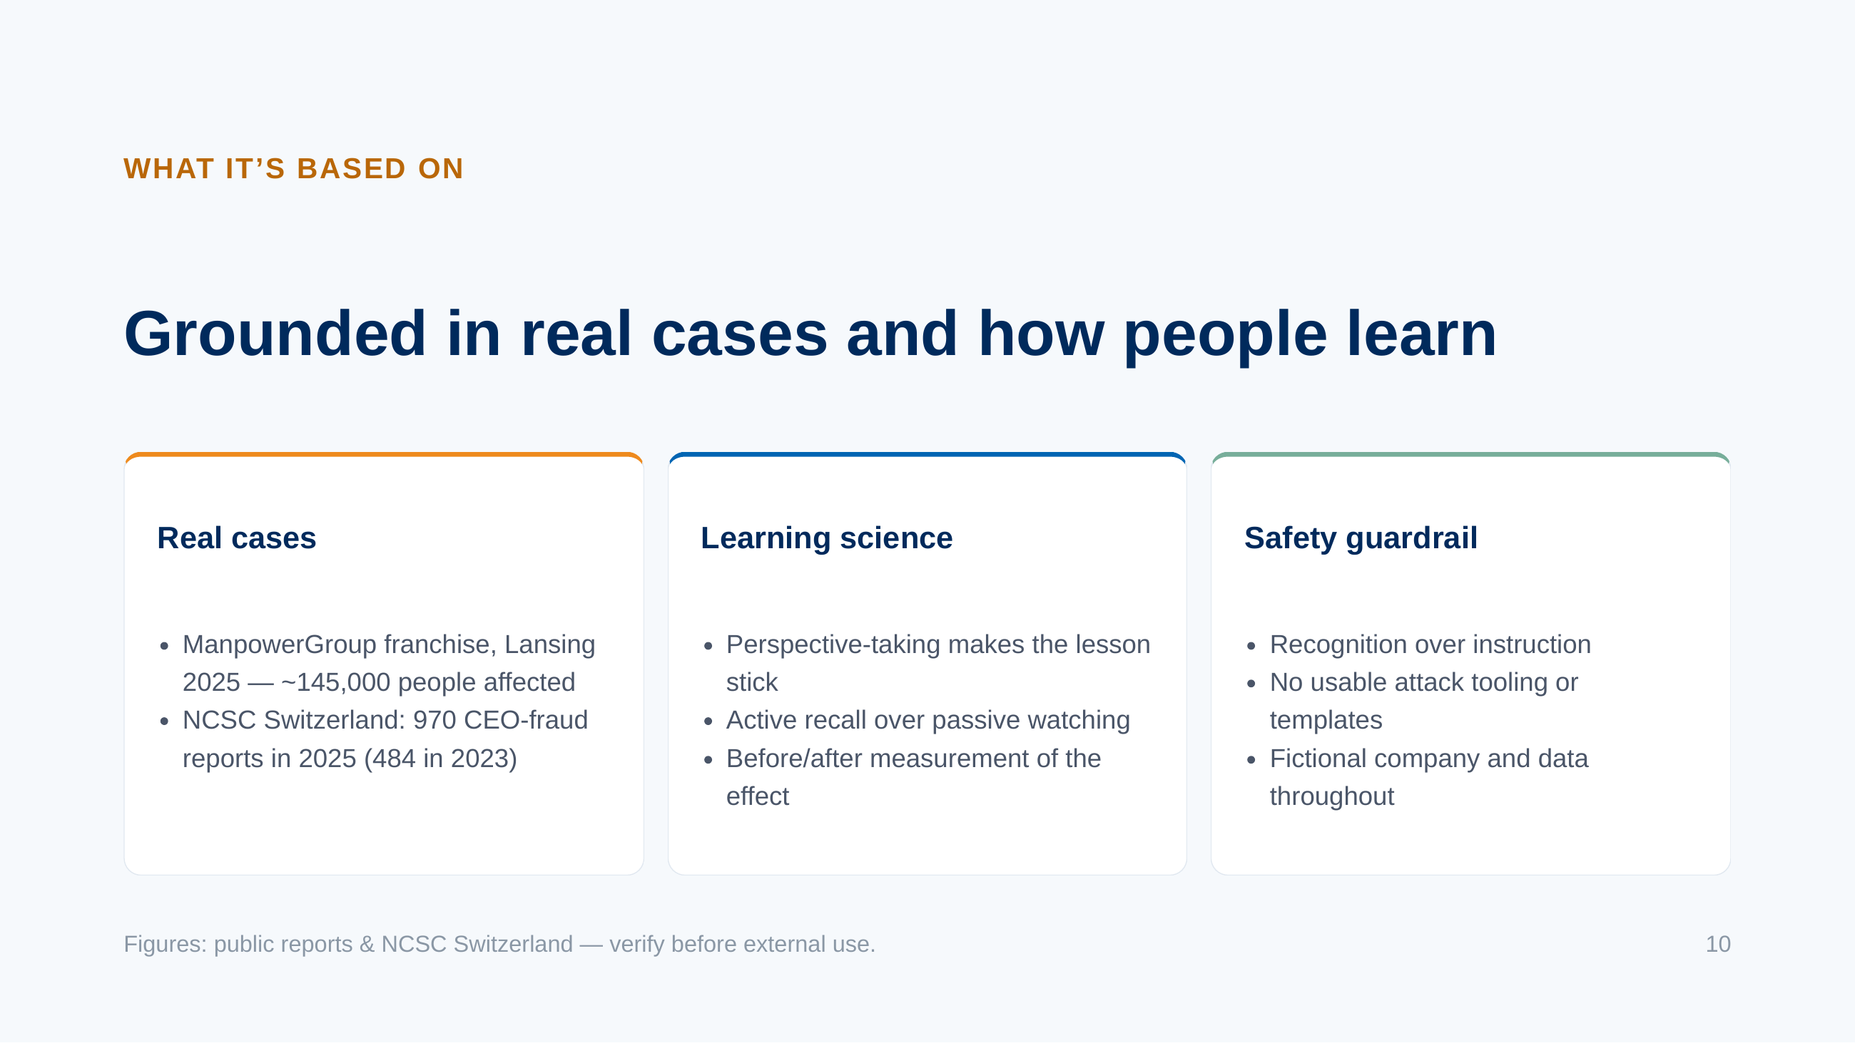
Notes:
Three pillars: real incidents that make it relevant, learning science that makes it effective, and a guardrail that keeps it responsible.

Slide 11
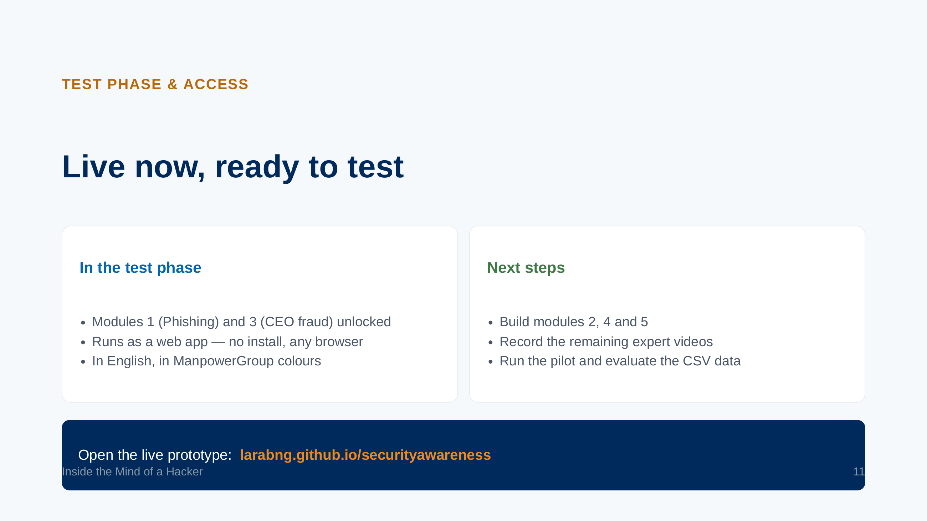
Notes:
The prototype is already online and playable end to end for the two test modules. The remaining modules and videos are the next build.

Slide 12

Notes:
Close on the single habit the training instils. Thank the audience and invite questions or a pilot date.

