Slide 1
Telemilitary - CW2 Final Submission
COMM2020 Project 7 | Indie Game Telemetry and Fair Progression Balancer

Slide 2
Recap (What You'll See)
Game concept and telemetry-driven balancing problem
How we capture, validate, and store telemetry events
Dashboard views: funnels, spikes, progression, and fairness indicators
Balancing toolkit: rule suggestions, simulation previews, and decision logging
Testing, handover pack, and evaluation highlights

Slide 3
1. What We Delivered in Sprint 2
Playable browser memory game with 10 stages across easy/balanced/hard configs
Telemetry pipeline captures and validates gameplay events in Flask + SQLite
Designer dashboard supports funnel, spikes, progression, fairness, and comparison views
Rule-based balancing toolkit with simulation and decision logging
Live demo focus: game -> telemetry -> dashboard -> balancing decision.

Slide 4
2. CW2 Specification Alignment (Core)
Spec requirement | Project status | Evidence in this build
10+ stages + 3 mechanics | Met | 10-stage progression, timer/moves, powerups
12+ telemetry event types | Met | 15 documented event types in shared schema
Dashboard with fairness + comparisons | Met | Dashboard pages and metrics endpoints
6+ balancing rules + simulation | Met | 6 rules in balancing logic + /simulate route
RBAC and pseudonymous telemetry | Met | Designer login and role checks
All points trace to current repository implementation and docs.

Slide 5
3. Gameplay and Telemetry Flow
Player sessions emit stage_start, stage_complete/fail, retries, resources, and quit events
Backend validation catches missing fields, impossible sequences, and invalid payload values
Telemetry is stored pseudonymously and reused for seeded analytics even offline
Post-run summary gives players completion/time/resource feedback
Talk track: show one short run, then open dashboard immediately.

Slide 6
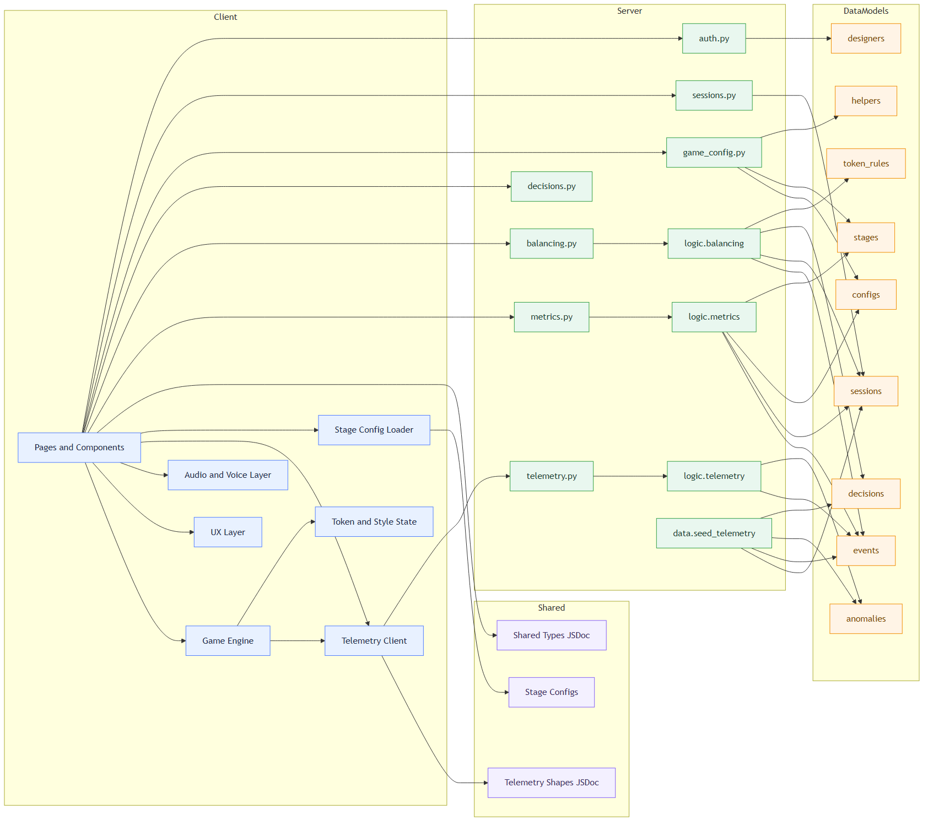
4. Architecture Overview
Client (React) -> API (Flask) -> SQLite telemetry store -> analytics and balancing endpoints.

Slide 7
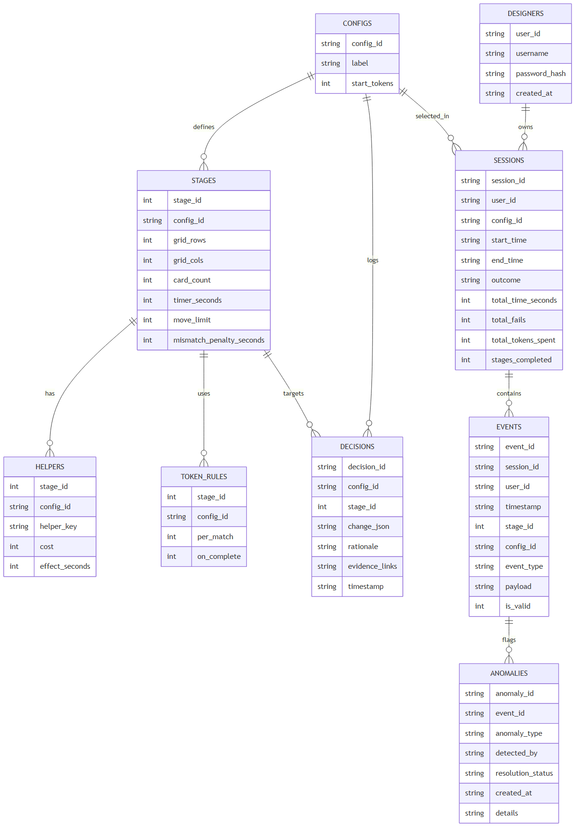
5. Data Model for Analytics and Auditing
Core entities include users, sessions, events, configs, rules, decisions, and anomalies.

Slide 8
6. Dashboard Insights for Designers
Funnel analytics: stage-by-stage completion and drop-off rates
Difficulty spike detection: high fail/time pressure stages are highlighted
Progression curves: completion time and token economy trends by stage
Fairness indicators: segment comparison (e.g., fast vs slow players)
Config comparison mode for easy vs balanced vs hard

Slide 9
7. Balancing Toolkit Demo Scenario
Rule triggers flag problematic stages (e.g., fail rate too high, fairness gap too large)
Designer edits parameters (timer, move limits, helper costs, penalties, rewards)
Simulation estimates before/after completion, failure, and quit rates
Decision log captures change, rationale, and evidence link for auditability
Demo example: +10 seconds on Stage 2 increased predicted completion rate.

Slide 10
8. Testing and Quality Evidence
Area | Automated coverage | Current evidence
Telemetry validation | Unit tests | Event required fields and types validated
Data ingestion/storage | Integration tests | POST /api/events persisted to SQLite
Dashboard computations | Metrics tests | Funnel/stage/fairness computations verified
Balancing rules/simulation | Balancing tests | Simulation route returns expected deltas
Export endpoints | API tests | CSV export route behavior covered
Repository currently contains 15 automated tests across backend test modules.

Slide 11
9. Client Handover and Maintainability
Deployment guide includes local run, production setup, and test commands
System remains usable with seeded telemetry data if external services are unavailable
Environment-variable based configuration avoids hardcoded secrets
Maintainer extension path: add new event type + update schema, ingestion, and metrics

Slide 12
10. Evaluation Highlights and Limitations
Detection validity: rules identify known difficult stages in seeded data
Fairness analysis: segment gaps are measurable and can drive mitigations
Balancing effectiveness: simulation previews expected progression improvements
Limitation: simulation is lightweight and should be validated with further playtesting
Limitation: final manual testing evidence should be packaged in testing_evidence.pdf

Slide 13
11. Risks, Next Steps, and Closing
Risk: over-tuning for one segment can hurt fairness for others
Risk: telemetry quality degrades insight quality if validation rules are bypassed
Next step: continue scenario-based balancing cycles with decision audit trail
Next step: extend manual E2E evidence pack and maintainer runbook details
Final outcome: Telemilitary provides a practical telemetry-driven balancing workflow
Final minute in presentation: recap value, limitations, and practical roadmap.

