Slide 1

Amazon Review Analyzer Introduction to Computer Science and Programming 25. January 2024 Florian Goldinger, Lara Filippone

Slide 2
Agenda
Agenda
1
Problem Pitch
2
Solution Overview
3
Live Demonstration
4
Q&A

Slide 3
Problem Pitch
The Problem
Vast Number of Reviews
-Online platforms like Amazon have products with thousands of reviews.
Challenge in Insight Extraction
-Difficult to gain valuable insights from a large volume of reviews.
Lack of Automated Services:
-Amazon does not offer a service to manage and analyze this information in an automated and efficient way.
Limitations of Star Ratings:
-Star ratings only provide limited information. Need for deeper insights into sentiment and keywords.

Slide 4
Problem Pitch
Relevance of the Problem
Impact on Product Management and Development
-Rapid market evolution requires quick adaptation based on customer feedback.
-Ineffective response to customer preferences can lead to loss of market share.
Importance for Customer Service Teams
-Delays in resolving customer issues can negatively impact satisfaction and loyalty.
-Inefficiencies in handling complaints can damage brand reputation.

Slide 5
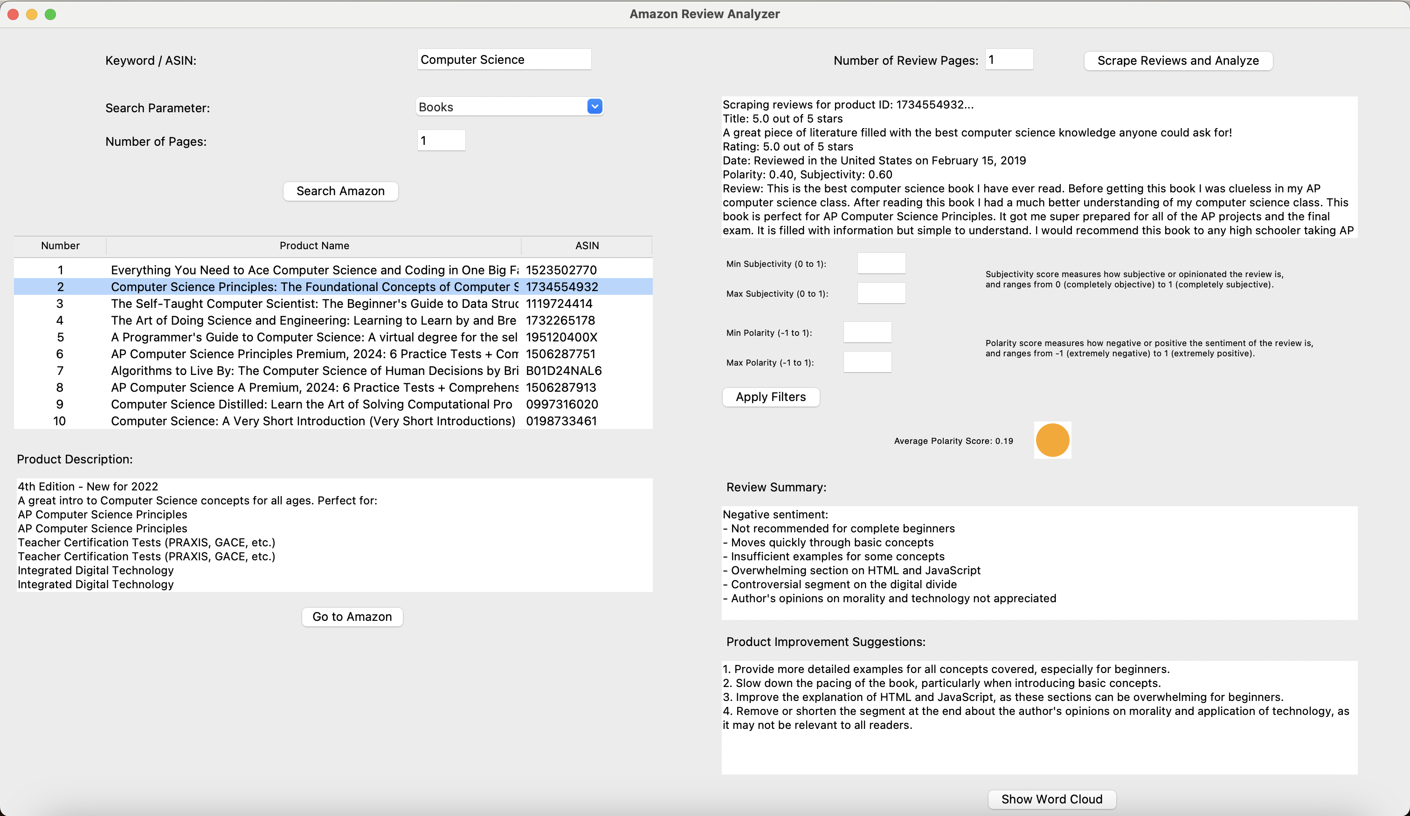
Solution Overview
GUI with different features
Amazon Search Feature
- Keyword / ASIN
Product Description
- Scraping / Various HTML formats
Scraping Amazon Reviews
Sentiment Analysis (Score, Graphical)
- Subjectivity/Polarity
- Visual representation of average polarity (red, orange, green)
Review Summary
- Generative AI
Product Improvement Suggestions
- Generative AI
WorldCloud
- Key Words

Slide 6
Solution Overview
Technology / Techniques
Graphical User Interface
- Tkinter
Webscraping Techniques
- BeautifulSoup
- Used for: Amazon search, Product Description, Reviews
- Diverse structure of Amazon pages (analysis of Amazon search function, exploration of different structures of html code)
Sentiment Analysis
- TextBlob
- Score / Visual representation / Filter function
Generative AI
- OpenAI API
- Used for: Summary of Reviews / Suggestions for product improvement

Slide 7
Solution Overview
GUI entry point to access the different features:
-Search for dedicated products is possible using keywords or ASIN, replicating the familiar Amazon homepage.
-Retrieve automated analysis of reviews along with its graphical representation.
-Seamless integration of various technologies, including web scraping, sentiment analysis, and generative AI.

Slide 8
Live Demonstration
Switch to Visual Studio Code
Demostration of the Amazon Review Analyzer

Slide 9
Q&A
Thank you for your attention!
Do you have any questions about our project?

