Slide 1
AUTOMATIC SPEECH PROCESSING · 2026
Speech Translation into English
Comparing cascaded ASR–MT with
fine-tuned direct Whisper models
Lara Husain · Luting Hou · Guo Tian
University of Tübingen · July 2026

Slide 2
Project overview
Task
Cantonese / North Azerbaijani speech → English text
Three pipelines:
ASR-MT, DST, baseline
Data & Evaluation
Dataset: FLEURS
Metric: WER for ASR; BLEU for speech translation
Additional analysis: qualitative error analysis

Slide 3
Whisper
Multilingual encoder–decoder Transformer
Trained on 680,000 hours of labelled audio
Supports ASR and speech translation
Translation direction: X → English
Language and task tokens specify the required output
Whisper Small: 244M parameters

Slide 4
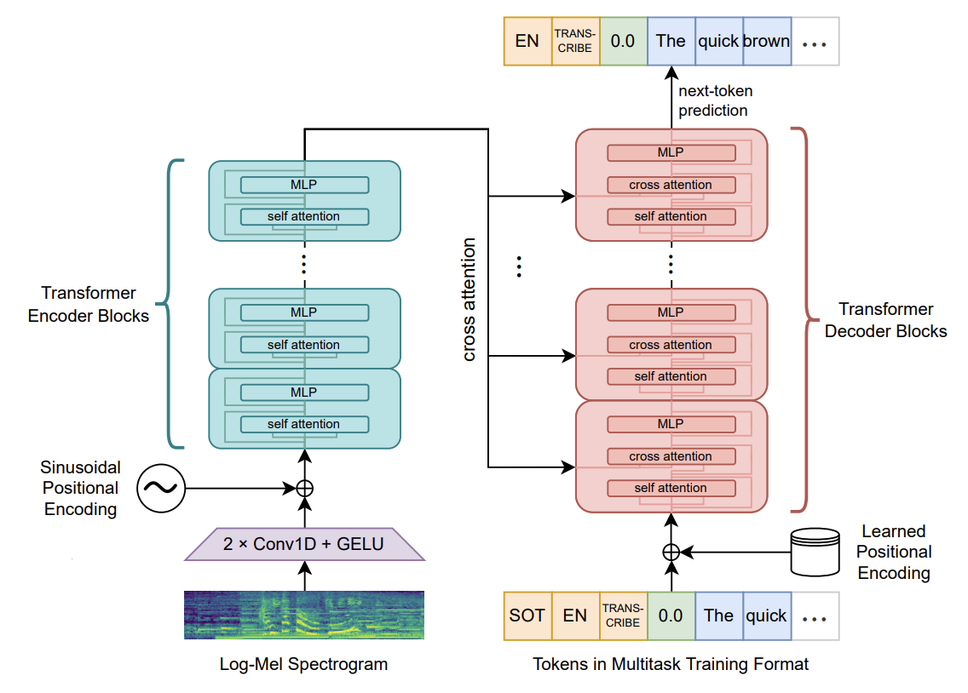
Radford et al. 2023

Slide 5
FLEURS
Multilingual speech dataset covering 102 languages
Based on translated Wikipedia sentences
Recordings from multiple speakers
Audio sampled at 16 kHz
Official train, validation and test splits
Provides both:
Source language transcriptions
English reference translations

Slide 6

Examples
id | audio | transcription | Raw_transcription | gender | language
1740 |  | 金 字 塔 的 聲 光 秀 對 小 孩 來 說 是 該 地 區 最 有 趣 的 東 西 之 一 | 金字塔的聲光秀對小孩來說是該地區最有趣的東西之一。 | 1 | Chinese
1817 |  | yenə də şengen zonası bu baxımdan bir qədər tək dövlət funksiyasına malikdir | Yenə də, Şengen zonası bu baxımdan bir qədər tək dövlət funksiyasına malikdir. | 0 | Azerbaijani

Slide 7
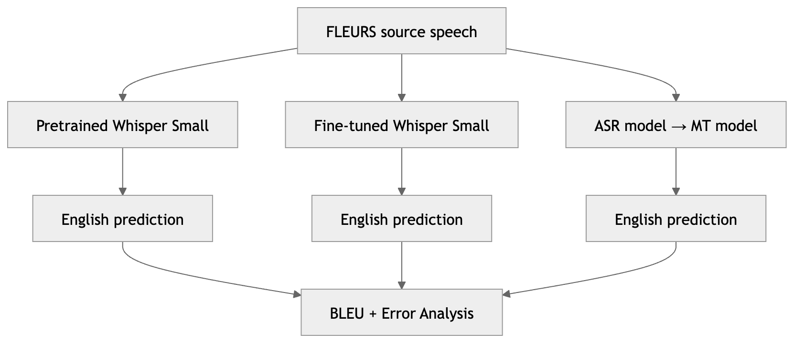
Methodology overview

Slide 8
Cascaded vs. Direct Speech Translation
Cascaded ASR–MT | Direct Speech Translation
Speech → ASR → source text → MT → English | Speech → Whisper → English
Uses separate ASR and MT models | Uses one encoder–decoder model
Intermediate transcription is available | No intermediate transcription
ASR errors may propagate to MT | Must learn the speech-to-English mapping directly
Cascaded approach: existing ASR model + existing MT model
Direct approach: pretrained or fine-tuned Whisper Small

Slide 9
Language Selection
Cantonese | North Azerbaijani
Not included in Whisper’s speech-translation training | Included in Whisper’s speech-translation training
Represents a new translation direction | Represents a previously seen translation direction
Main language required by the assignment | Additional comparison language

Slide 10
Research Questions
How do the fine-tuned direct ST model and the cascaded ASR–MT pipeline perform compared with the pretrained Whisper baseline?
Which approach performs better: fine-tuned direct speech translation or cascaded ASR–MT?
How do the performance patterns differ between Cantonese and Azerbaijani, given their different levels of representation in Whisper’s translation training?

Slide 12
Pretrained Whisper Baseline
Cantonese / Azerbaijani Speech
Pretrained Whisper Small
English Text
Cantonese | Azerbaijani
BLEU 0.97 | BLEU 5.80¹
Unseen translation language | Seen during translation training
¹ Radford et al. 2023.

