Slide 1


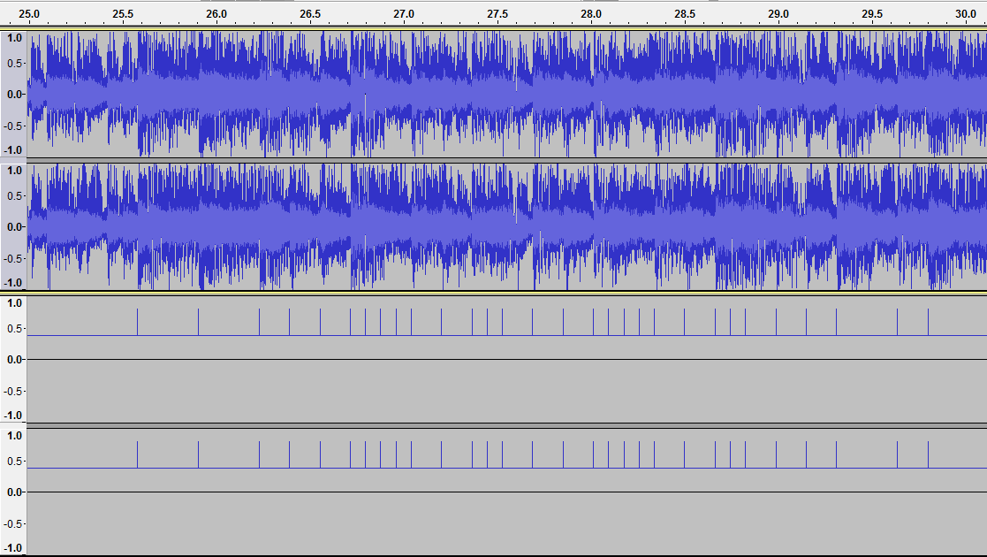
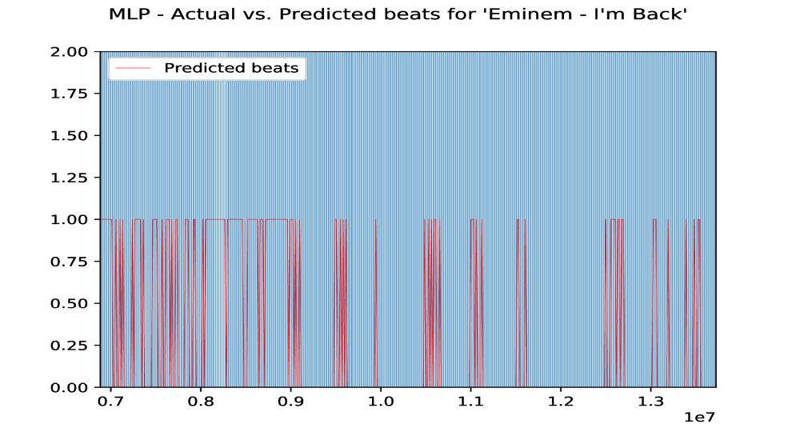
Winter 2017 – ECE457B Computational Intelligence
ECE Dept, University of Waterloo
Instructor: Fakhri Karray
Beat Detection via Neural Networks for Step Files
Group 8: Hong Wang, Daniel Cardoza, Lara Janecka
Abstract and Overview:
DDR games are ones that map songs to times at which a button must be pressed. The main problem with DDR as a game is the lack of SM files for a wide selection of songs. This is due to the fact that to generate each SM file, a step maker will need to spend around 4 hours. This project aims to apply neural networks, fuzzy logic, frequency analysis, and other digital processing techniques to generate a DDR step file for any given song.
Text Size: 32
Tools, Algorithms:
Problem Formulation:
Experiments, Analysis:
Songs are represented as a series of amplitudes at a given sample rate. Simple frequency and beat analysis is not enough to generate step files due to the human element of DDR games. A neural network is needed to learn from existing step files and songs on how to interpret the values generated by different methods of signal analysis.
Frequency Analysis Tools
Sound Energy calculations
Fast Fourier Transforms
Bandwidth Power calculations
Peak Frequency calculations
Visualization Tools
Stepmania game
Audacity – for viewing song data
Data Sets
Million song dataset – for getting song metadata, beats
Google Play – for getting song files
Zenius – for getting step files
Neural Networks
Custom Multilayer Adeline
Keras Multilayer Perceptron
Experiment Setup
Train network with labeled songs from custom repository. Chose a song at random for testing and run it through the network. 300 songs used.
Evaluation Metrics
10 – 30% accuracy for identifying beats
Analysis
Some of the most obvious beats were identified
Text Size: 32
Proposed Solution:
Frequency analysis is used to generate the power variance, bandwidth variance, and peak frequency variance for buckets of the song. These values are fed into a trained and tuned multilayer Adeline which gives the probability of a step at that given sample. The step probability and time since the last step was generated are then put into a fuzzy logic system to assign steps to each sound sample in a song.
Conclusion:
Our experimental results showed that using a simple feedforward network to predict whether a specific timeframe is a beat is inaccurate. The features we extracted from an uncompressed audio file were not able to correctly classify a sample a significant portion of the time. One of the reasons for this is that classifcation problems are suited for neural networks with 'memory', specifcally recurrent neural networks. A recurrent neural network has the advantage of using past outputs of the network when training future inputs to the system. Future work should utilize this approach because it lends itself to sequential data, like music files.

