Slide 1
DIRECT FARM MARKET

Slide 2
ABSTRACT | SYSTEM ARCHITECTURE | HARDWARE /SOFTWARE REQUIREMENT
DOMAIN INTRODUCTION | FLOWCHART | SCOPE PROJECT
INTRODUCTION | USECASE- DIAGRAM | CONCLUSION
OBJECTIVES | ER DIAGRAM | FUTURE ENCHANCEMENT
EXISTING SYSTEM | SEQUENCE DIAGRAM | PROBLEM STATEMENT
DISADAVANTAGE | MODULES | SAMPLE CODE
PROPOSED SYSTEM | MODULES DESCRIPTION | SAMPLE SCREENSHOT
ADAVANTAGE | LITECTURE SURVEY(1-5) | REFERENCE

Slide 3
ABSTRACT
Direct Farm-to-Consumer Platform: A web-based system connecting farmers directly with consumers
Technology Stack: Built using HTML, CSS, JavaScript, Java, and MySQL
Eliminates Intermediaries: Removes middlemen from agricultural supply chain
Dual User Roles: Dedicated modules for Farmers and Consumers
Farmer Features: Product listing, inventory management, order tracking
Consumer Features: Product browsing, shopping cart, order placement

Slide 4
DOMAIN INTRODUCTION
Agriculture & E-commerce intersection
Farm-to-Table digital transformation
Local food distribution systems
Rural-Urban economic bridge
Digital agriculture technology
Sustainable food ecosystems

Slide 5
INTRODUCTION
Digital platform connecting farmers directly with consumers
Eliminates middlemen from agricultural supply chain
Built using HTML, CSS, JavaScript, Java, MySQL
Aims to revolutionize traditional farming commerce
Promotes fresh, local produce at fair prices
Supports sustainable agricultural practices

Slide 6
OBJECTIVES
Connect farmers directly with consumers
Eliminate middlemen from supply chain
Increase farmer income and profits
Provide fresh produce to consumers
Create user-friendly web platform
Ensure secure user authentication

Slide 7
PROBLEM STATEMENT
Middlemen take 50-70% profit margins
Farmers receive only 20-30% of retail price
Consumers pay 2-3 times farmgate prices
30-40% post-harvest food wastage
Limited market access for small farmers
Lack of transparency in supply chain
No direct farmer-consumer communication

Slide 8
SCOPE OF PROJECT
Web-based platform (no mobile app initially)
Two primary user roles: Farmer & Consumer
Local database implementation (MySQL)
Basic e-commerce functionality
Review and rating system
Order tracking capabilities

Slide 9
EXISTING SYSTEM
Multi-layered traditional supply chain
Farmer → Agent → Wholesaler → Retailer → Consumer
Manual transactions and record-keeping
Local markets and mandi-based systems
Supermarket-dominated retail
No digital traceability
Limited price transparency

Slide 10
DISADVANTAGE
Platform currently web-only (no mobile app)
No integrated payment gateway
Limited to local database deployment
Basic analytics capabilities
No blockchain traceability
Single-language interface

Slide 11
PROPOSED SYSTEM
Direct Digital Marketplace: Farmer ↔ Consumer
Real-time Inventory Management: Automatic stock updates
Transparent Pricing: No hidden charges or commissions
Direct Communication: Built-in messaging system
User Profiles: Detailed farmer and consumer profiles
Order Tracking: Real-time order status updates

Slide 12
ADVANTAGE
For Farmers:
50-80% higher profit margins
Direct market access
Real-time demand insights
For Consumers:
20-40% cost savings
Fresher produce
Transparent sourcing
Direct farmer communication

Slide 13
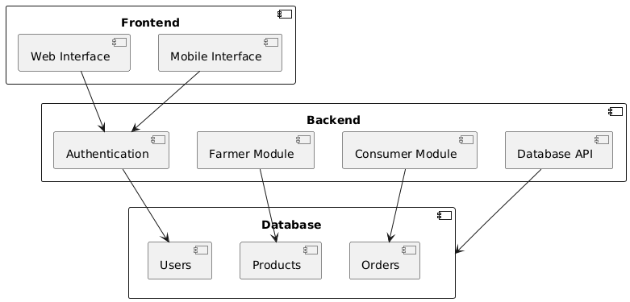
BLOCK DIAGRAM

Slide 14
Flow Chart - Farmer
Start
Authentication
Dashboard - Farmer
View Product
Create User, Edit, Delete, Update
Add Product
View Orders

Slide 15
Flow Chart - Consumer
Start
Authentication
Dashboard – Consumer
Feedback
Marketplace
Favourite
View Orders

Slide 16
DFD LEVEL 1
Start
Authentication
Dashboard
Consumer
Farmer

Slide 17
Start
DFD LEVEL 2
Login
Authentication
Register
Dashboard – Role Based Access
Farmer
Consumer
Add Product
View Product
View Orders
Progress
Marketplace
Favourite
Add to Cart
View Orders
Feedback

Slide 18
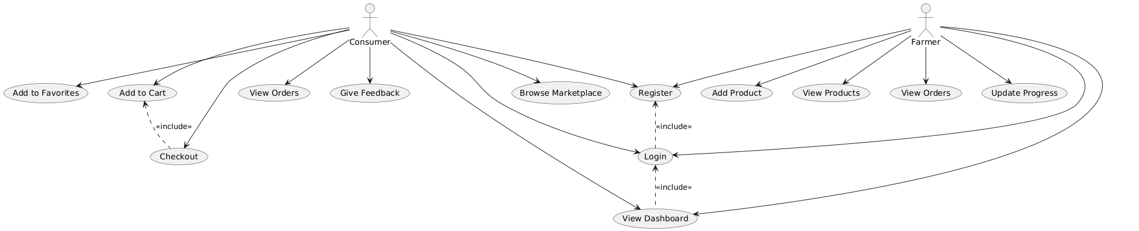
USECASE- DIAGRAM

Slide 19
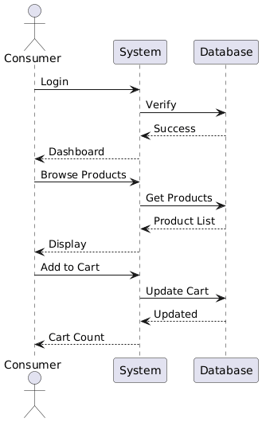
SEQUENCE DIAGRAM

Slide 20
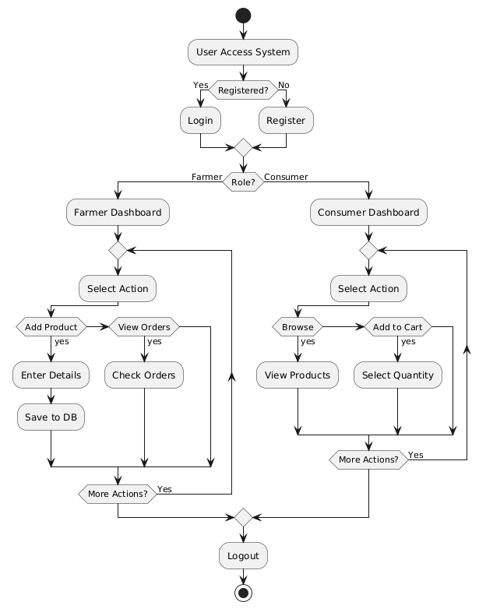
ACTIVITY DIAGRAM

Slide 21
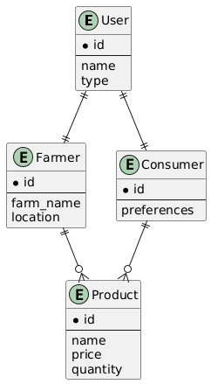
ER ARCHITECTURE

Slide 22
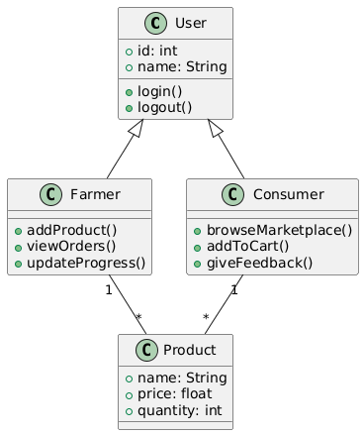
CLASS DIAGRAM

Slide 23
LITERATURE SURVEY

Slide 24
LITERATURE SURVEY 1
Title | year | Author | Methodology | Demerits
Real-Time Inventory Management Systems for Perishable Goods | 2025 | X. Wang, P. Gupta, H. Rodriguez | Development and testing of machine learning algorithms for dynamic inventory prediction using historical sales data, weather patterns, and seasonal trends. Implemented as a case study across 50 farm businesses over 12 months, comparing waste reduction and sales optimization metrics. | Requires substantial historical data for algorithm accuracy, posing challenges for new farmers.

Slide 25
LITERATURE SURVEY 2
Title | year | Author | Methodology | Demerits
Sustainable Impact Assessment of Digital Farm-to-Consumer Models | 2025 | . Garcia, T. Schmidt, M. O'Connor | Life cycle analysis comparing carbon footprints of traditional vs. digital-direct agricultural supply chains across multiple metrics: transportation emissions, packaging waste, energy consumption in storage, and overall resource utilization. Includes case studies from 30 different farm operations. | Does not account for the digital infrastructure's carbon footprint (servers, devices, etc.).

Slide 26
LITERATURE SURVEY 3
Title | year | Author | Methodology | Demerits
Digital Payment Security in Agricultural E-Commerce Platforms | 2024 | R. Singh, K. O'Brien, J. Nakamura | Security vulnerability assessment of existing agricultural payment systems, followed by design and implementation of a multi-layered security framework. Includes penetration testing, encryption protocol evaluation, and user authentication mechanism testing across 20 platforms. | Focuses heavily on technical security measures with less emphasis on social engineering vulnerabilities.

Slide 27
LITERATURE SURVEY 4
Title | year | Author | Methodology | Demerits
Mobile-First Design for Rural User Engagement | 2023 | Z. Abdullah, R. O'Connor, H. Lim | User-centered design study with 200 rural farmers across developing regions, testing interface prototypes with varying complexity levels. Measures task completion rates, error frequencies, and satisfaction scores across different demographic segments and digital literacy levels. | Cultural and linguistic variations in icon interpretation may limit universal applicability.

Slide 28
LITERATURE SURVEY 5
Title | year | Author | Methodology | Demerits
Blockchain Implementation for Agricultural Supply Chain Transparency | 2025 | P. Rossi, W. Zhang, A. Brooks | Pilot implementation of blockchain technology across three agricultural supply chains, tracking produce from farm to consumer. Measures data integrity, system performance, user adoption rates, and cost-effectiveness compared to traditional tracking methods. | High computational requirements and energy consumption may be prohibitive for small-scale operations.

Slide 29
SYSTEM REQUIREMENTS
SOFTWARE REQUIREMENTS
O/S : Windows 10
Language : Java
Database : MySql (Local)
Software Used : Visual Studio Code
HARDWARE REQUIREMENTS
System : Pentium IV 2.4 GHz
Hard Disk : 800 GB
Mouse : Logitech.
Keyboard : 110 keys enhanced
Ram : 8GB

Slide 30
MODULES
Farmer
Consumer or Customer

Slide 31
FARMER
Add Product: List produce with details, images, pricing
Stock Management: Real-time inventory tracking & updates
Order Management: View, process, and track customer orders
Profile Management: Farm details, contact information
Sales Dashboard: Performance analytics and insights
Communication Center: Direct messaging with customers

Slide 32
CONSUMER
Marketplace: Browse and search farm products
Shopping Cart: Add/remove items, calculate totals
Order Management: Track purchases and delivery status
Favorites List: Save preferred products
Review System: Rate products and farmers
Profile Management: Delivery addresses, preferences
Direct Messaging: Communicate with farmers

Slide 33
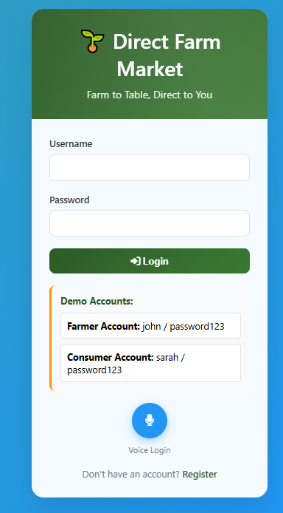
Login

Slide 34
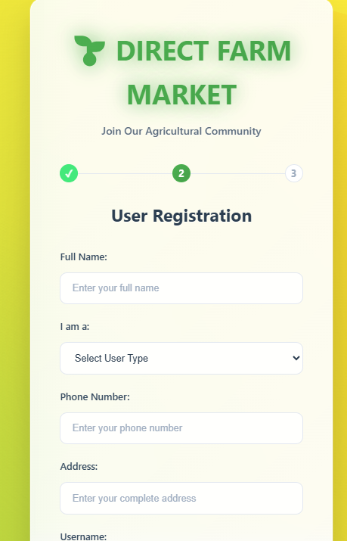
Register Page

Slide 35
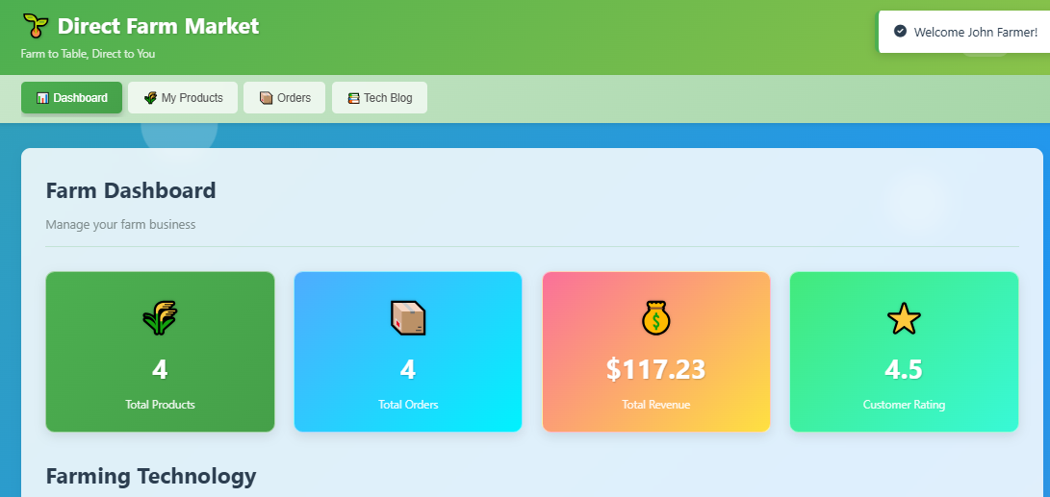
Farmer
Dashboard

Slide 36
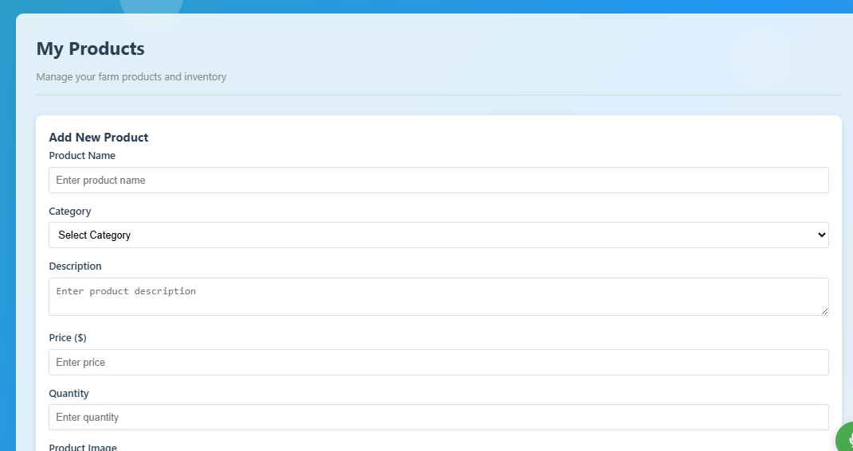
Add Product

Slide 37
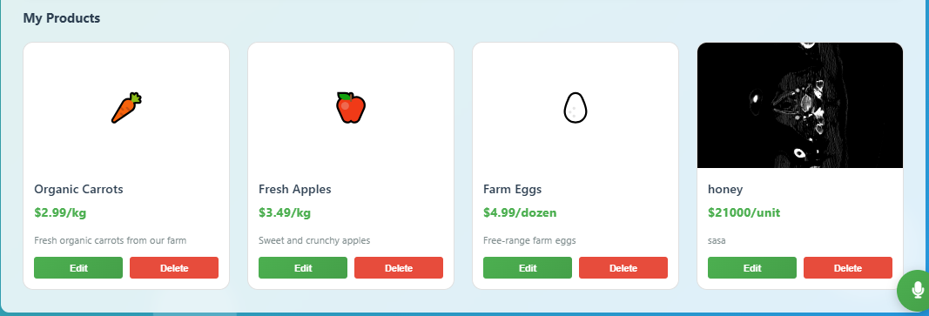
View Product

Slide 38
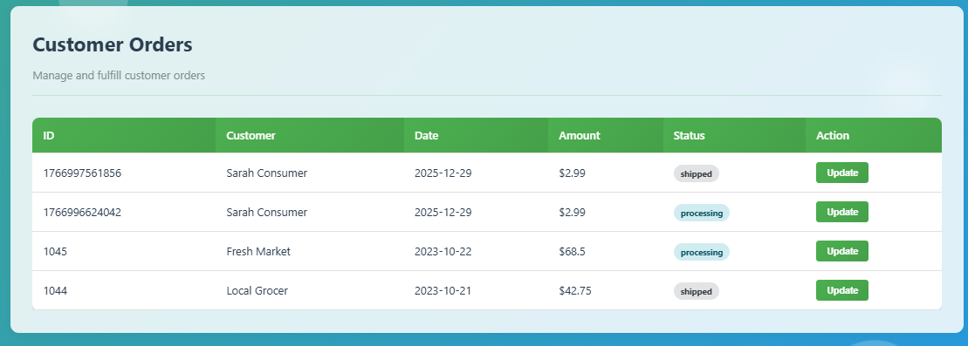
View Orders

Slide 39
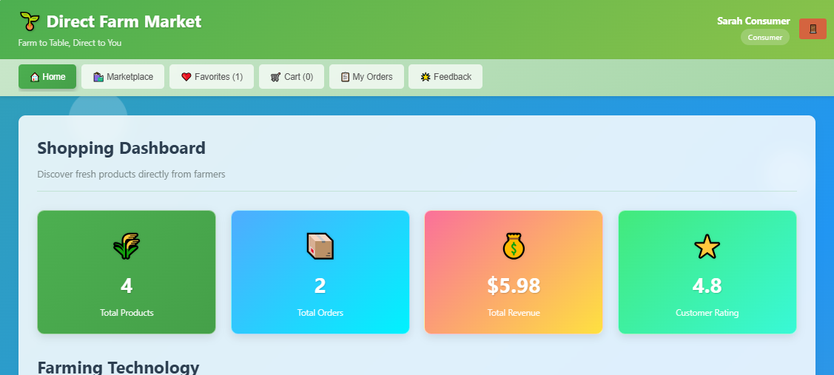
Consumer
Dashboard

Slide 40
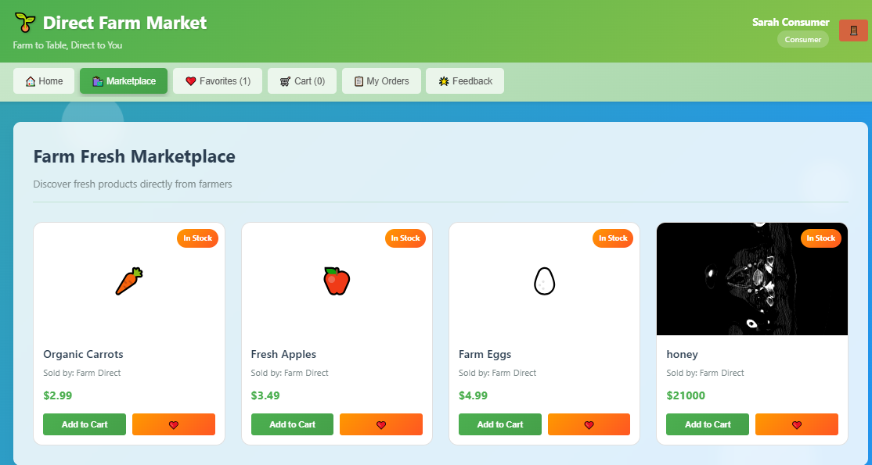
Marketplace

Slide 41
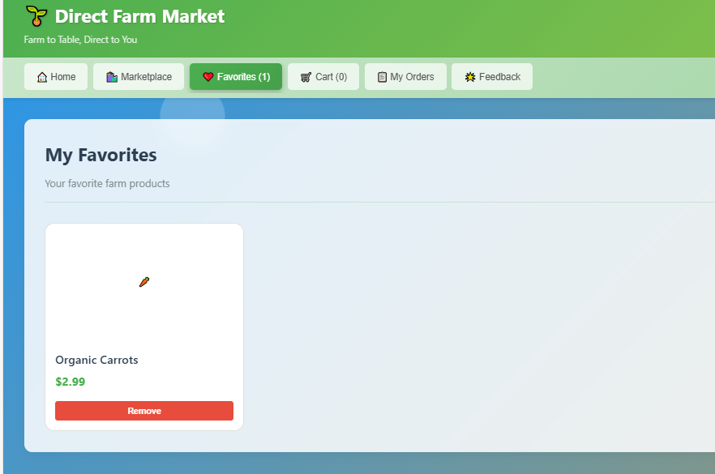
Favorites

Slide 42
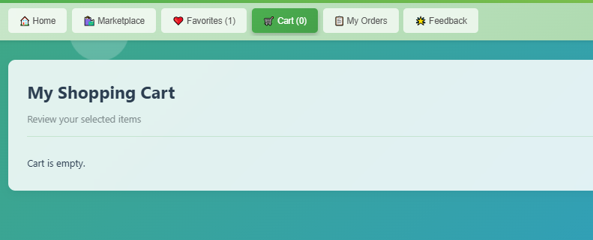
Cart

Slide 43
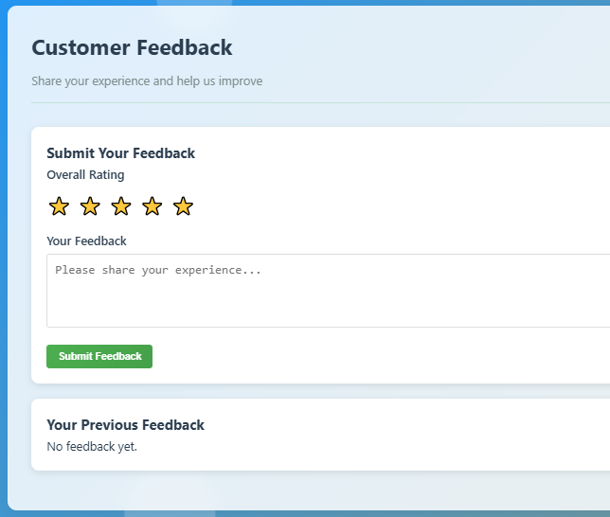
Feedback

Slide 44
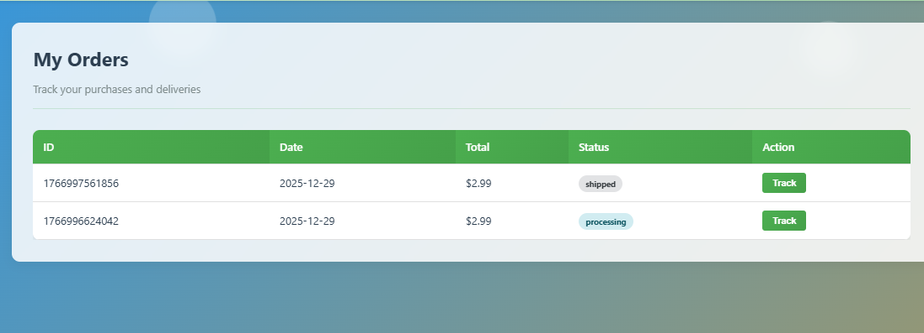
My Orders

Slide 45
CONCLUSION
Successfully bridges farmer-consumer gap
Eliminates intermediaries effectively
Increases farmer income significantly
Reduces consumer costs substantially
Promotes sustainable agriculture
Enhances supply chain transparency

Slide 46
FUTURE ENCHANCEMENT
Mobile Applications: Android & iOS native apps
Payment Integration: UPI, wallets, cards integration
Blockchain Traceability: Immutable product journey tracking
AI Recommendations: Personalized product suggestions
IoT Integration: Quality monitoring during transit
Multi-language Support: Regional language interfaces

Slide 47
REFERENCE PAPER
Sharma, A., & Patel, R. (2024). Digital Disintermediation in Agricultural Markets. Journal of Agricultural Economics, 75(2), 123-145.
Chen, L., & Williams, M. (2024). Consumer Willingness to Pay for Direct-from-Farm Products. Food Quality and Preference, 112, 104-118.
Kumar, S., & Zhang, Y. (2024). Mobile Technology Adoption Among Smallholder Farmers. Information Technology for Development, 30(1), 45-67.
Garcia, M., & Schmidt, T. (2025). Sustainability Impacts of Short Food Supply Chains. Sustainable Production and Consumption, 35, 78-92.

Slide 48
Oliveira, J., & Kim, H. (2024). Trust Mechanisms in Digital Agricultural Marketplaces. Electronic Commerce Research, 24(3), 567-589.
Wang, X., & Gupta, P. (2025). Real-Time Inventory Management for Perishable Goods. Computers and Electronics in Agriculture, 178, 105-120.
Singh, R., & O'Brien, K. (2024). Digital Payment Systems for Rural E-commerce. Journal of Rural Studies, 95, 234-250.
Martinez, L., & Chen, W. (2025). Social Influence in Agricultural Digital Marketplaces. Social Networks, 68, 89-102.

Slide 49
Thank You…

