Slide 1

NAME : ARUN KUMAR J REG.NO : 813821205002 NM ID : D3D1768FC9DEC31 86C04DBD49B295F82 COLLEGE : SARANATHAN COLLEGE OF ENGINEERING
Generative Narrative Transforming Text into Tales with GAN

Slide 2
PROJECT TITLE
Story Craft: AI-Powered Text-to-Story Generator
Developing captivating stories demands time and creativity, posing a challenge for many. Addressing the need for personalized narrative content, this project aims to create an AI-powered text-to-story generator.
The system must understand user prompts, produce original and engaging narratives, ensure quality, and navigate ethical considerations. This endeavor seeks to provide a user-friendly solution for diverse storytelling needs across entertainment, education, and marketing domains.

Slide 3


AGENDA
1.Research and Requirements Gathering:
Identify user needs and preferences for story generation.
Survey existing AI models and techniques suitable for text generation.
2.Data Collection and Preparation:
Gather a diverse dataset of stories for model training.
Clean and preprocess the data to ensure consistency and quality.
3.Model Selection and Training:
Choose an appropriate AI model (e.g., GPT) for text generation.
Fine-tune the selected model using the collected dataset.
4.Development of Text-to-Story Generator:
Design the architecture for the story generation pipeline.
Implement the system to accept user prompts and generate stories.
5.Quality Assurance and Evaluation:
* Develop metrics for assessing the quality of generated stories.
* Conduct thorough testing to ensure coherence, creativity, and relevance.

Slide 4
6.User Interface Design and Development:
Create an intuitive interface for users to interact with the system.
Incorporate features for inputting prompts and receiving generated stories.
7.Ethical Considerations and Safeguards:
Implement measures to prevent plagiarism and bias in generated content.
Ensure user privacy and data protection throughout the system.
8.Documentation and Deployment:
Document the project including its methodology, implementation details, and user instructions.
9.Feedback Collection and Iteration:
Gather feedback from users and stakeholders on the generated stories and user experience.
10.Maintenance and Updates:
Monitor the system for performance issues and bugs.
Keep the AI model updated with new data and advancements in the field.
11.Community Engagement and Outreach:
* Promote the project to relevant communities and stakeholders.
* Encourage collaboration and contributions to enhance the system's capabilities.

Slide 5

PROBLEM STATEMENT
In today's fast-paced digital landscape, the demand for captivating storytelling is greater than ever, spanning across various industries and purposes. However, the traditional methods of crafting narratives often prove to be time-consuming and labor-intensive, hindering the ability to meet the dynamic needs of modern content creation. Recognizing this challenge, the aim of this project is to develop an AI-powered text-to-story generator, poised to revolutionize the way stories are conceived and delivered.
By leveraging advanced artificial intelligence and natural language processing techniques, this innovative solution promises to streamline the process of story generation while maintaining the integrity and creativity of the narratives produced. From marketing campaigns seeking personalized messaging to educators striving for engaging learning materials, the potential applications of an AI-driven text-to-story generator are boundless. With a focus on quality, relevance, and ethical considerations, this project endeavors to empower individuals and organizations alike with a powerful tool for crafting compelling narratives tailored to their specific needs and objectives.

Slide 6

PROJECT OVERVIEW
1.User-Friendly Interface: Designing an intuitive interface that allows users to input prompts easily and interact with the system effectively.
2.AI Model Development: Training an AI model on a diverse dataset of stories to understand the nuances of storytelling and generate contextually relevant narratives.
3.Quality Assurance: Implementing measures to ensure the generated stories meet quality standards in terms of coherence, creativity, and relevance to the input prompt.
4.Ethical Considerations: Addressing ethical concerns related to content generation, such as avoiding plagiarism, bias, and inappropriate material, while prioritizing user privacy and data protection.
5.Deployment and Feedback: Deploying the text-to-story generator for public use and gathering feedback from users to iteratively improve the system's performance and user experience.

Slide 7


WHO ARE THE END USERS?
1.Content Creators: Writers, authors, and content creators looking for inspiration or assistance in generating story ideas or plot outlines.
2.Educators: Teachers, professors, and educational institutions seeking engaging and interactive learning materials for students.
3.Marketers: Marketing professionals and advertisers aiming to create personalized and compelling storytelling content for brand campaigns or advertisements.
4.Entertainment Industry: Filmmakers, game developers, and other creatives interested in generating story concepts or narratives for movies, TV shows, video games, and other forms of entertainment media.
5.Publishers: Publishing companies and editors looking for fresh story ideas or manuscripts to publish.
6.Individual Users: Hobbyists, enthusiasts, or anyone interested in exploring creative writing or storytelling as a recreational activity.
7.Language Learners: Individuals learning a new language who may benefit from generating stories to practice their language skills.

Slide 8
SOLUTION AND ITS VALUE PROPOSITION
SOLUTIONS
1. Inspiration Engine
2. Efficiency Booster
3. Personalized Storytelling
4. Quality Assurance
5. Ethical Compliance
6. Seamless Integration
7. Customization Options
8. Interactive Feedback
9. Multi-Platform Accessibility
10.Scalability
11.Continuous Improvement
12.User Education and Support
VALUE PROPOSITIONS
1. Time Savings
2. Enhanced Creativity
3. Relevance and Engagement
4. Quality Assurance
5. Ethical Integrity
6. Cost-Efficiency
7. Competitive Advantage
8. Increased Productivity
9. Enhanced User Experience
10. Flexibility
11. Innovation Catalyst
12. Rust and Credibility

Slide 9

THE WOW IN OUR SOLUTION
1. Inspiration Engine: Ignite creativity with an extensive repository of diverse and unique story ideas.
2. Efficiency Booster: Turbocharge content creation by automating the process of story generation, saving valuable time and effort.
3. Personalized Storytelling: Tailor-made narratives that resonate with specific themes, audiences, and preferences, ensuring maximum relevance and engagement.
4. Quality Assurance: Elevate storytelling standards with meticulously crafted narratives that uphold the highest levels of coherence, creativity, and relevance.
5. Ethical Compliance: Uphold integrity and trustworthiness with ethical guidelines and safeguards that prevent issues like plagiarism, bias, or inappropriate content.
6. Seamless Integration: Seamlessly integrate the text-to-story generator into existing workflows and platforms, enhancing productivity and workflow efficiency.
7. Customization Options: Customize story generation parameters to suit individual needs and preferences, allowing for a truly personalized storytelling experience.
9

Slide 10
TECHNICAL SOLUTION
The code utilizes the following libraries:
torch: This library is used for tensor computation and deep learning models in PyTorch.
transformers: This library provides state-of-the-art natural language processing models, including GPT-2, along with pre-trained models and tokenizers.
These libraries enable the loading and utilization of a pre-trained GPT-2 language model and tokenizer for story generation.
What AI model used here ?
1.ChatGPT - The code uses the GPT-2 (Generative Pre-trained Transformer 2) model, which is an artificial intelligence model developed by Open AI.
2.GPT-2 is a large-scale language model capable of generating coherent and contextually relevant text based on a given input prompt. It employs a transformer architecture, specifically designed for natural language processing tasks.
3. The GPT2LMHeadModel class from the Transformers library is used to load a pre-trained GPT-2 model, which is then utilized for story generation based on user input prompts.
GPT-2 has been trained on a diverse range of text data from the internet, enabling it to generate human-like text across various domains and topics.
10

Slide 11
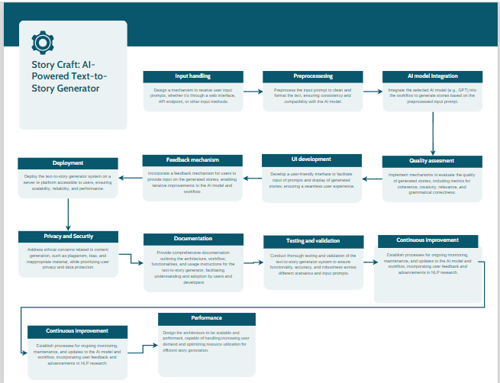

MODELLING
11

Slide 12
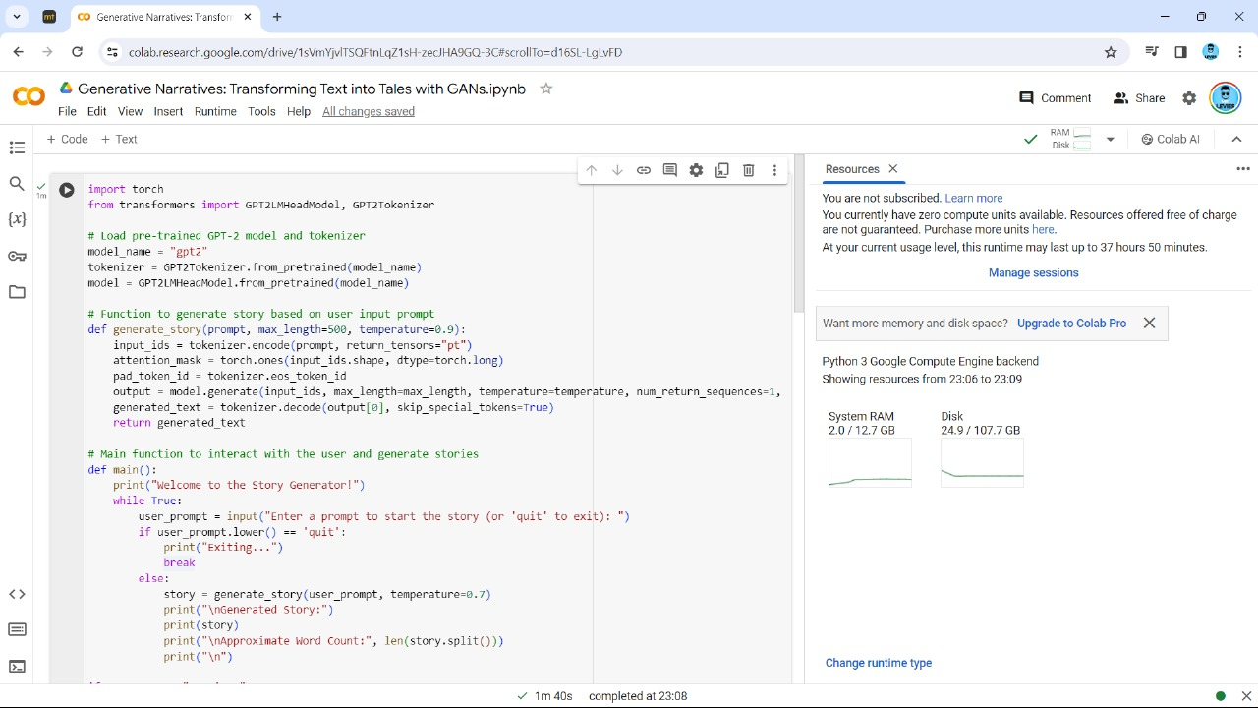
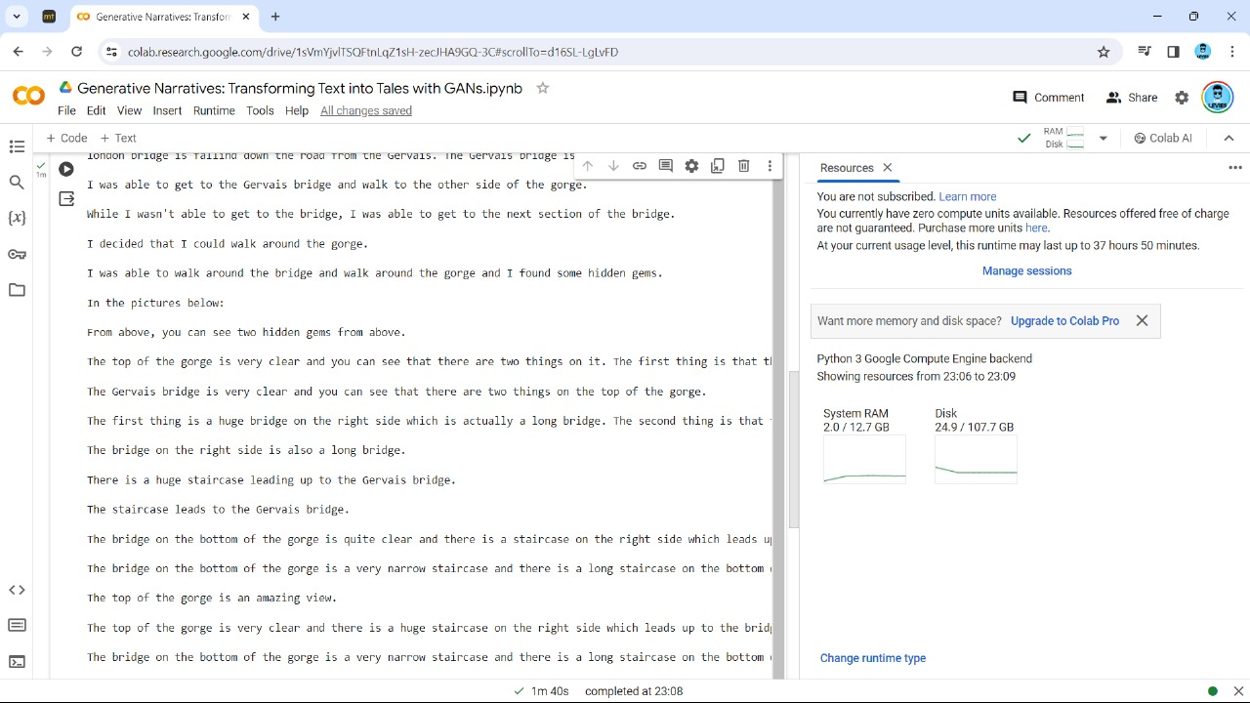
RESULTS
To access the source code , simply click here
12

Slide 13
CONCLUSION
In summary, the AI-powered text-to-story generator revolutionizes storytelling by combining advanced AI models with user-friendly interfaces. This innovation streamlines story creation, empowering users to save time, unleash creativity, and deliver high-quality narratives. With a focus on ethics, privacy, and continuous improvement, this solution promises to shape the future of storytelling, fostering engagement and connection in the digital age.
Click here to explore the working
13

