Slide 1
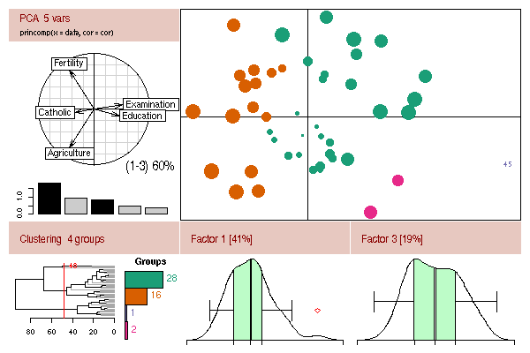
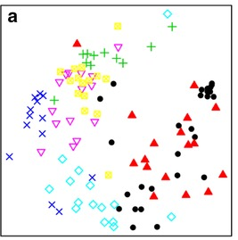
WLE 650-0002 – Multivariate statistics
Lecture 1
What is Multivariate Statistics?

Slide 2
Class outline
Introduction to Multivariate Statistics
Syllabus / Logistics
Community Guidelines
To do for Friday’s Lab

Slide 3


Content shout out
Dr. Kevin McGarigal Dr. Ben Baiser
UMass Amherst U Florida

Slide 4
What are multivariate data?

Slide 5
What are multivariate data?
Multiple response variables are recorded for each unit (sample)

Slide 6
Multivariate data examples ?

Slide 7
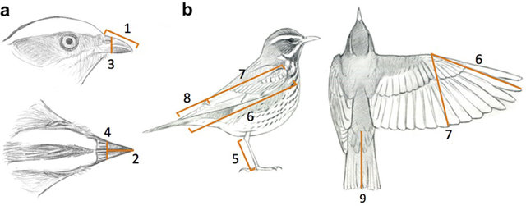
Multivariate data example # 1
Morphological measures of an individual specimen
Photo Credit – Pigot et al. (2020) Nature Ecology & Evolution

Slide 8
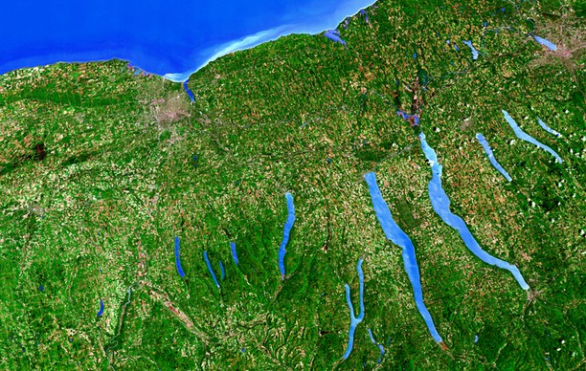
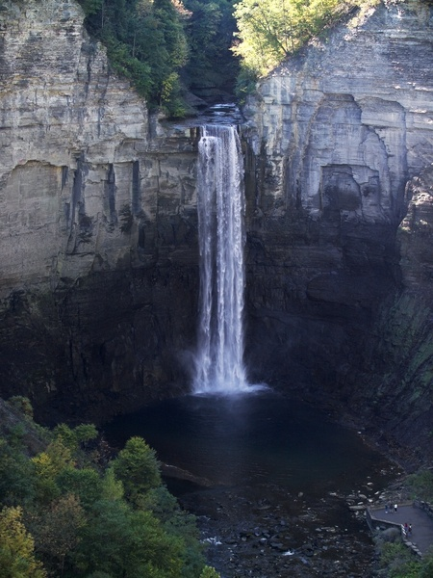
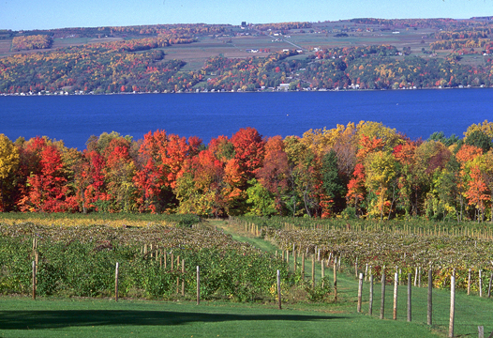
Multivariate data example # 2
Water chemistry measurements of a lake
pH
DO
Salinity
NO₃-N

Slide 9
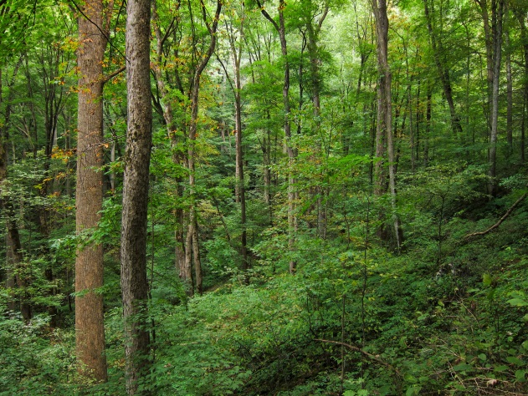


Multivariate data example # 3
Forest Structure
Canopy height
Canopy cover
Shrub cover
Snag Density
DBH

Slide 10
Multivariate data example # 4
Species abundances in a community

Slide 11
Multivariate Data
 | Variable 1 | Variable 2 | Variable 3 | Variable 4 | Variable n
Unit 1 | 4 | 1 | 3 | 1 | 9
Unit 2 | 0 | 1 | 1 | 8 | 2
Unit 3 | . | . | . | . | .
Unit 4 | . | . | . | . | .
Unit n | 2 | 2 | 1 | 10 | 5

Slide 12
Multivariate Data
 | Measure 1 | Measure 2 | Measure 3 | Measure 4 | Measure n
Beak 1 | 4 | 1 | 3 | 1 | 9
Beak 2 | 0 | 1 | 1 | 8 | 2
Beak … n | . | . | . | . | .
Wing 5 | . | . | . | . | .
Wing …n | 2 | 2 | 1 | 10 | 5

Slide 13
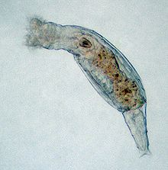

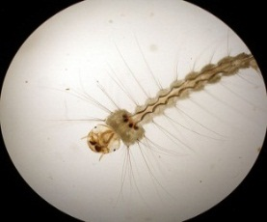


Multivariate Data
 | Species 1 | Species 2 | Species 3 | Species 4 | Species n
Pitcher 1 | 4 | 1 | 3 | 1 | 9
Pitcher 2 | 0 | 1 | 1 | 8 | 2
Pitcher 3 | . | . | . | . | .
Pitcher 4 | . | . | . | . | .
Pitcher n | 2 | 2 | 1 | 10 | 5

Slide 14
Multivariate Models
Model Technique
y = x1 + x2 + … x Regression, ANOVA
y1 + y2 + … yi = x Multivariate ANOVA
Discriminant Analysis, CART
y1 + y2 + … yi = x1 + x2 + … xj Constrained Ordination
y1 + y2 + … yi Ordination, Cluster Analysis
Multivariate Statistics
Adapted from Kevin McGarigal

Slide 15
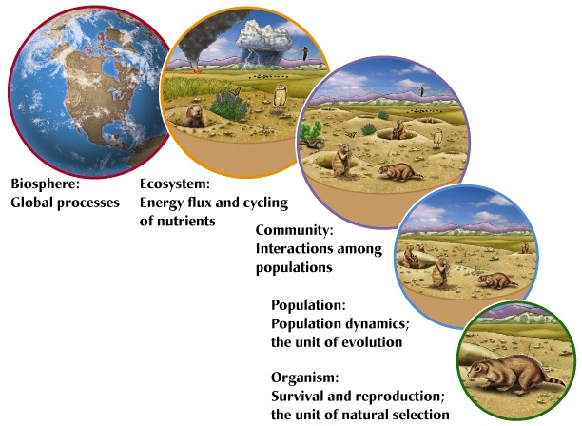
Univariate vs. Multivariate
Univariate is powerful when response is a single
variable and other variables can be controlled.
but, the world is a complex place…
Figure from J. M. Dirnberger

Slide 16
Advantages of Multivariate Statistics
Reflects more accurately the multidimensional, multivariate nature of complex systems
Allows for visualization of multivariate data
Provide means for exploring complex data sets for patterns that can generate hypotheses to be
tested with experiments

Slide 17
3-D Glasses
4
2
0
4
Rotifer
3
-2
2
1
0
Midge
-4
-1
-2
-6
-3
-3
-2
-1
0
1
2
3
4
5
Mosquito

Slide 18
Advantages of Multivariate Statistics
Provides a way to handle large data sets with many variables by summarizing the redundancy
Provides rules for combining variables in an “optimal” way
Provides for post-hoc analysis of new variables

Slide 19
3-D Glasses
4
2
0
4
Rotifer
3
-2
2
1
0
Midge
-4
-1
-2
-6
-3
-3
-2
-1
0
1
2
3
4
5
Mosquito

Slide 20

Multivariate Alphabet Soup!
Technique | Alternative Names
Ordination Principal components analysis (PCA) Factor analysis (FA) Principal coordinates analysis (PCoA) Non-Metric Multidimensional Scaling (NMDS) Correspondence analysis (CA) Canonical correspondence analysis (CCA) Cluster analysis Discriminant analysis (DA) Classification Canonical correlation analysis | Factor analysis (FA) None Multidimensional Scaling (MDS) None Reciprocal averaging (RA) None Classification Clumping Grouping Morphometrics Numerical Taxonomy Systematic Typology Discriminant function analysis (DFA) Fisher’s linear discriminant function analysis Canonical variants analysis Multiple discriminant analysis Discriminant function analysis Fisher’s linear discriminant function analysis Canonical variants analysis Multiple discriminant analysis Canonical analysis

Slide 21
Multivariate Statistics Key Points
Multivariate statistics involve cases with multiple “dependent” variables
All multivariate problems can be represented as a two-way data
matrix in which rows represent sampling units and columns
represent variables
All multivariate data sets can be conceptualized as a data cloud in
P-dimensional data space, where the dimensions (or axes) are defined
by the variables of interest
Adapted from K. McGarigal

Slide 22
Course Goals
1) learn the appropriate application of ordination, clustering, and discrimination techniques for different multivariate data structures and questions,
2) learn how to manipulate, and analyze multivariate data in R,
3) learn how to interpret and present results from multivariate analysis through figures and text, and
4) learn how to use RMarkdown and beginner’s Git to promote reproducible computational science.

Slide 23
Class outline
Introduction to Multivariate Statistics
Syllabus / Logistics
Community Guidelines
To do for Friday’s Lab

Slide 24

Community Guidelines http://tinyurl.com/WLE650communityguidelines2024

Slide 25
Class outline
Introduction to Multivariate Statistics
Syllabus / Logistics
Community Guidelines
To do for Friday’s Lab

Slide 26

Getting Started… Lab this Friday
R Markdown for reproducible analyses and GitHub for accessing course code
Loading, organizing, and managing multivariate data in R

Slide 27
To Do Before Friday’s Lab
Bring you own data set to work with. Upload it to our course Google Drive into the student datasets folder.
Fill out poll for Computational Learning Center.
Sign up for and begin contributing to Piazza.
Links to Google drive, poll, and Piazza are on the Course Resources section of our class Brightspace page.

