Slide 1





Multivariate Data
Screening Data, Missing Data,
Data Transformations,
and Distance
125
82
8
94
50
56.6

Slide 2
Announcements
Opt out of McGarigal Textbook on Brightspace by 1/30 if you do not want to purchase the digital copy
Lab 1 due 9 pm on Thursday (upload via Brightspace)
Make sure you have your dataset ready to use in lab on Friday

Slide 3
Class Outline
Data Screening
Data Transformations & Standardizations
Outliers
Distance vs. Disimilarity

Slide 4
Data Screening
Examine summary statistics
 | var | n | mean | sd | median | min | max | range | skew | kurtosis | se
SO2 | 1 | 41 | 30.05 | 23.47 | 26 | 8 | 110 | 102 | 1.58 | 2.26 | 3.67
temp | 2 | 41 | 55.76 | 7.23 | 54.6 | 43.5 | 700 | 32 | 0.82 | 0.09 | 1.13
manu | 3 | 41 | 463.1 | 563.47 | 347 | 35 | 3344 | 3309 | 3.48 | 14.33 | 88
popul | 4 | 41 | 608.61 | 579.11 | 515 | 71 | 3369 | 3298 | 2.94 | 10.58 | 90.44
wind | 5 | 41 | 9.44 | 1.43 | 9.3 | 6 | 12.7 | 6.7 | 0 | 0.06 | 0.22
precip | 6 | 41 | 36.77 | 11.77 | 38.74 | 7.05 | 59.8 | 52.75 | -0.69 | 0.5 | 1.84
predays | 7 | 41 | 113.9 | 26.51 | 115 | 36 | 166 | 130 | -0.55 | 0.72 | 4.14
Look for unrealistic values

Slide 5
Data Screening
Examine summary statistics
 | var | n | mean | sd | median | min | max | range | skew | kurtosis | se
SO2 | 1 | 41 | 30.05 | 23.47 | 26 | 8 | 110 | 102 | 1.58 | 2.26 | 3.67
temp | 2 | 41 | 55.76 | 7.23 | 54.6 | 43.5 | 700 | 32 | 0.82 | 0.09 | 1.13
manu | 3 | 41 | 463.1 | 563.47 | 347 | 35 | 3344 | 3309 | 3.48 | 14.33 | 88
popul | 4 | 41 | 608.61 | 579.11 | 515 | 71 | 3369 | 3298 | 2.94 | 10.58 | 90.44
wind | 5 | 41 | 9.44 | 1.43 | 9.3 | 6 | 12.7 | 6.7 | 0 | 0.06 | 0.22
precip | 6 | 41 | 36.77 | 11.77 | 38.74 | 7.05 | 59.8 | 52.75 | -0.69 | 0.5 | 1.84
predays | 7 | 41 | 113.9 | 26.51 | 115 | 36 | 166 | 130 | -0.55 | 0.72 | 4.14
Look for unrealistic values

Slide 6
Missing Data
 | Variable 1 | Variable 2 | Variable 3 | Variable 4 | Variable n
Unit 1 | 4 | 1 | 3 | NA | 9
Unit 2 | NA | 1 | 1 | 8 | NA
Unit 3 | 4 | 9 | 8 | 21 | 3
Unit 4 | 10 | 4 | 8 | 3 | 5
Unit n | 2 | NA | 1 | 10 | 5
Lost data
Unable to take a measurement
- broken equipment
- no response
- poor field conditions

Slide 7
Dealing with Missing Data
1. Complete case: omit any case that is missing data
- discard information
- decrease sample size
- non-random removals
2. Imputation: “filling in” missing data with plausible values
- regression models, monte carlo simulations
-still not “real data” can bias estimates

Slide 8
Class Outline
Data Screening
Data Transformations & Standardizations
Outliers
Distance vs. Disimilarity

Slide 9
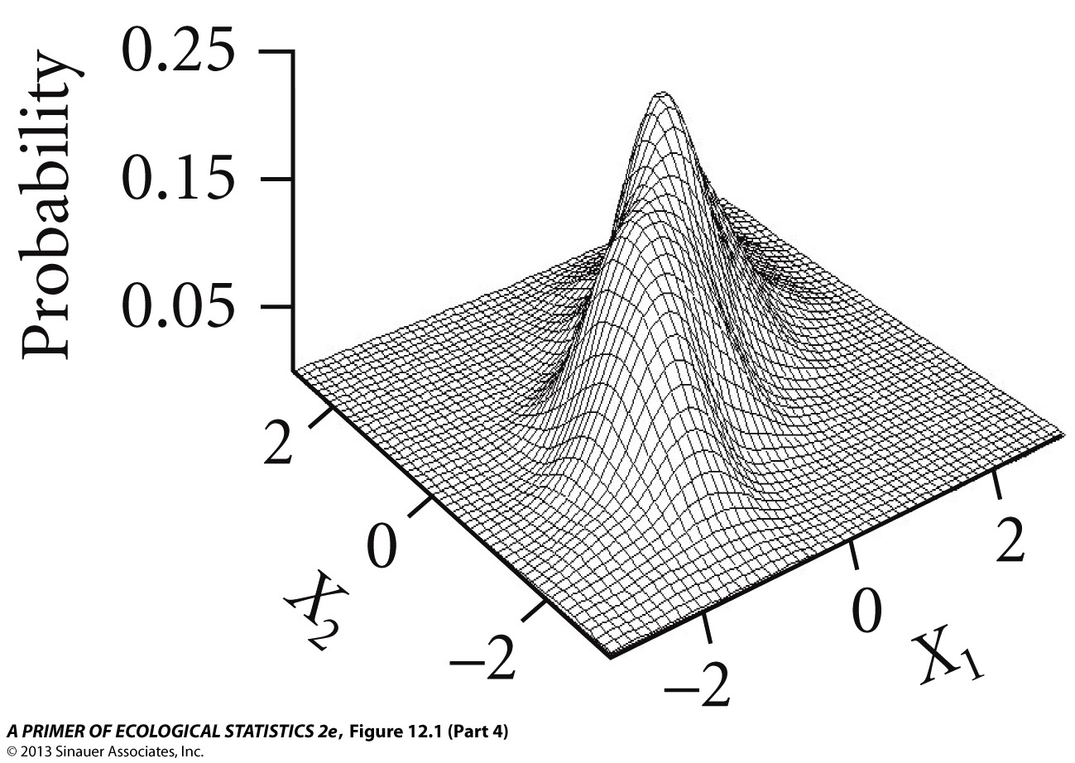
Multivariate Normality & Model Assumptions

Slide 10
Multivariate Normality
Many tests, rarely used (Mardia’s, Henze-Zirkler’s, Royston’s)
Test each variable for univariate normality
If any variable is not normally distributed, no multivariate normality
Opposite is not true

Slide 11
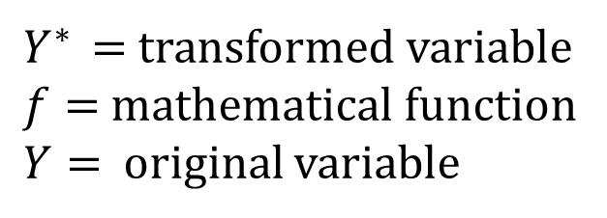

Data Transformation
$$Y^{∗ }=f\left(Y\right)$$
$Y^{∗ }$ $=$transformed variable
$f=$mathematical function
$Y=$ original variable

Slide 12
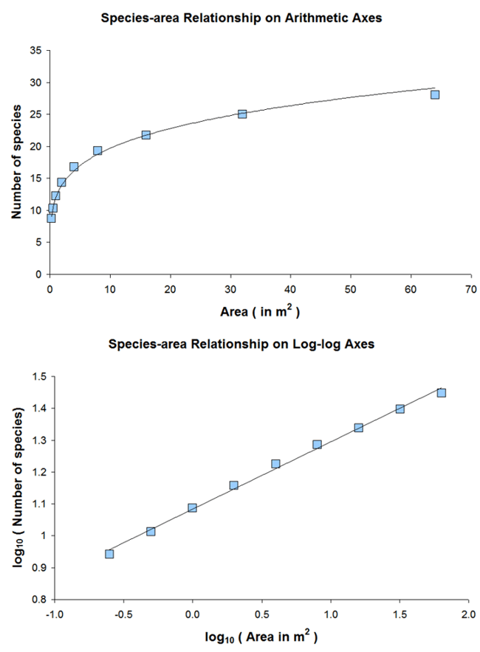
Data Transformation
Improve assumptions of normality, linearity, homogeneity of variances
Patterns in transformed data may be easier to understand and communicate than
patterns in the raw data (e.g., species area curve)

Slide 13

Log Transformation
$$b_{ij}=log\left(x_{ij}+1\right)$$
 | Variable 1 | Variable 2 | Variable 3 | Total
Unit 1 | 4 | 1 | 3 | 8
Unit 2 | 100 | 112 | 0 | 212
Unit 3 | 4 | 9 | 8 | 21
Unit 4 | 10 | 4 | 8 | 22
Total | 118 | 126 | 19 | 263
 | Variable 1 | Variable 2 | Variable 3 | Total
Unit 1 | 0.70 | 0.30 | 0.60 | 1.60
Unit 2 | 2.00 | 2.05 | 0.00 | 4.06
Unit 3 | 0.70 | 1.00 | 0.95 | 2.65
Unit 4 | 1.04 | 0.70 | 0.95 | 2.69
Total | 4.44 | 4.05 | 2.51 | 11.01
X ≥ 0
Compresses high values and spreads low values
Equalizes variances when mean and var. are correlated
When ratio of largest to smallest is >10
Highly positively skewed data

Slide 14
Log Transformation
30
10
25
8
20
6
Frequency
Frequency
15
4
10
5
2
0
0
0
500
1000
2000
3000
4
5
6
7
8
Manufacturing
log(Manufacturing +1)

Slide 15

Square Root Transformation
$$b_{ij}=\sqrt{x_{ij}}$$
 | Variable 1 | Variable 2 | Variable 3 | Total
Unit 1 | 4 | 1 | 3 | 8
Unit 2 | 100 | 112 | 0 | 212
Unit 3 | 4 | 9 | 8 | 21
Unit 4 | 10 | 4 | 8 | 22
Total | 118 | 126 | 19 | 263
 | Variable 1 | Variable 2 | Variable 3 | Total
Unit 1 | 2.00 | 1.00 | 1.73 | 4.73
Unit 2 | 10.00 | 10.58 | 0.00 | 20.58
Unit 3 | 2.00 | 3.00 | 2.83 | 7.83
Unit 4 | 3.16 | 2.00 | 2.83 | 7.99
Total | 17.16 | 16.58 | 7.39 | 41.13
X ≥ 0
Similar, but less dramatic than log transformation
Used with count data
Count data follow Poisson distribution (i.e., mean = var)
Yields variance independent of mean

Slide 16
Square Root Transformation
30
20
25
15
20
Frequency
Frequency
15
10
10
5
5
0
0
0
500
1000
2000
3000
0
10
20
30
40
50
60
Manufacturing
Sqrt(Manufacturing)

Slide 17

Arcsine Square Root Transformation
$$b_{ij}=arcsine\sqrt{x_{ij}}$$
 | Variable 1 | Variable 2 | Variable 3 | Total
Unit 1 | 0.4 | 1.00 | 0.03 | 1.43
Unit 2 | 1.00 | 1.00 | 0.00 | 2.00
Unit 3 | 0.04 | 0.09 | 0.08 | 0.21
Unit 4 | 0.1 | 0.04 | 0.08 | 0.22
Total | 1.54 | 2.13 | 0.19 | 3.86
 | Variable 1 | Variable 2 | Variable 3 | Total
Unit 1 | 0.68 | 1.57 | 0.17 | 2.43
Unit 2 | 1.57 | 1.57 | 0.00 | 3.14
Unit 3 | 0.20 | 0.30 | 0.29 | 0.79
Unit 4 | 0.32 | 0.20 | 0.29 | 0.81
Total | 2.78 | 3.65 | 0.75 | 7.17
0 ≥ X ≤ 1
Good for proportions and percentages
Spreads end of scale while compressing middle

Slide 18
Arcsine Square Root Transformation
15
20
15
10
Frequency
Frequency
10
5
5
0
0
0.0
0.2
0.4
0.6
0.8
1.0
0.0
0.5
1.0
1.5
raw
asin(sqrt(raw))

Slide 19

Arcsine Square Root Transformation
$$b_{ij}=arcsine\sqrt{x_{ij}}$$
 | Variable 1 | Variable 2 | Variable 3 | Total
Unit 1 | 0.4 | 1.00 | 0.03 | 1.43
Unit 2 | 1.00 | 1.00 | 0.00 | 2.00
Unit 3 | 0.04 | 0.09 | 0.08 | 0.21
Unit 4 | 0.1 | 0.04 | 0.08 | 0.22
Total | 1.54 | 2.13 | 0.19 | 3.86
 | Variable 1 | Variable 2 | Variable 3 | Total
Unit 1 | 0.68 | 1.57 | 0.17 | 2.43
Unit 2 | 1.57 | 1.57 | 0.00 | 3.14
Unit 3 | 0.20 | 0.30 | 0.29 | 0.79
Unit 4 | 0.32 | 0.20 | 0.29 | 0.81
Total | 2.78 | 3.65 | 0.75 | 7.17
Inappropriate for binomial data or probabilities

Slide 20
Transformations Summary
Use log or square root for highly skewed data or data ranging > 2 orders
of magnitude
Arcsine square root for proportions
Transformations applied to a related variable set (e.g. species) should use
the same transformation
Unrelated variables can be transformed independently

Slide 21
Data Standardizations
Facilitate comparisons and analysis of variables with unequal
and variable sample units.
Applied to rows or columns of a data matrix

Slide 22
Row and Column Standardizations
 | Variable 1 | Variable 2 | Variable 3 | Total
Unit 1 | 4 | 1 | 3 | 8
Unit 2 | 100 | 112 | 0 | 212
Unit 3 | 4 | 9 | 8 | 21
Unit 4 | 10 | 4 | 8 | 22
Total | 118 | 126 | 19 | 263
Row Standardization
Adjust for differences among
sample units.
Focus is on the profile within
a sample unit.
Column Standardization
Adjust for differences among
variables.
Focus is on the profile across
a sample unit.

Slide 23

Column Z-score Standardization
$$b_{ij}=\left(x_{ij}−\overline{x_{j}}\right)/s_{j}$$
 | Variable 1 | Variable 2 | Variable 3 | Total
Unit 1 | 4 | 1 | 3 | 8
Unit 2 | 100 | 112 | 0 | 212
Unit 3 | 4 | 9 | 8 | 21
Unit 4 | 10 | 4 | 8 | 22
Total | 118 | 126 | 19 | 263
 | Variable 1 | Variable 2 | Variable 3 | Total
Unit 1 | -0.54 | -0.57 | -0.44 | -1.55
Unit 2 | 1.50 | 1.50 | -1.20 | 1.79
Unit 3 | -0.54 | -0.42 | 0.82 | -0.14
Unit 4 | -0.41 | -0.51 | 0.82 | -0.10
Total | 0 | 0 | 0 | 0
Converts data to z-scores (mean = 0, variance = 1)
Places variables on equal footing
Necessary when variables have different scales or
units of measurement

Slide 24
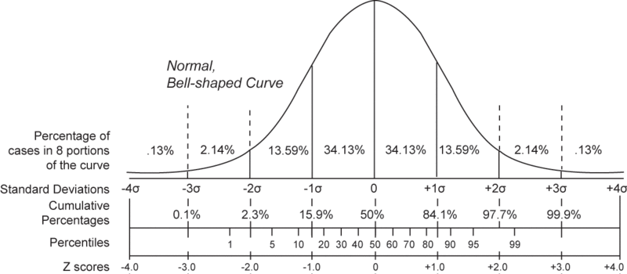
Standard deviation units

Slide 25

Column Total Standardization
$$b_{ij}=x_{ij}/\sum{x_{j}}$$
 | Variable 1 | Variable 2 | Variable 3 | Total
Unit 1 | 4 | 1 | 3 | 8
Unit 2 | 100 | 112 | 0 | 212
Unit 3 | 4 | 9 | 8 | 21
Unit 4 | 10 | 4 | 8 | 22
Total | 118 | 126 | 19 | 263
 | Variable 1 | Variable 2 | Variable 3 | Total
Unit 1 | 0.03 | 0.01 | 0.16 | 0.20
Unit 2 | 0.85 | 0.89 | 0.00 | 1.74
Unit 3 | 0.03 | 0.07 | 0.42 | 0.53
Unit 4 | 0.08 | 0.03 | 0.42 | 0.54
Total | 1.00 | 1.00 | 1.00 | 3.00
x ≥ 0
Commonly used to adjust for unequal
abundances among species
Relative abundance across sample units/ sites

Slide 26
Row Total Standardization
$$b_{ij}=x_{ij}/\sum{x_{j}}$$
 | Variable 1 | Variable 2 | Variable 3 | Total
Unit 1 | 4 | 1 | 3 | 8
Unit 2 | 100 | 112 | 0 | 212
Unit 3 | 4 | 9 | 8 | 21
Unit 4 | 10 | 4 | 8 | 22
Total | 118 | 126 | 19 | 263
 | Variable 1 | Variable 2 | Variable 3 | Total
Unit 1 | 0.50 | 0.13 | 0.38 | 1.00
Unit 2 | 0.47 | 0.53 | 0.00 | 1.00
Unit 3 | 0.19 | 0.43 | 0.38 | 1.00
Unit 4 | 0.45 | 0.18 | 0.36 | 1.00
Total | 1.62 | 1.26 | 1.12 | 4.00
x ≥ 0
Commonly used to adjust for unequal
abundances among sampling units
Relative abundance within sample unit/ site

Slide 27
Standardization Example

Slide 28
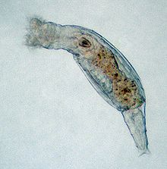
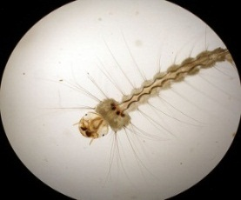



Raw Data
 | MOSQUI | CHIRON | MITESS | COPEPO | CLADOC | BLAESO | NEMATO | AMPHIP | GASTRI | TARDIG | ROTHAB | ROTLOR | ROTUNK
SUM | 0.93 | 1.36 | 0.77 | 0.27 | 0.42 | 0.00 | 0.00 | 0.00 | 0.00 | 0.00 | 23.75 | 80.00 | 0.00
NAC | 2.22 | 0.13 | 1.94 | 1.05 | 0.00 | 0.00 | 0.33 | 0.00 | 0.00 | 0.00 | 60.00 | 55.00 | 10.00
BAU | 3.61 | 0.49 | 1.77 | 0.00 | 0.00 | 0.19 | 0.00 | 0.00 | 0.00 | 0.00 | 156.67 | 10.00 | 10.00
CRE | 1.88 | 2.29 | 0.71 | 1.75 | 0.00 | 0.50 | 0.18 | 0.00 | 0.00 | 0.00 | 88.89 | 0.00 | 0.00
BAY | 1.05 | 1.68 | 2.96 | 0.00 | 0.00 | 0.00 | 0.20 | 0.00 | 0.00 | 0.00 | 30.00 | 0.00 | 50.00
GEO | 2.41 | 1.68 | 3.76 | 0.55 | 0.00 | 0.00 | 0.00 | 0.00 | 0.00 | 0.00 | 25.00 | 0.00 | 0.00
GRS | 0.68 | 0.80 | 1.41 | 0.00 | 0.43 | 0.10 | 0.00 | 0.00 | 0.00 | 0.00 | 76.25 | 0.00 | 0.00
CHE | 0.95 | 1.44 | 0.00 | 0.00 | 0.00 | 0.00 | 0.00 | 0.00 | 0.00 | 0.00 | 0.00 | 0.00 | 0.00
VIR | 0.44 | 6.06 | 0.20 | 0.00 | 0.00 | 0.00 | 0.00 | 0.00 | 0.00 | 0.00 | 20.00 | 0.00 | 0.00
HIL | 0.00 | 0.85 | 2.00 | 7.88 | 0.00 | 0.00 | 0.14 | 0.00 | 0.00 | 0.00 | 15.00 | 20.00 | 20.00
SD | 1.09 | 1.67 | 1.19 | 2.44 | 0.18 | 0.16 | 0.12 | 0.00 | 0.00 | 0.00 | 47.16 | 28.29 | 15.95

Slide 29
Z-standardized Data
 | MOSQUI | CHIRON | MITESS | COPEPO | CLADOC | BLAESO | NEMATO | AMPHIP | GASTRI | TARDIG | ROTHAB | ROTLOR | ROTUNK
SUM | -0.44 | -0.19 | -0.65 | -0.36 | 1.86 | -0.49 | -0.71 | 0.00 | 0.00 | 0.00 | -0.55 | 2.24 | -0.56
NAC | 0.74 | -0.93 | 0.32 | -0.04 | -0.47 | -0.49 | 2.06 | 0.00 | 0.00 | 0.00 | 0.22 | 1.36 | 0.06
BAU | 2.01 | -0.72 | 0.18 | -0.47 | -0.47 | 0.68 | -0.71 | 0.00 | 0.00 | 0.00 | 2.27 | -0.23 | 0.06
CRE | 0.43 | 0.37 | -0.70 | 0.25 | -0.47 | 2.62 | 0.76 | 0.00 | 0.00 | 0.00 | 0.83 | -0.58 | -0.56
BAY | -0.34 | 0.00 | 1.18 | -0.47 | -0.47 | -0.49 | 0.95 | 0.00 | 0.00 | 0.00 | -0.41 | -0.58 | 2.57
GEO | 0.91 | 0.00 | 1.85 | -0.25 | -0.47 | -0.49 | -0.71 | 0.00 | 0.00 | 0.00 | -0.52 | -0.58 | -0.56
GRS | -0.67 | -0.52 | -0.12 | -0.47 | 1.93 | 0.10 | -0.71 | 0.00 | 0.00 | 0.00 | 0.57 | -0.58 | -0.56
CHE | -0.43 | -0.15 | -1.30 | -0.47 | -0.47 | -0.49 | -0.71 | 0.00 | 0.00 | 0.00 | -1.05 | -0.58 | -0.56
VIR | -0.90 | 2.63 | -1.13 | -0.47 | -0.47 | -0.49 | -0.71 | 0.00 | 0.00 | 0.00 | -0.63 | -0.58 | -0.56
HIL | -1.29 | -0.49 | 0.38 | 2.76 | -0.47 | -0.49 | 0.48 | 0.00 | 0.00 | 0.00 | -0.73 | 0.12 | 0.69
SD | 1.00 | 1.00 | 1.00 | 1.00 | 1.00 | 1.00 | 1.00 | 0.00 | 0.00 | 0.00 | 1.00 | 1.00 | 1.00

Slide 30
Why does it matter?
Raw
Standardized

Slide 31
When to standardize?
Depends on variability among rows and columns as measured by the coefficient of variation (cv).
cv = sd/mean

Slide 32
When to standardize?
Row standardization is good when variables are measured in
the same units (e.g., species)
Column standardization to “equalize” variables measured in different scales

Slide 33
Class Outline
Data Screening
Data Transformations & Standardizations
Outliers
Distance vs. Disimilarity

Slide 34
Outliers
Outliers are recorded values of measurements
or observations that are outside the range of
the bulk of the data.
Outliers can have dramatic effects on statistical
tests by increasing the variance in the data
Inflated variances decrease the power of the test
and increase the chance of a Type II error (failure to reject a null hypothesis)

Slide 35
Univariate Outliers
Examine standard deviation scores (z-scores)
for each variable separately
Population Size
25
US Air Pollution
20
Extreme observations:
> 3 Standard Deviations
City | SO2 | temp | manu | popul | wind | precip | predays
Albany | 46 | 47.6 | 44 | 116 | 8.8 | 33.36 | 135
Albuquerque | 11 | 56.8 | 46 | 244 | 8.9 | 7.77 | 58
Atlanta | 24 | 61.5 | 368 | 497 | 9.1 | 48.34 | 115
Baltimore | 47 | 55 | 625 | 905 | 9.6 | 41.31 | 111
Buffalo | 11 | 47.1 | 391 | 463 | 12.4 | 36.11 | 166
Charleston | 31 | 55.2 | 35 | 71 | 6.5 | 40.75 | 148
Chicago | 110 | 50.6 | 3344 | 3369 | 10.4 | 34.44 | 122
Cincinnati | 23 | 54 | 462 | 453 | 7.1 | 39.04 | 132
15
Frequency
10
5
0
-1
0
1
2
3
4
5
Standard Deviations

Slide 36
Multivariate Outliers
Examine deviations (z-scores) of the sample average
distances to other samples
Histogram of Bray-Curtis Distance
15
15
Extreme observations:
> 3 Standard Deviations
10
10
Frequency
Frequency
5
5
0
0
0.2
0.3
0.4
0.5
0.6
0.7
-1
0
1
2
3
4
Average Distance
Standard Deviation of Average Distance

Slide 37
Multivariate Outliers
Examine standard deviations of the sample average
distances to other samples
mean = 0.34
sd = 0.10
3*sd = 0.3
mean + 3*sd = 0.64
Histogram of Bray-Curtis Distance
15
10
3 sd
Frequency
5
0
0.2
0.3
0.4
0.5
0.6
0.7
Average Distance

Slide 38
Rules for checking outliers
Examine data at all stages (i.e., raw, transformed,
standardized, distance)
Know impacts of outliers for a given analysis
Delete extreme values only if it makes sense
Conduct sensitivity analysis to quantify the
influence of outliers

Slide 39
Class Outline
Data Screening
Data Transformations & Standardizations
Outliers
Distance vs. Disimilarity

Slide 40






Multivariate Dataset: 2-way data matrix
City | SO2 | temp | predays
Wichita | 8 | 56.6 | 82
Dallas | 9 | 66.2 | 78
San Francisco | 12 | 56.7 | 67
Philadelphia | 69 | 54.6 | 115
Providence | 94 | 50 | 125
Chicago | 110 | 50.6 | 122
City-by-measurement
2-way data matrix

Slide 41
p-dimensional space
City | SO2 | temp | predays
Wichita | 8 | 56.6 | 82
Dallas | 9 | 66.2 | 78
San Francisco | 12 | 56.7 | 67
Philadelphia | 69 | 54.6 | 115
Providence | 94 | 50 | 125
Chicago | 110 | 50.6 | 122
predays
125
Each city is represented as a point in p-dimensional
space based on it’s measured values along each of
the p axes.
The collection of points forms a data cloud in this
p-dimensional space.
The shape, clumping, and dispersion of the data
cloud contains information we seek to describe
82
8
94
50
SO2
56.6
temp

Slide 42
How similar (or dissimilar)?
City | SO2 | temp | predays
Wichita | 8 | 56.6 | 82
Dallas | 9 | 66.2 | 78
San Francisco | 12 | 56.7 | 67
Philadelphia | 69 | 54.6 | 115
Providence | 94 | 50 | 125
Chicago | 110 | 50.6 | 122
v
v
v

Slide 43
Measuring (Dis)similarity
Similarity
Similarity is the ratio of the number of attributes two objects have in common to the total list of attributes between them
Objects that have everything in common are identical and have a similarity of 1.0; objects that have nothing in common have a similarity of 0.0.
Dissimilarity
Dissimilarity is the complement of similarity, and is the number of attributes two objects have uniquely compared to the total list of all attributes
In general, dissimilarity can be calculated as 1 - similarity.
Both range between 0-1

Slide 44
Measuring Distance
predays
Distance is a geometric conception of the proximity of objects in high dimensional space defined by measurements on the attributes
125
?
82
8
94
50
SO2
56.6
temp

Slide 45
Distance vs. Dissimilarity
Distances and dissimilarities are often used interchangeably.
However, they do have unique properties:
- Dissimilarities are bound between [0,1]
- Distances are usually unbounded on the upper end

Slide 46
Raw data to dissimilarity/distance matrix
Original data matrix
Dissimilarity matrix
City | SO2 | temp | predays
Wichita | 8 | 56.6 | 82
Dallas | 9 | 66.2 | 78
San Francisco | 12 | 56.7 | 67
Philadelphia | 69 | 54.6 | 115
Providence | 94 | 50 | 125
Chicago | 110 | 50.6 | 122
 | Wichita | Dallas | San Francisco | Philadelphia | Providence | Chicago
Wichita | 0.00 | 0.05 | 0.07 | 0.25 | 0.33 | 0.34
Dallas | 0.05 | 0.00 | 0.08 | 0.28 | 0.35 | 0.37
San Francisco | 0.07 | 0.08 | 0.00 | 0.29 | 0.36 | 0.38
Philadelphia | 0.25 | 0.28 | 0.29 | 0.00 | 0.08 | 0.10
Providence | 0.33 | 0.35 | 0.36 | 0.08 | 0.00 | 0.04
Chicago | 0.34 | 0.37 | 0.38 | 0.10 | 0.04 | 0.00

Slide 47
Raw data to dissimilarity/distance matrix
Original data matrix
Dissimilarity matrix
City | SO2 | temp | predays
Wichita | 8 | 56.6 | 82
Dallas | 9 | 66.2 | 78
San Francisco | 12 | 56.7 | 67
Philadelphia | 69 | 54.6 | 115
Providence | 94 | 50 | 125
Chicago | 110 | 50.6 | 122
 | Wichita | Dallas | San Francisco | Philadelphia | Providence | Chicago
Wichita | 0.00
Dallas | 0.05 | 0.00
San Francisco | 0.07 | 0.08 | 0.00
Philadelphia | 0.25 | 0.28 | 0.29 | 0.00
Providence | 0.33 | 0.35 | 0.36 | 0.08 | 0.00
Chicago | 0.34 | 0.37 | 0.38 | 0.10 | 0.04 | 0.00

Slide 48
So Many Metrics!
Euclidean
Jaccard
Manhattan
Bray-Curtis
Sorensen
The metric used will be dictated by the type of data , question, or analysis.
When several metrics are plausible, the choice is guided by personal preference.
Always good to test out several metrics to see how they may influence interpretation

Slide 49
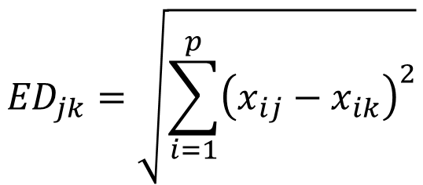
Euclidean Distance
City | SO2 | temp | predays
Wichita | 8 | 56.6 | 82
Dallas | 9 | 66.2 | 78
San Francisco | 12 | 56.7 | 67
Philadelphia | 69 | 54.6 | 115
Providence | 94 | 50 | 125
Chicago | 110 | 50.6 | 122
$${ED}_{jk}=\sqrt{\sum_{i=1}^{p}{{\left(x_{ij}−x_{ik}\right)}^{2}}}$$
Most commonly used distance metric
Data are usually column standardized
Used in Principal Components Analysis (PCA)
(ED)²
(110-9)²
SO2
(66.2-50.6)²
Temp

Slide 50
Euclidean Distance
City | SO2 | temp | predays
Wichita | 8 | 56.6 | 82
Dallas | 9 | 66.2 | 78
San Francisco | 12 | 56.7 | 67
Philadelphia | 69 | 54.6 | 115
Providence | 94 | 50 | 125
Chicago | 110 | 50.6 | 122
$${ED}_{jk}=\sqrt{\sum_{i=1}^{p}{{\left(x_{ij}−x_{ik}\right)}^{2}}}$$
Emphasizes outliers
Not appropriate for presence/absence data or
count data with many zeros
(ED)²
(110-9)²
SO2
(66.2-50.6)²
Temp

Slide 51
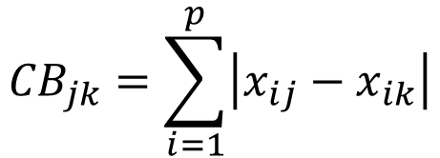
City-block (Manhattan) Distance
City | SO2 | temp | predays
Wichita | 8 | 56.6 | 82
Dallas | 9 | 66.2 | 78
San Francisco | 12 | 56.7 | 67
Philadelphia | 69 | 54.6 | 115
Providence | 94 | 50 | 125
Chicago | 110 | 50.6 | 122
$${CB}_{jk}=\sum_{i=1}^{p}{\left|x_{ij}−x_{ik}\right|}$$
Compared to ED, gives less weight to
outliers (no squared differences)
SO2
110-9
66.2-50.6
Temp

Slide 52
Proportional (Dis)similarity Metrics
Express (dis)similarity as a ratio of shared (C) to total (A,B,C)
A
C
B

Slide 53
Proportional (Dis)similarity Metrics
Express dissimilarity as a ratio of unshared (A,B) to total (A,B,C)
A
C
B

Slide 54
Proportional (Dis)similarity Metrics
Express dissimilarity as a ratio of unshared (A,B) to total (A,B,C)
C
A
B

Slide 55






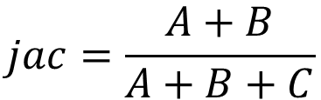


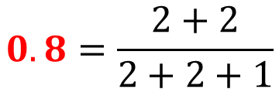

Jaccard Index
(presence/absence data)
C
A
B
$$jac=\frac{A+B}{A+B+C}$$
$$+$$
$$jac=$$
$$0.8=\frac{2+2}{2+2+1}$$
$$+$$
$$+$$

Slide 56
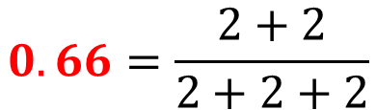
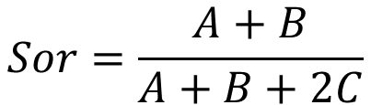




Sørensen’s Index
(presence/absence data)
C
A
B
$$Sor=\frac{A+B}{A+B+2C}$$
$$+$$
$$Sor=$$
$$0.66=\frac{2+2}{2+2+2}$$
$$+$$
$$+$$
**Bray-Curtis is for continuous data but collapses down to
Sørensen’s with ones and zeros*

Slide 57
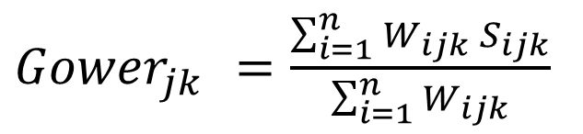
Gower Index
Appropriate for mixed data (binary, interval, ratio, ordinal)
Can handle missing data
Sample | COLOR | MASS | FAT DEPOSIT
1 | blue | 7.6 | 1
2 | white | 7.3 | 3
3 | NA | 6.9 | 5
${Gower}_{jk }=\frac{\sum_{i=1}^{n}{W_{ijk} }S_{ijk}}{\sum_{i=1}^{n}{W_{ijk}}}$

Slide 58
Proportional Dissimilarity Metrics
Commonly used for species abundance data but can be
used for data of any scale (e.g., presence/ absence)
Less emphasis on outliers than ED
Unlike ED and Manhattan, maximum when no species are shared
Not compatible with all analyses (e.g., DA, CCA)

