Slide 1
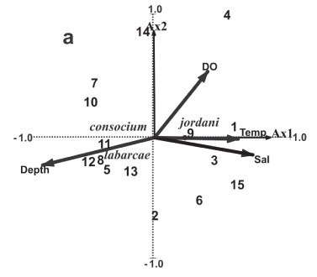
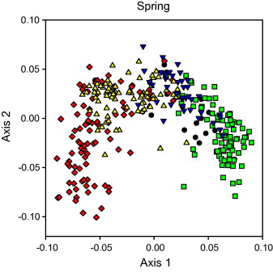
Ordination
Principal Components Analysis (PCA)

Slide 2
Class outline
Primer of matrix algebra (delve as deep as you want)
Ordination
Principal Components Analysis (PCA)
PCA Example – Pitcher plant foodwebs

Slide 3
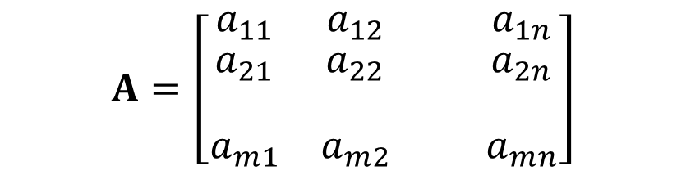
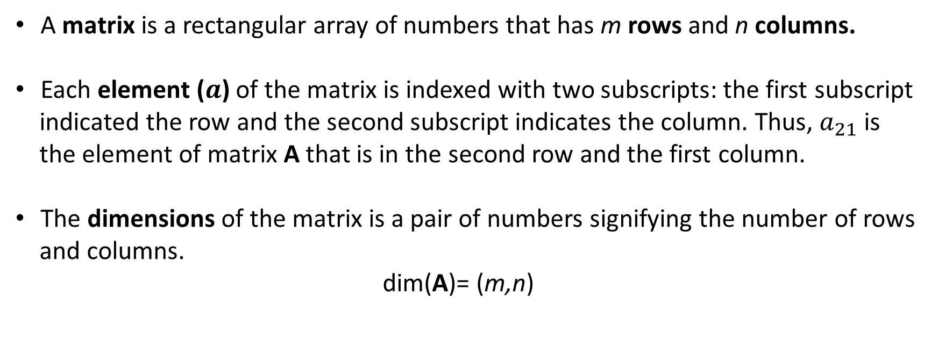
A Primer of Matrix Algebra
$$A=\left[\begin{matrix}a_{11} & a_{12} & { a}_{1n} \\ \begin{aligned}a_{21} \\ \end{aligned} & \begin{aligned}a_{22} \\ \end{aligned} & \begin{aligned}{ a}_{2n} \\ \end{aligned} \\ a_{m1} & a_{m2} & a_{mn}\end{matrix}\right]$$
A matrix is a rectangular array of numbers that has m rows and n columns.
Each element ($a$) of the matrix is indexed with two subscripts: the first subscript
indicated the row and the second subscript indicates the column. Thus, $a_{21}$ is
the element of matrix A that is in the second row and the first column.
The dimensions of the matrix is a pair of numbers signifying the number of rows
and columns.
dim(A)= (m,n)

Slide 4

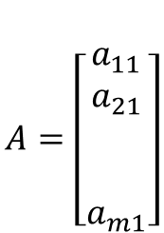

A Primer of Matrix Algebra
$$A=\left[\begin{matrix}\begin{aligned}a_{11} \\ a_{21}\end{aligned} \\ \begin{aligned} \\ \end{aligned} \\ a_{m1}\end{matrix}\right]$$
A column vector is a matrix with m rows and one column.
A row vector is a matrix with one row and n columns.
A scalar is a single number .
...
$$A=\left[\begin{matrix}{ a}_{11} & a_{12} & a_{1n}\end{matrix}\right]$$
$$A=\left[{ a}_{11}\right]$$
**ROW, COLUMN**

Slide 5
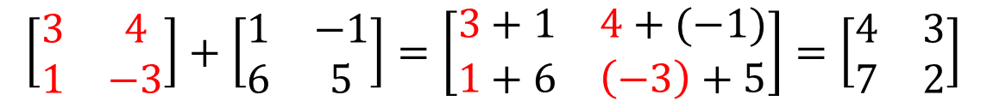
Basic Mathematical Operations on Matrices
Addition and Subtraction
Adding and subtracting matrices is done element by element:
$$\left[\begin{matrix}3 & 4 \\ 1 & −3\end{matrix}\right]+\left[\begin{matrix}1 & −1 \\ 6 & 5\end{matrix}\right]=\left[\begin{matrix}3+1 & 4+(−1) \\ 1+6 & \left(−3\right)+5\end{matrix}\right]=\left[\begin{matrix}4 & 3 \\ 7 & 2\end{matrix}\right]$$
Subtraction is the same, but subtracting…
Because matrix addition and subtraction are performed element
by element basis, matrices must have the same dimensions

Slide 6
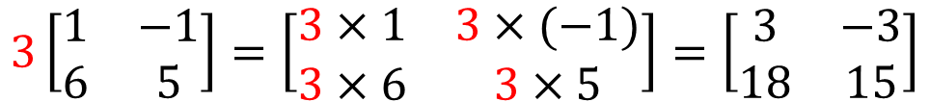
Basic Mathematical Operations on Matrices
Scalar Multiplication
Multiplying matrix A of any dimension by a scalar k, results in the
product kA which is a new matrix of the same dimension as A
$$3\left[\begin{matrix}1 & −1 \\ 6 & 5\end{matrix}\right]=\left[\begin{matrix}3×1 & 3×(−1) \\ 3×6 & 3×5\end{matrix}\right]=\left[\begin{matrix}3 & −3 \\ 18 & 15\end{matrix}\right]$$
Scalar multiplication is:
- communicative kA = Ak
- associative c(kA) = (ck)A
- distributive k (A+B) = kA + kB
for addition

Slide 7

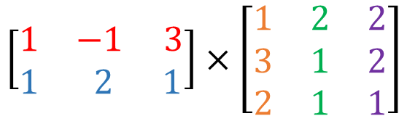
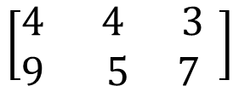

Basic Mathematical Operations on Matrices
Matrix Multiplication
You can multiply two matrices A and B with dimensions (m,n) and (p,q)
respectively, but only if the number of columns in the first matrix equals
the number of rows in the second.
$$\left[\begin{matrix}1 & −1 3 \\ 1 & 2 1\end{matrix}\right]×\left[\begin{matrix}1 & 2 & 2 \\ 3 & 1 & 2 \\ 2 & 1 & 1\end{matrix}\right]$$
$$=$$
$$\left[\begin{matrix}1\left(1\right)+\left(−1\right)(3)+3(2) & 1\left(2\right)+\left(−1\right)(1)+3(1) & 1\left(2\right)+\left(−1\right)(2)+3(1) \\ 1\left(1\right)+2(3)+1(2) & 1\left(2\right)+2(1)+1(1) & 1\left(2\right)+2(2)+1(1)\end{matrix}\right]$$
$$=$$
$$\left[\begin{matrix}4 & 4 3 \\ 9 & 5 7 \end{matrix}\right]$$
New matrix AB, has the dimensions (m,q), where m
is the number of rows in A and q is the number of
Columns in B

Slide 8
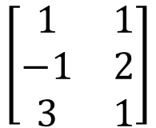
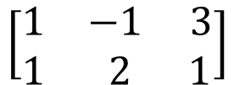
Basic Mathematical Operations on Matrices
Matrix Transposition
Interchanging the rows and columns of a matrix yields it’s transpose.
For matrix A with dimension (m,n), the transpose of A is written as either A’ or A^{T}
with dimension (n,m).
T
$$\left[\begin{matrix}1 & 1 \\ −1 & 2 \\ 3 & 1\end{matrix}\right]$$
$$\left[\begin{matrix}1 & −1 3 \\ 1 & 2 1\end{matrix}\right]$$
=

Slide 9
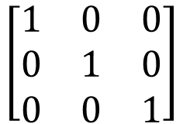
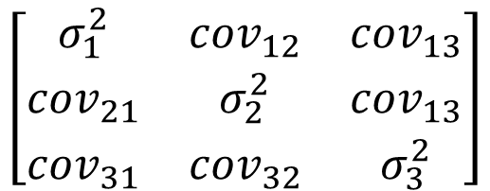
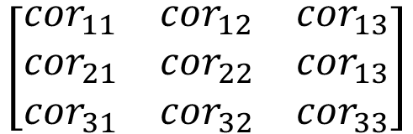
Basic Mathematical Operations on Matrices
Symmetric Matrices
Contain the same number of rows and columns and are symmetric
across the diagonal
Three important symmetric matrices:
Variance-Covariance Matrix
Correlation Matrix
Identity Matrix (I)
Var 1 Var2 Var3
Var 1 Var2 Var3
Var1
Var2
Var3
$$\left[\begin{matrix}σ_{1}^{2} & {cov}_{12} & {cov}_{13} \\ {cov}_{21} & σ_{2}^{2} & {cov}_{13} \\ {cov}_{31} & {cov}_{32} & σ_{3}^{2}\end{matrix}\right]$$
Var1
Var2
Var3
$$\left[\begin{matrix}1 & 0 & 0 \\ 0 & 1 & 0 \\ 0 & 0 & 1\end{matrix}\right]$$
$$\left[\begin{matrix}{cor}_{11} & {cor}_{12} & {cor}_{13} \\ {cor}_{21} & {cor}_{22} & {cor}_{13} \\ {cor}_{31} & {cor}_{32} & {cor}_{33}\end{matrix}\right]$$

Slide 10
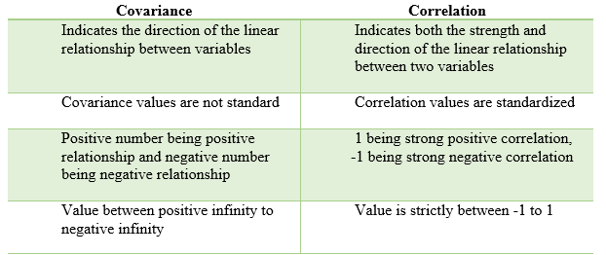

Slide 11
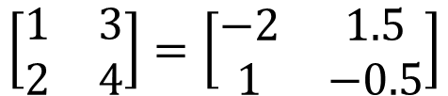
Basic Mathematical Operations on Matrices
Matrix Inversion
The inverse of matrix A is A⁻¹ .
A x A⁻¹ = I
Inverse matrices are only defined for square matrices
-1
$$\left[\begin{matrix}1 & 3 \\ 2 & 4\end{matrix}\right]=\left[\begin{matrix}−2 & 1.5 \\ 1 & −0.5\end{matrix}\right]$$

Slide 12



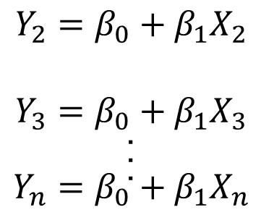

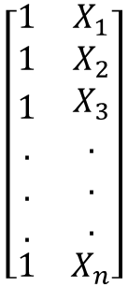



Basic Mathematical Operations on Matrices
Solving Linear Equations
$$Y_{1}=β_{0}+β_{1}X_{1}$$
$$Y$$
$$X$$
$$b$$
$$Y_{2}=β_{0}+β_{1}X_{2}$$
$$Y_{3}=β_{0}+β_{1}X_{3}$$
.
.
.
$$Y_{n}=β_{0}+β_{1}X_{n}$$
$$\left[\begin{aligned}\begin{matrix}Y_{1} \\ Y_{2} \\ Y_{3}\end{matrix} \\ . \\ . \\ . \\ Y_{n}\end{aligned}\right]$$
$$\left[\begin{matrix}1 & X_{1} \\ 1 & X_{2} \\ \begin{aligned}\begin{aligned}1 \\ . \\ . \\ .\end{aligned} \\ 1\end{aligned} & \begin{aligned}X_{3} \\ . \\ . \\ . \\ X_{n}\end{aligned}\end{matrix}\right]$$
$$\left[\begin{aligned}β_{0} \\ β_{1}\end{aligned}\right]$$
Best fit regression model using least-squares
$$b={\left[X^{T}X\right]}^{−1}\left[X^{T}Y\right]$$

Slide 13

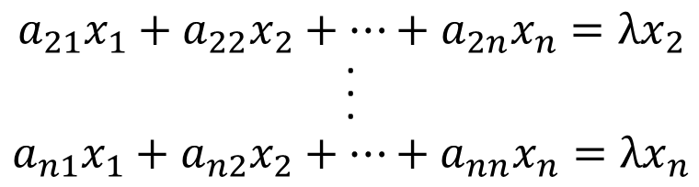
Basic Mathematical Operations on Matrices
Eigenvalues and Eigenvectors
$$a_{11}x_{1}+a_{12}x_{2}+…+a_{1n}x_{n}={λx}_{1}$$
$$a_{21}x_{1}+a_{22}x_{2}+…+a_{2n}x_{n}={λx}_{2}$$
.
.
.
$$a_{n1}x_{1}+a_{n2}x_{2}+…+a_{nn}x_{n}={λx}_{n}$$
$Ax=$ $λx$
Where:
A is a square matrix with elements a_{ij}
x is an n x 1 column vector
λ is a scalar

Slide 14


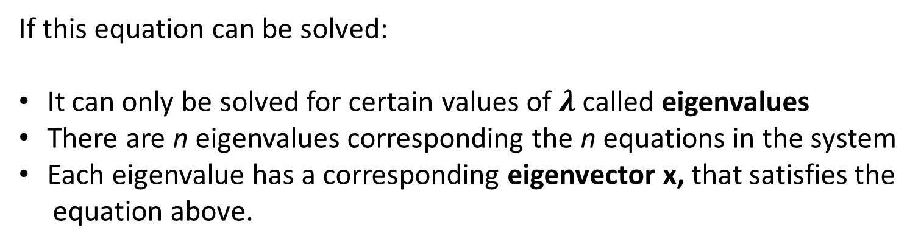
Basic Mathematical Operations on Matrices
Eigenvalues and Eigenvectors
$Ax=$ $λx$
$(A−λI)x=$ $0$
If this equation can be solved:
It can only be solved for certain values of $λ$called eigenvalues
There are n eigenvalues corresponding the n equations in the system
Each eigenvalue has a corresponding eigenvector x, that satisfies the
equation above.

Slide 15
Class outline
Primer of matrix algebra (delve as deep as you want)
Unconstrained Ordination
Principal Components Analysis (PCA)
PCA Example – Pitcher plant foodwebs

Slide 16
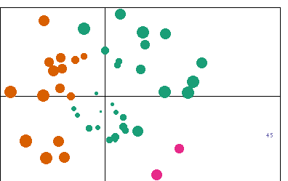
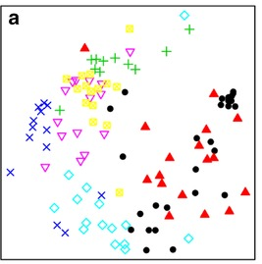
Unconstrained
Ordination
Order (ordinate) multivariate data
Create new variables (principal axes)
Data reduction technique
Discriminate or separate samples along an axis
Assess relationship between a single set of variables;
no attempt to relate independent and dependent variables

Slide 17
4 Unconstrained Ordination Techniques
Principal Components Analysis (PCA)
Principal Coordinates Analysis (PCoA)
Non-Metric Multidimensional Scaling (NMDS)
Correspondence Analysis

Slide 18
Class outline
Primer of matrix algebra (delve as deep as you want)
Unconstrained Ordination
Principal Components Analysis (PCA)
PCA Example – Pitcher plant foodwebs

Slide 19
4 Unconstrained Ordination Techniques
Principal Components Analysis (PCA)
Principal Coordinates Analysis (PCoA)
Non-Metric Multidimensional Scaling (NMDS)
Correspondence Analysis

Slide 20
Principal Components Analysis
Primary goal is to reduce the dimensionality of multivariate data
Create composite variables (PCA axes) that characterize variation
PCA axes are linear combinations of the original variables
PCA axes are not correlated
Notes:
Correlation is good! Allows us to condense variables into a single axis

Slide 21
PCA – Conceptual
Connectance
First principal axis
-
+
Species Richness
principal component scores

Slide 22
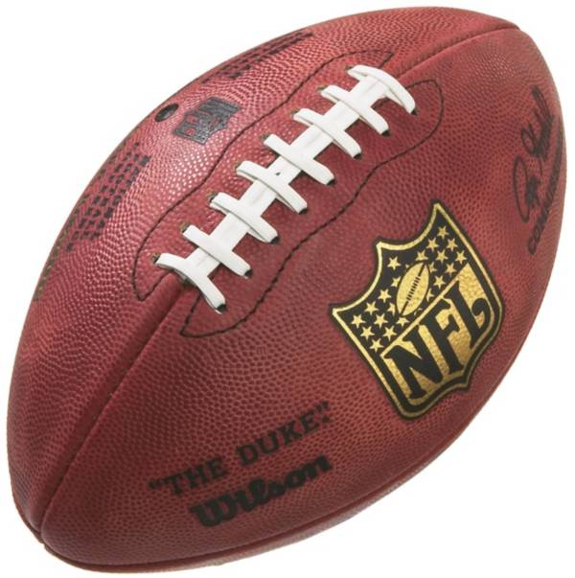
PCA – Conceptual

Slide 23
PCA – Conceptual

Slide 24
Data for PCA
Single set of variables; no distinction between independent
and dependent variables.
Continuous, categorical, or count variables (preferably continuous).
Every sample entity (N) must be measured for the same set of variables (P).
Ideally more samples (rows) than variables (columns)
Rule of Thumb: N ≥ 3*P
Notes:
e.g., climate data, species abundance data, binary data (not the best for this type of data)

Slide 25
Assumptions for PCA
Data are Multivariate normal:
- check univariate normality of original variables
- check univariate normality of pca scores
Data are sampled randomly and independently
across multivariate space.
- good sampling design
Variables change linearly along an underlying gradient
- plot variables vs. PCA axes
- plot PCA axes vs each other
- if relationships are non-linear, potentially use (ca)

Slide 26
What if assumptions are not met?
Multivariate normality: collect more samples, NMDS
Independent samples: stratified random sample
Linearity: sample shorter environmental gradient, NMDS, DCA
All the above: consider descriptive rather than inferential interpretation

Slide 27
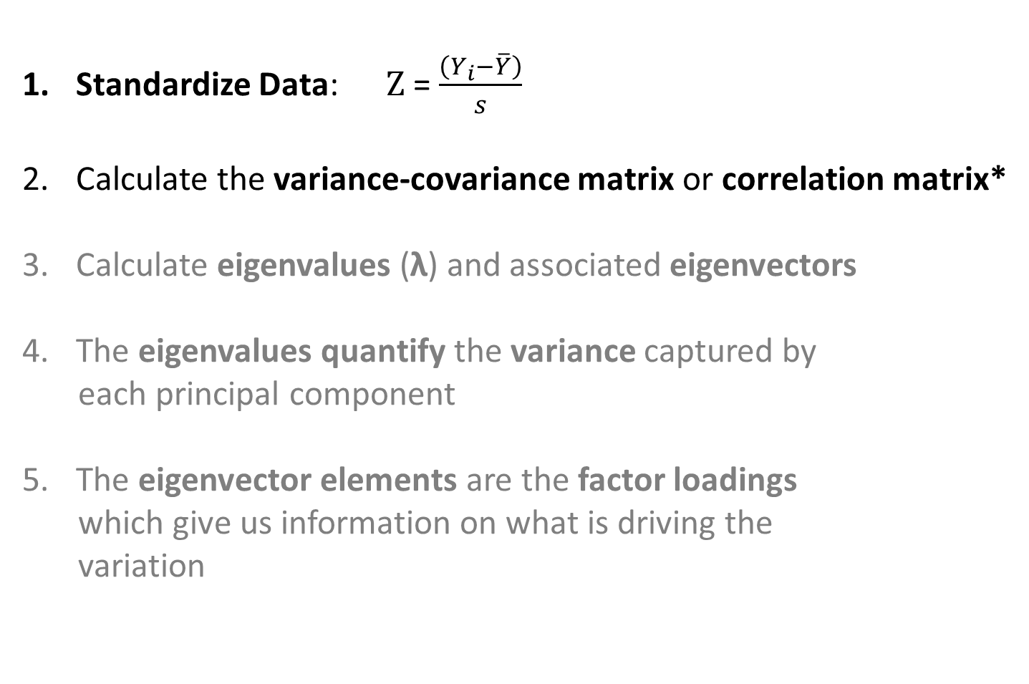
PCA Procedure
Standardize Data: Z = $\frac{\left(Y_{i}−\overline{Y}\right)}{s}$
Calculate the variance-covariance matrix or correlation matrix*
Calculate eigenvalues (λ) and associated eigenvectors
The eigenvalues quantify the variance captured by
each principal component
The eigenvector elements are the factor loadings
which give us information on what is driving the
variation

Slide 28
Variance-Covariance Matrix
 | Var 1 | Var 2 | Var 3 | Var 4
Var 1 | σ₁² | cov₁₂ | cov₁₃ | cov₁₄
Var 2 | cov₂₁ | σ₂² | cov₂₃ | cov₂₄
Var 3 | cov₃₁ | cov₃₂ | σ₃² | cov₃₄
Var 4 | cov₄₁ | cov₄₂ | cov₄₃ | σ₄²

Slide 29
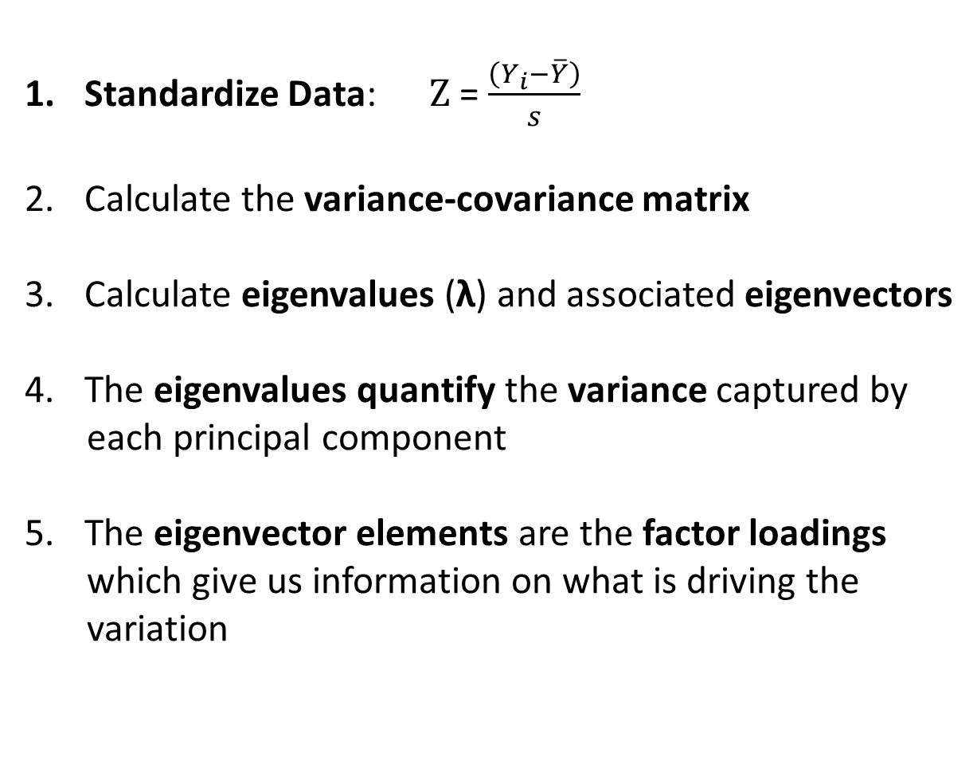
PCA Procedure
Standardize Data: Z = $\frac{\left(Y_{i}−\overline{Y}\right)}{s}$
Calculate the variance-covariance matrix
Calculate eigenvalues (λ) and associated eigenvectors
The eigenvalues quantify the variance captured by
each principal component
The eigenvector elements are the factor loadings
which give us information on what is driving the
variation

Slide 30

Eigenvalues in PCA
Equation:
$\left|R−λI\right|=$ $0$
Where: R = covariance or correlation matrix
λ = vector of eigenvalue solutions
I = identity matrix
An N x P data set has P eigenvalues
Eigenvalues = variances of corresponding PC’s
λ₁ > λ₂ > λ₃ > λ₄ > … > λ_{p}

Slide 31

Eigenvectors in PCA
Equation:
$\left|R−λ_{i}I\right|v_{i}=$ $0$
Where: λ_{i} = eigenvalue corresponding to the i^{th} PC
v_{i} = eigenvector associated with the i^{th} PC
Eigenvectors equal the coefficients (i.e. weights) of the
variables in the linear equations that define the principal
components.

Slide 32
PCA Procedure
Standardize Data: Z = $\frac{\left(Y_{i}−\overline{Y}\right)}{s}$
Calculate the variance-covariance matrix
Calculate eigenvalues (λ) and associated eigenvectors
The eigenvalues quantify the variance captured by
each principal component
The eigenvector elements are the factor loadings
which give us information on what is driving the
variation

Slide 33

Calculating Principal Components
$$Z_{j}= a_{i1}Y_{1}+a_{i2}Y_{2}+ … +a_{in}Y_{n}$$
Principal component
coefficient
variable
coefficient
Factor loadings = eigenvector elements

Slide 34
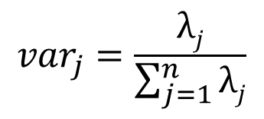
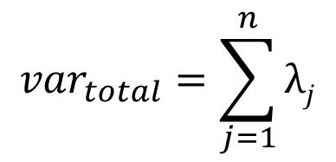
Eigenvalue (λ) = variance explained
$${var}_{total}=\sum_{j=1}^{n}{λj}$$
$${var}_{j}=\frac{λj}{\sum_{j=1}^{n}{λj}}$$
How much variation does each axis account for?
Which axes to keep?

Slide 35
Class outline
Primer of matrix algebra (delve as deep as you want)
Unconstrained Ordination
Principal Components Analysis (PCA)
PCA Example – Pitcher plant foodwebs

Slide 36
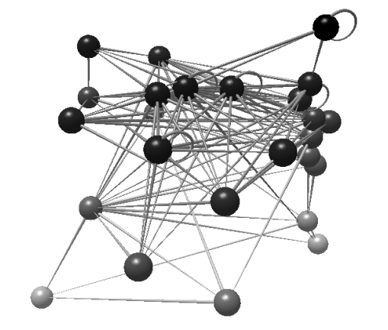
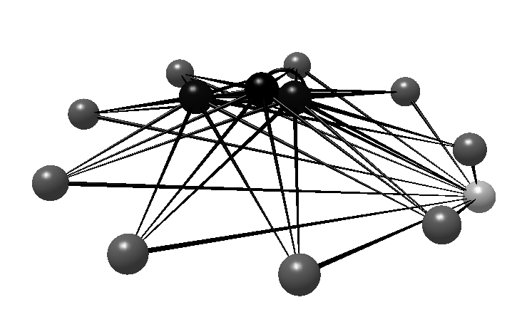
Example Data – Food Web Structure

Slide 37
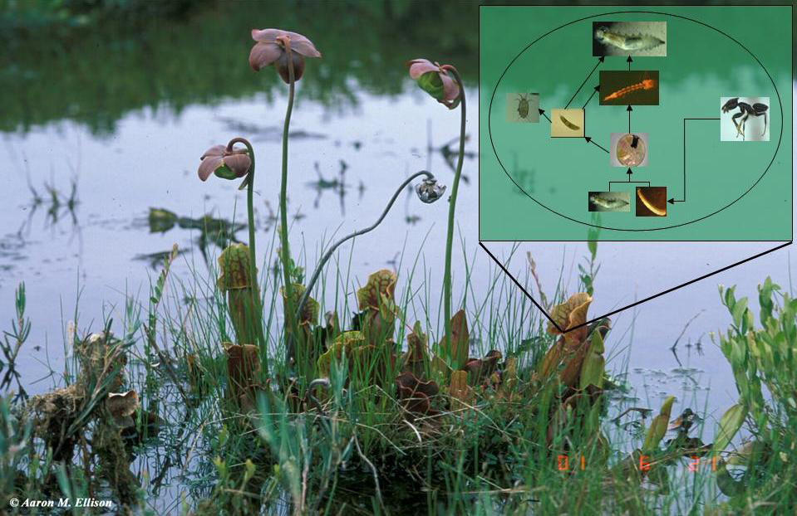
Pitcher Plant Food Webs

Slide 38
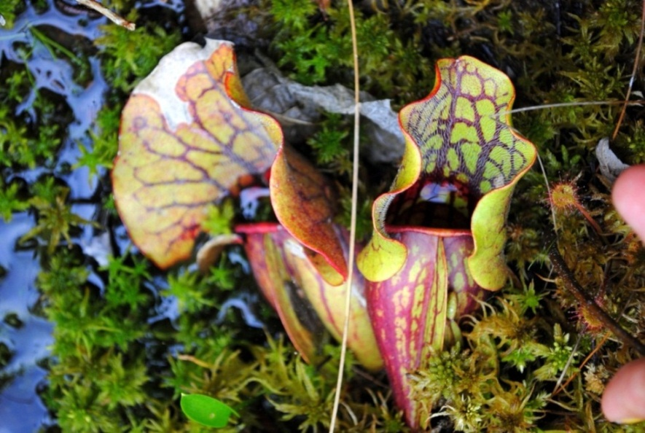
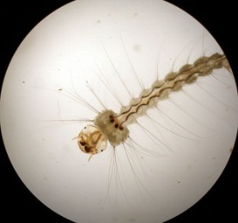
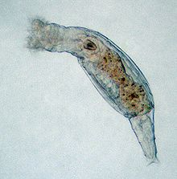

Pitcher Plant Food Webs
Pitcher ID | Site | S | LS | C | Top | Int | Det | Omn | GenSD | VulSD | LinkSD | TL | MaxSim | Path | Clust | ChnLn
1 | QUS | 1.01 | 1.35 | 0.94 | -0.11 | 0.32 | -0.94 | 1.86 | -0.75 | -0.38 | -1.04 | 1.20 | 0.28 | -0.66 | 0.62 | 1.01
2 | SUM | 1.01 | 0.92 | 0.10 | -0.11 | 0.32 | 0.27 | -0.48 | 0.40 | -0.56 | -0.12 | 0.34 | 0.76 | 0.14 | -0.04 | 0.45
3 | VT | 1.95 | 1.36 | -0.54 | -0.42 | 0.66 | 0.91 | 0.18 | 1.36 | -0.43 | 0.75 | -0.16 | 0.89 | 0.84 | 0.17 | -0.21
4 | BC | 1.32 | 1.40 | 0.46 | -0.23 | 0.45 | -0.05 | -0.05 | 0.05 | -0.51 | -0.41 | 0.49 | 0.52 | -0.17 | 0.27 | 0.37
5 | SUM | 1.32 | 1.34 | 0.34 | -0.23 | 0.45 | -0.05 | -0.59 | 0.09 | -0.61 | -0.46 | 0.75 | 0.78 | -0.05 | 0.00 | 0.90
6 | ALA | -2.11 | -2.22 | -2.33 | 4.22 | -4.52 | 1.78 | -2.23 | -1.97 | 4.22 | 2.14 | -2.99 | -2.17 | 1.29 | -2.45 | -2.65
. | . | . | . | . | . | . | . | . | . | . | . | . | . | . | . | .
. | . | . | . | . | . | . | . | . | . | . | . | . | . | . | . | .
. | . | . | . | . | . | . | . | . | . | . | . | . | . | . | . | .
780 | VT | 1.95 | 1.36 | -0.54 | -0.42 | 0.66 | 0.91 | 0.18 | 1.36 | -0.43 | 0.75 | -0.16 | 0.89 | 0.84 | 0.17 | -0.21
Notes:
S-species, ls- mean links per species, c-connectance, top-top predator, int-intermediate species, det-detritivores, omn-ominivores, gensd-standard deviation of generality, vulsd-standard deviation of vulnerability, linksd-standard devaiation of number of links, tl-mean weighted trophic level of all species, maxsim-maximum trophic similarity of all species, path-mean path length, clust-number of clusters, chnln-mean chain length

Slide 39
Food-web metrics are highly correlated
S
LS
C
Top
Int
Det
Omn
GenSD
VulSD
LinkSD
TL
MaxSim
Path
Clust
ChnLn

Slide 40
Prcomp in R
 | Eigenvalues | Proportion of Variance | Cumulative Proportion
PC1 | 6.81 | 0.45 | 0.45
PC2 | 3.75 | 0.25 | 0.70
PC3 | 1.85 | 0.12 | 0.83
PC4 | 1.06 | 0.07 | 0.90
PC5 | 0.66 | 0.04 | 0.94
PC6 | 0.32 | 0.02 | 0.96
PC7 | 0.24 | 0.02 | 0.98
PC8 | 0.14 | 0.01 | 0.989
PC9 | 0.08 | 0.01 | 0.994
PC10 | 0.04 | 0.003 | 0.997
PC11 | 0.03 | 0.002 | 0.999
PC12 | 0.01 | 0.001 | 1.000
PC13 | 0.004 | 0.000 | 1.000
PC14 | 0.003 | 0.000 | 1.000
PC15 | 0.001 | 0.000 | 1.000

Slide 41
How Many Axes?
 | Eigenvalues | Proportion of Variance | Cumulative Proportion
PC1 | 6.81 | 0.45 | 0.45
PC2 | 3.75 | 0.25 | 0.70
PC3 | 1.85 | 0.12 | 0.83
PC4 | 1.06 | 0.07 | 0.90
PC5 | 0.66 | 0.04 | 0.94
PC6 | 0.32 | 0.02 | 0.96
PC7 | 0.24 | 0.02 | 0.98
PC8 | 0.14 | 0.01 | 0.989
PC9 | 0.08 | 0.01 | 0.994
PC10 | 0.04 | 0.003 | 0.997
PC11 | 0.03 | 0.002 | 0.999
PC12 | 0.01 | 0.001 | 1.000
PC13 | 0.004 | 0.000 | 1.000
PC14 | 0.003 | 0.000 | 1.000
PC15 | 0.001 | 0.000 | 1.000

Slide 42
Look for number of principal components where variance starts to level off on y-axis
How Many Axes?
Variance
Scree Plot
Component

Slide 43
How Many Axes?
 | Eigenvalues | Proportion of Variance | Cumulative Proportion
PC1 | 6.81 | 0.45 | 0.45
PC2 | 3.75 | 0.25 | 0.70
PC3 | 1.85 | 0.12 | 0.83
PC4 | 1.06 | 0.07 | 0.90
PC5 | 0.66 | 0.04 | 0.94
PC6 | 0.32 | 0.02 | 0.96
PC7 | 0.24 | 0.02 | 0.98
PC8 | 0.14 | 0.01 | 0.989
PC9 | 0.08 | 0.01 | 0.994
PC10 | 0.04 | 0.003 | 0.997
PC11 | 0.03 | 0.002 | 0.999
PC12 | 0.01 | 0.001 | 1.000
PC13 | 0.004 | 0.000 | 1.000
PC14 | 0.003 | 0.000 | 1.000
PC15 | 0.001 | 0.000 | 1.000
Relative Percent Variance Criterion:
Measures how much of total variance
is captured by each principal component
Total of all eigenvalues equals 100%
Use in conjunction with other methods

Slide 44
PC Factor Loadings
Metric | PC1 | PC2
S | -0.21 | 0.31
LS | -0.30 | 0.20
C | -0.33 | -0.18
Top | 0.20 | -0.32
Int | -0.23 | 0.36
Det | 0.27 | 0.33
Omn | -0.29 | -0.02
GenSD | 0.06 | 0.45
VulSD | 0.32 | -0.10
LinkSD | 0.29 | 0.24
TL | -0.33 | -0.03
MaxSim | -0.10 | 0.36
Path | 0.25 | 0.30
Clust | -0.25 | 0.01
ChnLn | -0.28 | 0.00

Slide 45
Significance of PC Factor Loadings
Metric | PC1 | PC2
S | -0.21 | 0.31
LS | -0.30 | 0.20
C | -0.33 | -0.18
Top | 0.20 | -0.32
Int | -0.23 | 0.36
Det | 0.27 | 0.33
Omn | -0.29 | -0.02
GenSD | 0.06 | 0.45
VulSD | 0.32 | -0.10
LinkSD | 0.29 | 0.24
TL | -0.33 | -0.03
MaxSim | -0.10 | 0.36
Path | 0.25 | 0.30
Clust | -0.25 | 0.01
ChnLn | -0.28 | 0.00
Rule(s) of thumb: loadings ≥ +-0.30
Bootstrap estimation:

Slide 46
Significance of PC Factor Loadings
Metric | PC1 | PC2
S | -0.21 | 0.31
LS | -0.30 | 0.20
C | -0.33 | -0.18
Top | 0.20 | -0.32
Int | -0.23 | 0.36
Det | 0.27 | 0.33
Omn | -0.29 | -0.02
GenSD | 0.06 | 0.45
VulSD | 0.32 | -0.10
LinkSD | 0.29 | 0.24
TL | -0.33 | -0.03
MaxSim | -0.10 | 0.36
Path | 0.25 | 0.30
Clust | -0.25 | 0.01
ChnLn | -0.28 | 0.00
Rule(s) of thumb: loadings ≥ +-0.30
Bootstrap estimation:
- randomly sample N rows
- run pca to obtain factor loadings
- repeat X times (usually 1000)
- count the number of times the
bootstrapped factor loadings are
≥ 0 for negative loadings or ≤ 0 for
positive loadings

Slide 47

Calculating Principal Components
$$Z_{j}= a_{i1}Y_{1}+a_{i2}Y_{2}+ … +a_{in}Y_{n}$$
Y =
Obs. | S | LS | C | Top | Int | Det | Omn | GenSD | VulSD | LinkSD | TL | MaxSim | Path | Clust | ChnLn
1 | 1.01 | 1.35 | 0.94 | -0.11 | 0.32 | -0.94 | 1.86 | -0.75 | -0.38 | -1.04 | 1.20 | 0.28 | -0.66 | 0.62 | 1.01
a =
PC1 = | -0.21 | -0.3 | -0.33 | 0.2 | -0.23 | 0.27 | -0.29 | 0.06 | 0.32 | 0.29 | -0.33 | -0.1 | 0.25 | -0.25 | -0.28
Z₁ = -0.21*1.10 + -0.3*1.35 + -0.33*0.94 + . . . -0.28*1.01
Z₁ = 3.78
Z₂ = -0.46

Slide 48
PCA Plot
Observation 1
-0.46
3.78

Slide 49
PCA Biplot
-0.2
0.0
0.2
0.4
0.6
0.6
10
GenSD
0.4
Int
MaxSim
Det
S
Path
Factor Loadings
*
*
5
*
*
*
*
LinkSD
*
*
LS
*
*
*
0.2
*
*
*
*
*
*
*
*
*
*
*
*
*
*
*
*
*
*
*
PC 2, 25%
*
*
*
*
*
*
*
*
*
*
*
*
*
*
*
*
*
*
*
*
*
*
*
*
*
*
*
*
*
*
*
*
*
*
*
*
*
*
*
*
*
*
*
*
*
*
*
*
*
*
*
*
*
*
*
*
*
*
*
*
*
*
*
*
*
*
*
*
*
*
*
*
*
*
*
*
*
*
*
*
*
*
*
*
*
*
*
*
*
*
*
*
*
*
*
*
*
*
*
*
*
*
*
*
*
*
*
*
*
*
*
*
*
*
*
*
*
*
*
*
*
*
*
*
*
*
*
*
*
*
*
*
*
*
*
*
*
*
*
*
*
*
*
*
*
*
*
*
*
*
*
*
*
*
*
*
*
*
*
*
*
*
*
*
*
*
*
*
ChnLn
*
*
*
*
*
*
*
*
*
*
*
*
*
*
*
*
*
*
*
*
*
*
*
*
*
*
*
*
*
*
*
*
*
*
*
*
*
*
*
*
*
*
*
*
*
*
*
*
*
*
*
*
*
*
*
*
*
*
*
*
*
*
*
*
*
*
*
*
*
*
*
*
*
*
*
*
*
*
*
*
*
*
*
*
*
*
*
*
*
*
*
*
*
*
*
*
*
*
*
*
*
*
*
*
*
*
*
*
*
*
*
*
*
*
*
*
*
*
*
*
*
*
*
*
*
*
*
*
*
*
*
*
*
*
*
*
*
*
*
*
*
*
*
*
*
*
*
*
*
*
*
*
*
*
*
*
*
*
*
*
*
*
*
*
*
*
*
*
*
*
*
*
*
*
*
*
*
*
*
*
*
*
*
Clust
*
*
*
*
*
*
*
*
*
*
*
*
*
0
*
*
0.0
*
*
*
*
*
*
*
*
*
*
*
*
*
*
*
*
*
*
*
*
*
*
*
*
*
*
*
*
*
*
*
*
*
*
*
*
*
*
*
*
*
*
*
*
*
*
*
*
*
*
*
*
*
*
*
*
*
*
*
*
*
*
*
*
*
*
*
*
Omn
*
*
*
*
*
*
*
*
*
*
*
*
*
*
*
*
*
*
*
*
*
*
*
*
*
*
*
*
*
*
*
*
*
*
*
*
*
*
*
*
*
*
*
*
*
*
*
*
*
*
*
*
*
*
*
*
*
*
*
*
*
*
*
TL
*
*
*
*
*
*
*
*
*
*
*
*
*
*
*
*
*
*
*
*
*
*
*
*
*
*
*
*
*
*
*
*
*
*
*
*
*
*
*
*
*
*
*
*
*
*
*
*
*
*
*
*
*
*
*
*
*
*
*
*
*
*
*
*
*
*
*
*
*
*
*
*
*
*
*
*
*
*
*
*
*
*
*
*
*
*
*
*
*
*
*
*
*
*
*
*
*
*
*
*
*
*
*
*
*
*
*
*
*
*
*
*
*
*
*
*
*
*
*
*
*
*
*
*
*
*
*
*
*
VulSD
*
*
*
*
*
*
*
*
*
*
*
*
*
*
*
*
*
*
*
*
*
*
*
*
*
*
*
*
*
*
*
*
*
*
*
*
*
*
*
*
*
*
*
*
*
*
*
*
*
*
*
*
*
*
*
*
*
*
*
*
*
*
*
*
*
*
*
*
*
*
*
*
*
*
*
*
*
*
*
*
*
*
*
*
*
*
*
*
*
*
*
*
*
*
*
*
C
*
*
-0.2
*
*
*
*
*
*
*
*
*
*
*
*
*
*
-5
*
*
*
*
*
*
*
*
*
Top
*
*
*
-5
0
5
10
PC 1, 45%

Slide 50
PCA Biplot
Length of arrow show how well
variable reflects the variance of the PC
-0.2
0.0
0.2
0.4
0.6
0.6
10
GenSD
0.4
Int
MaxSim
Det
Angle between arrows shows
correlation between variables
S
Path
*
*
5
*
*
*
*
LinkSD
*
*
LS
*
*
*
0.2
*
*
*
*
*
*
*
*
*
*
*
*
*
*
*
*
*
*
*
PC 2, 25%
*
*
*
*
*
*
*
*
*
*
*
*
*
*
*
*
*
*
*
*
*
*
*
*
*
*
*
*
*
*
*
*
*
*
*
*
*
*
*
*
*
*
*
*
*
*
*
*
*
*
*
*
*
*
*
*
*
*
*
*
*
*
*
*
*
*
*
*
*
*
*
*
*
*
*
*
*
*
*
*
*
*
*
*
*
*
*
*
*
*
*
*
*
*
*
*
*
*
*
*
*
*
*
*
*
*
*
*
*
*
*
*
*
*
*
*
*
*
*
*
*
*
*
*
*
*
*
*
*
*
*
*
*
*
*
*
*
*
*
*
*
*
*
*
*
*
*
*
*
*
*
*
*
*
*
*
*
*
*
*
*
*
*
*
*
*
*
*
ChnLn
*
*
*
*
*
*
*
*
*
*
*
*
*
*
*
*
*
*
*
*
*
*
*
*
*
*
*
*
*
*
*
*
*
*
*
*
*
*
*
*
*
*
*
*
*
*
*
*
*
*
*
*
*
*
*
*
*
*
*
*
*
*
*
*
*
*
*
*
*
*
*
*
*
*
*
*
*
*
*
*
*
*
*
*
*
*
*
*
*
*
*
*
*
*
*
*
*
*
*
*
*
*
*
*
*
*
*
*
*
*
*
*
*
*
*
*
*
*
*
*
*
*
*
*
*
*
*
*
*
*
*
*
*
*
*
*
*
*
*
*
*
*
*
*
*
*
*
*
*
*
*
*
*
*
*
*
*
*
*
*
*
*
*
*
*
*
*
*
*
*
*
*
*
*
*
*
*
*
*
*
*
*
*
Clust
*
*
*
*
*
*
*
*
*
*
*
*
0
*
*
*
0.0
*
*
*
*
*
*
*
*
*
*
*
*
*
*
*
*
*
*
*
*
*
*
*
*
*
*
*
*
*
*
*
*
*
*
*
*
*
*
*
*
*
*
*
*
*
*
*
*
*
*
*
*
*
*
*
*
*
*
*
*
*
*
*
*
*
*
*
*
Omn
*
*
*
*
*
*
*
*
*
*
*
*
*
*
*
*
*
*
*
*
*
*
*
*
*
*
*
*
*
*
*
*
*
*
*
*
*
*
*
*
*
*
*
*
*
*
*
*
*
*
*
*
*
*
*
*
*
*
*
*
*
*
*
TL
*
*
*
*
*
*
*
*
*
*
*
*
*
*
*
*
*
*
*
*
*
*
*
*
*
*
*
*
*
*
*
*
*
*
*
*
*
*
*
*
*
*
*
*
*
*
*
*
*
*
*
*
*
*
*
*
*
*
*
*
*
*
*
*
*
*
*
*
*
*
*
*
*
*
*
*
*
*
*
*
*
*
*
*
*
*
*
*
*
*
*
*
*
*
*
*
*
*
*
*
*
*
*
*
*
*
*
*
*
*
*
*
*
*
*
*
*
*
*
*
*
*
*
*
*
*
*
*
*
*
*
*
*
*
VulSD
*
*
*
*
*
*
*
*
*
*
*
*
*
*
*
*
*
*
*
*
*
*
*
*
*
*
*
*
*
*
*
*
*
*
*
*
*
*
*
*
*
*
*
*
*
*
*
*
*
*
*
*
*
*
*
*
*
*
*
*
*
*
*
*
*
*
*
*
*
*
*
*
*
*
*
*
*
*
*
*
*
*
*
*
*
*
*
*
*
*
*
C
*
*
-0.2
*
*
*
*
*
*
*
*
*
*
*
*
*
*
-5
*
*
*
*
*
*
*
*
*
Top
*
*
*
-5
0
5
10
PC 1, 45%

Slide 51

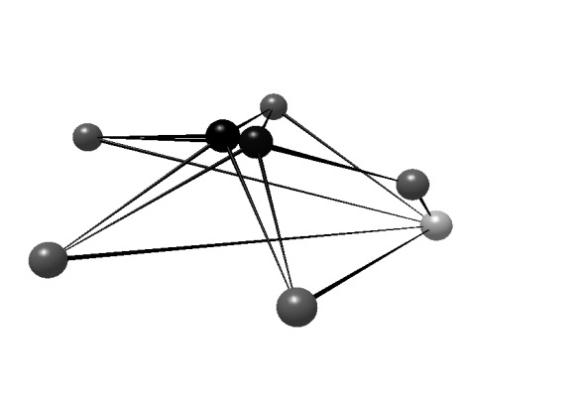
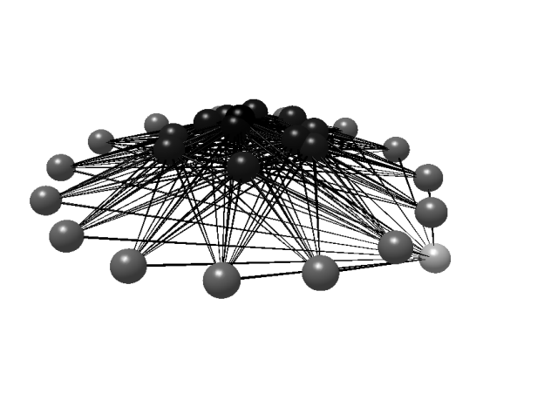
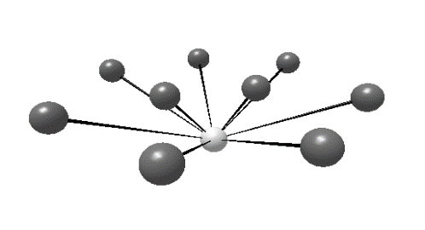
-0.2
0.0
0.2
0.4
0.6
0.6
10
GenSD
0.4
Int
MaxSim
Det
S
Path
*
*
5
*
*
*
*
LinkSD
*
*
LS
*
*
*
0.2
*
*
*
*
*
*
*
*
*
*
*
*
*
*
*
*
*
*
*
PC 2, 25%
*
*
*
*
*
*
*
*
*
*
*
*
*
*
*
*
*
*
*
*
*
*
*
*
*
*
*
*
*
*
*
*
*
*
*
*
*
*
*
*
*
*
*
*
*
*
*
*
*
*
*
*
*
*
*
*
*
*
*
*
*
*
*
*
*
*
*
*
*
*
*
*
*
*
*
*
*
*
*
*
*
*
*
*
*
*
*
*
*
*
*
*
*
*
*
*
*
*
*
*
*
*
*
*
*
*
*
*
*
*
*
*
*
*
*
*
*
*
*
*
*
*
*
*
*
*
*
*
*
*
*
*
*
*
*
*
*
*
*
*
*
*
*
*
*
*
*
*
*
*
*
*
*
*
*
*
*
*
*
*
*
*
*
*
*
*
*
*
ChnLn
*
*
*
*
*
*
*
*
*
*
*
*
*
*
*
*
*
*
*
*
*
*
*
*
*
*
*
*
*
*
*
*
*
*
*
*
*
*
*
*
*
*
*
*
*
*
*
*
*
*
*
*
*
*
*
*
*
*
*
*
*
*
*
*
*
*
*
*
*
*
*
*
*
*
*
*
*
*
*
*
*
*
*
*
*
*
*
*
*
*
*
*
*
*
*
*
*
*
*
*
*
*
*
*
*
*
*
*
*
*
*
*
*
*
*
*
*
*
*
*
*
*
*
*
*
*
*
*
*
*
*
*
*
*
*
*
*
*
*
*
*
*
*
*
*
*
*
*
*
*
*
*
*
*
*
*
*
*
*
*
*
*
*
*
*
*
*
*
*
*
*
*
*
*
*
*
*
*
*
*
*
*
*
Clust
*
*
*
*
*
*
*
*
*
*
*
*
0
*
*
*
0.0
*
*
*
*
*
*
*
*
*
*
*
*
*
*
*
*
*
*
*
*
*
*
*
*
*
*
*
*
*
*
*
*
*
*
*
*
*
*
*
*
*
*
*
*
*
*
*
*
*
*
*
*
*
*
*
*
*
*
*
*
*
*
*
*
*
*
*
*
Omn
*
*
*
*
*
*
*
*
*
*
*
*
*
*
*
*
*
*
*
*
*
*
*
*
*
*
*
*
*
*
*
*
*
*
*
*
*
*
*
*
*
*
*
*
*
*
*
*
*
*
*
*
*
*
*
*
*
*
*
*
*
*
*
TL
*
*
*
*
*
*
*
*
*
*
*
*
*
*
*
*
*
*
*
*
*
*
*
*
*
*
*
*
*
*
*
*
*
*
*
*
*
*
*
*
*
*
*
*
*
*
*
*
*
*
*
*
*
*
*
*
*
*
*
*
*
*
*
*
*
*
*
*
*
*
*
*
*
*
*
*
*
*
*
*
*
*
*
*
*
*
*
*
*
*
*
*
*
*
*
*
*
*
*
*
*
*
*
*
*
*
*
*
*
*
*
*
*
*
*
*
*
*
*
*
*
*
*
*
*
*
*
*
*
*
*
*
*
*
VulSD
*
*
*
*
*
*
*
*
*
*
*
*
*
*
*
*
*
*
*
*
*
*
*
*
*
*
*
*
*
*
*
*
*
*
*
*
*
*
*
*
*
*
*
*
*
*
*
*
*
*
*
*
*
*
*
*
*
*
*
*
*
*
*
*
*
*
*
*
*
*
*
*
*
*
*
*
*
*
*
*
*
*
*
*
*
*
*
*
*
*
*
C
*
*
-0.2
*
*
*
*
*
*
*
*
*
*
*
*
*
*
-5
*
*
*
*
*
*
*
*
*
Top
*
*
*
-5
0
5
10
PC 1, 45%

Slide 52
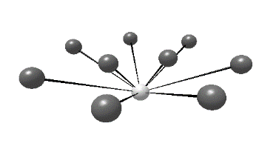

Hypothesis testing with PCA axes
Is food web complexity (PC1) related to ecosystem size?
Parameter | Estimate | Std. Error | t-value | Pr(>|t|)
(Intercept) | 0.80 | 0.26 | 3.05 | 0.002
log Volume | -0.42 | 0.13 | -3.26 | 0.001
R² = 0.01
10
5
PC1
0
-5
0
1
2
3
4
Log(volume)

