Slide 1
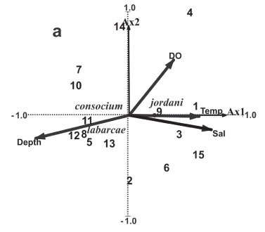
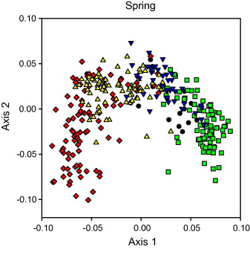
Ordination II
Principal Coordinates Analysis (PCoA), Non-Metric Multidimensional Scaling (NMDS), and Correspondence Analysis (CA)
Notes:
Be really clear if you aren’t meeting the assumptions of a particular model

Slide 2
Class outline
Ordination II
Principal Coordinates Analysis (PCoA)
Nonmetric multidimensional scaling (NMDS)
Overview of ordination approaches with brief mention of Correspondence Analysis
Project Assignments

Slide 3
4 Ordination Techniques
Principal Components Analysis (PCA)
Principal Coordinates Analysis (PCoA)
Non-Metric Multidimensional Scaling (NMDS)
Correspondence Analysis – just a brief mention…

Slide 4
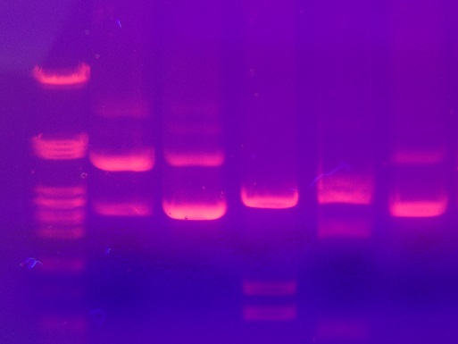
Principal Coordinates Analysis (PCoA)
Also called multidimensional scaling (MDS)
Similar to PCA
Used when Euclidian distance is not appropriate
(e.g. binary data, genetic distances)
PCoA on a Euclidean distance matrix gives the
same eigenvalues and eigenvectors as PCA
Site | 1 | 2 | 3 | 4 | 5 | 6
a | 1 | 1 | 1 | 1 | 1 | 1
b | 1 | 0 | 0 | 1 | 1 | 1
c | 1 | 1 | 1 | 1 | 1 | 1
d | 1 | 1 | 1 | 0 | 0 | 0
e | 1 | 1 | 1 | 1 | 1 | 1
f | 1 | 1 | 1 | 1 | 1 | 1

Slide 5
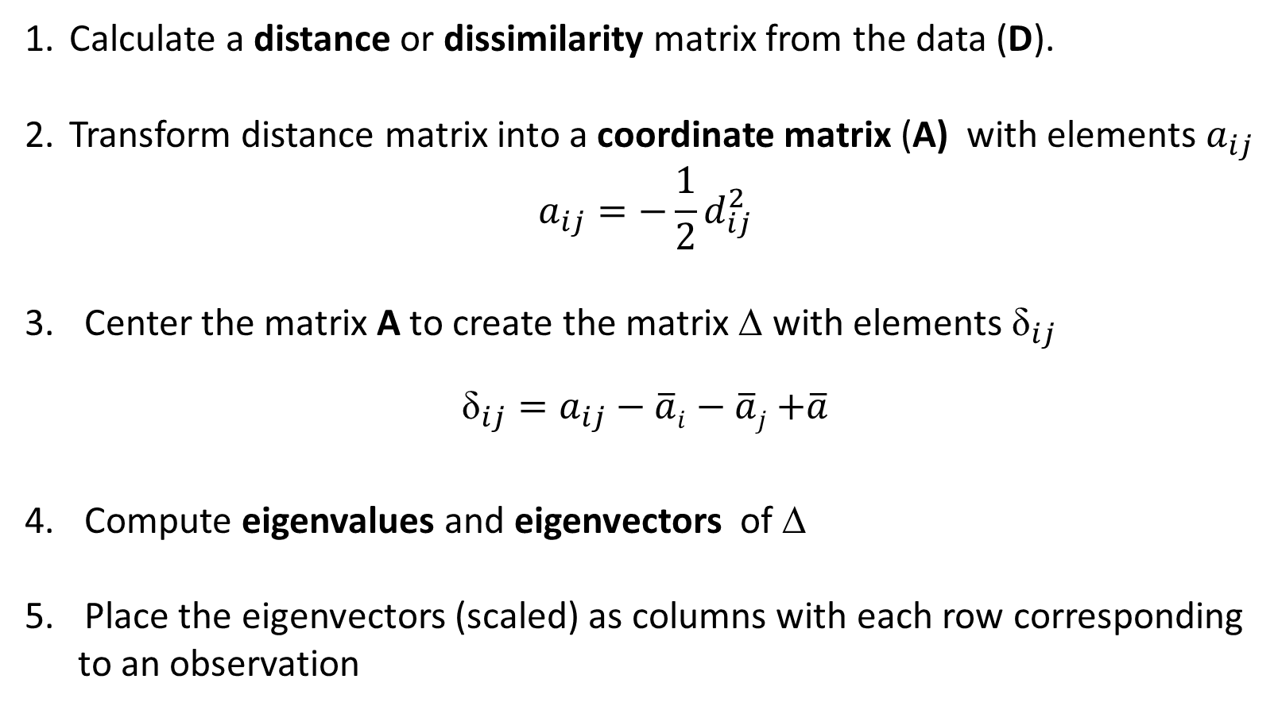
PCoA procedure
Calculate a distance or dissimilarity matrix from the data (D).
Transform distance matrix into a coordinate matrix (A) with elements $a_{ij}$
$$a_{ij}=−\frac{1}{2}d_{ij}^{2}$$
Center the matrix A to create the matrix ∆ with elements ${\text{δ}}_{ij}$
${\text{δ}}_{ij}=a_{ij}−\overline{a}i−\overline{a}j$ $+\overline{a}$
Compute eigenvalues and eigenvectors of ∆
Place the eigenvectors (scaled) as columns with each row corresponding
to an observation

Slide 6
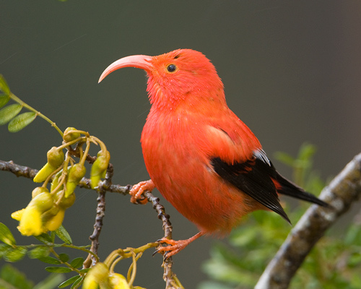
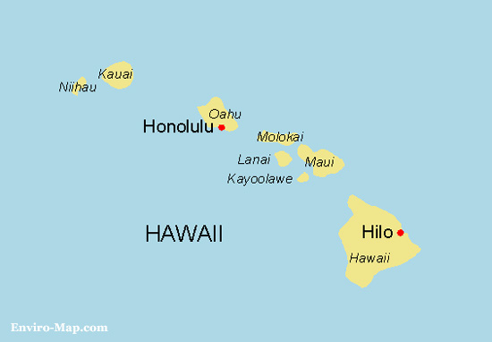
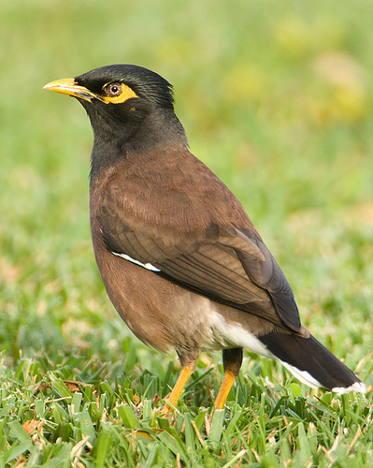
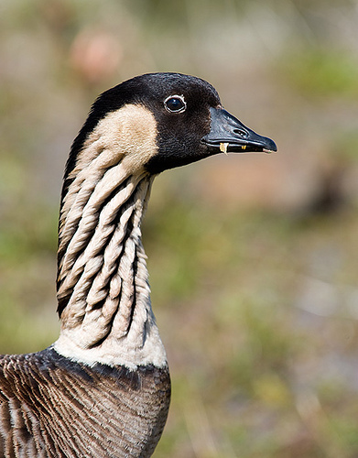
Hawaiian Island Avifauna
Photos by Haole in Hawaii

Slide 7
Hawaiian Island Avifauna
Species Id# | 1 | 2 | 3 | 4 | 5 | 6 | 7 | 8 | 9 | 10 | 11 | 12 | 13
Kauai | 1 | 1 | 1 | 1 | 1 | 1 | 1 | 1 | 0 | 0 | 1 | 1 | 0
Oahu | 1 | 0 | 0 | 1 | 1 | 1 | 1 | 1 | 1 | 1 | 1 | 1 | 0
Molokai | 1 | 1 | 1 | 1 | 1 | 1 | 1 | 1 | 1 | 1 | 1 | 1 | 1
Lanai | 1 | 1 | 1 | 0 | 0 | 0 | 0 | 0 | 1 | 1 | 0 | 1 | 1
Maui | 1 | 1 | 1 | 1 | 1 | 1 | 1 | 1 | 1 | 1 | 1 | 1 | 1
Hawaii | 1 | 1 | 1 | 1 | 1 | 1 | 1 | 1 | 1 | 1 | 1 | 0 | 1
. . .
. . .
. . .
Sørensens’s dissimilarity
 | Kauai | Oahu | Molokai | Lanai | Maui | Hawaii
Kauai | 0 | 0.310924 | 0.326316 | 0.456522 | 0.396226 | 0.391304
Oahu | 0.310924 | 0 | 0.36 | 0.443299 | 0.369369 | 0.383333
Molokai | 0.326316 | 0.36 | 0 | 0.178082 | 0.195402 | 0.3125
Lanai | 0.456522 | 0.443299 | 0.178082 | 0 | 0.214286 | 0.354839
Maui | 0.396226 | 0.369369 | 0.195402 | 0.214286 | 0 | 0.28972
Hawaii | 0.391304 | 0.383333 | 0.3125 | 0.354839 | 0.28972 | 0

Slide 8
Principal Coordinates (Scaled Eigenvectors)
PCoA Axes
 | 1 | 2 | 3 | 4 | 5
Kauai | -0.219 | -0.070 | -0.134 | 0.014 | 0.022
Oahu | -0.203 | 0.000 | 0.165 | -0.022 | -0.003
Molokai | 0.078 | -0.081 | -0.036 | -0.025 | -0.064
Lanai | 0.205 | -0.072 | 0.018 | -0.059 | 0.043
Maui | 0.115 | 0.001 | 0.038 | 0.116 | 0.004
Hawaii | 0.025 | 0.221 | -0.051 | -0.025 | -0.002

Slide 9
Eigenvalues - variance explained
 | Eigenvalues | Proportion of Variance | Cumulative Variance
PCoA 1 | 0.15 | 0.52 | 0.52
PCoA 2 | 0.07 | 0.22 | 0.74
PCoA 3 | 0.05 | 0.17 | 0.91
PCoA 4 | 0.02 | 0.06 | 0.98
PCoA 5 | 0.01 | 0.02 | 1

Slide 10
Scree Plot

Slide 11
Eigenvalues - variance explained
 | Eigenvalues | Proportion of Variance | Cumulative Variance
PCoA 1 | 0.15 | 0.52 | 0.52
PCoA 2 | 0.07 | 0.22 | 0.74
PCoA 3 | 0.05 | 0.17 | 0.91
PCoA 4 | 0.02 | 0.06 | 0.98
PCoA 5 | 0.01 | 0.02 | 1
Notes:
May be limited by how many axes you can include in future model like an SDM

Slide 12
Contemporary Hawaiian Islands Avifauna
0.3
Hawaii
0.2
Principal coordinate axis 2 (22%)
0.1
0.0
Oahu
Maui
Kauai
Molokai
Lanai
-0.1
-0.2
-0.1
0.0
0.1
0.2
0.3
Principal coordinate axis 1 (52%)

Slide 13
Contemporary Hawaiian Islands Avifauna
0.3
Hawaii
0.2
0.1
Principal coordinate axis 2
0.0
Oahu
Maui
Kauai
Molokai
Lanai
-0.1
-0.2
-0.1
0.0
0.1
0.2
0.3
Principal coordinate axis 1 (52%)

Slide 14
Class outline
Ordination II
Principal Coordinates Analysis (PCoA)
Nonmetric multidimensional scaling (NMDS)
Overview of ordination approaches with brief mention of Correspondence Analysis
Project Assignments

Slide 15
Non-Metric Multidimensional Scaling (NMDS)
Main goal is to place similar observations close together and
dissimilar items far apart in ordination space
Does not assume linear relationship between dissimilarities and axes
Only preserves rank order of original dissimilarities or distances
Can take any dissimilarity or distance measure
Illustrates relatedness among observations
Notes:
Parametric statistics: assumptions of normality, homogeneity of variance
Non-parametric stats: based on ranking observations based on similarity or dissimilarity, no assumptions of normality

Slide 16
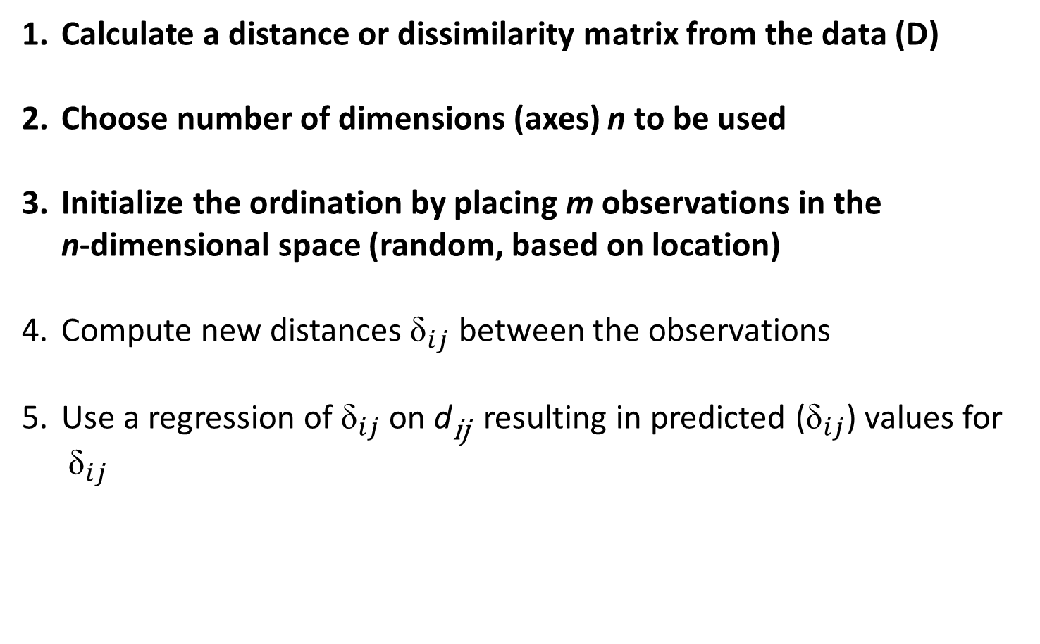
NMDS Procedure
Calculate a distance or dissimilarity matrix from the data (D)
Choose number of dimensions (axes) n to be used
Initialize the ordination by placing m observations in the
n-dimensional space (random, based on location)
Compute new distances ${\text{δ}}_{ij}$ between the observations
Use a regression of ${\text{δ}}_{ij}$ on d_{ij} resulting in predicted (${\text{δ}}_{ij}$) values for
${\text{δ}}_{ij}$
˄

Slide 17
Initial Locations (Random)

Slide 18
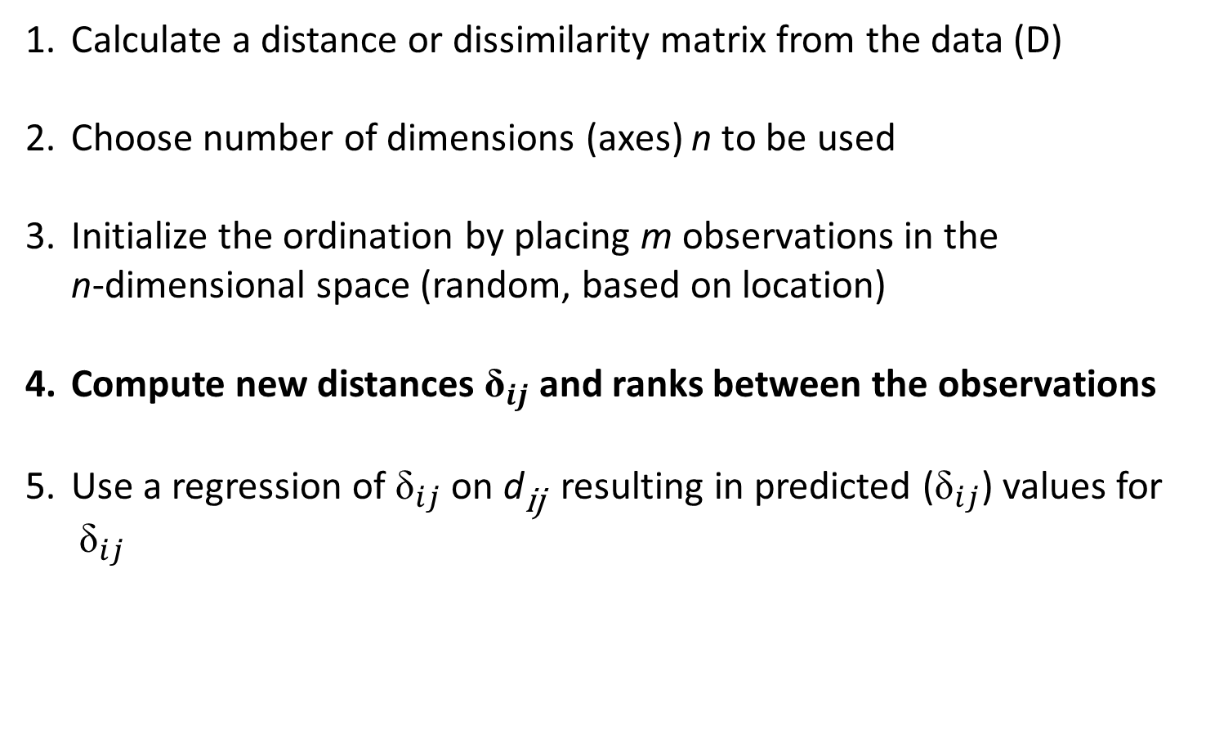
NMDS Procedure
Calculate a distance or dissimilarity matrix from the data (D)
Choose number of dimensions (axes) n to be used
Initialize the ordination by placing m observations in the
n-dimensional space (random, based on location)
Compute new distances ${\text{δ}}_{ij}$ and ranks between the observations
Use a regression of ${\text{δ}}_{ij}$ on d_{ij} resulting in predicted (${\text{δ}}_{ij}$) values for
${\text{δ}}_{ij}$
˄

Slide 19


Measure Distance (${\text{δ}}_{ij}$)Between Initial Locations
$${\text{δ}}_{ij}$$

Slide 20

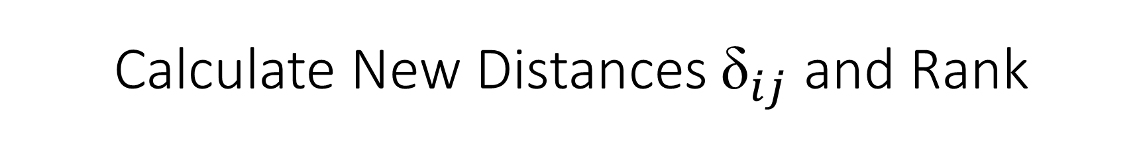
Calculate New Distances ${\text{δ}}_{ij}$ and Rank
Matrix D containing d_{ij}
Matrix D* containing ${\text{δ}}_{ij}$
 | A | B | C | D | E
A
B | 0.31
C | 0.33 | 0.36
D | 0.46 | 0.44 | 0.18
E | 0.39 | 0.37 | 0.19 | 0.21
 | A | B | C | D | E
A
B | 0.33
C | 0.34 | 0.3
D | 0.5 | 0.6 | 0.172
E | 0.39 | 0.4 | 0.18 | 0.29
Rank dissimilarities
 | A | B | C | D | E
A
B | 4
C | 5 | 6
D | 10 | 9 | 1
E | 8 | 7 | 2 | 3
 | A | B | C | D | E
A
B | 5
C | 6 | 4
D | 9 | 10 | 1
E | 7 | 8 | 2 | 3

Slide 21
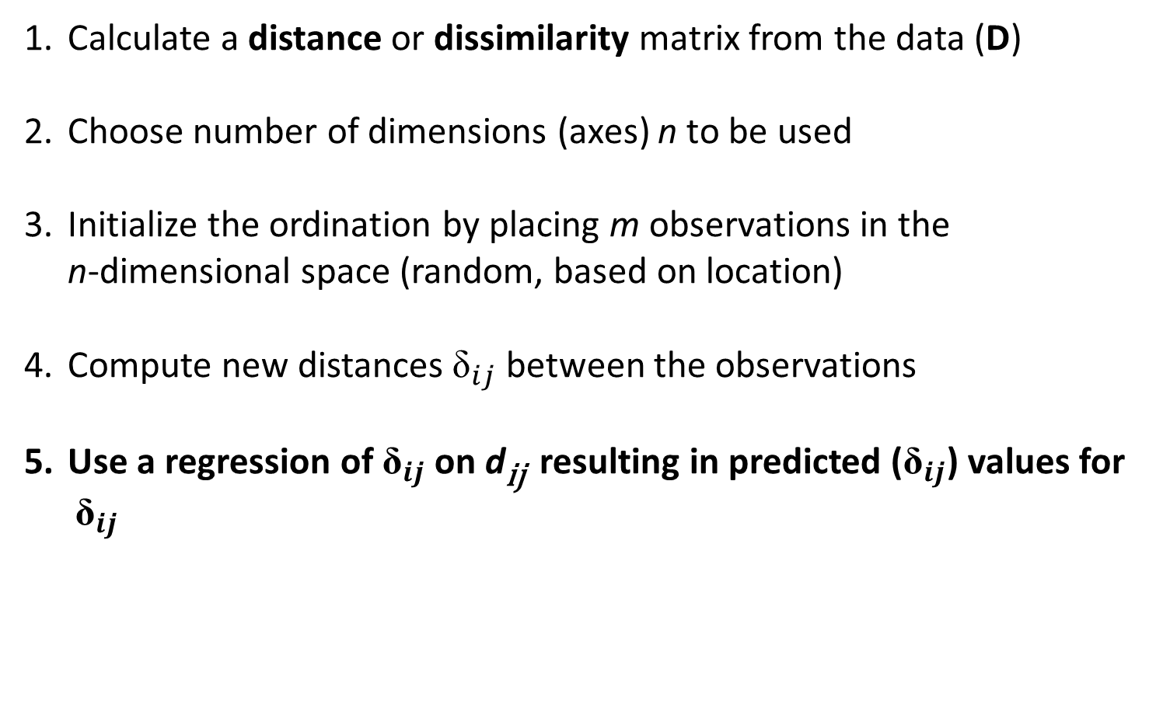
NMDS Procedure
Calculate a distance or dissimilarity matrix from the data (D)
Choose number of dimensions (axes) n to be used
Initialize the ordination by placing m observations in the
n-dimensional space (random, based on location)
Compute new distances ${\text{δ}}_{ij}$ between the observations
Use a regression of ${\text{δ}}_{ij}$ on d_{ij} resulting in predicted (${\text{δ}}_{ij}$) values for
${\text{δ}}_{ij}$
˄

Slide 22
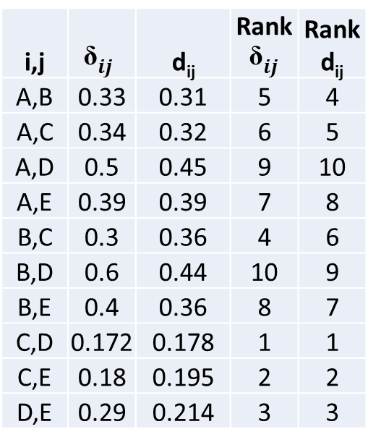
NMDS Regression Table
i,j | $${\text{δ}}_{ij}$$ | d_{ij} | Rank $${\text{δ}}_{ij}$$ | Rankd_{ij}
A,B | 0.33 | 0.31 | 5 | 4
A,C | 0.34 | 0.32 | 6 | 5
A,D | 0.5 | 0.45 | 9 | 10
A,E | 0.39 | 0.39 | 7 | 8
B,C | 0.3 | 0.36 | 4 | 6
B,D | 0.6 | 0.44 | 10 | 9
B,E | 0.4 | 0.36 | 8 | 7
C,D | 0.172 | 0.178 | 1 | 1
C,E | 0.18 | 0.195 | 2 | 2
D,E | 0.29 | 0.214 | 3 | 3

Slide 23

Shepard Plot – Monotonic Regression
3.0
Non-metric fit, R2 = 0.995
Linear fit, R2 = 0.98
2.5
˄
$${\text{δ}}_{ij}$$
2.0
Ordination Distance (${\text{δ}}_{ij}$)
1.5
1.0
0.5
0.2
0.3
0.4
0.5
0.6
0.7
0.8
0.9
Observed Dissimilarity (d_{ij})

Slide 24
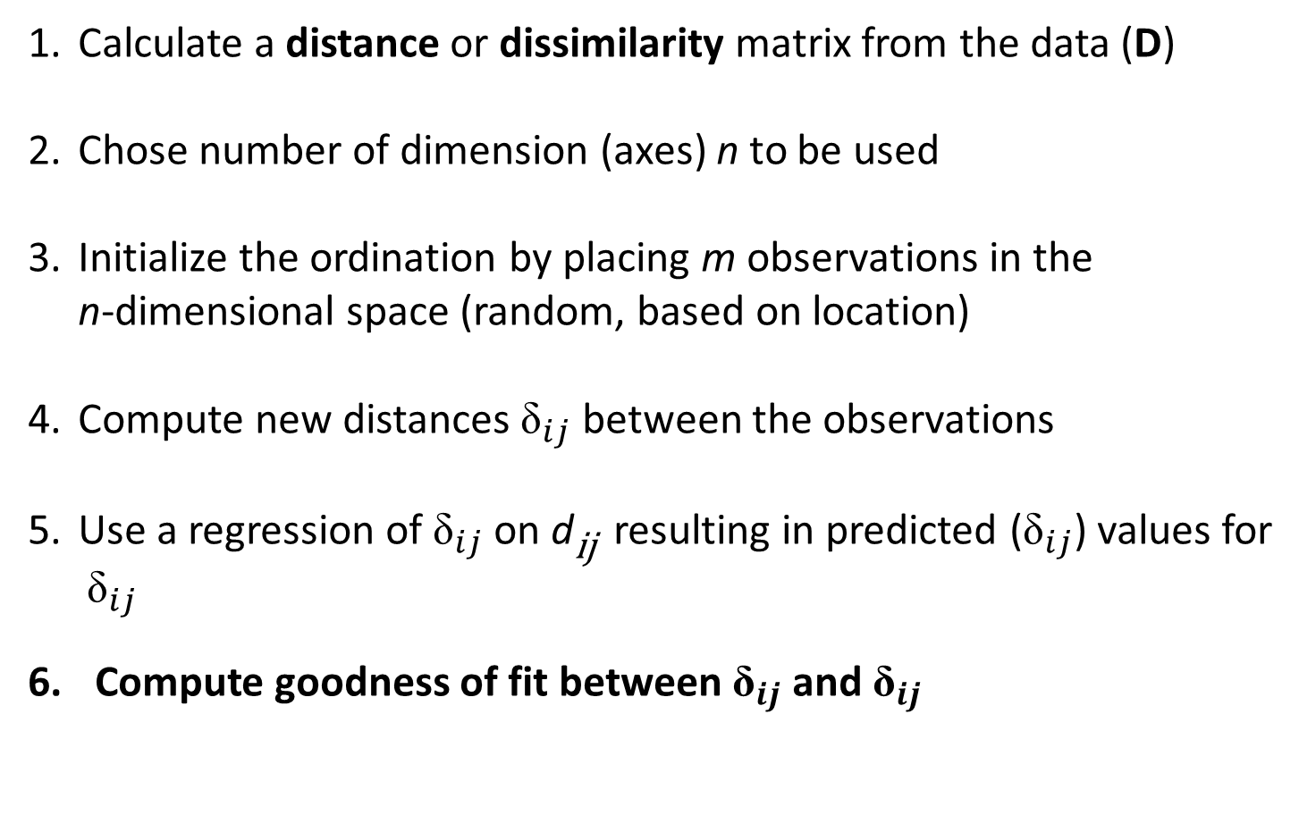
NMDS Procedure
Calculate a distance or dissimilarity matrix from the data (D)
Chose number of dimension (axes) n to be used
Initialize the ordination by placing m observations in the
n-dimensional space (random, based on location)
Compute new distances ${\text{δ}}_{ij}$ between the observations
Use a regression of ${\text{δ}}_{ij}$ on d_{ij} resulting in predicted (${\text{δ}}_{ij}$) values for
${\text{δ}}_{ij}$
Compute goodness of fit between ${\text{δ}}_{ij}$ and ${\text{δ}}_{ij}$
˄
˄

Slide 25

Goodness of fit - Stress
$$Stress=\sqrt{\frac{\sum_{i=1}^{m}{\sum_{j=1}^{n}{{\left({\text{δ}}_{ij}−{\text{δ}}_{ij}\right)}^{2}}}}{\begin{aligned} \\ \sum_{i=1}^{m}{\sum_{j=1}^{n}{{{\text{δ}}_{ij}}^{2}}}\end{aligned}}}$$
˄
˄
minimize stress!

Slide 26
Goodness of fit - Stress
Stress Value | Interpretation
< 0.05 | Excellent representation of original distance matrix
0.05 - 0.10 | Good
0.1 – 0.20 | Fair
> 0.20 | Unreliable
minimize stress!

Slide 27
NMDS Procedure
Alter the position of the m observations to further reduce the stress
Iteratively repeat steps 4-7 until stress can no longer be reduced
For the minimized stress configuration, plot m observations in
n-dimensional space

Slide 28
Reduce Stress

Slide 29
NMDS Procedure
Alter the position of the m observations to further reduce the stress
Iteratively repeat steps 4-7 until stress can no longer be reduced
For the minimized stress configuration, plot m observations in
n-dimensional space

Slide 30
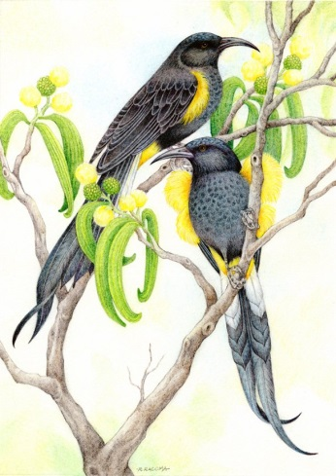

Hawaiian Island Avifauna: Past and Present
Photos by Haole in Hawaii

Slide 31
NMDS – Hawaiian Avifauna
Historical
Stress = 0.126
Contemporary
Lanai
Molokai
Lanai
Maui
Maui
NMDS2
Molokai
Hawaii
Hawaii
Oahu
Kauai
Oahu
Kauai
NMDS1

Slide 32
Class outline
Ordination II
Principal Coordinates Analysis (PCoA)
Nonmetric multidimensional scaling (NMDS)
Overview of ordination approaches with brief mention of Correspondence Analysis
Project Assignments

Slide 33
Advantages and Disadvantages of Ordination
Advantages:
Reduce complex data
Visualize multidimensional data
Develop hypotheses
Easily applied through statistical packages (e.g.: R, SAS, Primer)
Disadvantages:
Relies heavily on matrix algebra
Principal axes are rescaled, so scores are interpretable only relative
to one another

Slide 34
Comparison of Ordination Techniques
Technique | Data Matrix | Metric | Mapping
PCA | Covariance | Euclidean | Linear
PCoA | Distance | Any | Linear
NMDS | Distance | Any | Nonlinear
CA | Raw | Chi-square | Unimodal

Slide 35
Comparison of Ordination Techniques
Technique | When to use
PCA | Data reduction with continuous data; when linear model is appropriate
PCoA | When Euclidean metric and linear mapping are desirable, but PCA assumptions are not met (e.g. binary data)
NMDS | When other models are not suitable; most flexible
CA | Unimodal assumption (i.e. long gradients); count and categorical data.

Slide 36
Class outline
Ordination II
Principal Coordinates Analysis (PCoA)
Nonmetric multidimensional scaling (NMDS)
Overview of ordination approaches with brief mention of Correspondence Analysis
Project Assignments

