Slide 2
Data CodeLabs Module 2 – High-Scale Data Processing in Azure
L705
Romit Girdhar
Software Engineer – Developer Experience Group

Slide 3
Key Takeaways
Understand how to process Big data in Azure
Analyze terabytes and petabytes of data to identify patterns, understand your audience better or perform complex computations to improve your business.
Learn about the tools available to process your data
From HDInsight (Apache Hadoop) to Azure SQL Data Warehouse, learn about the different tools available for you to process your data.
Orchestrate your Data Processing Workloads
Using Azure Data Factory

Slide 4
Solution Overview
Data stored in a cheap No-SQL storage gets picked up by your compute engine.
The aggregated data gets moved to a “staging” data store
PowerBI (or any other visualization tool) is used for visualization of data stored in the “staging” store.

Slide 5
Run the Setup.cmd
Go through Steps 1, 2 & 3
Open another Setup.cmd
Go through Step #4
1st Three rows: East US
2nd Three rows: Central US
3rd Three rows: South Central US

Slide 6
(Alternatively) Create Azure HDInsight Cluster
Go to the Azure Portal -> https://portal.azure.com
Click on New -> Data & Analytics -> HDInsight
Cluster Name: hdicluster-{SuffixNumber}
Select Cluster Type -> OS: Windows/Linux & Version: 2.7.0
Credentials -> Username: admin ; Password: P@ssword123 (or something else…)
Data Source -> Create a New Storage Account
Location: West US
(Optional) Configure your Node VM sizes to optimize cost

Slide 7
(Alternatively) Create SQL DW Cluster
From the Azure Portal
Click New -> Data & Storage -> Data Warehouse
SQL DW Server Name: buildlab-{SuffixNumber}
SQL DW Name: buildlab-dw
Username: dwadmin
Password: P@ssword123 (or anything else you’d like)
Location: West US

Slide 8
Generate Some Data to play with
Run the Setup.cmd (as Administrator) located in:
C:\CodeLabs-Data\Module2-GainInsights\Setup\Setup.cmd
Select Option 1
Check out the Generated data in: ..\Setup\Assets\logs folder

Slide 9
Azure Data Factory
Create an Azure Data Factory
Go to New -> Data & Analytics -> Data Factory
Name: datalab-factory-{Suffix Number}
Location: West US

Slide 10
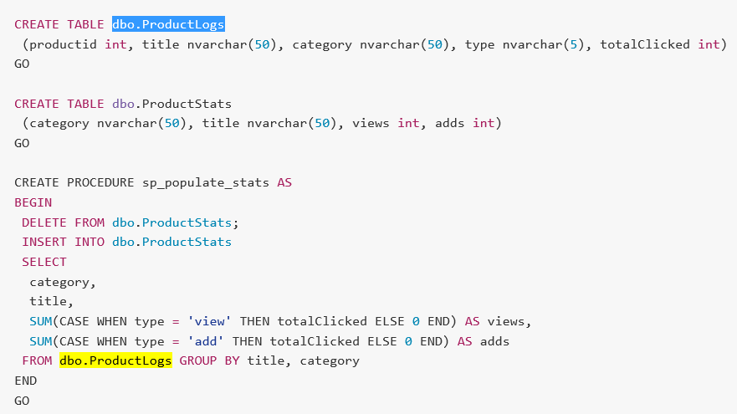
SQL Data Warehouse
Create Tables & Stored Procedure

Slide 11
Azure Data Factory
Create Linked Services
Azure Storage Linked Service
HDInsight Linked Service

Slide 12
Azure Data Factory
Create Datasets
Azure Storage Raw Dataset
Azure Storage Dummy Dataset

Slide 13
Azure Data Factory
Create Pipeline
Adding Partitions for Hive

Slide 14
HDInsight
Enable SSH on your Cluster through the Azure Portal
Ssh into your cluster
Putty is located under C:\CodeLabs-Data\putty.exe
Enter the following Link in Putty:
{Cluster Name}-ssh.azurehdinsight.net
Open the script ‘createtables.hql’ located in the ‘Scripts’ folder
Replace the Hive variables with your storage account name and execute!

Slide 15
Data Factory Automation
Open Command Prompt (Start -> Type “cmd”)
Go to: C:\CodeLabs-Data\Tools\ADFSetup
Type the following:
ADFSetup.exe <SubscriptionID> <Resource Group Name> <DataFactoryName> <part1/part2/all>
Follow the Prompts…

Slide 16
Architecture Across The Data Modules

Slide 17
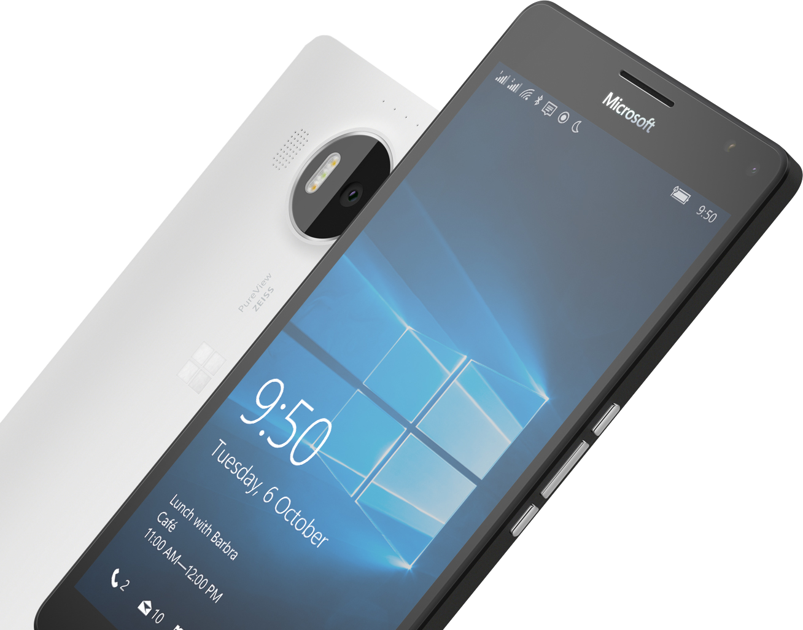
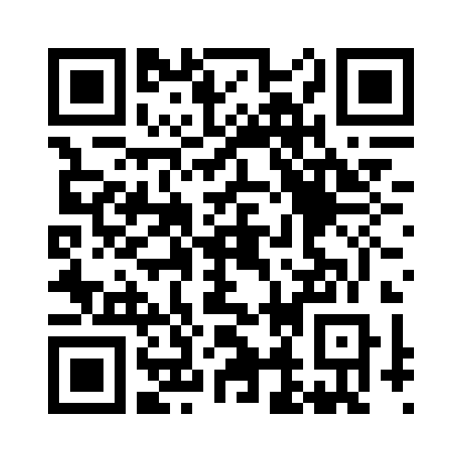

Please Complete An Evaluation Form Your input is important!
Required Slide
*delete this box when your slide is finalized
or
Notes:
Update phone image to a Microsoft phone.

Slide 18
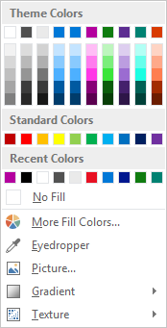
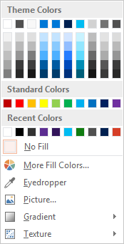
Slide palette info
The PowerPoint palette for this template has been built for you and is shown below. Avoid using too many colors in your presentation.
Select the 4th color from the left for subheads and 1st level non-bulleted text color, or wherever “color” text is preferred over the default black/white text
Accent colors 1-6 – (6 Theme Colors to the far right)
Text
Dark 2
Accent 1
Accent 2
Accent 3
Accent 4
Accent 5
Accent 6
Use Accent 1 as the main accent color. Use Accent 2 and Accent 3 when additional colors are needed.
Use Accents 4-6 sparingly – only when more colors are necessary.

Slide 19
Charts
For content: Type is what articulates the message. Text doesn’t need to be bulleted. Text size can reinforce and impact.

Slide 20
Charts
For content: Type is what articulates the message. Text doesn’t need to be bulleted. Text size can reinforce and impact.

Slide 21
Table
Column 1 | Column 2 | Column 3 | Column 4 | Column 5
Text | Text | Text | Text | Text
Text | Text | Text | Text | Text
Text | Text | Text | Text | Text
Text | Text | Text | Text | Text
Text | Text | Text | Text | Text
Text | Text | Text | Text | Text
Text | Text | Text | Text | Text
Text | Text | Text | Text | Text
This is a content box, always 24pts and sentence case.

Slide 22
Diagram with text
This is a content box, always 24pts and sentence case.
Windows Style App
<audio src=“…”>
<video src=“…”>
Windows Runtime (WinRT)
Playback/Preview
(Media Engine)
Capture
(Capture Engine)
Transcode
Streaming
(Sharing Engine)
Media Foundation
Audio/Video
Source
Video
Decoder
Video
Effect 1
Video
Effect N
Video
Encoder
Audio/Video
Sink
Audio
Decoder
Audio
Effect 1
Audio
Effect N
Audio
Encoder

Slide 23
Diagram without text
New Windows 8 app
<audio src=“…”>
<video src=“…”>
Windows Runtime (WinRT)
Playback/Preview
(Media Engine)
Capture
(Capture Engine)
Transcode
Streaming
(Sharing Engine)
Media Foundation
Audio/Video
Source
Video
Decoder
Video
Effect 1
Video
Effect N
Video
Encoder
Audio/Video
Sink
Audio
Decoder
Audio
Effect 1
Audio
Effect N
Audio
Encoder

Slide 24
Video

Slide 25
Demo
Speaker name

Slide 26
Photo layout 1
Notes:
Use developer type photo.

Slide 27
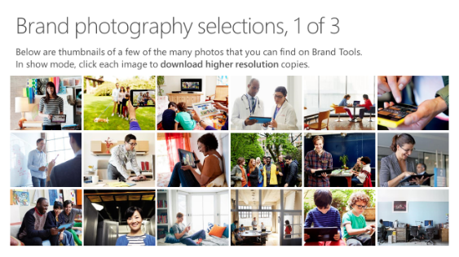
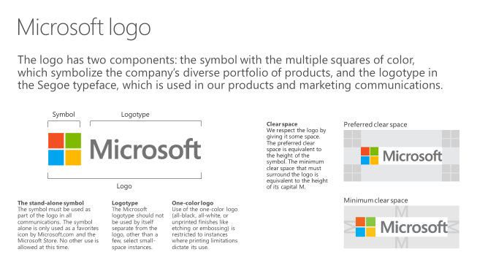
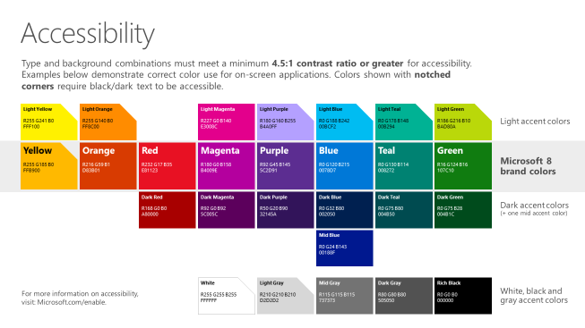
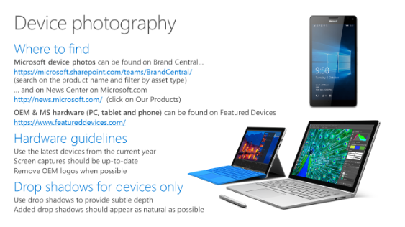
Microsoft brand guidelines
Looking for more slide resources?
Brand guidelines for PowerPoint templates is a separate slide deck that provides an overview of the Microsoft brand, guidelines, resources, tips and much more.
A few of the slides are shown at right.
Download from: https://microsoft.sharepoint.com/teams/BrandCentral/Pages/Presentations.aspx

Slide 28
Section title

Slide 29
Section title
Notes:
Make text black in master.

Slide 30
“If you could only sense how important you are to the lives of those you meet; how important you can be to the people you may never even dream of. There is something of yourself that you leave at every meeting with another person.”
FRED ROGERS

Slide 31
Software code slide
This slide layout uses Consolas, a monotype font which is ideal for showing software code.

Slide 32
Notes (hidden)
Some speakers at Microsoft like to use this slide for hidden “notes slides”.
Delete it if you don’t want to use it.
NEXT: <next slide title>

Slide 33
Call to Action
Use this slide to list resources, white papers, videos and links.
Let attendees know their next step after seeing this session.
Re-visit Build on Channel 9.
Continue your education at Microsoft Virtual Academy online.

Slide 34
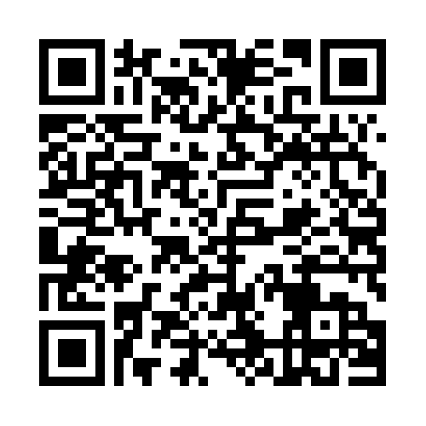
Please Complete An Evaluation Form Your input is important!
Required Slide
*delete this box when your slide is finalized
SAMPLE
or
Notes:
Update phone image to a Microsoft phone.

Slide 35
Evaluate this session
Required Slide
*delete this box when your slide is finalized
Speakers: This slide will be updated during the scrub process with a unique QR code. Attendees scan the QR code to access the eval for your session.
SAMPLE
Notes:
Speakers: Please note this slide will be updated with your session’s QR code during the scrub process which is outlined on side 3. Attendees can scan the QR code for access to your session’s eval.

Slide 36
Notes:
Dark gray background.

Slide 38
Presentation title goes here
Speaker name
Title

Slide 39
Preferred text layout (no bullets)
Main topic 1: size 40pt
Size 20pt for the subtopics
Size 20pt for the subtopics
Main topic 2: size 40pt
Size 20pt for the subtopics
Size 20pt for the subtopics
Main topic 3: size 40pt
Size 20pt for the subtopics
Size 20pt for the subtopics

Slide 40
Bullet points layout with subtitle Subtitle
Example of a bulleted slide with a subhead
Set the slide title to “Sentence case”
Set subheads to “Sentence case”
Hyperlink style
www.microsoft.com

Slide 41
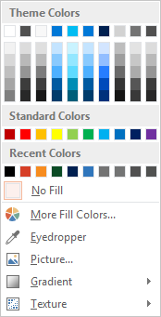
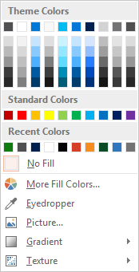
Slide palette info
The PowerPoint palette for this template has been built for you and is shown below. Avoid using too many colors in your presentation.
Accent colors 1-6 – (6 Theme Colors to the far right)
Accent 1
Accent 2
Accent 3
Accent 4
Accent 5
Accent 6
Use Accent 1 as the main accent color. Use Accent 2 and Accent 3 when additional colors are needed.
Use Accents 4-6 sparingly – only when more colors are necessary.

Slide 42
Charts
For content: Type is what articulates the message. Text doesn’t need to be bulleted. Text size can reinforce and impact.

Slide 43
Charts
For content: Type is what articulates the message. Text doesn’t need to be bulleted. Text size can reinforce and impact.

Slide 44
Table
Column 1 | Column 2 | Column 3 | Column 4 | Column 5
Text | Text | Text | Text | Text
Text | Text | Text | Text | Text
Text | Text | Text | Text | Text
Text | Text | Text | Text | Text
Text | Text | Text | Text | Text
Text | Text | Text | Text | Text
Text | Text | Text | Text | Text
Text | Text | Text | Text | Text
This is a content box, always 24pts and sentence case.

Slide 45
Diagram with text
This is a content box, always 24pts and sentence case.
Windows Style App
<audio src=“…”>
<video src=“…”>
Windows Runtime (WinRT)
Playback/Preview
(Media Engine)
Capture
(Capture Engine)
Transcode
Streaming
(Sharing Engine)
Media Foundation
Audio/Video
Source
Video
Decoder
Video
Effect 1
Video
Effect N
Video
Encoder
Audio/Video
Sink
Audio
Decoder
Audio
Effect 1
Audio
Effect N
Audio
Encoder

Slide 46
Diagram without text
New Windows 8 app
<audio src=“…”>
<video src=“…”>
Windows Runtime (WinRT)
Playback/Preview
(Media Engine)
Capture
(Capture Engine)
Transcode
Streaming
(Sharing Engine)
Media Foundation
Audio/Video
Source
Video
Decoder
Video
Effect 1
Video
Effect N
Video
Encoder
Audio/Video
Sink
Audio
Decoder
Audio
Effect 1
Audio
Effect N
Audio
Encoder

Slide 47
Video

Slide 48
Demo
Speaker name

Slide 49
Photo layout 1
Notes:
Use developer type photo.

Slide 50
“If you could only sense how important you are to the lives of those you meet; how important you can be to the people you may never even dream of. There is something of yourself that you leave at every meeting with another person.”
FRED ROGERS

Slide 51
Section title

Slide 52
Section title
Notes:
Make text black in master.

Slide 53
Software code slide
This slide layout uses Consolas, a monotype font which is ideal for showing software code.

Slide 54
Notes (hidden)
Some speakers at Microsoft like to use this slide for hidden “notes slides”.
Delete it if you don’t want to use it.
NEXT: <next slide title>

Slide 55
Call to Action
Use this slide to list resources, white papers, videos and links.
Let attendees know their next step after seeing this session.
Re-visit Build on Channel 9.
Continue your education at Microsoft Virtual Academy online.

Slide 56
Please Complete An Evaluation Form Your input is important!
Required Slide
*delete this box when your slide is finalized
SAMPLE
or
Notes:
Update phone image to a Microsoft phone.

Slide 57
Evaluate this session
Required Slide
*delete this box when your slide is finalized
Speakers: This slide will be updated during the scrub process with a unique QR code. Attendees scan the QR code to access the eval for your session.
SAMPLE
Notes:
Speakers: Please note this slide will be updated with your session’s QR code during the scrub process which is outlined on side 3. Attendees can scan the QR code for access to your session’s eval.

Slide 58
Notes:
Dark gray background.

