Slide 1
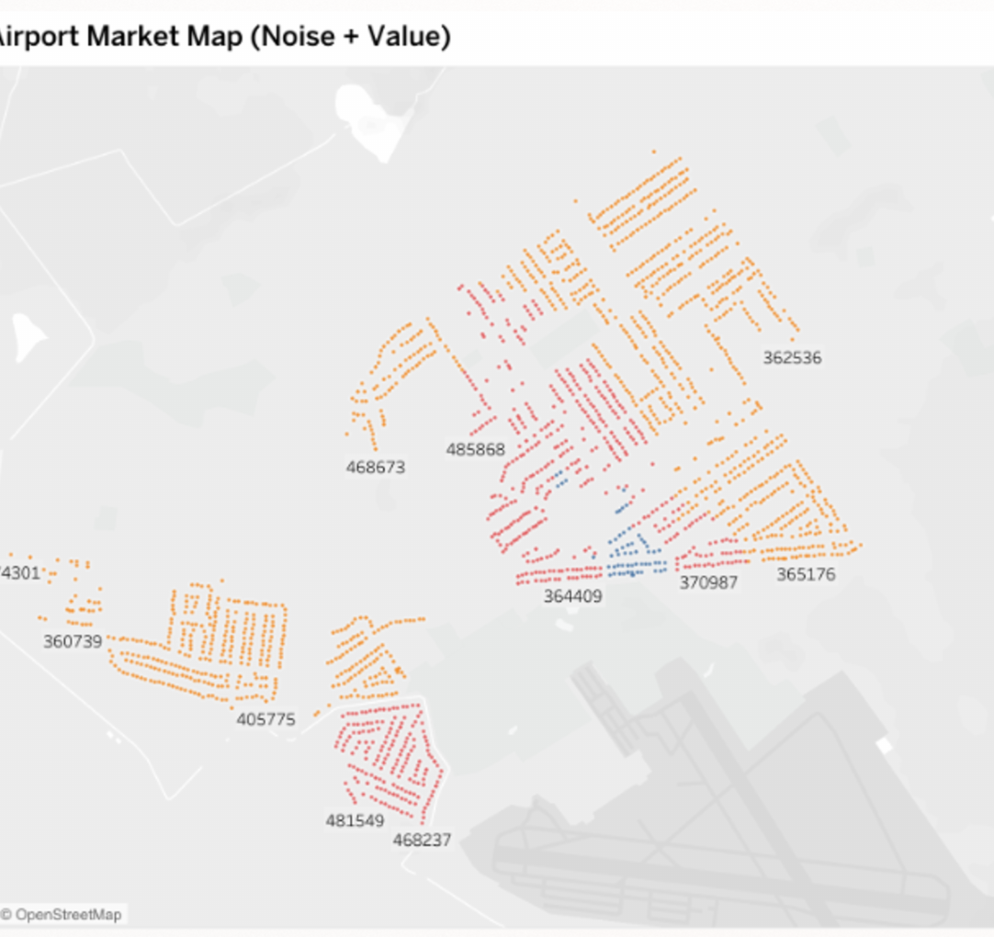
AIRPORT NOISE AND
HOUSING MARKET
ANALYSIS
Property values around Salinas and Watsonville airports
Lara Gunseli Safak
Data visualisation and investment analysis

Slide 2
Executive summary
02
2,119
-0.088 / -0.089
$176.7k
properties analysed after cleaning
within-market noise-price correlations
difference in average market value
The apparent noise premium is misleading
Property characteristics matter more
Pooling the two markets produces a positive correlation because Watsonville is both noisier and more expensive.
Square footage, property age, and neighbourhood explain much more of the observed price variation than noise or distance.
Investment view
Continue to detailed feasibility work, with greater attention to unit size, design quality, planning constraints, and project economics.
Airport Noise and Housing Market Analysis
2

Slide 3
Business question and analytical approach
03
PDC is considering a residential development near a municipal airport. The analysis tests whether noise and proximity could materially affect property values.
Dataset
Salinas and Watsonville property records
Zillow value estimates
CNEL noise contours
Driving distance to each airport
Property size, age, bedrooms, and neighbourhood
Core decision test
If noise and proximity explain little after separating the markets, PDC should focus its feasibility work on the property and location factors that show stronger relationships with value.
Analysis
Market-level comparisons
Pooled and within-market correlations
Noise Depreciation Index estimates
Confounder analysis
Airport Noise and Housing Market Analysis
3

Slide 4
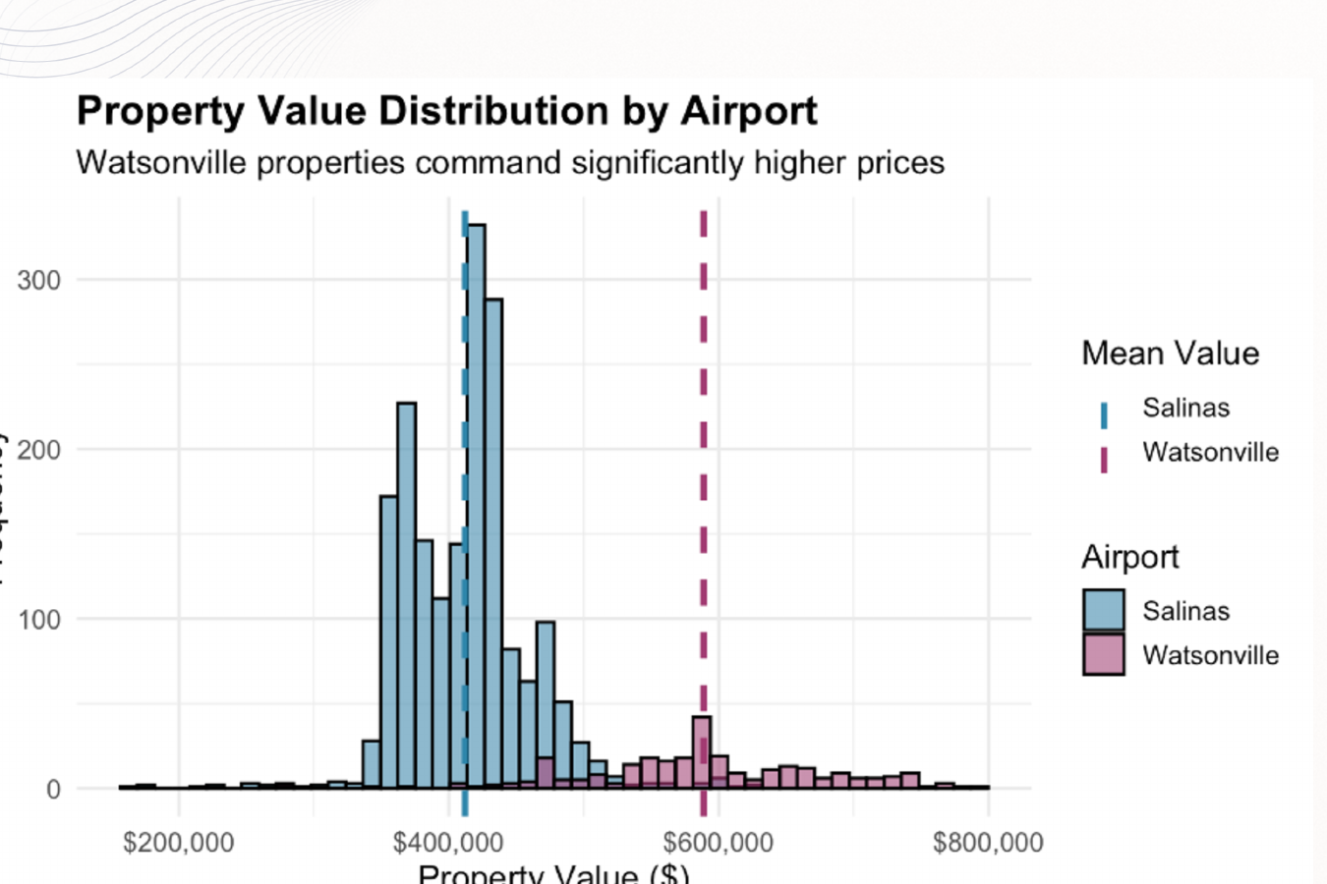
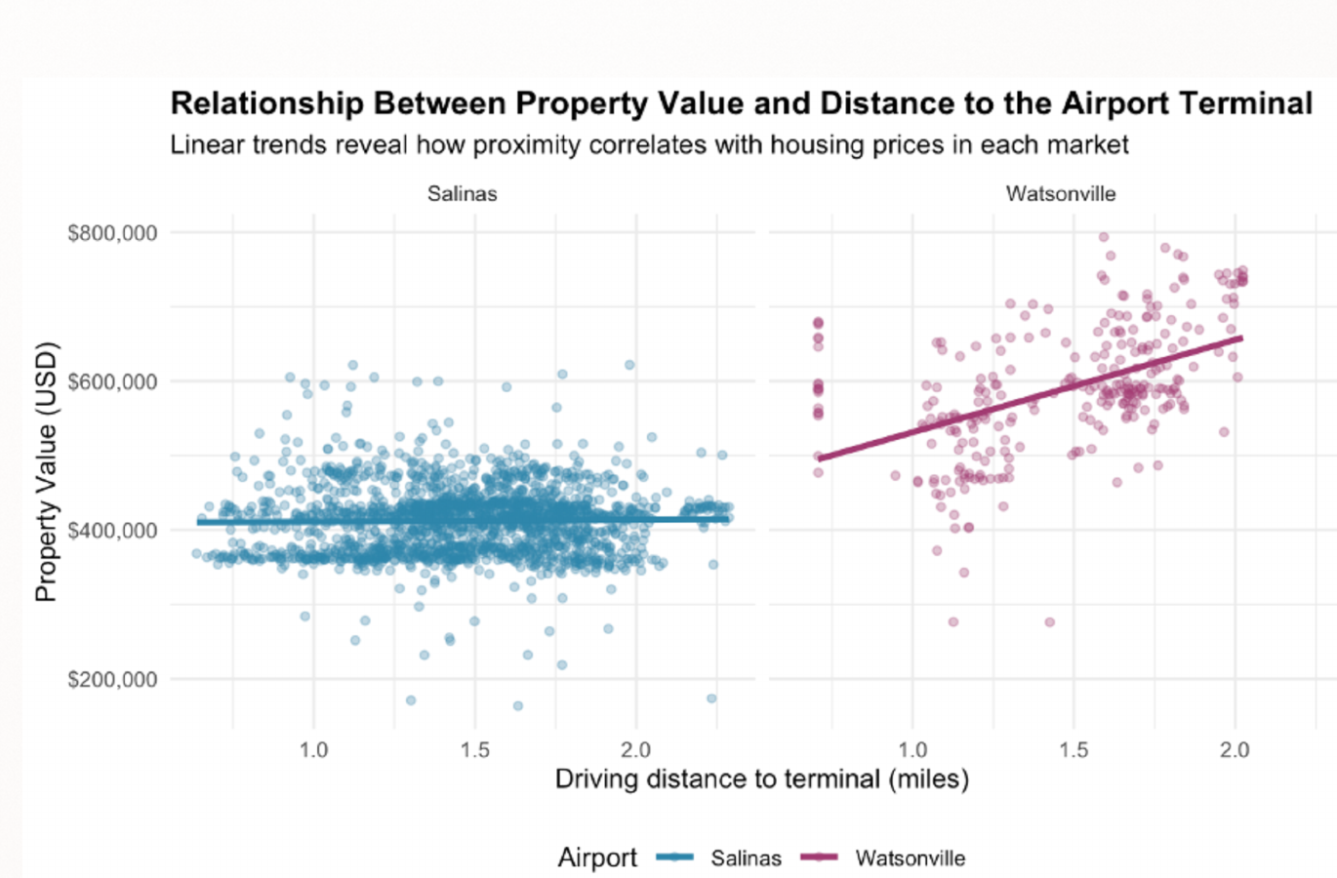
Two distinct housing markets
04
Salinas average
Watsonville average
Distance shows little relationship with value in Salinas and only a modest positive pattern in Watsonville. Market-level differences dominate the pooled comparison.
$412,076
$588,758
Airport Noise and Housing Market Analysis
4

Slide 5
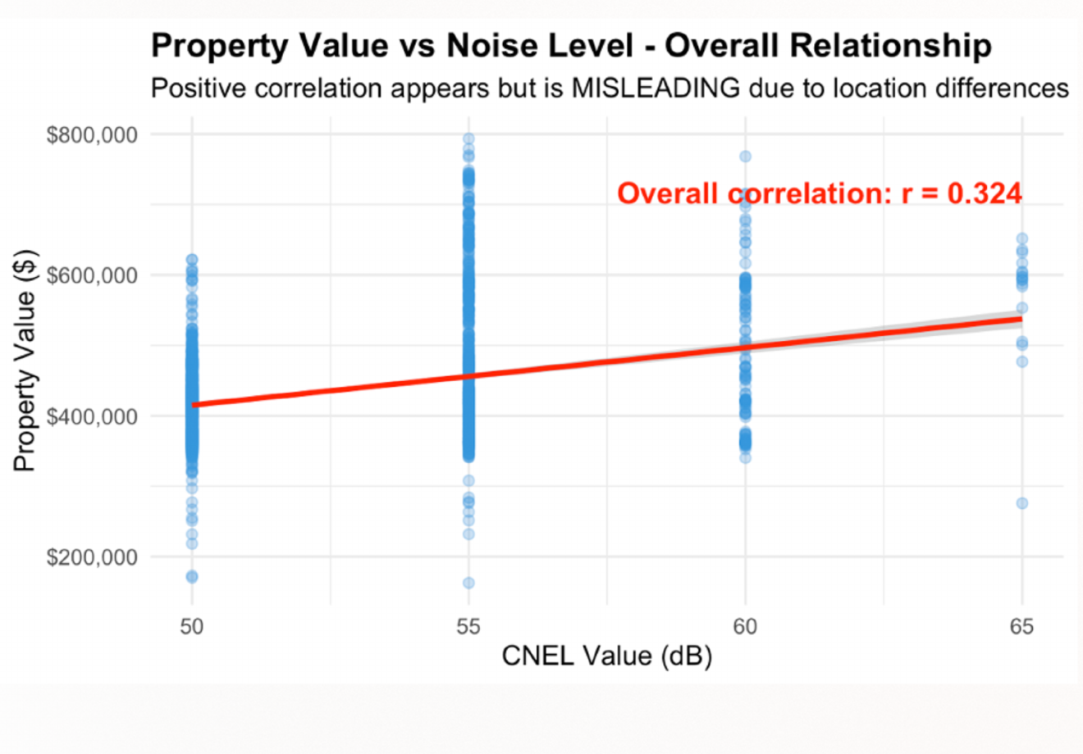
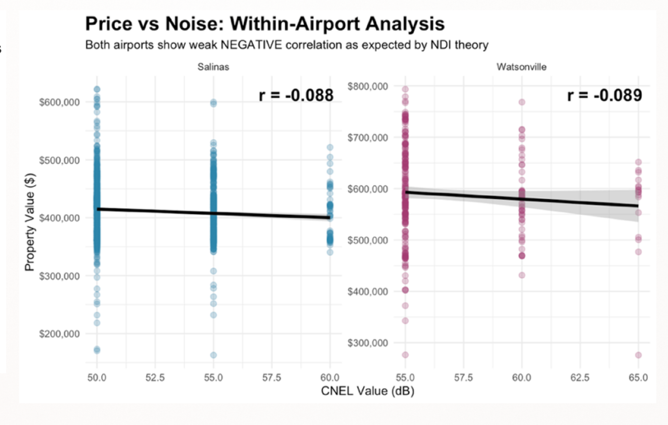
Market structure reverses the pooled noise signal
05
Pooled result
Driven by Watsonville's higher prices and higher noise exposure.
Within-market result
Both relationships are weak and negative once the markets are separated.
r = 0.324
r = -0.088 / -0.089
Airport Noise and Housing Market Analysis
5

Slide 6
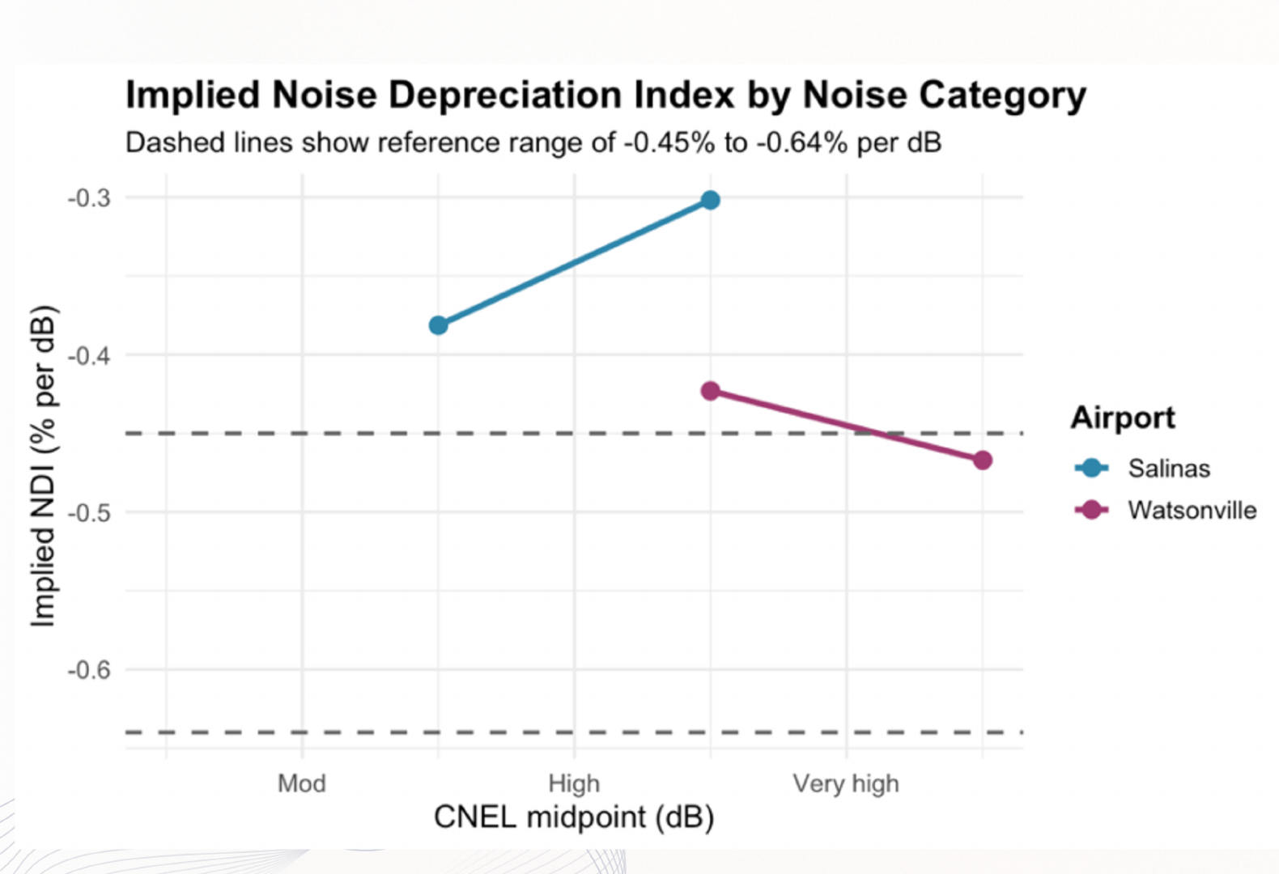
Noise Depreciation Index
06
Salinas
Estimated price penalties remain closer to zero, indicating a flatter descriptive relationship across noise bands.
Watsonville
The highest band approaches the upper edge of the reference range, but the pattern remains based on a small subset of properties.
Interpretation
The NDI supports a limited noise effect, but sparse high-noise observations and omitted property differences reduce precision.
Airport Noise and Housing Market Analysis
6

Slide 7
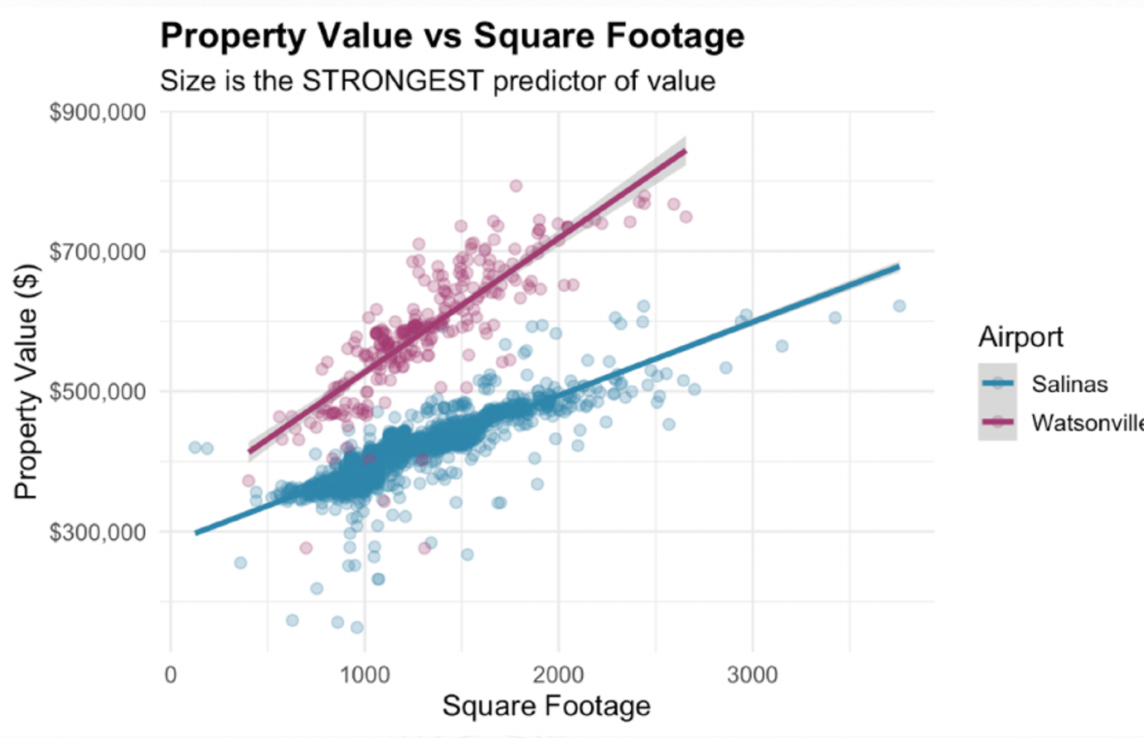
Property size dominates price variation
07
Property value by square footage
r = 0.60
Pooled correlation between square footage and property value
Consistent relationship
Larger properties command higher values in both markets, with a nearly linear pattern.
Market premium
Watsonville properties sit at a higher price level for a given amount of space.
Airport Noise and Housing Market Analysis
7

Slide 8
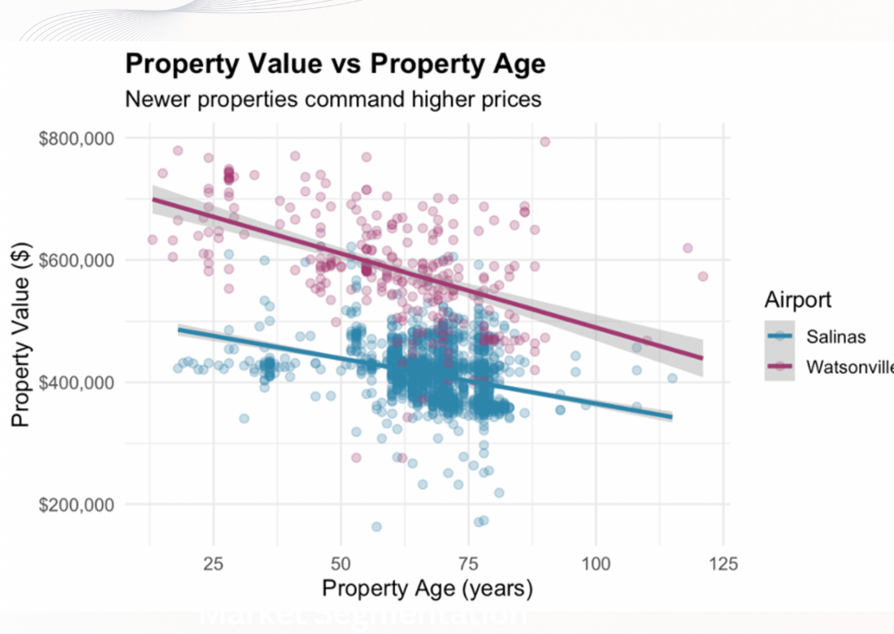
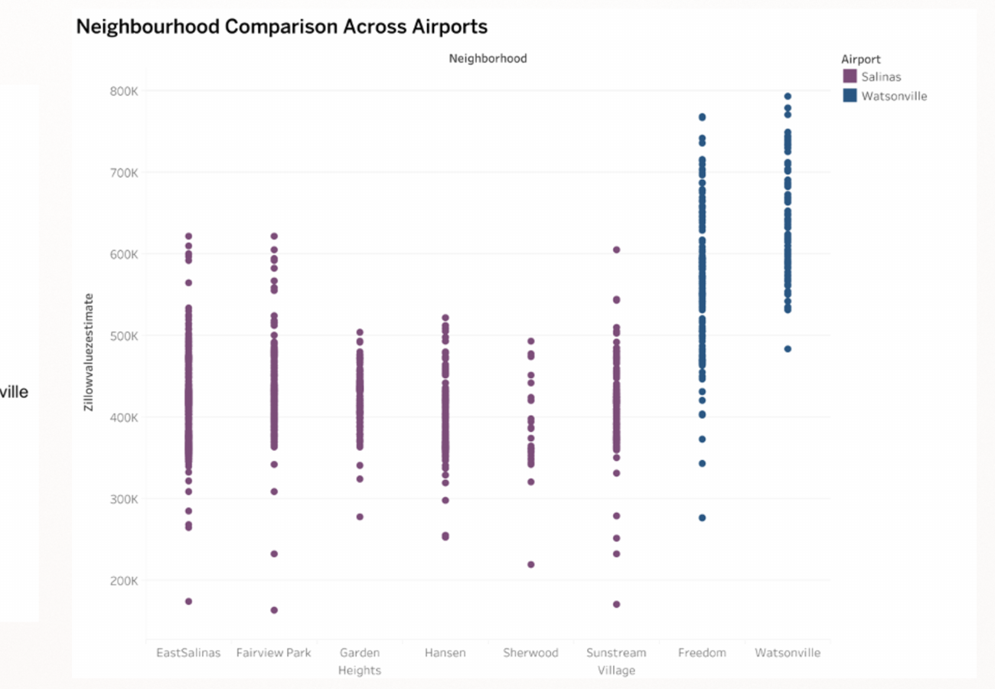
Age and neighbourhood add local variation
08
Older properties tend to have lower estimated values in both markets, although size remains the stronger relationship.
Watsonville neighbourhoods occupy a higher price range, reinforcing the importance of local market structure.
Airport Noise and Housing Market Analysis
8

Slide 9
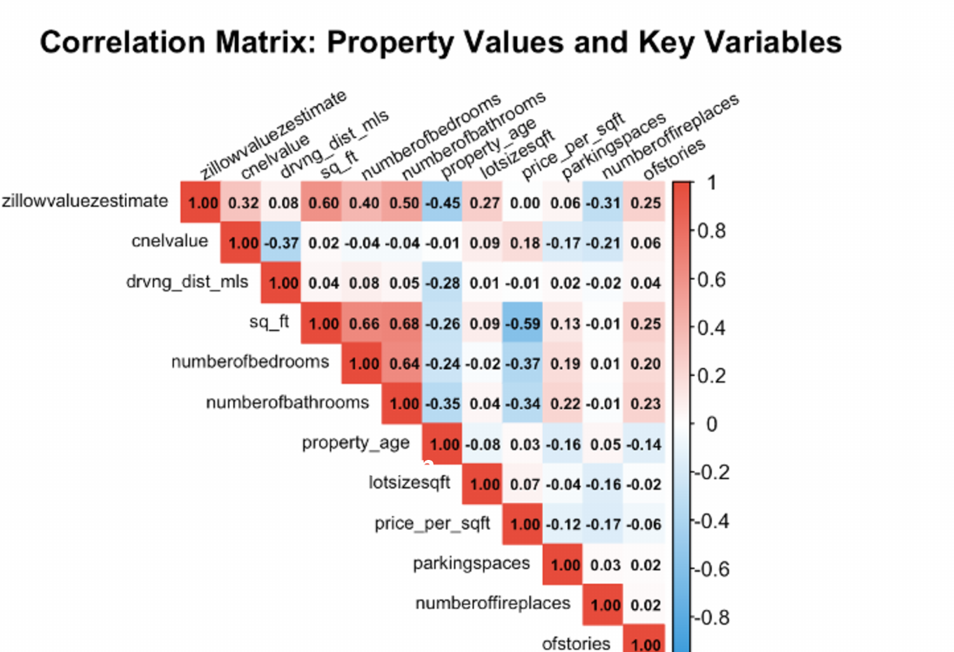
Correlation view of the main value drivers
09
Size
Square footage (r = 0.60), bathrooms (r = 0.50), and bedrooms (r = 0.40) have the strongest positive relationships with value.
Age
Property age has a negative correlation with value (r = -0.45).
Distance and noise
Distance contributes little (r = 0.08). The pooled noise figure (r = 0.32) remains confounded by the market split.
Airport Noise and Housing Market Analysis
9

Slide 10
Investment recommendation and remaining evidence gaps
10
Proceed to detailed feasibility assessment
Noise and airport proximity do not appear to be the main constraints on value in the benchmark markets.
Focus the next stage on
Evidence gaps
Unit size and usable space
Design quality and target segment
Neighbourhood positioning
Zoning and planning requirements
Construction costs and expected returns
The analysis is observational and uses modelled outdoor noise contours. The market samples are unbalanced, and few homes fall in the highest noise bands. A final decision also requires site-specific planning, valuation, and financial analysis.
Airport Noise and Housing Market Analysis
10

