Slide 1
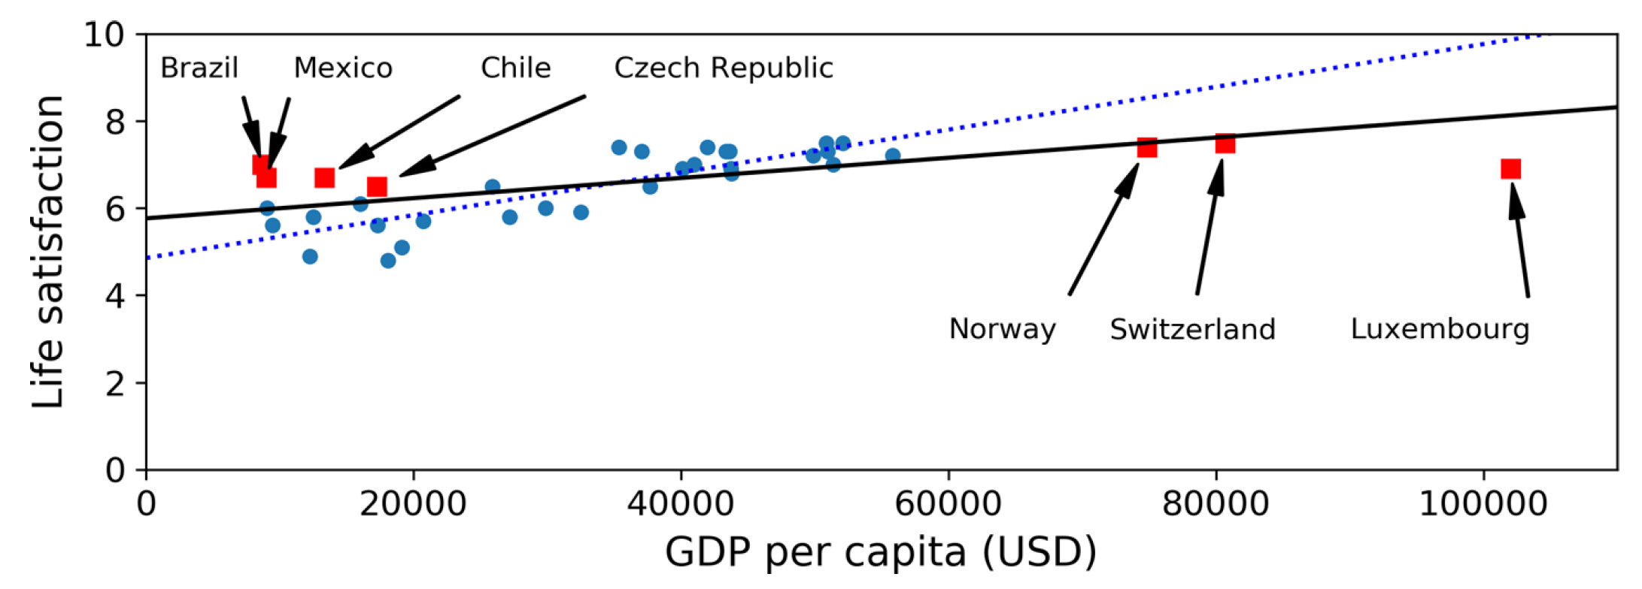
Clarifications from last class
Source: Géron (2019)

Slide 2
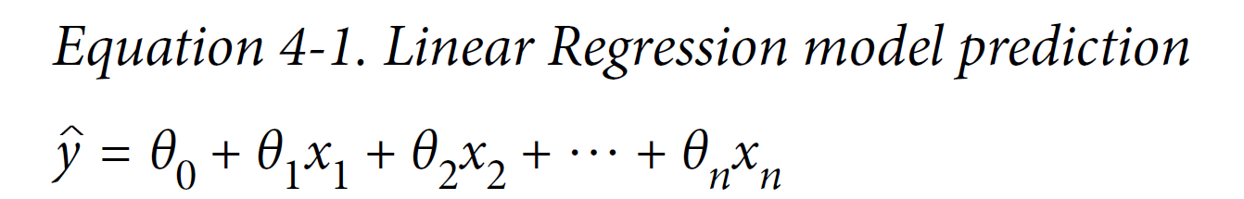
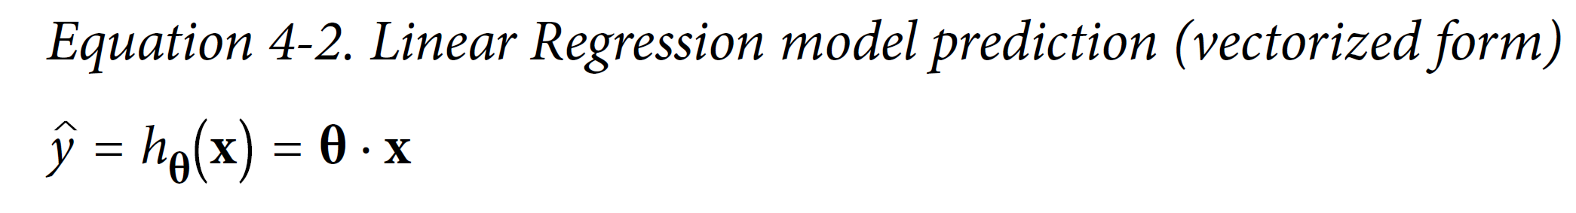
Multiple Linear Regression: Defining the bias/intercept
Weights (Slope)
Intercept (Bias)
+ b

Slide 3
Min 105-115: Review Moodle Quiz
Learning Objectives (Géron Ch3+4):
Distinguish classification from regression
Define a loss/cost function
Understand how to train a logistic/softmax regression for binary/multiclass classification
Know how to benchmark a classifier
Understand how to train a (multiple) linear regression
Know how to benchmark a regression model
Notes:
Questions?
Not graded

Slide 4
Start thinking about your final project and book a one-on-one meeting on Friday, March 11th in the afternoon
The final project’s goal is to answer a well-defined scientific question by applying one of the ML algorithms introduced in class on an environmental dataset of your choice (e.g., related to your Masters thesis or your PhD research).
Can you think of a large environmental dataset linked to a scientific question you are passionate about?
In the affirmative, how could you format the dataset to facilitate its manipulation in Python?
In the negative, consider browsing the list of benchmark datasets maintained by Pangeo (http://mldata.pangeo.io/index.html) or browse the class syllabus’ datasets
Notes:
Questions?

