Slide 1
Skin Disease Prediction Using Machine Learning

Slide 2
Abstract
Skin diseases are very common nowadays and spreading widely among people in present time. With the growth of computer-based technology and relevance of different machine learning methods in current decade, the development of skin disease prediction using classifier methods is analytical and exact.
We use skin disease dataset for analyzing various machine learning algorithms to classify the different classes of skin disease.
The proposed data mining techniques were checked on skin disease datasets for analyzing 12 types of skin disease, which are Acne, Bowens, Chickenpox, Chiggers, and Dermatofibroma and so on.
The system is developed the different machine learning algorithms such as random forest and decision tree. Finally, the experimental results shows that some performance metrics such as accuracy and error rate.

Slide 3
Objectives
The main objective of our project is,
• To detect or to classify the skin disease effectively.
• To implement the machine learning algorithm such as DT and RF.
• To enhance the overall performance for classification algorithms.
• To implement the web application.

Slide 4
Introduction
The skin is the most significant part of human body. The skin protects the body from UV radiation infections, injuries, heat and harmful radiation, and also helps in the manufacture of vitamin D.
The skin plays an important role in controlling body temperature, so it is important to maintain good health and protect the body from skin diseases.
The fast development of computer technology in present decades, the use of data mining technology plays a crucial role in the analysis of skin diseases. Researchers are constantly developing various prediction methods, but the largest researchers use only a few classification algorithms instead of ensemble methods.
The ensemble method uses different data mining techniques and combines them to find predictions.

Slide 5
Existing system
In existing system, In existing system, melanoma detected by removing the part of effected skin in our body and send to check whether the cancer cells are present or not.
If the cancer cells are present will checking then it will diagnosed. It is a time taken process and also it make patient life in risk.
Melanoma detection using machine learning is difficult to handle large data so it may not provide best accuracy.
It is technically challenging because of the large amount data collect by Images. So that, we bring a concept of melanoma detection using deep learning because it can handle large number of data set.

Slide 6
Disadvantages
The results is low when compared with proposed.
The prediction of medonoma is poor
The performance is low.

Slide 7
Proposed system
In this system, the skin disease dataset is collected from dataset repository. Then, we have to implement the image pre-processing step. In this step, we have to implement image resize and grey scale conversion.
Then, we have to implement the image splitting into train is used for evaluation and test is used for prediction.
After that, we have to implement the machine learning algorithm such as decision tree and random forest. The experimental results shows that the accuracy and error rate.
Finally, we have to classify or predict the disease whether it is affected or not by using classification algorithm. Then, we can implement the framework for user friendly.

Slide 8
Advantages
It is efficient for large number of datasets.
Time consumption is low.
The prediction of disease is effective.

Slide 9
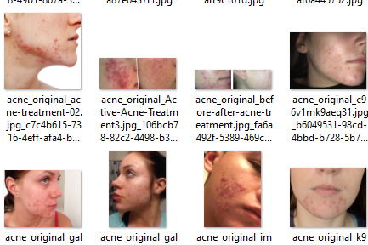
Flow Diagram
Image Resize
Input image
Gray Scale
Preprocessing
Feature Extraction
LBP
Testing
Image Splitting
Training
DT
Classification
RF
Accuracy
Estimations
Error rate
Normal
Prediction
Abnormal

Slide 10
Modules
Input image
Preprocessing
Feature extraction
Image splitting
Classification
Prediction
Performance metrics

Slide 11
Modules description

Slide 12
Input image
The dataset, skin disease dataset is implemented as input. The dataset is taken from dataset repository. The input dataset is in the format ‘.png, ‘.jpg.
In this step, we have to read or load the input image by using the imread () function.
The input image is used to detect or classify the input image.
In our process, we are used the tkinter file dialogue box for selecting the input image.

Slide 13
Preprocessing
In our process, we have to resize the image and convert the image into gray scale.
To resize an image, you call the resize () method on it, passing in a two-integer tuple argument representing the width and height of the resized image.
The function doesn't modify the used image; it instead returns another Image with the new dimensions.
Convert an Image to Grayscale in Python Using the Conversion Formula and the matplotlib Library.
We can also convert an image to grayscale using the standard RGB to grayscale conversion formula that is imgGray = 0.2989 * R + 0.5870 * G + 0.1140 * B.

Slide 14
Feature extraction
In our process, we have to extract the features from preprocessed image.
Local Binary Pattern (LBP) is a method that used to describe texture characteristics of the surfaces. By applying LBP, texture pattern probability can be summarised into a histogram. LBP values need to be determined for all of the image pixels.

Slide 15
Image splitting
During the machine learning process, data are needed so that learning can take place.
In addition to the data required for training, test data are needed to evaluate the performance of the algorithm in order to see how well it works.
In our process, we considered 70% of the input dataset to be the training data and the remaining 30% to be the testing data.
Data splitting is the act of partitioning available data into two portions, usually for cross-validator purposes.

Slide 16
Classification
In our process, we have to implement the two different machine learning algorithm such as DT and RF.
A decision tree is a non-parametric supervised learning algorithm, which is utilized for both classification and regression tasks. It has a hierarchical, tree structure, which consists of a root node, branches, internal nodes and leaf nodes.
Random forest is a commonly-used machine learning algorithm trademarked by Leo Breiman and Adele Cutler, which combines the output of multiple decision trees to reach a single result. Its ease of use and flexibility have fueled its adoption, as it handles both classification and regression problems.

Slide 17
Performance metrics
The Final Result will get generated based on the overall classification and prediction. The performance of this proposed approach is evaluated using some measures like,
Accuracy
Accuracy of classifier refers to the ability of classifier. It predicts the class label correctly and the accuracy of the predictor refers to how well a given predictor can guess the value of predicted attribute for a new data.
AC= (TP+TN)/ (TP+TN+FP+FN)
Then, we can detect or to classify the input image is affected by skin disease or not.

Slide 18
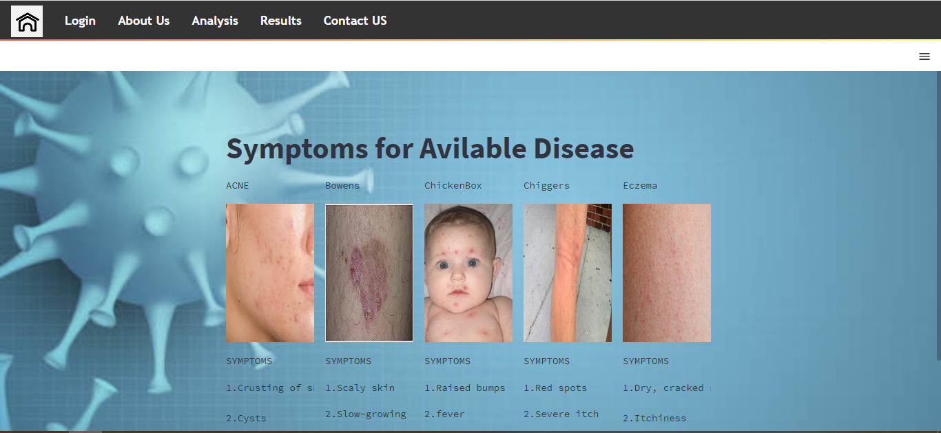
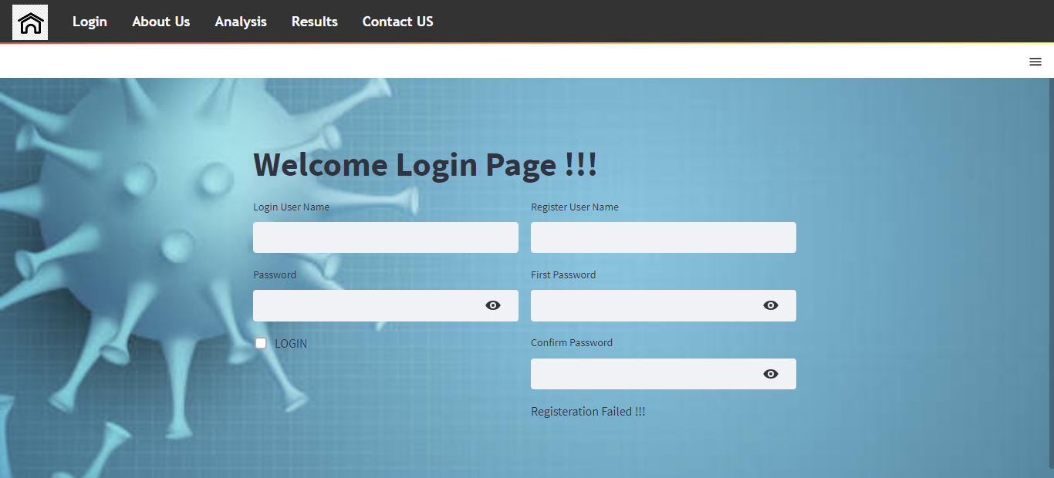
Screenshots

Slide 19
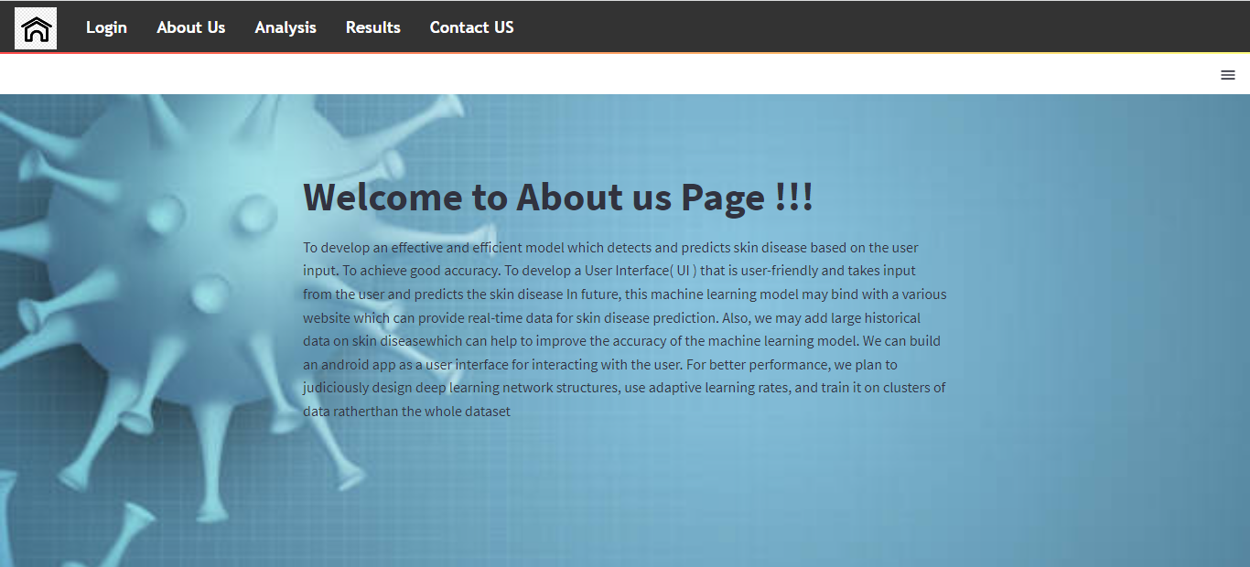
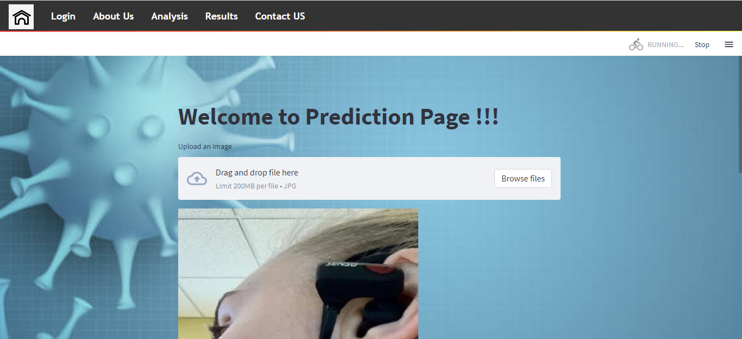
Screenshots

Slide 20
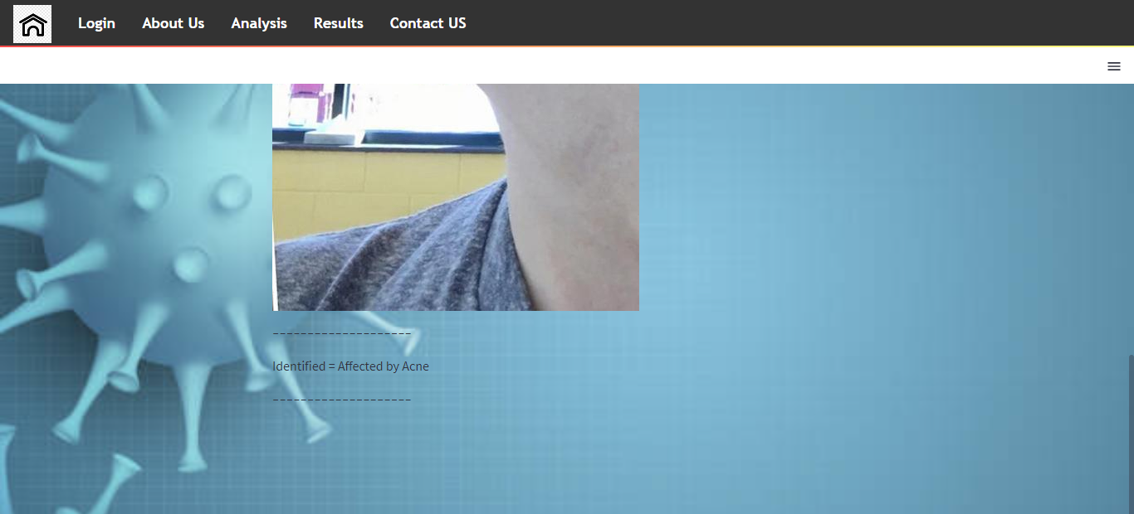
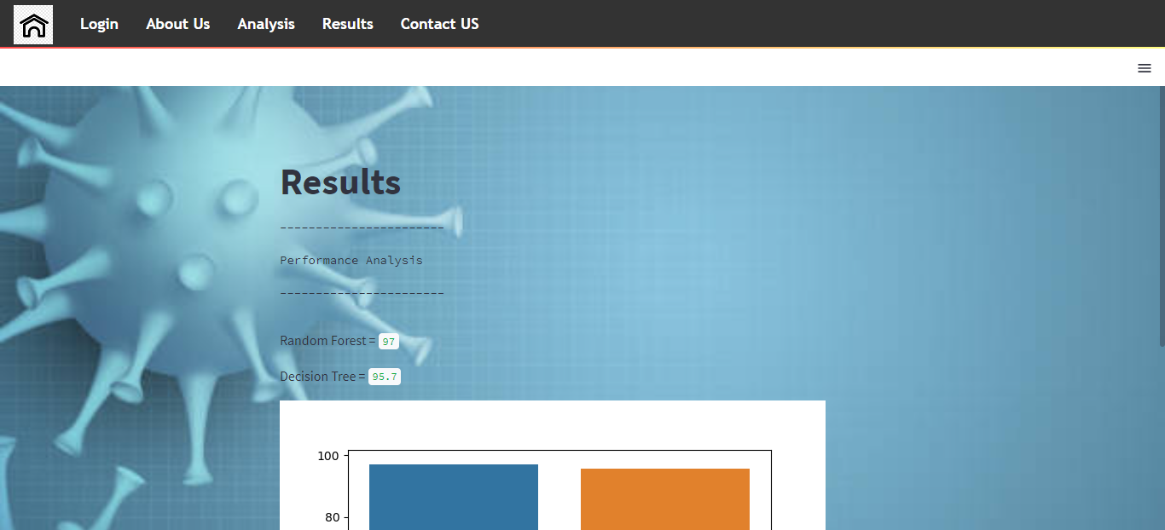
Screenshots

Slide 21
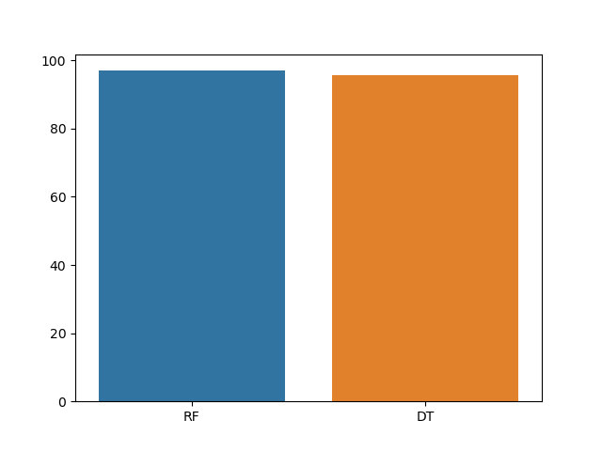
Screenshots

Slide 22
System requirements
SOFTWARE REQUIREMENTS:
O/S : Windows 7.
Language : Python
Front End : Anaconda Navigator – Spyder
HARDWARE REQUIREMENTS:
System : Pentium IV 2.4 GHz
Hard Disk : 200 GB
Ram : 4GB

Slide 23
Literature survey

Slide 24
Title | Year | Author | Methodology | Merits/demerits
An improved border detection in dermoscopy images for density based clustering | 2011 | S. Suer, S. Kockara, and M. Mete | One of the most important steps in dermoscopy image analysis is automated detection of lesion borders. To our knowledge, in our 2010 study we achieved one of the highest accuracy rates in the automated lesion border detection field by using modified density based clustering algorithm. In the previous study, we proposed a novel method which removes redundant computations in well-known spatial density based clustering algorithm, DBSCAN; thus, in turn it speeds up clustering process considerably. | • It works on color images without any pre-processing and generates more accurate results than existing method. • It cannot find any point density-reachable from the starting point.

Slide 25
Title | Year | Author | Methodology | Merits/demerits
Digital monitoring by whole body photography and sequential digital dermoscopy detects thinner melanomas | 2010 | M. Rademaker and A. Oakley | Excisions due to mere DELM changes detected 66.7% of melanomas in familial atypical mole and multiple melanoma (FAMMM) and 32.5% of melanomas in atypical mole syndrome (AMS) patients. We conclude that DELM is a valuable tool for the long-term follow-up of atypical nevi, especially in the high-risk groups of FAMMM and AMS patients. Randomized controlled trials are needed to validate the data from this clinical trial. | • It remains to be determined whether earlier diagnosis results in improved survival. • It may not be detected until they are quite advanced.

Slide 26
Title | Year | Author | Methodology | Merits/demerits
SKINcure: A real time image analysis system to aid in the malignant melanoma prevention and early detection | 2014 | O. Abuzaghleh, B. D. Barkana, and M. Faezipour | The proposed system exploits PH2 Dermoscopy image database from Pedro Hispano Hospital for development and testing purposes. The image database contains a total of 200 dermoscopy images of lesions, including normal, atypical, and melanoma cases. The experimental results show that the proposed system is efficient, achieving classification of the normal, atypical and melanoma images with accuracy of 96.3%, 95.7% and 97.5%, respectively. | • Portability and low cost. And can make a significant impact on health care delivery as assistive devices in underserved and remote areas. • Their system didn’t allow the user to capture images using the smart phone.

Slide 27
Title | Year | Author | Methodology | Merits/demerits
SkinScan: A portable library for melanoma detection on handheld devices | 2011 | T. Wadhawan, N. Situ, K. Lancaster, X. Yuan, and G. Zouridakis | This paper is about to develop a portable library for automated detection of melanoma termed SkinScan that can be used on smartphones and other handheld devices. Compared to desktop computers, embedded processors have limited processing speed, memory, and power, but they have the advantage of portability and low cost. | • It is possible to run sophisticated biomedical imaging applications on smartphones and other handheld devices, which have the advantage of portability and low cost, and therefore they can make a significant impact on health care delivery as assistive devices in underserved and remote areas. • User cannot use this on other Portable device.

Slide 28
Title | Year | Author | Methodology | Merits/demerits
A mobile automated skin lesion classification system | 2011 | K. Ramlakhan and Y. Shang | A skin lesion image is converted to a monochrome image for outline contour detection. Color and shape features of the lesion are extracted and used as input to a kNN classifier. Initial experimental result shows that the system is efficient and works well on well-lighted test images, achieving an average accuracy of 66.7%, with average malignant class recall/sensitivity of 60.7% and specificity of 80.5%. | • Color and shape features of the lesion are extracted and used as input to a KNN classifier. • It does not identified any previous non-Edinburgh research using 3D depth data for skin cancer analysis.

Slide 29
Conclusion
We conclude that, the dataset was taken from dataset repository. We are extracted the features from pre-processed image by using LBP.
We are developed the machine learning algorithms such as decision tree and random forest. Finally, the experimental results shows that accuracy and error rate. Then, we are predicted or classified the disease is either affected or not.

Slide 30
Future enhancement
In future work, we will hybrid the transfer learning or combine the two different machine learning algorithms or combine the two different deep learning algorithms for better performance or efficiency.
This will help in detection of skin disease in rural parts of India where there is already a huge lack of basic medical facilities.

Slide 31
References
[1] M. Bojarski, A. Choromanska, K. Choromanski, B. Firner, L. D. Jackel, U. Muller, and K. Zieba. Visualbackprop: visualizing cnns for autonomous driving. CoRR, abs/1611.05418, 2016. 3
[2] N. C. F. Codella, J. Cai, M. Abedini, R. Garnavi, A. Halpern, and J. R. Smith. Deep learning, sparse coding, and CNN for melanoma recognition in dermoscopy images. In Machine Learning in Medical Imaging, pages 118–126, MLMI 2015. 2
[3] N. C. F. Codella, D. Gutman, M. Emre Celebi, B. Helba, M. A. Marchetti, S. W. Dusza, A. Kalloo, K. Liopyris, N. K. Mishra, H. Kittler, and A. Halpern. Skin lesion analysis toward melanoma detection: A challenge at the 2017 international symposium on biomedical imaging (ISBI), hosted by the international skin imaging collaboration (ISIC). CoRR, abs/1710.05006, 2017. 2

Slide 32
Thank You…

