Slide 1
COVID-19 Data Text Mining
Garrick Byrne,
Chidera Okafor,
Guadalupe Perez,
Lareisha Lewis
This template was created by Slidesgo

Slide 2
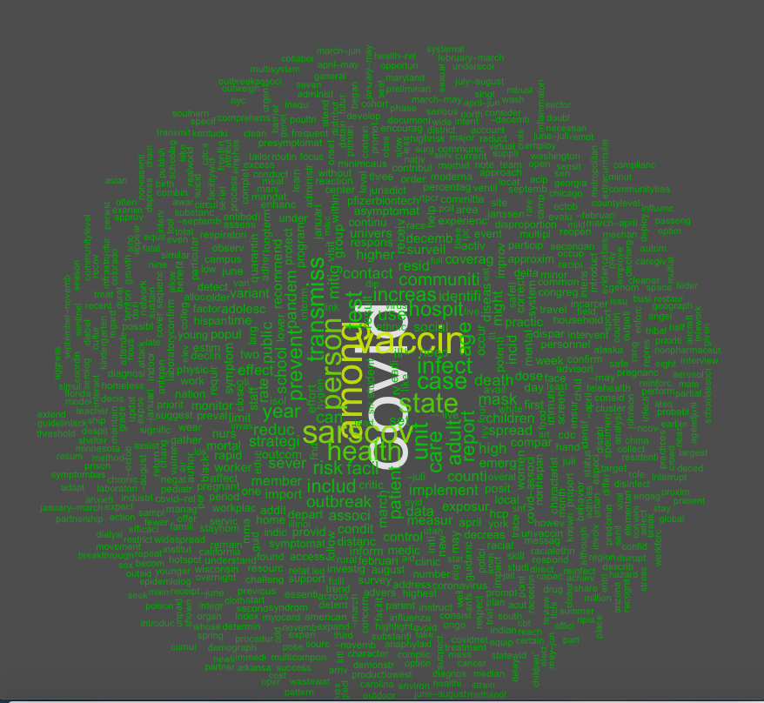
COVID-19 MOST COMMON WORDS

Slide 3
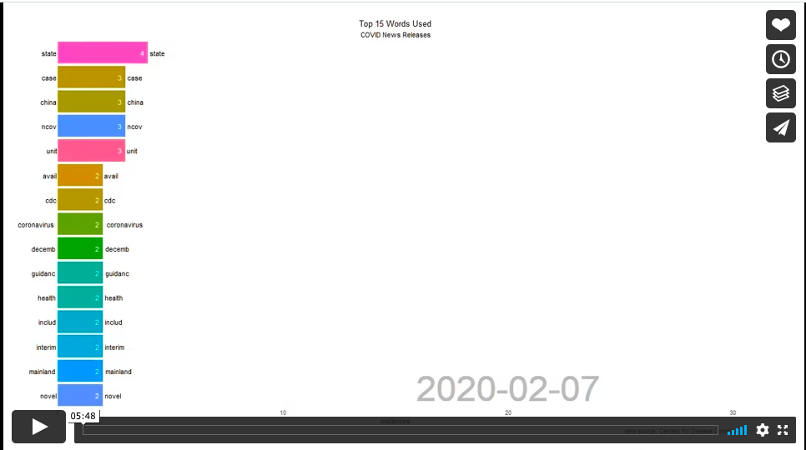
https://vimeo.com/642927868

Slide 4
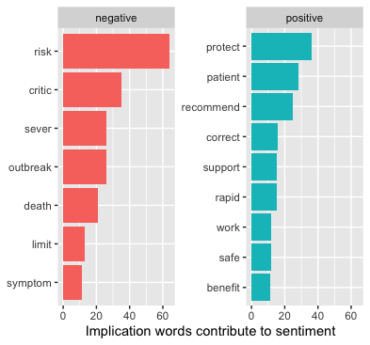
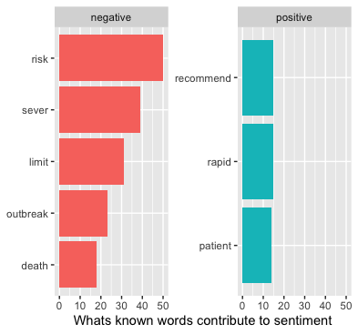

Slide 5


Conclusion:
Analyzing text in R, cleaning data, and transforming it is demonstrated in this exercise. To identify prominent themes in the text, a word frequency table, and a word cloud were created. Lastly, it demonstrated how to implement a sentiment classifier and created two plots to analyze and interpret the negative and positive sentiments in the text.

