Slide 1
Optimal Control Informed Low-Thrust Maneuver Reconstruction in Cislunar Space
Darin Lin
2/3/2025

Slide 2
Outline
Motivation
Research Concept
Methodology
Future Work

Slide 3
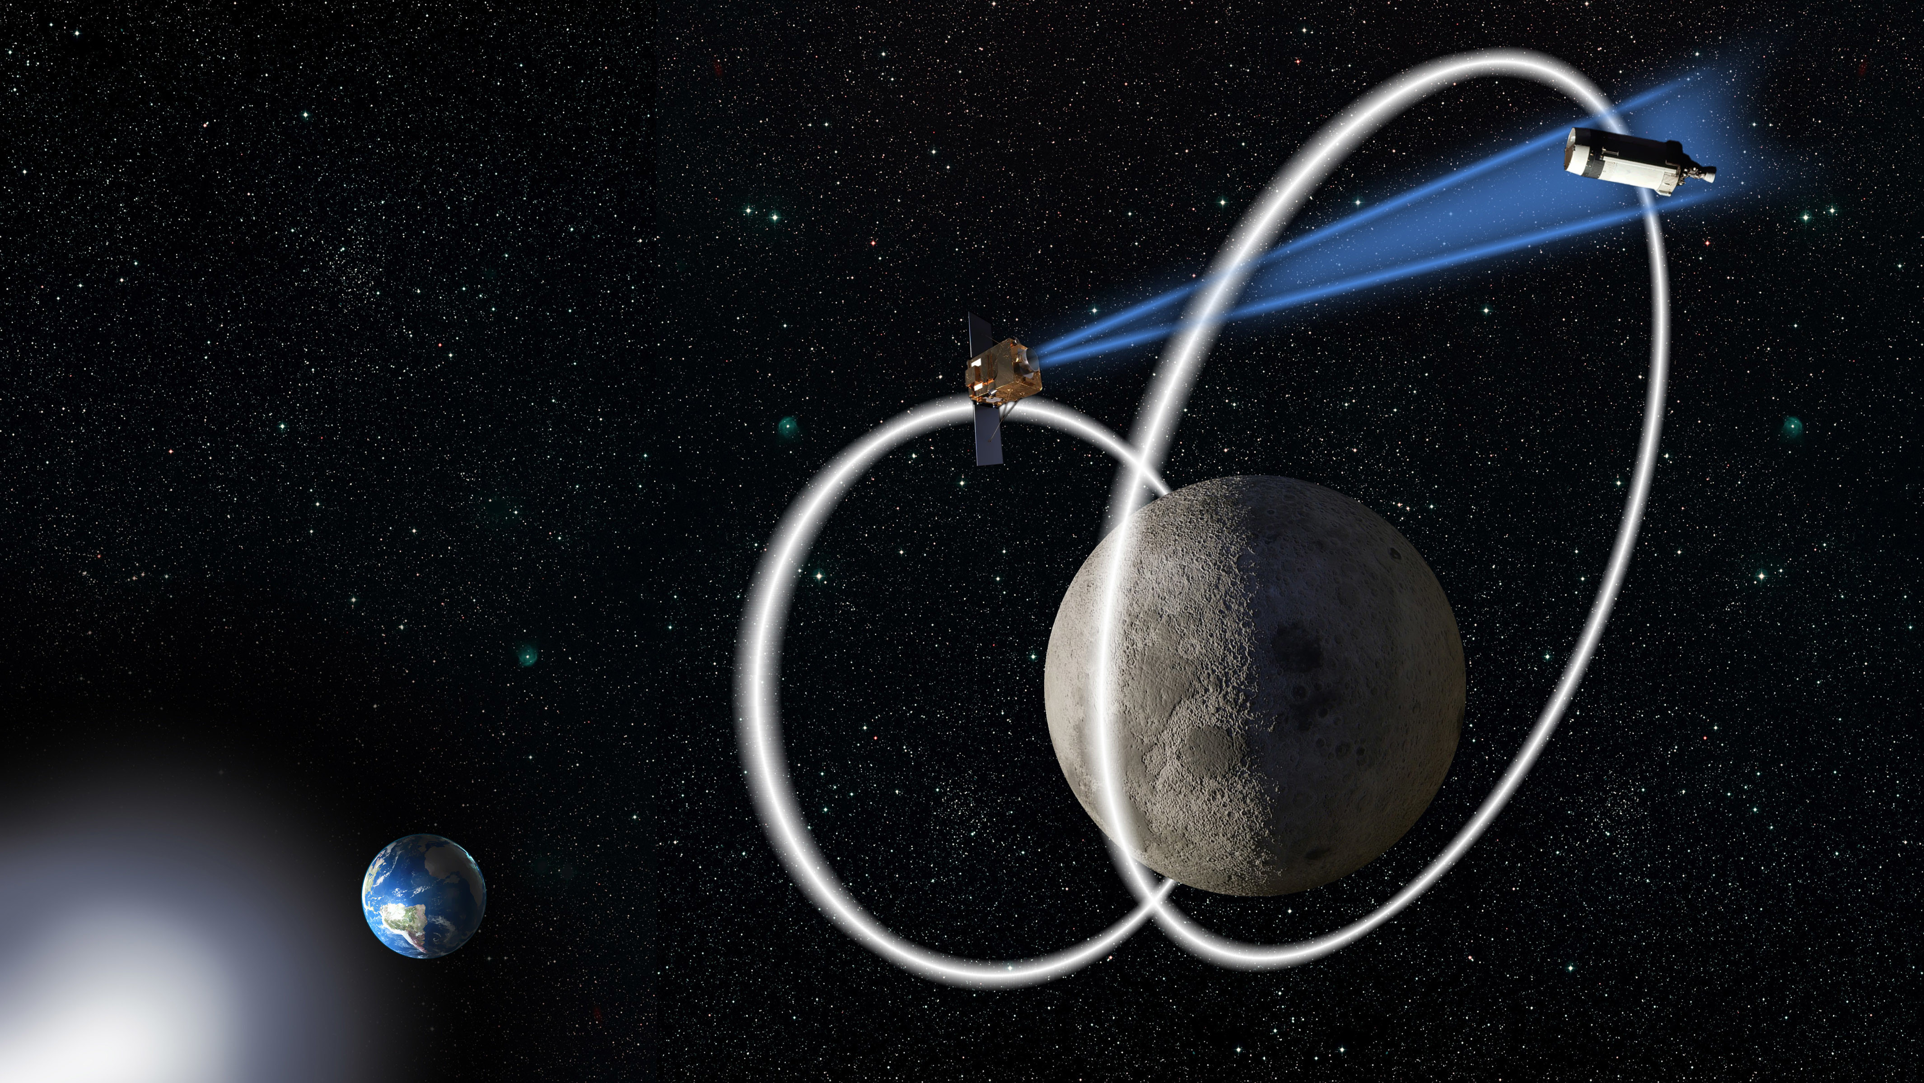
Motivation
Cooperative and uncooperative traffic in cislunar space increasing, e.g. Artemis program, Chang’E program
Space Situational Awareness (SSA) beyond GEO is important, as evidenced by AFRL’s Oracle program
Tracking uncooperative spacecraft is difficult because of great distances, highly nonlinear dynamics, and sparse observational resources
In addition to this already difficult problem, spacecraft can also maneuver, which dramatically increases complexity
How can we track these spacecraft?
“In the same way that the DoD monitors activity in space near the Earth, monitoring spacecraft above GEO is necessary to ensure safety of operations and to provide attribution if any harmful actions are taken by an adversary.” - AFRL

Slide 4
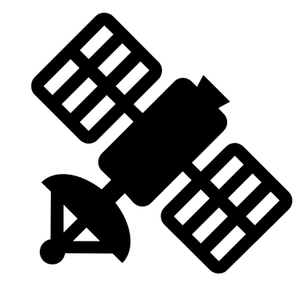
Research Concept
All possible maneuvers
Spacecraft are very expensive and are operated by smart people, so we can assume maneuvers are not random
If we assume that the maneuvers will be optimal, then we can reduce the search space and even predict when the spacecraft will perform another maneuver
Answer gets reduced from “where the spacecraft could be” to “where the spacecraft should be”
Assume optimal control (min energy, time, fuel)
Optimal maneuvers

Slide 5
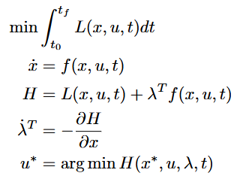
Methodology
Pontryagin’s Minimum Principle
Need a way to mathematically describe optimality
We choose to apply Pontryagin’s minimum principle
  Introduces the costate to define optimal control
  Constitutes a new dynamical system
Since optimality is now defined as a dynamical system, the tracking problem is now a state estimation problem
If we know the costates, we know the control

Slide 6
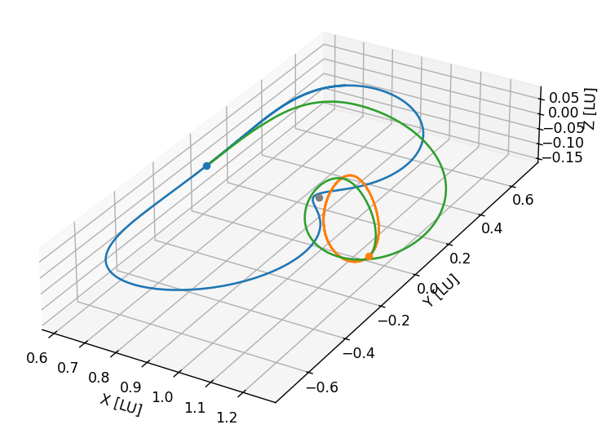
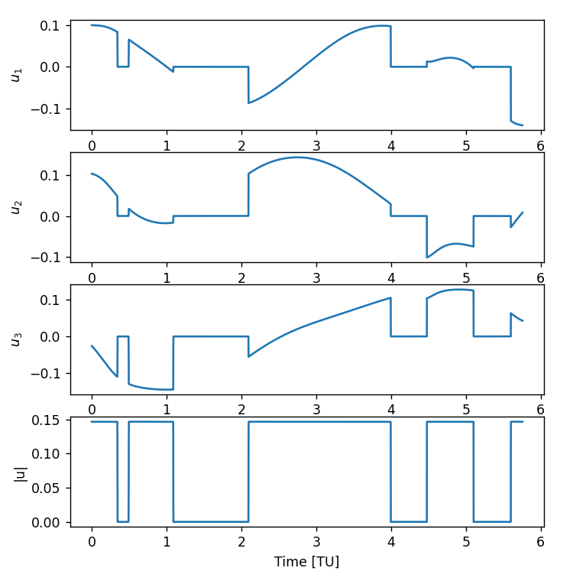
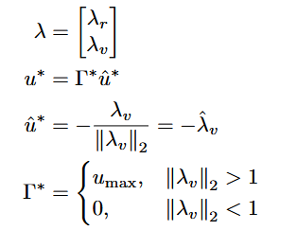
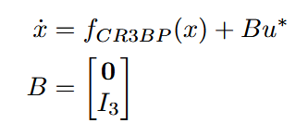
Methodology
Minimum-Fuel Control in the CR3BP
Use CR3BP dynamics as approximation of reality, with space-based observers with angles-only measurements
Assume minimum-fuel control, since it is a likely control policy (fuel is a valuable resource)
The fuel-optimal control is bang-bang, with alternating periods of maximum control effort and coasting

Slide 7
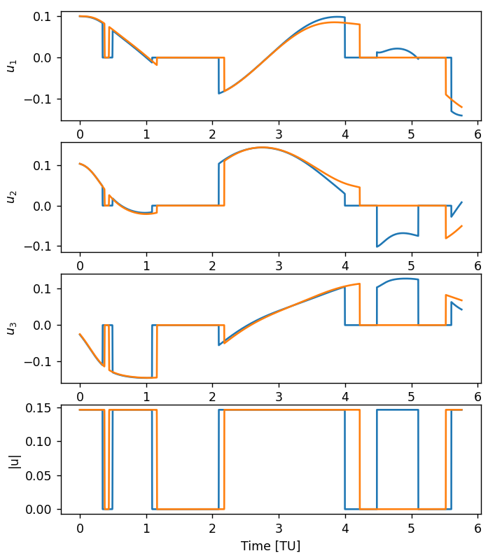
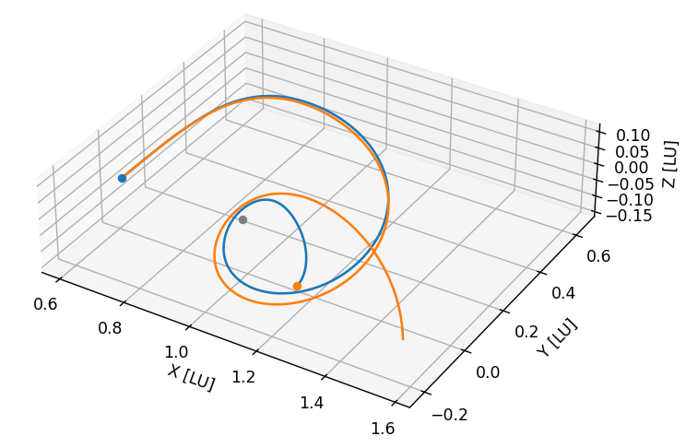
Methodology
Difficulties of Applying Filtering to Fuel-Optimal Dynamics
Bang-bang control results in a difficult to observe costate and extremely nonlinear dynamics
(Un)observability of the costate
  We can only observe the costate through the control
  During coasting, we have no information about the costate except |λ_{v}| < 1
  During thrusting, we only know |λ_{v}| > 1 and the direction of λ_{v}
  No direct information about λ_{r}
System is extremely nonlinear
  Slight difference in |λ_{v}| is the difference between thrusting and coasting
  Combined with CR3BP dynamics, this accelerates divergence

Slide 8








Methodology
Obtain Costate from Observed Control
EKF or other sequential filtering algorithms are not effective
  Costates are too unobservable
  Dynamics are too nonlinear
Instead, use an initial orbit determination approach when a maneuver is detected
  Construct a cost function, then find the initial costate which minimizes it using a nonlinear minimizer
In this case, the cost function is the sum of predicted measurement residuals

Slide 9
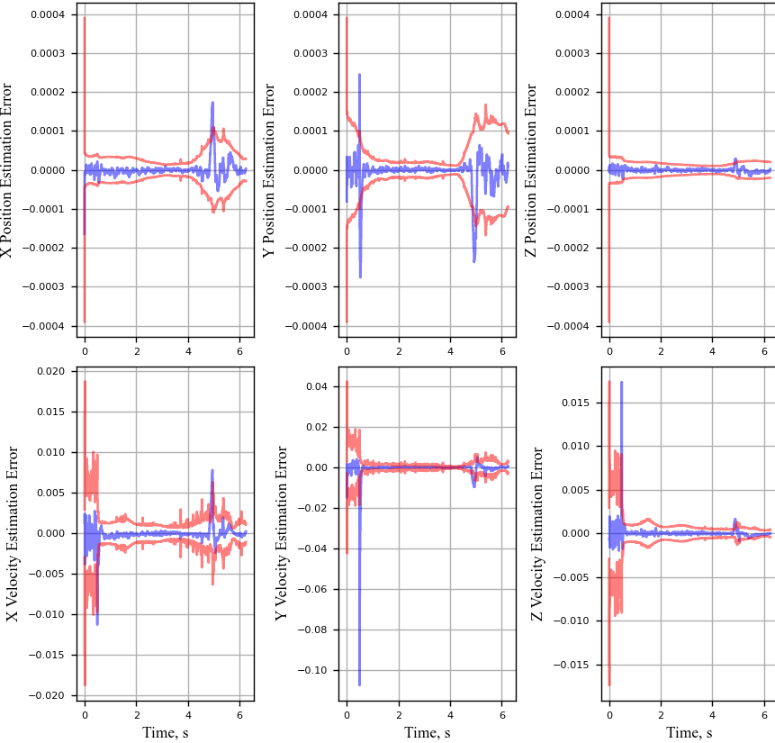
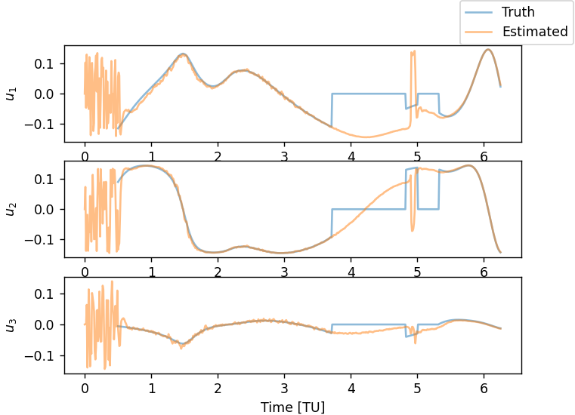
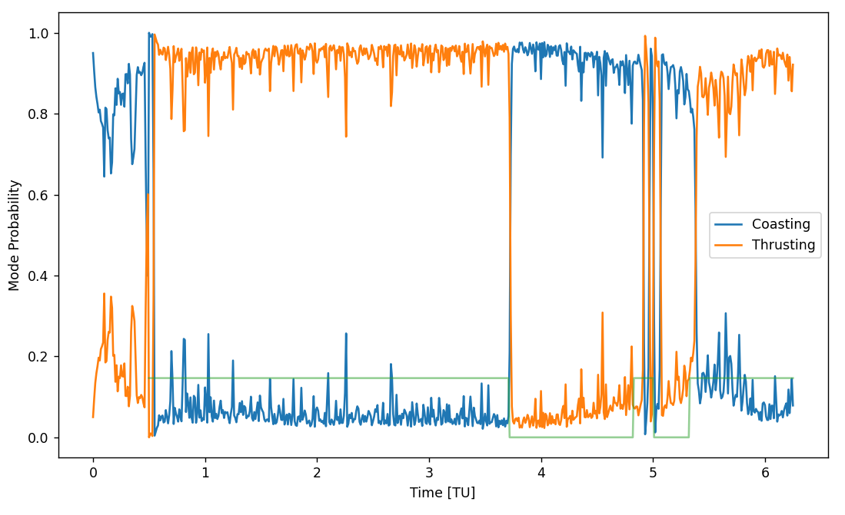
Methodology
Initial Filtering Algorithm
Apply an IMM with two modes:
  Coasting: CR3BP dynamics
  Thrusting: Assumed minimum-energy dynamics
This solves two issues:
  Detects when a maneuver is occurring with mode probabilities
  Helps give an initial guess for costate
The initial IMM gives estimates for state and thrusting direction

Slide 10
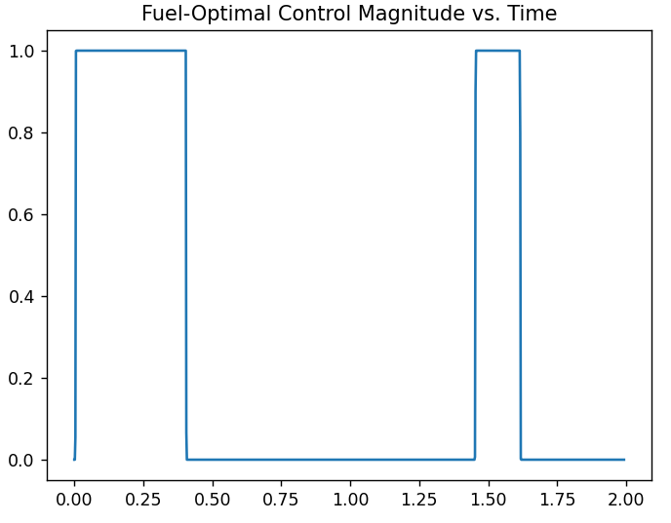
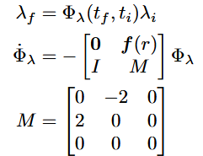
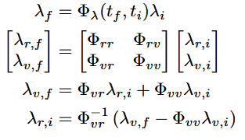
Methodology
|λ_{v}| > 1
Initial Costate Guessing Algorithm
|λ_{v}| = 1
Utilize dynamical knowledge of the costate to obtain an initial guess for the nonlinear solver
  |λ_{v}| is generally unknown, except the instant in time when a thrusting arc begins or ends and |λ_{v}| = 1
  The STM DE for the costate is surprisingly simple and is only dependent on the spacecraft position, r
  Thus, if we observe the end of the maneuver, we can construct an STM which will map the costate from the end of the maneuver to the beginning of the maneuver (or anywhere in-between)
  Since we know the initial thrusting direction, we can obtain guesses of λ_{r,i} with different |λ_{v,i}|
STM is generated by integrating over a cubic spline with the IMM’s estimates
We obtain an initial guess for the costate using that STM and the output from the IMM’s maneuvering mode
|λ_{v}| < 1

Slide 11

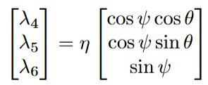


Methodology
Modified Minimization Problem
Make some changes to the minimization problem
Assume initial state estimate is sufficiently close to truth to remove from optimization parameters
Reformulate λ_{v,I} as two angles and magnitude so optimization can be constrained to a single value of |λ_{v,i}|
  Multiple values of |λ_{v,i}| are feasible, so constrain |λ_{v,i} | to a single value to explore the solution space

Slide 12
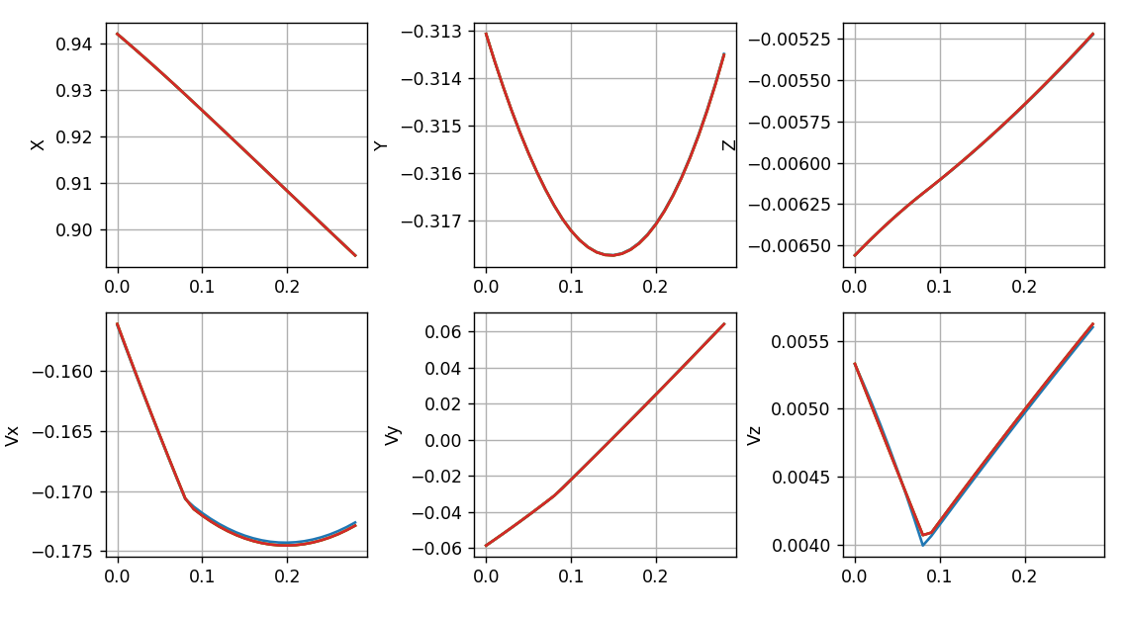
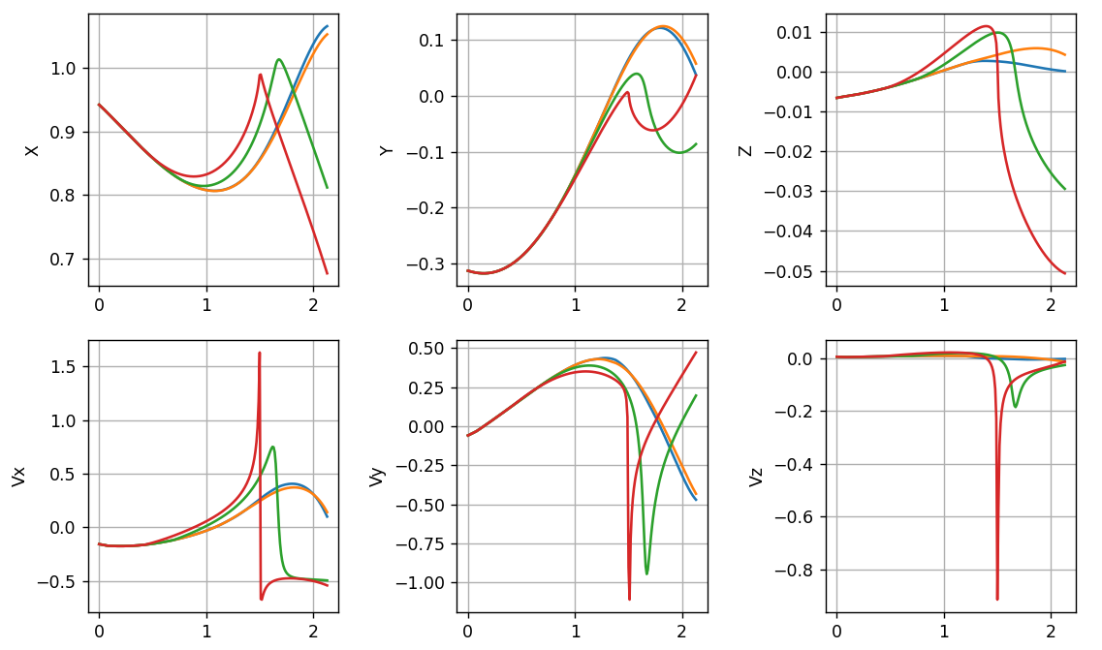
Results
Modified Minimization Problem
Looks good!
Nonlinear minimizer successfully finds initial conditions which minimize the measurement residual over the observation period
Propagating these solutions over a longer period reveals the non-uniqueness of the control
These different possibilities can be differentiated with a particle filter
Increase
time
Until…

Slide 13
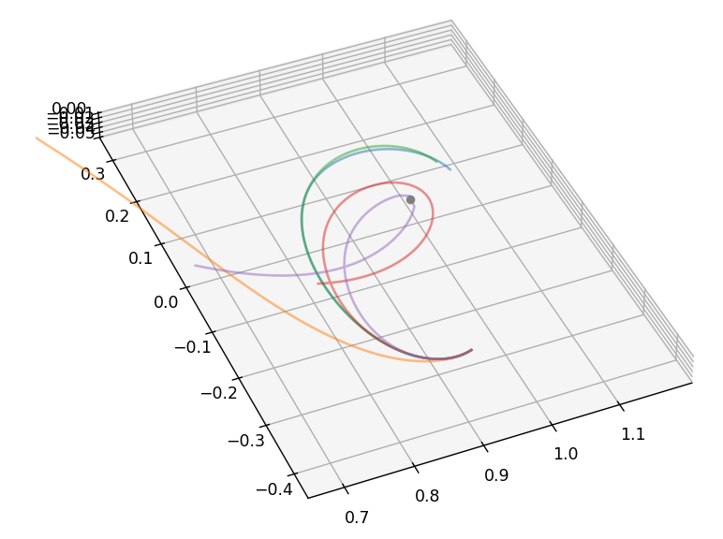
Future Work
Investigate the dynamics of the costate to obtain more possible trajectories
  Another trajectory which is not a minimum may be the true trajectory
  A faster way to pick adjacent trajectories using STM and statistical analysis
Add analytic gradient to numerical solver to speed up convergence
Implement these solutions as the initial conditions of a particle filter

Slide 14
Thank You
Questions?

