Slide 1
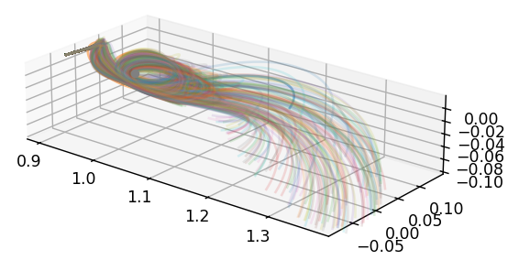
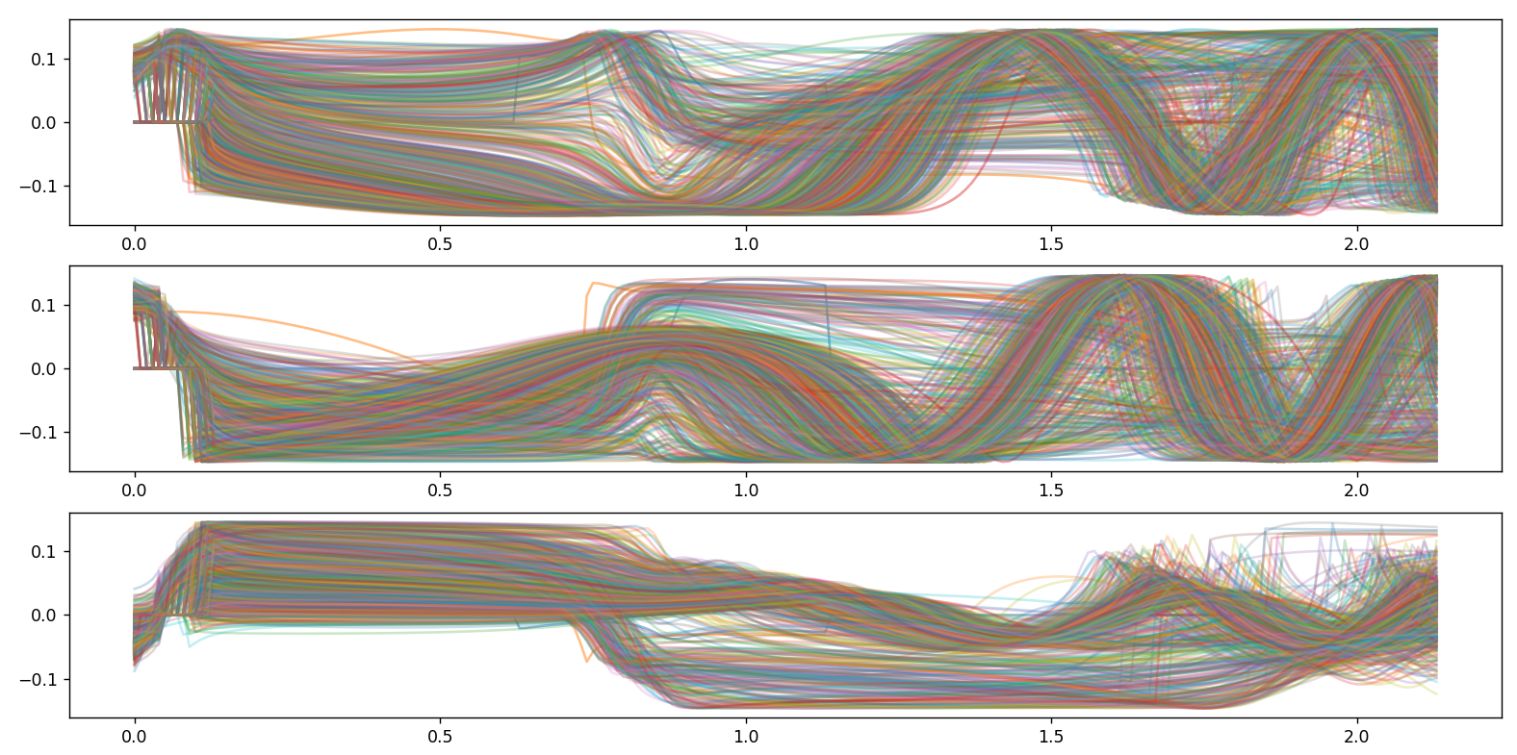
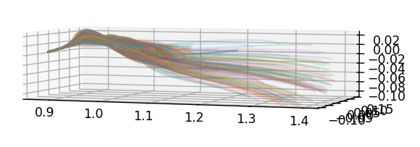
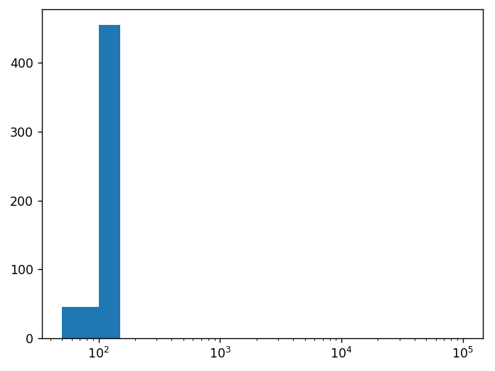
LM, 3 to 1,
initial [1.01, 1.5],
final [0.998, 1.002]
10 thrusting observations,
5 additional observations,
500 particles

Slide 2
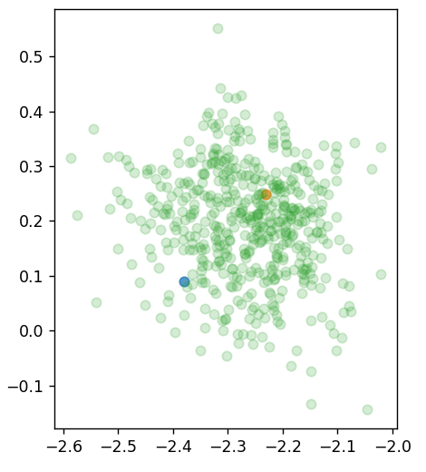
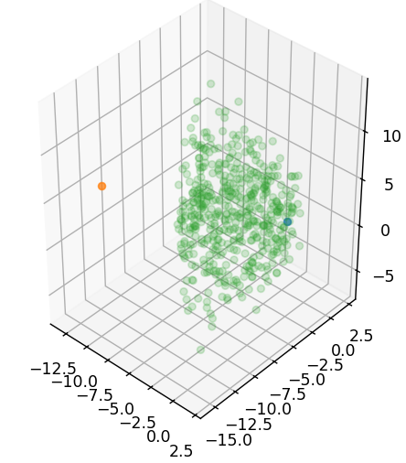
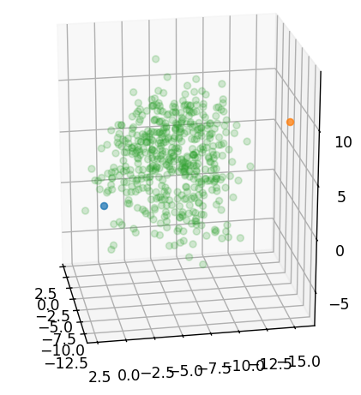
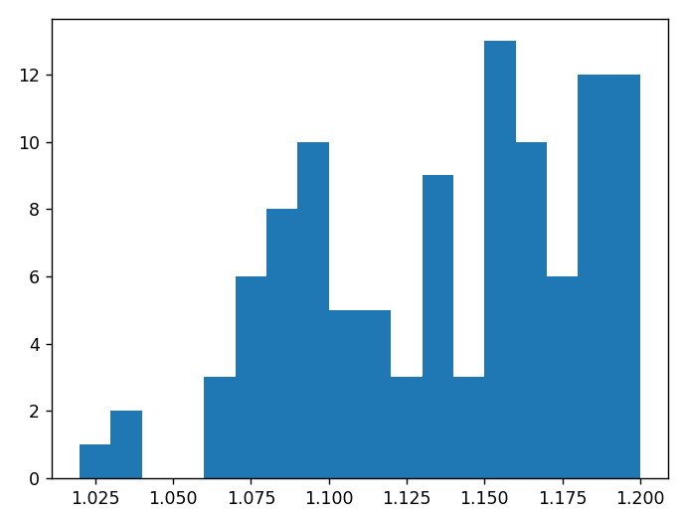
LM, 3 to 1,
initial [1.01, 1.5],
final [0.998, 1.002]
10 thrusting observations,
5 additional observations,
500 particles

Slide 3
3 to 1,
0 initial state cov,
1e-2 initial costate cov,
1e-4 roughening cov,
100 particles

