Slide 1
Problem: Current algorithm for calculating initial costate is pretty good, which is not good enough
Solutions:
Approach 1: Improve initial guess by incorporating more information than the current constant thrust assumption
This is simple, since the STM DE for costate is only dependent on position, which we know. We can construct multiple STMs then chain them together
Approach 2: Improve filtering so that the smallish errors in initial costate are corrected
Currently considering a reformulation of the costate, since current implementation using linearization does not make sense for the discontinuous control
May still be insufficient for observing small duration thrusting arcs, since information is limited for a sequential filter

Slide 2
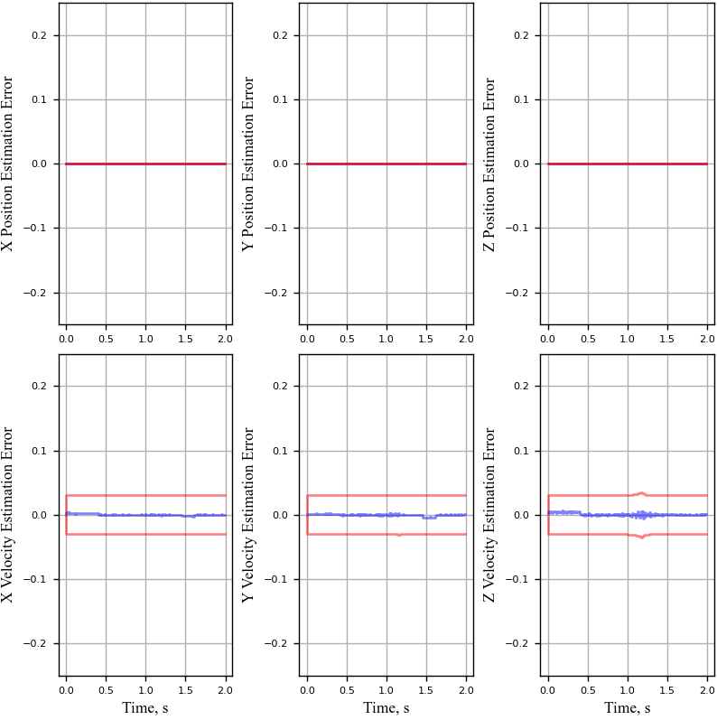
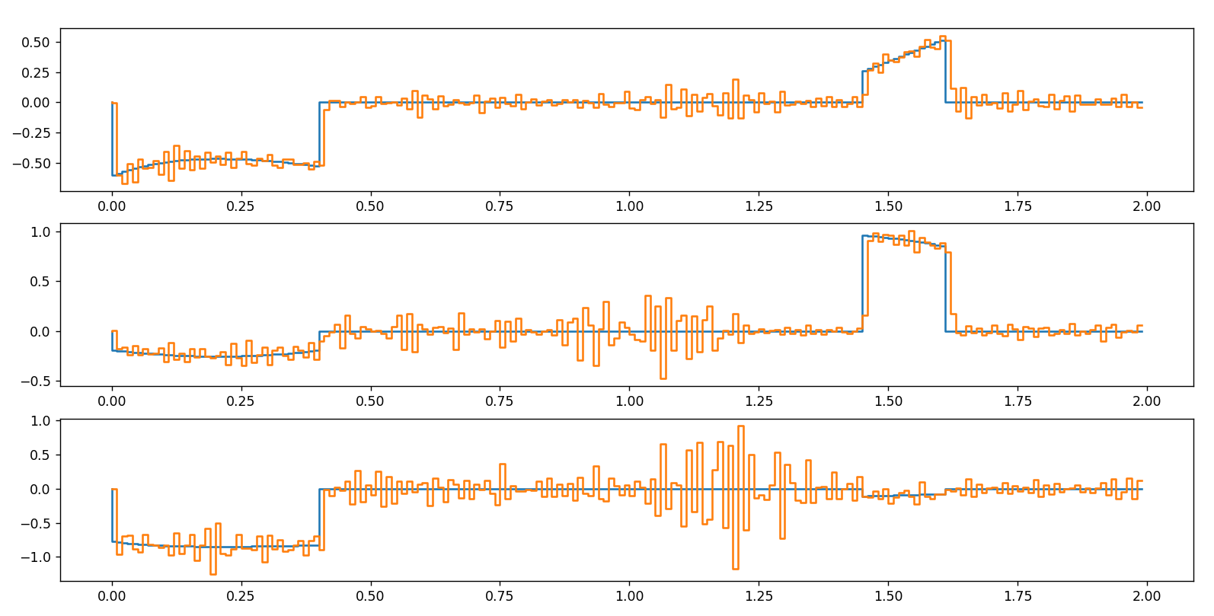
Approach 1
To compute STMs, state and control input must be known for each timestep during thrusting arc

Slide 3
