Slide 1
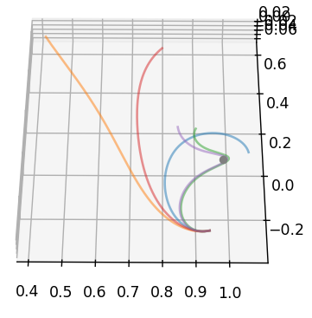
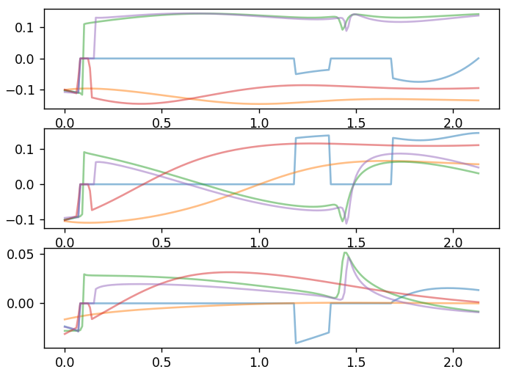
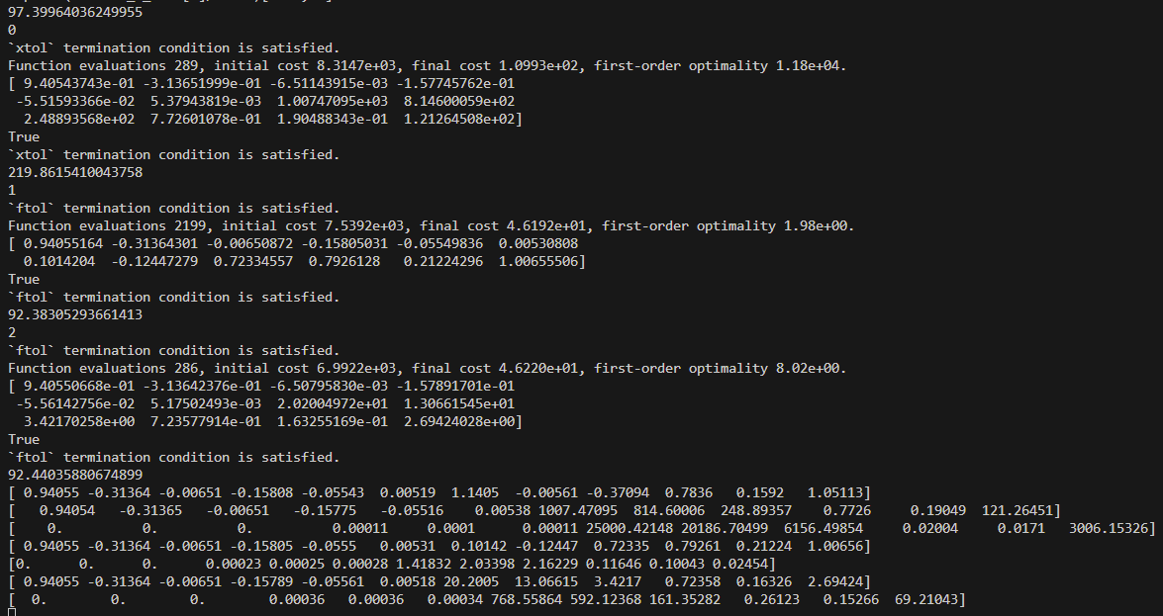
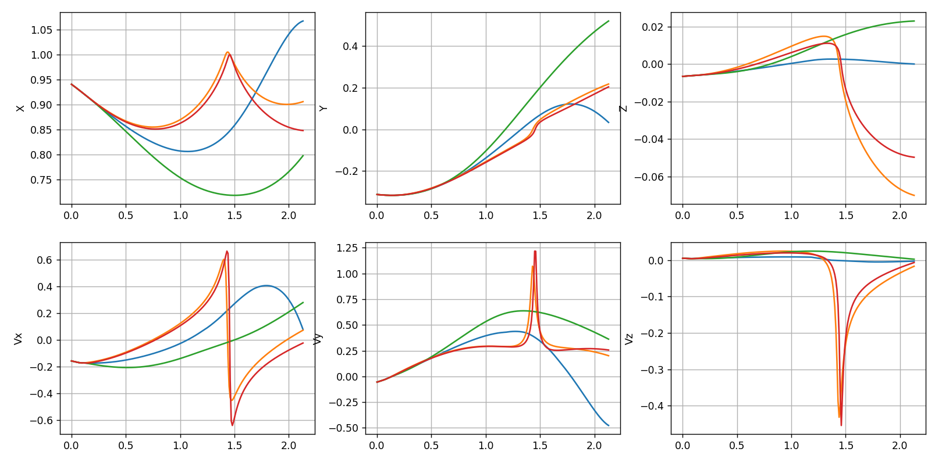
LM, 3 to 2, [1.0, 1.1, 1.2],
10 thrusting observations, 5 additional observations,
Reformulated, state and magnitude included

Slide 2
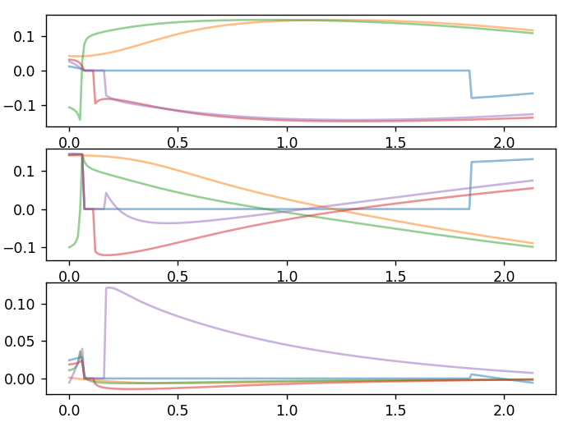
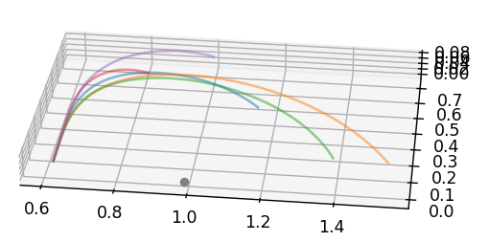
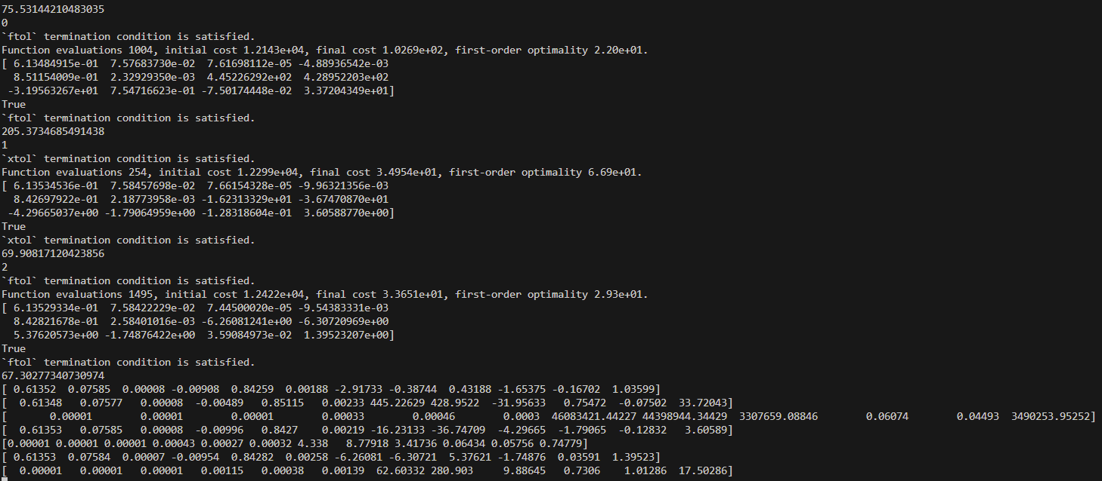
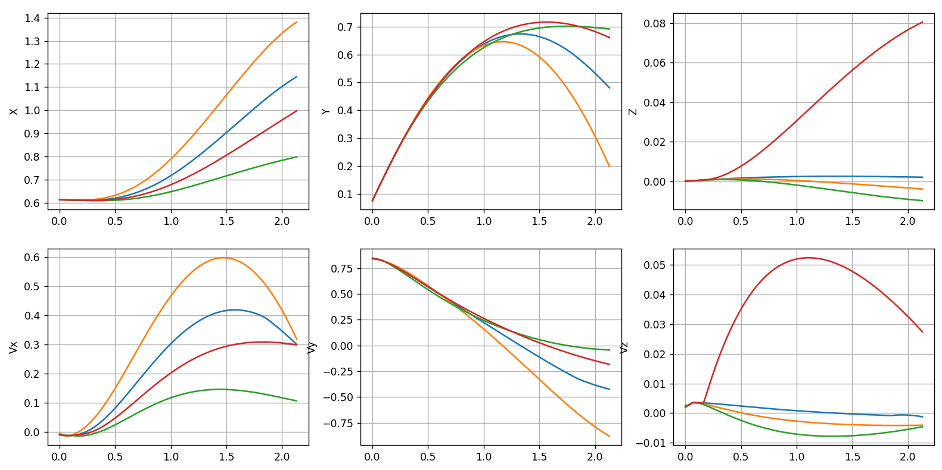
LM, 1 to 3, [1.0, 1.1, 1.2],
10 thrusting observations, 5 additional observations,
Reformulated, state and magnitude included

Slide 3
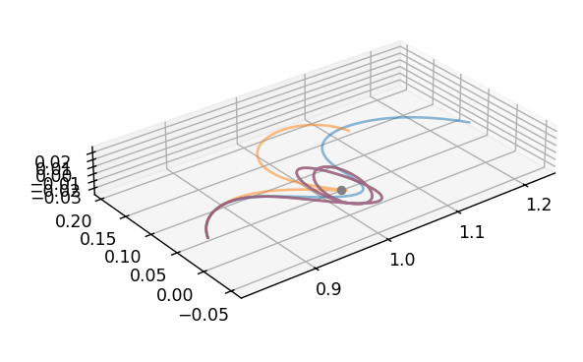
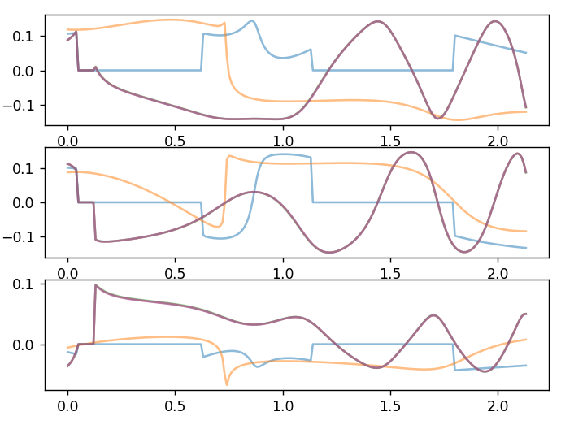
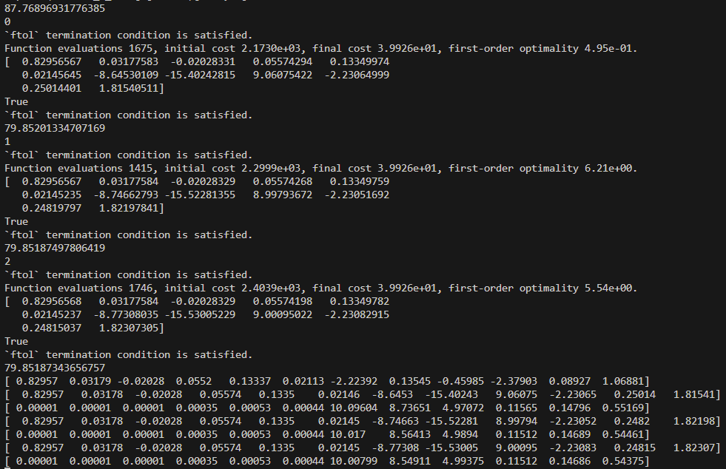
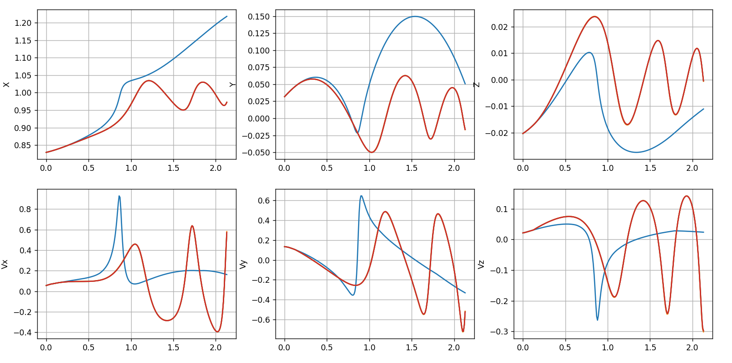
LM, 3 to 1, [1.0, 1.1, 1.2],
10 thrusting observations, 5 additional observations,
Reformulated, state and magnitude included

Slide 4
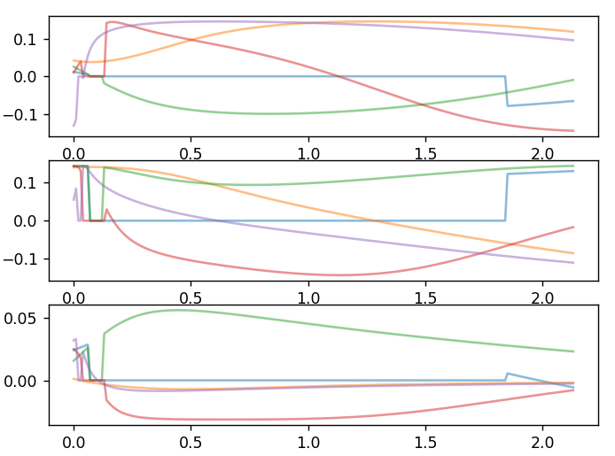
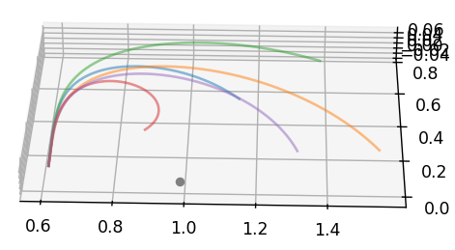
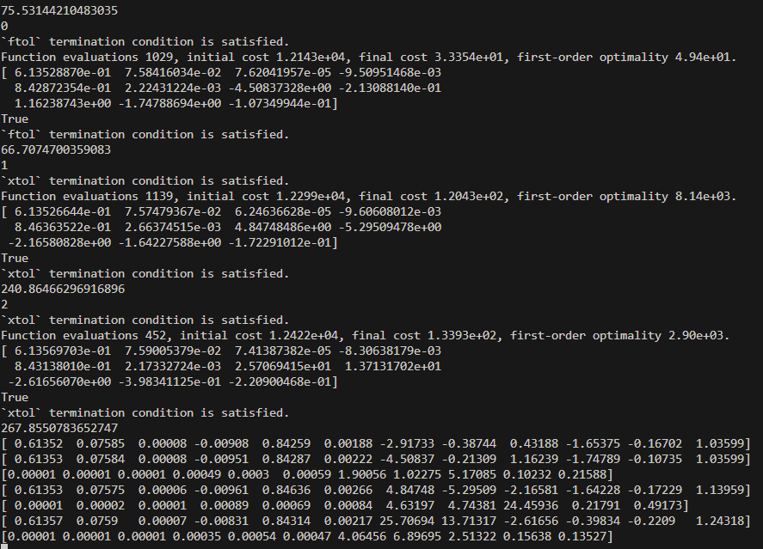
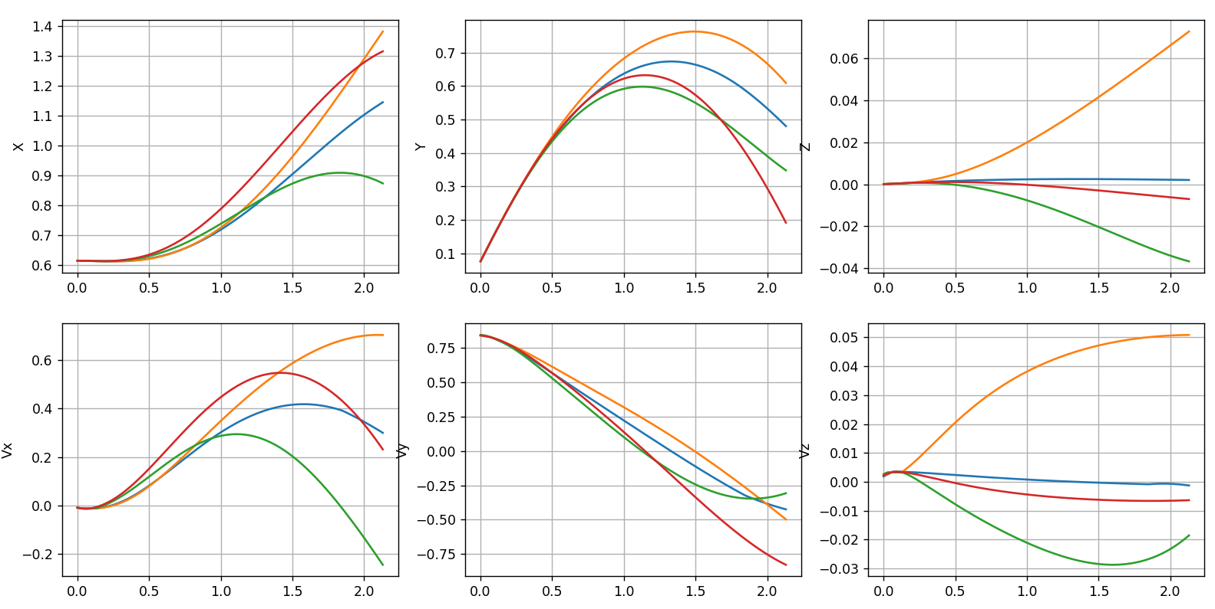
LM, 1 to 3, [1.0, 1.1, 1.2],
10 thrusting observations, 5 additional observations,
Reformulated, state included (no magnitude)

Slide 5
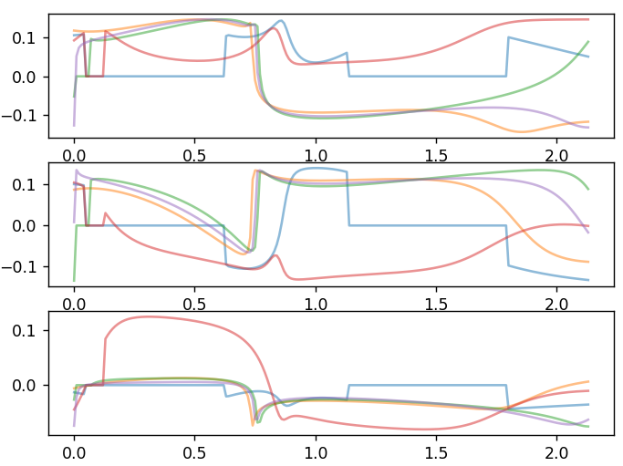
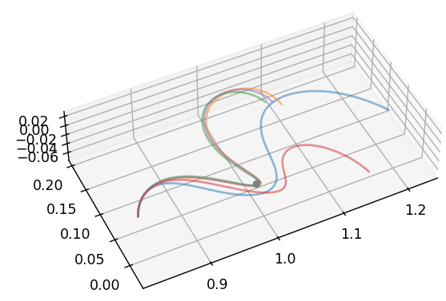
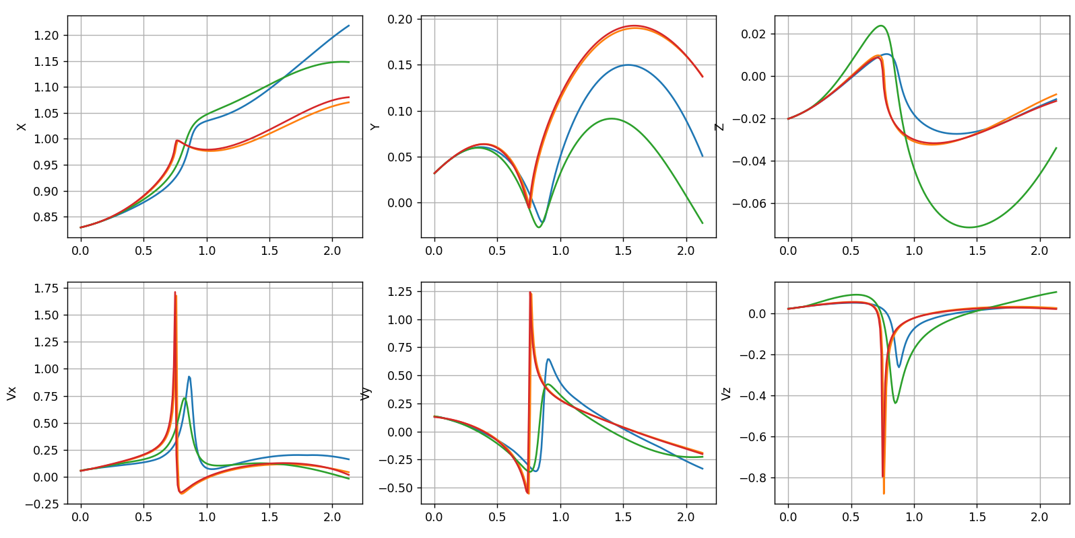
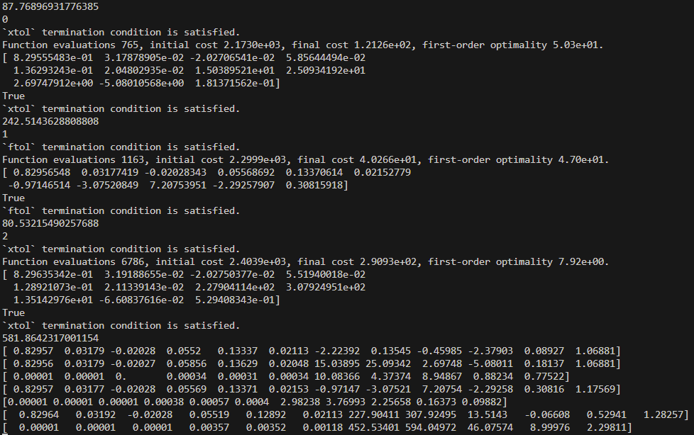
LM, 3 to 1, [1.0, 1.1, 1.2],
10 thrusting observations, 5 additional observations,
Reformulated, state included (no magnitude)

