Slide 1
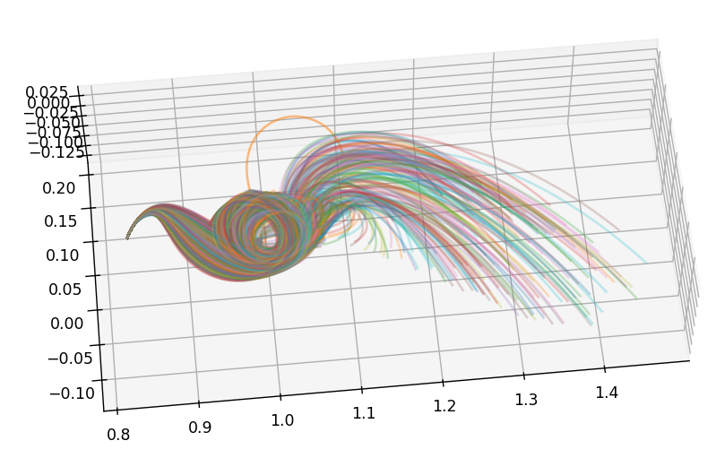
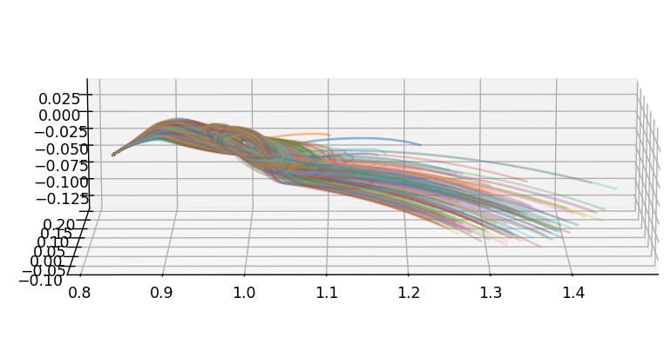
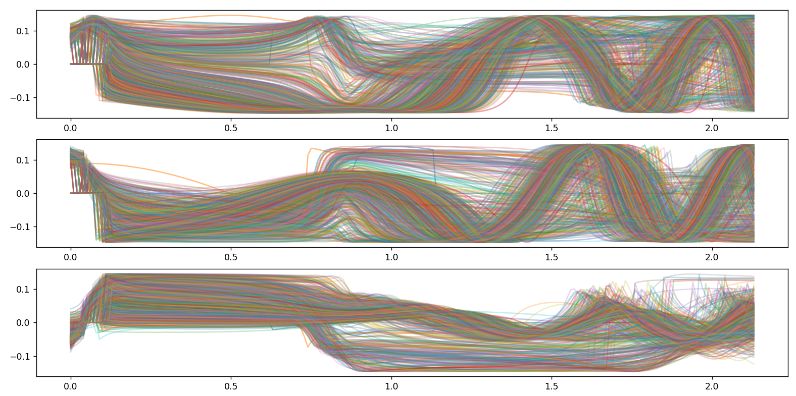
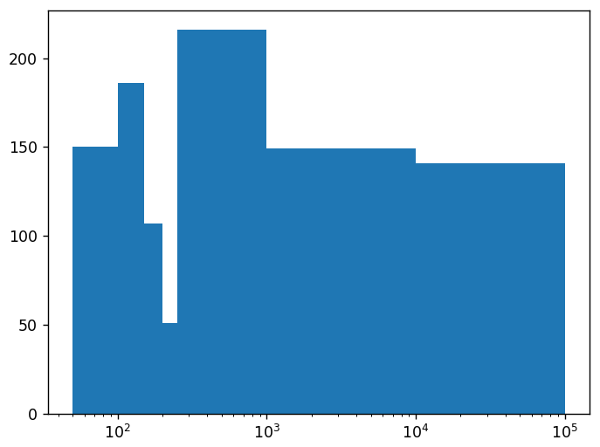
LM, 3 to 1, [1.1],
10 thrusting observations,
5 additional observations,
Reformulated, state and magnitude included,
1000 particles

Slide 2
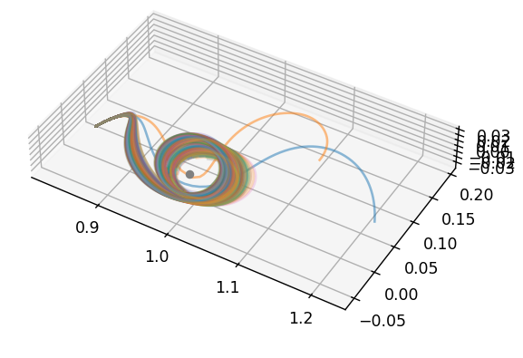
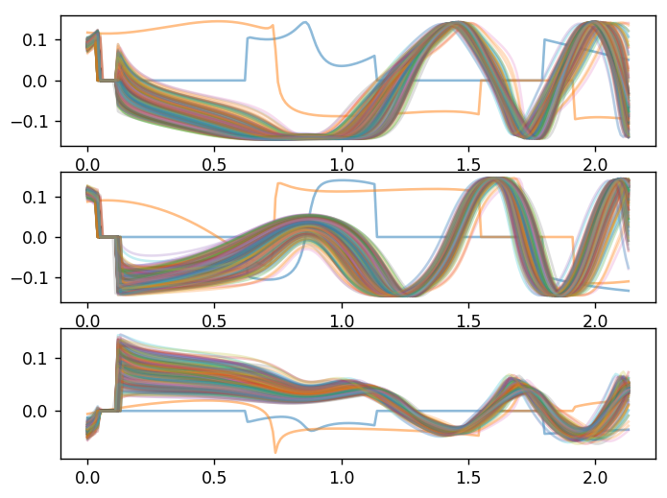
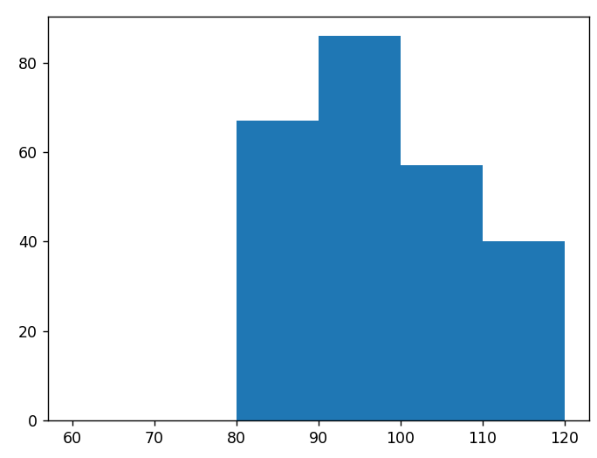
LM, 3 to 1, [1.1],
10 thrusting observations,
5 additional observations,
Reformulated, state and magnitude included,
99.7% confidence interval
250 particles

Slide 3
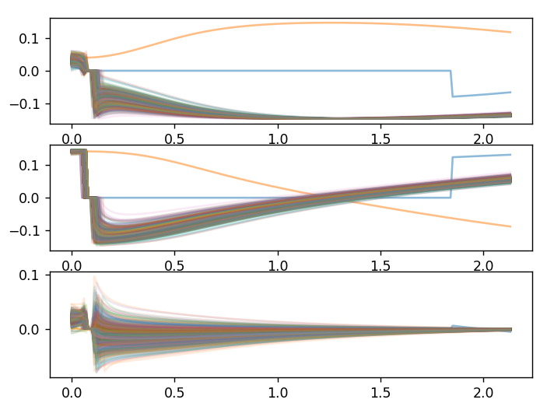
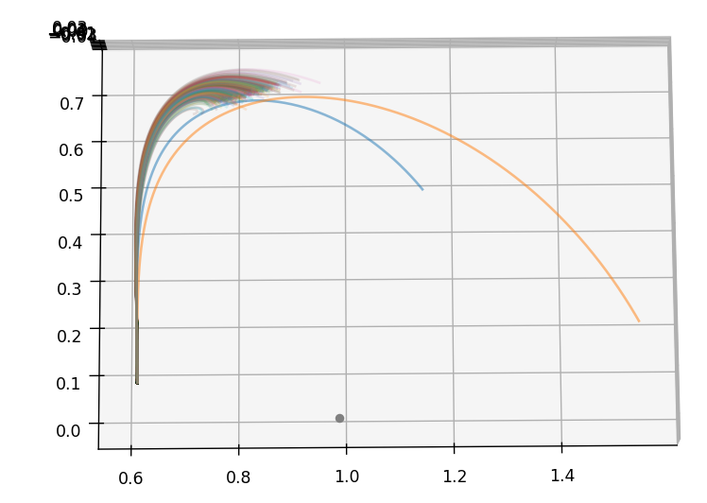
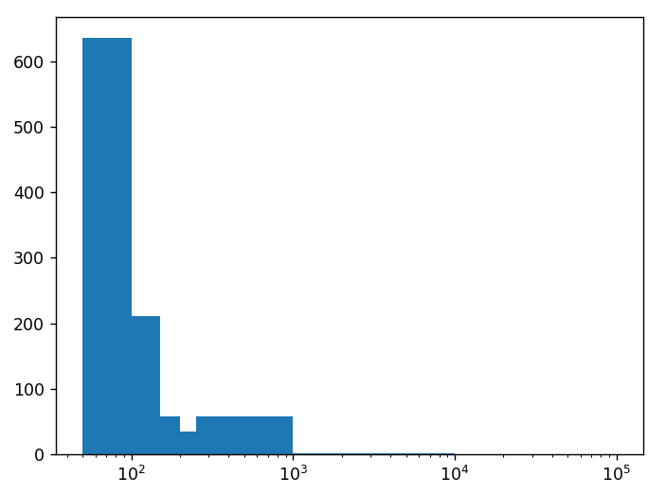
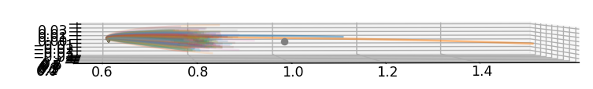
LM, 1 to 3, truth*[1.1],
10 thrusting observations,
5 additional observations,
Reformulated, state and magnitude included,
1000 particles

Slide 4
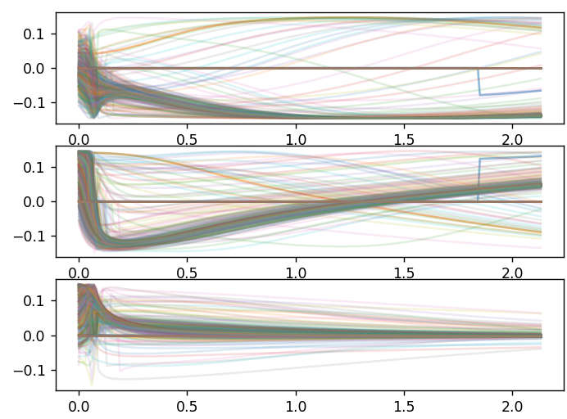
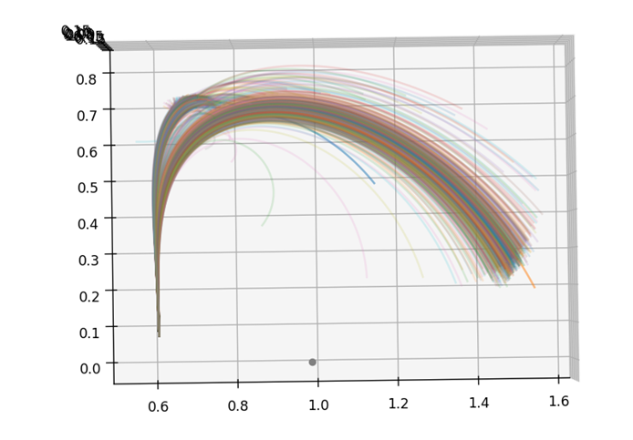
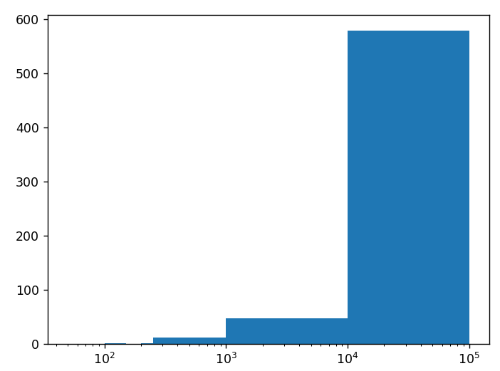
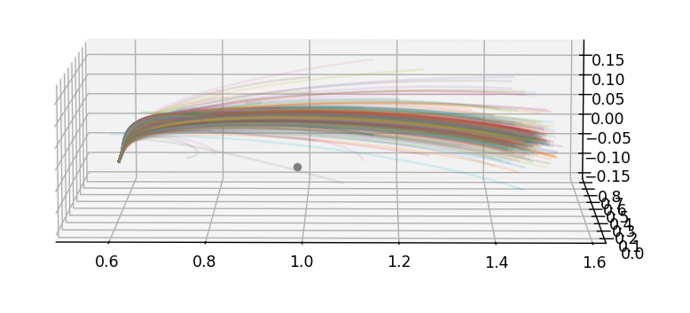
LM, 1 to 3, truth*[1.2],
10 thrusting observations,
5 additional observations,
Reformulated, state and magnitude included,
1000 particles

Slide 5
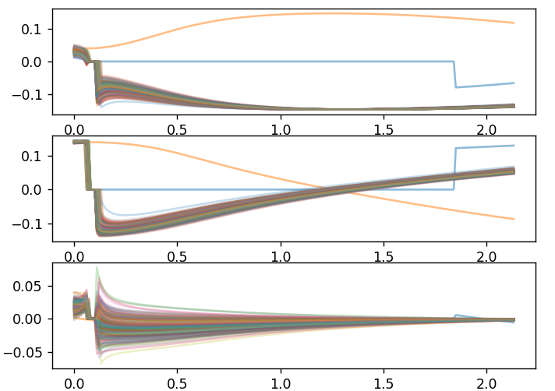
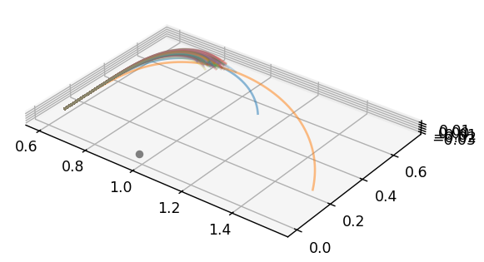
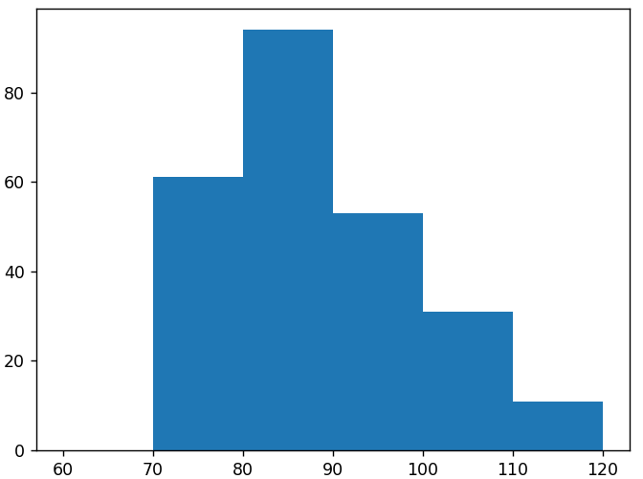
LM, 1 to 3, truth*[1.1],
10 thrusting observations,
5 additional observations,
Reformulated, state and magnitude included,
99.7% confidence interval
250 particles

