Slide 1
Optimal Control-Informed Tracking of Maneuvering Spacecraft in Cislunar Space
Darin Lin
12/02/2024

Slide 2
Introduction

Slide 3
Outline
Motivation and Problem Statement
Research Concept and Comparison to Other Work
Methodology
  Pontryagin’s Minimum Principle
  Filtering Strategy
Future Work

Slide 4
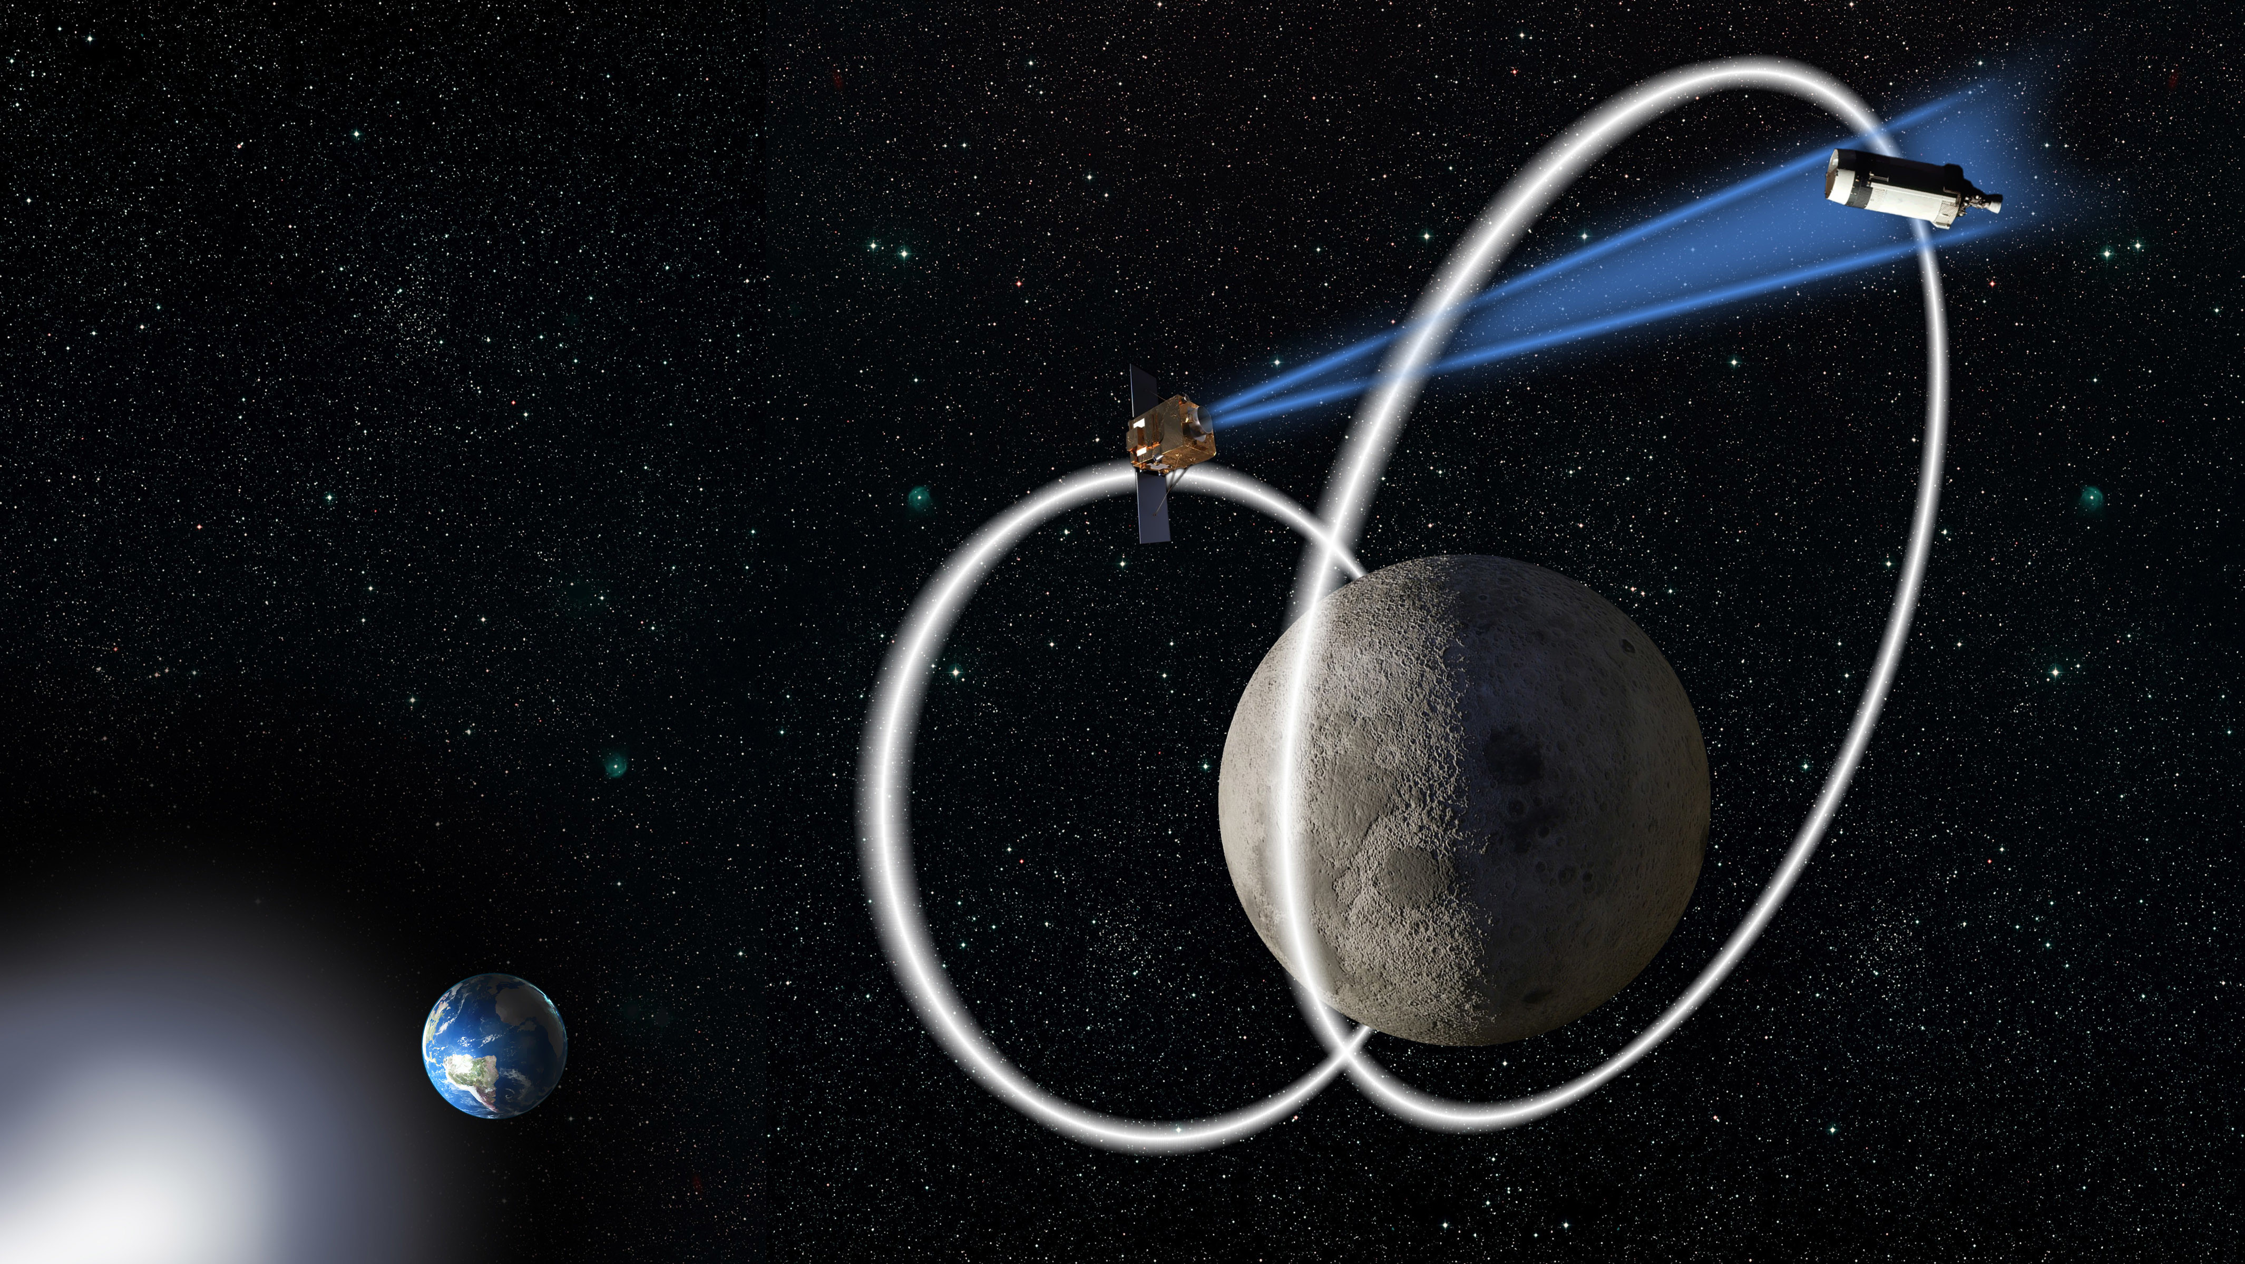
Motivation and Problem Statement
Cooperative and uncooperative traffic in cislunar space increasing, e.g. Artemis program, Chang’E program
Space Situational Awareness (SSA) beyond GEO is important, as evidenced by AFRL’s Oracle program
Tracking uncooperative spacecraft is difficult because of highly nonlinear dynamics and sparse observational resources
In addition to this already difficult problem, spacecraft can also maneuver, which dramatically increases complexity
How can we track these spacecraft?
“In the same way that the DoD monitors activity in space near the Earth, monitoring spacecraft above GEO is necessary to ensure safety of operations and to provide attribution if any harmful actions are taken by an adversary.” - AFRL

Slide 5
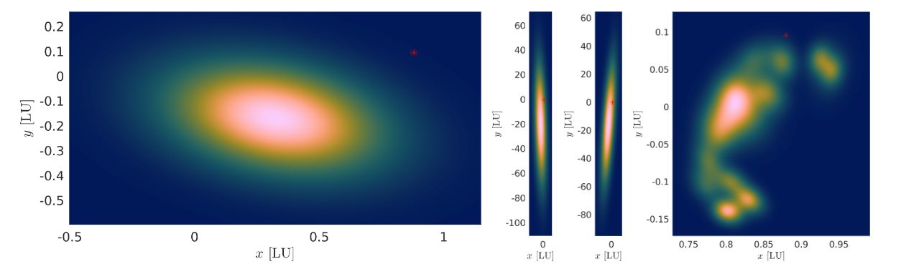
Research Concept and Comparison to Other Work
Areas of Research
Many areas of research:
  Observation strategy
    Sensor placement, including sensors on Moon and observation satellites
    Sensor tasking algorithms
  Filtering strategy
    EKF, UKF, GMM, IMM, GMIMM, AGMIMM, OCBE, etc.
Highlight Jack Iannamorelli’s paper for the AGMIMM
  Models maneuvering spacecraft as jump Markov system, with a maneuvering and non-maneuvering mode
  Models maneuvers as random process noise, then uses clever GM techniques to handle nonlinearity and maintain convergence
  Tells you where a spacecraft “could” be
However, maneuvers aren’t random. How can we use this information?
Credit: Iannamorelli, LeGrand

Slide 6
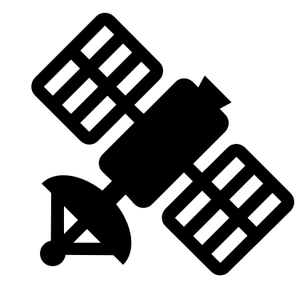
Research Concept and Comparison to Other Work
All possible maneuvers
Research Concept
Spacecraft are very expensive and are operated by smart people, so we can assume maneuvers are not random
If we assume that the maneuvers will be optimal, then we can reduce the search space and even predict when the spacecraft will perform another maneuver
Answer gets reduced from “where the spacecraft could be” to “where the spacecraft should be”
Assume optimal control (min energy, time, fuel)
Optimal maneuvers

Slide 7
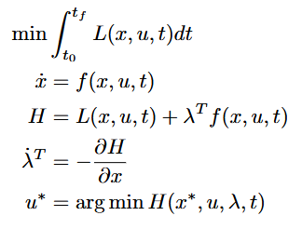
Methodology
Pontryagin’s Minimum Principle
Need a way to mathematically describe optimality
We choose to apply Pontryagin’s minimum principle
  Introduces the costate to define optimal control
  Constitutes a new dynamical system
Since optimality is now defined as a dynamical system, we can apply filtering techniques to it (EKF, UKF, GMM, etc.)
If we can estimate the costates, we can estimate the control

Slide 8
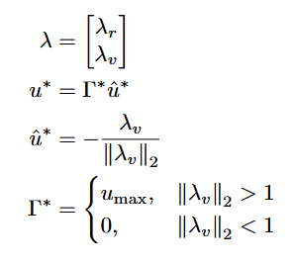
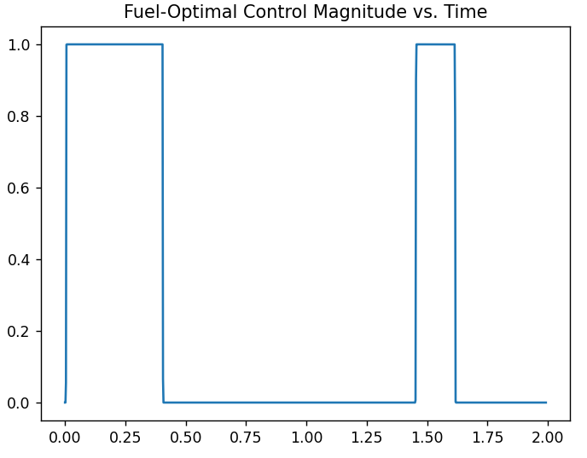
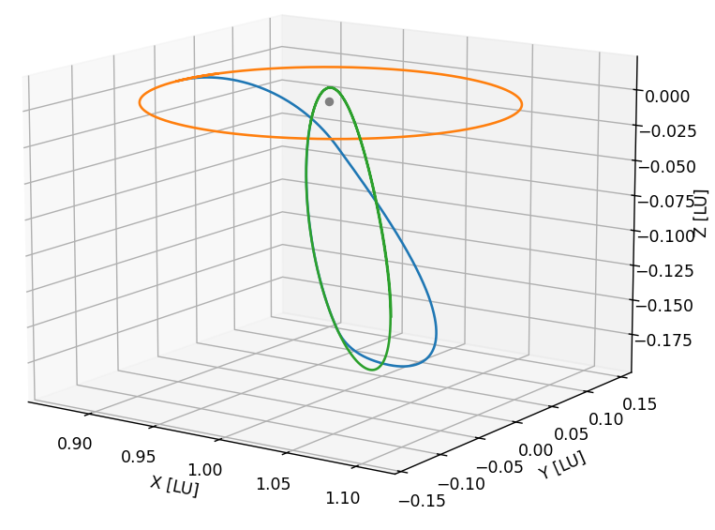
Methodology
Minimum-Fuel Control in the CR3BP
Use CR3BP dynamics as approximation of reality, with space-based observers with angles-only measurements
Assume minimum-fuel control, since it is a likely control policy (fuel is a valuable resource)
The fuel-optimal control is bang-bang, with alternating periods of maximum control effort and coasting

Slide 9
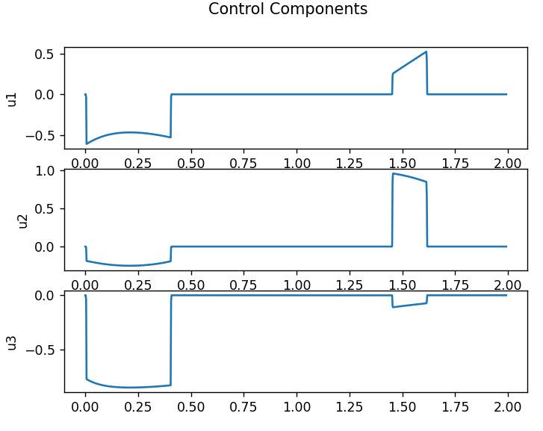
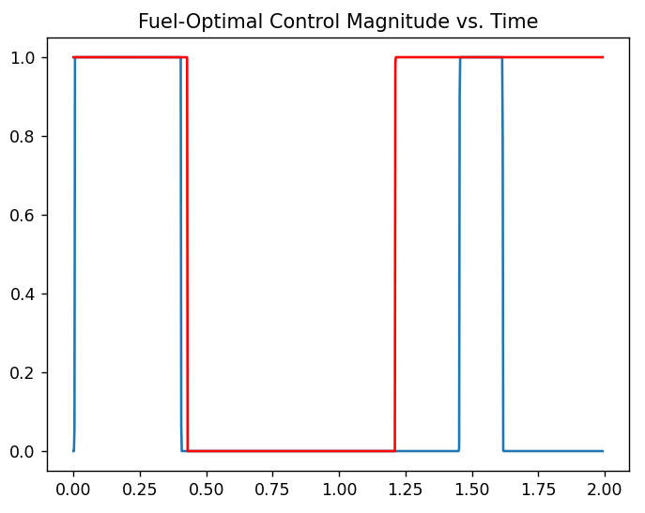
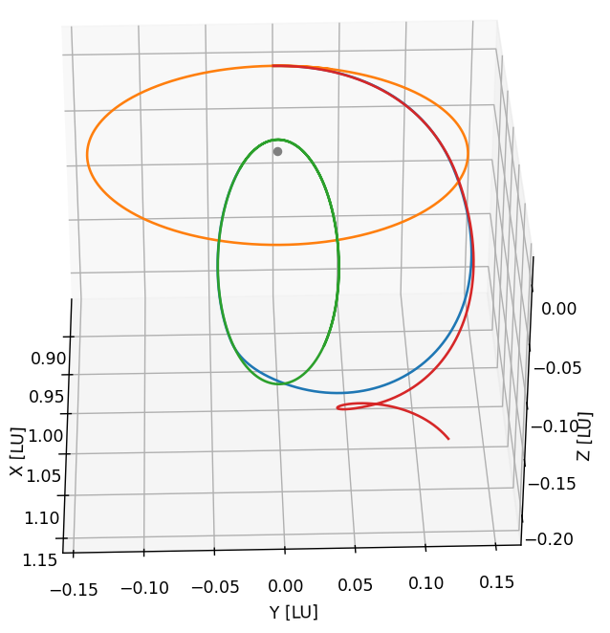
Methodology
Difficulties of Applying Filtering to Fuel-Optimal Dynamics
Bang-bang control results in a difficult to observe costate and extremely nonlinear dynamics
(Un)observability of the costate
  We can only observe the costate through the control
  During coasting, we have no information about the costate except |λ_{v}| < 1
  During thrusting, we only know |λ_{v}| > 1 and the direction of λ_{v}
  No direct information about λ_{r}
System is extremely nonlinear
  Slight difference in |λ_{v}| is the difference between thrusting and coasting
  Combined with CR3BP dynamics, this accelerates divergence

Slide 10
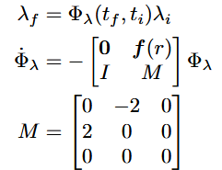
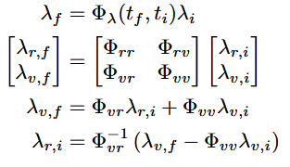
Methodology
Obtain Costate from Observed Control
|λ_{v}| = 1
Cannot obtain accurate costate estimate from single measurement because of observability, and cannot rely on measurement updates because of extreme nonlinearity
Use a batch estimation approach
  |λ_{v}| is generally unknown, except the instant in time when a thrusting arc begins or ends and |λ_{v}| = 1
  The STM DE for the costate is surprisingly simple and is only dependent on the spacecraft position, r
  Thus, if we observe the end of the maneuver, we can construct an STM which will map the costate from the end of the maneuver to the beginning of the maneuver (or anywhere in-between)
  Since we know the initial thrusting direction, we can obtain guesses of λ_{r,i} with different |λ_{v,i}|
This knowledge of the STM is also extremely useful for predicting future thrusts, since the STM can be propagated very accurately during the coasting arc

Slide 11
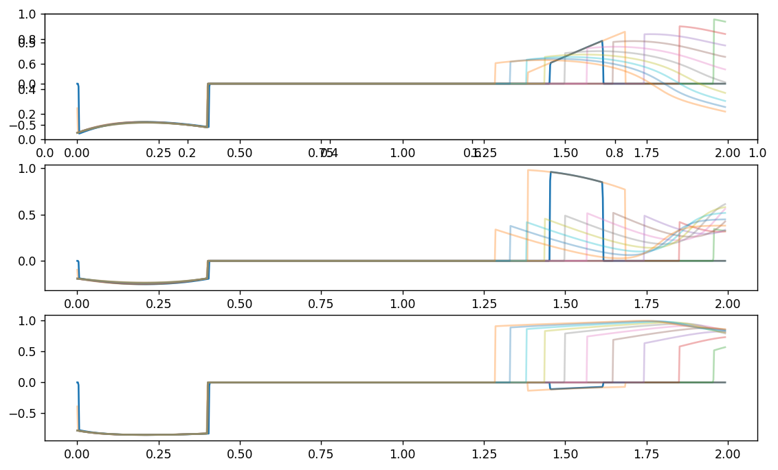
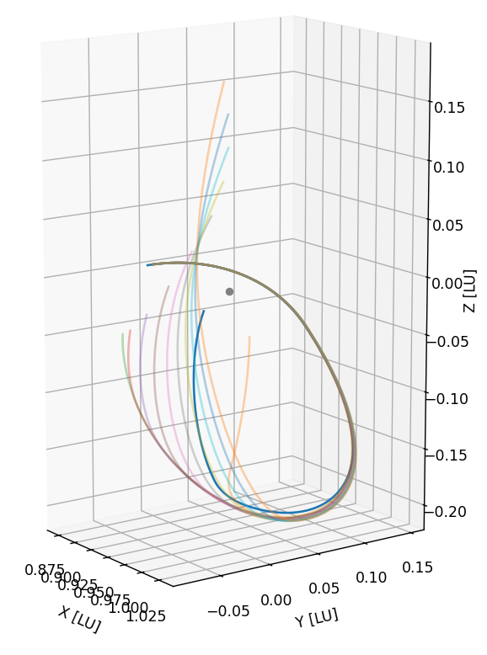
Methodology
Costate Guessing Algorithm
The costate guessing algorithm is very effective, so long as we have good knowledge of λ_{v,i}, λ_{v,f}, and the position history during the thrusting arc (examples are computed with truth data)
Different |λ_{v,i}| are required since multiple costate histories can result in the same initial thrusting arc
Additional variation must also be added to account for estimation errors

Slide 12
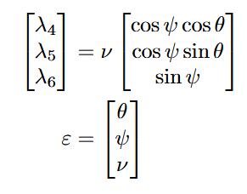
Methodology
Reformulation of λ_{v}
The magnitude and direction of control are both controlled by λ_{v}
If we can separate these two aspects of the control, we can affect them individually
Reformulate λ_{v} as two angles and a magnitude
Performs better than original formulation, but still not enough to make traditional filtering algorithms work

Slide 13
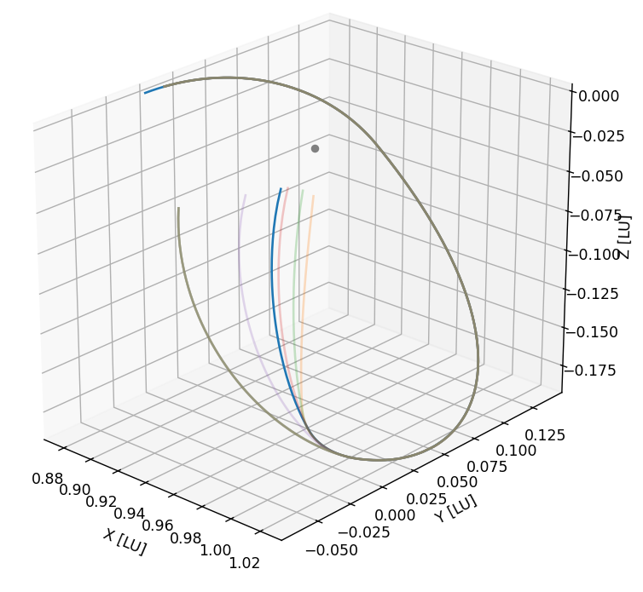
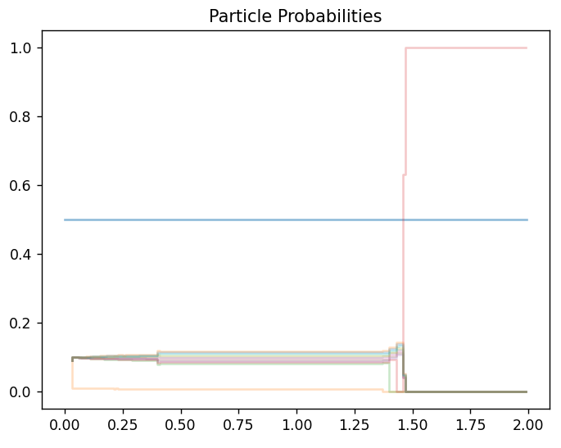
Methodology
Particle Filtering
Because of the extreme nonlinearity of the problem, it makes sense to abandon the Gaussian assumption and approximate the distribution with individual particles
Becomes a type of genetic algorithm, since each particle represents a different hypothesis, and we eliminate infeasible hypotheses and generate likely hypotheses as information becomes available
Additionally, we can increase particle density for hypotheses involving thrusting near unstable manifolds

Slide 14
Future Work
Improve initial filter for costate guessing algorithm
Implement particle filtering
  Need to develop a way to choose particles smartly, both for initialization and to replace eliminated particles
  Cannot choose directly between adjacent particles, since a costate “between” two particles does not result in a control between the two particles
  Could involve utilizing knowledge of the unstable manifolds
Test against a variety of data sets
  Optimal transfers obtained from indirect AND direct methods
  A variety of transfers
  Different observational conditions

Slide 15
Thank You
Questions?

