Slide 1
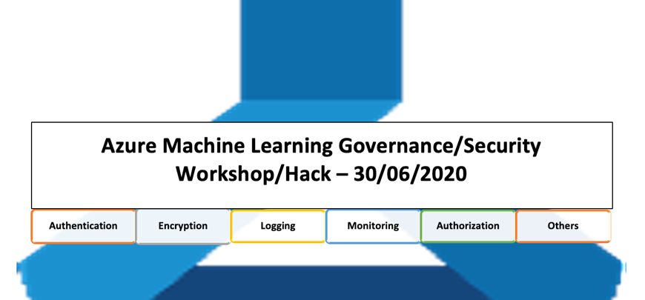
Mufajjul Ali
Alan Weaver
FatOS ISMALI
Robin Lester
Alessandro Recino
Wasim Ahmed
Joe Plumb
Ben Coleman

Slide 2
Overview
Access control is a fundamental building block for enterprise customers, where protecting assets at various level is imperative to ensure that only the relevant people with certain position of authority are given the relevant access with different privileges. This is more so prevalent in machine learning, where data is absolutely essential in building ML models, and companies are highly cautious about the how the data is accessed and managed, especially with the introduction of GDPR. We are seeing increasing number of customers seeking for explicit control of not only the data, but various stages of machine learning lifecycle, starting from experimentation to operationalization. Assets such as generated models, cluster creation and model deployment require to be governed to ensure that controls are in line with the company’s policy.

Slide 3
Agenda (morning)
9:00 – 9:05
Introduction (Mufajjul Ali)
9:05 – 10:00
Overview of Azure ML and Security / Governance (Fatos Ismali/Joe Plumb)
10:00 – 10:45
Azure Networking (Wasim Ahmed)
10:45 – 11:00
Break
11:00 – 12:00
Data ingestion ( Encryption at Rest/Transit, Key Vault management) & Explainability / Interpretability(Robin Lester)
12:00 – 12:10
Hands-on deployment of secure AML platform(Robin)
12:10 – 13:10
Lunch

Slide 4
Agenda (afternoon)
13:10 – 14:10
MLOps, RBAC roles, environments, and implementation (Mufajjul Ali/Alan Weaver)
14:10 – 14:40
Inference security/monitoring (AKS endpoints, https, key, token, etc.) (Ben / Fatos)
14:50 – 16:00
Model Governance (Ethical AI, Fair learn, Data drift) (Alessandro Recino/Alan Weaver)
16:00 – 16:30
PG session (FAQ and Features)
(Aashish Bhateja / Jumpei Hirono)
16:30
summary and close
14:40 - 14:50 Coffee Break

Slide 5
REPO
https://github.com/mufajjul/aml-govsec2020-workshop

Slide 6
Feedback
https://forms.office.com/Pages/ResponsePage.aspx?id=v4j5cvGGr0GRqy180BHbRy65IxdWegNLmkUZoFUsoatUMko0SjZKSjFMNjFIUzQ0Q0RENTkzWlFDNS4u

