Slide 1
Azure Machine Learning MlOPs & RBAC
Mufajjul Ali
Alan Weaver

Slide 2


Bring ML models to production
Azure Machine Learning service
Author Experiments
Train Models
Package & Validate
Deploy & Serve
Monitor
Automated ML & ML Pipelines
Azure ML Compute
Package & certify models
Run inference at scale
Monitor models & analyze drift
Azure DevOps integration
CI/CD and model retraining

Slide 3
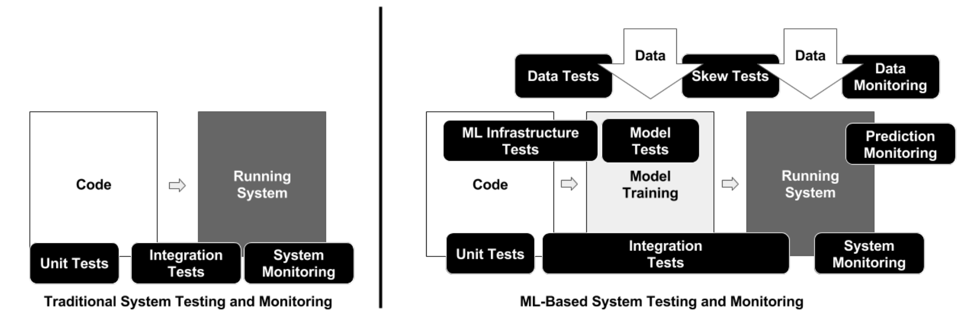
Traditional vs. ML infused systems

Slide 4
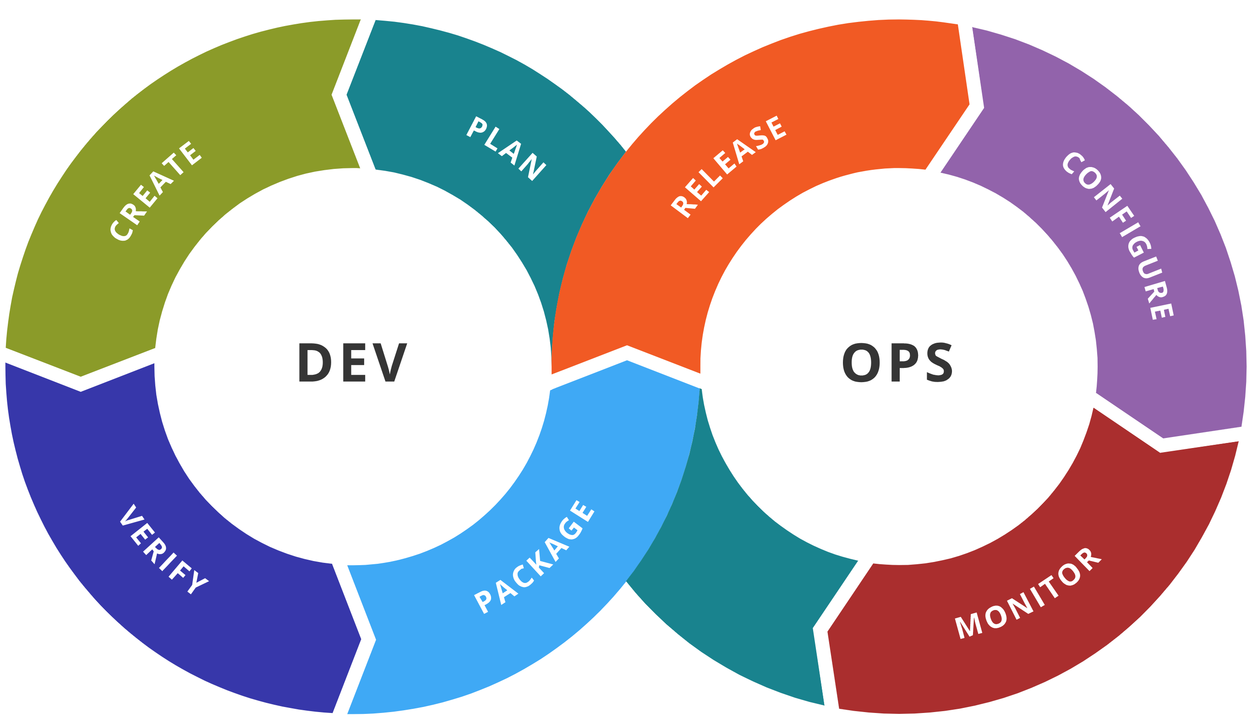
MLOps = ML + DEV + OPS
Help bring models to production
ML
Experiment
Data Acquisition
Business Understanding
Initial Modeling
Develop
Modeling
Operate
Continuous Delivery
Data Feedback Loop
System + Model Monitoring
+ Testing
Continuous Integration
Continuous Deployment

Slide 5


MLOps Process
Enterprise ready machine learning development
Data Engineer
Train Model
Data Scientist
Data Catalog
Prepare Data
Prepare
Train
Evaluate
Model Registry
Code Repo
Data Lake
Release Model
DevOps
Package
Validate
Profile
Approve
Deploy

Slide 6
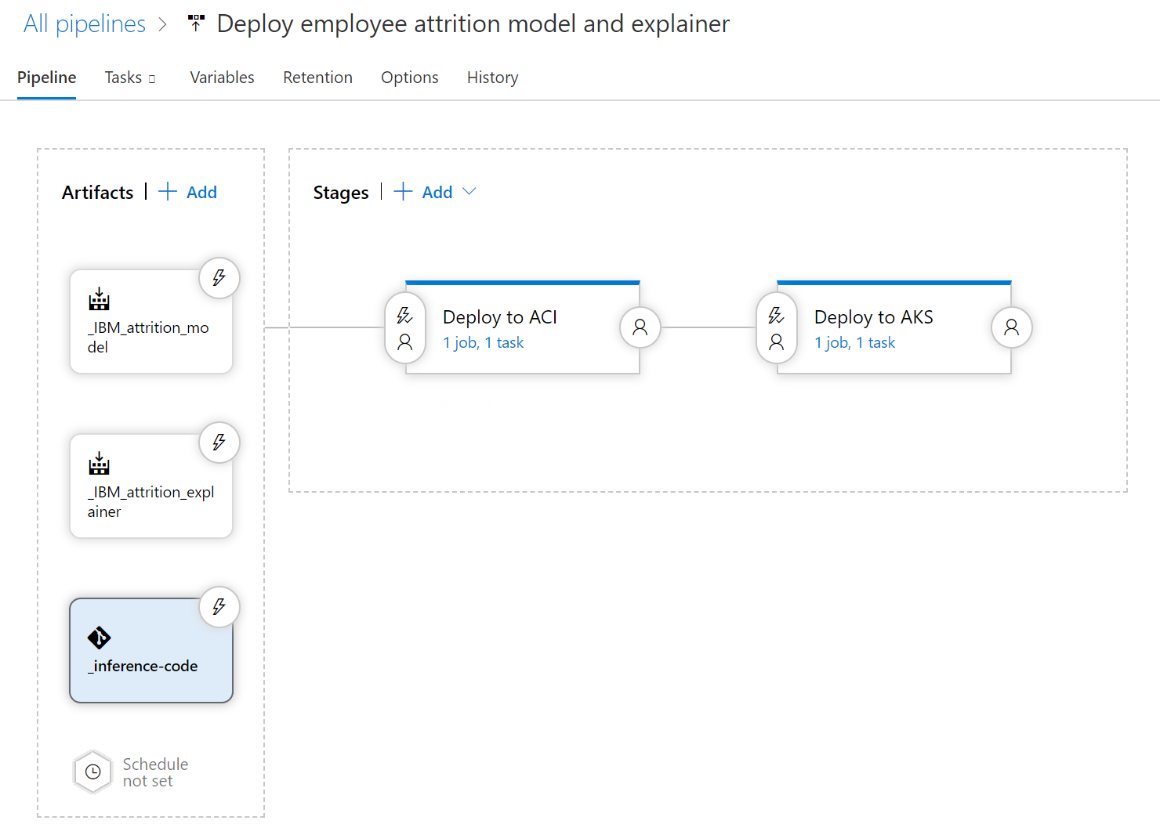
Automate model deployment with Azure DevOps
Trigger release on:
New model(s) available
New inference code
New base image / dependencies available
Notes:
https://azure.microsoft.com/mediahandler/files/resourcefiles/gigaom-Delivering-on-the-Vision-of-MLOps/Delivering%20on%20the%20Vision%20of%20MLOps.pdf
https://azure.microsoft.com/mediahandler/files/resourcefiles/mlops-infographic/MLOps%20Infographic.pdf

Slide 7
Standard RBAC in AML
Role – Defines a collection of permissions
Reader
Contributor
View, create, edit, or delete (where applicable) assets in a workspace. For example, contributors can create an experiment, create or attach a compute cluster, submit a run, and deploy a web service.
Read-only actions in the workspace. Readers can list and view assets in a workspace, but can't create or update these assets.
Owner
Full access to the workspace, including the ability to view, create, edit, or delete (where applicable) assets in a workspace. Additionally, you can change role assignments.

Slide 8
Advance RBAC in AML
Control Plane
Workspace operations (like create, upgrade Edition)
Compute operations (like create, update, delete)
Data Plane
Controlling experimentation, deployment, pipelines and data
Studio also supports RBAC out of the box
UX operations will show/hide button based on your role

Slide 9
Component Level RBAC
Datastore
Dataset
Models
Environments
Deployments
Experimentation
Pipelines
Compute
Workspace
ComputeInstance
DataDrift
DataLabelling

Slide 10
Example of Permissions
Datastore
Microsoft.MachineLearningServices/workspaces/datastores/write
Microsoft.MachineLearningServices/workspaces/datastores/read
Microsoft.MachineLearningServices/workspaces/datastores/delete

Slide 11
Out of the box roles
Technical Roles
Data Scientist
Data Scientist Super User
Office Data Scientist
Operational Roles
IT Admin
Workspace Admin
Subscription Admin
Notes:
https://docs.microsoft.com/en-us/azure/machine-learning/how-to-manage-quotas

Slide 12
Data Scientist
Allowed
Able to create experiment and submit runs
Able to deploy to an ACI but not to a PROD aks cluster
Able to create a draft pipeline but not publish a pipeline endpoint
Able to complete a Hyperdrive or an AutoML run
Able to register datastores and datasets
Can view workspace and subscription level quota allocated for that workspace
Can do all data plane operations within the workspace that are part of a data scientists lifecycle
Not Allowed
Not able to create a compute instance or a training cluster
Not able to upgrade the workspace
Cannot create a new workspace but can use an existing workspace created by the subscription admin
Cannot create new roles or assign users any roles within that workspace

Slide 13
Data Scientist Super User
Allowed
Able to do all operations in the workspace
Able to add new users to the workspace against a pre-created role or a custom role, but not create a new role
Not Allowed
Not able to allocate workspace level quota
Not able to update the Edition of the workspace

Slide 14
Office Data Scientist
Allowed
Start, stop, and restart Notebook VMs
Access the Azure ML workspace portal and see experiments, pipelines, computes, models and deployments.
Create, publish, clone, and delete experiments and pipelines
Run pipelines from SDK and portal
Download log files and statistics
Register and unregister models
List, read and write on any registered datastore
List, read, register and unregister datasets
Not Allowed
Create, update, or delete an AML workspace
Create, update, or delete a Notebook VM
Create, update, delete, or attach computes
Deploy models to any service other than single node AKS cluster
Register/Unregister datastores
Update any type of roles

Slide 15
IT Admin
Allowed
Can create workspace and update Editions of the workspace
Can set workspace level quota
Same as sub level admin (owner)
Not Allowed
Rest are not allowed

Slide 16
Workspace Admin
Allowed
Can create a new workspace and also use an existing workspace created by the subscription admin
Can view workspace and subscription level quota allocated for that workspace
Can create new compute within the bounds of the workspace level quota that the sub admin set on their workspace
Can do all data plane operations within the workspace that are part of a data scientists lifecycle
Can create a compute instance and assign it to a specific data scientist as a personal compute instance
Not allowed
Cannot create new roles but can assign users specific roles within that workspace

Slide 17
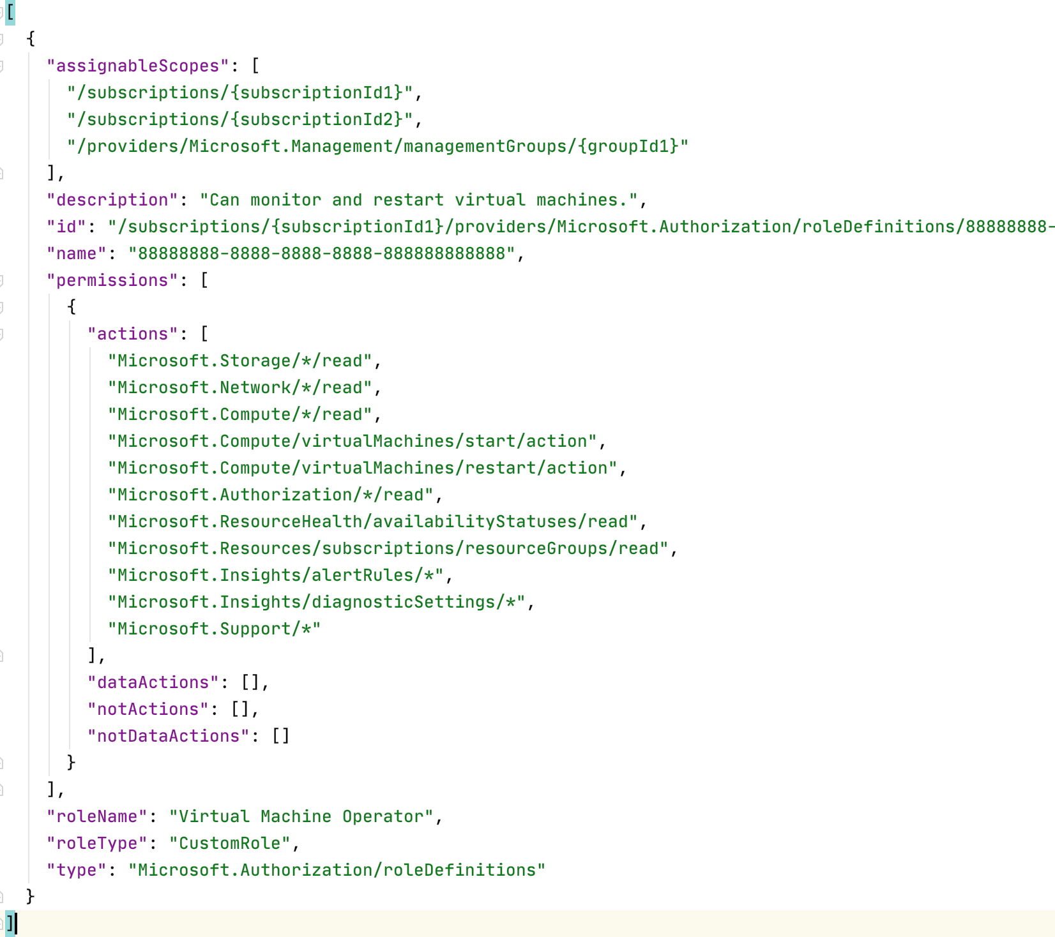
Custom Roles
Can be any combination of data or control plane actions
Useful for creating scoped roles to a specific action like an MLOps Engineer.

Slide 18
Environments
DEV
QA
Prod

Slide 19
Any Questions

