Slide 1
Common mistakes in writing software
Andrei Larionescu
Răzvan Dragomir
29.10.2014

Slide 2
Agenda
Please write clean code!
Common mistakes
Code Smells
Don’t forget to write clean code!
Refactoring

Slide 3
Please write clean code!
Any fool can write code that a computer can understand. Good programmers write code that humans can understand.
Martin Fowler, 2008

Slide 4
Common mistakes
parsing data
using strings
using static modifier
by ref or by val
exceptions
disposing
abusing linq
N+1
switch instead of IF
using CONST for configuration
complex conditions

Slide 5
Code smells
Duplicated code
Long method
Large class
Long parameter list
Using out parameter
Divergent change / shotgun surgery
Feature envy
Data clumps
Switch statements

Slide 6
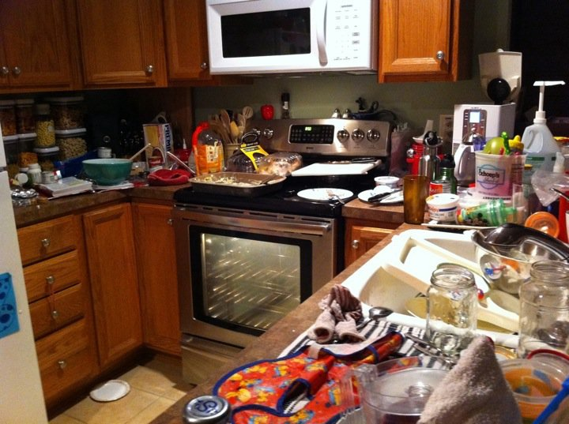
Don’t forget to write clean code!
When your task is considered done?
When cooking is considered done?

Slide 7
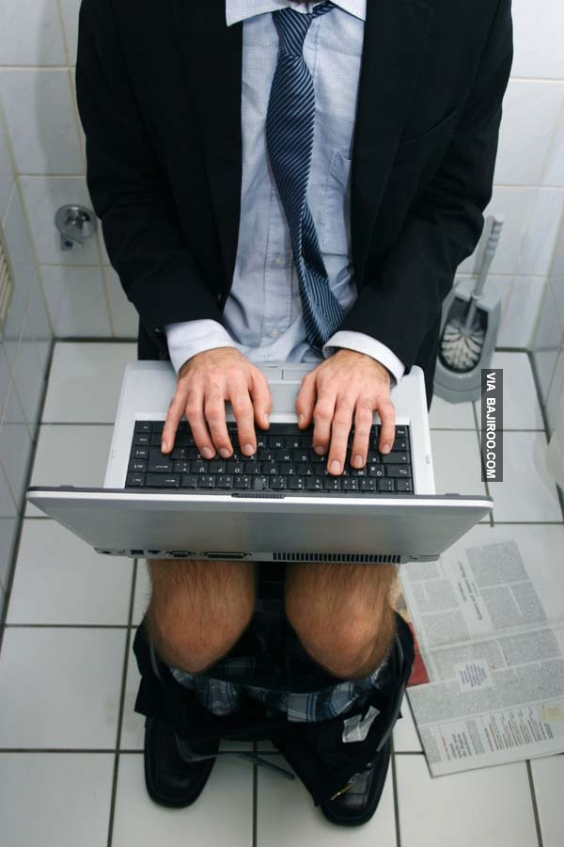
Don’t forget to write clean code!
Refactor your code every time before checking it, otherwise ...

Slide 8
Don’t forget to write clean code!
Refactoring:
leave the code in a better shape than
makes software easier to understand
helps you find bugs
helps you program faster
don't tell your manager that you are going to refactor
do it right away, it is faster
deliver quality code or nothing
you should do on a daily basis

Slide 9
Q & A
Next workshop ideas?

