Slide 1
Web technologies using java
Lab 1
Georgiana Frusescu
Georgiana.Frusescu@endava.com
soare.georgiana95@gmail.com

Slide 2
Agenda
Setup the environment
Java Servlets

Slide 3
Setup the environment
Setup Java Development Kit (JDK) :
Download the open-source build from: https://jdk.java.net/11/
Extract the zip file into a folder: e.g. C:\Program Files\Java\jdk-11.0.6
Edit the system environment variables to support java:
Add the location of the bin folder of the JDK installation to the PATH variable in System Variables;
Set JAVA_HOME: Under System Variables, click New-> Enter the variable name as JAVA_HOME -> Enter the variable value as the installation path of the JDK ( where the zip file was extracted)
Test the installation: open the Command Prompt and type java –version
Download and install an Integrated Development Environment for Java (IntelliJ)-ideaU-2020.2.3
Install a distributed version control system (Git)
Create a GitHub repository:
Create a GitHub account: https://github.com/join?source=header
Create a new repository web-technologies-java-labs from https://github.com/new
Clone the repository: Open the Command Prompt and run the following command:
git clone https://github.com/<<git-username>>/web-technologies-java-labs.git

Slide 4
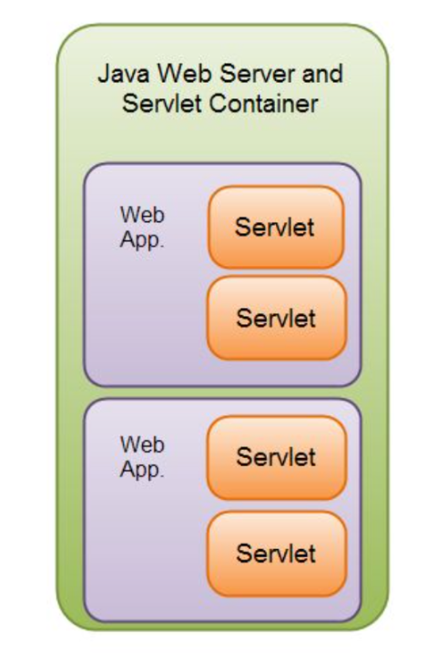
Java Servlets
What is a Servlet?
A Servlet is a Java class that handles requests, processes them and reply back with a response.
A servlet is used to create a Java web application, in order to dynamically generate the contents according to a particular type of a request received by the client (most commonly an HTTP request).
A Java Servlet runs inside a Servlet container. A Servlet container may run multiple web applications at the same time, each having multiple servlets running inside.

Slide 5
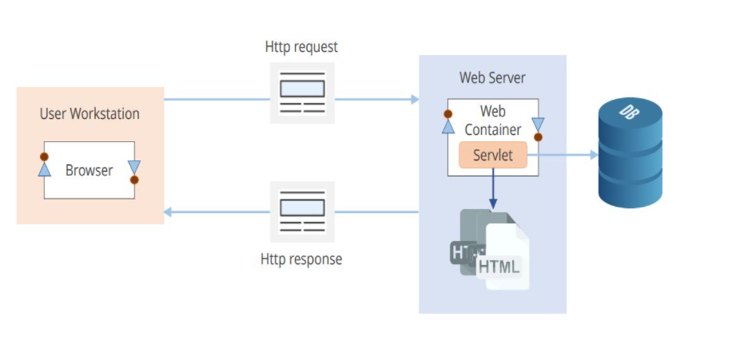
Java Servlet usages:
A Java Servlet can be used:
collect input from a user through an HTML form;
query records from a database;
create web pages dynamically;

Slide 6
Servlet container
Servlet container, also known as Servlet engine, uses Java to dynamically generate a web page on the Server Side.
In a nutshell, it is a system that manages the Java Servlet components on top of the Web server to handle the Web client requests (e.g. parsing an HTTP request, connection handling etc).
One of the best-known open source servlet containers is Tomcat.

Slide 7
Servlet Lifecycle
The Servlet container manages the servlet lifecycle. There are three methods which define the servlet lifecycle and they can be found in the Servlet interface.
init()
The first time a servlet is invoked, the init() method is called (only once during a lifetime of a servlet)
service()
The Container calls the service() method after the init method was successfully completed, to handle requests coming from the client, interprets the HTTP request type (GET, POST, PUT, DELETE, etc.) and calls doGet, doPost, doPut, doDelete, etc. methods as appropriate.
destroy()

Slide 8
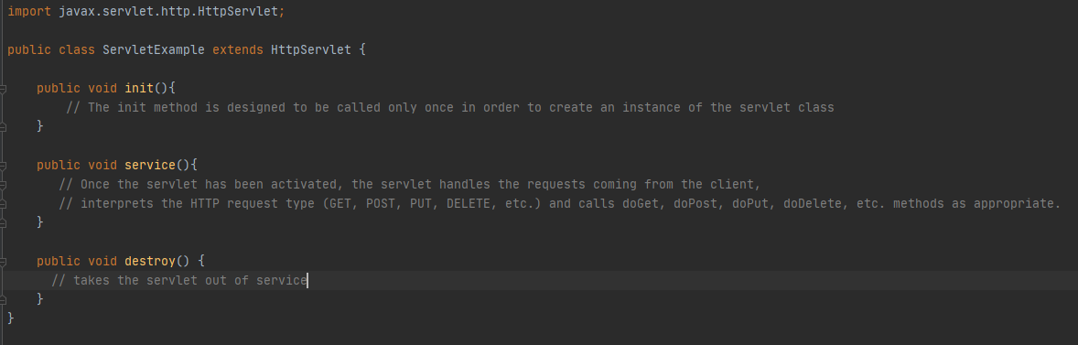

Slide 9
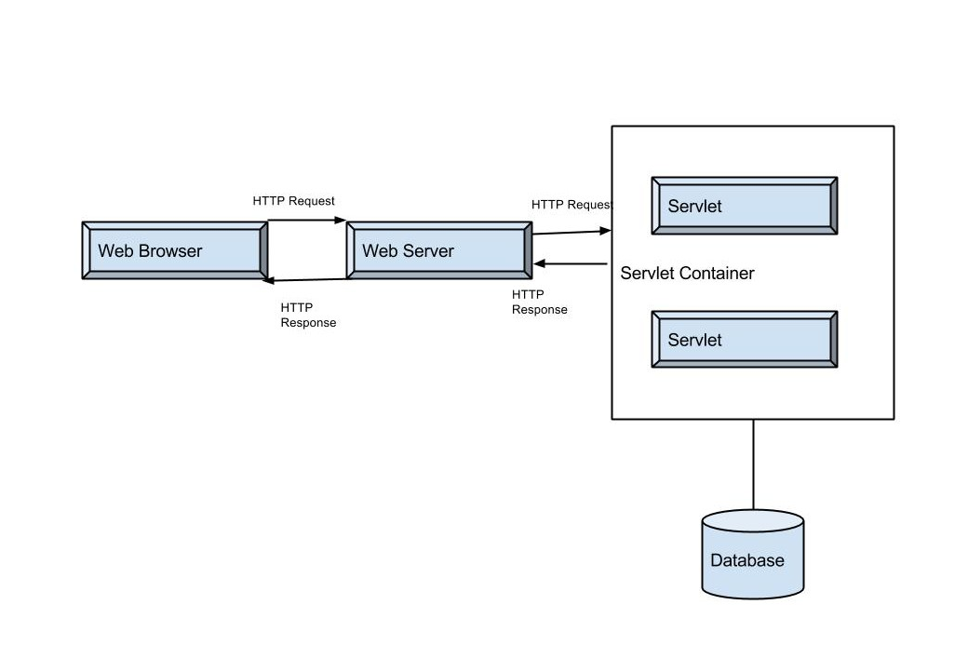
Execution of Servlets
Execution of Servlets involves six basic steps:
The clients send the request to the web server.
The web server receives the request.
The web server passes the request to the corresponding servlet.
The servlet processes the request and generates the response in the form of output.
The servlet sends the response back to the web server.
The web server sends the response back to the client and the client browser displays it on the screen.

Slide 10
Practice Time
Java servlet containers are usually running inside a Java web server such as Jetty, Tomcat, etc.
For our lab, we will use a Tomcat web server.
Let’s setup a Tomcat web server by:
Download Tomcat from https://tomcat.apache.org/ - Tomcat 9.0 zip file
Unzip and add the folder in a location of your preference
In your IDE create a project: Java Enterprise and setup the application server as the downloaded tomcat web server.

Slide 11
Requirements:
Create a JavaEE project in IntelliJ running on a Tomcat Application Server;
Create a form on JSP file;
Create a Servlet:
Configure URL through web.xml/ @WebServlet annotation
Receive Request parameters from URL (GET)
Receive Request parameters from form (POST)
Send values to a new JSP page
Validate login-form

Slide 12
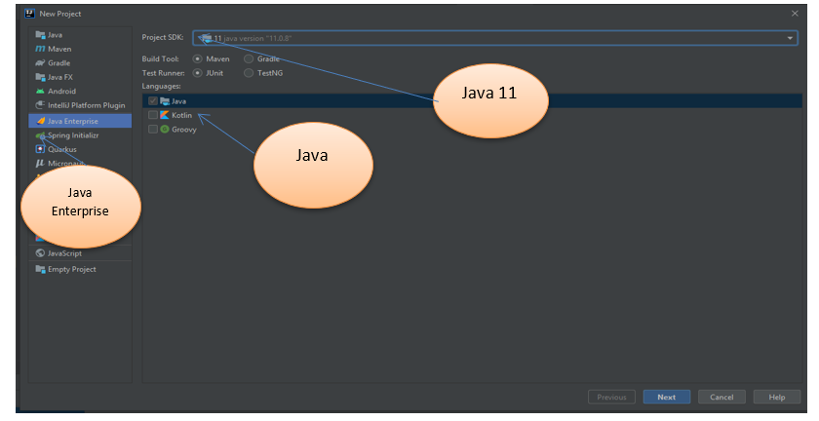
Ensure the IntelliJ IDEA version is :
Create a new Java Enterprise project and configure it as following:

Slide 13
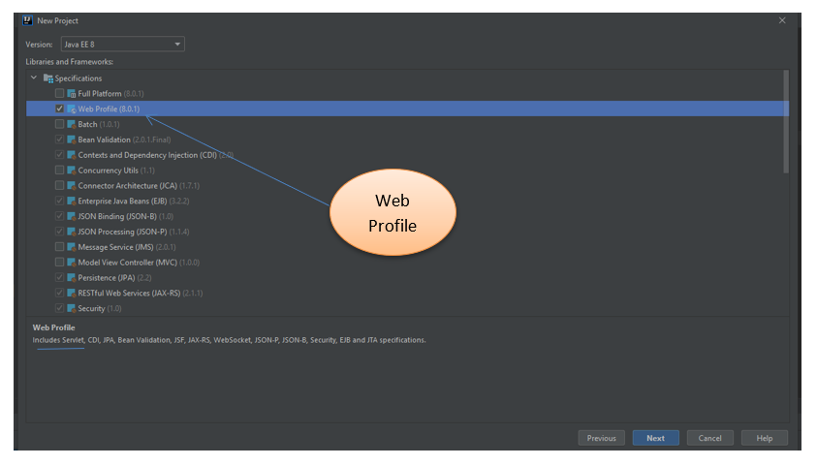
Choose the Web Profile (includes Servlets)

Slide 14
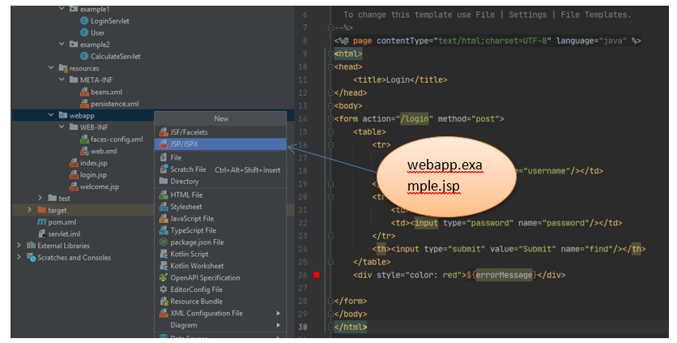
Create a JSP file
A JSP file is a server-generated web page. It is similar to an .ASP or .PHP file, but contains Java code instead of ActiveX or PHP.
The code is parsed by the web server, which generates HTML that is sent to the user's computer.

Slide 15
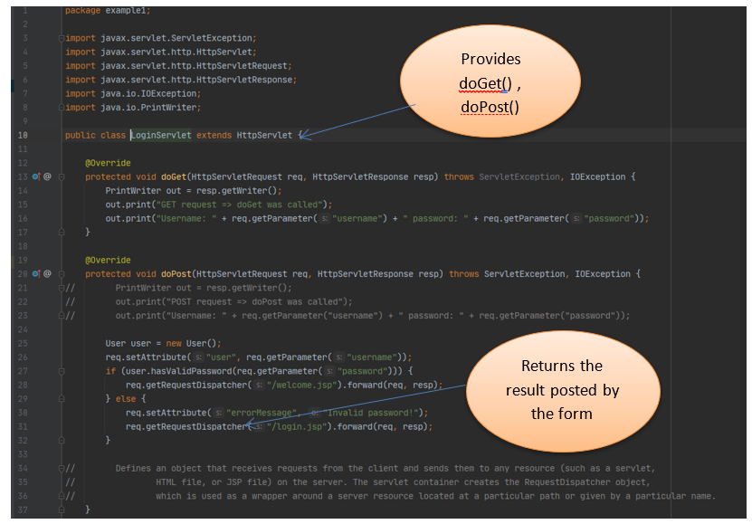
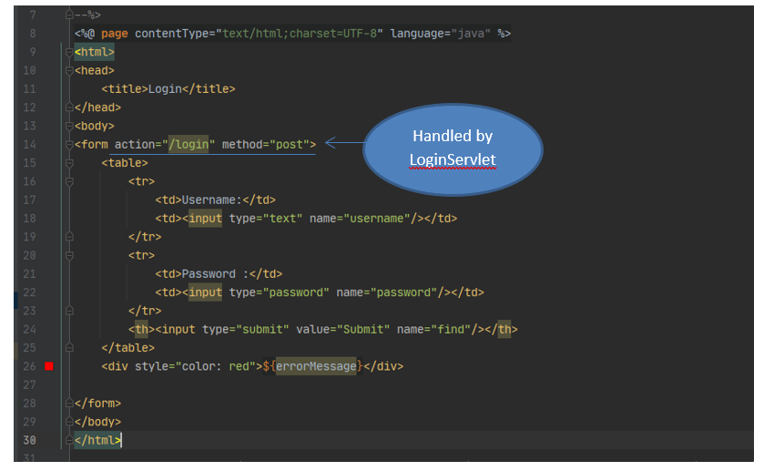
Create a Java Servlet All servlets must implement the Servlet interface, which defines life-cycle methods. When it comes to HTTP Servlets, the java class must extend the abstract HttpServlet class which provides methods, such as doGet and doPost, for handling HTTP-specific services.

Slide 16
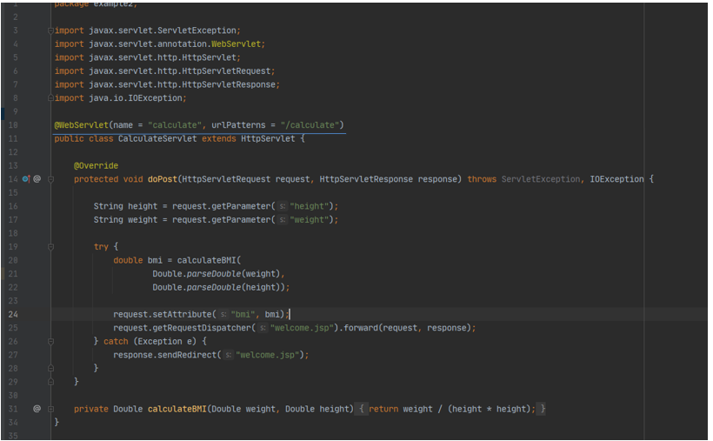
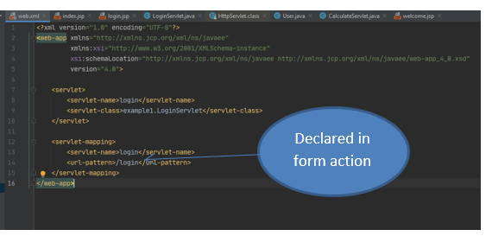
Mapping the Servlet
We can avoid using XML deployment descriptor named web.xml for our Servlet mapping by using the @WebServlet annotation which is processed by the container at deployment time, and the corresponding servlet made available at the specified URL patterns:
Map the servlet using XML deployment descriptor named web.xml

Slide 17

Questions

