Slide 1

Exploratory Data Analysis
G2M Case Study
15-March-2021

Slide 2

Agenda
Problem Statement
Dataset
Hypothesis
Recommendation

Slide 3
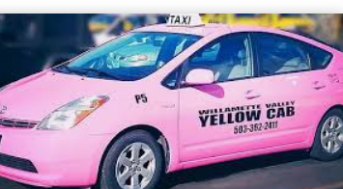
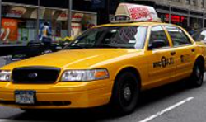
Problem Statement
VS
Context: XYZ is a private equity firm in US. Cab Industry in US has grown considerably in last few years.
Purpose: Provide a reliable recommendation in which of the two most popular companies
(Yellow Cab and Pink Cab) it would be more advantageous to invest in.

Slide 4


Dataset
Dataset:
City.csv * users considering the total number of users no matter the company
Transaction_id.csv
Customer_id.csv
Cab_data.csv]
Master_ data.csv
Number features: 17
Data entries: 359392

Slide 5
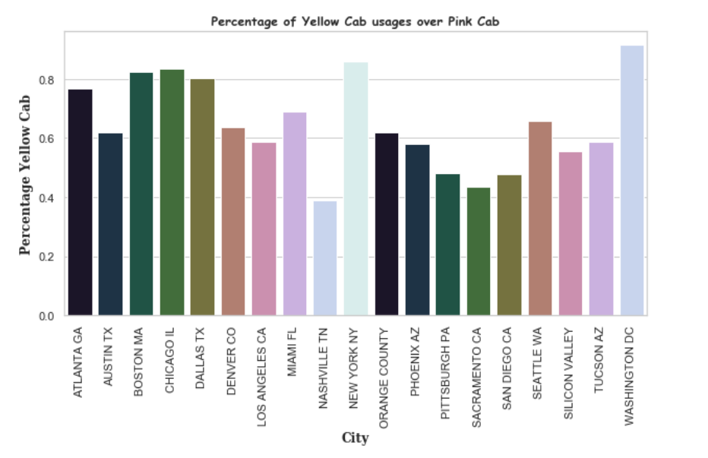
Hypothesis
Is there a preference for Yellow Cab
when travelling by taxi around each city?
According to the distribution of the two companies in every cities, in some cities, like New York, Washington DC, Boston, Chicago, Dallas the most popular ones, the Yellow Cab is over 80% more preferable over Pink Cab.
On the other hand, in cities like Nashville, Sacramento, San Diego, Pink Cab is around 60% more preferable than Yellow Cab.
Yellow Cab seems to in the first place in cities distributions.

Slide 6
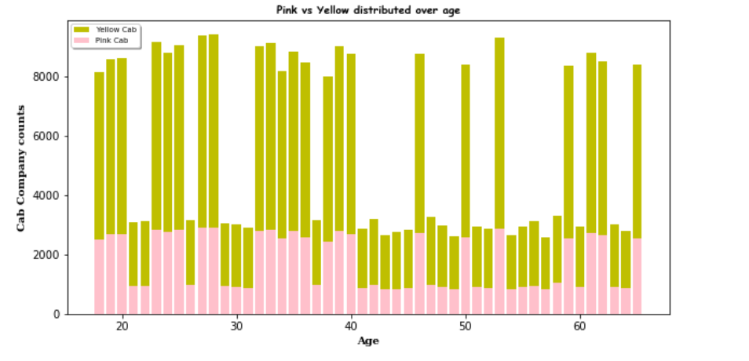
Hypothesis
Is any company preferred by a certain category of age?
Yellow Cab is preferred by everyone, no matter the age.

Slide 7
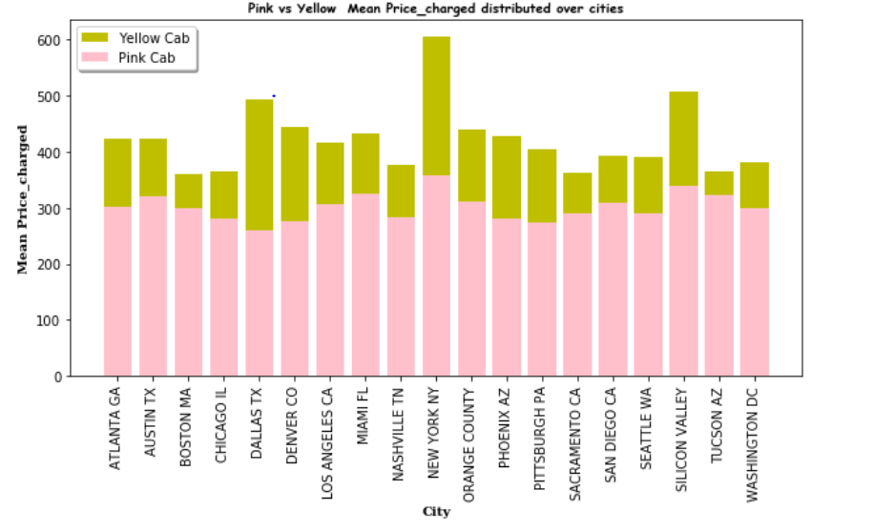
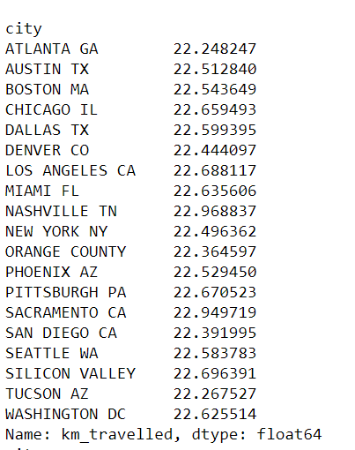
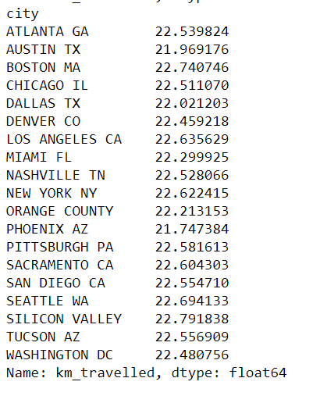
Hypothesis
What is the mean price_charged /km
in every city for each company?
Mean km - Pink
Mean km - Yellow
In every city, with both company the km_travelled mean is 22 km. The price for the same km_travelled in different cities, the price is really different, even a significantly difference is noticed when using Yellow Cab company.
New York, Sillicon Valley and Dallas seems to be the most expensive cities.

Slide 8
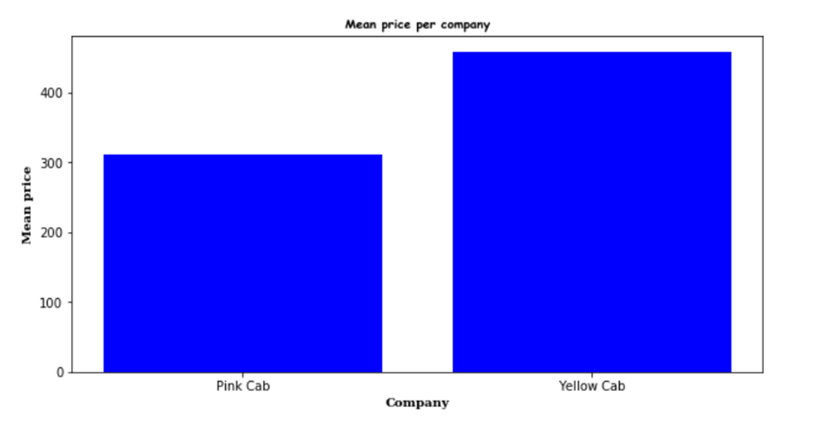
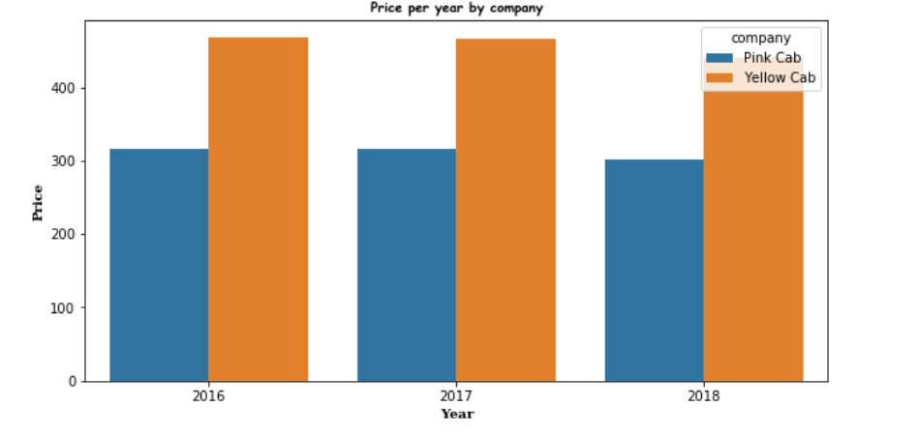
Hypothesis
Mean price per company
Evolution of price along years by company
Yellow Cab is the most expensive company.
Along years, price remained in the same range.
In 2018, it was noticed a decrease for both companies.

Slide 9
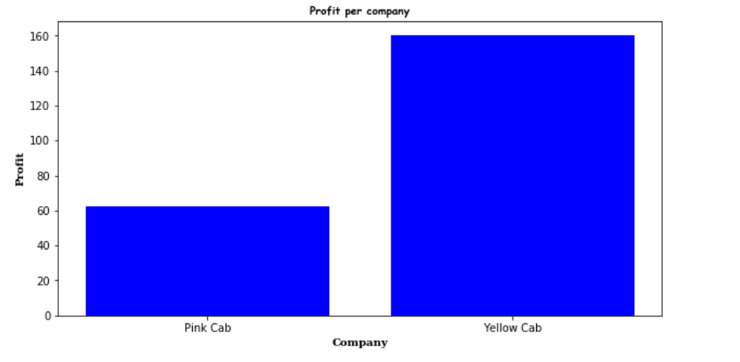
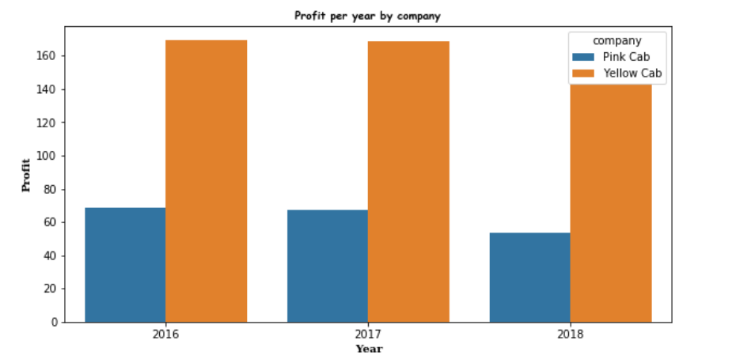
Hypothesis
Mean profit per company
Evolution of profit along years by company
Yellow Company has brought the highest profit.
Along years, profit remained in the same range.
In 2018, it was noticed a decrease for both companies.

Slide 10
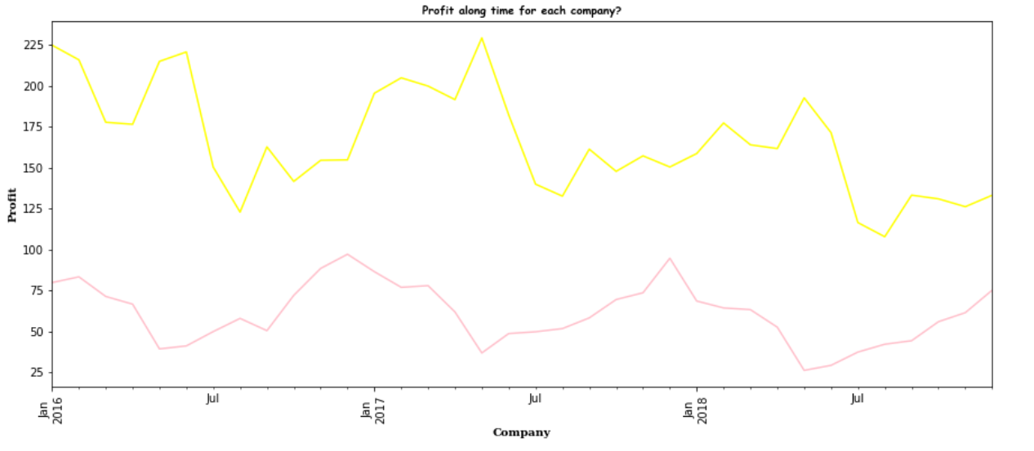
Hypothesis
Profit along years for each company
No matter the time, Yellow Company has the highest profit.

Slide 11
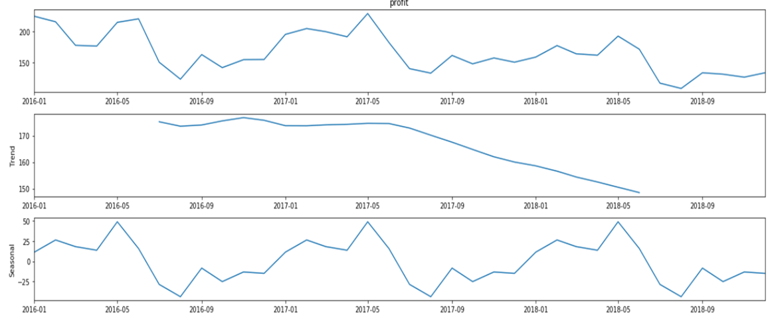
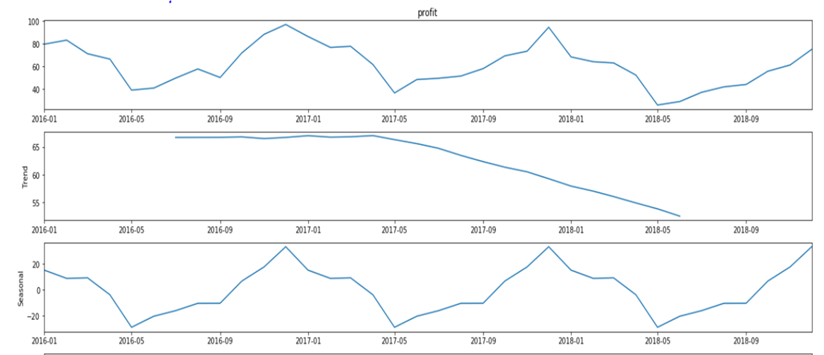
Hypothesis
Evolution profit & Trend & Seasonality
Y
E
L
L
O
W
We may notice that on May time, every year, Yellow Company has the highest profit.
On the other hand, on May time, every year, Pink Company has the lowest profit.
Pink Company seems to have the higher profit during winter holidays. Yellow Company have the lowest profit during end of summer.
Starting from 2017 May, to the summer of 2018, there was a tendency of profit decreasing for both companies.
P
I
N
K

Slide 12
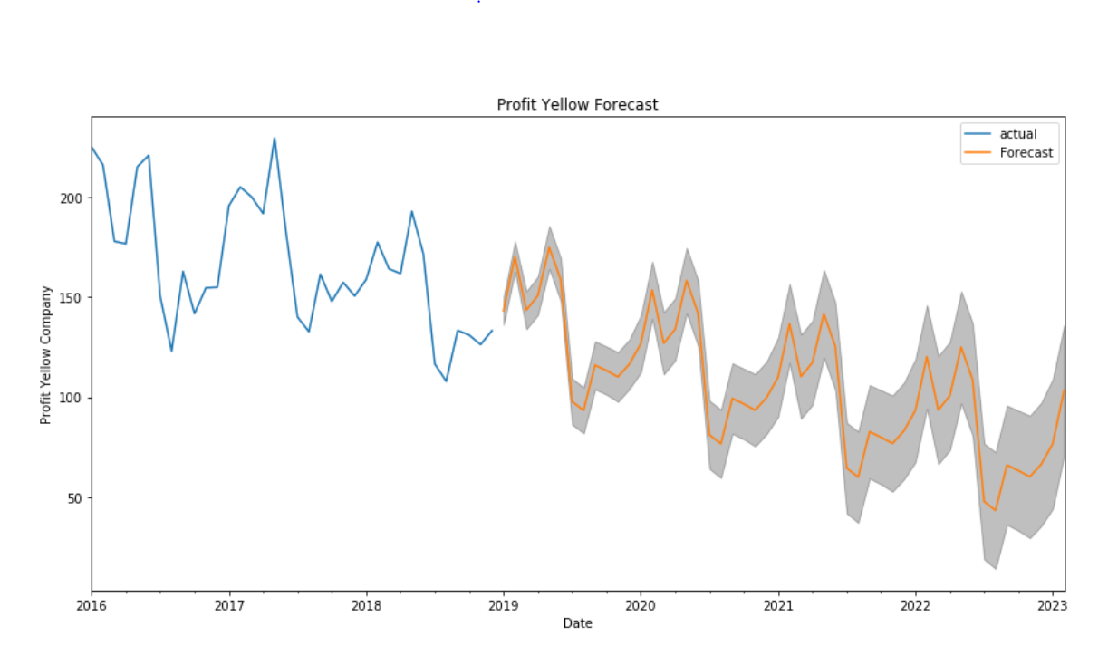
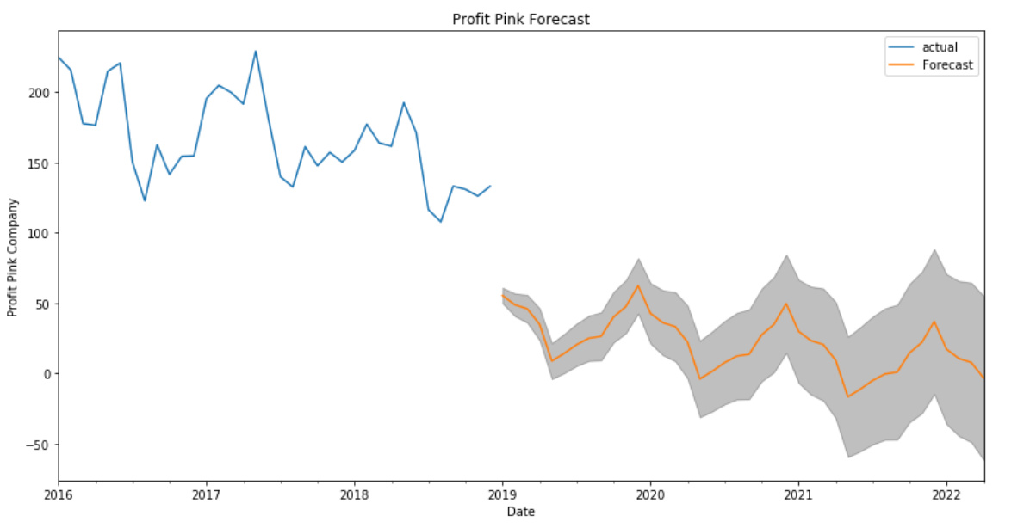
Hypothesis
Forecasting
Considering the forecast plots above for both companies, the profit for both companies tend to decrease in the following years, but the rate is different.
It would not be so much loss considering Yellow Company.

Slide 13
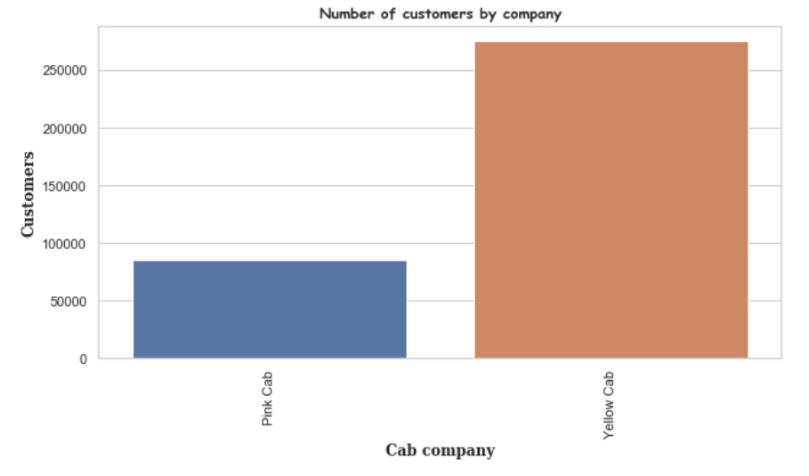
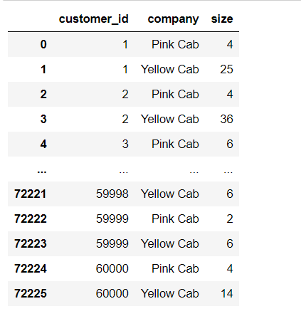
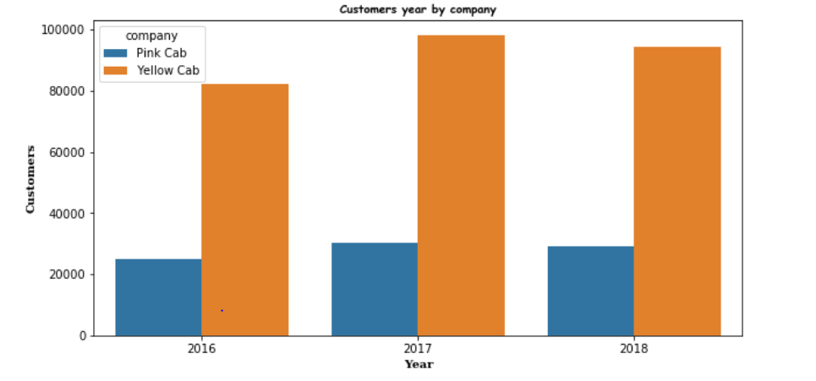
Hypothesis
Number of customers per company
Evolution of customers along years by company
Same customers travel by both companies.
Most of them prefer Yellow Company.
2017 was the year with the highest number of customers for both companies.
Yellow Cab has the highest number of customers.

Slide 14
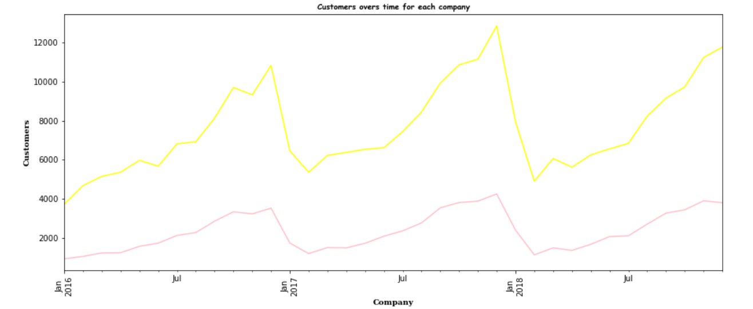
Hypothesis
Customers along years for each company
No matter the time, Yellow Company has the highest number of customers.

Slide 15
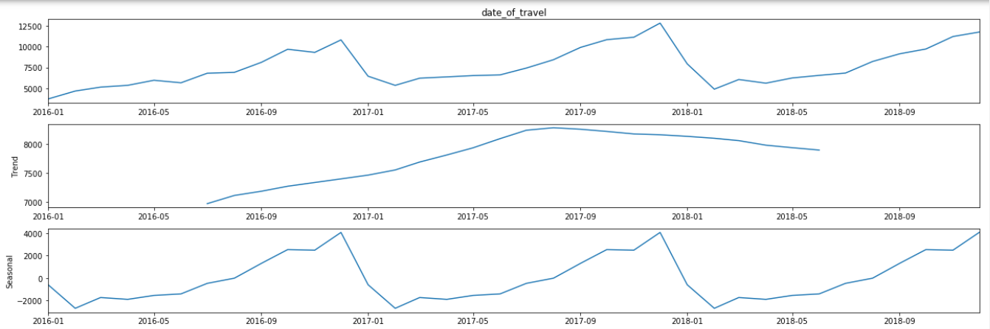
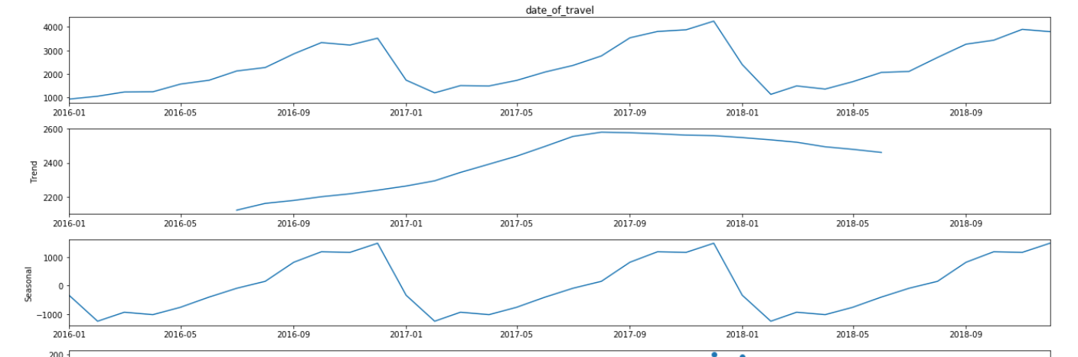
Hypothesis
Evolution customers & Trend & Seasonality
Y
E
L
L
O
W
Number of customers is lowest near the end of the each year for both companies.
P
I
N
K

Slide 16
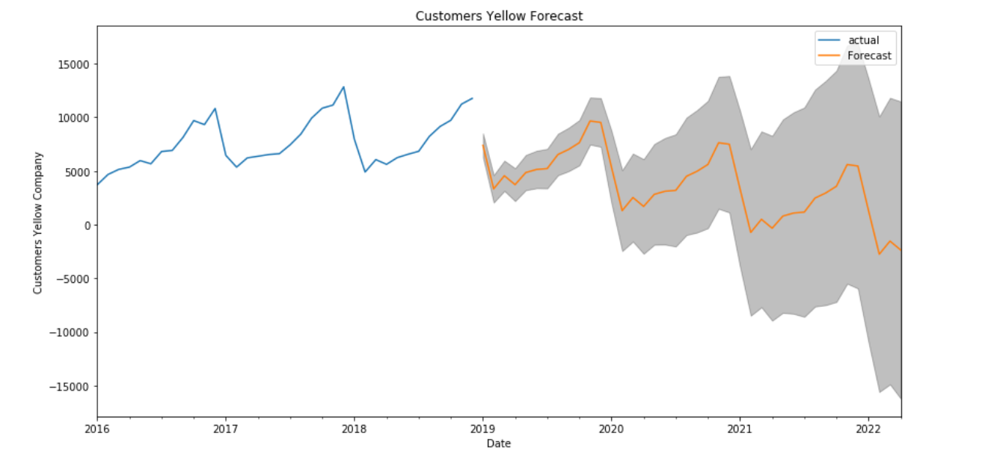
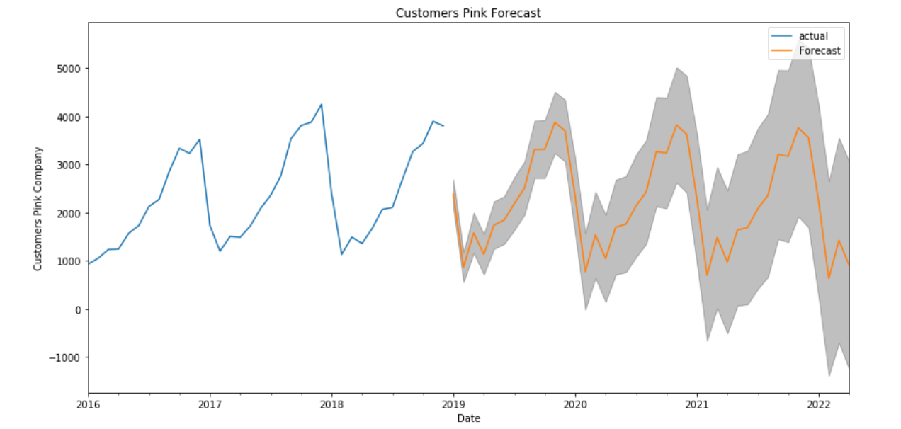
Hypothesis
Forecasting
There is a tendency of decreasing, but more customers will choose Yellow Company.

Slide 17

Yellow Company because:
it is mostly used no matter the season
it has the higher profit
it is preferred by everyone, no matter the age
it has great popularity along most of the cities
Conclusions
and Recommendation

Slide 18
Thank You

