Slide 1
Husky: A Functional Library for C++
Ayo Fapohunda (oaf2119@columbia.edu)
Larissa Passos (ln2307@columbia.edu)
Vinicius Cousseau (vd2299@columbia.edu)

Slide 2
Abstract
Project object was to write higher order functions for C++11/14 that extend the current STL, in order to enable better functional programming, showing how it compares to other libraries/languages.
Show that C++11/14 provides much better resources for functional-style programming.
Time needed:
Q&A:
(Slide will be hidden)

Slide 3

Outline
Functional programming context
Previous approaches in imperative languages (C++)
Our Design
Comparisons
Our results

Slide 4
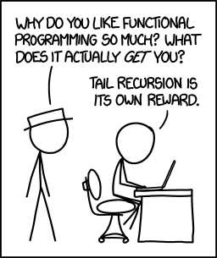
Functional Programming
What is functional programming?
Programming paradigm
Mathematical functions
Avoids side-effects
Abstractions
Contrast to imperative programming
Subroutines
Notes:
Tell that we're based on Haskell. What is it:
functional programming is a programming paradigm—a style of building the structure and elements of computer programs—that treats computation as the evaluation of mathematical functions and avoids changing-state and mutable data. It is a declarative programming paradigm, which means programming is done with expressions
In contrast, imperative programming changes state with commands in the source language, the most simple example being assignment. Imperative programming does have functions, not in the mathematical sense, but in the sense of subroutines. For example C++
Lazy Evaluation
Briefly talk about its usefulness and what it is (introduce it)

Slide 5
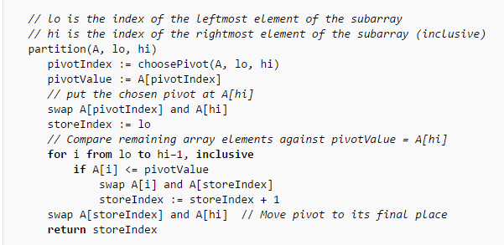
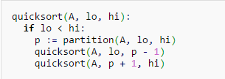
Quicksort

Slide 6
“Quicksort”
quicksort [] = []
quicksort (p:xs) = (quicksort lesser) ++ [p] ++ (quicksort greater)
where
lesser = filter (< p) xs
greater = filter (>= p) xs

Slide 7
“Quicksort”
qs (a:as) = qs [x| x <- as, x <= a] ++ [a]
++ qs [ x | x <- as, x > a]

Slide 8
Comparison Targets
Existing libraries: FC++ (2000) and FTL (~2014)
Other languages: Haskell, Python
Criteria
Notes:
The C++ library we are comparing against are FC++ and FTL
FC++ - introduce 2005 at ACM Sigplan conference
FTL – not as prestigious, not published (recent)
Python widely used and functional is being added to language (Talk about generators)
Criteria for comparison
Code readability
Speed
Ease of coding.

Slide 9
Husky Design
~50 Functions based on Haskell Prelude
General structure
Tests, tests, tests...
Notes:
Talk about how C++11 and C++14 offer more and more higher order functions and how happy we were to discover that.
Cons, Concat (2 versions), Head, Last , Tail, Init, Null, Length, At, Reverse, Foldl, Foldl1, Foldr, Foldr1, And, Or, Any, All, Sum, Product, Concat, concatMAp, maximum ,minimum ,scanl ,scanl1, scanr, scanr1, take, drop, dopWhile, takeWhile, spliAt, break, span, elem, notElem, zip, zip3, zipWith, zipWith3, unzip, unzip3, map, lines, words, unlines, unwords, << operator, filter, compose
FC++ – imlements wrapper class
FTL - extends STL containers
Us

Slide 10
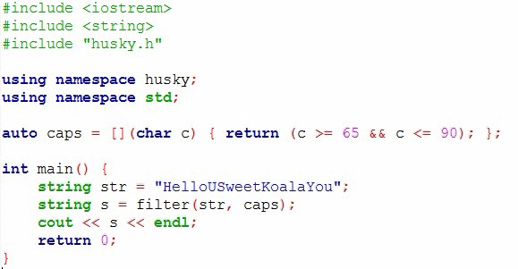
Husky Design
HUSKY

Slide 11
Testing Suite
OS X 10.10.3
2.3 GHz intel i7 quad-core
16gb RAM 1600Mhz DDR3
Clang++
Input vectors of
int
std::string
Record { int, std::string }
Average of 3 iterations for each input vector, 100k – 500k
Notes:
struct Record {
int num;
string str;
};
3 random inputs were generated for each object tested.
Ran tests for sizes 100k to 500k
Bash script to run all tests
Tested for all functions which we implemented and the language/library had. All of them, except from Haskell, didn’t have all functions. This goes to show a more comprehensive implementation.
* Except for FC++

Slide 12
Additional Considerations
Less Functions
Timing in Haskell
Lack of proper documentation/tutorials (FC++ and FTL)
Notes:
-Haskell
o Timing difficulties due to the lazy evaluation
o Did not test for records
-Python
Didn’t have all functions we wrote
-FTL
o It had ~10 functions only
-Fc++
o Is old; generates lots of warnings in modern compilers
o Wrapper class made us spend some time converting from vectors to List<>. Besides, the wrapper class is not as efficient as a std::vector
o Lack of documentation and tutorials (we had to look in the actual implementation of the library in order to learn how to use the functions.
o Some functions could not be tested even though they were being called as specified in the implementation.
o Didn’t have all functions we wrote
o Library has error which causes destructor calls to overflow the stack
Realized that this (tutorials and documentation) is reaaally important

Slide 13
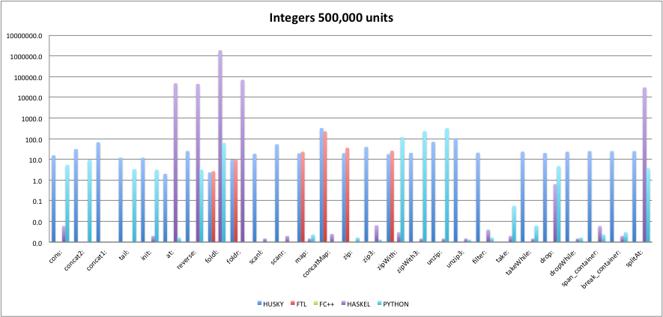
Results

Slide 14
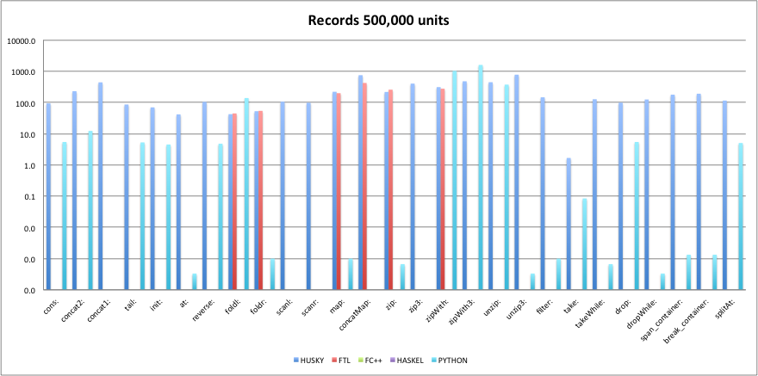
Results

Slide 15
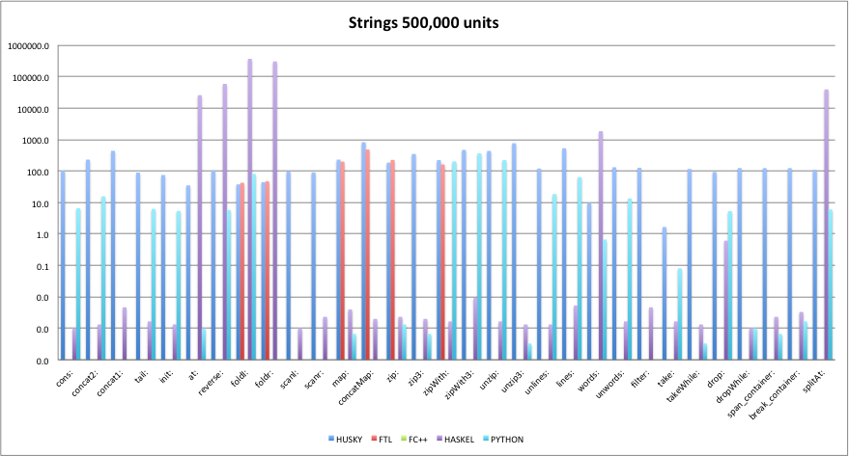
Results

Slide 16
Additional Testing Suite
Windows 8.1 64-bit
16 Gb RAM
2.5 GHz i7
g++
Input vectors of ints, size 100k
Notes:
struct Record {
int num;
string str;
};
3 random inputs were generated for each object tested.
Ran tests for sizes 100k to 500k
Bash script to run all tests
Tested for all functions which we implemented and the language/library had. All of them, except from Haskell, didn’t have all functions. This goes to show a more comprehensive implementation.
* Except for FC++

Slide 17
Case Study
// Long lists create long recursions of destructors that blow the
// stack. So we have an iterative destructor. It is quite tricky to
// get right. The danger is that, when "bypassing" a node to be
// unlinked and destructed, that node's 'next' pointer is, in fact, a
// List object, whose destructor will be called. As a result, as you
// bypass a node, you need to see if its refC is down to 1, and if
// so, mutate its next pointer so that when its destructor is called,
// it won't cause a recursive cascade.
Long lists ~ 130k elements
Notes:
Talk about their implementation and how it has problems, but they implement lazy evaluation. So we can say how nice of a feature it could be for a 1.2 implementation. Couldn’t get it to work with the standard safe list fc++ implementation. Had to manually set a flag (by looking at the actual implementation of their list.h since they have no documentation whatsover) to make the lists safe, that is, avoid a cascading recursion of destructor calls by their functions which were causing the stack to overflow. The comment in the slide is from their header implementation. Couldn’t get it to work on the mac which we were testing for all the other languages/libraries. Got a Killed:9 error everytime.

Slide 18
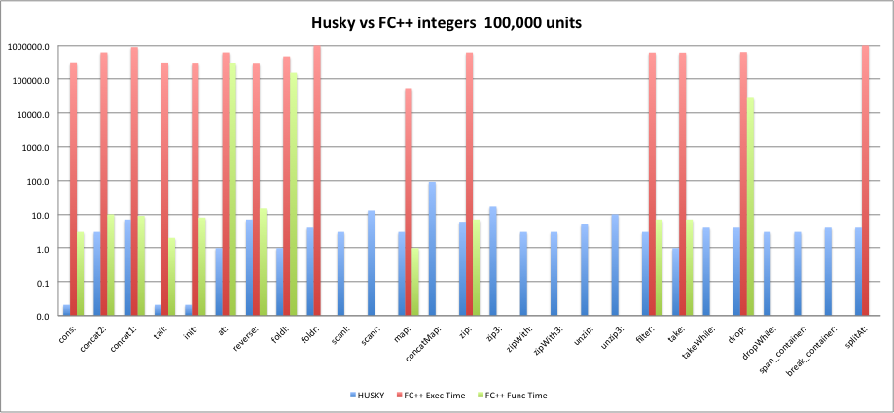
Results

Slide 19
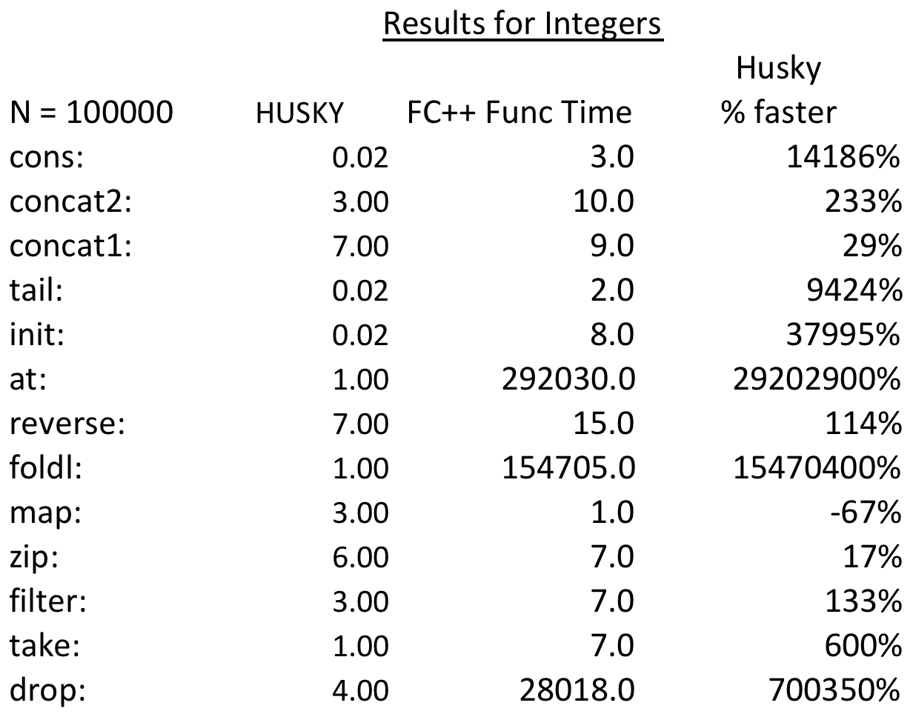
Results

Slide 20
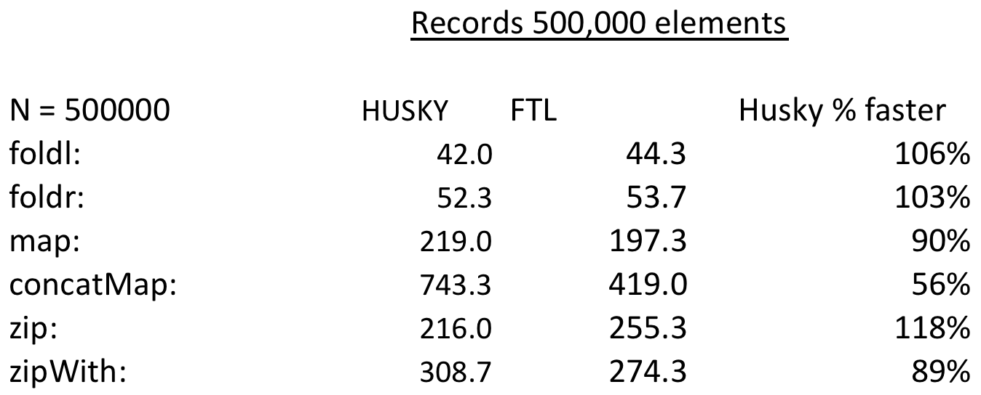
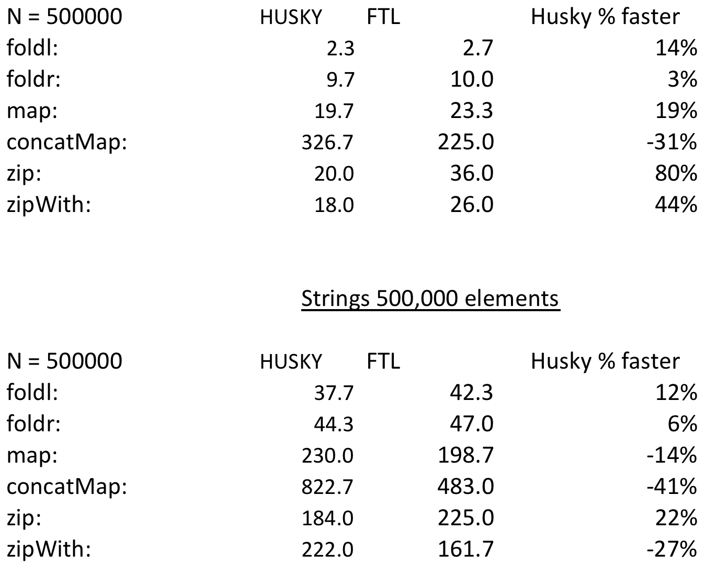
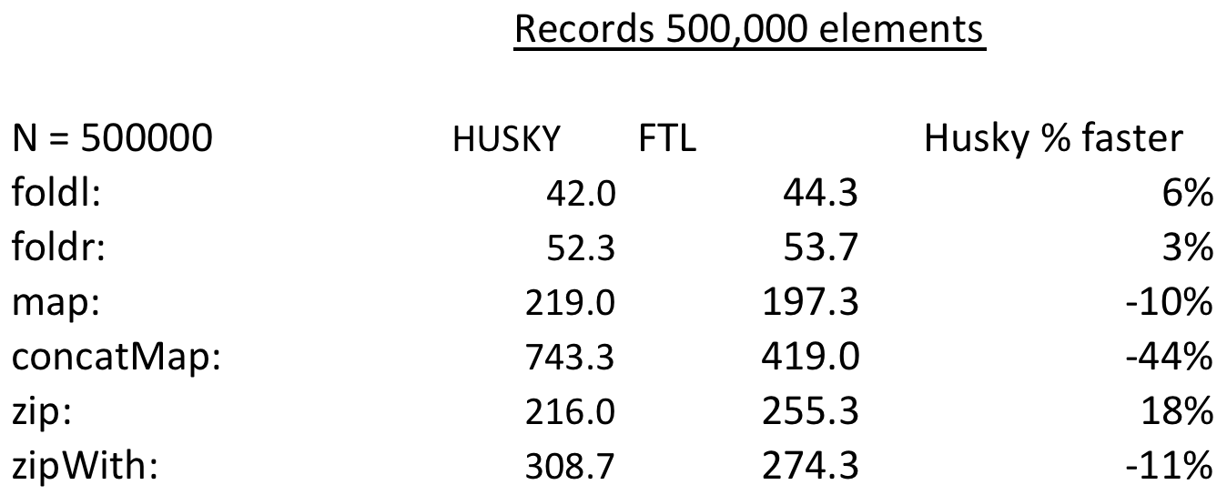
Results

Slide 21
Summation
Comprehensive higher order functional library
Extension of STL
More intuitive way to code
Performs better than our main benchmarks (FC++ & FTL)
Far more and far better documentation/tutorials (FC++ & FTL)

Slide 22
Acknowledgements
FTL : https://github.com/beark/ftl
FC++ : http://cgi.di.uoa.gr/~smaragd/fc++/

Slide 23
Final Considerations
C++14 extending even more!
(1.2) Currying, Lazy Evaluation ?

Slide 24
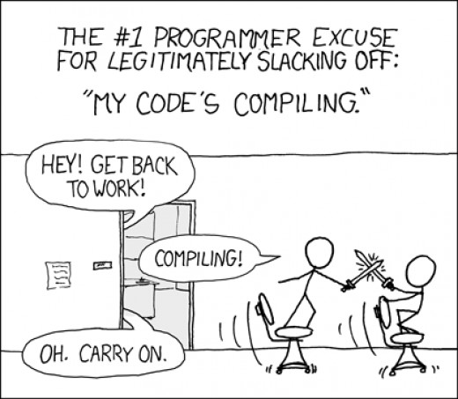
Final Considerations
ln2307@columbia.edu
oaf2119@columbia.edu
vd2299@columbia.edu

Slide 25
References
Husky will be available at https://github.com/larissapassos/Husky
More about functional programming:
https://wiki.haskell.org/Introduction
http://learnyouahaskell.com/

