Slide 1
UNIVERSITÉ CONSTANTINE 1 · TRONC COMMUN SM (LMD) · 2026/2027
INFORMATIQUE 1 • COURS 1_SESSION 1
Algorithmics: From Problem to Program
Informatique 1 — computers, algorithms, pseudocode and first steps in Python
L1 — Sciences de la Matière
Lecture 1h30
DR. FARIDA LARIT
Informatique 1 — Algorithmics · Université Constantine 1 · Tronc Commun SM

Slide 2
LEARNING GOALS
Course Objectives:
Understand Algorithmic Thinking: Grasp the foundational concepts of algorithms and their vital role in structured problem-solving.
Master Python Essentials: Gain practical proficiency in basic Python syntax, data types, and fundamental operators.
Build Program Logic: Design and implement sequential algorithms using core control flow structures, including conditional statements and loops.
Informatique 1 — Algorithmics · Université Constantine 1 · Tronc Commun SM

Slide 3
LEARNING GOALS
What will we learn?
THINK
DESIGN
Break a scientific problem into clear steps.
Build a finite sequence of instructions.
TRANSLATE
VERIFY
Move from an algorithm to Python.
Use AI critically — not blindly.
PROBLEM → ALGORITHM → PYTHON → RESULT
Informatique 1 — Algorithmics · Université Constantine 1 · Tronc Commun SM

Slide 4
OVERVIEW
Lecture roadmap
1
The computer and the program
2
What is an algorithm?
3
Data: constants, variables, types
4
Operators, expressions, assignment
5
Input/Output, flowcharts and Python
6
Worked exercises, common mistakes, quiz
Informatique 1 — Algorithmics · Université Constantine 1 · Tronc Commun SM
3

Slide 5
OVERVIEW
By the end of this lecture, you will be able to…
Explain
Distinguish
How a computer runs a program: hardware, software, memory, and the CPU.
An algorithm (the method) from a program (its translation into a language).
Write
Translate & test
Sequential algorithms in pseudocode using variables, operators, Read, and Write.
An algorithm into Python and check it with a trace table.
Informatique 1 — Algorithmics · Université Constantine 1 · Tronc Commun SM
2

Slide 6
CONCEPT
What is Informatics?
Informatics is the systematic processing, storage,
transmission, and use of information using computers.
English
Français
العربية
Informatics
Informatique
الإعلام الآلي / المعلوماتية
Informatique 1 — Algorithmics · Université Constantine 1 · Tronc Commun SM

Slide 7
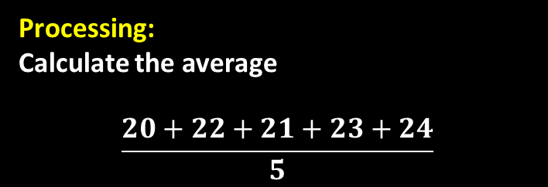
CONCEPT
What is a computer?
INPUT
PROCESSING
OUTPUT
STORAGE
Data enter the system
Instructions are executed
Results are produced
Information is kept
Scientific example: temperature sensor → computer → average temperature
Input:
Temperature sensor
→ 20, 22, 21, 23, 24 °C
Processing:
Calculate the average
$$\frac{20+22+21+23+24}{5}$$
Output:
22 °C
Informatique 1 — Algorithmics · Université Constantine 1 · Tronc Commun SM

Slide 8
1 · THE COMPUTER
A computer system has two halves
HARDWARE
SOFTWARE
The physical parts
The instructions
Processor (CPU) and graphics card (GPU)
Memory: RAM, and storage (SSD / HDD)
Motherboard and buses linking everything
Peripherals: keyboard, mouse, screen, printer, lab sensors
Firmware (BIOS/UEFI) that starts the machine
Operating system: Windows, Linux, macOS, Android
Applications: browser, spreadsheet, simulation tools
Your own programs, written in a language such as Python
Informatique 1 — Algorithmics · Université Constantine 1 · Tronc Commun SM
4

Slide 9
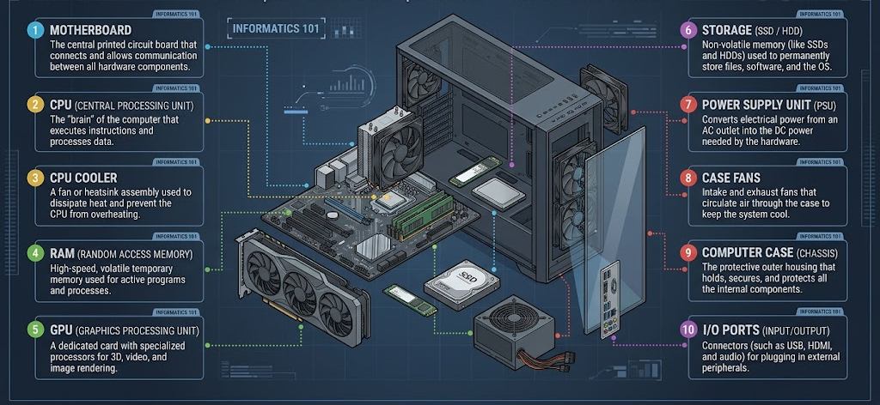
1 · THE COMPUTER
Anatomy of a modern computer
Informatique 1 — Algorithmics · Université Constantine 1 · Tronc Commun SM

Slide 10
1 · THE COMPUTER
Key components and their role
CPU
RAM
Storage (SSD/HDD)
Decodes and executes instructions; modern chips have several cores working in parallel.
Very fast working memory. Holds running programs and data; loses content when the power is off.
Permanent memory for files and installed programs. SSDs are much faster than HDDs.
GPU
Motherboard + bus
Firmware (UEFI)
Specialised for massively parallel work: graphics, image processing, simulation, machine learning.
Circuit board that supplies power and carries data between all components.
Software built into hardware to make it work.
UEFI/BIOS is just the most familiar example, since its job is literally to wake up the hardware and hand control to the operating system.
Informatique 1 — Algorithmics · Université Constantine 1 · Tronc Commun SM
5

Slide 11
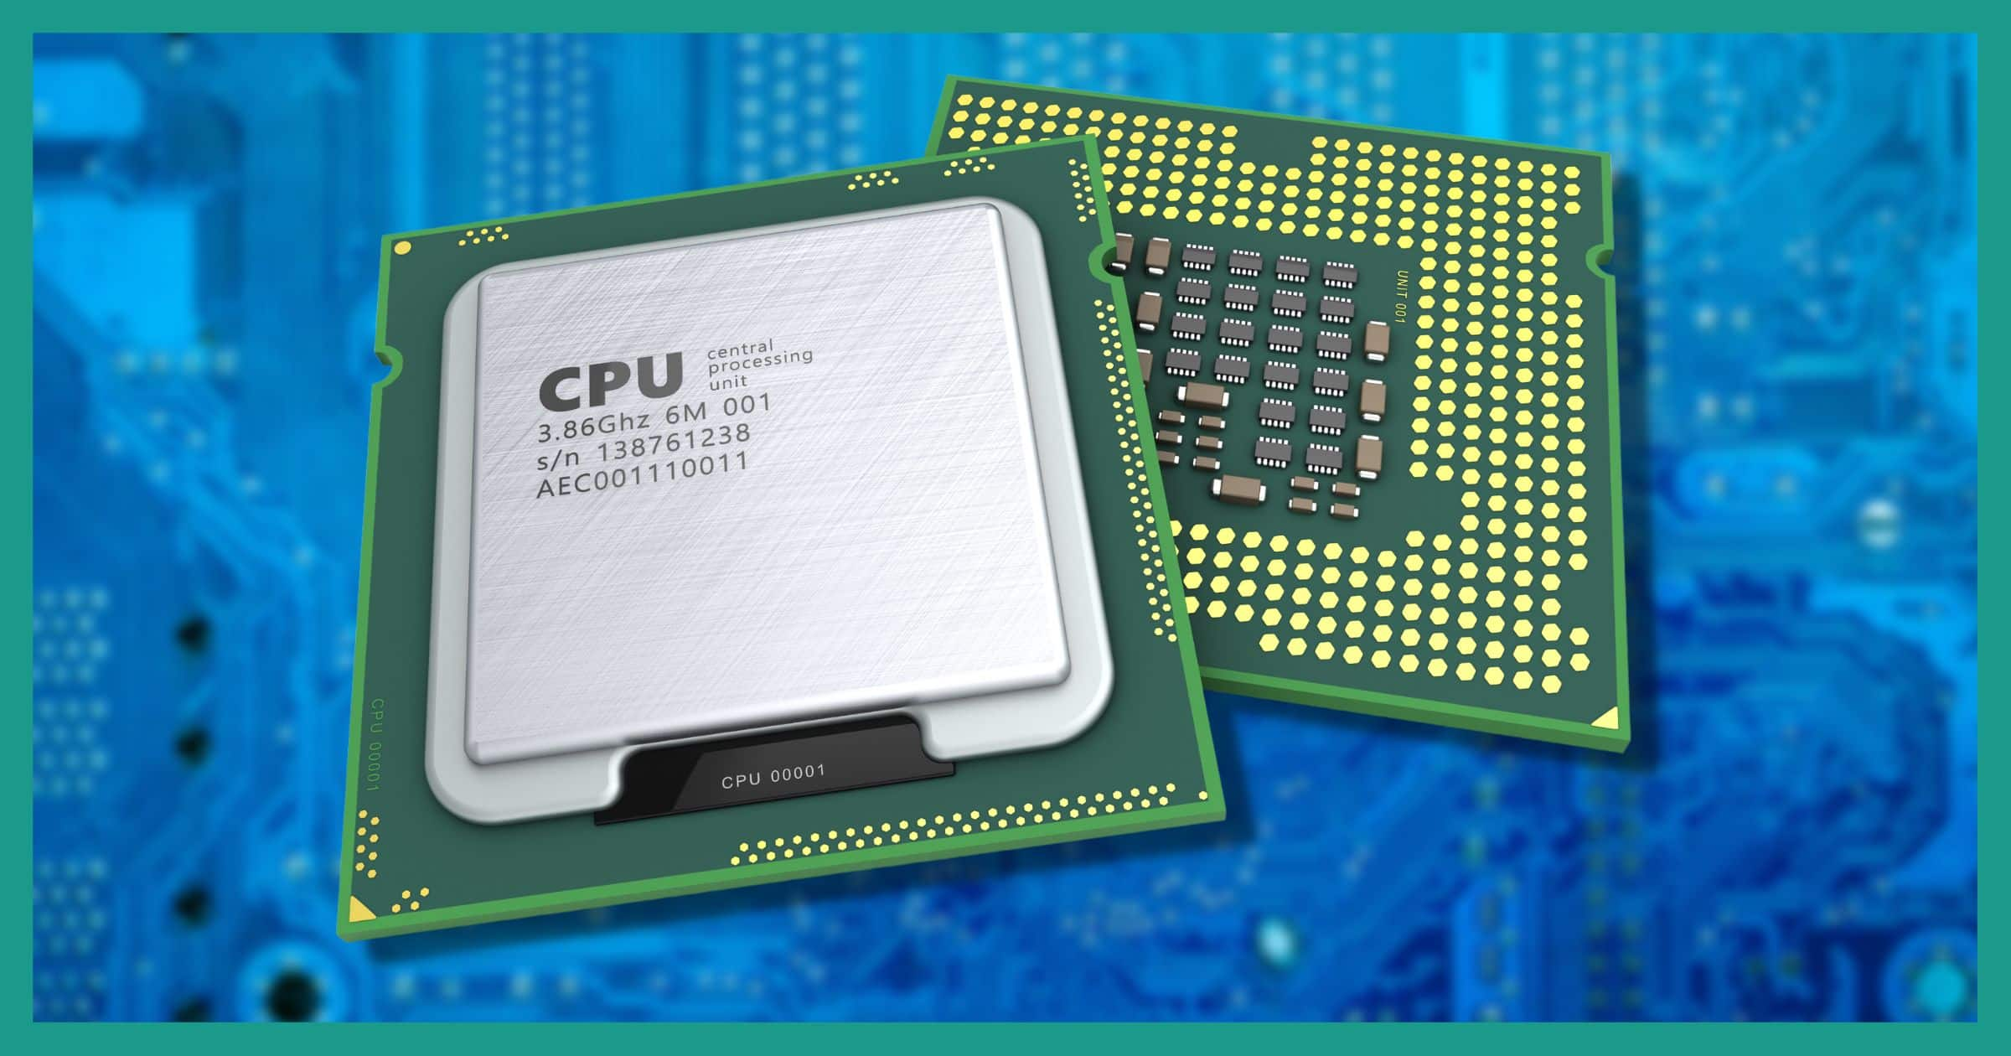
1 · THE COMPUTER
CPU (Central Processing Unit / Processeur)
Core Role: The primary "brain" of the computer that executes program instructions and processes system data.
Key Components:
  Control Unit (CU): Directs operations, manages data flow, and decodes instructions.
  Arithmetic Logic Unit (ALU): Performs mathematical calculations and logical decisions.
  Cache Memory (L1/L2/L3): Ultra-fast onboard memory for immediate data retrieval.
Instruction Cycle: Continuously operates on a Fetch → Decode → Execute loop to run tasks.
Informatique 1 — Algorithmics · Université Constantine 1 · Tronc Commun SM

Slide 12
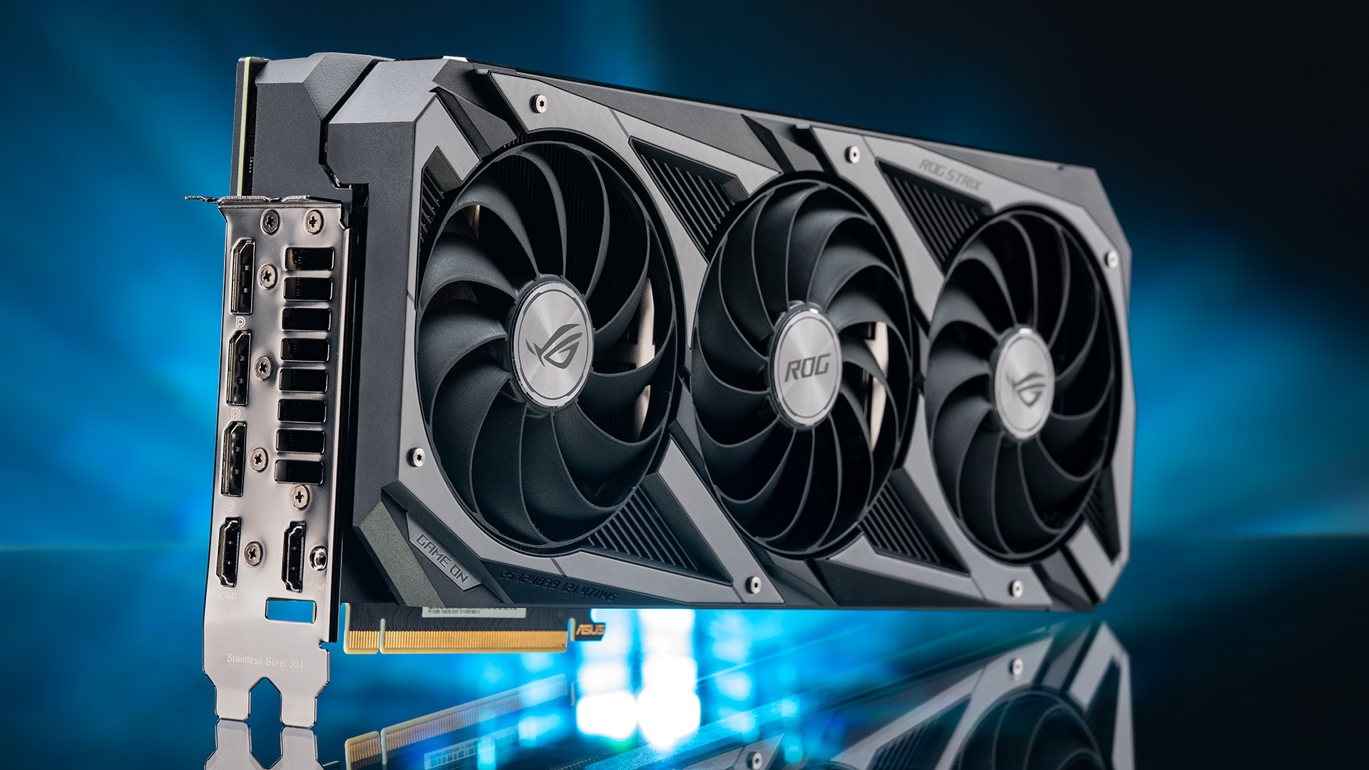
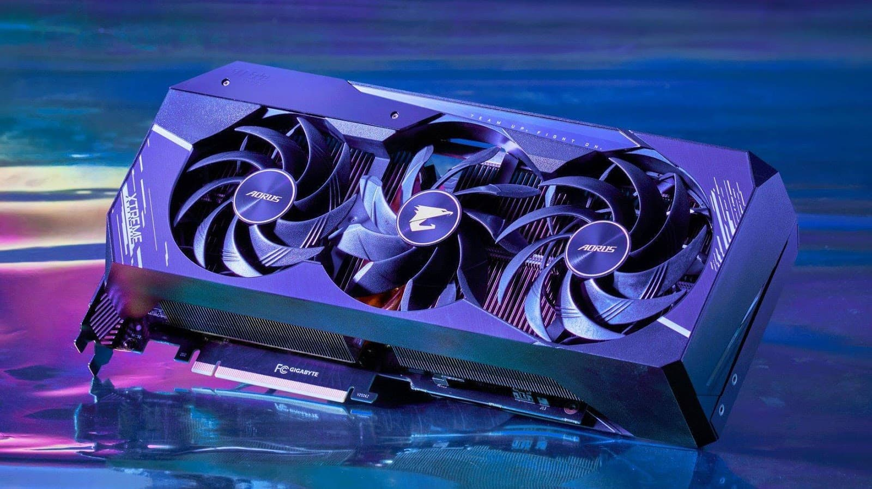
1 · THE COMPUTER
GPU (Graphics Processing Unit)
Core Role: Specialized processor designed to rapidly calculate, manipulate, and render visual data, 3D graphics, and video output.
Parallel Architecture: Features thousands of smaller, efficient cores optimized for executing multiple mathematical operations simultaneously.
Key Applications: Accelerates 3D rendering, video editing, scientific simulations, molecular modeling, and AI/machine learning workloads.
Types:
  Integrated: Embedded directly within the CPU, sharing system RAM for lighter tasks.
  Discrete/Dedicated: Standalone expansion card equipped with its own high-speed VRAM for high-performance computing.
Informatique 1 — Algorithmics · Université Constantine 1 · Tronc Commun SM

Slide 13
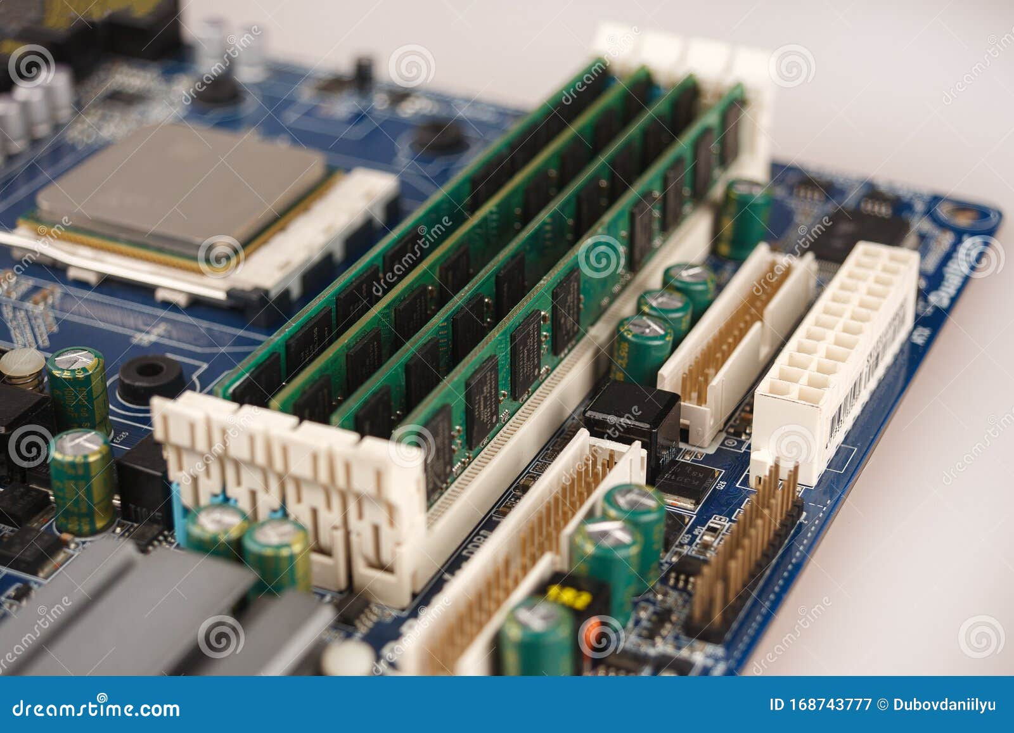
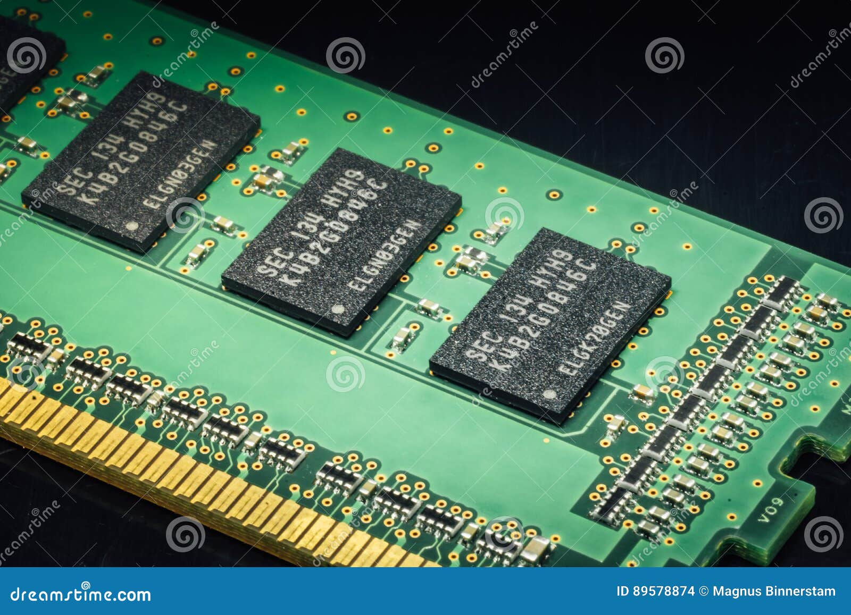
1 · THE COMPUTER
RAM (Random Access Memory)
Core Role: High-speed primary memory that temporarily holds active programs and data currently being processed by the CPU.
Key Feature (Volatility): Volatile storage—all data is cleared immediately when the power is turned off.
Random Access: Allows the CPU to access any memory location directly with near-instantaneous, consistent speed.
System Impact: Higher capacity enables smooth multitasking and prevents performance bottlenecks during heavy workloads.
Informatique 1 — Algorithmics · Université Constantine 1 · Tronc Commun SM

Slide 14
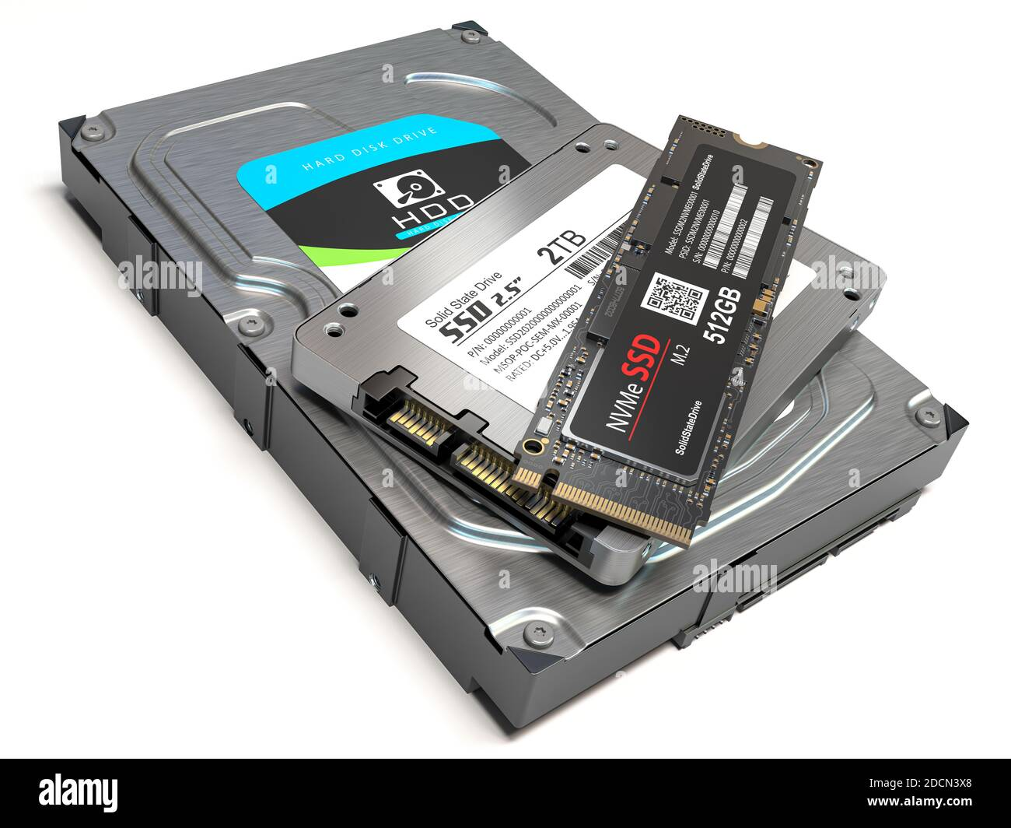
1 · THE COMPUTER
Storage (SSD/HDD)
Core Role:
Non-volatile secondary memory that permanently holds the operating system, applications, and user files even when powered off.
SSD (Solid-State Drive):
Uses microchip flash memory with no moving parts.
Offers ultra-fast read/write speeds, low power consumption, and high physical durability.
HDD (Hard Disk Drive):
Uses spinning magnetic platters and mechanical read/write heads.
Provides high storage capacity at a lower cost per gigabyte, though at significantly slower speeds.
Key Comparison: SSDs prioritize system speed and performance, whereas HDDs excel in high-volume, economical data archiving.
Informatique 1 — Algorithmics · Université Constantine 1 · Tronc Commun SM

Slide 15
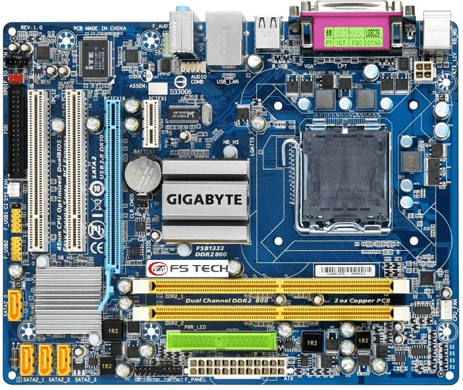
1 · THE COMPUTER
Motherboard + bus (la carte mère et les bus informatiques. )
Motherboard: The main circuit board that connects and powers the CPU, RAM, and storage devices.
System Bus: Data highways (conductive tracks) that transfer signals between components
.
Informatique 1 — Algorithmics · Université Constantine 1 · Tronc Commun SM

Slide 16
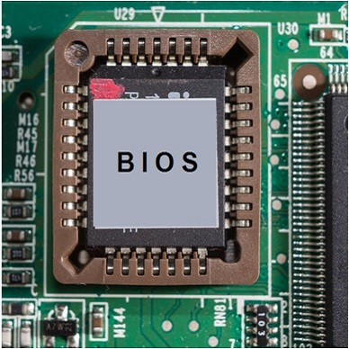
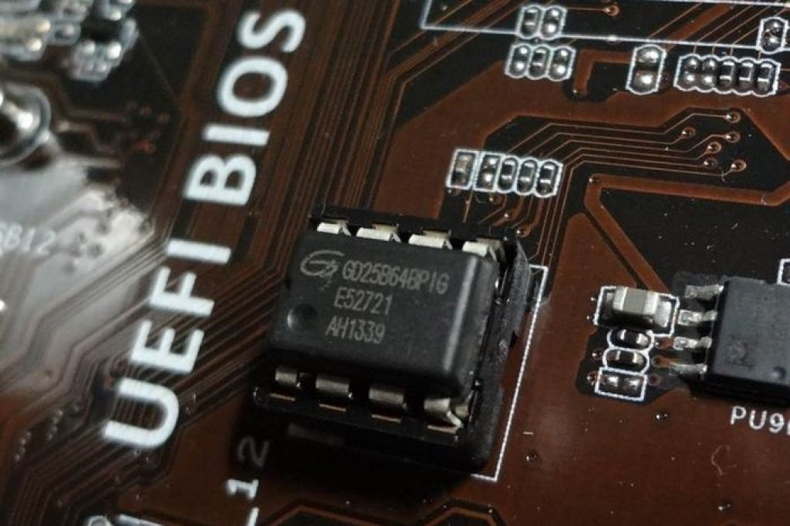
1 · THE COMPUTER
What is Firmware?
Firmware is specialized software embedded permanently or semi-permanently into hardware chips (non-volatile flash memory). Unlike regular applications stored on hard drives, firmware is immediately accessible to the processor the instant power is supplied to the system.
Firmware (UEFI)
UEFI stands for Unified Extensible Firmware Interface (Interface micrologicielle extensible unifiée).
It is the modern industry standard for PC firmware, developed to replace the older BIOS (Basic Input/Output System) standard.
Informatique 1 — Algorithmics · Université Constantine 1 · Tronc Commun SM

Slide 17
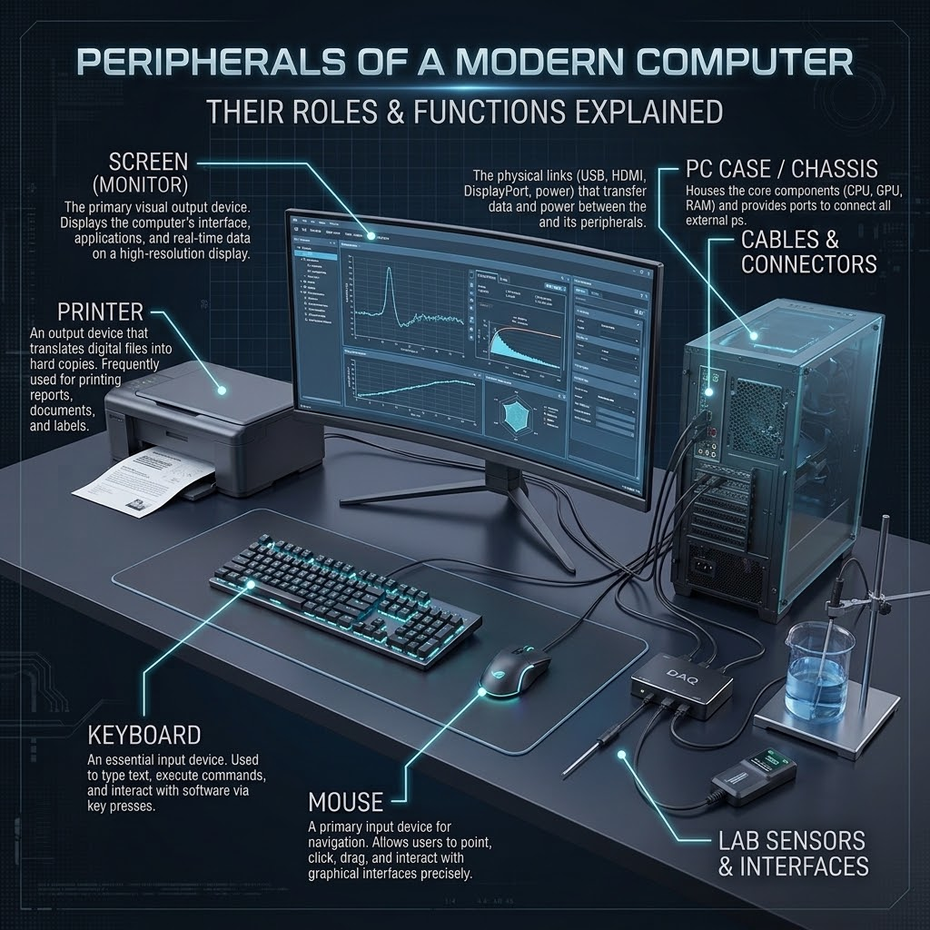
1 · THE COMPUTER
Around the PC, devices are divided into two main categories:
Input devices:
Bring information to the system, such as a mouse, keyboard, or game controller.
Output devices:
Allow information to be output/displayed, such as a printer or a screen.
Informatique 1 — Algorithmics · Université Constantine 1 · Tronc Commun SM

Slide 18

1 · THE COMPUTER
Everything is stored as bits
Bit
byte
Definition: Short for binary digit, a bit is the smallest basic unit of digital information.
Values: It represents a single binary state: 0 or 1.
Symbol: Lowercase b.
Usage: Commonly used to measure data transfer speeds and network bandwidth (e.g., Mbps, Gbps).
Definition: A group of 8 bits addressed as a single unit of data storage.
Function: A single byte can store enough information to represent one text character (such as a letter, number, or symbol).
Symbol: Uppercase B.
Usage: Commonly used to measure file sizes and storage capacities (e.g., MB, GB, TB).
Conversion
$$\text{1 Byte}=8\text{ Bits}$$
Informatique 1 — Algorithmics · Université Constantine 1 · Tronc Commun SM
7

Slide 19
2. Program
What is a program?
A computer program is a structured set of instructions written in a programming language (e.g., Python, C, Java)..
These instructions direct the computer to execute specific operations, such as performing computations, rendering information, managing data, and controlling hardware devices.

Slide 20
2. Program
How does a program run?
Storage
RAM
CPU
Screen
Program installed on the SSD/HDD
→
Program and data loaded into memory
→
Fetches, decodes, executes instructions
→
Result displayed to the user
The CPU reads instructions from RAM, writes intermediate results back to RAM, and the final result goes to an output device.
Informatique 1 — Algorithmics · Université Constantine 1 · Tronc Commun SM
6

Slide 21
3· ALGORITHMS
What is an algorithm?
An algorithm is a finite sequence of precise and ordered instructions designed to solve a problem or perform a task.
Properties of a good algorithm
FINITE
PRECISE
ORDERED
PURPOSEFUL
العربية: خوارزمية | Français: algorithme
Informatique 1 — Algorithmics · Université Constantine 1 · Tronc Commun SM
9

Slide 22
3· ALGORITHMS
A Short History of the Algorithm
From a 9th-century mathematician to the code you write today
c. 820
1936
1991
Al-Khwarizmi
Alan Turing
Python
Writes step-by-step methods for solving equations — the origin of the word “algorithm.”
Formally defines what “computation” means.
Released — the language you use in this course.
1843
1945
Today
Ada Lovelace
ENIAC
Everywhere
Publishes the first algorithm written for a machine.
First algorithms run automatically by an electronic computer.
Same idea: precise, ordered steps — now powering everything.
Informatique 1 — Algorithmics
1

Slide 23
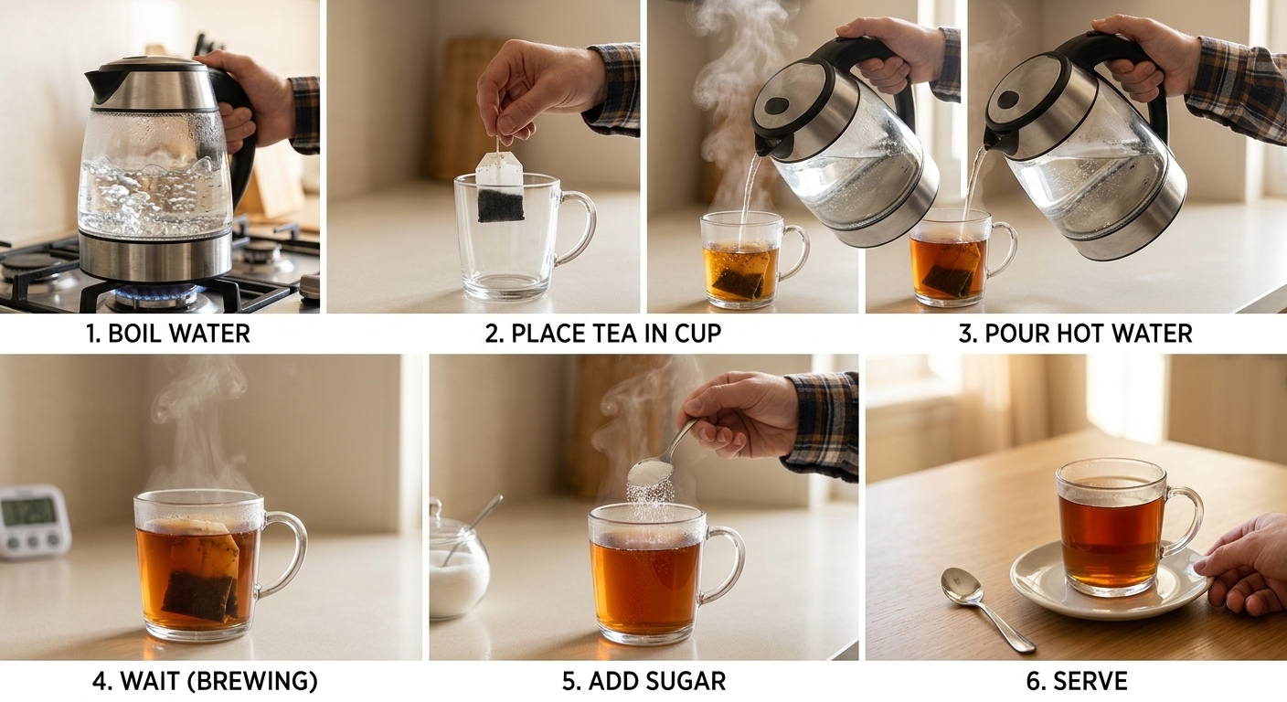
3· ALGORITHMS
REAL LIFE EXAMPLE
Everyday algorithm: making tea
Question: What happens if we change the order?
The order of instructions can change the result.
Informatique 1 — Algorithmics · Université Constantine 1 · Tronc Commun SM
9

Slide 24
3· ALGORITHMS
SCIENTIFIC EXAMPLE
Scientific algorithm: calculating density
INPUT
FORMULA
CALCULATE
OUTPUT
Mass m
Volume V
ρ = m / V
Divide mass by volume
Density ρ
1. Read m 2. Read V 3. Compute ρ = m/V 4. Display ρ
Informatique 1 — Algorithmics · Université Constantine 1 · Tronc Commun SM
9

Slide 25
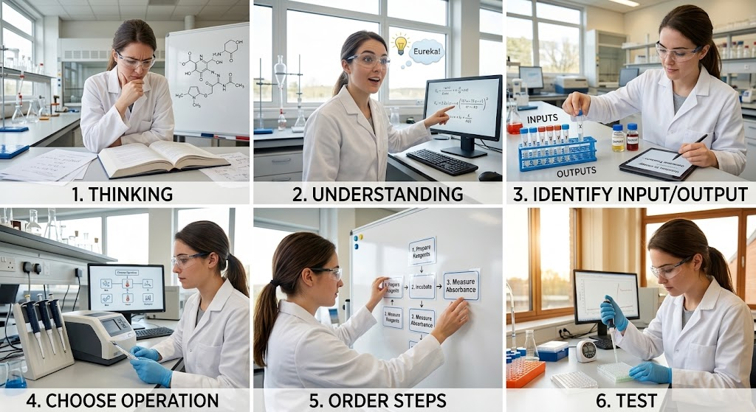
3· ALGORITHMS
From problem to algorithm
Informatique 1 — Algorithmics · Université Constantine 1 · Tronc Commun SM
9

Slide 26
3· ALGORITHMS
Algorithmic thinking
DECOMPOSITION
SEQUENCE
DECISION
Put actions in the correct order.
Break a large problem into smaller tasks.
Choose what to do when a condition changes.
REPETITION
ABSTRACTION
Repeat a task efficiently.
Focus on what matters.

Slide 27
3· ALGORITHMS
Programming languages
Human reasoning → algorithm → programming language → executable instructions
Algorithmic language
Programming language
Machine language
Pseudocode / flowchart
Focus: logic
Python / C / Java …
Focus: executable syntax
Binary instructions executed by hardware

Slide 28
3. ALGORITHMS
Algorithm vs. program
ALGORITHM
PROGRAM
A conceptual, step-by-step set of logical instructions designed to solve a specific problem. It is independent of any computer hardware or programming language.
The practical implementation of an algorithm written in a specific programming language (such as Python, C, or Java) so that a computer can execute it.
Algorithm ≠ Program

Slide 29
3 · ALGORITHMS
Algorithm vs. program
Real-World Analogy: The Cooking Recipe
Algorithm = The Recipe:
A recipe written on paper in human language explaining how to bake a cake step-by-step. Anyone who reads French or English can understand the logic.
ALGORITHM = the method
PROGRAM = the translation
Program = The Baking Process: The actual actions performed using ingredients, kitchen equipment, and energy to bake the cake following that recipe.
Informatique 1 — Algorithmics · Université Constantine 1 · Tronc Commun SM
8

Slide 30
3 · ALGORITHMS
Algorithm vs. program
Concrete Example: Finding the Larger of Two Numbers
The Algorithm (Conceptual Logic)
1. Read two numbers, 𝐴and 𝐵.
2. Compare 𝐴and 𝐵.
3. If 𝐴is greater than 𝐵, the result is 𝐴.
4. Otherwise, the result is 𝐵.
5. Display the result.
ALGORITHM = the method
PROGRAM = (Executable Python Code)
a = float(input("Enter first number: "))
b = float(input("Enter second number: "))
if a > b:
max_val = a
else:
max_val = b
print (f"The maximum number is: {max_val}")
Informatique 1 — Algorithmics · Université Constantine 1 · Tronc Commun SM
8

Slide 31
3 · ALGORITHMS
Why Python?
READABLE
SCIENTIFIC
Syntax supports clear reasoning.
Widely used for data, science and AI.
FLEXIBLE
ECOSYSTEM
From simple calculations to advanced projects.
Many libraries support scientific work.
Goal: use computation to solve scientific problems.

Slide 32
3 · ALGORITHMS
1. Basic Static Algorithm ("Hello, World!")
Program Implementations (Python)
Algorithm (Pseudocode)
START
OUTPUT "Hello, World!"
END
Python
print("Hello, World!")
2. Interactive Algorithm ("Hello, [Name]!")
This version explicitly demonstrates the complete information processing cycle.
Program Implementation (Python)
# 1. Input step
user_name = input("Enter your name: ")
# 2. Processing step
greeting_message = f"Hello, {user_name}!"
# 3. Output step
print(greeting_message)
Algorithm (Pseudocode)
1. START
2. INPUT: Prompt user to enter their name (userName)
3. PROCESSING: Combine "Hello, " + userName + "!" into greetingMessage
4. OUTPUT: Display greetingMessage
5. END
Informatique 1 — Algorithmics · Université Constantine 1 · Tronc Commun SM
10

Slide 33
4 · DATA
Constants, variables and basic types
Algorithms use essential building blocks to structure and process data:
Constants: Fixed values that remain unchanged throughout execution (PI = 3.14, N = 100).
Variable: Named memory spaces whose values can change during execution, categorized by Data Types
Pseudocode type | Meaning | Examples | Python type
Integer | Whole numbers | 5, -12, 100 | int
Real/float | Decimal numbers | 3.14, -0.5, 12.0 | float
Character/ String | Text or individual symbol | 'A’, “Hello” | str (length 1)
Boolean | Logical truth value | True, False | bool
Informatique 1 — Algorithmics · Université Constantine 1 · Tronc Commun SM
11

Slide 34
5 · OPERATORS
Arithmetic operators
Operation | Pseudocode | Python | Example → result
Addition / subtraction | + - | + - | 5 + 3 → 8
Multiplication | * | * | 4 * 2 → 8
Real division | / | / | 9 / 2 → 4.5
Integer division | div | // | 9 div 2 → 4
Remainder (modulo) | mod | % | 9 mod 2 → 1
Power | x ^ n | x ** n | 2 ^ 3 → 8
div and mod are the tools for digits, parity and time conversions (see the practice exercises).
Informatique 1 — Algorithmics · Université Constantine 1 · Tronc Commun SM
12

Slide 35
5 · OPERATORS
Comparison and logical operators
Test | Pseudocode | Python
equal | = | ==
not equal | ≠ or <> | !=
less / greater | < > | < >
≤ / ≥ | ≤ ≥ | <= >=
A | B | A AND B | A OR B | NOT A
True | True | True | True | False
True | False | False | True | False
False | True | False | True | True
False | False | False | False | True
Example: (x > 5) AND (y < 10) is true only when both conditions hold. In pseudocode, = tests equality; assignment uses ←.
Informatique 1 — Algorithmics · Université Constantine 1 · Tronc Commun SM
13

Slide 36
5 · OPERATORS
Expressions and assignment
Expressions
Assignment
Built from constants, variables and operators. Arithmetic: z ← (x + y) * 3. Logical: ok ← (a ≥ 0) AND (b ≥ 0).
Priority: ( ) → power → * / div mod → + - → comparisons → NOT → AND → OR.
variable ← expression: evaluate the right side, then store the result in the variable.
x ← 10
y ← x + 5 // y = 15
x ← x + 1 // x = 11
// ← is NOT mathematical equality
Informatique 1 — Algorithmics · Université Constantine 1 · Tronc Commun SM
14

Slide 37
6 · INPUT/OUTPUT
Read and Write become input() and print()
Algorithm Sum
Variables x1, x2, x3 : Real
Begin
Read x1
Read x2
x3 ← x1 + x2
Write "The sum is ", x3
End
x1 = float(input("x1: "))
x2 = float(input("x2: "))
x3 = x1 + x2
print("The sum is", x3)
# input: 5 and 7
→ The sum is 12.0
input() returns text, so convert it with float() or int() before calculating.
Informatique 1 — Algorithmics · Université Constantine 1 · Tronc Commun SM
15

Slide 38
6 · INPUT/OUTPUT
The same algorithm as a flowchart
Start
Oval: start/end
Parallelogram: input/output
Rectangle: calculation
Diamond: decision (next chapters)
Read x1, x2
Arrows show the order of execution.
x3 ← x1 + x2
Write x3
End
Informatique 1 — Algorithmics · Université Constantine 1 · Tronc Commun SM
16

Slide 39
7· TESTING
Tracing an algorithm with a trace table
Run the algorithm by hand with real values and record each variable after every instruction. Input: x1 = 5, x2 = 7.
Step | Instruction | x1 | x2 | x3 | Output
1 | Read x1 | 5 | – | –
2 | Read x2 | 5 | 7 | –
3 | x3 ← x1 + x2 | 5 | 7 | 12
4 | Write x3 | 5 | 7 | 12 | The sum is 12
Tracing finds logic errors before the computer does — the single best debugging habit to build.
Informatique 1 — Algorithmics · Université Constantine 1 · Tronc Commun SM
17

Slide 40
8. CLASS ACTIVITY
Interactive challenge
Problem
Your task
“Calculate the average of three temperatures.”
Is this already an algorithm?
Identify inputs • operations • output • order of steps
THINK → DISCUSS → PROPOSE AN ALGORITHM

Slide 41
CHECK YOUR UNDERSTANDING
Mini quiz
1
2
What is an algorithm?
Which is language-independent: algorithm or program?
3
4
Give two properties of a good algorithm.
What are the inputs for density = mass / volume?

Slide 42
REFERENCE
Glossary (English / Français)
English | Français
Algorithm | Algorithme
Variable / Constant | Variable / Constante
Assignment | Affectation
Integer / Real / Boolean | Entier / Réel / Booléen
Trace table | Table de trace
Flowchart | Organigramme
Hardware / Software | Matériel / Logiciel
Informatique 1 — Algorithmics · Université Constantine 1 · Tronc Commun SM
26

Slide 43
REFERENCE
Further reading
Introduction to Algorithms
Python Programming: An Introduction to Computer Science
Cormen, Leiserson, Rivest, Stein — MIT Press (course bibliography).
John Zelle — Franklin, Beedle & Associates (course bibliography).
The Python Tutorial
Think Python
docs.python.org — official, free and always up to date.
Allen B. Downey — O'Reilly, free online edition.
Informatique 1 — Algorithmics · Université Constantine 1 · Tronc Commun SM
27

