Slide 1

Getting Started with Python
Informatique 1 — L1 Sciences de la Matière
Cours 2 — Session 1 · 90 minutes
>>> print("Hello, science!")
Hello, science!
DR. FARIDA LARIT
Notes:
Welcome. Today is the first formal introduction to Python. By the end of the session everyone will have written and run their first instructions.

Slide 2
From a problem to a Python program
Scientific problem
Mathematical model
Algorithm
Python program
Computer execution
Scientific result
Find the density of a sample
ρ = m / V
Store m and V, compute m / V, display
print(54/20)
Python runs the instructions
2.7 g/cm³
Today's focus: writing and running the Python program (step 4)
Notes:
Recall the progression seen in Cours 1. Today we focus on step 4: writing the Python program. Follow the density example through all six steps.

Slide 3
Learning objectives
1
Explain what Python is and why scientists use it
2
Describe the role of the Python interpreter
3
Use IDLE in interactive mode and in script mode
4
Write first instructions: calculations, print() and comments
Notes:
Read the four objectives. Insist that the aim today is modest: understand what Python is and write the first simple instructions.

Slide 4
What is Python?
High-level
Interpreted
Close to human language, far from machine code
An interpreter executes your instructions
Readable
Free and open source
Clear, simple syntax — ideal for beginners
Available on Windows, macOS and Linux
Created by Guido van Rossum — first released in 1991
Notes:
Python is a programming language: a precise way of writing instructions for a computer. It was created by Guido van Rossum and first released in 1991.

Slide 5
Why Python in science?
Simple syntax
Focus on the science, not on the grammar
Scientific libraries
NumPy, SciPy, Matplotlib, pandas
Data and graphs
Process measurements and plot results
Widely used
Research, industry and education
In this course we start with the core language — libraries come later.
Notes:
Python lets us concentrate on the science rather than on complicated syntax. The libraries are mentioned only as a horizon: in this course we start with the core language.

Slide 6
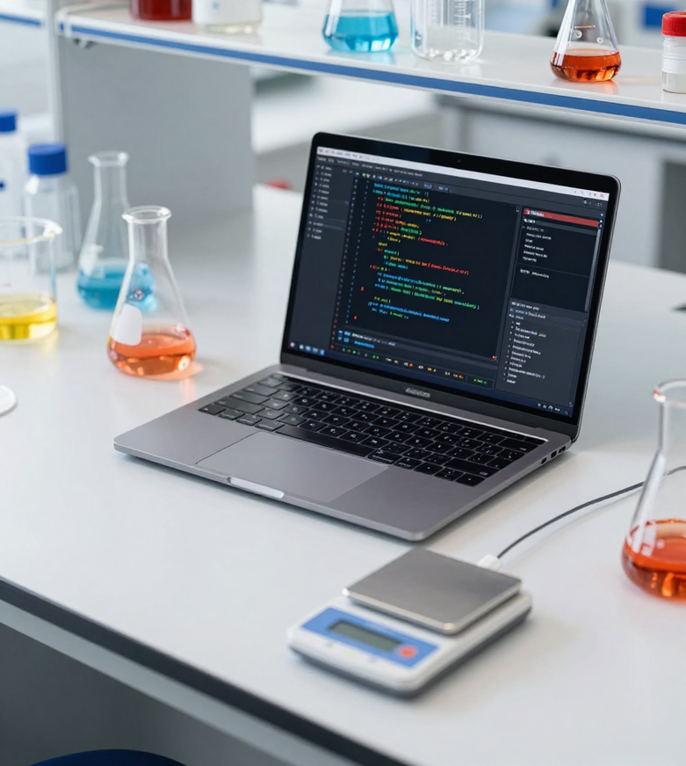
Why Python in science?
Python for Scientific Computing
89%
OF DATA SCIENTISTS USE PYTHON
75%
Python enables scientists to :
Automate repetitive calculations
-Ensure reproducibility,
-Analyze large datasets with precision.
FASTER THAN MANUAL CALCULATIONS
100%
REPRODUCIBLE RESULTS EVERY TIME
Informatique 1 — L1 Sciences de la Matière

Slide 7
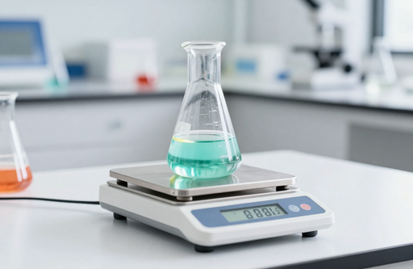


Why Python in Science?
CONNECTING PYTHON TO CHEMISTRY, PHYSICS, AND MEASUREMENTS
Python is the preferred language for scientists because it handles calculations naturally, processes experimental data efficiently, and presents results clearly. Let's see three concrete examples.
Calculating Density
density = mass / volume
Processing Measurements
mean = sum(data) / len(data)
Presenting Results
print("Result:", value)
Informatique 1 — L1 Sciences de la Matière

Slide 8
From student to computer
You write
Python code
Python interpreter
reads your instructions
Computer
executes them
Result
shown on screen
The interpreter is a translator between you and the computer.
OUTPUT
print(54 / 20)
2.7
Example: a one-line Python program and its result
Notes:
The computer does not understand Python directly. The Python interpreter reads the instructions and has the computer carry them out: it acts as a translator between you and the machine.

Slide 9
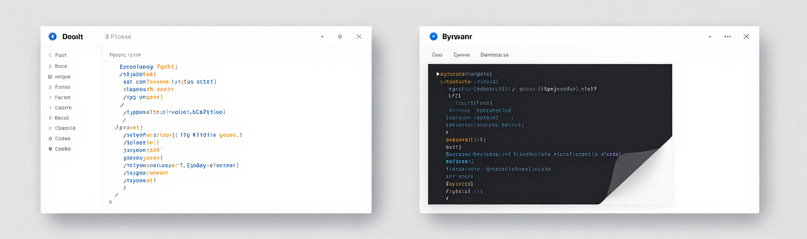
Introduction to IDLE
IDLE: Your Python
Workspace
IDLE comes with Python and provides two modes:
• Interactive mode: Type code, get instant results. Perfect for quick experiments and testing calculations.
• Script mode: Write complete programs, save as .py files, and run them repeatedly.
Informatique 1 — L1 Sciences de la Matière

Slide 10
Introduction to IDLE
IDLE Shell
script.py — IDLE Editor
>>> 2 + 3
5
>>> print("Hello")
Hello
>>>
# My first script
print("Hello, Python!")
Shell — immediate answers
Editor — write a program
Type after the >>> prompt, then press Enter
Save as a .py file, then Run → Run Module (F5)
Notes:
IDLE is installed with Python. It has two main windows: the Shell, where we type at the >>> prompt, and the Editor, where we write and save programs. Demonstrate live if possible: File > New File, then Run > Run Module (F5).

Slide 11
Interactive mode vs script mode
Interactive mode
Script mode
Type one instruction at the >>> prompt
Result appears immediately
Ideal to test and explore
Nothing is saved
Write several instructions in a file
Run the whole program (F5)
Saved as a .py file
Can be re-run and shared
Same Python language — two ways of working.
Notes:
Same language, two ways of working. Use the shell to test an idea quickly; use a script when the program has several instructions or must be kept.

Slide 12
First Python calculations
>>> 2 + 3
5
>>> 6 * 7
42
>>> 15 / 4
3.75
>>> 2 ** 3
8
>>> 0.5 * 2 * 3 ** 2
9.0
+
addition
-
subtraction
*
multiplication
/
division
**
power
Last line: E = ½ m v² with m = 2 kg and v = 3 m/s gives 9.0 J
Notes:
Python works as a calculator. Type each line in the shell. Point out that ** is the power and that Python respects the usual priority of operations. The last line is the kinetic energy E = 1/2 m v^2 for m = 2 kg and v = 3 m/s.

Slide 13
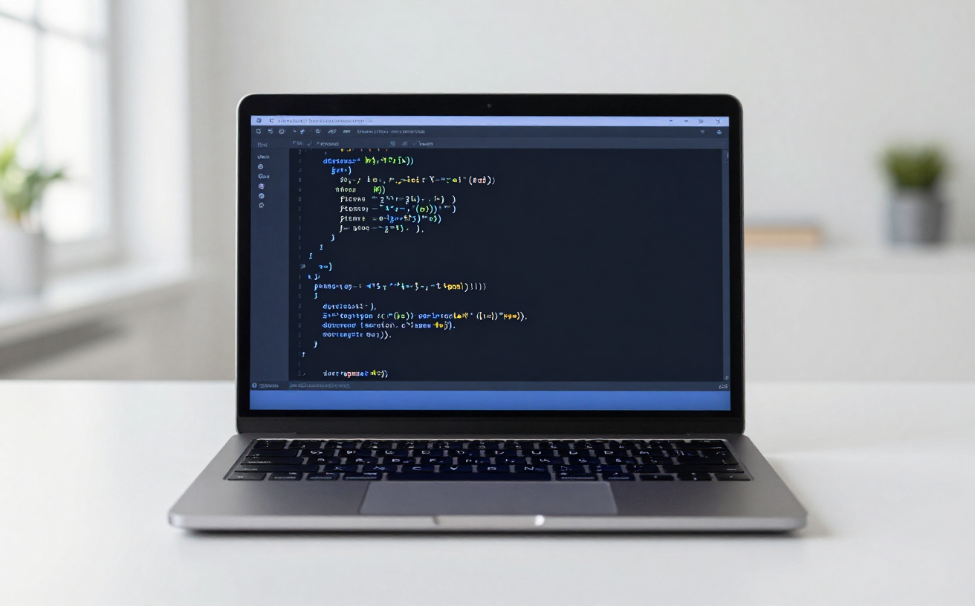
First Python calculations
Practice Basic Arithmetic
Addition: 2 + 3
Try typing 2 + 3 in IDLE and press Enter. Python immediately returns 5. The + operator adds two numbers, just like your calculator.
Division: 10 / 4
Enter 10 / 4 to get 2.5. Python 3 always returns a decimal (float) for division. This is useful for scientific calculations like concentration = moles / volume.
Exponentiation: 5 ** 2
Type 5 ** 2 to calculate 5². Python uses ** for powers, not ^. This is essential for physics formulas like E = mc² or chemistry's rate laws.
Informatique 1 — L1 Sciences de la Matière

Slide 14
The print() function
print("Hello, Python!")
print(2 + 3)
print("Mass of the sample:", 54, "g")
Remember
In a script, Python displays nothing unless you call print().
OUTPUT
Hello, Python!
5
Mass of the sample: 54 g
Notes:
In interactive mode Python shows results automatically. In a script, nothing is displayed unless we ask for it with print().

Slide 15
Understanding print()
print("Hello")
function name
argument
( ) parentheses
Lowercase only
Text between quotes
Several items
Python is case-sensitive: print works, Print does not.
print("Hello") shows the text Hello.
Separate with commas: print("Mass:", 25) shows Mass: 25
Notes:
Break the instruction into parts: the function name, the parentheses, and the argument, which is what we want to display. Python is case-sensitive: Print is not print.

Slide 16
Scientific example: calculating density
print(54 / 20)
print("Density =", 54 / 20, "g/cm3")
Problem
A sample has mass 54 g and volume 20 cm³. What is its density?
OUTPUT
Model
2.7
Density = 2.7 g/cm3
ρ = m / V
Python calculates, then print() displays.
Notes:
Walk through: problem, model, then Python. 54 / 20 = 2.7. The second version adds text and a unit to make the result readable.

Slide 17
Text versus calculation in Python
TEXT — with quotes
CALCULATION — no quotes
print("2 + 3")
print(2 + 3)
OUTPUT
OUTPUT
2 + 3
5
Displayed exactly as written
Python computes, then displays
print("54 / 20") shows the formula — print(54 / 20) shows 2.7
Notes:
Quotes mean text: Python displays it exactly as written. No quotes means a calculation: Python computes it first. This distinction will matter a lot in the next session.

Slide 18
Comments
# Density of a sample
print(54 / 20) # mass / volume
1
Start with #
everything after # on the line is a comment
2
Ignored by Python
comments never change the result
OUTPUT
2.7
Written for humans
3
explain what the code does and why
Notes:
A comment starts with the # symbol. Python ignores it completely. Comments are written for humans: you, your classmates and your teacher. Good comments explain what and why.

Slide 19
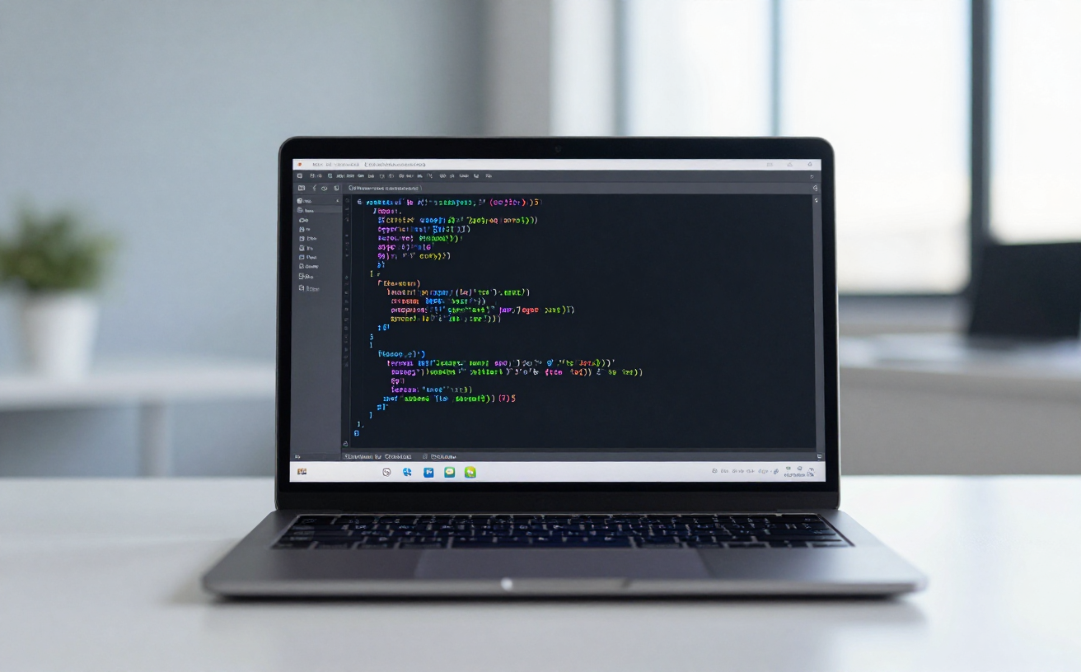
Comments & Complete Program
Building Your First Scientific Script
Comments with # symbol
Comments explain your code to humans:
This calculates densitymass in grams, volume in mLPython ignores everything after #
Store values in variables
Assign your measurements:
mass = 45.0 # grams
volume = 15.0 # milliliters
density = mass / volume
Print the labeled result
Display your calculation:
print("Density:", density, "g/mL")
Output: Density: 3.0 g/mL
Informatique 1 — L1 Sciences de la Matière

Slide 20
First complete scientific program
# Density of a sample
mass = 54 # grams
volume = 20 # cm3
density = mass / volume
print("Density =", density, "g/cm3")
A preview
mass, volume and density are variables: names that store values.
We will study them formally in the next session.
OUTPUT
Density = 2.7 g/cm3
Notes:
Run this as a script (F5). The names mass, volume and density are variables: names that store values. They are used here only briefly; variables will be studied formally in the next session.

Slide 21
What happens when the program runs?
1
Python reads the program from top to bottom
COMPUTER MEMORY
mass
54
2
Comments (#) are ignored
volume
20
3
mass and volume are stored in memory
density
2.7
4
density = mass / volume is calculated: 2.7
5
print() displays the result on the screen
Density = 2.7 g/cm3
Notes:
Python reads the program from top to bottom, one instruction after another. Comments are skipped. Values are stored in memory under their names. print() finally shows the result.

Slide 22

STEP 1: READ
How does Python Executes a Program?
Python reads your program line by line, from top to bottom. Each instruction is processed in sequential order, exactly as you wrote it.
STEP 2: EVALUATE
For each line, Python evaluates expressions and performs assignments. Example: mass = 5.2 stores the value, then density = mass/volume calculates the result.
STEP 3: OUTPUT OR ERROR
Python displays results via print() or reports a SyntaxError if something is wrong. Errors stop execution and show the problematic line number.
Informatique 1 — L1 Sciences de la Matière

Slide 23
Syntax errors are normal
print("Hello)
1
Read the message
2
Go to the line it points to
ERROR MESSAGE
SyntaxError: unterminated string literal (detected at line 1)
3
Fix it and run again
A closing quote is missing.
Errors are part of learning — even experienced programmers see them.
Notes:
A syntax error means Python cannot understand the instruction as written. It is not a failure. The message tells us where to look. Wording of the message can vary slightly between Python versions.

Slide 24
Common beginner errors
Missing closing quote
Missing parenthesis
Wrong: print("Hello)
Correct: print("Hello")
Wrong: print("Hello"
Correct: print("Hello")
Wrong capital letter
x instead of *
Wrong: Print("Hello")
Correct: print("Hello")
Wrong: 2 x 3
Correct: 2 * 3
Always read the last line of the error message first.
Notes:
Four frequent mistakes. Ask students to spot the difference between the wrong and the correct line. Advice: always read the last line of the error message first.

Slide 25
Mini student challenge
OUTPUT
A runner covers 150 m in 12 s. Write a Python program that displays the average speed.
Speed = 12.5 m/s
Model:
v = d / t
5
minutes — work alone, then compare
Use a comment, two values, the calculation and print().
Notes:
Give 5 minutes. Expected program: a comment, d = 150, t = 12, v = d / t, and print("Speed =", v, "m/s"). Expected output: Speed = 12.5 m/s.

Slide 26
Summary and what comes next
1
Python: a readable language for science
NEXT SESSION
Variables and Basic Data Types
2
The interpreter runs your instructions
3
IDLE: Shell and Editor
What is a variable?
How does Python store a value?
Is 2.7 the same as "2.7"?
4
print(), calculations and comments
5
Errors are normal — read the message
Notes:
Summarise the five key ideas, then open the next session: variables will explain what mass, volume and density really are, and data types will explain the difference between 2.7 and the text "2.7".

