Slide 1
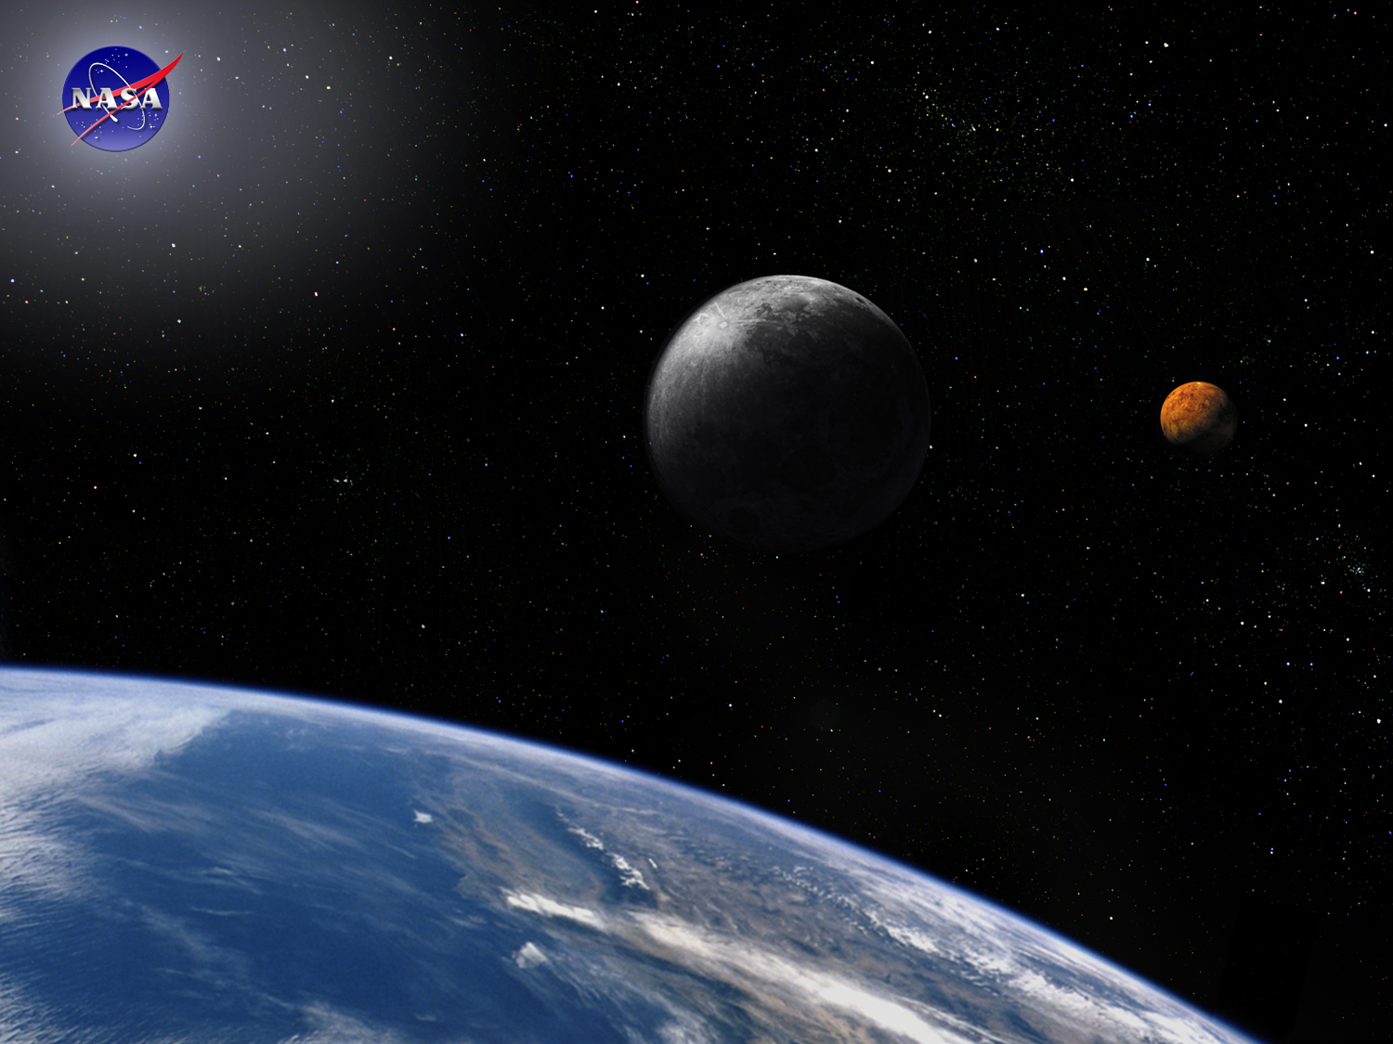
Trade Studies Module
Space Systems Engineering, version 1.0
Notes:
Version 1.0
SOURCE INFORMATION:
The material contained in this lecture was developed by Lisa Guerra of NASA’s Exploration Systems Mission Directorate while on assignment in the Department of Aerospace Engineering at the University of Texas at Austin. As part of a course entitled, Space Systems Engineering, the lecture was piloted at UT-Austin in Spring 2008.
The content that follows was also reviewed and edited by Dr. Paul Graf, Adjunct Professor at the University of Colorado at Boulder.

Slide 2
Module Purpose: Trade Studies
Describe the typical trade study process and show an example.
Recognize that trade studies support decision making throughout the project lifecycle.
Provide some trade study heuristics to improve the application and value of future trade studies.
Describe and provide a trade tree - an option management graphic.
Notes:
Note:
In the curriculum materials is the paper Lunar Lander Conceptual Design by Eagle Engineering,1988 (Eagle_LL_trades_paper.pdf). This paper is a good example of how to use trade studies to inform vehicle design.
One could add to this lecture as a reading and a Pause and Learn Opportunity for discussion.

Slide 3
What is a Trade Study?
A trade study (or trade-off study) is a formal tool that supports decision making.
A trade study is an objective comparison with respect to performance, cost, schedule, risk, and all other reasonable criteria of all realistic alternative requirements; architectures; baselines; or design, verification, manufacturing, deployment, training, operations, support, or disposal approaches.
A trade study documents the requirements, assumptions, criteria and priorities used for a decision. This is useful since new information frequently arises and decisions are re-evaluated.
Notes:
Trade study definition from - Space and Missile Systems Center (SMC) Systems Engineering Primer and Handbook 2005
(SMC_SE_Primer4-05.pdf)

Slide 4
Trade Studies Support Decision Making Throughout the Development Lifecycle
Trade studies support:
  Requirements development - e.g., to resolve conflicts; to resolve TBDs and TBRs
  Functional allocations - e.g., system architecture development
  System synthesis - e.g., assess the impact of alternative performance or resource allocations
  Investigate alternate technologies for risk or cost reduction
  Assess proposed design changes
  Make/buy decisions (i.e., build the part from a new design or buy from commercial, existing sources)
Notes:
Source: SMC Systems Engineering Primer and Handbook; 2005; Chapter 2.
Recall:
TBD - to be determined
TBR - to be resolved

Slide 5
The Trade Study Process (1/2)
Define the objectives of the trade study
Review inputs, including the constraints and assumptions
Choose the evaluation criteria and their relative importance (these can be qualitative)
Identify and select the alternatives
Assess the performance of each option for each criteria
Compare the results and choose an option
Document the trade study process and its results
Notes:
See DAU Systems Engineering Fundamentals; 2001; Chapter 12, and
Systems Engineering - Principles and Practice; Kossiakoff and Sweet; 2003; chapter 14

Slide 6
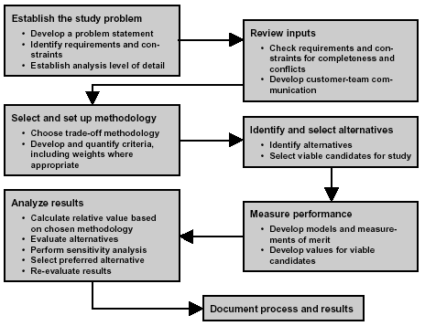
The Trade Study Process (2/2)
Notes:
Source: DAU Systems Engineering Fundamentals; 2001 chapter 12

Slide 7
Evaluation Criteria — Measures (1/2)
Trade studies depend upon having criteria for making decisions based on measures of effectiveness (voice of the customer) and measures of performance (voice of the engineer).
Measure of Effectiveness (MOE) - A measure of how well mission objectives are achieved. MOEs are implementation independent - they assess ‘how well’ not ‘how’.
Example measures of effectiveness include
  Life cycle cost
  Schedule, e.g., development time, mission duration
  Technology readiness level (maturity of concept/hardware)
  Crew capacity
  Payload Mass
Notes:
NASA Systems Engineering Handbook, 2007, SP-6105; Chapter 6

Slide 8
Evaluation Criteria — Measures (2/2)
Measure of Performance (MOP) - A quantitative measure that, when met by the design solution, will help ensure that an MOE for a product or system will be satisfied. There are generally two or more measures of performance for each MOE.
Example measures of performance
  Mass
  Power consumption
  Specific impulse
  Consumables required
  Propellant type
Both MOEs and MOPs are system figures of merit; an MOE refers to the effectiveness of a solution and an MOP is a measure of a particular design.
Notes:
NASA Systems Engineering Handbook, 2007, SP-6105; Chapter 6

Slide 9
Trade Study Heuristics
Rules of Thumb:
  Manage the number of options under consideration
  Revisit the original problem statement
  If a baseline solution is established, use it as a ‘yardstick’ to measure the alternatives.
Decisions are frequently made with imperfect information.
  Do not get stuck in ‘analysis paralysis’.
  Decide how deep the analysis must go. {Deep enough to make a decision with confidence, but no deeper.}
Does the decision feel right? If not, why?
Conduct further what-if scenarios by changing assumptions.
Reject alternatives that do not meet an essential requirement.
Ignore evaluation criteria that do not discriminate between alternatives.
Trades are usually subjective; numeric results usually give a false sense of accuracy.
If an apparent preferred option is not decisively superior, further analysis is warranted.
Notes:
See Kossiakoff and Sweet; op cit; chapter 14

Slide 10
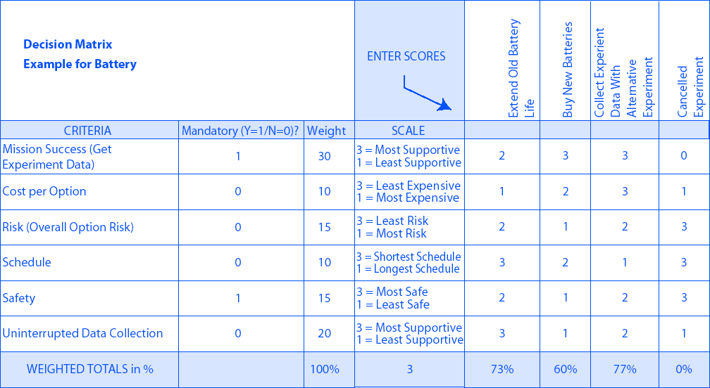
Example Decision Matrix Trade Study
Preferred Solution
Notes:
Figure 6.8-2 Example Decision Matrix; NASA Systems Engineering Handbook; 2007

Slide 11
Example Qualitative Decision Matrix
For a Lunar Thermal Control Trade Study
Characteristics | Single Phase Fluid | Two Phase Fluid | Heat Pipe
Safety: (3) Operating Pressure | Low | High | Low-Medium
Safety: Toxicity | Fluid Dependent | Fluid Dependent | Fluid Dependent
Safety: Flammability | Fluid Dependent | Fluid Dependent | Fluid Dependent
Reliability (1) | High | Fair | Fair
Performance: (2) Pumping Cost | Low | High | Fair
Complexity: (4) Controls | Simple | Nominal | Complex
Complexity: (5) Manufacturing Difficulty | Simple | Nominal | Complex
Notes:
Comparison is for a lunar pressurized rover.
Based on an Eagle Engineering report: “Lunar Surface Transportation Systems Conceptual Design”, 1988.

Slide 12
Do A Reality Check On The Tentative Selection
Key questions to ask:
Have the requirements and constraints truly been met?
Is the tentative selection heavily dependent on a particular set of input values and assumptions, or does it hold up under a range of reasonable input values (i.e., is it ‘robust’)?
Are there sufficient data to back up the tentative selection?
Are the measurement methods sufficiently discriminating to be sure that the tentative selection is really better than the alternatives?
  If close results, is further analysis warranted?
Have the subjective aspects of the problem been fully addressed?
Test the decision robustness.
  Is the tentative selection very sensitive to an estimated performance or constraint? If so, explore the full reasonable range of each performance variable to understand the domain where your tentative selection is appropriate.

Slide 13
Trade Trees
A trade tree is a graphical method of capturing alternatives with multiple variables.
Each layer of the tree represents some aspect of the system that will be treated in a trade study to determine the best alternative.
Some alternatives can be eliminated (or ‘pruned’) a priori because of technical feasibility, launch vehicle constraints, cost, risk or some other disqualifying factor.
The total number of alternatives is given by the number of end points of the tree.
Even with just a few layers, the number of alternatives can increase quickly, so manage their numbers.
Notes:
See NASA Systems Engineering Handbook; 2007; Chapter 6.8

Slide 14
Top-level Trade Tree-Example for Mars
1988 “Mars Expedition”
 1989 “Mars Evolution”
Ž 1990 “90-Day Study”
 1991 “Synthesis Group”
 1995 “DRM 1”
‘ 1997 “DRM 3”
’ 1998 “DRM 4”
“ 1999 “Dual Landers”
” 1989 Zubrin, et.al*
• 1994-99 Borowski, et.al
 2000 SERT (SSP)
‚ 2002 NEP Art. Gravity
2001 DPT/NEXT
M1 2005 MSFC MEPT
M2 2005 MSFC NTP MSA
Human Exploration
Of Mars
Decision Package 1
Long vs Short
Mission
Type
Conjunction Class
Long Surface Stay
Opposition Class
Short Surface Stay
Special Case
1-year Round-trip
ƒ
Cargo
Deployment
Pre-Deploy
All-up
Pre-Deploy
All-up
Mars Capture
Method
Aerocapture
Propulsive
Aerocapture
Propulsive
Aerocapture
Propulsive
Aerocapture
Propulsive
Mars Ascent
Propellant
ISRU
No
ISRU
ISRU
No
ISRU
ISRU
No
ISRU
ISRU
No
ISRU
ISRU
No
ISRU
ISRU
No
ISRU
ISRU
No
ISRU
ISRU
No
ISRU
Interplanetary
Propulsion
(no hybrids
in Phase 1)
NTR
Electric
Electric
Electric
Electric
Electric
Electric
Electric
Chemical
NTR
Electric
Chemical
NTR
Chemical
NTR
Chemical
NTR
Chemical
NTR
Chemical
NTR
Chemical
NTR
Electric
Chemical
NTR
Electric
Chemical
NTR
Electric
Chemical
NTR
Electric
Chemical
Electric
Chemical
NTR
Electric
Chemical
Chemical
NTR
Electric
Electric
NTR
NTR
Chemical
NTR
Chemical
1
2
3
4
5
6
7
8
9
10
11
13
16
19
22
25
28
31
34
37
40
43
46
47
12
14
15
17
18
20
21
23
24
26
27
29
30
32
33
35
36
38
39
41
42
44
45
48

”
“

•
•

Ž
‚
M2
Œ

M2
M1 M1
M2
‘
’
M1
M2 M2
NTR- Nuclear Thermal Rocket
Electric= Solar or Nuclear Electric Propulsion
Notes:
Mars crewed mission example on this slide (from 2007 Mars Assessment Working Group, NASA study)
Note: the red and blue highlighted lines are the trade tree options under consideration by the Constellation Program Office.
Definition of key terms:
Pre-deploy - split the transfer of the crew and cargo on separate vehicles, with the cargo and lander arriving before the crew, I.e., pre-deployed assets.
All-up - the crew and all mission cargo transfer to Mars in the same mission opportunity. They arrive at Mars at the same time.
ISRU - In situ resource utilization. This trade option involves converting either Martian soil or atmosphere into viable propellant, like oxygen or methane. Using isru propellants would reduce the amount of cargo mass from the Earth.
A trade tree is a representation of all the competing study alternatives.
As the trade study progresses, branches of the trade tree containing unattractive alternatives will be “pruned”,
and greater detail in terms of system design will be added to those branches that merit further attention.

Slide 15
Earth-Moon Transit Trade Tree
High Priority Medium Priority Low Priority
2,3
1,4&C4,5-8,12
9, 13
7,8
11
1,3-6,10,12
H = Human Mission Segment
C = Cargo Mission Segment
2,11
10
C1-3,5-13
9,13
H
C
Orbital Operations & Earth-Moon Transit; Propulsion Options
Lunar Descent/Ascent Lander Options
Earth EDL Orbit
Capture Options
Earth Entry Vehicle L/D Options
Aerocapture
Propulsive Capture
N/A
Low L/D
Medium L/D
High L/D
N/A
Integrated Crew Transit/Lander
Function
Modular Elements
7
8
1-6,9-13
N
1-11,13
12
All Chemical
Chemical + Electric
NTR
Other Hybrid Options
L
M
K
1-4, 7-13
5
6
13
1-12
Notes:
This is a NASA trade tree for round trip options from Earth to the Moon, for both cargo and human missions.
Node points include:
ES - Earth surface
EO - Earth Orbit
L1 - Earth-Moon libration point 1
LO - Lunar Orbit
LS - Lunar surface
Other abbreviations:
EDL - entry, descent and landing
L/D - lift over drag configuration
NTR - nuclear thermal rocket

Slide 16
Example: Earth-Moon Transit Trade Option Analyses
Key measure of performance: mass
Notes:
This example chart shows the level of analysis for a key measure of performance, mass, for the trade tree on the previous chart. 5 of the options in the tree are under consideration, and these are the comparative results. DRM represents the design reference mission (the preferred solution) which other tree options are compared to.
Abbreviations:
TEI - trans Earth injection (propulsive maneuver)
TLI - trans lunar injection (propulsive maneuver 1 & 2)
IMLEO - initial mass in low Earth orbit
DRM - Design reference mission (the baseline to compare to)
LO - lunar orbit
L1 - Earth Moon libration point
OM, SH, EV - are the various vehicle parts (dry mass, ie no propellant in the vehicle)

Slide 17
Further Considerations for Trade Studies and Class Discussion
Based on Observations from
The University of Texas at Austin
Senior Mission Design Class, 2007
(Department of Aerospace Engineering)

Slide 18
Trade Study Considerations (1/4)
Assumptions
Trade studies are based on assumptions the team makes.
Examples of driving assumptions:
  Crew size assumption drives the amount of consumables and the viability of an open ECLSS versus partially closed ECLSS.
  Mission duration assumption drives the amount of power required which in turn drives the choice of power subsystem.
  Landing location on the moon drives delta-v requirements which in turn drives best orbit selection and propulsion subsystem.
Changing assumptions within the trade study allows the team to perform a ‘what-if’ analysis.
  Allows the team to understand the integrity of the design alternative selected
  Shows the importance of that assumption
Notes:
Abbreviations:
ECLSS - Environmental Control and Life Support System

Slide 19
Trade Study Considerations (2/4)
Mission environment
The trade space for subsystem alternatives is often defined by the space environment for the mission.
  Why use RTGs when the mission is at 1 AU or on the Moon. When do we use RTGs? For deep space missions where solar intensity is less.
  Types of thermal control - need to consider the operating temperature extremes
  Types of rendezvous and ‘landing’ with a NEO - need to understand the orbit, spin and known composition of asteroid
  Sometimes the worst of the space environment, such as a solar particle event (SPE) for radiation, can be avoided by operational solutions rather than design solutions, i.e., perform the mission during the minimum of the solar cycle or using early warning sentinel satellites.
  Lunar missions - is your system operating at one particular location or region (like Apollo at equatorial latitudes), or at global sites depending on the particular mission?
Notes:
Abbreviations:
RTGs - Radioisotope thermoelectric generator
AU - astronomical unit
NEO - Near-Earth Object

Slide 20
Trade Study Considerations (3/4)
Importance of information for each alternative
Trade study analysis should use information that is relevant. Extraneous information can distract the decision maker.
‘Materials’ example:
  Do material characteristics such as tensile strength and Poisson’s ratio really matter in the selection process.
  In considering so many material alternatives, was heritage considered as a design factor, i.e, has this material flown on previous space missions?
    If not, what is the cost to your project for bringing that technology up to flight-ready status?
    Did you violate one of your original mission scope assumptions of using current state-of-the-art technology?
  In considering material alternatives, were other correlated factors included which would shorten the trade space to begin with, such as material’s impact on radiation protection; use for a pressure vessel vs. landing struts.

Slide 21
Trade Study Considerations (4/4)
Trade study vs. spacecraft design
Is a trade study really necessary?
  Cargo capsule example:
    Structural design of capsule is not a trade. Evaluation criteria are the design characteristics; heritage is reference information for actual design work.
  Seismic vehicle example:
    Two existing concepts versus determining which characteristics are most valuable for your team design to include
  Mars habitat example:
    What are the communications requirements for the mission (voice, video, etc) => amount of bandwidth to specify for comm subsystem.
What makes for a successful mission? Answer defines which trades are of most importance & might drive additional trades.
  Maximum surface exploration time => robust power and ECLSS
  Precise NEO orbit tracking for X years => tracking method
  1-week cargo delivery => launch vehicle availability and mission plan

Slide 22
Module Summary: Trade Studies
Trade studies are common decision-support tools that are used throughout the project lifecycle to capture and help assess alternatives.
The steps in the trade study process are:
  Define the objectives of the trade study
  Review inputs, including the constraints and assumptions
  Choose the evaluation criteria and their relative importance
  Identify and select the alternatives
  Assess the performance of each option for each criteria
  Compare the results and choose an option
  Document the trade study process and its results
Trade trees are graphical tools that help manage multi-variable options.

Slide 23
Back-up Slides for Trade Studies Module

Slide 24
Trade Studies
The systems engineering method relies on making design decisions by the use of trade studies.
Trade studies are necessary when the system is complex and there is more than one design approach.
Trade studies involve the comparison of alternatives
  Good to explore a number of different alternatives
  Alternatives should be compared at the same level of detail
  Key is for characteristics to be evaluated relative to one another
Trade study approaches:
  Comparing advantages and disadvantages of several alternatives; can be qualitative.
  Using a formal ranking system based on multiple criteria and a weighting system; quantitative approach.
Notes:
Early scope definition keeps requirement writers from diverging, reduces requirement inconsistencies, and keeps the BIG PICTURE in view.
It also shortens the time required for requirement writing and rewriting and reduces debates.
The scope definition prevents you from losing sight of important constraints as well as customer needs.

Slide 25
Example Trade Study Outline
Purpose of Study
  • Resolve an Issue
  • Perform Decision Analysis
  • Perform Analysis of Alternatives (Comparative analysis)
Scope of Study
  • State level of detail of study
  • State Assumptions
  • Identify Influencing requirements & constraints
Trade Study Description
  • Describe Trade Studies To Be Performed
  • The Studies Planned To Make Tradeoffs Among Concepts, User Requirements, System Architectures, Design, Program Schedule, Functional, Performance Requirements, And Life-cycle Costs
  • Describe Trade Methodology To Be Selected
  • Describe Technical Objectives
  • Identify Requirements And Constraints
  • Summarize Level of Detail of Analysis
Analytical Approach
  • Identify Candidate solutions to be studied/compared
  • Measure performance
    o Develop models and measurements of merit
    o Develop values for viable candidates
  • Selection Criteria -- risk, performance, and cost are usually at lease three of the factors
  • Scoring
    o Measures of results to be compared to criteria
    Weighted reflecting their relative importance in the selection process
  Sensitivity Analysis
Trades Results
  • Select User/Operational Concept
  • Select System Architecture
  • Derive Requirements
    o Performing trade studies to determine alternative functional approaches to meet requirements
    o Alternate Functional Views
    o Requirements Allocations
• Derive Technical/Design Solutions
• Cost Analysis Results
• Risk Analysis Results
• Understand Trade Space
Notes:
Source: SMC Systems Engineering Primer & Handbook, 2005 (SMC_SE_Primer4_05.pdf)

Slide 26
Decisions to Make Before Beginning a Trade Study
Has success been defined?
Which trades need to be done and at what phase of the project?
For each trade what criteria will be used and what are their relative weights?
How deep will the analysis go?
  Deep enough to make a decision with confidence, but no deeper.
Criteria for doing a trade study?
  The easiest trade study to do is the one that does not have to be done.
  Do not do a trade study just because you can.

Slide 27
Trade Study Process
Define Evaluation Criteria/ Weighting factors
Study Inputs:
Constraints
Ops Concept
Existing requirements
Assumptions
Relevant plans & documents
Determine Scope of the Trade Study
Evaluate Alternatives
Against Criteria
Perform Sensitivity
Analyses
TRADE STUDY
RESULTS
Data - graphical
Recommended approach
Benefits
Resulting risk posture
Summary of results
Summary of approach
Generate
Viable
Alternative
Solutions
Create Trade Tree
Notes:
Reference: NAS System Engineering Manual. Version 3.0; 9/30/04 (made edits)
At the end of the process, the following questions should be considered:
Have the goals/objectives and constraints been met?
Is the tentative selection robust?
Is more analytical refinement needed to distinguish among alternatives?
Have the subjective aspects of the problem been addressed?
From NASA SE Handbook process chart, page 59

Slide 28
Focused Trade Study
Phase I Analysis
Requirements
Design Environments
Subsystem Technologies
Mass Estimation Benchmark
“Pseudo-Apollo”
Baseline Reference Mission
Architectural Variations
2-launch solution
3-launch solution
25mt launch constraint
Initial CEV/lander mating in LEO
Single pass aerocapture, deorbit phasing, and capability of land landing
Parametric Variations
Alternate propellants.
Alternate power sources.
Variation in return payload
Variation of delivered payload to the lunar surface
All versus partial crew to the lunar surface
Reduce crew size to 2
Increase crew size to 6
Change in time between launches (7 to 30 days)
Reduce lunar surface stay time to 3 days
Increase lunar surface stay time to 14 days
Effects of elimination of CEV contingency EVA requirement
Mass effect of supplemental radiation shielding
Sensitivity Analyses
Architectural Variation
Lunar Orbit Rendezvous of CEV/lander

Slide 29
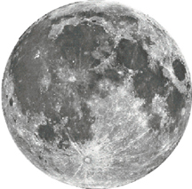
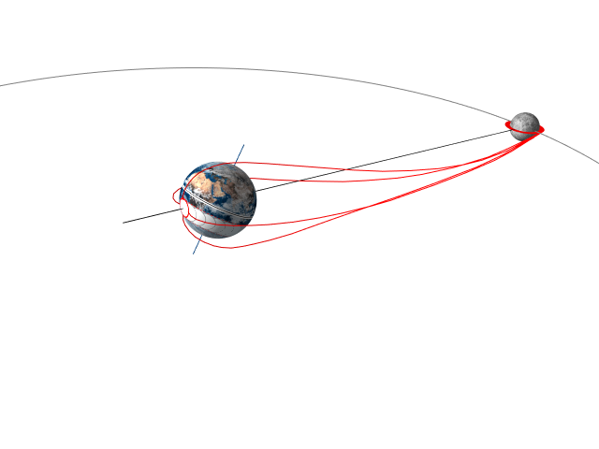

Focused Trade Study Results
Mission Design
Reference Operations Concept
Kick Stage Expended
MOON
900
Low Lunar Orbit
5-Day Flight Time
L₁ (~322,000 km)
Expended
800
4 weeks
4-Day Flight Time
800
Earth Departure Stage Expended
3-Day Flight Time
Earth Departure Stage Expended
900
Service Module Expended
1000
1100
LEO 407 km
1200
1300
Water Landing
Continue Missions
Initial Mass in LEO
CEV Reused?
EARTH
Key Figures of Merit
Safety
# of Critical Events
Mission Complexity
Abort Options
Crew Time
Technology Risk
Probability of launch success
Etc.
Effectiveness
Total Mass
Dry Mass
Surface Time
Etc.
Extensibility
Long-Stays
Mars
Other destinations
Etc.

Slide 30
Affordability Trades
Notes:
Trade studies are at the heart of the affordability process, and their solutions are often represented in a multi-dimensional trade space bounded
by a cost element and by one or more performance parameters. The figure above illustrates a simplified, two-dimensional trade space with a plot connecting
candidate design alternatives. (In real life, the alternatives shown may not be readily connected because their attributes are not orthogonal,
but it helps to sort them out by establishing which alternatives offer only marginal performance improvement with relatively large cost
expenditures.) A multi-dimensional trade space may be substituted to show the interaction of multiple cost drivers, including performance,
schedule, and risk.
Solutions (data points) at the far left of the trade space may show alternatives that look attractive from a cost perspective but that may
not satisfy even the threshold (minimal required) performance. Similarly, data points at the far right may be alternatives that exceed the
threshold cost boundary, only to provide performance beyond the requirement, which are not justified.
The overall trade space is defined by the objective and threshold performance parameters, as well as by the objective and threshold cost
values. If enough alternatives can be compared, their relationship might indicate a curve that may detect the “knee,” or point of diminishing
return, i.e., where a slight performance improvement incurs an unacceptable cost increase. Initial performance-cost trades may be limited to
the Key Driving Requirements (KDR) to focus on primary cost drivers and to validate (or challenge) the main requirements based on affordability.

Slide 31
Broad Trade Study Overview
Multi-center team assessed potential mission concept trade options around two broad Lunar Mission Scenarios
  LMS-1 - global access, 7-day surface stays
  LMS-2 - south pole access, 30-90 day surface stays
Screening of breakthrough technologies conducted for applicability to Spirals 1 and 2
Trade tree defined for each LMS served as the basis for trade option identification
Initial down-selection of major trade tree branches was performed to:
  Establish data/rationale for potentially infeasible mission concepts
  Provide focus on trade options to be analyzed in more detail
Analysis of numerous trades and options conducted
  LMS-1: 10 trade options + alternatives
  LMS-2: 13 trade options + alternatives
LMS Trade Tree Definition
Trade Option Analyses
Sensitivity Analyses

Slide 32
Example: Trade Option Analyses

Slide 33
ECLSS Design Options for a Lunar Rover
Design Factor | Option 1 | Option 2 | Option 3
Recovery | Open | Partially Closed | Totally Closed
Consumables | Non-regenerate | Base regenerate | Vehicle regenerate
O2 | Carry all | Carry all | Carry part; recover part from CO2 & H2O
CO2 | Absorb, dump | Absorb, carry back to base | Regenerate in vehicle
H2O | Absorb, dump | Condense and carry back or sublimate | Electrolysis in vehicle
Cooling | Sublimator | Sublimator | Radiator
Losses | O2 & H2O | Only lose water for cooling by sublimator; O2 is recovered at base | Nothing
Notes:
Comparison is for a lunar pressurized rover.
Based on an Eagle Engineering report: “Lunar Surface Transportation Systems Conceptual Design”, 1988.

