Slide 1
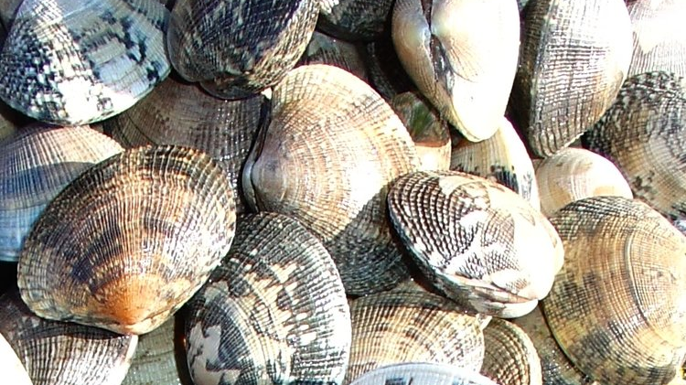
Parental Priming of Manila Clams for Ocean Acidification
PCSGA 2023
September 19th, 2023
Potential hatchery practices to build
resilience for clam aquaculture
Larken Root, UW/NOAA
Mackenzie Gavery, NOAA
Ryan Crim, Puget Sound Restoration Fund
Graclyn Ham, Eckerd University

Slide 2

Ocean Acidification and Shellfish Aquaculture
The Pacific Coast currently experiences acidified water conditions, and these are likely to get worse in the future
Shellfish are negatively impacted by acidification, especially in larval stages when they are growing rapidly
Methods are needed to enhance the ability of juvenile clams to survive OA stressors

Slide 3
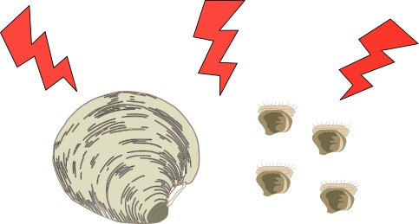
Parental Priming
Larvae are more sensitive to stressors such as OA than adult clams
adult
larvae

Slide 4
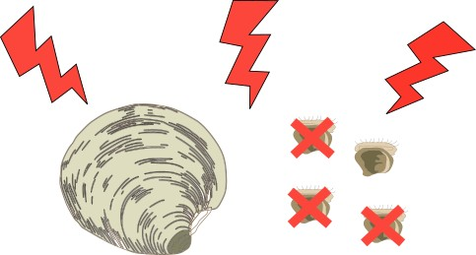
Parental Priming
Mortality will be higher in larvae when a stressful event occurs
adult
larvae

Slide 5
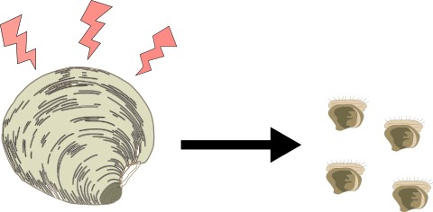
Parental Priming
Parental priming involves exposing broodstock to a moderate stress before and/or during reproductive maturation

Slide 6
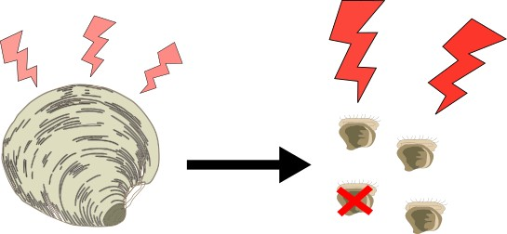
Parental Priming
Larval offspring from primed broodstock may have higher tolerance to stress and lower mortality
Notes:
Parental priming has been shown to confer advantages in other shellfish species,
At the pH level used in this experiment, no negative effects were seen on adult clams
The method we used to test this is as follows.

Slide 7
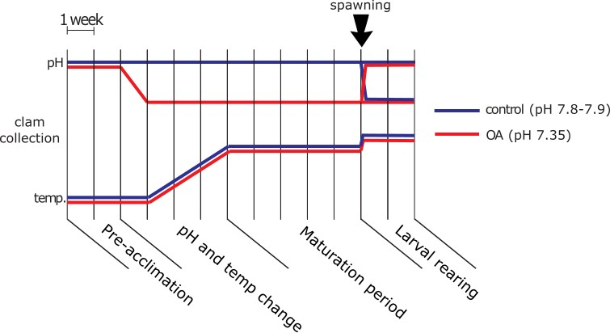
Acclimation
Notes:
Clams were collected before initiation of gametogenesis (Jan-Feb)
OA primed broodstock were held at pH 7.35 for 2 months, with control broodstock in ambient water taken from near Manchester, WA (pH 7.8-7.9)
Temperature was raised to 20ºC and held constant for 1+ month for all clams
After spawning, larvae were split into OA and Ambient treatments from each spawn

Slide 8
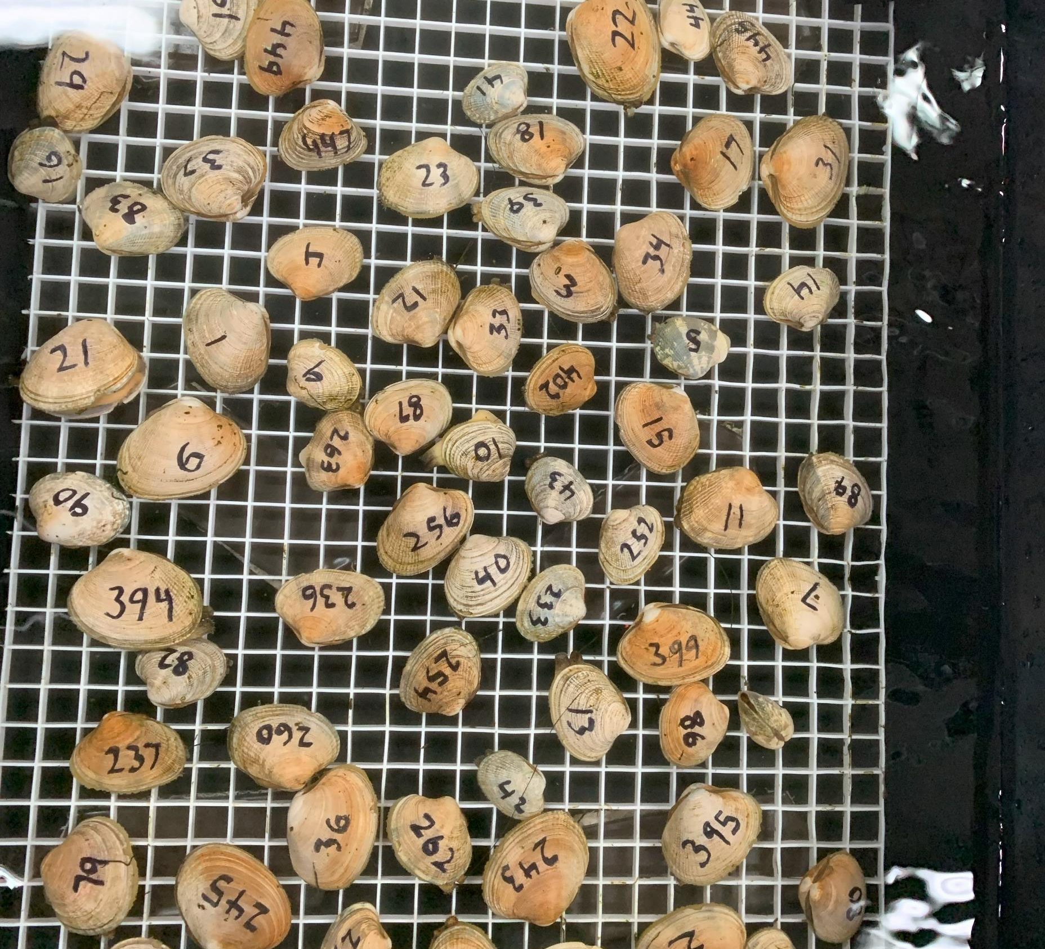
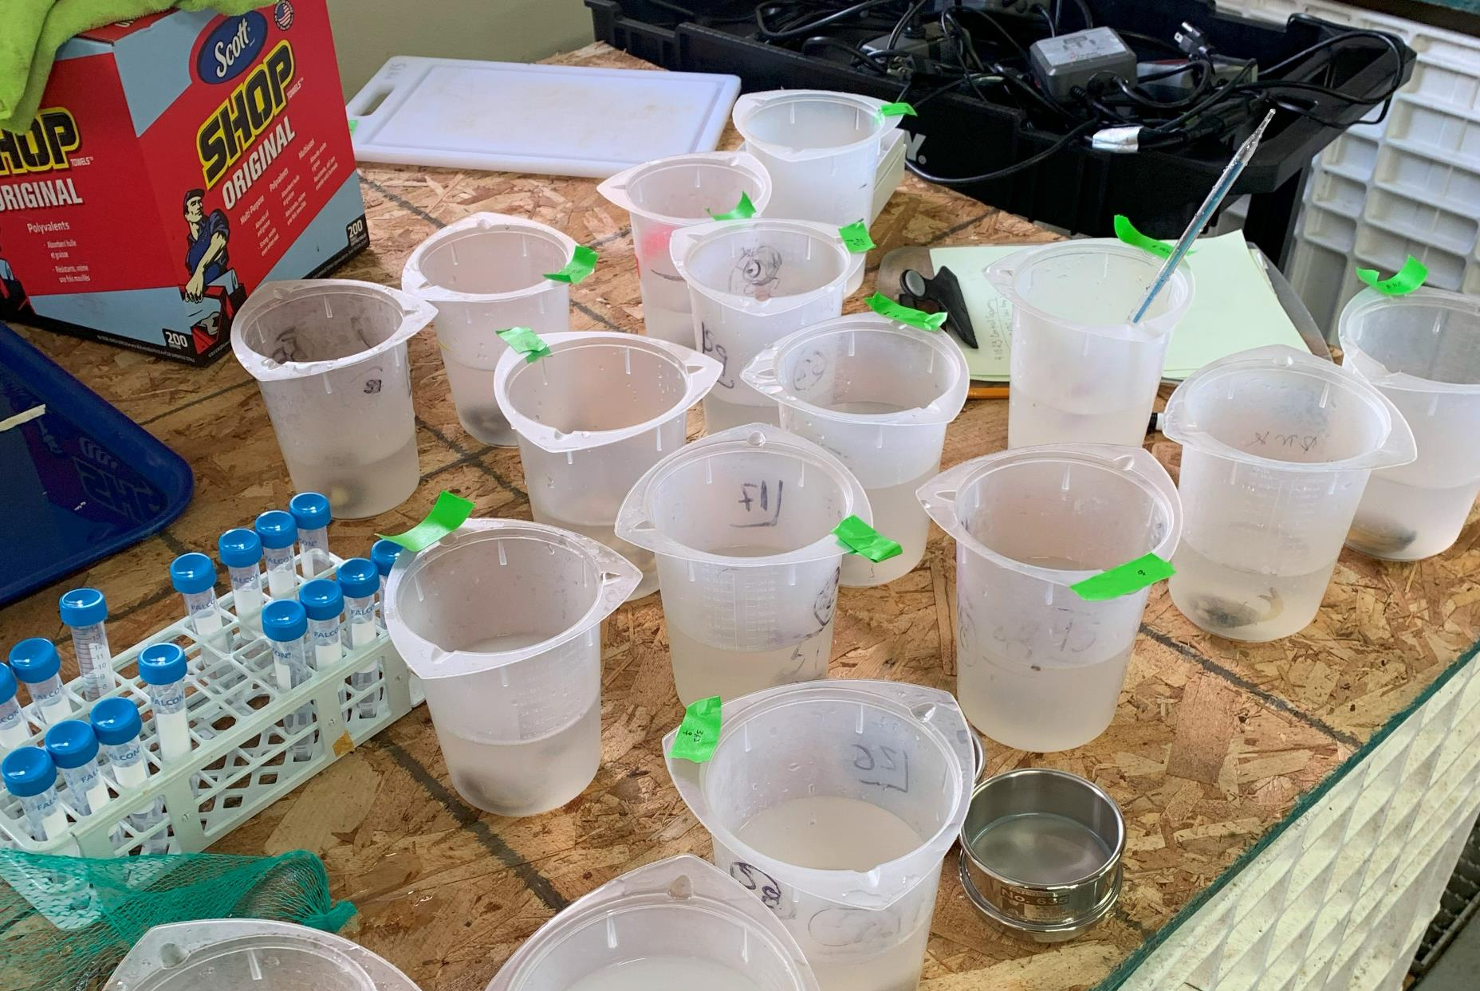
Spawning
Spawning was induced by temperature shock with all clams of each sex/treatment held in a common tray
Once spawning initiated, individual clams was moved to a 1L container
5 Brood-groups were created for each broodstock treatment with eggs from 5 females and sperm from 4 males
Notes:
Brood groups were created by mixing eggs from five females in equal proportions, fertilizing for 10 minutes with sperm from four males in individual containers to avoid sperm competition, rinsed and recombined in a tripour
(fertilization occurring in individual containers to avoid sperm competition)
Larvae in tripours were placed in a sealed container with OA water conditions starting at 1 hour post fertilization (hpf) until 48 hpf
After 48 hours, larvae were moved to screened silos and kept until 14 dpf

Slide 9
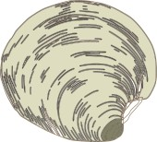
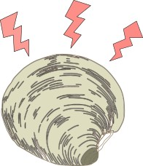
Spawning rate increases in OA
Spawning Results
Sex | Spawned | Non-spawner | Spawn Rate
 | Yes | No
Males | 24 | 18 | 57.1%
Females | 29 | 45 | 32.9%
Spawning rate was significantly higher for broodstock in the OA priming treatment
Egg size was not different between treatments
Sex | Spawned | Non-spawner | Spawn Rate
 | Yes | No
Males | 33 | 3 | 91.7%
Females | 47 | 24 | 66.2%

Slide 10
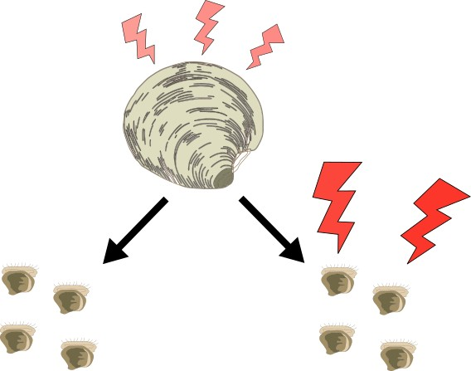
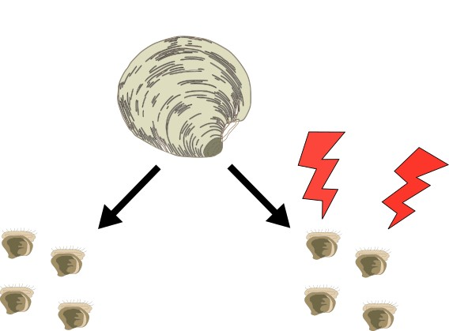
Larval rearing
Larvae were held for 14 days post fertilization (dpf) in sealed, static containers in ambient or OA conditions with sampling at 2, 7 and 14 dpf
Four Treatments:
n = 5
n = 5
Am-Am
Am-OA
OA-Am
OA-OA

Slide 11
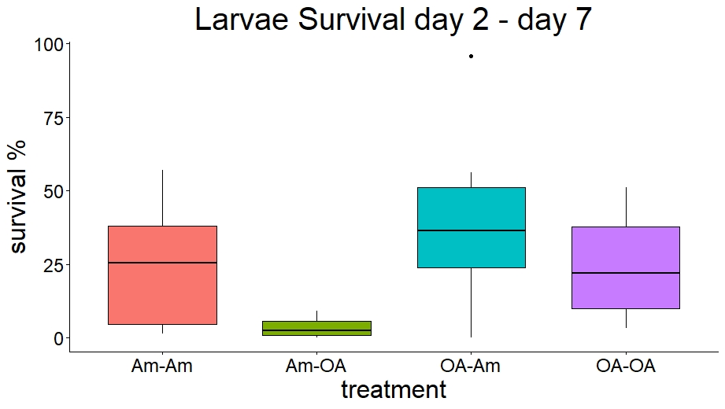
Larvae Results – 7 days
OA reduces larval survival
Notes:
4000 larvae were transferred to new containers at 2 dpf, and remaining living larvae were assessed at 7 dpf.

Slide 12
Larvae Results – 7 days
Priming likely increases larval survival if exposed to OA
Notes:
Survival was not significantly different for larvae from the same broodstock treatment because of high variability and low replicate number, but trend was towards better survival for primed larvae in OA

Slide 13
Larvae Results – 7 days
Priming likely increases larval survival if exposed to OA
not significant
not significant
Notes:
Survival was not significantly different for larvae from the same broodstock treatment because of high variability and low replicate number, but trend was towards better survival for primed larvae in OA

Slide 14
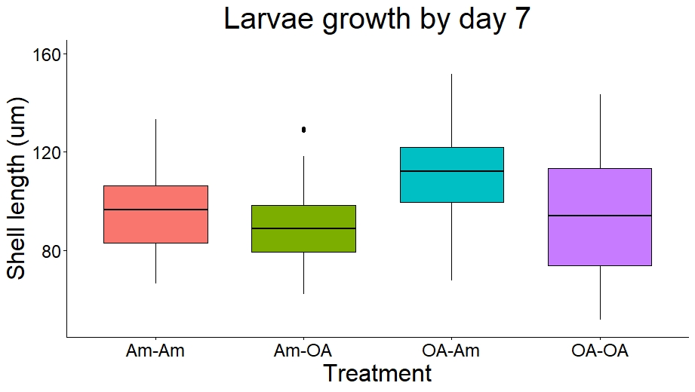
Priming increases larval size
Larvae Results – 7 dpf (preliminary)
c
b
a
ab
Notes:
Size was greatest for larvae from OA-primed broodstock in ambient conditions (OA-Am)
Size was greater in larvae raised in ambient conditions compared to the same brood-group raised in OA conditions

Slide 15
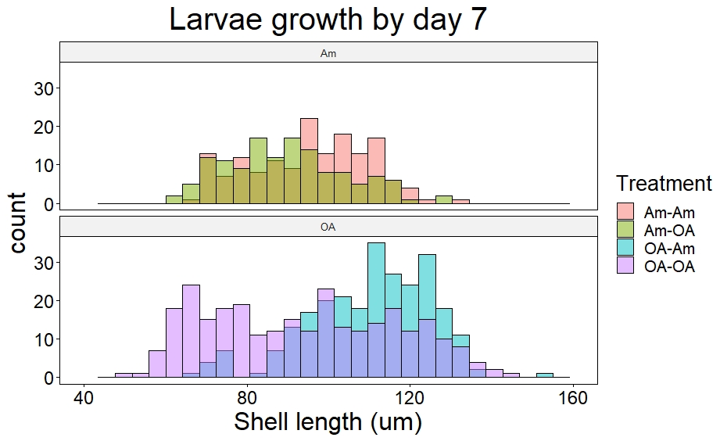
Larvae Results – 7 dpf (preliminary)

Slide 16
Larvae Results – 7 dpf (preliminary)

Slide 17
Larvae Results – 7 dpf (preliminary)

Slide 18
Takeaways
Priming for OA has potential as a clam husbandry practice.
OA priming had no negative physiological impacts on adult clams from our protocol
OA priming can stimulate reproduction and produce more spawning animals
Larvae from OA primed adults grew faster and showed trend of higher survival, but were still susceptible to OA exposure
Notes:
Builds on previous work showing positive impacts from priming

Slide 19
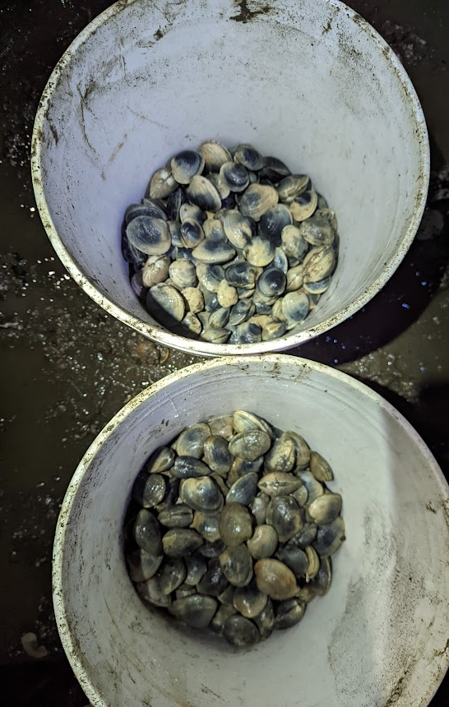
Ongoing research
Parental Priming: how does it work?
Transcriptomics of gametes – role of gene expression survival and size differences
Lipidomics of eggs – indicate potential role of nutrition
Interviews with producers about the feasibility of implementing parental priming in hatcheries.
Notes:
This information can help in developing tools to evaluate priming for other stressors, etc.
Interviews with UW collaborators

Slide 20
Acknowledgements
We received invaluable support and guidance from:
Elizabeth Unsell, Suquamish Tribe
Alexa Romersa, Pacific Hybreed
Matt George, WDFW
Eileen Bates, UW SAFS
Steven Roberts, UW SAFS
Ariana Huffmyer, UW/URI
Mollie Middleton, NOAA
Kate Rovinski, NOAA
Abby Piegols, PSRF
Teighan Shore, PSRF
Jess Capista, PSRF
Malise Yun, PSRF
This research was made possible with funding
from the NOAA Ocean Acidification Program

