Slide 1

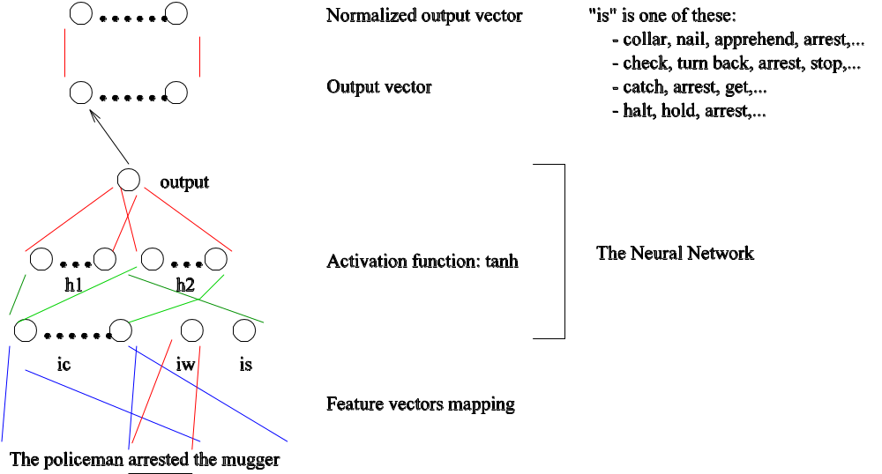
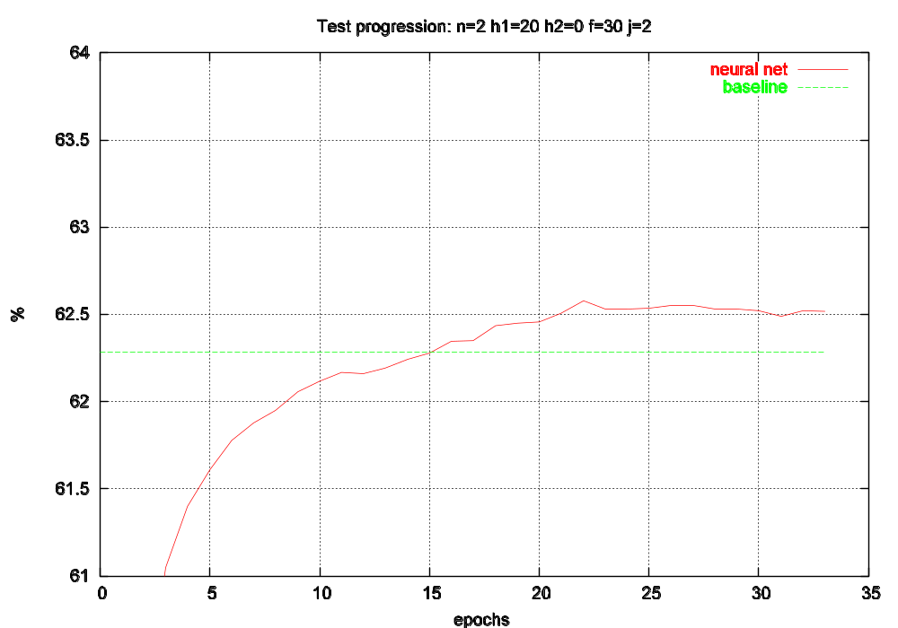
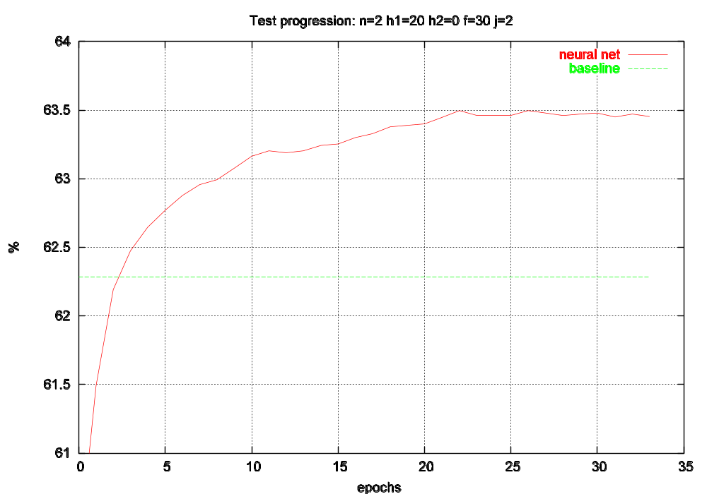

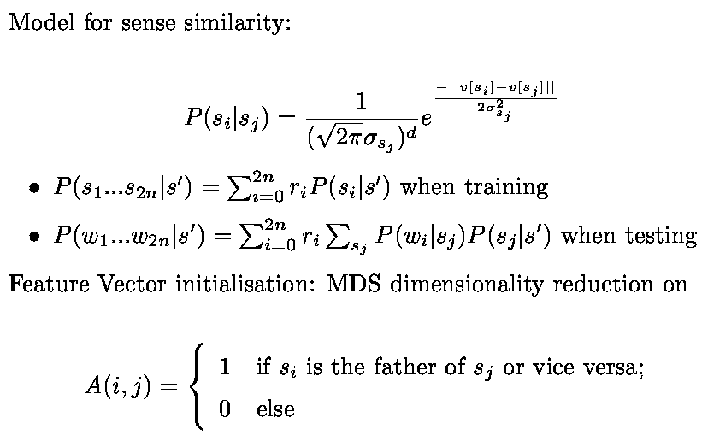
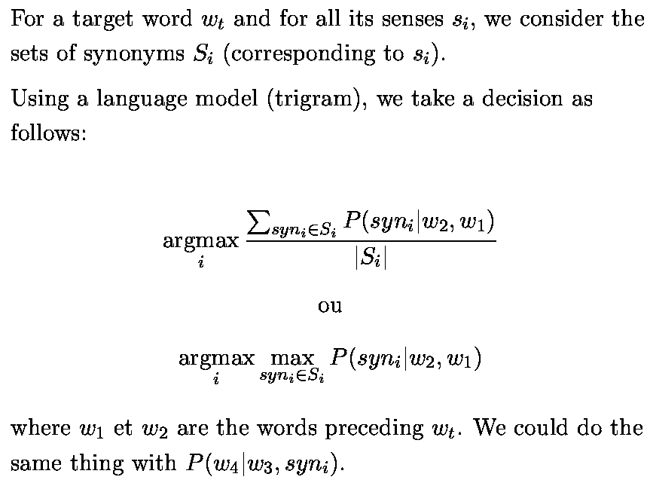
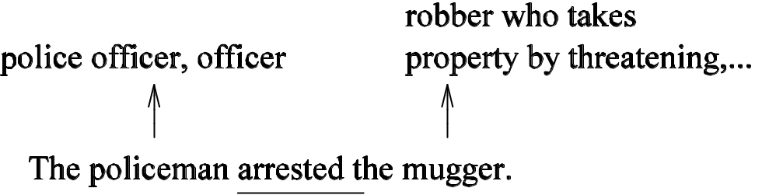
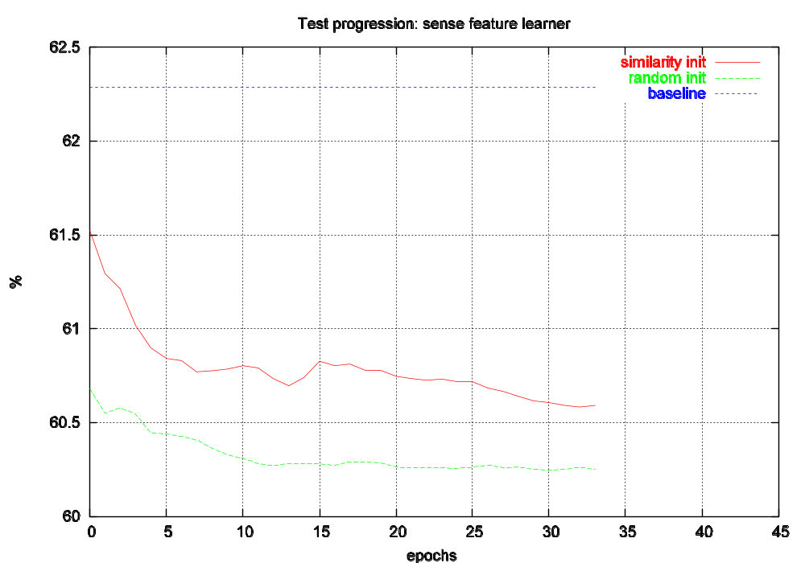

Some Supervised Models in Disambiguation
Hugo Larochelle, Christian Jauvin, Yoshua Bengio
Introduction
What is disambiguation ?
- activity of finding the correct sense for a given word, according to its context;
What is the sense of a word ?
- Petit Larousse: “Set of representations suggested by a word [...]; signification”;
- Meillet (1926): “The sense of a word is only defined by the average of its linguistic uses”;
Why disambiguation ?
- Automatic translation, information retrieval, etc.
Disambiguation using what ?
Supervised data: SemCor
- 240 000 tagged words, among them 190 000 polysemous
- 23 346 different lemmas
Sense dictionary: WordNet
- 61 000 senses for 42 000 different words
- relationship between words of many types (IS-A, HAS-PART, etc.)
Neural Network Approach:
Results:
Neural Network only
Neural Network and baseline
Sense Similarity Approach:
Let’s try to use the context senses to disambiguate the target word:
Language Model Approach:
Maybe a language model could help:
What to do next ?
Semi-supervised learning with the Neural Network approach
Better feature vector initialisation with the Neural Network and
Sense Similarity approaches
More sophisticated use of WordNet
Combine the Language Model and the Neural Network
approaches with the Naive Bayes predictor
Find more tagged data:
* eXtended WordNet (564 748 tagged words)
* Open Mind Word Expert (70 000 tagged words, 230
different lemmas)

