Slide 1
Extreme Subgroup Effects
Under a Uniform Treatment Benefit
Section 6.6.4 — High-Risk Subgroup Analysis
Larry F. Leon
forestsearch

Slide 2
The Question
Statistical and clinical motivation
STATISTICAL OBJECTIVE
WHY IT MATTERS
When a treatment has a perfectly uniform benefit across all patients, how often do standard subgroup analyses produce extreme-looking results by chance alone?
Regulatory reviewers see forest plots with apparently alarming subgroup hazard ratios or upper confidence bounds. Are these real signals — or sampling noise from small denominators?
Answer: extreme results are routine in small subgroups — clinical rationale provides no statistical protection.

Slide 3
The Simulation Setup
Real-data DGM with a perfectly uniform treatment effect
1
Source data
GBSG breast cancer trial: N = 686 patients, 299 events
2
Weibull AFT model
Fit to the source data; build a super-population (N = 5,000)
3
Uniform treatment effect
True hazard ratio = 0.70 for every patient — no heterogeneity, by construction
4
Censoring calibration
uniroot-based search matches simulated censoring to the source data
5
10,000 synthetic trials
Each trial: 686 patients × 56 pre-defined subgroups × Cox stratified by grade

Slide 4
Subgroups Under Study
56 subgroups examined in every simulated trial
Why so many — and what each adds
ITT (1) Full trial — anchors the comparison
Clinical (4) Standard categorical splits (meno, grade)
Continuous (13) Median / quartile cut-points on age, size, nodes, PGR, ER
Two-way (29) Pairwise clinical x biomarker combinations
3-way (5) Three-way intersections — progressively smaller N
Random (4) Pure-noise benchmarks: random60 / 40 / 20 / 15

Slide 5
Section 6.6.4 — High-Risk Subgroups
Filtering to subgroups most prone to extreme upper bounds
FILTER RULE
Pr( UB(HR) >= 2.0 ) >= 10% across 10,000 simulated trials
All Patients (ITT) included for comparison regardless of whether it meets the filter.
Two views, one set of subgroups
11 subgroups + ITT comparator
UB(HR) panel asks: how alarming can the upper confidence bound look by chance?
HR panel asks: how misleading can the point estimate itself be?
Random benchmarks (random15 / 20 / 40 / 60) lead the list — pure sampling noise.
Clinical and biomarker-defined subgroups of similar size are statistically indistinguishable from them.

Slide 6
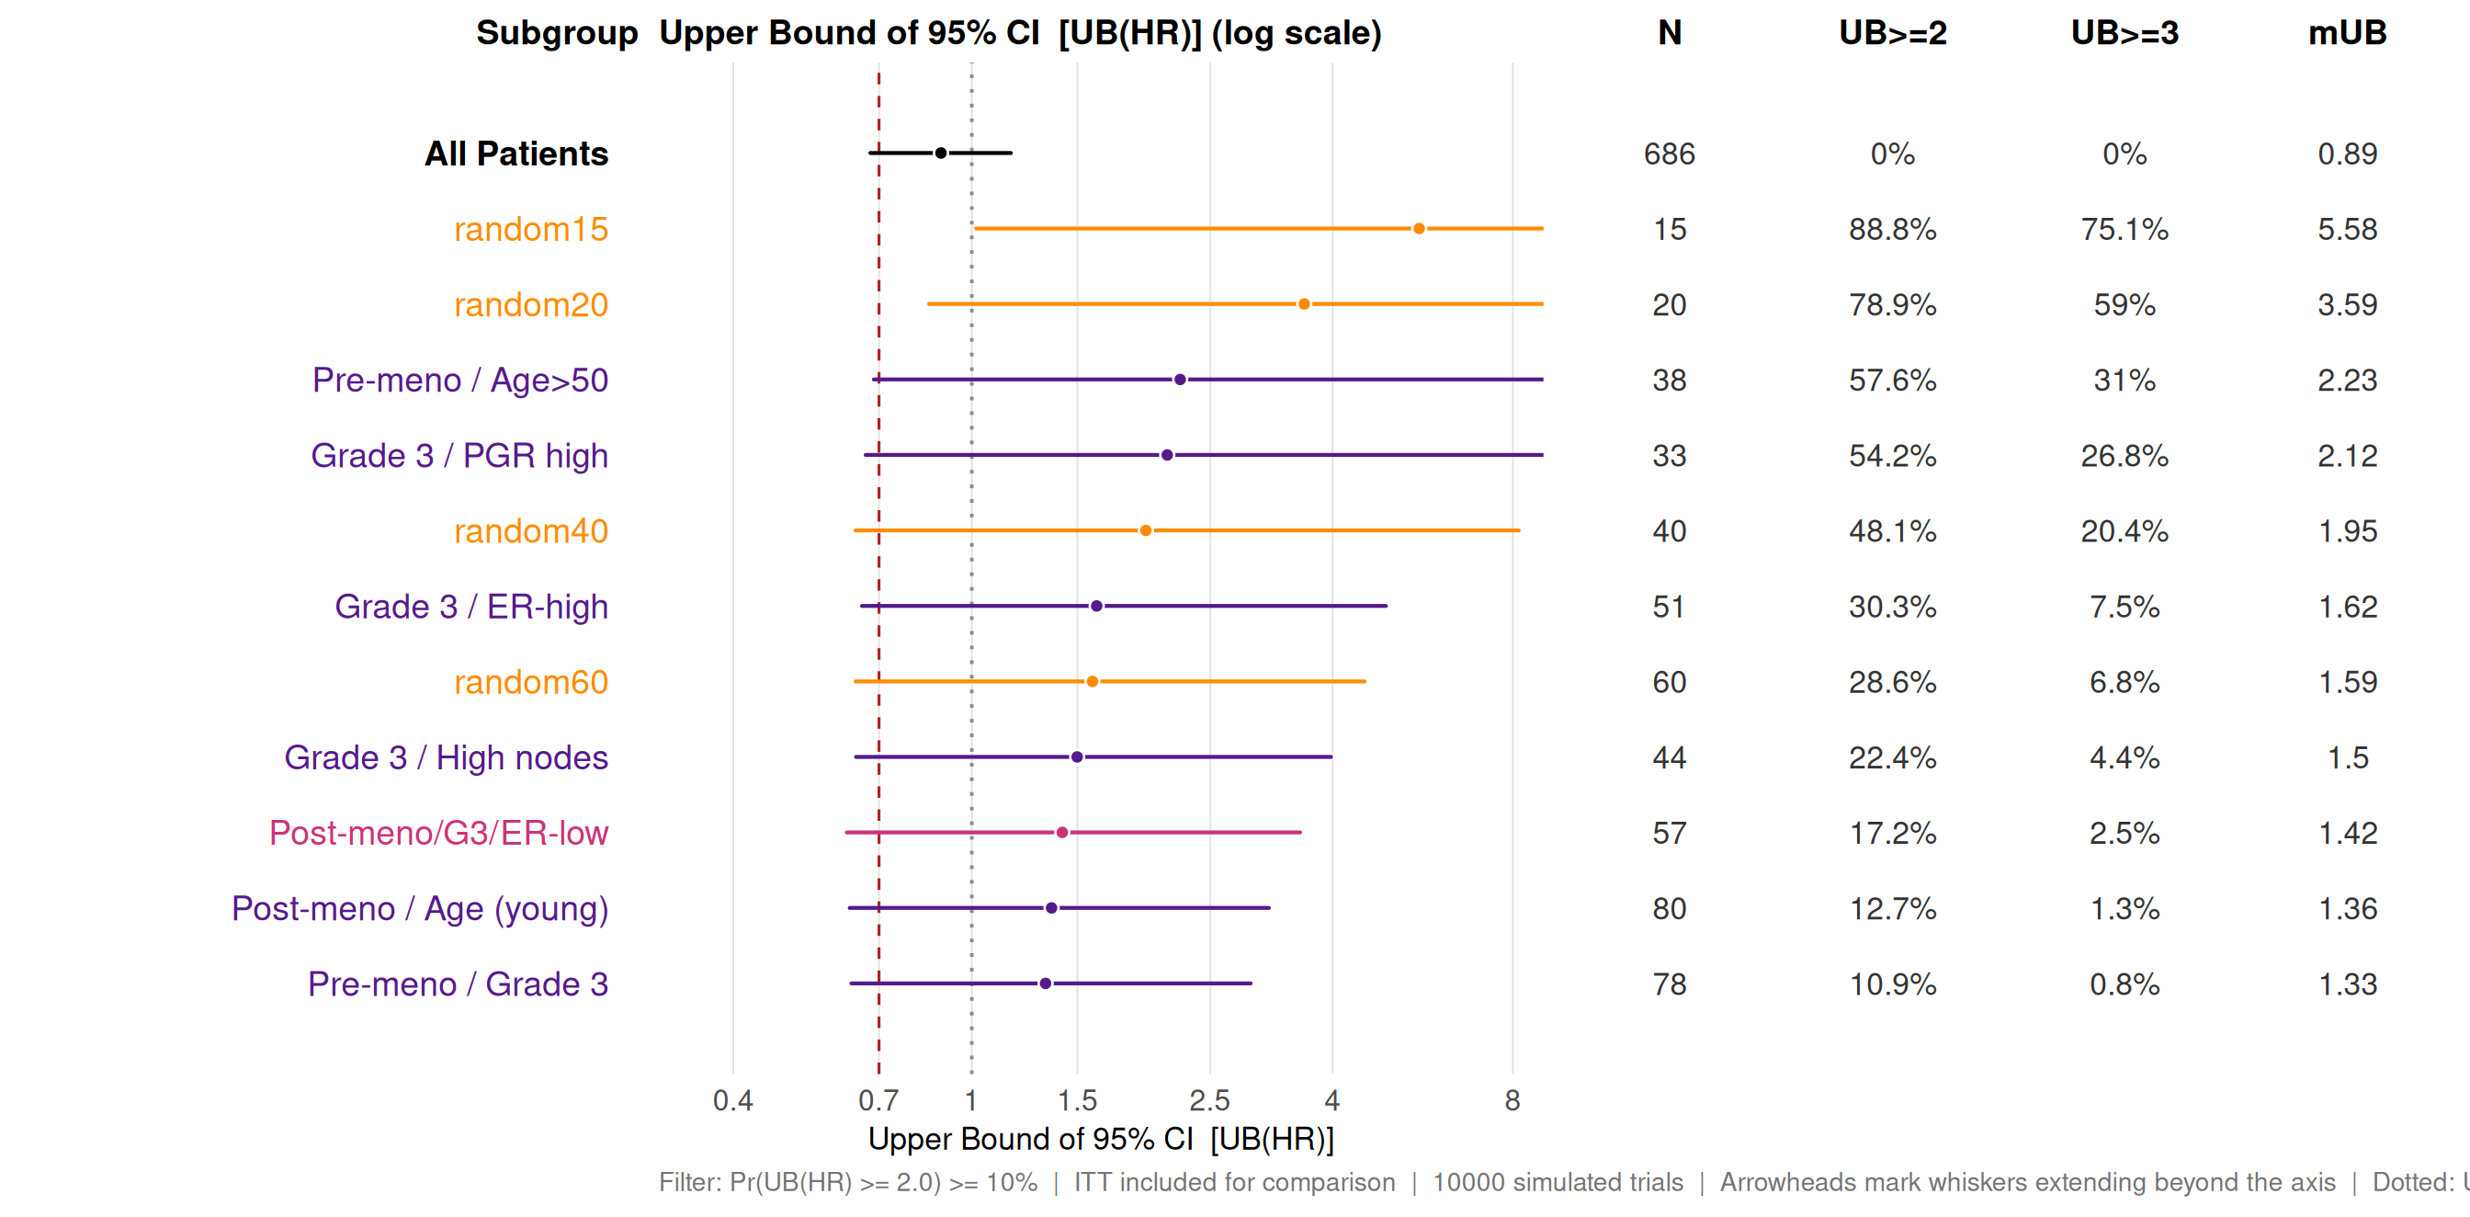
UB(HR) Distribution — Section 6.6.4 Panel A
What a safety reviewer sees: the upper 95% confidence bound, across simulations
random15 / random20 produce UB >= 2 in 75-89% of trials and UB >= 3 in 59-75%.
Clinical / biomarker subgroups of similar size (Pre-meno/Age>50, Grade 3/PGR high, ...) show indistinguishable distributions.
Arrowheads mark whiskers whose 99th percentile extends beyond the visible axis.

Slide 7
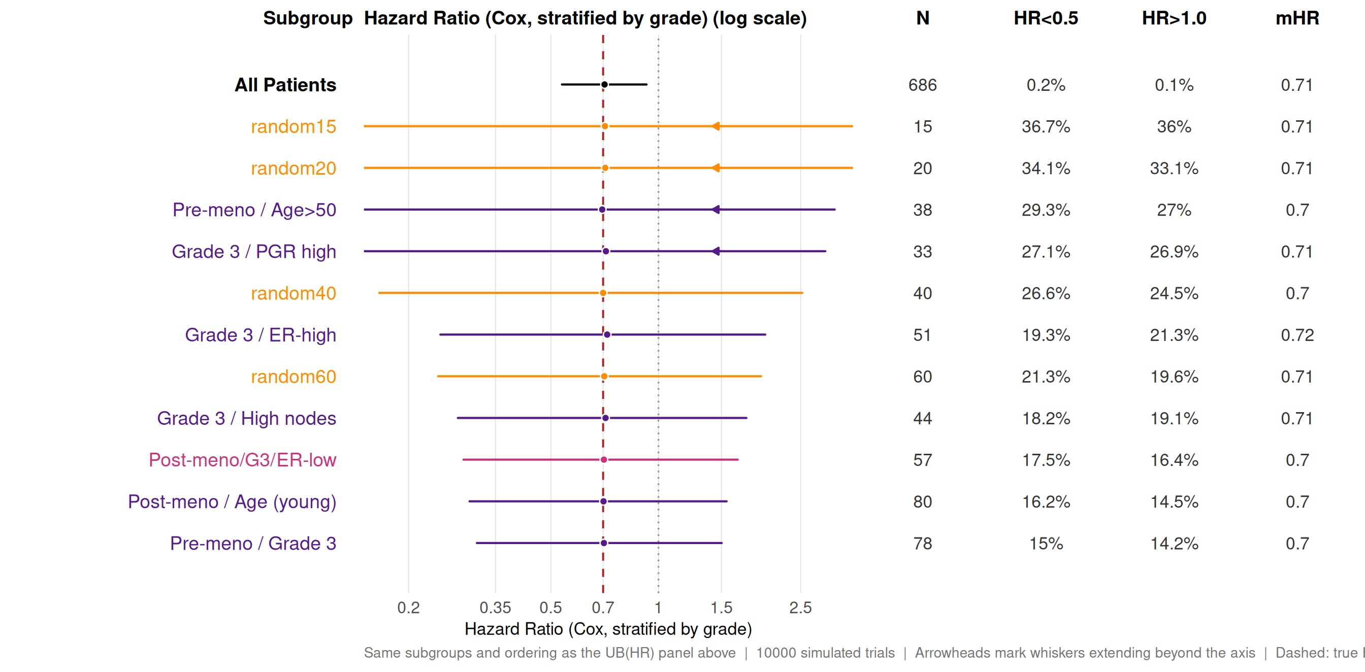
HR Distribution — Section 6.6.4 Panel B
Same subgroups, point-estimate view: how misleading can the headline HR be?
Every row's median HR is approximately 0.70 — the Cox model is unbiased even at N = 15.
But 27-37% of trials in small subgroups produce HR < 0.5 (looks like a huge benefit); 25-36% produce HR > 1.0 (looks like harm).
All this variability is sampling noise — the true HR is 0.70 by construction.

Slide 8
Key Takeaways
Reading the UB and HR panels together
1
Extremes are routine in small subgroups
2
Clinical rationale != protection
Under a uniform HR = 0.70, random15 trials produce UB(HR) > 5 about three-quarters of the time. Same true effect for everyone — the apparent heterogeneity is sampling noise.
Pre-meno/Age>50 (N approx 38) behaves like random40 (N approx 40). A defined subgroup of size N has the same chance distribution as a random pick of N.
3
The Cox model is working correctly
4
Simulation-based calibration is the fix
Median HR is approximately 0.70 across every row. The wide CIs accurately reflect uncertainty — the problem is interpretation, not the statistics.
Without a null benchmark, no reviewer can quantify how 'extreme' UB = 3.5 in a 40-patient subgroup actually is. The random* anchors provide that calibration.

Slide 9
Resources
Package
github.com/larry-leon/forestsearch
Documentation
larry-leon.github.io/forestsearch/
Vignette
larry-leon.github.io/forestsearch/articles/extreme_subgroups.html
Install
pak::pak("larry-leon/forestsearch")
Larry F. Leon - forestsearch

